Slide 1
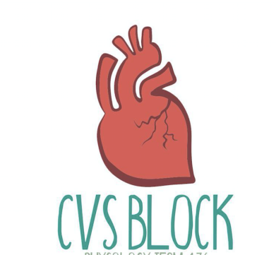
Cardiac Output
Red: very important.
Green: Doctor’s notes.
Pink: formulas.
Yellow: numbers.
Gray: notes and explanation.
Physiology Team 436 – Cardiovascular Block Lecture 8
Lecture: If work is intended for initial studying.
Review: If work is intended for revision.

Slide 2
Objectives
Study Smart: focus on mutual topics.
From the students’ guide:
By the end of this lecture the students are expected to:
Define cardiac output, stroke volume, end-diastolic and end-systolic volumes.
Define physiological conditions affecting CO
List causes of high and low output pathological states.
Define venous return and describe factors controlling venous return.

Slide 3
The Cardiac Output (C.O)
C.O.: is the volume of blood flow ejected from the right or left ventricle per minute. = 5 L\min at rest.
Stroke volume: is the volume of blood ejected from each ventricle per beat. = 70 ml\beat at rest
Heart Rate = 72 beats\ min.
Thus, the cardiac output = the volume of blood pumped by one ventricle per beat X the number of beats per minute:
C.O regulation: is well regulated according to tissue metabolic demands.
Basic determinant of C.O.: is the O₂ requirements of body tissues, for their metabolic rates.
Accordingly, if the metabolic rate is increased → the CO and VR are increased WHY? to maintain optimal O₂ supply to the active tissues.
Video of (Cardiac Physiology of CO)
Duration: (8:48 mins)
Video of (Cardiac Output)
Duration: (9;39mins)
Resting C.O
Men
5.6 L/min
Women
4.9 L/min
Average adult
5 L/min
Per minutes NOT beat
C.O (Q) = Heart rate X stroke volume
ONLY IN FEMALES’ SLIDES
Cardiac output: volume of blood out of heart per minute
Stroke volume: volume of blood out of heart per beat

Slide 4
Cardiac Reserve: VR and CO
ONLY IN MALES’ SLIDES
The cardiac output at rest is approximately 5 L/min.
The body’s blood volume averages 5 to 5.5 liters.
Thus, each ventricle pumps the equivalent of the entire blood volume each minute.
During exercise, the CO can increase to 20 - 25 liters/min and to as high as 35 - 40 liters/min in well trained athletes.
The difference between the resting CO and the maximum volume of blood: the heart is capable of pumping per minute is known as the cardiac reserve.
Venous return (VR): refers to the volume of blood entering each atrium per minute.
Venous return: flow rate into the heart
Cardiac output: flow rate out of the heart (heart rate)
VR = Heart rate X Diastolic filling volume = 5 L/min
Coupling of cardiac and vascular functions
The ventricles function: as the central pumps in the closed circuit of the CVS.
Thus, the cardiac output should be equal to the rate of venous blood return to each ventricle.

Slide 5
Regulation of the Cardiac Pump
ONLY IN MALES’ SLIDES
The hemodynamic function of the human heart has two components:
To be filled by the venous return (VR)
To produce an outflow (i.e., cardiac output) with pressure.
2 groups of factors that regulate the haemodynamic functions of the heart:
Factors affecting the pump ability to eject (i.e., CO)
Factors affecting the pump filling (i.e., VR)
These factors include:
Intrinsic properties of the heart and blood vessels → which provide an autoregulation to the heart pump.
(زي كهربائية القلب او تضيق الشرايين والاوردة)
Neuro-hormonal factors outside the CVS → which constitute an extrinsic regulation.

Slide 6
Factors affecting & regulating cardiac output
Heart rate
Increase HR
Decrease HR
Stroke volume
Hormones
pregnancy
Sympathetic Nervous system*
Decrease blood volume
Exercise**
Bainbridge reflex = Atrial reflex
Frequency-force relationship
Increase temperature
Epinephrin (neurotransmitter)
Thyroxine
crisis (e.g. Stress , anxiety , fear .. etc.).
High BP
muscle need more O2 → heart need to pump more blood.
E.g. Trauma
In the right atrium there is Stretch receptor, which response to venous return ( increase in pressure ) by increasing the heart rate through sympathetic activity.
Increase cardiac contractility i.e.
hyperthyroidism
Video of (Regulation of CO)
Duration: (14:33 mins)
(thyroid hormone which increases HR)
i.e. hemorrhage
*Increase contractility (strength of contraction) and BP and SV (volume of blood) and therefore increase CO
**Increases HR then increases CO because muscles need more O2 supply and that is done by increasing HR to pump more blood to the muscles to supply them and remove lactic acid

Slide 7
Physiological/Pathological Changes In Cardiac Output
ONLY IN MALES’ SLIDES
Physiological changes
During the first 3 hours after meal: the CO is increased by ≈ 30% to enhance blood flow in the intestinal circulation.
Later months of pregnancy: are accompanied by > 30% increase in CO due to increased uterine blood flow.
At environmental temperature above 30 °C : the CO is increased due to increased skin blood flow.
At low environmental temperature: CO is increased due to shivering that increases blood flow to the muscles.
Increased sympathetic activity: during anxiety and excitement enhances the CO up to 50% - 100%.
Sitting or standing from the lying position: deceases the CO by 20% - 30%.
Exercise: (next slide)
Pathological changes
Causes of low CO:
Low VR (e.g., haemorrhage)
Reduced contractility (e.g., heart failure)
Tachyarrhythmias (e.g., atrial fibrillation and ventricular tachycardia)
Marked bradycardia (e.g., complete heart block)
Causes of high CO:
Hyperthyroidism: the increase in the CO is due to the high metabolic rate → vasodilatation →↑ CO to 50%+ of control.
AV fistulas
Fever
Anaemia
Anxiety
Hyperthyroidsm → more metabolism → more oxygen

Slide 8
Physiological Changes In Cardiac Output
Moderate Exercise
HR increases to 200% of resting (140 bts/min)
SV increases to 120% (85ml)
CO increases to 240% (12L)
Severe Exercise
HR increases to 300% of resting (200 bts/min)
SV increases to 175% (125ml)
CO increases to 500% - 700% (25 - 35 L)
In athletes: maximum CO may be 35L or more - can't increase maximum HR beyond 200 bts - hence - SV increases to 175 ml.
In severe exercise:
CO is increased by 5-7 times
(due to increase in HR & SV)
Athletes at rest:
HR less
CO is the same
SV more

Slide 9
Factors affecting & regulating cardiac output
Heart rate
Increase HR
Decrease HR
Stroke volume
Myocardial contractility
Parasympathetic nervous system
High blood pressure or blood volume
ventricular myocardiam
Preload
Afterload
End systolic/ diastolic volume
The Bainbridge reflex, is an increase in heart rate due to an increase in central venous pressure. Increased blood volume is detected by stretch receptors (baroreceptors) located in both atria at the venoatrial junctions.
• The stretch receptors are sensitive to venous return.
• volume of blood entering the right atrium will cause stretching in the receptors.
• when the receptors are stretched, they will send signals to the brain which will increase the heart rate.
by negative effect

Slide 10
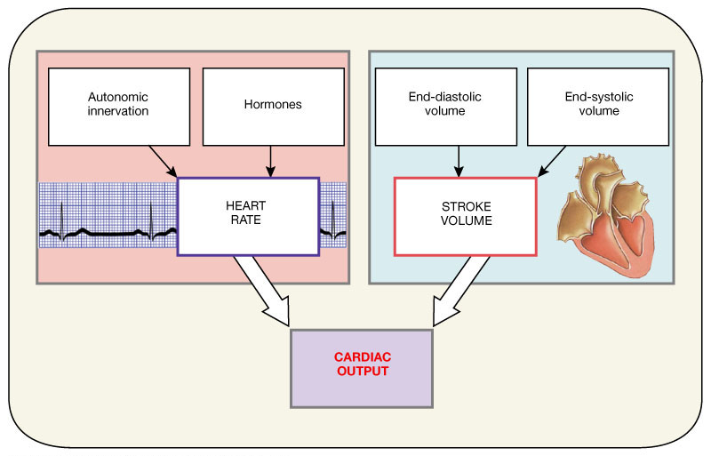
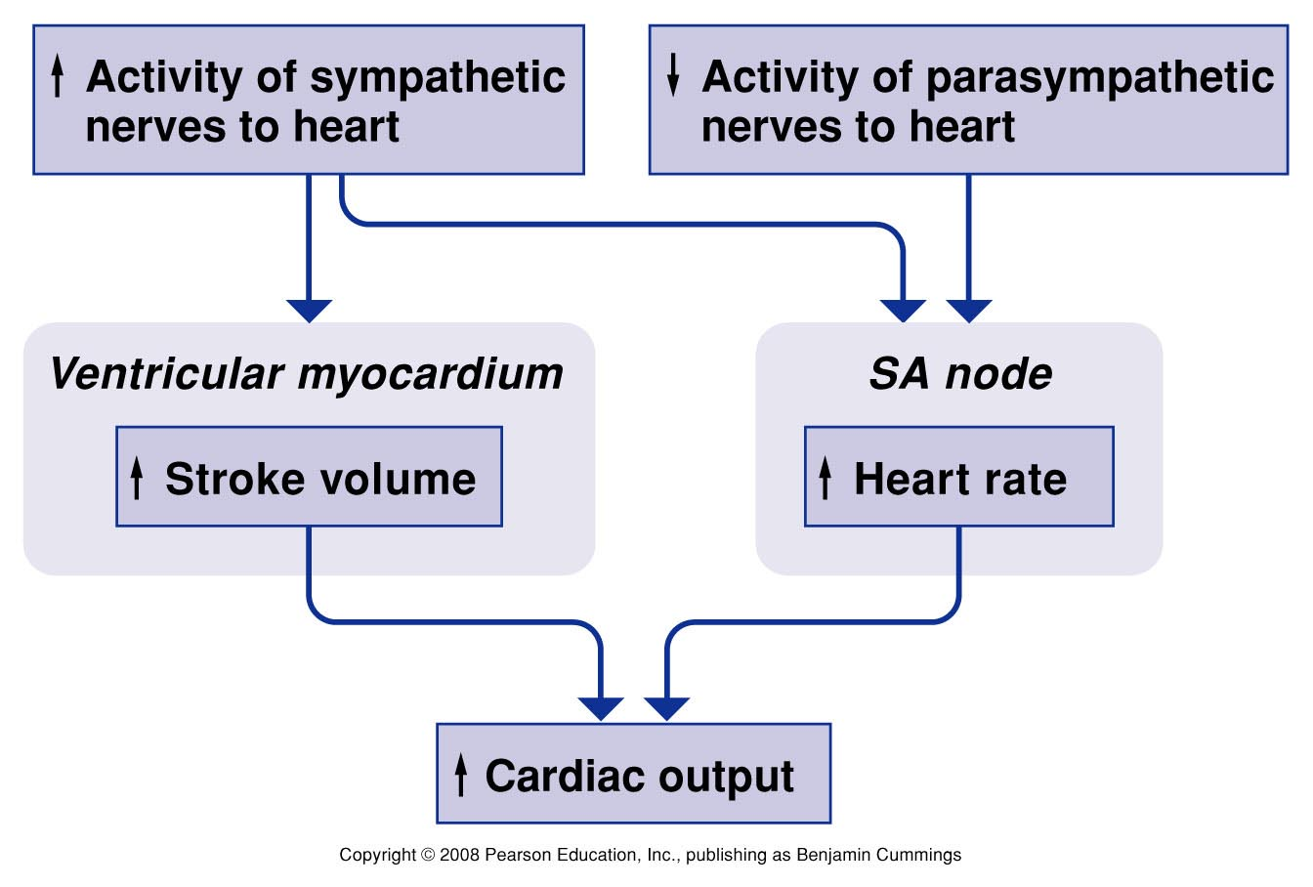
Regulation of CO

Slide 11
Summary
ONLY IN FEMALES’ SLIDES

Slide 12
Factors Affecting Cardiac Output
ONLY IN MALES’ SLIDES
Heart Rate
Since the CO is = SV x HR, as the heart rate increases → CO increases (logically).
At heart rates up to about 180 Beats/min →ventricular filling is adequate as long as there is enough venous return, and cardiac output per minute is increased by an increase in heart rate. أللي يبغاك تعرفه انه طالما الوريد يرجع دم كافي لما تكون نبضات القلب عالية من الاذين للبطين ما يكون في مشكلة
However, at very high heart rates, filling may be compromised to such a degree that cardiac output per minute falls. لما تكون نبضات القلب عالية جدا يكون الشخص معرض انه قلبه ما يطلع كمية كافية
Nerve Supply to the Heart
Sympathetic nerves
Innervate the whole heart.
Release noradrenaline (adrenaline), which stimulates heart β₁-receptors → increase HR
Parasympathetic nerves
Innervate the SA and AV nodes, and the atria and Purkinje system.
Do not innervate most of the ventricular myocardium.
Release ACh that stimulates muscarinic (M₂) receptors → reduce HR
Slows the heart but has little inotropic action.
CO=Cardiac Output SV=Stroke Volume Atrium = اذين Ventricle = بطين

Slide 13
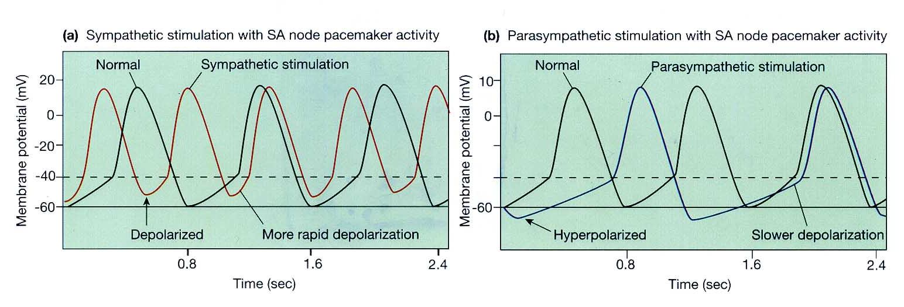
1- Mechanisms of Neural Control
ONLY IN MALES’ SLIDES
Mechanisms:
The ß₁-adrenoreceptors on SA node cells are coupled to excitatory G-proteins →This activates the enzyme adenylate cycles → increases cAMP as a second messenger inside the cell
This results in:
Opening of Na⁺ and Ca²⁺ channels → speed up the rate of depolarization and hence the heart rate.
Decrease in K⁺ permeability by accelerating inactivation of the K⁺ channels. Thus, fewer positive potassium ions leave the cell → the inside of the cell becomes less negative → depolarizing effect.
The net effect is: → swifter drift to threshold → greater frequency of action potential → increase the heart rate.
Mechanisms:
M₂ (muscarinic-2) ACh receptors respond to ACh from the vagus nerve by activating a different G-protein.
This results in:
Reduces the levels of cAMP in the cell
Closure of Na⁺ and Ca²⁺ channels
Opening of potassium channels in the cell membrane
Hyperpolarizes the cell and makes it more difficult to initiate an action potential.
The net effect is: → slower drift to threshold → lesser frequency of action potential → decrease the heart rate.

Slide 14
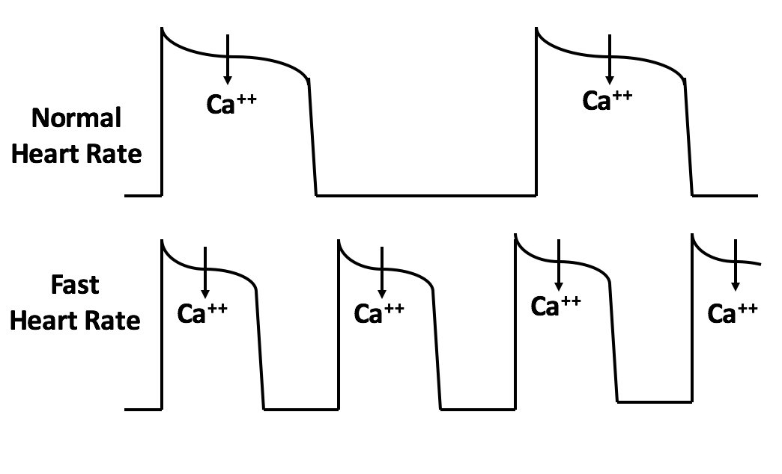
2- Frequency Force Relationship
ONLY IN MALES’ SLIDES
The force of contraction of the cardiac muscle is increased when it is more frequently stimulated.
This frequency dependency of force generation in the heart is probably due to accumulation of Ca2+ ions within the myocytes as a result of:
The increased in number of depolarizations/min → more frequent plateau phases → more Ca²⁺ entry.
The magnitude of Ca2+ current is also increased → increases the intracellular Ca²⁺ stores.
Both effects enhance the release and uptake of Ca2⁺ by the sarcoplasmic reticulum, thus Ca²⁺ availability to the contractile proteins with more force generation through cross-bridge cycling.
So, Increase HR due to increase Contractility
كل ما زاد تحفيز عضلة القلب زادت قوة الانقباض
هذا الشيء بسبب احتمالين :1- عندك ديبولارايزيشن بالدقيقة كثير بالتالي يدخل زيادة كالسيوم لان فيز ٢ أكثر
2- الماقنيتيود حق الكالسيوم ازداد مما ادى الى زياة في مخازن الكالسيوم
هذولي الاحتمالين يزيدو كمية ارجاع الكالسيوم وزيادته في الساركوبلازمك ريتكيلم يؤدي الى انقباض اقوى

Slide 15
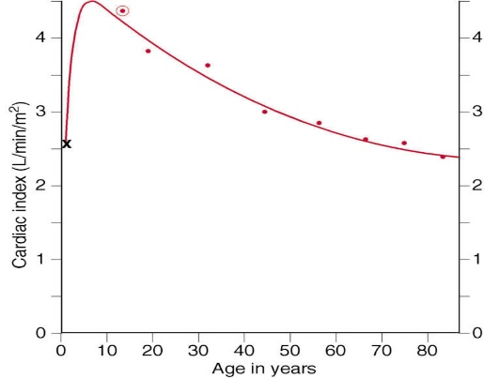
Cardiac Index and Cardiac Output
Cardiac index: is a ratio or relation
Cardiac Index
Cardiac Output Measurement
The Direct Fick’s Method:
The amount or volume of any substance taken up by an organ or by the whole body is equal to:
(The arterial level of the substance ─ the venous level) X blood flow.
Amount
Blood flow = —————————
(Arterial level ─ Venous level)
It relates the cardiac output to body surface area.
Thus relating heart performance to the size of the individual.
The unit of measurement is liter per minute per square meter of body surface area (L/min/m²).
(Measuring the concentration of any substance in the arteries and veins)
Cardiac index for the human being at different ages:
ONLY IN FEMALES’ SLIDES

Slide 16
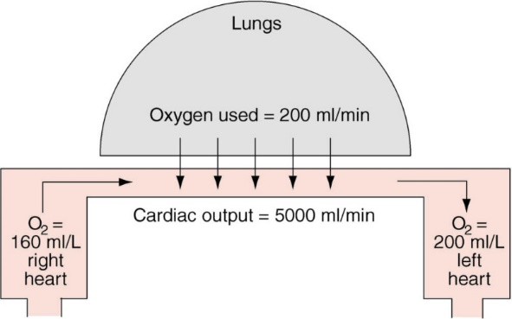
Methods for Measuring Cardiac Output
ONLY IN FEMALES’ SLIDES
Girls’ Doctor said that the scientist and the equation are important but the rest is not so just read it.
Cardiac output can be measured using the Fick principle:
- In the steady state, the cardiac output of the left and right ventricles is equal.
- In the steady state, the rate of O2 consumption by the body must equal the amount of O2 leaving the lungs in the pulmonary vein minus the amount of O2 returning to the lungs in the pulmonary artery.
Total O2 consumption or the rate of O2 absorption by the lungs can be measured by the rate of disappearance of oxygen from respired air, using any oxygen meter.
The amount of O2 in the pulmonary veins is pulmonary blood flow multiplied by the O2 content of pulmonary venous blood. Likewise, the amount of O2 returned to the lungs via the pulmonary artery is pulmonary blood flow multiplied by the O2 content of pulmonary arterial blood.
O2 consumption = cardiac output × [O2] pulmonary vein − cardiac output × [O2] pulmonary artery
Cardiac output = O2 absorbed by the lungs per minute/arteriovenous O2 difference

Slide 17
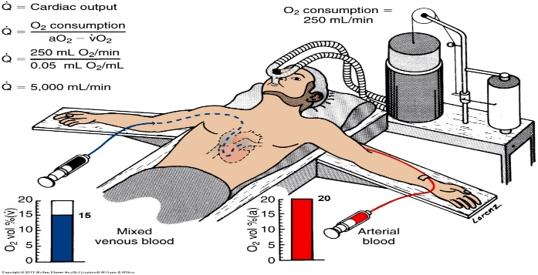
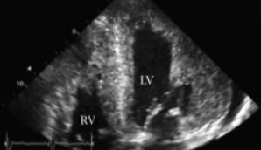
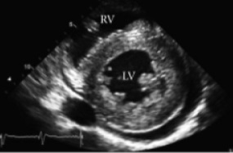
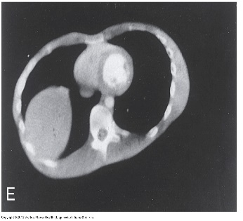
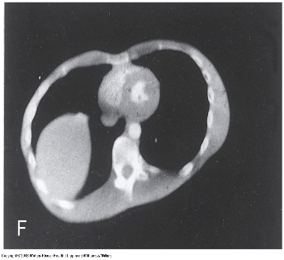
Measurement of Cardiac Output
ONLY IN MALES’ SLIDES
2-Dimensional echocardiography | Fick’s principle | Ultra-fast computer tomography
Records real-time changes in ventricular dimensions during systole and diastole. It thus computes : stroke volume, which when multiplied by heart rate, gives the = cardiac output | Fick’s principle assumes that the amount of oxygen consumed by an organ = the amount of oxygen delivered to that organ by the arterial blood minus the amount of oxygen left in the venous blood of the organ. O2 consumed = O2 delivered-O2 in venous | Can measure changes in ventricular diameter at several depths to estimate changes in ventricular volume.
Amount of oxygen delivered by the arterial blood = aO₂ . Blood flow through the organ (Q).
Amount of oxygen left in the venous blood = vO₂ . Q.
The amount of oxygen consumed by the organ = (aO₂ . Q) - (vO₂ . Q) = Q (aO₂ - vO₂).
Thus Q =The amount of oxygen consumed
aO₂ - vO₂

Slide 18
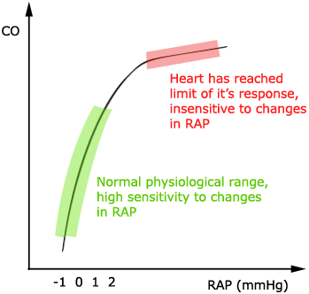
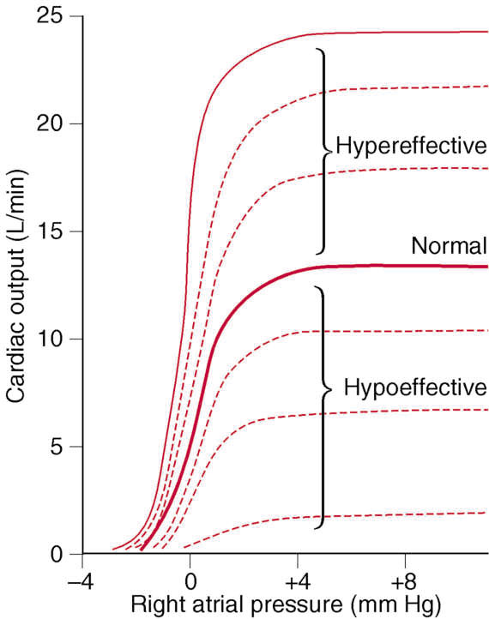
The Heart has Limits for Achievable Cardiac Output (Girl’s doctor said just read it)
ONLY IN FEMALES’ SLIDES
Factors that can cause hypereffective heart:
Nervous stimulation
Hypertrophy of the heart muscle
Sympathetic stimulation and parasympathetic inhibition can increase the effectiveness of the heart via:
Increasing the heart rate
Increasing the strength of heart contraction
Increased pumping effectiveness caused by heart hypertrophy 50-75%→ increase in the heart mass of marathon runners→ which increases the plateau of cardiac output 60-100%.
This figure shows the normal cardiac output curve at each level of right atrial pressure.The plateau level of this normal cardiac output is 13 L/min. This means that the heart can pump an amount of venous return up to 2.5 times the normal venous return before the heart becomes a limiting factor in the control of cardiac output.

Slide 19
Link to Editing File (Please be sure to check this file frequently for any edits or updates on all of our lectures.)
Quiz
https://www.onlineexambuilder.com/stroke-volume/exam-140345
References:
Girls’ and boys’ slides.
Guyton and Hall Textbook of Medical Physiology (Thirteenth Edition.)

Slide 20
Thank you!
اعمل لترسم بسمة، اعمل لتمسح دمعة، اعمل و أنت تعلم أن الله لا يضيع أجر من أحسن عملا.
The Physiology 436 Team:
Female Members:
Rana Barasain
Ashwaq Almajed
Amal AlQarni
Jawaher Abanumy
Reema Alotaibi Leena Alwakeel Hayfaa Alshaalan
Male Members:
Abdullah Abu-amarah
Abdulmajeed AL-Amar
Ali Alsubaie
Muhammad Almutlaq
Team Leaders:
Qaiss Almuhaideb
Lulwah Alshiha
Contact us:
Physiology436@gmail.com
@Physiology436

