Slide 1
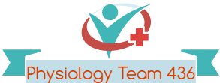
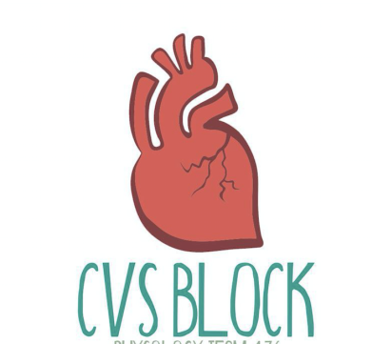
Stroke Volume and Heart Failure
Black/Blue: text.
Red: very important.
Green: Doctor’s notes.
Pink: formulas.
Yellow: numbers.
Gray: notes and explanation.
Physiology Team 436 – Cardiovascular Block Lecture 9
Lecture: If work is intended for initial studying.
Review: If work is intended for revision.

Slide 2
Objectives
Study Smart: focus on mutual topics.
From the students’ guide:
Explain how cardiac contractility affect stroke volume.
Calculate CO using Fick’s principle equation.
Explain pathophysiology of heart failure and differentiate between left and right failure.
Explain how the pathophysiology associated with heart failure results in typical signs and symptoms.

Slide 3
Stroke Volume
Stroke volume: is the volume of blood pumped (ejected) by each ventricle per beat (during each ventricular systole), and it is about 70-80 ml/beat.
Factors Affecting It:
1- End diastolic volume (EDV) (Preload):
It is: the volume of blood present in each ventricle at the end of ventricular diastole.
Preload: load on the muscle in the relaxed state.
Normal amount: 120-130 ml, can be increased during diastole
(filling of ventricles) to a volume of (120-130mL).
Applying preload to a muscle causes:
1- The muscle to stretch.
2- The muscle to develop passive tension.
EDV Depends on:
A- Filling time: the duration of ventricular diastole.
B- Venous return: the rate of blood flow during ventricular diastole.
Indices of left ventricular preload:
1- Left ventricle end diastolic volume Or pressure (LVEDV)
2- Right atrial pressure
More relaxation time, more filling, more volume.

Slide 4
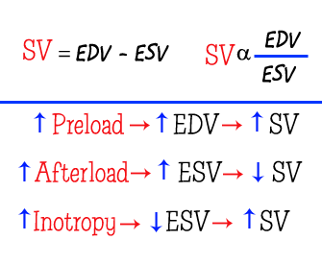
Stroke Volume and Factors Affecting it
1- End diastolic volume (EDV) (Preload):
Mechanism:
The larger the EDV, the more the ventricle is stretched → the longer the initial myocardiac-fiber length before contraction → higher degree of overlap of thick and thin filaments → more cross-bridge interactions between myosin and actin → greater force on the subsequent cardiac contraction → greater SV.
The relationship is also explained by:
the greater sensitivity to calcium → at greater lengths.
2- End systolic volume (ESV) (Residual):
It is: volume of blood present (that remains) in each ventricle at the end of ventricular systole.
Normal amount: 50-60 ml.
↑ End-Systolic Volume (ESV) → ↓ stroke volume
↓ End-Systolic Volume (ESV) → ↑ stroke volume
↑ preload → ↓ ESV
↑ Contractility → ↓ ESV
↑ Afterload → ↑ ESV

Slide 5
The Frank–Starling Principle (Starling’s Law of the Heart)
Represent: the intrinsic relationship between EDV and SV.
It is based on: the length-tension relationship within the ventricle.
Mechanism: if venous return increased → ventricular end diastolic volume (preload) is increased (increase both stroke volume & cardiac output) → ventricular fiber length is also increased → resulting in an increased ‘tension’ of the muscle.
Sum up definition: it is the ability of the heart to change its force of contraction and therefore stroke volume in response to changes in venous return.
→ ↑ Venous return → ↑ EDV
→ ↑ Force of ventricular contraction
→ ↑ Stroke Volume
→ ↑ Cardiac Output
When you stretch a rubber and leave it, It will contract.
Stronger stretch (more increase in length) = stronger contraction
Filling of blood is what does the stretching.

Slide 6
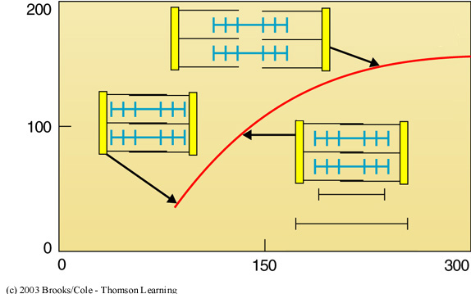
Cardiac Function Curve (Starling’s Law of the Heart)
ONLY IN MALES’ SLIDES
Cardiac Output =
Stroke Volume x Heart Rate.
If HR is constant Then CO will reflect SV.
So On the Y-axis we can either use SV or CO.
On the X-axis we have Diastolic filling or left Ventricular preload which can be represented by:
1- Right Atrial Pressure(RAP).
2- Ventricular EDV.
3- Ventricular EDP. (P for pressure)
Stroke volume (ml)
Video of (Frank-Starling Mechanism)
Duration: (14:18 mins)
Ventricular end-diastolic volume (ml)
As we know Starling’s Law states that there is an intrinsic relation between EDV & SV
That relation occurs because larger EDV the more stretched the ventricle is this results in
More Cross-bridges between myosin and acting because of higher degree of overlap between them.
This will result in Greater force of contraction.

Slide 7
Cont.
ONLY IN MALES’ SLIDES
In a controlled experiment If the right atrial pressure (RAP) (Independent variable) increases the cardiac output (dependent variable) will also increase.
RAP is normally 0 mmHg (note that RAP normally fluctuates with atrial contraction and respiration).
When RAP is 0, the cardiac output is about 5 L/min.
The curve is steep(منحنى حاد) so very small changes in RAP can lead to large changes in cardiac output.
As venous return increases, RAP increases, EDV and end diastolic fiber length increase.
Increase in End-diastolic fiber length equal more contraction which equals more CO.
So More Venous return = More CO.
15-
10-
CARDIAC OUTPUT (L/min)
5-
RAP mmHg
-4
0
+4
+8
Thus, in the steady state, the volume of blood the left ventricle ejects as cardiac output equals or matches the volume it receives in venous return.
Increases in end-diastolic volume (i.e., right atrial pressure) produce increases in cardiac output by the Starling mechanism.

Slide 8
Starling Law & Factors Affecting Preload (EDV)
ONLY IN MALES’ SLIDES
In the ventricles, increases in ventricular preload increase both end-diastolic volume and stroke volume almost equally.
EDV is increased with
Increased total blood volume.
Increased Venous return :
Increased skeletal muscle pump
Increased –ve intrathoracic pressure
Stronger Atrial contraction
EDV is decreased with
Standing.
Decreased Venous return.
Increased intrapericardial pressure (From pericardial effusion etc.).
Decreased Ventricular Compliance.

Slide 9
Cardiac Function Curve (Starling’s Law of the Heart)
15-
15-
10-
10-
CARDIAC OUTPUT (L/min)
CARDIAC OUTPUT (L/min)
Decreased
Contractility
5-
Increased
Contractility
5-
-4
0
+4
+8
-4
0
+4
+8
RAP mmHg
RAP mmHg

Slide 10
Afterload
It is: the load on the muscle during contraction.
Represents: tension (force) which must be developed in the walls of ventricles (muscle) during systole to open the semilunar valves and eject blood to aorta /pulmonary artery.
Is increased by any factor that restricts arterial blood flow like:
Increased arterial blood pressure (systemic Arterial hypertension).
Vasoconstriction.
Is decreased by systemic Arterial hypotension.
When aortic pressure is reduced,→ velocity of shortening of the LV myocardial fibers increases so , reduced after load, the LV can eject blood more rapidly. → This increases the rate blood ejection → less blood is left within the LV at the end of systole → ↓ ESV.
Thus, afterload ↓ , SV ↑ as a result of the ↓ in ESV.
The opposite is true with increased LV after load.
Left ventricular afterload = Mean aortic pressure
LV afterload is increased in conditions of : 1- aortic stenosis 2- arterial hypertension
The LV must respond and compensate to changes of afterload
For example : LV work must increase in attempt to maintain the SV constant in the face of an increased afterload.
(afterload increases when there is resistance (by any factor that resists blood pumping))

Slide 11
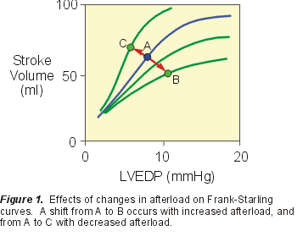
ONLY IN MALES’ SLIDES
Afterload & Starling’s Curve
Afterload & Stroke Volume
Increase afterload → increase in ESV →decrease in SV. → increase in afterload shifts Starling’s curve down and to the right (from A to B).
Explanation: increase in afterload → decreases the velocity of fiber shortening → this reduces the rate of volume ejection so that more blood is left within the ventricle at the end of systole → ↑ ESV.
Vice versa : A decrease in afterload shifts Starling’s curve up and to the left (A to C).
The figure shows : the effect of changes in afterload on cardiac muscle shortening; (ventricular stroke volume)
In pathological situations such as :
1- hypertension and
2- aortic valve obstruction,
ventricular function is adversely influenced by abnormally high ventricular afterload. → stroke volume is decreased because end-systolic volume is increased.

Slide 12
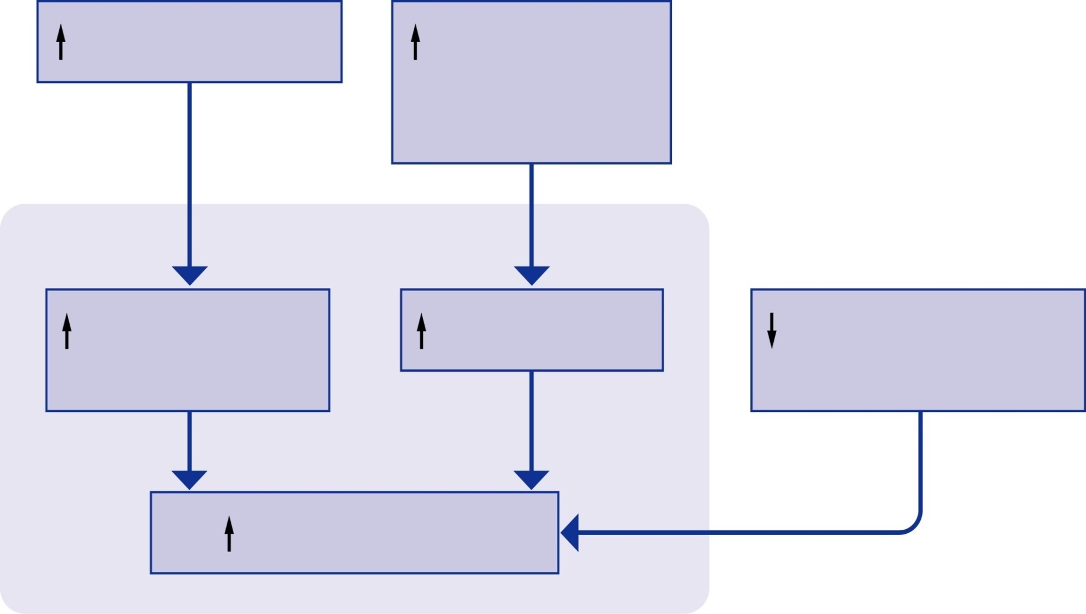
Factors Affecting Stroke Volume
Venous return
Sympathetic
activity or
Epinephrine
Ventricle
End-diastolic
volume
Contractility
Arterial pressure
(afterload)
Stroke volume
11

Slide 13
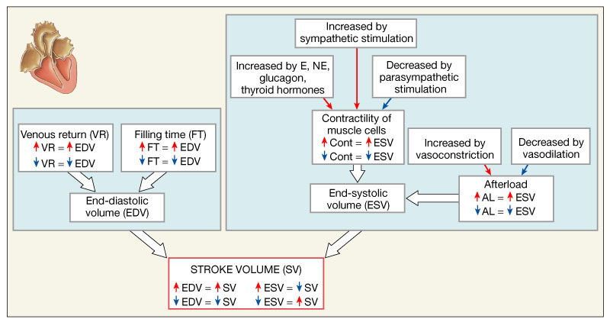
Factors Affecting Stroke Volume
Contractility of
Muscle cells
Cont = ESV
Cont = ESV

Slide 14
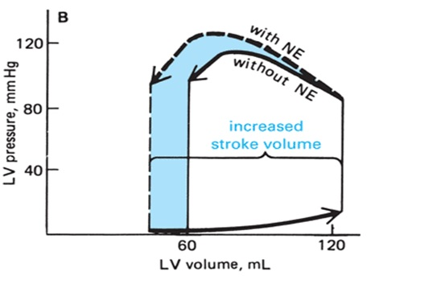
Myocardial Contractility (Inotropic State)
Inotropic: any factor affecting contractility:
Increase contractility: +
Decrease contractility: -
Inotropic effect of noradrenaline and adrenaline:
it is: an intrinsic property of the myocardium independent of the preload. Thus, myocardial contractility can increase without an increase in pre-load.
Changes in myocardial contractility are due to changes in the intracellular dynamics of calcium.
Drugs that increase contractility usually provide more calcium and at a faster rate to the contractile machinery.
More calcium will activate more cross-bridges and thereby strengthen the heart beat.
Factors affecting myocardial contractility
(Ionotropic effectors)
Starling’s law of the heart
EDV
Cardiac innervation
Oxygen supply
Ca & K ions concentration in ECF
Physical factors
Hormonal & chemical factors
(drugs)
Mechanical factors

Slide 15
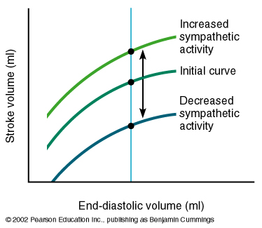
Factors Affecting Contractility (Inotropic Effectors)
1- Starling’s Law of the Heart: ‘‘Length- Tension Relationship’’
Within limits, the power of contraction is directly proportional to the initial length of the muscle fibers.
Overstretching of the fibers as in heart failure its power of contractility decreases.
Graphs on the next slide
2- Cardiac Innervation
Sympathetic nerve stimulation:
force of contraction ( + inotropic) (contractility)
At rest the heart is under sympathetic tone.
Noradrenaline enhances calcium entry into cardiac cells.
Parasympathetic nerve stimulation (vagal):
Atrial force of contraction .
No significant effect on ventricular contraction.
Recall: Stimulation of vagus nerve -> parasympathetic effect
Increased ventricular contractility
How does contractility increase without an increase in preload? By increasing calcium by sympathetic stimulation
Decreased
ventricular
contractility
Any pathologies affecting coronary arteries affect blood supply to the heart.

Slide 16
Factors Affecting Myocardial Contractility (Inotropic Effectors)
ONLY IN FEMALES’ SLIDES except number 4
3- Oxygen supply
Hypoxia = contractility.
4- Ca & K ions
Ca+2 = contractility.
K+ = contractility.
5- Physical factors
warming = contractility.
Cooling = contractility.
Recall:
Hyperkalemia: high K - Hypercalcemia: high Ca
+ve ionotropic
Adrenaline
Noradrenaline
Alkalosis
Digitalis
Ca+ ( hypercalcemia)
Caffeine.
6- Hormonal & chemical factors (drugs)
-ve ionotropic
Acetylcholine.
Acidosis.
Ether.
Chloroform.
Some bacterial toxin ( e.g. diphtheria toxins) .
K+ (hyperkalaemia).
strengthens contractility (pharma)

Slide 17
ONLY IN FEMALES’ SLIDES
Cont.
7- Mechanical factors:
Cardiac muscle obey ‘‘all or none law’’:
Minimal or threshold stimuli lead to maximal cardiac contraction, because cardiac muscle behaves as a syncytium
Cardiac muscle can’t be stimulated while it is contracted:
Because its excitability during contraction is zero due to long absolute refractory period, so it can’t be tetanized.
Tetanized means: the prolonged contraction of a muscle caused by rapidly repeated stimuli.
Cardiac muscle can perform both isometric (no change in the length) & isotonic (no change in the tone) types of contractions.
(as one unit)

Slide 18
Heart failure
Definition:
It is the pathophysiological process in which the heart as pump is unable to meet the metabolic requirements of the tissue for oxygen and substrates despite the venous return to the heart is either normal or increased.
Heart failure occurs when either side of heart cannot keep up with the flow of blood left or right side of the heart or both, but usually the left side is affected first.
Thus, the resting CO may be low, normal or even elevated, despite the presence of heart failure as long as this level is inadequate for body organs’ need of blood and O2. (Heart failure is defined by heart not being able to pump enough blood to fulfil body’s demands, not the magnitude of CO)
Manifested mainly by:
Inadequate cardiac output.
Build-up of blood in veins behind left heart or right heart (increased venous pressure).

Slide 19
Heart Failure
ONLY IN FEMALES’ SLIDES
Systolic failure | Diastolic failure
The heart looses it’s ability to contract or pump blood into the circulation. | The heart looses it’s ability to relax because it becomes stiff. Heart cannot fill properly between each beat.
Left Heart Failure | Right Heart Failure
Systolic and diastolic heart failure are treated with different type of medication . blood pumped normally to the lungs by the RV blood accumulates in pulmonary circulation increasing the pulmonary capillary pressure → serious filtration of fluid in the lung interstitial space and alveoli (pulmonary edema). Fluid may also build up in tissues throughout the body (edema) | Usually occurs as result of left heart failure. Occasionally isolated right heart failure can occur due to lung disease or blood clots to the lung (pulmonary embolism). blood pumped normally to the systemic circulation by the LV blood accumulates in systemic circulation increasing the systemic capillary pressure → filtration of fluid in the body tissues (systemic edema)

Slide 20
How fast does heart failure develop?
ONLY IN FEMALES’ SLIDES
Usually a chronic disease.
Compensating for the loss of pumping function by
Developing more muscle mass
Enlarging
Pumping faster
Heart failure can be categorized into:
Acute – chronic
Systolic – diastolic
Left-sided and right-sided
Hypertrophy - يتضخم
يتوسع

Slide 21
Acute vs. Chronic Heart Failure
ONLY IN MALES’ SLIDES
Acute (hours-days) | Chronic (months-years)
Caused by: Sudden serious abnormalities of the heart (e.g., massive infarction, arrhythmias, valve rupture; acute infection (sepsis)) | Long-term condition
Heart does not have time to undergo compensatory adaptations. | Associated with the heart undergoing adaptive responses (e.g., dilation, hypertrophy).#previous slide
Sudden reduction in CO and blood pressure →decreased perfusion to vital organs | These adaptive responses, however, can be deleterious
Usually left-sided (more serious)
Cardiogenic shock may develop if the heart became unable to pump enough to even keep tissues alive

Slide 22
Causes of Heart Failure
FEMALES’ SLIDES
MALES’ SLIDES
1- Impaired cardiac function
1 .Intrinsic myocardial causes (These result in reduction in ventricular contractility):
myocardial infarction (death of cardiac myocytes due to blockage of the coronary arteries)
Cardiomyopathy
Myocarditis
2. Cardiac arrhythmias: e.g., complete heart block
3. Extrinsic causes (These make it more difficult to eject blood into aorta):
systemic hypertension
aortic stenosis
Coronary heart disease
Cardiomyopathies
Rheumatic fever
Endocarditis
(diseases in the muscle of the heart)
(affects heart and valves and may lead to heart failure)
2- Increased cardiac workload
3- Acute non-cardiac conditions
Increase in blood volume which the kidneys control and therefore the kidneys are not functioning properly as they are unable to produce normal urine volume therefore water retention happens which leads to not excreting toxins and eventually volume overload.
The heart is fine but demand is too high so the person can either perform more efforts to relieve overload or else it may lead to heart failure
Hypertension
Valvular disorders
Anemias
Congenital heart defects
Volume overload
Hyperthyroidism, Fever, Infection increase the heart rate and the contractility.
22

Slide 23
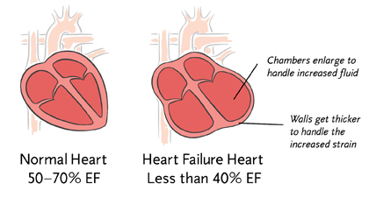
How Heart Failure Is Diagnosed
ONLY IN FEMALES’ SLIDES
DIAGNOSIS
Tests
- Chest X-ray
- Blood tests
- Electrical tracing of heart (Electrocardiogram or “ECG”)
- Ultrasound of heart (Echocardiogram or “Echo”)
- X-ray of the inside of blood vessels (Angiogram)
Physical exam is done
Medical history is taken to reveal symptoms
Indicator for Diagnosing Heart Failure
Ejection Fraction (EF):
is the percentage of blood that is pumped out of your heart during each beat.
How do we calculate EF ?
It is the fraction of end-diastolic volume ejected during a heart beat.
EF = stroke volume / end diastolic volume
70 ml / 130 ml = 0.54 “no unit”
Good indication of starting of heart failure measured through volume of blood with echo.
يروحون مع بعض

Slide 24
Mechanism of Congestive Heart Failure (CHF)
ONLY IN MALES’ SLIDES
Video of (CHF)
Duration: (14:28 mins)
Though each side of the heart can undergo failure separately, dysfunction of one side may lead to a sequence of events that make the opposite side also to fail.
Congestive Heart Failure Symptoms:
Shortness of breath
Leg swelling (edema)
Breathing worsens with lying flat (orthopnea)
Fatigue
Decreased arterial pressure
Decreased oxygen supply
Increased systemic resistance
Increased force of left ventricular contraction
Increased left ventricular oxygen demand
Increased left ventricular hypoxia
Decreased left ventricular contraction
Increased left atrial pressure
Increased left ventricular end diastolic pressure
Pulmonary congestion & pulmonary edema
Increased pulmonary vascular resistance
Right ventricular failure
CHF is heart failure in both the right and left ventricles

Slide 25
Physiological Adaptation to CHF (Compensation Mechanisms)
ONLY IN MALES’ SLIDES
Decreased cardiac output (CO) leads to:
1-Decreased firing of carotid sinus baroreceptor → increased sympathetic stimulation:
vasoconstriction of arterioles (increased afterload),
2-Decreased renal perfusion→ Activation of RAA system→ renin is released by JG cells → renin cleaves angiotensinogen to Ang I → ACE in lung converts Ang I to Ang II → Ang II causes
Vasoconstriction (increased BP and afterload)
3-Decreased effective circulating blood volume
posterior pituitary releases ADH (vasopressin) → increased H2O reabsorption
vasoconstriction of veins (increased preload).
increased HR and force of contractility.
increased CO and increased BP.
Na+/H2O reabsorption from kidneys → increase Blood pressure
Aldosterone release from adrenal cortex → reabsorption of Na+/H2O.
Myocyte hypertrophy.
Myocardial fibrosis.
Enhanced sympathetic activity

Slide 26
Physiological adaptation to CHF (compensation mechanisms)
ONLY IN MALES’ SLIDES
These compensatory mechanisms are great if there is acute blood loss, but do not help much with failing heart! Why?
1-Increased afterload: the failing heart has to work against.
2-Increased preload: that failing heart has to pump out.
3-Retention of salt and water: greater blood volume → peripheral and pulmonary edema.

Slide 27
Complications of Progressive Heart Failure: Factors Contributing to Decompensation
ONLY IN MALES’ SLIDES
1-Prolonged sympathetic activation to the heart
down regulation of the myocardial adrenergic receptors → ↓ the myocardial adrenergic receptors density and sensitivity to catechol amines. Consequently, the ionotropic and chronotropic responses of the heart cannot be elevated in parallel to increased body requirements
2-Vasoconstriction of the arterioles (under enhanced sympathetic activity)
This increases resistance, thus the cardiac afterload.
3-Hypertrophied heart
Has to consume more energy and generate more wall tension to develop the required ejection pressure (Laplace law)
4-Excessive salt and water retention
imbalance between the O2 supply and need → deterioration of the ability to generate force.
5-Over-distended ventricle

Slide 28
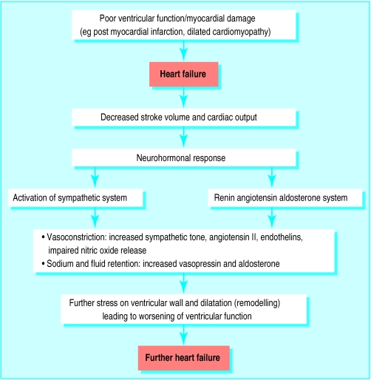
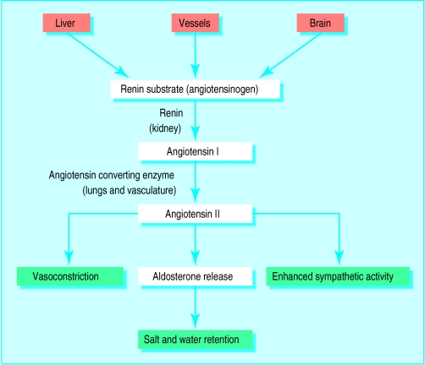
ONLY IN MALES’ SLIDES
Complications of Progressive Heart Failure
RAA System (Renin-Angiotensin-Aldosterone System)

Slide 29
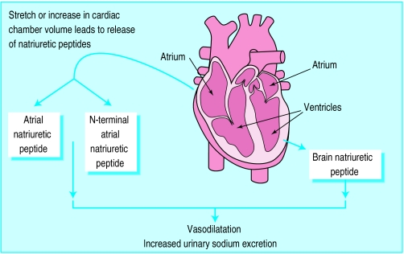
ANP and BNP
ONLY IN MALES’ SLIDES
Atrial natriuretic peptide (ANP) is a hormone that is released from myocardial cells in the atria and in some cases the ventricles in response to volume expansion.
Brain natriuretic peptide (BNP) is a natriuretic hormone initially identified in the brain but released primarily from the heart, (particularly the ventricles).
ANP and BNP are major antagonizing agents of the renin–angiotensin–aldosterone system.
In heart failure: ANP systemic vascular resistance inhibits renin–angiotensin–aldosterone system.

Slide 30
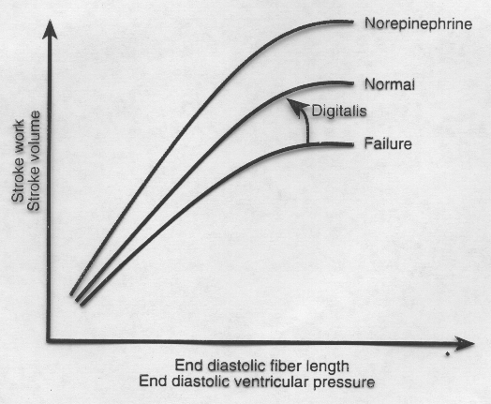
How to Control Heart Failure
ONLY IN MALES’ SLIDES
1-Reduction of cardiac workload, including both preload and afterload
2-Control of excessive retention of salt and water
3-Enhancement of myocardial contractility.
CHANGES IN
CONTRACTILITY
Remember the 4 D’s:
Digoxin (contractility), Diuretics (to remove excess fluids), Diet with less salt (reduce water retention) and Dilator (reduce afterload)

Slide 31
Signs and Symptoms of Heart Failure
WHY? |  | SYMPTOM
Respiratory sign: Persistent Cough Fluid ]Breathing worsens with lying flat (orthopnea)[ | “Backs up” in the lungs or Wheezing | Coughing that produces white or pink blood-tinged sputum
Edema | Decreased blood flow out of the weak heart Blood returning to the heart from the veins “backs up” causing fluid to build up in tissues | Swelling in feet, ankles, legs or abdomen - Weight gain
Tiredness, fatigue | Heart cannot pump enough blood to meet needs of body tissues Body diverts blood away from less vital organs (muscles in limbs) and sends it to the heart and brain | Constant tired feeling - Difficulty with everyday activities
Lack of appetite/ nausea | The digestive system receives less blood causing problems with digestion | Feeling of being full or sick to your stomach
(due to hypoxia)

Slide 32
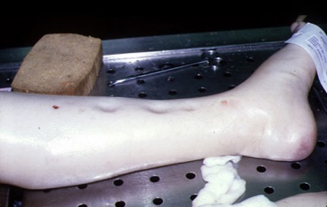
Right Heart Failure | Left Ventricular Failure
Signs and Symptoms
Fatigue ascites Distended jugular vein Weakness Lethargy Weight gain, including abdominal girth Anorexia Elevated neck veins Hepatomegaly | Dyspnea Orthopnea and paroxysmal nocturnal dyspnea* Cheyne Stokes breathing abnormal pattern of breathing which is deeper and faster than normal fatigue Anxiety Rales (crackles) abnormal sound heard from unhealthy lung by stethoscope pallor, cyanosis (late sign of extremely severe pulmonary edema) Increased HR and BP Lateral displacement of apex beat Gallop rhythm (additional heart sounds) may be heard as a marker of increased blood flow, or increased intra-cardiac pressure. Tachypnea
Ascites: excess fluid like edema but in the peritoneal cavity
Pathogenesis : Increase Right Ventricle pressure causes backward pressure on Right Atria → Increasing right atrial pressure → Stagnation of the blood On the : 1- Superior Vena Cava → increased Jugular venous pressure 2- Inferior Vena Cava → Ascites ( An accumulation of fluid in the peritoneal cavity –Abdomen- ). | Pathogenesis : Increase Aortic pressure causes backward pressure travels to Left ventricle → Then Pulmonary Veins → finally goes to the lung → Sort of accumulation of the blood in the lung that can not go back to the heart, , Causing Pulmonary Edema present as area of consolidation on the X-ray imaging's.
*Orthopnea: is shortness of breath (dyspnea) that occurs when lying flat, causing the person to have to sleep propped up in bed or sitting in a chair.
Paroxysmal nocturnal dyspnea: refers to attacks of severe shortness of breath and coughing that generally occur at night. It usually awakens the person from sleep.
Pitting edema
(present in the extremity)

Slide 33
ONLY IN MALES’ SLIDES
Clinical Representation of Left and Right-Sided Failure
Right-sided Failure | Left-sided Failure | Clinical Representation
Moderate to sever | Mild to moderate | Pitting edema (legs,hands)
Abdomen (ascites) | Pulmonary edema (fluid in lungs), and pleural effusion (fluid in the pleural cavity) | Fluid retention
Liver. Mild jaundice may be present | Heart | Organ enlargement
Sever elevation in JVP. Neck veins are visibly distended | Mild to moderate elevation in JVP | Neck veins
Dyspnea is present but not as prominent | Prominent dyspnea, paroxysmal nocturnal dyspnea, and orthopnea | Shortness of breath
Loss of appetite, bloating, constipation. Symptoms are significantly more prominent than in left-sided failure | Present but not as prominent as in right-sided failure | GIT symptoms
Additional signs LVF include:
Lateral displacement of apex beat (occurs if the heart is enlarged.
Gallop rhythm (additional heart sounds) may be heard as a marker of increased blood flow, or increased intra-cardiac pressure.

Slide 34
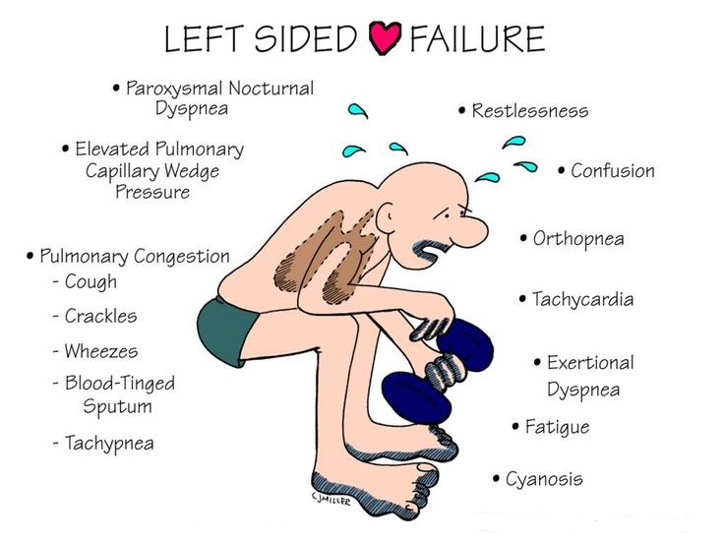
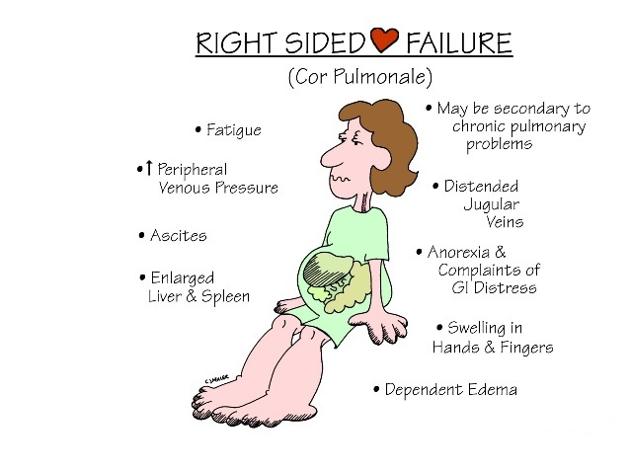
Clinical Picture of Left and Right-Sided Heart Failure

Slide 35
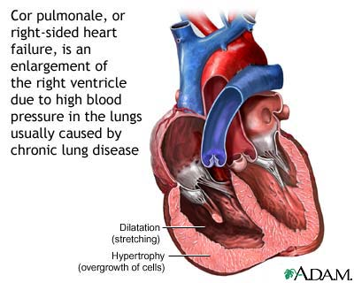
ONLY IN FEMALES’ SLIDES
Can You Have RVF without LVF?
This is called
COR PULMONALE
Or right sided heart failure
It is an enlargement of the right ventricle due to high blood pressure in the lungs usually caused by chronic lung disease.
Video of (LHF) Duration: (4:56 mins)
Video of (RHF) Duration: (4:21 mins)

Slide 36
Link to Editing File (Please be sure to check this file frequently for any edits or updates on all of our lectures.)
Quiz
https://www.onlineexambuilder.com/stroke-volume/exam-140345
References:
Girls’ and boys’ slides.
Guyton and Hall Textbook of Medical Physiology (Thirteenth Edition.)

Slide 37
Thank you!
اعمل لترسم بسمة، اعمل لتمسح دمعة، اعمل و أنت تعلم أن الله لا يضيع أجر من أحسن عملا.
The Physiology 436 Team:
Female Members:
Rana Barasain
Ashwaq Almajed
Amal AlQarni
Jawaher Abanumy
Reema Alotaibi Leena Alwakeel Hayfaa Alshaalan
Male Members:
Abdullah Abu-amarah
Abdulmajeed AL-Amar
Ali Alsubaie
Muhammad Almutlaq
Team Leaders:
Qaiss Almuhaideb
Lulwah Alshiha
Contact us:
Physiology436@gmail.com
@Physiology436

