Slide 1
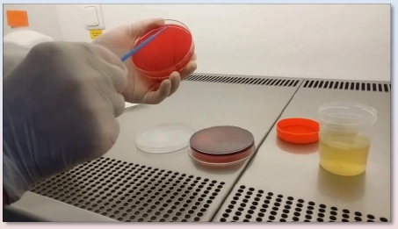
URINARY TRACT
INFECTION
Microbiology Practical Class
Renal System Block
First Year
Dr. Fawzia Al-Otaibi

Slide 2
Objectives
It is expected that by the end of this practical class, students should
be able to:
1.
2.
3.
Know the important steps in specimen collection and transport to
the lab.
How to process urine Specimens in the lab.
– Urine microbiological and biochemical analysis.
– Organisms culture and identification.
– Antibiotic susceptibility testing.
– Results interoperation.
Know the clinically important etiological Organisms associated
with UTI, their identification and susceptibility testing.

Slide 3
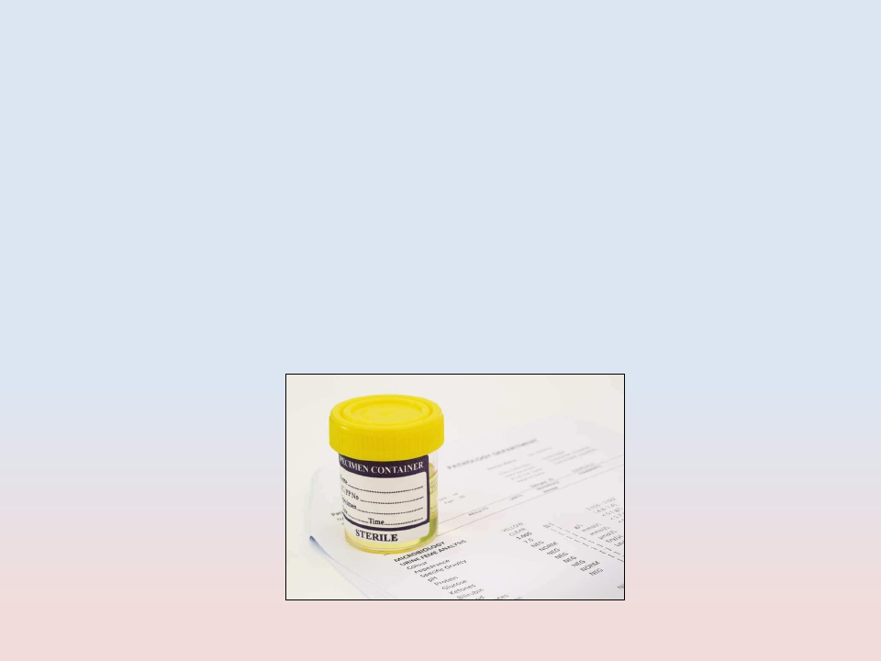
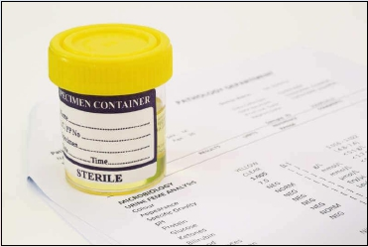
SPECIMEN
COLLECTION

Slide 4
TYPE OF SPECIMENS
➢Midstream urine (MSU)
➢Adhesive bag
➢Suprapubic Aspiration
➢Catheter sample

Slide 5
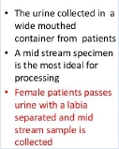
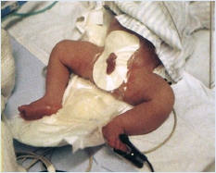
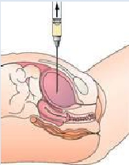
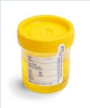
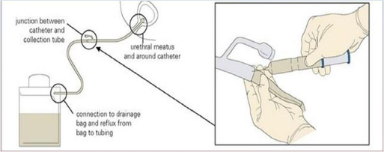
TYPE OF SPECIMENS
MidstreamUrine(MSU) | Adhesivebag | SuprapubicAspiration
Theurinarycatheter Urinespecimensforlaboratory investigationscanbecollectedfrom catheterizedpatientsasshown (left).Thesecondportisforputting fluidsintothebladder(right). Urinefromthedrainagebagshould notbetestedbecauseitmayhave beenstandingforseveralhours. Cathetersample

Slide 6
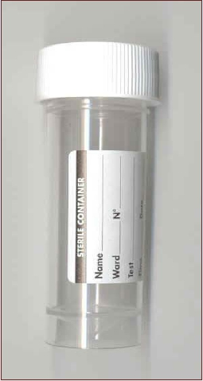
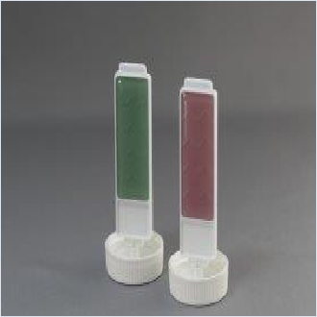
Sterile Urine Container
Dip slides
One side is CLED media, the
other can be MacConkey (MAC)
agar or blood agar.

Slide 7
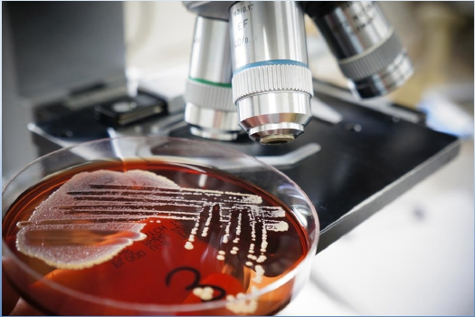
SPECIMEN
PROCESSING

Slide 8
Specimen processing:
1. Urine analysis
• Microbiological
• Biochemical
2. Culture and identification (ID)
3. Antimicrobial Susceptibility
testing
4. Results interpretation

Slide 9
1. Urine Analysis
➢ Biochemical
➢ Microbiological
❑ Macroscopic
❑ Microscopic

Slide 10
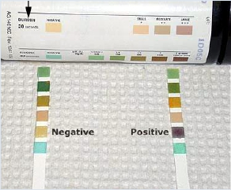
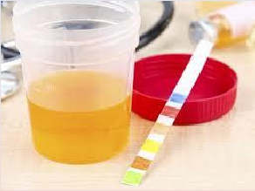
➢ Biochemical Urine
Examination (Dip stick)
• leukocyte esterase
• Nitrate test
• PH
• Glucose
• Bilirubin
• Protein

Slide 11
Testing for UTI
❑ Midstream clean catch with dipstick analysis
❑ Nitrite + → for gram-negative bacteria which can convert nitrate
to nitrite (sensitivity 92-100%, low specificity);
❑ false negative with bacteria that do not reduce nitrate
❑ gram-positive bacteria
❑ excess dietary Vitamin C
❑ Leukocyte esterase + → indicates presence of white blood cells,
(sensitivity 75-95%, specificity 94-98%) –
❑ Dipstick results may be affected by medications/dyes, ie pyridium,
nitrofurantoin, metronidazole, bilirubin, methylene blue, Vitamin B
complex

Slide 12
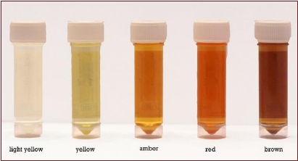
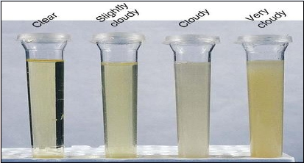
➢ Physical Urine Examination
❑ Macroscopic
• Color
• Odor
• Turbidity

Slide 13
Microbiological Urine
Examination
❑ Microscopic:
• Cell-counting (WBC, RBC)
• Parasite
• Casts
(Ovum, Trichomonas, yeast)

Slide 14
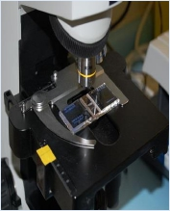
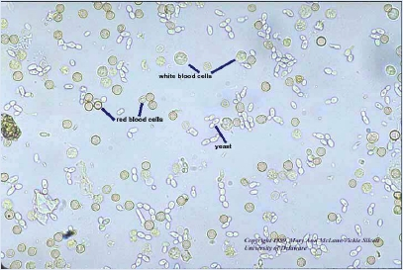
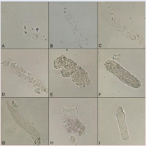
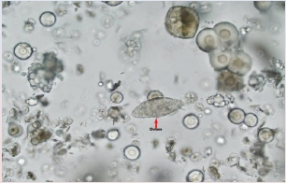
Microscopic Urine
Examination (WET MOUNT)
cell-counting(WBC,RBC)
Casts | Parasite

Slide 15
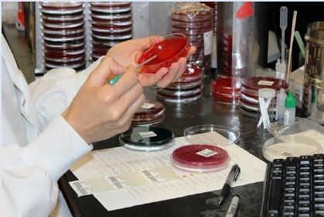
2. CULTURE AND ID

Slide 16
Culture and Identification
➢ Culture media
➢ Urine inoculation and reading of culture
➢ Identification of cultured organisms

Slide 17
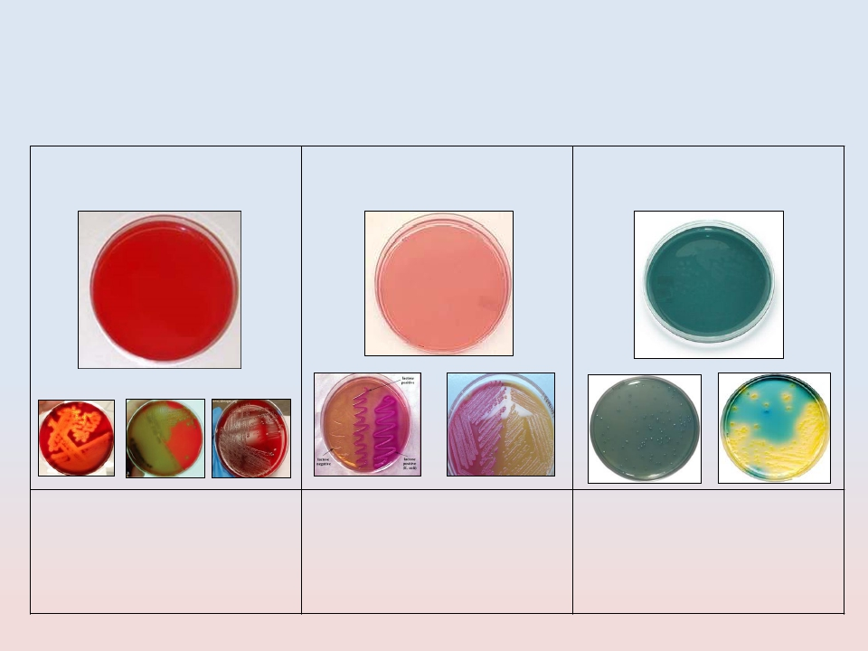
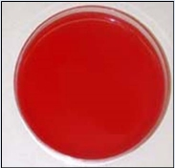
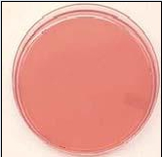
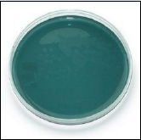
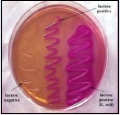
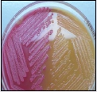
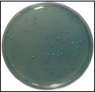
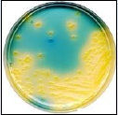
➢ Culture Media Routinely
Used for Urine Culture
BloodAgar | MacConkeyAgar | CLEDAgar
Enrichedculturemedium,for culturingfastidiousorganism andobservedthehemolytic reaction(Beta,Alpha,Gama). | Differentialculturemedium, showingbothlactoseandnon- lactosefermentingcolonies. LFC=PinkNLFC=Colorlessor appearsameasthemedium. | Selectiveculturemedium,for detectionandisolation ofE.coliandcoliformbacteria inurine.

Slide 18
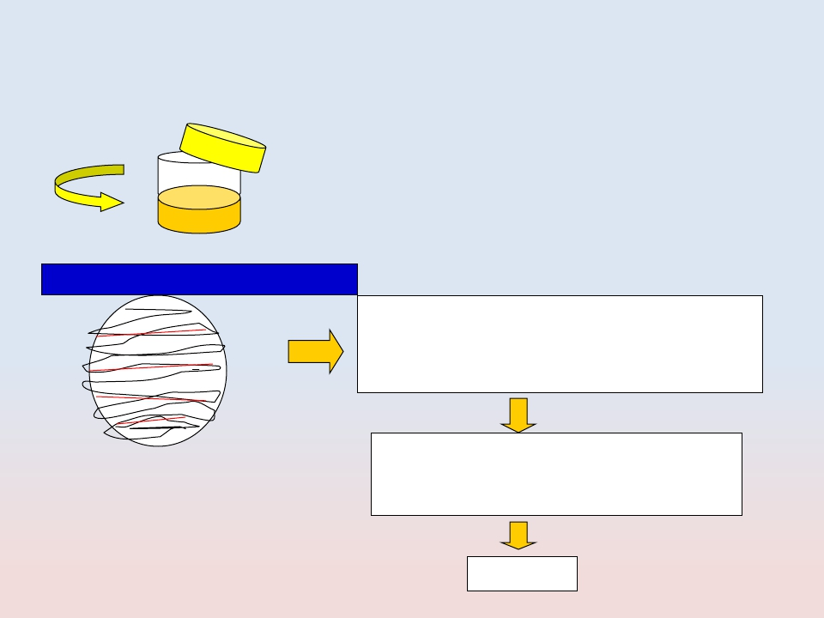
➢ Urine Inoculation
Quantitative (Colony counts)
+1
+2
+3
+4
a urine sample is streaked on surface of
Blood Agar plate and CLED agar / Mc
Conkey agar with a special loop
calibrated to deliver a known volume.
Over night incubation
Isolation of colonies,
Biochemical tests,
Drug susceptibility test,
Over night incubation
RESULT

Slide 19
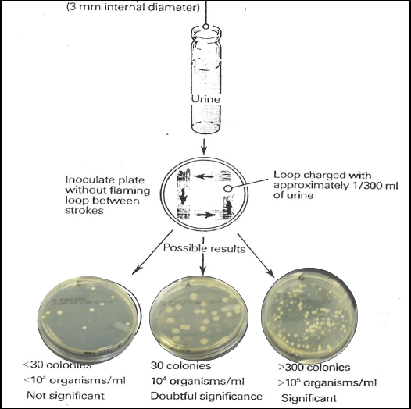
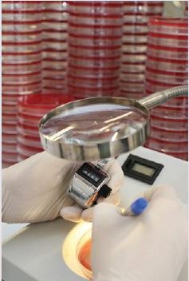
Smi-Qantitative Culture of
Urine Sample

Slide 20
➢ ID of cultured organisms
➢ Biochemical tests.
➢ Type of hemolysis
➢ Serological tests

Slide 21
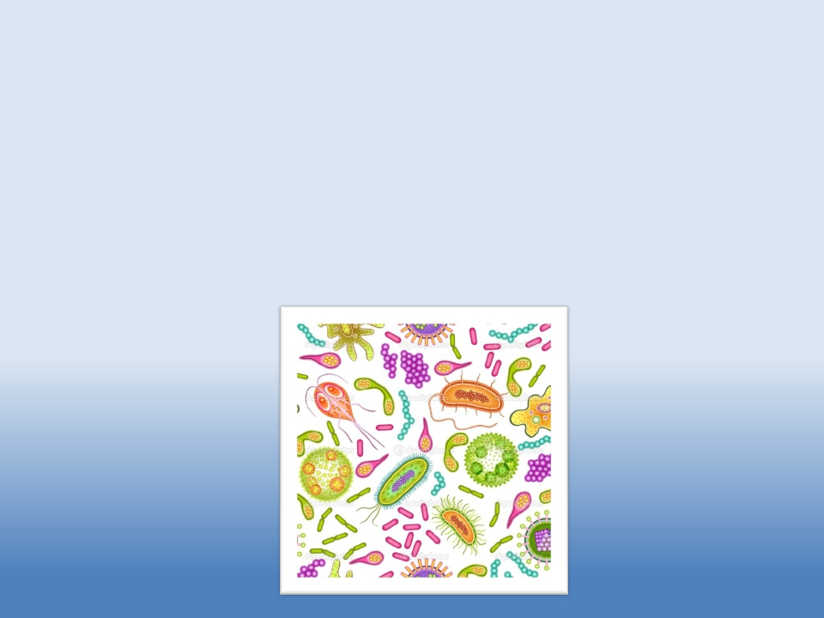
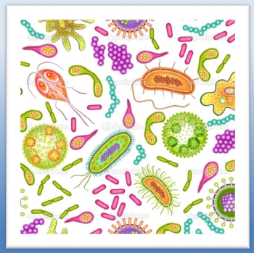
CLINICALLY IMPORTANT
MICROORGANISMS
CAUSING UTI

Slide 22
Etiological Agents of UTI
➢ Bacteria
➢ Fungi
➢ Parasites

Slide 23
BACTERIA
➢ Gram- negative bacilli
•
Enterobacteriace
• Non-Enterobacteriace
➢ Gram-positive cocci
➢ Staphylococci
▪
▪
Coagulase-positive (Staph. aureus)
Coagulase negative (Staph. saprophyticus , Staph.
Epidermidis)
➢ Streptococci
▪
▪
Streptococcus (group B)
Enterococci

Slide 24
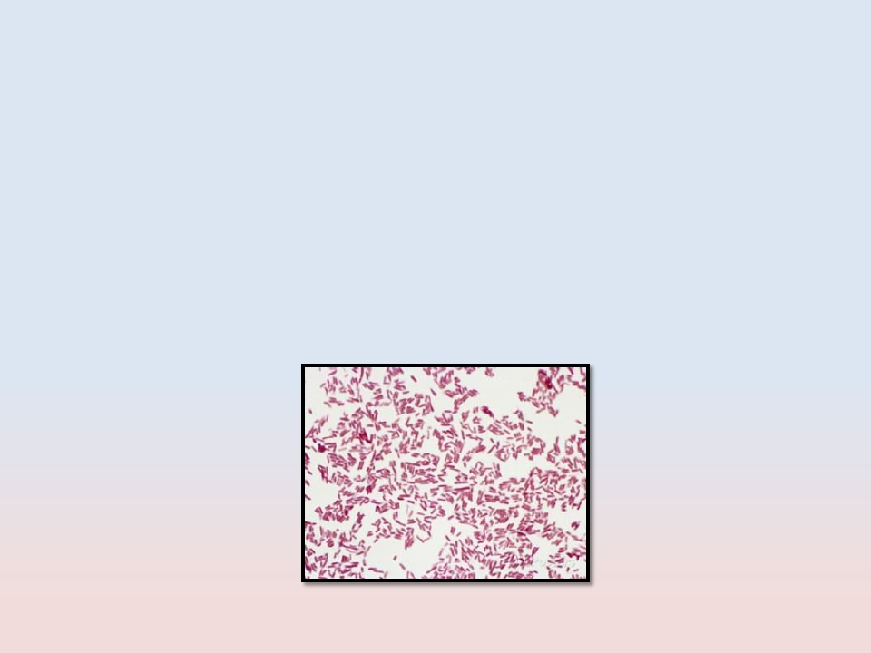
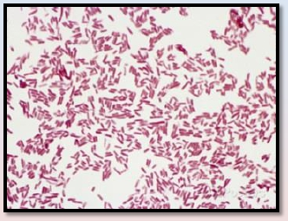
Gram Negative Bacilli
➢ Enterobacteriacae
➢ Non-Enterobacteriacae

Slide 25
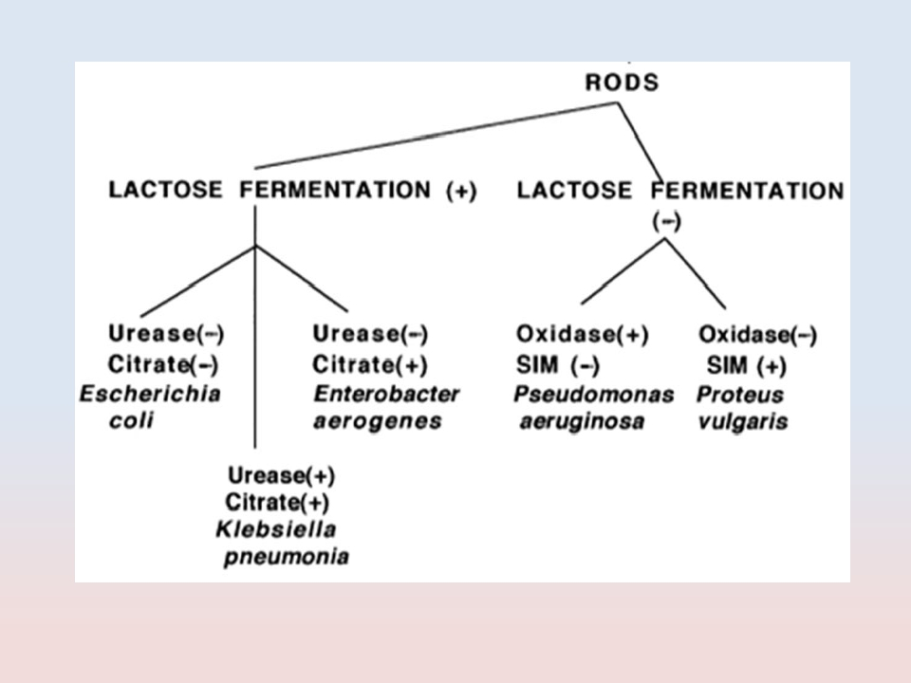
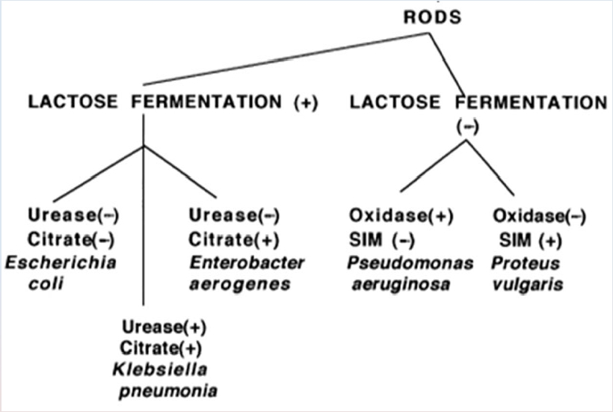

Slide 26
➢ Enterobacteriacae
• Escherichia coli
• Klebseilla
• Proteus
• Enterobacter
• Citrobacter

Slide 27
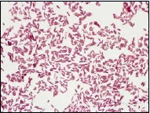
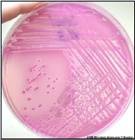
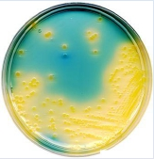
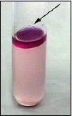
▪ E. coli
Morphology | MicroscopicappearanceGramnegativebacilli
Culture | MacConkeyagar showinggrowth ofLactose fermenter Pinkcolonies LFC |  | CLEDagar showinggrowth ofLactose fermenter yellowcolonies LFC
Identification | Indole Reactions Test: Positive | APE20Etest

Slide 28
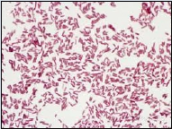
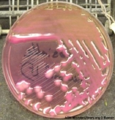
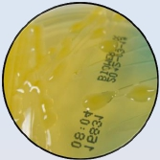
▪ Klebseilla spp
Morphology | MicroscopicappearanceGramnegativebacilli
Culture | MacConkeyagar showinggrowth ofLactose Fermenter MucoidPink colonies LFC |  | CLEDagar showinggrowth ofLactose fermenter Mucoidyellow colonies LFC
Identification | Indole Reactions Test: Negative | APE20Etest

Slide 29
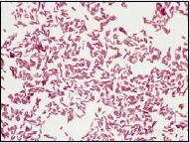
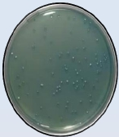
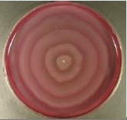
▪ Proteus spp
Morphology | MicroscopicappearanceGramnegativebacilli
Culture | Bloodculture plateshowing swarmof Proteus |  | CLED[(Cystine- Lactose-Electrolyte- Deficient)-Inhibits TheProteus Swarming
Identification | ProteusisUrease positive Ureasesplitsurea intoammonia;and alkalinizestheurine withproductionof crystals | APE20Etest

Slide 30
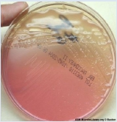
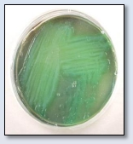
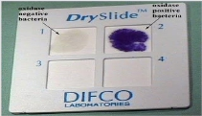
➢ Non-Enterobacteriacae
Pseudomonas spp
Morphology | MicroscopicappearanceGramnegativebacilli
Culture | MacConkeyagar showinggrowthof Non-Lactose Fermenter MucoidPink colonies LFC |  | NutrientAgar showinggrowth ofPseudomonas pigmentation
Identification | Oxidasepositivetest | APE20Etest

Slide 31
Gram Positive Cocci
➢ Staphylococci
➢
➢
➢
Coagulase-positive (Staph. aureus)
Coagulase negative (Staph. saprophyticus)
Coagulase negative (Staph. epidermidis)
➢ Streptococcus
➢ Enterococci
(group B)

Slide 32
Staph. aureus
Morphology | Microscopicappearance:Grampositivecocciinclusters
Culture | Bloodcultureplate showinggrowthof goldenyellowcolonies
Identification | + _ Coagulasetest=Positive | Catalase 2H2O2O2+2H2O Catalasetest=Positive Streptococcivs.Staphylococci

Slide 33
Staph. epidermidis
Morphology | Microscopicappearance:Grampositivecocciinclusters
Culture | Bloodcultureplate showinggrowthof whitecolonies
Identification | + _ Coagulasetest Negative | Catalase 2H2O2O2+2H2O Catalasetest=Positive Streptococcivs. Staphylococci | RS Staph.epidermidisvs.Staph. saprophyticus Novobiocintest Sensitive

Slide 34
Staph. saprophyticus
Morphology | Microscopicappearance:Grampositivecocciinclusters
Culture | Bloodcultureplate showinggrowthof whitecolonies
Identification | + _ Coagulasetest= Negative | Catalase 2H2O2O2+2H2O Catalasetest=Negative Streptococcivs. Staphylococci | RS NovobiocinTest Resistant

Slide 35
Strept. agalactiae
(group B)
Morphology | Microscopicappearance:Grampositivecocciinchains
Culture | Bloodcultureplateshowing growthofBeta-haemolitic colonies
Identification | CAMPtest Positive | Catalase 2H2O2O2+2H2O Catalasetest=Negative Streptococcivs.Staphylococci | Streptics Mixbacterialcolonywith variousgroup-specific antiseraonaslide

Slide 36
Enterococci
Morphology | Microscopicappearance:Grampositivecocciinchains
Culture | Bloodcultureplateshowing growthofBeta-haemolitic colonies
Identification | +- +- BothGroupDstreptococciand enterococciproduceapositive(left) bileEsculinhydrolysistest. | Catalase 2H2O2O2+2H2O Catalasetest=Negative Streptococcivs.Staphylococci

Slide 37
FUNGI

Slide 38
Candida albicans
Morphology | Microscopicappearance:Grampositivecocciinchains
Culture | Candidaalbicans onbloodagar | Candidaalbicanson(SDA) Sabouraud'sDextroseMedia
Identification | Chlamydosporetest Positive | Germtubetest Psitive

Slide 39
PARASITES CAUSING UTI
➢Schistosoma haematobium

Slide 40
FUNGI CAUSING UTI
➢Candida albicans

Slide 41
Schistosoma haematobium
(urine; eggs 115-170 x 45-65 micrometers)
(primates)

Slide 42
3. Antimicrobial
Susceptibility Testing
(AST)

Slide 43
Methods of AST
➢ Disk diffusion test
➢ E test

Slide 44
The Antibiotic Sensitivity Testing Method
Selectwell- isolatedcolonies | Inoculumsuspension | Spreadtheinoculum
Applyantibiotics disks | Readtheresult

Slide 45
➢ Disk Diffusion Method

Slide 46
➢ E TEST
• E-TEST
• Is a well-established method for
antimicrobial resistance testing
in microbiology laboratories.
• Consists of a predefined
gradient of antibiotic
concentrations on a plastic strip
• Used to determine the
Minimum Inhibitory
Concentration (MIC) of
– Antibiotics
– Antifungal agents
– Antimycobacterial agents

Slide 47
Enterobacteriacae
Antibiotic Susceptibility Test
• First line UTI treatment:
–
–
–
–
–
–
Ampicillin
TMP/SMX
Ciprofloxacin
Gentamicin
Amikacin
Nitrofunatoin

Slide 48
Bacterial Resistance to UTI Antibiotics
❑ Nitrofurantoin
– E. coli <5%
– Other uropathogens 15-20%
– Not active against
• Proteus,
• some Enterobacter
• Klebsiella
❑ TMP-SMX (Bactrim)
10-22% varies geographically
❑ Fluoroquinolones (Cipro)
therapy for acute uncomplicated cystitis
❑ Ampicillin
– 30% of E. coli resistant

Slide 49
Emerging resistant to
Ampicillin and TMP/SMX
Antibiotic
Ampicillin
Cephalexin
Ciprofloxacin
TMP/SMX
Nitrofurantoin
Gentamicin
Ceftriaxone
Imipenem
Organism
Source
MIC
≥ 32
≤ 4
≤ 4
≥ 2
≤ 16
≤ 8
≤ 1
≤ 1
E coli
urine
Interpretation
R
S
S
R
S
S
S
S

Slide 51
Extended spectrum β-lactamase (ESBL)
producing E coli
Antibiotic
Ampicillin
Cephalexin
Ciprofloxacin
TMP/SMX
Nitrofurantoin
Gentamicin
Ceftriaxone
Ceftazidime
Imipenem
MIC
≥ 32
≥ 46
≤ 4
≥ 2
≤ 16
≤ 8
≥ 46
≥ 46
≤ 1
Interpretation
R
R
S
R
S
S
R
R
S
ESBL positive E coli

Slide 53
Pseudomonas spp
Antibiotic Susceptibility Test

Slide 55
Staph. aureus
Antibiotic Susceptibility Test
Methicillin Sensitive Staph Aureus (MSSA)

Slide 57
MRSA

Slide 58
Staph. saprophyticus
Antibiotic Susceptibility Test
Novobiocin Test
Resistant

Slide 60
Results interpretation
❑ high probability of UTI requiring treatment
❑ If midstream clean catch positive for
❑ pyuria
❑ microscopic hematuria, with or without positive nitrites
❑ + UTI symptoms
❑ Presence of pyuria without bacteria on culture (sterile
pyuria) rule out:
– Tuberculosis
– Interstitial cystitis (IC)
– Chlamydia urethritis
– Kidney disease (stone, glomerulonephritis)

