Slide 1
Renal block
Hala kfoury, md

Slide 2
objectives
Understand the relationship between the anatomical structures of different components of the Renal system and their functions.
Discuss the pathology, microbiology, pathogenesis, and factors contributing to the development of most common diseases affecting the Renal system.
Use basic sciences to explain patient’s signs and symptoms, interpret investigation results, and provide justifications for their views.

Slide 3
objectives
Develop communication skills and explore psychosocial, and ethical issues in their assessment.
Use clinical cases to apply knowledge learnt, generate hypotheses, build an enquiry plan, and use evidence to refine their hypotheses, and justify their views.
Design a management plan, and understand the pharmacological basis of drugs used in the management of common diseases affecting the Renal system.

Slide 4
Acute kidney injury objectives
Introduction to the renal pathology
Acute Kidney Injury
Definition, Types, Clinical Overview, Causes
Pathological findings
Differential Diagnosis

Slide 5
This paraffin embedded 2µm section illustrates a normal glomerulus with normal vascular pole with minimal periglomerular interstitial fibrosis and surrounding intact tubules

Slide 6
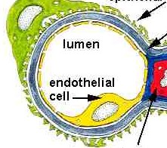
CAPILLARY WALL
FOOT PROCESSES
GBM
MESANGIUM

Slide 7
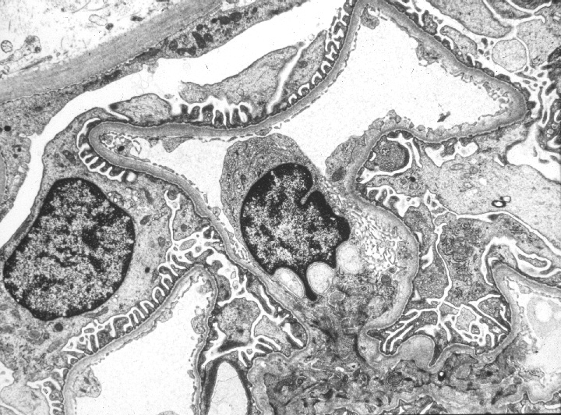
US
BC
Ep
CL
End
Ep
CL
Notes:
Ultrastructural details of normal capillary loops adjacent to Bowman's capsule (BC). CL=capillary lumen; US=urinary space, End=emdothelium, Ep=visceral epithelial cell.

Slide 8
Acute kidney injury is a syndrome defined by a sudden loss of renal function over several hours to several days.
Mayo Clin Proc. 2001;76:67-74
Notes:
Acute Kidney Injury

Slide 9
What constitutes the syndrome of ARF?
Accumulation of nitrogenous waste products.
Increased Scr.
Derangement of extracellular fluid balance.
Acid-base disturbance.
Electrolyte and mineral disorders.

Slide 10
What Constitutes Uremia?
Renal failure
Lethargy
Anorexia
Dysgeusia
Pericarditis
Neuropathy
Nausea and vomiting
Pruritis
Dyspnea

Slide 11
Azotemia: elevated blood urea nitrogen not from an intrinsic renal disease
Oliguria: urine output less than 500cc/24hr.
Nonoliguria: urine output greater than 500cc/24hr.
Anuria: urine output less than 50cc/24hr.

Slide 12
Etiology of ARF among Outpatients
AJKD 17:191-198, 1991

Slide 13
Etiology of ARF among Inpatients
KI 50:811-818, 1996

Slide 14
Etiology of ARF

Slide 15
Mortality of ARF
“Despite technical progress in the management of acute renal failure over the last 50 years, mortality rates seem to have remained unchanged at around 50%.”

Slide 16
Predictors of Dialysis in ARF
Oliguria:
<400cc/24hr 85% will require dialysis
>400cc/24hr 30-40% will require dialysis
Mechanical ventilation
Acute myocardial infarction
Arrhythmia
Hypoalbuminemia
ICU stay
Multi-system organ failure
JASN 9(4):692-698, 1998 Arch IM 160:1309-1313, 2000

Slide 17
The Pathophysiology of ARF
Acute renal failure
Prerenal
Intrarenal
Vascular
Glomerular
Tubular
Ischemia
Toxins
Pigments
Interstitial
Postrenal
Factitious
JASN 1998;9(4):710-718

Slide 18
Prerenal ARF (decreased renal blood flow)
Hypotension
Sepsis, cardiogenic, medication
Cardiogenic
Vascular
Vasculitis, renal artery compromise, AAA, atheroemboli
Third Spacing
Bowel obstruction, cirrhosis, nephrotic syndrome, major surgery,
Volume depletion
GI losses: vomiting, diarrhea
Skin losses: burns, sweat
Renal losses: DKA, DI, Addison’s, Na wasting
Drug-induced
NSAID, CsA, FK506, ACE, ARB

Slide 19
There is a continuum from prerenal physiology to ischemic pathology.

Slide 20
Tubular Toxins
Antimicrobials: aminoglycosides, vancomycin, foscarnet, pentamidine, amphotericin B
Chemotherapeutics: cisplatin, mitomycin C, ifosfamide
Immunotherapy: IVIG
Complex Sugars: maltose, sucrose, mannitol
Heavy metals
Sepsis, hypoxia
Radiocontrast agents

Slide 21
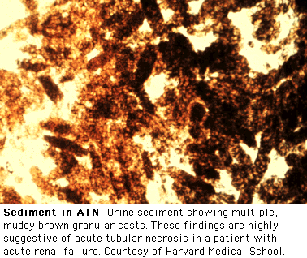
Uptodate Online 11.2, Rose BD, 2003

Slide 22
Acute tubular injury is a clinicopathological entity: defined by 1- acute renal failure. 2- tubular injury/necrosis
Notes:
Acute Kidney Injury

Slide 23
ACUTE RENAL FAILURE
Acute tubular necrosis (ATN)
Ischemic
1. Shock 2. Sepsis 3. Incompatible blood transfusions
4. thrombotic diseases

Slide 24
ACUTE RENAL FAILURE
Acute tubular necrosis (ATN)
III. Toxic : A- Endogenous: Crush injury- Hemoglobinopathy.
B- Exogenous: Drugs- radiocontrast dye- metals..

Slide 25
Acute tubular necrosis (ATN)
Clinicopathological entity
Destruction of tubular epithelial cell
Clin. acute suppression of renal function
(no urine or below 400 ml/24h)
Most common cause of renal failure

Slide 26
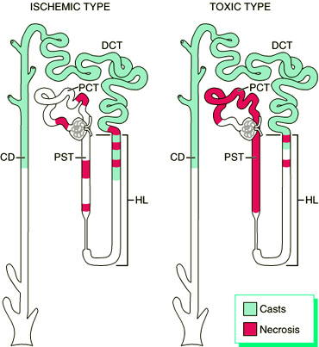
ATN :
Acute
tubular
necrosis

Slide 27
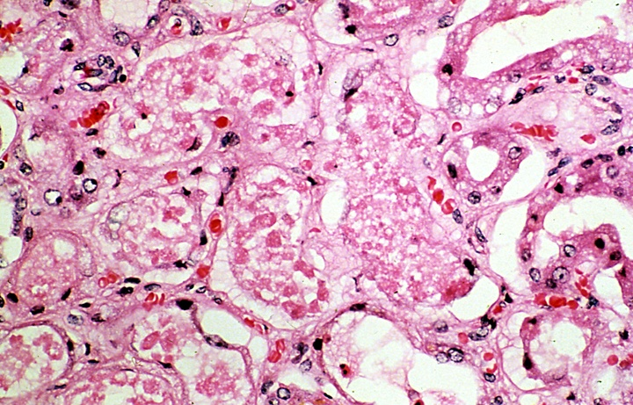

Slide 28
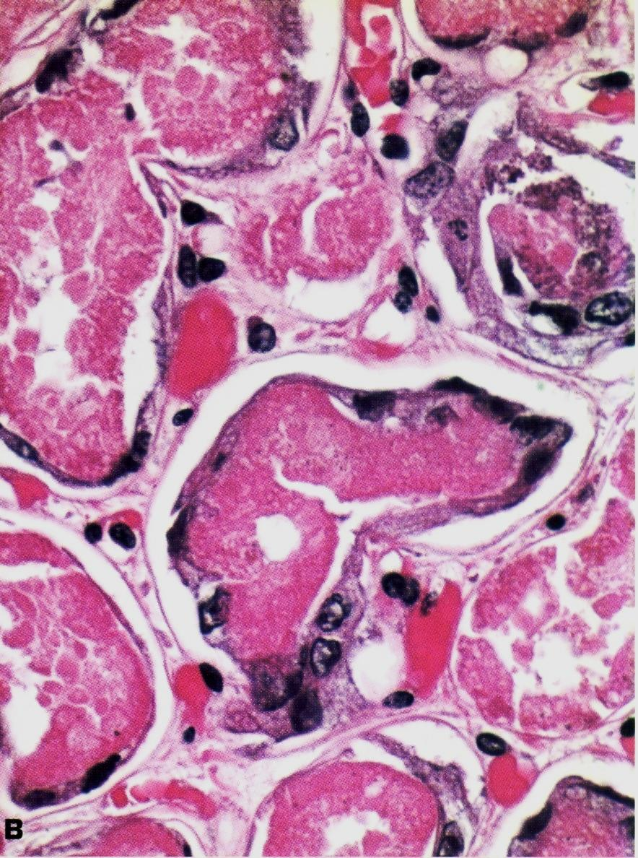
Kidney in acute tubular necrosis (ATN) showing pale, swollen cortex and congested medulla.
Elongated, stretched out, regenerating proximal tubular lining cells encompass the necrotic epithelium.

Slide 29
RPGN (Rapidly Progressive Glomerulonephritis) is a syndrome defined by the rapid loss of renal function over days to weeks due to acute glomerulonephritis.

Slide 30
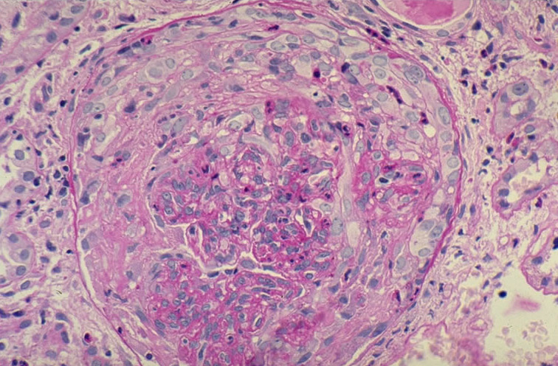
Notes:
Crescentic glomerulonephritis: this image shows details of the cellular composition of the crescent. Notice mostly mononuclear cells (monocytes, epithelioid cells, proliferated parietal epithelial cells from Bowman's capsule, some polymorphonuclear neutrophils) in the crescent and the collapsed, fragmented capillary tuft, as highlighted by the PAS positive basement membranes (center and right). (PAS)

Slide 31
Acute Kidney Injury
Homework :
1- Autosomal dominant polycystic kidney disease
2- Autosomal recessive polycystic kidney disease
3- Renal dysplasia

