Slide 1
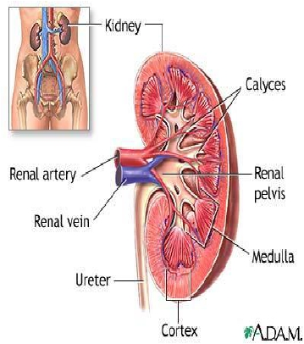
DIURETICS
Part 1
Prof. Hanan Hagar
Pharmacology Unit

Slide 2
Diuretics
Are drugs that increase renal excretion
of sodium and water resulting in
increase in urine volume.
Diuresis: is the process of excretion
of water in the urine.
○
○
Natriuresis:
is the process of excretion
of sodium in the urine .

Slide 3
Mechanism of actions of diuretics
Most
diuretics act by interfering with the
normal sodium reabsorption by the renal
tubules resulting into sodium and water
excretion.

Slide 4
Normal Sodium Re-absorption
Nephron Segment
Proximal convoluted
tubules
Ascending
Loop of Henle
Distal convoluted
tubules
Cortical Collecting
Tubules
Filtered Na+ re-absorbed
65 %
Na , HCO3
20-30%
Active reabsorption
Na, K, Cl
Ca and Mg
5-10%
Active reabsorption
Na, Cl
5%
Na reabsorption
K & H secretion

Slide 5
Normal Sodium Re-absorption
Nephron
Segment
Proximal
convoluted
tubules
Ascending
Loop of Henle
Distal
convoluted
tubules
Cortical
Collecting
Tubules
Na+Transporter
Na+/H+ transporter
Carbonic anhydrase
enzyme
Na+/K+/2Cl-
cotransporter
Na+/Cl-
transporter
Na+ channel
Aldosterone
Antidiuretic hormone
Filtered Na+ re-
absorbed
65 %
As Na, HCO3
20-30%
Active reabsorption
Na, K, Cl
5-10%
Active reabsorption
Na, Cl
5%
Na reabsorption
K & H secretion

Slide 6
Site of action of diuretics
segment
Proximal
convoluted
tubules
Proximal
Straight
Tubules
Function
Re-absorption of 100%
glucose and amino acids,
66% Na, K, Ca, Mg; 85%
NaHCO3
Secretion and re-
absorption of organic
acids and bases
transporter
Na/H transporter
Carbonic anhydrase
enzyme
Acid & base transporter
Thick ascending Active reabsorption
Na/K/2Cl transporter
loop
Distal
convoluted
tubules
Collecting
tubules
25% Na, K, Cl,
Secondary re-absorption
of Ca, Mg
Active tubular
reabsorption of 5%Na, Cl,
Ca
Na reabsorption
K & H secretion
Na and Cl cotransporter
Na channels
K & H transporter

Slide 7
Sites of action for diuretics
How diuretics produce their effects?
➢Diuretics
affect carriers or transporters in
luminal membrane of renal tubular cells
required for tubular reabsorption of
sodium from filtrate back into blood.

Slide 8
Types of diuretics
Nephron
Segment
Proximal
convoluted
tubules
Ascending
Loop of Henle
Distal
convoluted
tubules
Cortical
Collecting
Tubules
Na+
Transporter
Na+/H+ transporter
Carbonic anhydrase
enzyme
Na+/K+/2Cl-
cotransporter
Na+/Cl-
transporter
Na+ channel
Aldosterone
Diuretics
Carbonic anhydrase
inhibitors
Loop diuretics
Thiazide diuretics
K-sparing diuretics

Slide 9
Classification of diuretics
Carbonic anhydrase inhibitors
Loop diuretics
Thiazide diuretics
Potassium-sparing diuretics
Osmotic diuretics
○
○
○
○
○

Slide 10
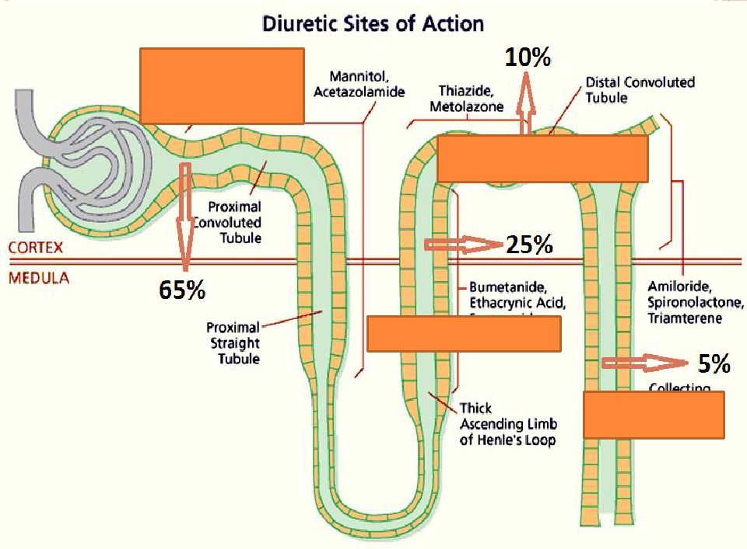
Carbonic
anhydrase
inhibitors
Thiazide
diuretics
Loop diuretics
K-sparing
diuretics

Slide 11
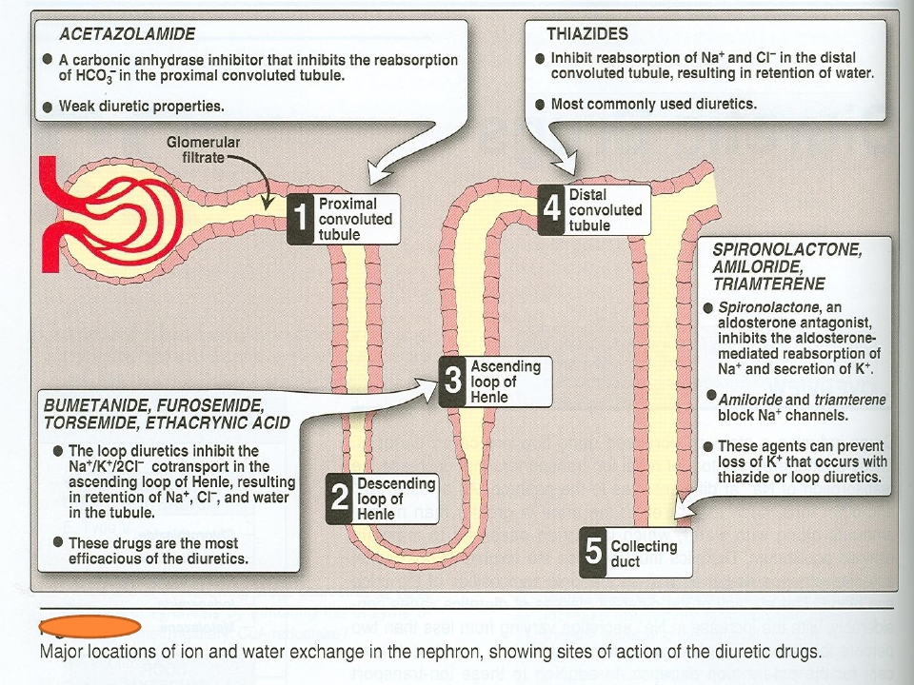

Slide 12
Carbonic Anhydrase Inhibitors

Slide 13
Carbonic Anhydrase Inhibitors
Acetazolamide – dorzolamide
Mechanism of action:
Site of action: proximal convoluted tubules
Inhibits carbonic anhydrase (CA) enzyme in
proximal convoluted tubules thus interferes with
NaHCO3 re-absorption and causes diuresis.

Slide 14
Carbonic Anhydrase Inhibitors
CA is required for reversible reaction,
in which CO2 +H2O
H2CO3
H+
HCO3-

Slide 15
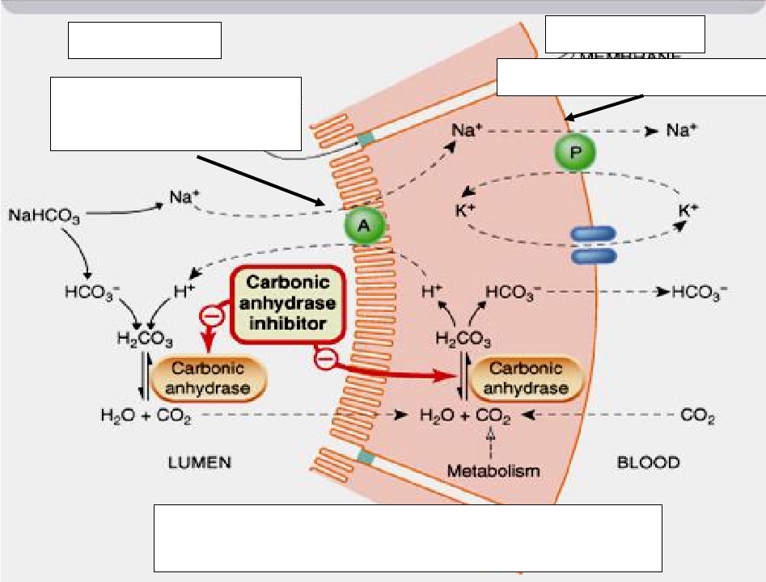
Lumen
Luminal membrane
Blood
Basolateral membrane
Proximal tubules

Slide 16
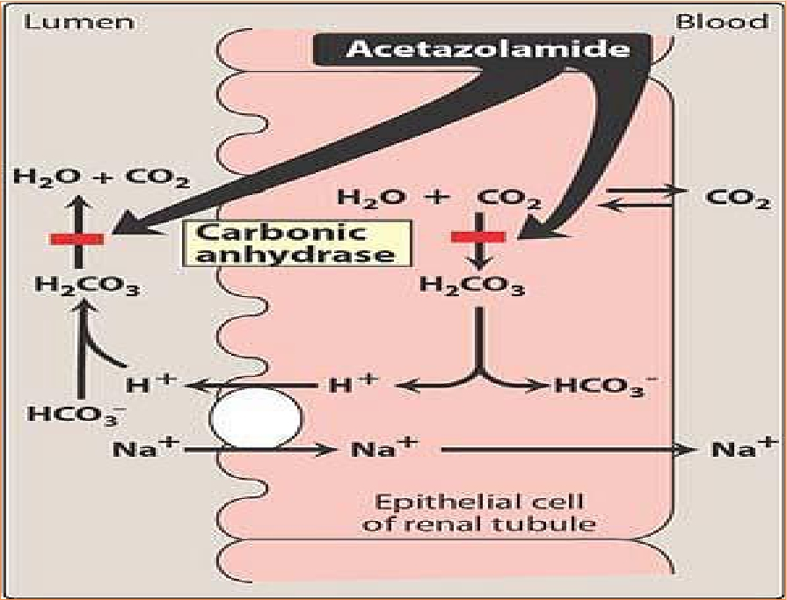

Slide 17
Pharmacokinetics:
 given
 Onset
orally once a day.
of action is rapid (30 min).
 Duration
 Excreted
of action (12 h).
by active secretion in
proximal convoluted tubules.
Produces alkaline urine


Slide 18
Pharmacological actions:
 ↑
 ↑
urine volume mildly
urinary excretion of sodium, potassium ,
bicarbonate (alkaline urine).
Metabolic acidosis.

 ↑
Urinary phosphate excretion.
 Promotes
K+ excretion by ↑the load of Na+
delivered to the distal tubules.

Slide 19
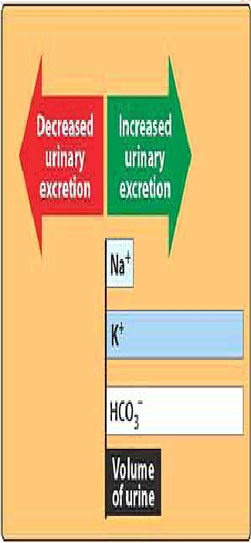
Why do CAinhibitors have
weak diuretic properties?
Diuretic propertiesdecreases
after several days as the blood
bicarbonate falls.

Slide 20
Therapeutic uses:

Open angle glaucoma
carbonic anhydrase inhibitors cause
↓ IOP by reducing aqueous humor
formation in ciliary body of eye.

As prophylactic therapy, in acute
mountain sickness ↓ CSF of brain
given nightly 5 days before the ascent ↓ weakness,
breathlessness , dizziness, nausea, cerebral & pulmonary
oedema.
IOP: Intraocular pressure; CSF: Cerebrospinal fluid

Slide 21
Therapeutic uses:




Epilepsy (decrease cerebrospinal fluid,
CSF).
Metabolic alkalosis
Urinary alkalinization to enhance renal
excretion of acidic substances (cysteine in
cystinuria).
Hyperphosphatemia

Slide 22
Adverse effects:




Hypokalemia (potassium loss).
Metabolic acidosis.
Renal stone formation (calcium
phosphate stones).
Hypersensitivity reaction.

Slide 23
Dorzolamide
Is a carbonic anhydrase inhibitor
Used topically for treatment of open-
angle glaucoma.
no diuretic or systemic side effects (Why?)




Slide 24
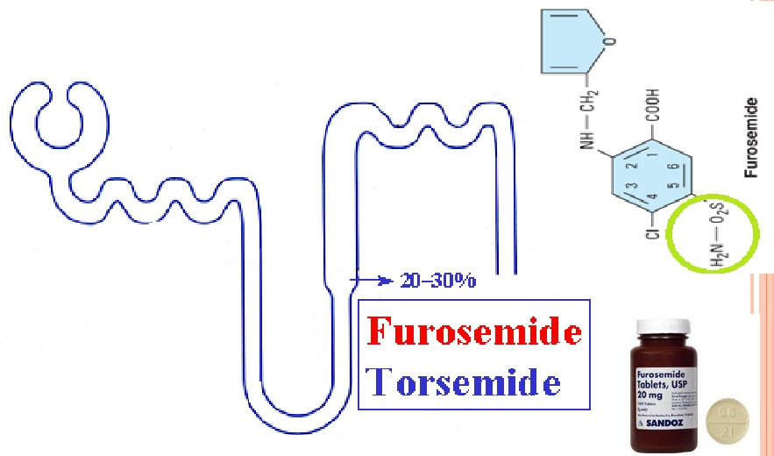
Loop Diuretics

Slide 25
LOOP DIURETICS
High Ceiling diuretics
most potent diuretic , termed “high
The
ceiling diuretic”
Efficacy: High natriuresis as 25-30% Na+ is
reabsorbed.
Drugs
as:


Furosemide - Torsemide
Bumetanide - Ethcrynic acid

Slide 26
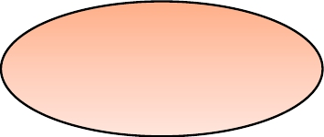
Loop Diuretics
High Ceiling Diuretics
Ethacrynic
Acid
Potency 0.7, t½ 1h
Torsemide
Potency 3, t½ 3.5h
Bumetanide
Potency40 ,t½ 0.8 h
Furosemide
Potency 1, t½ 1.5h

Slide 27
LOOP DIURETICS
Mechanism:
inhibit Na+ / K+ / 2 Cl- co-transporter
in the luminal membrane of the
thick ascending loop of Henle (TAL).
inhibit Ca++ and Mg ++re-absorption.
○
○

Slide 28
Ascending loop of Henle
Is impermeable to water
In thick ascending loop of Henle (TAL) is
responsible for active re-absorption of Na, K
and Cl (25-30% Na+ is reabsorbed) via
transport system in luminal membrane called
Na+/ K+ / 2Cl- co-transporter
Ca and Mg are reabsorbed and enter the
interstitial fluid via paracellular pathway




Slide 29
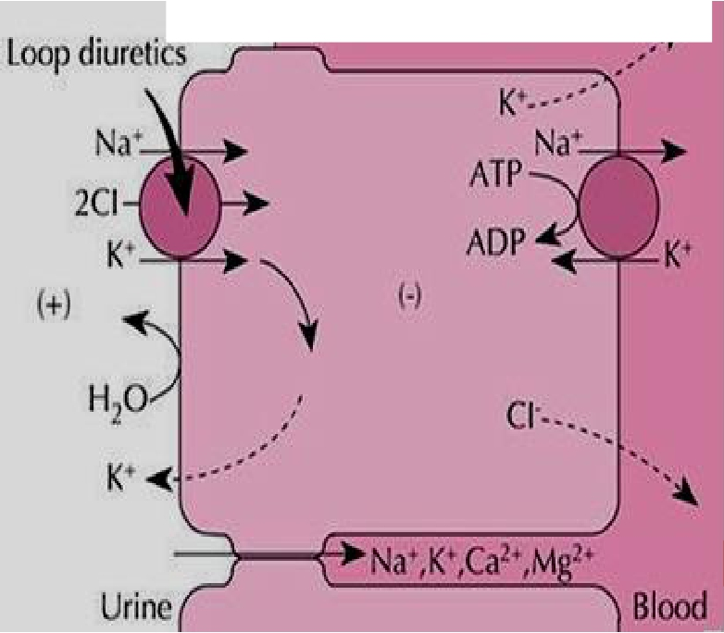
Ascending loop of Henle

Slide 30
Pharmacokinetics
 Given
orally or I. V.
 Have
fast onset of action (suitable
for emergency)
 Have
short duration of action.
 Excreted
by active tubular secretion
of weak acids into urine
 Interfere
with uric acid secretion
(hyperuricemia).

Slide 31
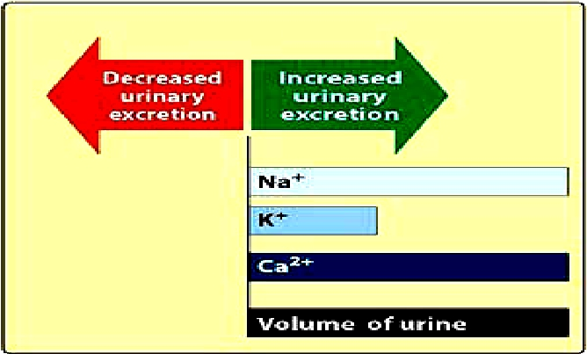
Pharmacological effects:
↑
urinary excretion of Na+ and K+
↑ urinary excretion Ca++ and Mg ++
↑ urine volume
↑ renal blood flow.

Slide 32
Uses:
are drug of choice for emergency
situations as:
 Edema
associated with congestive heart
failure, nephrotic syndrome
 Acute
 Acute
 Acute
pulmonary edema
hyperkalaemia.
hypercalcemia

Slide 33
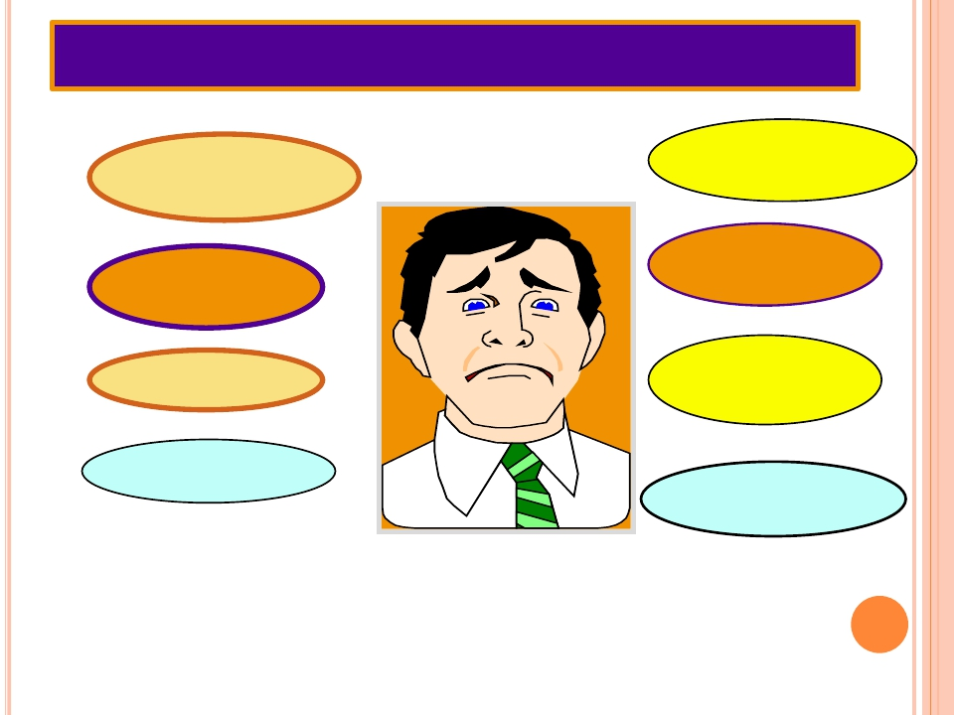
ADVERSE EFFECTS
Volume
Depletion
Hypokalemia
Hypocalcaemia
Hypomagnesaemia
Metabolic
Alkalosis
Ototoxicity
Hyperuricemia
Hyperglycemia

Slide 34
Adverse effects :
 Hypovolemia
 Hyponatraemia
(↓ blood Na+).
 Hypokalemia
(↓ blood K+)
 Hypomagnesaemia
(↓ blood Mg2+)
 Hypocalcaemia
(↓ blood Ca2+)
 Metabolic
alkalosis.
 Postural
hypotension

Dietary K supplementation or K-sparing diuretics
should be used to avoid hypokalemia .

Slide 35
Adverse effects :
 Hyperuricemia
(increase blood uric
acid and gouty attack).
 Ototoxicity
(risk increased if
combined with aminoglycosides)
 Allergic
reactions

Slide 36
Thiazide diuretics
Drugs as:
Chlorothiazide
Hydrochlorothiazide
Chlorthalidone
Metolazone
Indapamide

Slide 37
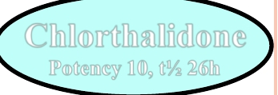
THIAZIDE DIURETICS
Chlorthalidone
Potency 10, t½ 26h
Indapamide
Potency 20, t½ 16h
Chlorothiazide
Potency 0.1, t½ 2h
Metolazone
Potency 5, t½ 5h
Hydrochlorothiazide
Potency 1 , t½ 3h

Slide 38
Thiazide diuretics
Mechanism of action:
acts via inhibition of Na/Cl
co-transporter on the luminal
membrane of distal convoluted
tubules.
Efficacy:
Moderate natriuresis (5-
10% of filtered load of sodium is
reabsorbed).

Slide 39
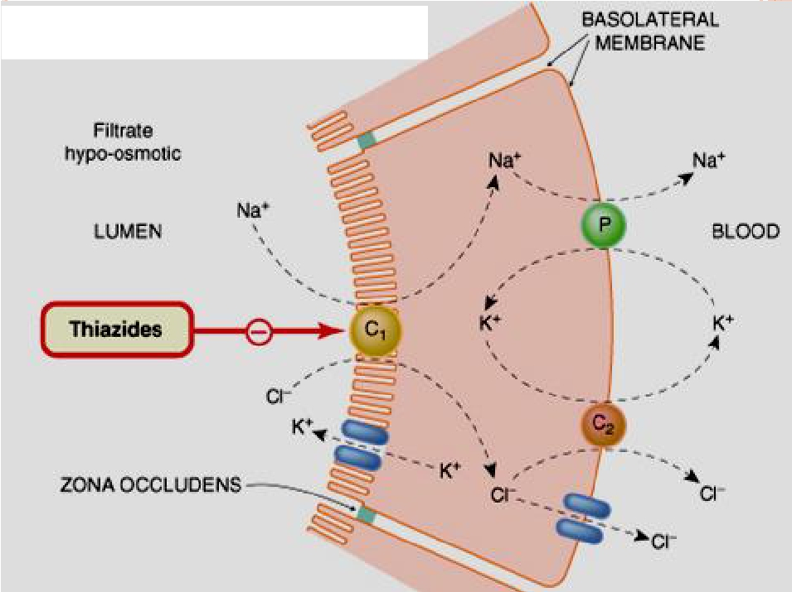
Distal convoluted tubules

Slide 40
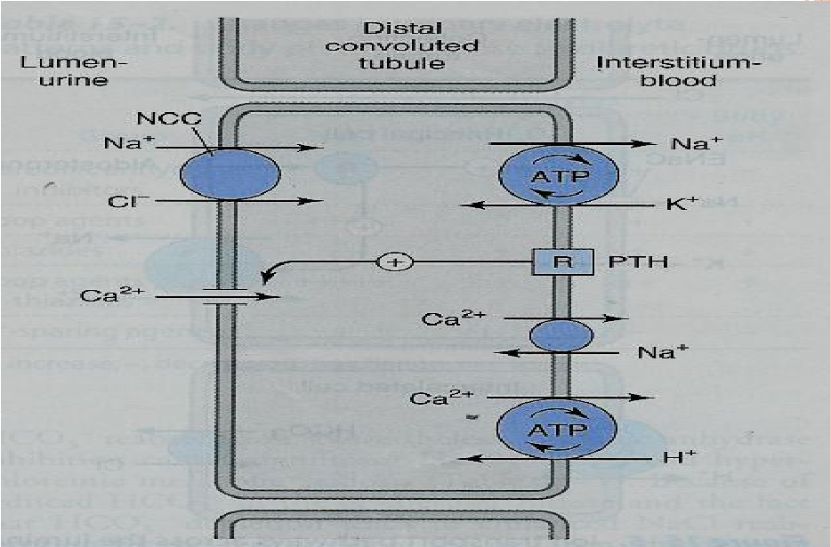
Mechanism of action of thiazide diuretics

Slide 41
Pharmacokinetics:
Given
orally, slow of onset
long duration of action (40 h)

are
secreted by active tubular
secretory system of the kidney
may
interfere with uric acid
secretion and cause hyperuricemia

Slide 42
Pharmacological effects:
urinary NaCl excretion
urinary K excretion (Hypokalemia)
urinary magnesium excretion
urinary calcium excretion
calcium re-absorption hypercalcemia

Slide 43
Thiazide diuretics

Slide 44
Uses:
Treatment
of essential hypertension
(cheap-well tolerated).
Treatment
of mild heart failure (to
reduce extracellular volume).

Slide 45
Uses:
Calcium
nephrolithiasis due to
hypercalciuria (to increase calcium
re-absorption and decrease renal
calcium stones)
Nephrogenic diabetes insipidus
(decrease blood volume and GFR)
○

Slide 46
Mechanism of antidiuretic effect of thiazide in diabetes
insipidus
Thiazide
Urine volume
Distal tubular Na+
reabsorption
Urinary
excretion
Distal delivery of Na+ &
water
Proximal Na+ &
Water reabsorption
Extracellular
volume

Slide 47
Adverse effects:
 Fluid
and electrolyte imbalance
 Hyponatremia
 Hypovolemia (volume depletion)
 Hypokalemia
 Metabolic alkalosis.
 Hyperuricaemia (gout)
 Hypercalcemia
 Hyperglycaemia
 Hyperlipidemia

Slide 48
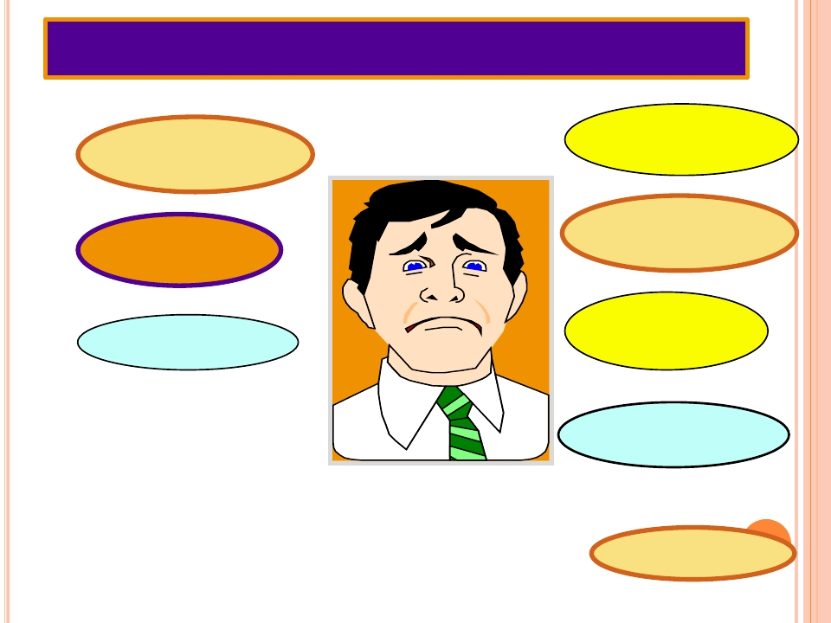
ADVERSE EFFECTS
Volume
Depletion
Hypokalemia
Hypomagnesaemia
Metabolic
Alkalosis
Hyperlipidemia
Hyperuricemia
Hyperglycemia
Hypercalcaemia

Slide 49
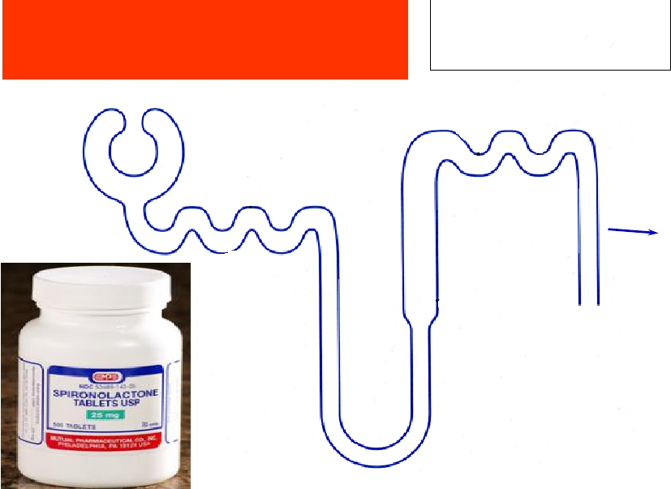
Potassium-
sparing diuretics
Amiloride
Triamterene
Spironolactone
5%

Slide 50
Potassium-sparing diuretics
Steroids
Nonsreroids
Aldosterone antagonists
•Spironolactone
Na+ channels
inhibitors
•Amiloride
•Triamterene

Slide 51
Mechanism of action
Act
in collecting tubules and ducts
by inhibiting Na re-absorption and K
& H excretion (K-sparing effect) by
either:
Inhibition
of Na influx through Na
channels in the luminal membrane
(triamterene – amiloride).

Slide 52
Mechanism of action

or by antagonizing cytoplasmic
aldosterone receptors (spironolactone).

Slide 53
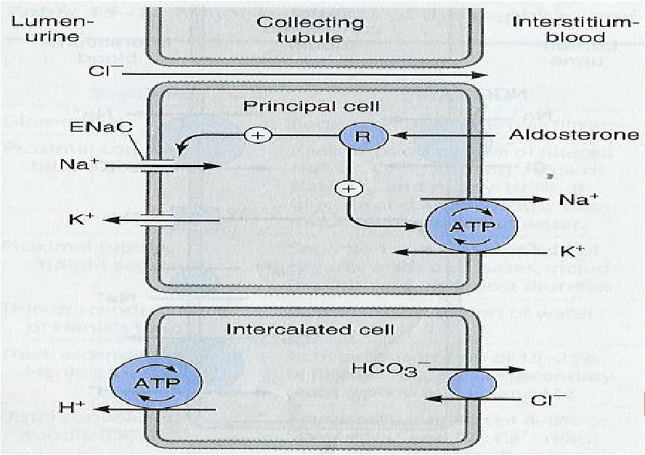
COLLECTED TUBULES (CT)

Slide 54
Pharmacodynamics:
urinary Na+ excretion
urinary K+ excretion Hyperkalemia
H+ excretion (acidosis)
○
○
○

Slide 55
Therapeutic uses:
Drug
of choice for patients with
hepatic cirrhosis

Secondary hyperaldosteronism
(CHF, hepatic cirrhosis, nephrotic
syndrome).

Treatment of hypertension
(combined with thiazide or loop
diuretics to correct for hypokalemia).

Slide 56
Adverse Effects
Hyperkalaemia.
Metabolic
acidosis.
Gynaecomastia
GIT
upset and peptic ulcer

Slide 57
Contraindications:
Hyperkalaemia: as in chronic
renal failure, K+ supplementation,
β-blockers or ACE inhibitors.
liver disease (dose adjustment is
needed).

Slide 58
Osmotic diuretics
60–80%

Slide 59
Osmotic diuretics
Mannitol:
Poorly absorbed


If given orally
osmotic diarrhea



Given intravenously
Not metabolized
Excreted by glomerular filtration without
being re-absorbed or secreted within 30-60 min

Slide 60
Mannitol
in proximal tubules & descending loop
Acts
of Henle by osmotic effect.

Mannitol, IV, ↑water excretion with
relatively less effect on Na+ (water diuresis).

Expand the extracellular fluid volume,
decrease blood viscosity, and inhibit renin
release, ↑renal blood flow.

Slide 61
Therapeutic Uses:

Acute renal failure due to shock or
trauma (maintain urine flow- preserve kidney
function).

In acute drug poisoning: To eliminate drugs
that are reabsorbed from the renal tubules e.g.
salicylates, barbiturates.
 To ↓ intracranial & intraocular pressure before
ophthalmic or brain procedures (cerebral edema).

Slide 62
Adverse Effects:
Headache,
nausea, vomiting

Extracellular volume expansion,
complicates heart failure & pulmonary
oedema
Excessive use→ dehydration &
hypernatremia (adequate water
replacement is required).

Slide 63
Therapeutic applications of diuretics
Treatment of hypertension:
o Thiazide diuretics
o used alone or in combination with beta-
blockers at low-dose (fewer side effects)
o In presence of renal failure, loop diuretic
is used.

Slide 64
Congestive Heart failure
➢ Thiazides may be used in only mild cases
with well-preserved renal function
➢ Loop diuretics are much preferred in
severe cases especially when GF is
lowered
➢ In life-threatening acute pulmonary
edema, furosemide is given IV.
Edema States Thiazide diuretic is used in
mild edema with normal renal function
o Loop diuretics are used in cases with
impaired renal function.

Slide 65
Renal failure
➢ Thiazides are used till GFR ≥ 40-50 ml/min
➢ Loop diuretic are used below given values.
Diabetes inspidus
Large volume(>10 L/day) of dilute urine
thiazide diuretics reduces urine volume
Hepatic cirrhosis with ascites
➢ Spironolactone is of choice.

Slide 66
Diuretics
CA inhibitors
Acetohexamide
Dorzolamide
Osmotic diuretic
Mannitol
Loop diuretics
Furosemide
Thiazide diuretics
hydrochlorothiazide
K-sparing diuretic
Spironolactone.
Mechanism of
action
Inhibition of
NaHCO3
reabsorption in
PCT
Osmotic effect in
PCT
Na/K/2Cl
transporter in TAL
the most effective
Na and Cl
cotransporter in
DCT
competitive
antagonist of
Effects
− Urinary Na HCO3, K
Urinary alkalosis
Metabolic acidosis
−Urine excretion
− Little Na
−Urinary Na, K, Ca, Mg
−Urinary Na, K, Mg
BUT↓ urinary Ca
(hypercalcemia)
Metabolic alkalosis
↑ Urinary Na
↓ K, H secretion
aldosterone in CCT Metabolic acidosis

Slide 67
Diuretics | Uses
CAinhibitors Acetohexamide Dorzolamide(topically)for glaucoma | Glaucoma,epilepsy Mountainsickness Alkalosis Phosphatemia
Osmoticdiuretic Mannitol | •Cerebraledema,glaucoma •Acuterenalfailure,drugtoxicities
Loopdiuretics Furosemide | Acutepulmonaryedema(Drugof choice) Heartfailure Hyperkalemia,Hypercalcemia
Thiazidediuretics hydrochlorothiazide | Commonlyused Hypertension,mildheartfailure, nephrolithiasis,diabetesinspidus
K-sparingdiuretic Spironolactone. | Hepaticcirrhosis (Drugofchoice)

Slide 68
Diuretics
CA inhibitors
Acetohexamide
Dorzolamide
Osmotic diuretic
Mannitol
Loop diuretics
Furosemide
Thiazide diuretics
hydrochlorothiazide
K-sparing diuretic
Spironolactone.
Side effects
Metabolic acidosis , Urinary alkalosis
Hypokalemia
Extracellular water expansion
Dehydration
Hypernatremia
Hypokalemia,
hypovolemia, hyponatremia, hypomagnesemia,
hypocalcemia
Precipitate gout, alkalosis
Hypokalemia, hyponatremia, hypovolemia,
hypomagnesemia, hypercalcemia
Alkalosis, precipitate gout
Hyperlipidemia, hyperglycemia
Gynaecomastia
Hyperkalaemia, Metabolic acidosis.
GIT upset and peptic ulcer

