Slide 1
ABNORMALITIES IN
ACID-BASE BALANCE

Slide 2
Abnormalities inAcid-Base Balance
• Many critical illnesses can disturb acid-base balance.
• Acid-base disturbances may indicate an underlying
disease or organ damage.
• Accurate interpretation of acid-base disturbances requires
the following:
✓ Arterial blood gases.
✓ Plasma electrolytes.
✓ Knowledge of the compensatory physiologic mechanisms.
(Appel & Downs. 2008. Understanding acid-base balance)

Slide 3
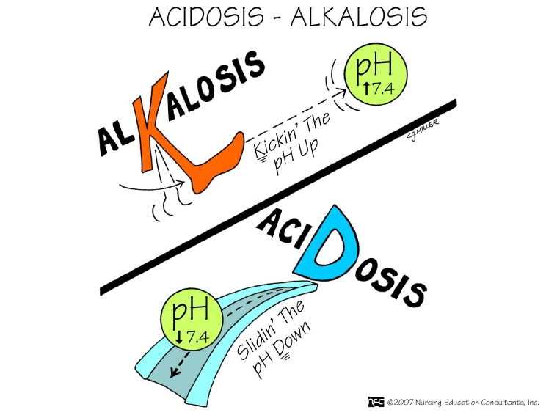
Abnormalities inAcid-Base Balance

Slide 4
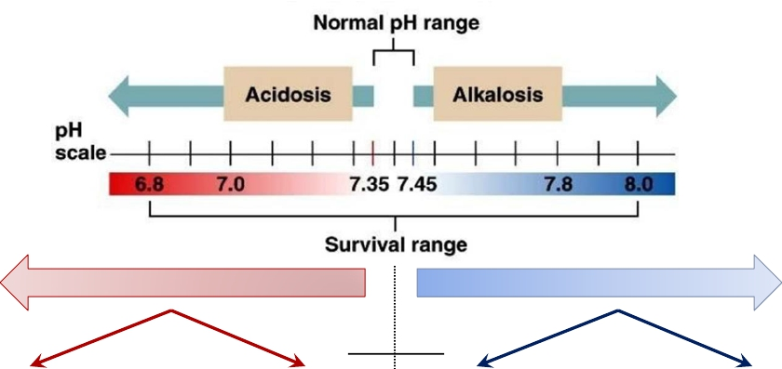
Abnormalities inAcid-Base Balance
Acidosis
Alkalosis
HCO3 −
PCO2
↑↑ PCO2
↓↓ HCO3-
↓↓ PCO2
↑↑ HCO3-
Respiratory
Metabolic
Respiratory
Metabolic

Slide 5
Fundamentals inAcid-Base Disorders
• Acid-base disorders are classified by changes in pH, PCO2
and HCO3-
• There are 4 primary acid-base disorders:
➢ Respiratory acidosis: ↑ PCO2
➢ Respiratory alkalosis: ↓ PCO2
➢ Metabolic acidosis: ↓ [HCO3-]
➢ Metabolic alkalosis: ↑ [HCO3-]
• The body normally attempts to correct the primary acid-
base disturbances by a secondary or compensatory
response trying to restore pH towards normal.
➢ The kidneys compensate for primary respiratory disorders.
➢ The lungs compensate for primary metabolic disorders.
(Dooley & Sisson.Acid-base disorders)

Slide 6
PrimaryAcid-Base Disturbances
Primary acid-base
disorders
Acidosis
Alkalosis
Respiratory
Decreased
ventilation
Inhibition of respiratory
center
Lung damage
Airway obstruction
Metabolic
Loss of HCO3- or
gain of H+
Renal tubular acidosis
Diarrhea
Diabetes
Ingestion of acids
(alcohol or aspirin)
Ch. renal failure
Respiratory
Increased
ventilation
Psychoneurosis
Metabolic
Excess HCO3- or
loss of H+
Diuretics except CAI
Excess aldosterone
Vomiting gastric
contents
Ingestion of alkaline
drugs

Slide 7
RespiratoryAcidosis
• Respiratory acidosis = ↓ pH + ↑ PCO2
➢ Due to alveolar hypoventilation.
Depression of
respiratory center
Opioid ingestion
Head injury
Causes of
respiratory acidosis
Alveolar
hypoventilation
Lung disease
COPD
Pneumonia
Pulmonary edema

Slide 8
RespiratoryAlkalosis
• Respiratory alkalosis = ↑ pH + ↓ PCO2
➢ Due to alveolar hyperventilation.
Mechanical
hyperventilation
Anxiety
Causes of
respiratory
alkalosis
Alveolar
hyperventilation

Slide 9
MetabolicAlkalosis
• Metabolic alkalosis = ↑ pH +↑ [HCO3-]
➢Due to loss of acids.
➢Due to gain of HCO3-
Vomiting gastric
contents.
Diuretics except CAI
Hyperaldosteronism.
Loss of acids
Causes of metabolic
alkalosis
Ingestion or
administration of
alkaline products
Gain of HCO3
-
(Appel & Downs. 2008. Understanding acid-base balance; Dooley & Sisson.Acid-base disorders)

Slide 10
MetabolicAcidosis
Metabolic acidosis = ↓pH due to ↓ [HCO3-]
➢ Due to acid gain.
➢ Due to loss of HCO3
↑acid production
Lactic acidosis
Diabetic ketoacidosis
Salicylate poisoning
Starvation
↓ acid elimination
↑ body acids
Causes of metabolic
acidosis
Renal failure
Through kidneys
(RTA)
↑ HCO3 loss
Through GIT
(diarrhea)
(Appel & Downs. 2008. Understanding acid-base balance; Dooley & Sisson.Acid-base disorders)

Slide 11
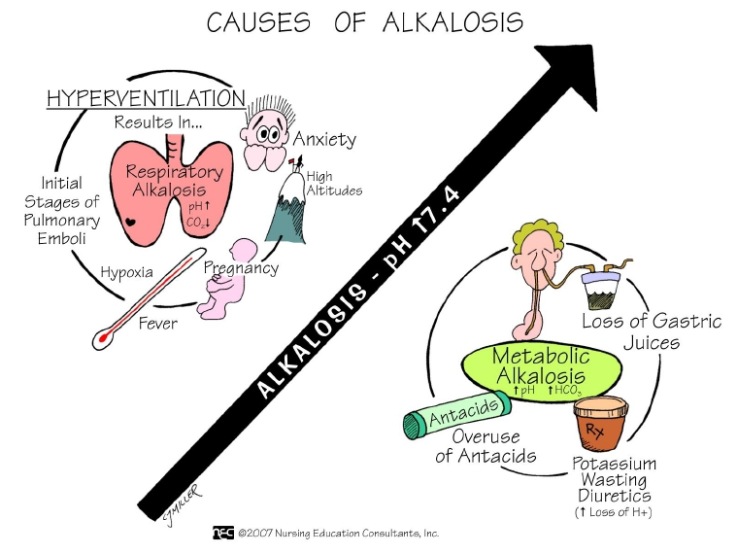

Slide 12
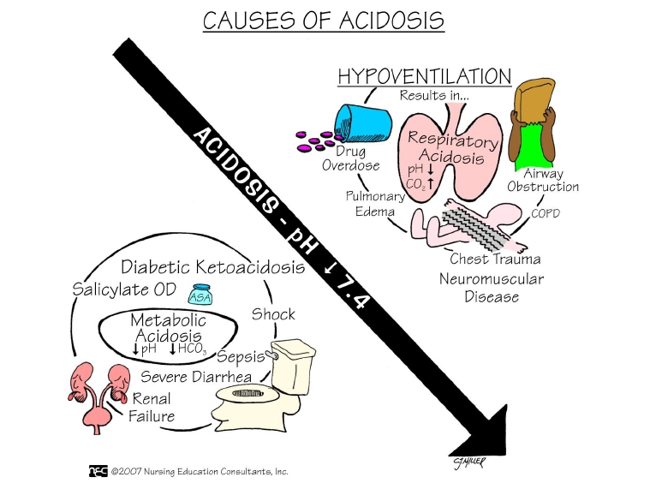

Slide 13
Compensatory Mechanisms
PrimaryDisturbance | CompensatoryMechanism
RespiratoryAcidosis | IncreaseHCO3
RespiratoryAlkalosis | DecreaseHCO3
MetabolicAcidosis | DecreasePCO2
MetabolicAlkalosis | IncreasePCO2

Slide 14
Summary of PrimaryAcid-Base Disorders

Slide 15
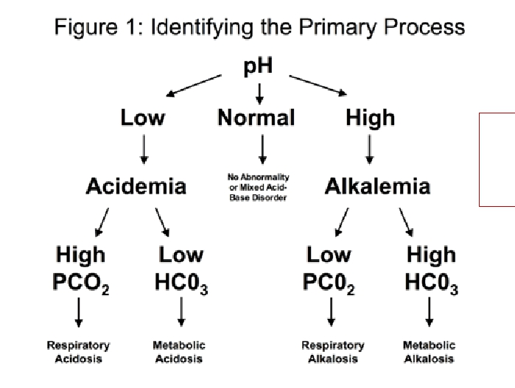
Interpretation ofAcid-Base Disturbances
Normal values;
pH =7.35-7.45
PCO2 =35-45 mmHg
HCO3-= 22-28 mmol/L

Slide 16
SimpleAcid-Base Disturbances
 | pH | PCO2(mmHg) | HCO3(mEq/L)
Normal | 7.35-7.45 | 35-45 | 22-28
Respiratory acidosis | Decrease | Increase | Increase
Respiratory alkalosis | Increase | Decrease | Decrease
Metabolic acidosis | Decrease | Decrease | Decrease
Metabolic alkalosis | Increase | Increase | Increase

Slide 17
Case study 1
• A patient known to have COPD presented with 3-day
history of fever, SOB, and cough productive of yellowish
sputum. His ABGs showed:
• pH = 7.25
• PCO2 = 80 mmHg.
• HCO3- = 34 mEq/L.

Slide 18
Case study 2
• A 21 year old man with IDDM presents to ER with mental
status changes, nausea, vomiting, abdominal pain and
rapid respirations. His ABGs showed:
• pH = 7.2
• PCO2 = 20 mmHg
• HCO3 = 8 mEq/l

Slide 19
Case study 3
• A 2-year old child who is lethargic and dehydrated has a
3-day history of vomiting. His ABGs showed:
• pH = 7.56
• PCO2 = 44 mmHg
• HCO3- = 37 mEq/l

Slide 20
Case study 4
• A 20-year old student suffered a panic attack while
awaiting an exam. Her ABGs showed:
• pH = 7.6
• PCO2 = 24 mmHg.
• HCO3 = 23 mEq/L.

Slide 21
OtherAcid-Base Disorders
Simple acid-base disorders
• Result from a single
primary abnormality with
appropriate physiologic
compensation.
Mixed acid-base disorders
• Result from multiple
primary processes.

Slide 22
MixedAcid-Base Disturbances
• Occurs when a patient has more than one primary acid
base disorder that occur at the same time.
• Examples:
✓ Respiratory alkalosis/acidosis along with a metabolic
acidosis/alkalosis.
✓ Two metabolic acid-base disorders occurring simultaneously.

Slide 23
Case study 5
• A 69 year old patient had a cardiac arrest soon after return to
the ward following an operation. Resuscitation was
commenced and included intubation and ventilation. Femoral
arterial blood gases were collected about five minutes after the
arrest. Other results: Anion gap 24, Lactate 12 mmol/l.
• Arterial Blood Gases
• pH 6.85
• pCO2 82 mmHg
• HCO3 14 mmol/l
(http://www.anaesthesiamcq.com/AcidBaseBook/AB9_6Case9.php)

Slide 24
THANK YOU

Slide 25
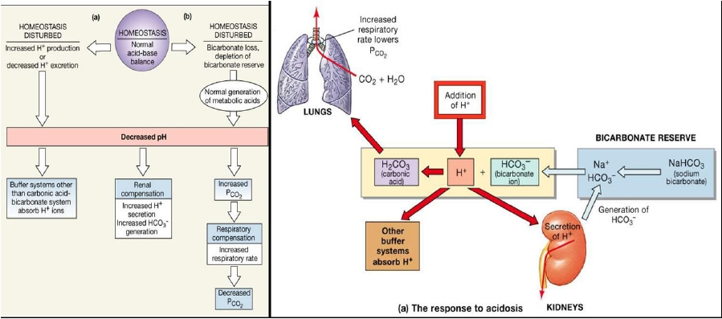
Body’s Response toAcidosis

Slide 26
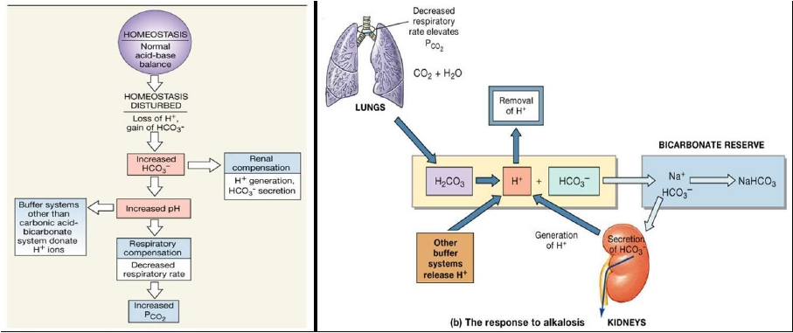
Body’s Response toAlkalosis

