Slide 1
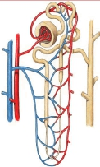
ACID-BASE BALANCE
Dr. Maha Saja
MBBS, MSc Physiology, PhD

Slide 2
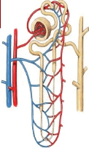
Contents
• What are acids and bases?
• What is meant by a weak and a strong acid or base?
•
• What is the normal pH of body fluids?
• Why is it important to keep body fluid pH within certain limits?
• What are the body’s defense mechanisms against changes in blood
pH: body buffers, the lungs and the kidney.
• Understand the role of the kidney in regulating pH of body fluids.
• Acid-base disturbances.

Slide 3
Acid-Base Balance
• Acid-base balance is concerned with the precise
regulation of free (unbound) hydrogen ion (H+)
concentration in body fluids.
• Normally, [H+] = 0.00004 mEq/L (40 nEq/L).
• Why is it important to control [H+]?
(Sherwood L. Human physiology: from cells to systems. 4th ed. 2001; Guyton & Hall. Textbook of medical physiology. 13th ed. )

Slide 4
Why Should [H+] be Tightly Controlled?
• Slight deviations in [H+] have profound effects on enzyme
and protein activity and thus the body’s metabolic activity
in general.
• Changes in [H+] affects K+ levels in the body.
(Sherwood L. Human physiology: from cells to systems. 4th ed. 2001; Guyton & Hall. Textbook of medical physiology. 13th ed. )

Slide 5
Why is the Body’s [H+] Constantly Changing?
A number of processes can alter [H+] concentration in
the body, such as;
1. Metabolism of ingested food.
2. GI secretions.
3. Generation of acids & bases from metabolism of stored
fat & glycogen.
4. Changes in CO2 production.
(Vander’s Renal Physiology. 8th ed)

Slide 6
Acid-Base Fundamentals
• An Acid = a molecule that can release H+ in a solution.
• H2CO3
(carbonic acid)
• HCl (hydrochloric acid)
• A base = a molecule that accepts H+ in a solution.
• Bicarbonate ions (HCO3-).
• Hydrogen phosphate (HPO4-2)
• What is the difference between carbonic &
hydrochloric acid?

Slide 7
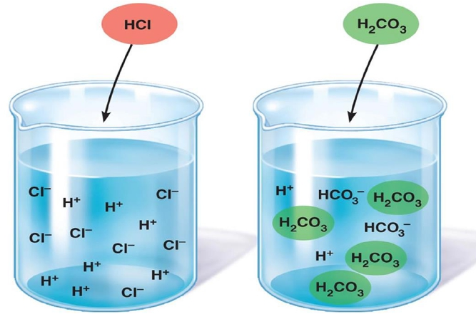
Strong vs WeakAcids & Bases
Strong acids dissociate rapidly
and release large amounts of H+
in solution
Weak acids dissociate incompletely
and less strongly releasing small
amounts of H+
in solution

Slide 8
WeakAcids
������������ ↔ ������− + ������+
������������������������ ↔ ������������������������������������������������������ ������������������������ + ������+
The extent to which a given acid dissociates in solution is
constant. And is known as the dissociation constant (K).
������+ [������−]
[������������]
������ =
������+ [������������������������−]
[������������������������������]
������������������������������ ↔ ������������������������− + ������+
������ =

Slide 9


[H+] & the pH
• H+ ion concentrations are expressed as pH.
• pH = - Log [H+]
• If the [H+] increase → pH will decrease (more acidic)
• If the [H+] decrease → pH will increase (more alkaline)
• What is the normal pH of the ECF?
Normally pH= 7.35-7.45
pH < 6.8
Acidosis
Alkalosis
pH > 8
pH= 7.35-7.45
Death
Death
(Guyton & Hall. Textbook of medical physiology. 13th ed. )

Slide 10
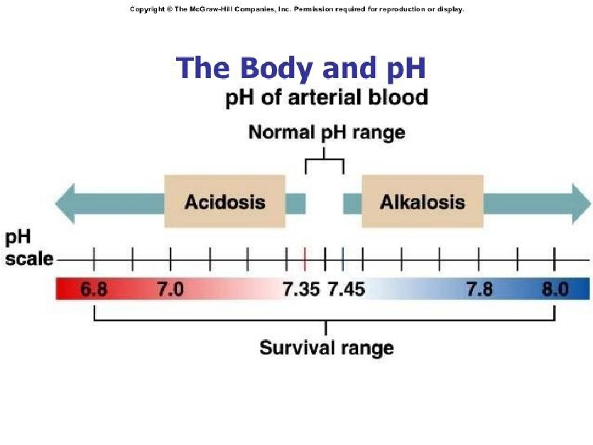

Slide 11
pH and H+ Concentration of Body Fluids
 | + [H](mEq/L) | pH
Extracellularfluid
Arterialblood | -5 4.0X10 | 7.4
Venousblood | -5 4.5X10 | 7.35
IF | -5 4.5X10 | 7.35
Intracellularfluid | -3-5 1X10to4X10 | 6-7.4
Urine | -2-5 3X10to1X10 | 4.5-8
GastricHCl | 160 | 0.8
(Guyton & Hall. Textbook of medical physiology. 13th ed. )

Slide 12
Acid Production by the Body
• The body produces large amounts of acids on daily basis
as by products of metabolism.
• Metabolism of dietary proteins.
• Anaerobic metabolism of carbs and fat.
• Acids in the body are of two kinds:
1.
2.
Volatile (CO2)
Non-volatile “fixed” (sulfuric acid, lactic acid) (daily acid load ≈
50-100 mEq/day) (0.8 mEq/kg/d).
(Vander’s Renal Physiology. 8th ed ; Guyton & Hall. Textbook of medical physiology. 13th ed. )

Slide 13
The Body’s DefenseAgainst Changes in
[H+]
Three main systems:
1. Body fluid buffers.
Works within seconds.
2. Lungs
Works within minutes.
3. Kidneys
Works within hours-days.
The most powerful of the three.

Slide 14
BODY FLUID BUFFERS

Slide 15



What is a Buffer?
A buffer = a solution that resists changes in pH upon
addition of small amount of acids and bases.
Acid
Base
Buffer
Buffer
Neutralizes small additions of bases/acids
pH remains constant

Slide 16
How do Buffers work?
• A buffer is a mixture of a weak acid and a weak base that
are in equilibrium.
• To be more accurate, its either made of:
• A weak acid and its conjugated base (H2CO3 & NaHCO3-).
• A weak base and its conjugated acid (NH3 & NH4+).
• How does a buffer do its job?

Slide 17
Chemical Buffer Systems in the Body
• There are 3 chemical buffers in the body;
1. The Bicarbonate buffer system.
2. The phosphate buffer system.
3. Proteins.
• They are the 1st line of defence against changes in pH i.e.
[H+], act within seconds.
• Some are more powerful extracellularly and others are
more powerful intracellularly.

Slide 18
The Bicarbonate Buffer System
• Composed of:
• A weak acid (H2CO3).
• Its conjugated base (NaHCO3).
CA
H+ + HCO3-
CO2 + H2O
H2CO3
NaHCO3
Na+ + HCO3-

Slide 19
The Bicarbonate Buffer System
H2CO3forms in the body by the reaction of CO2& H2O
1.
CO2+ H2O
Carbonic anhydrase
H2CO3
2.
H2CO3ionizes weakly to form small amounts of H+ &
HCO3-
H2CO3
H+ & HCO3-
3.
The second component is NaHCO3which dissociates to
form Na+ & HCO3-
NaHCO3
Na+ & HCO3-

Slide 20
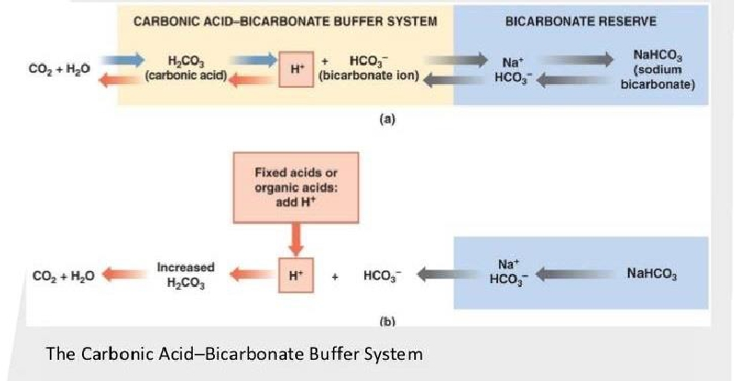
The Bicarbonate Buffer System
Putting it all together;
This is the main ECF buffer system
What happens if you add a base or an acid to the system?

Slide 21
The Henderson-Hasselbalch Equation
What is the HHE?
• It is an equation that enables the calculation of pH of a solution.
What is it?
������������������������−
������.������������ ������ ������������������������
������������ = ������������ + ������������������
K = dissociation constant, pK = 6.1
0.03 = solubility of CO2

Slide 22
The Henderson-Hasselbalch Equation
How was it derived?
H2CO3
H+ + HCO3-
1. H2CO3and its dissociated ions are always in equilibrium
→ the products of the reaction on one side of the
equation are proportional to the product on the other
side.
[H2CO3] α [H+ ] X [HCO3-]
2. Since H2CO3is a weak acid, it will not dissociate
completely and the concentration of its products will
depend on its dissociation constant (K)
K X [H2CO3] = [H+ ] X [HCO3-]

Slide 23

The Henderson-Hasselbalch Equation
3. Based on the previous equation, [H+] can be expressed
as follows;
[H2CO3]
[HCO3−]
H+ = ������ ������
4. Because H2CO3can rapidly dissociate into CO2 and
H2O. And since CO2 is much easier to measure it can
replace H2CO3 in the equation;
[C������������]
[HCO3−]
This is Henderson’s equation
(1908)
H+
= ������ ������
It means that;
↑ [CO2] →↑ [H+]
↑ [HCO3-] → ↓ [H+]

Slide 24
The Henderson-Hasselbalch Equation
5. In 1909, Sorensen created the pH scale to express [H+ ]
������������ = −������������������[������+]
6.
In 1916, Hasselbalch decided to merge Henderson’s
equation with Sorensen’s pH scale creating what we
now know as the “Henderson-Hasselbalch equation”.
[C������������]
[HCO3−]
[������������������]
[������������������������−]
H+
= ������ ������
−������������������ ������
+
= −������������������ ������ ������

Slide 25

The Henderson-Hasselbalch Equation
−������������������ ������+ = −������������������ ������ ������
[������������������]
[������������������������]
[������������������3]
[������������2]
This is Henderson-Hasselbach equation
(1908)
������������ = ������������ + log
7. Since it is much easier to measure PCO2 rather than dissolved
[CO2] and because dissolved CO2 is proportional to PCO2
multiplied by the solubility of CO2 (0.03 mmol/mmHg) → [CO2] was
replaced by PCO2 X 0.03
[������������������3]
0.03 ������ ������������������2
������������ = ������������ + log
Ta-Da

Slide 26
The Bicarbonate Buffer System
CA
H+ + HCO3-
CO2 + H2O
H2CO3
[������������������3−]
0.03 ������ ������������������2
������������ = ������������ + log
• What do we understand from this equation?
HCO3− Regulated by kidneys
Regulated by lungs
1.
pH α
PCO2
Each element of the buffer
system is regulated
• ↑↑ HCO3− will ↑↑ pH
• ↑↑ PCO2 will ↓↓ pH

Slide 27
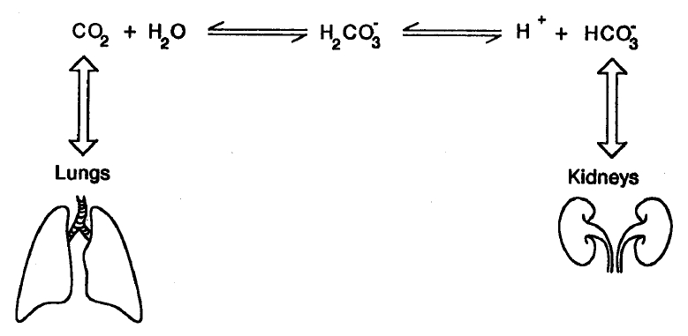
Summary of the Bicarbonate Buffer
System
Why is it the most important buffer system in the ECF?

Slide 28
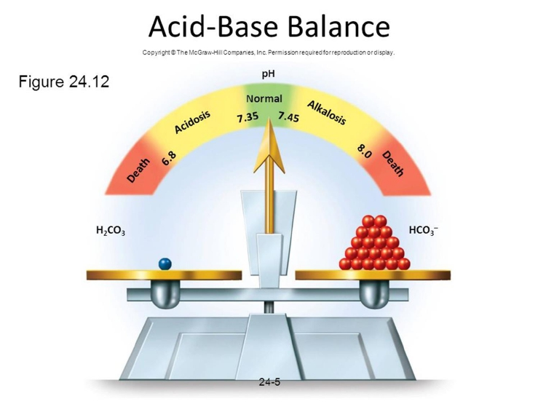
������������������������ −
������������������������
Ratio of
is ≈ 20:1

Slide 29
Other Buffering Systems
The phosphate buffer:
• Plays a major role in buffering intracellular & renal tubular
fluid.
• Composed of;
• H2PO4- (dihydrogen phosphate)
• HPO4-2 (Hydrogen phosphate)
Proteins:
• Contributes to buffering inside cells.
• E.g. Hb.

Slide 30
Summary of Body’s Buffering Systems
• Buffer systems do not work independently in body fluids
but actually work together.
• A change in the balance in one buffer system, changes
the balance of the other systems.
• Buffers do not reverse the pH change, they only limit it.
• Buffers do not correct changes in [H+] or [HCO3-], they
only limit the effect of change on body pH until their
concentration is properly adjusted by either the lungs or
the kidney.

Slide 31
RESPIRATORY REGULATION
OFACID-BASE BALANCE

Slide 32
Respiratory Regulation ofA/B
• 2nd line of defence against acid-base disturbances in the
body.
• HOW?
• By modulating CO2 excretion.
• ↑↑ [H+] → ↑↑ ventilation (RR) → ↓↓ PCO2
• ↓↓ [H+] → ↓↓ ventilation (RR) → accumulation of CO2→↑↑
PCO2.
• Normally, PCO2 = 40 mmHg (35-45 mmHg)

Slide 33
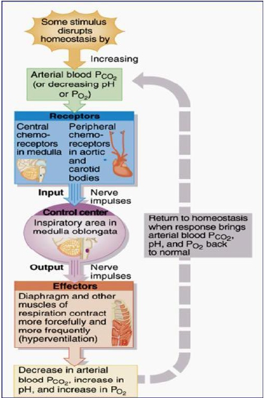
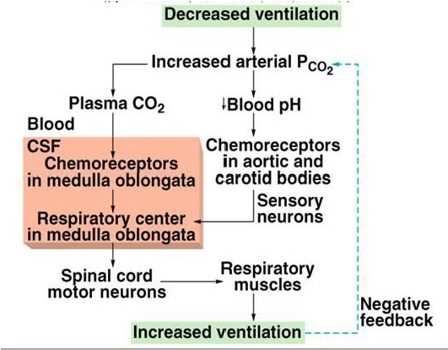
Respiratory Regulation of CO2

Slide 34
RENAL REGULATION OF
ACID-BASE BALANCE

Slide 35
Renal Regulation ofA/B Balance
• 3rd line of defence against acid-base disturbances and the
most powerful.
• It regulates by excreting either an acidic or basic urine.
• HOW?
1. Secreting H+
2. Reabsorbing HCO3-
3. Generating “new” bicarbonate ions.

Slide 36
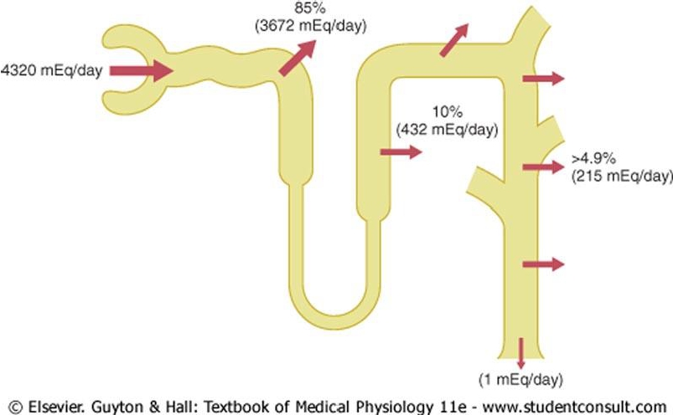
Overview HCO3- Reabsorption by the
Renal Tubules

Slide 37
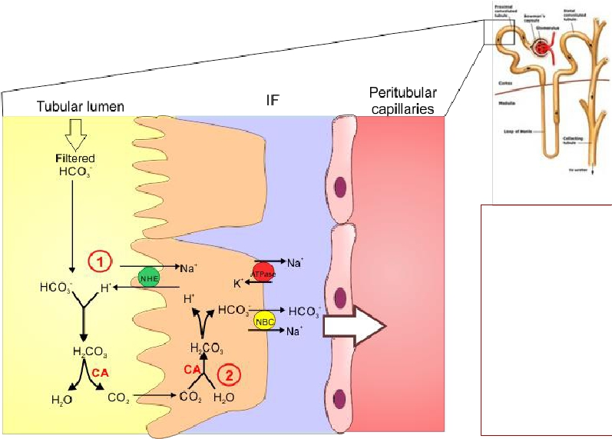
How is HCO3- Reabsorbed by the tubules?
What happens at the PCT?
The PCT
reabsorbs,
“reclaims”, 80-
90% of the filtered
HCO3-.
HCO3-
reabsorption is
linked to H+
secretion.

Slide 38

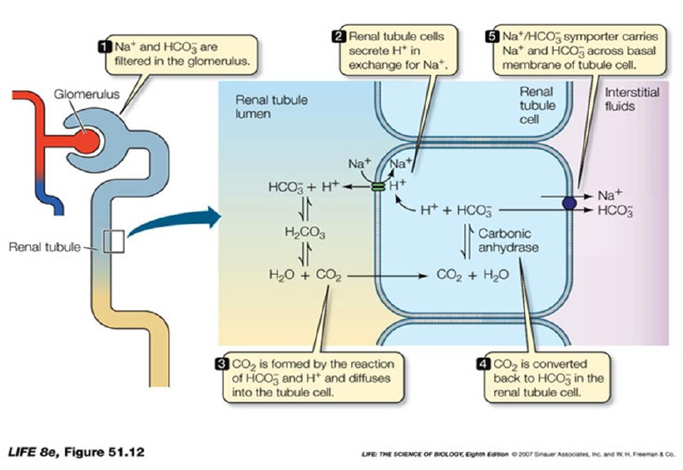
HCO3- Reabsorption by the PCT

Slide 39
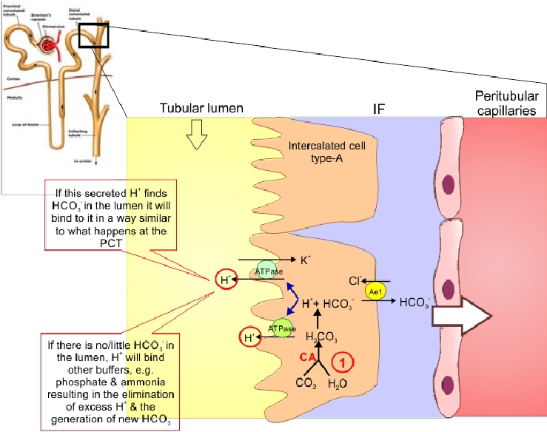
What happens at the DCT & CT?

Slide 40
What happens at the late DCT & CT?
• The filtrate arriving at the DCT & CT is low in HCO3-.
• The distal segments of the nephron are characterised by the
presence of “intercalated cells” capable of actively secreting
H+ through H+-ATPase and H+-K+ ATPase present on their
apical membrane (Type-A intercalated cells).
• Only a limited number of H+ can be excreted in its free form in
urine.
• Lowest possible urine pH=4.5 → ≈ 0.04 mmol/L of free H+.
• How does the kidney excrete the extra H+?
(Vander’s Renal Physiology. 8th ed)

Slide 41


Non-Bicarbonate Buffers in the Tubular
Lumen?
The extra H+ secreted will need to be buffered in the tubular lumen
2 main non-bicarbonate buffers in the tubule
Filtered
Synthesized
Phosphate buffer system
H2PO4- ↔ HPO4-2 + H+
(acid) (base)
Ammonia buffer system
NH4+↔ NH3 + H+
(acid) (base)

Slide 42
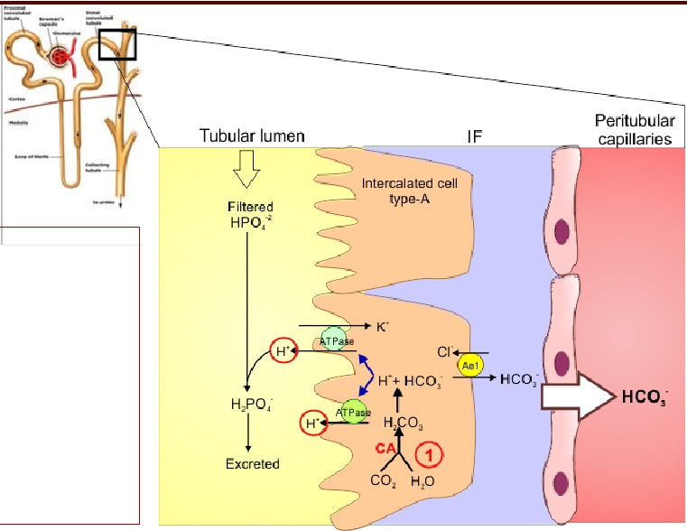
E xcretion of H+ and Generation of New HCO3-
The phosphate buffer system
Excretion of H+ as
phosphate is
capable of handling
a limited amount of
H+ and will not be
enough to rid the
body of its daily
acid load nor if
there is unusually
high acid
production.
(Vander’s Renal Physiology. 8th ed ; Guyton & Hall. Textbook of medical physiology. 13th ed. )

Slide 43
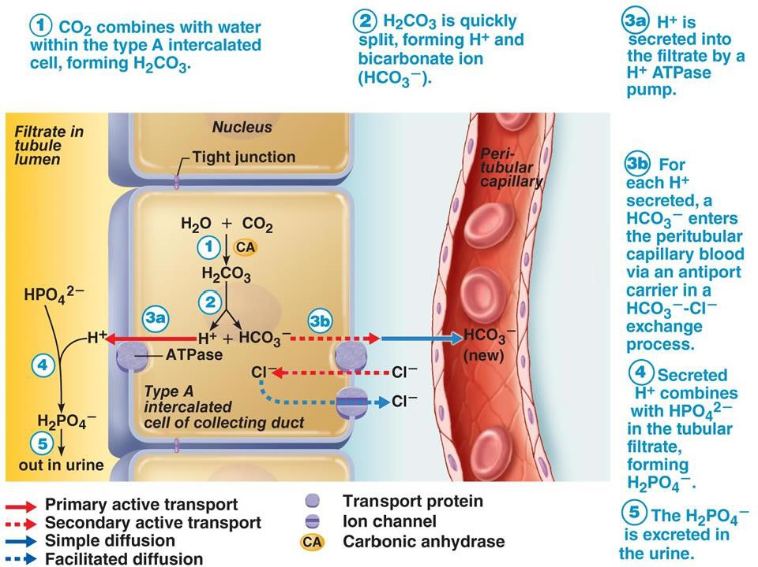

Slide 44
Excretion of H+ and Generation of New HCO3-
TheAmmonia Buffer System
• Renal tubular cells, especially PCT, are capable of
generating ammonium (NH4+) “ammoniagenesis” which
is then excreted in urine carrying with it H+.
• The rate of ammoniagenesis can be modified according to
the needs of the body.
• Quantitatively, the ammonia buffer system is more
important than the phosphate buffer system for H+
excretion in urine.
• It is the most important system in case of acidosis.

Slide 45
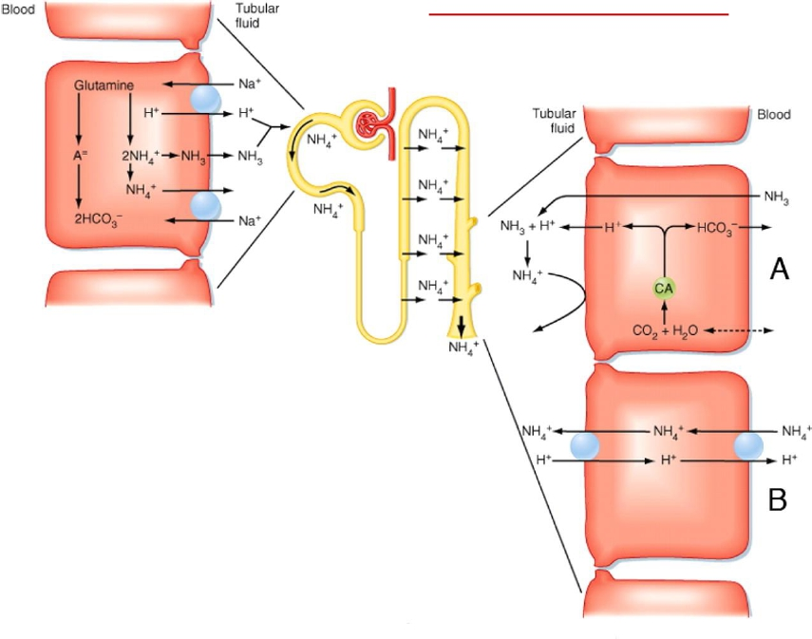
Ammonia buffer system

Slide 46
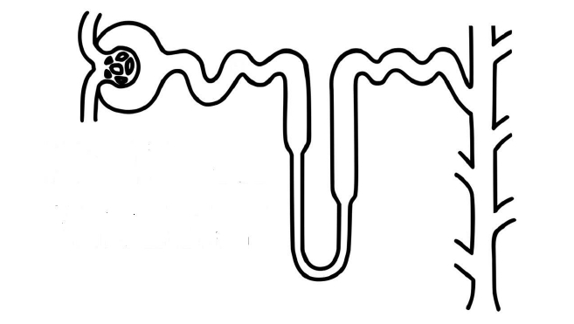
The Overall Scheme of Renal Excretion of
Acids & Bases
To excrete acid:
1. Freely filter HCO3-
2. Reabsorb the majority of filtered HCO3-
3. Reabsorb some additional HCO3-
4. Secrete H+ (titrate filtered bases, i.e. HPO4-2)
and secrete NH4+
5. Excrete acidic urine containing NH4+
1.
2.
To excrete base:
1. Freely filter HCO3-
2. Reabsorb the majority of filtered HCO3-
3. Reabsorb some additional HCO3-
4. Secrete some HCO3-
5. Excrete alkaline urine containing HCO3-
4.
3.
5.
(Adapted with modification from Vander’s Renal Physiology. 8th ed)

Slide 47
THANK YOU

