Slide 1
Diuresis
By
Dr. Ola Mawlana

Slide 2
Objectives
To measure the volumes and determine the compositions of urine excreted by 4 groups:
( fasting / drunk 1 L water/ drunk 1L saline / took 1 tab of lasix).
To be able to discuss the mechanisms by which the body maintain the water and sodium homeostasis in the 4 different conditions.
Definition and clinical applications of:
- GFR ( Glomerular Filtration Rate)
- C_{Cr} ( Creatinine Clearance )

Slide 3
Group 1
Emptied their bladders at 8:00 am and discarded the urine.
From 8:00 they are restricted to take any fluids and they are asked to provide various urine samples for analysis at:
10:00 am, 12:00 noon, 2:00 pm and 3:00 pm.

Slide 4
Group 1
What will happen?
Subsequent urine sample is lesser in volume and darker yellow in color that shows the kidneys try to conserve water in fasting state.

Slide 5
Group 1
Deprive of H₂O
1
Plasma osmolarity
2
Stimulates Osmoreceptors in anterior hypothalamus
Thirst
3
3
ADH secretion from posterior pituitary
H₂O drinking
4
H₂O permeability in late distal tubule and collecting duct
5a
Plasma Osmolarity Toward Normal
H₂O reabsorption
5b
Urine osmolarity and urine volume
6

Slide 6
Group 2(Water Diuresis)
Emptied their bladder at 08:00 am and discarded the urine.
At 10:00 am emptied their bladder again, but this time they measured its volume and provided a sample for analysis. This sample will be pre-experimental sample.
Drank 1 liter of water immediately after providing the pre-experimental sample.
Were then asked to empty their bladders and provide post-experimental samples every half an hour after drinking water until 3:00 pm.

Slide 7
Group 2

Slide 8
Group 2

Slide 9
m
Group 2
1
Drink 1L H₂O
Plasma Osmolarity
2
3
Thirst
Inhibits osmoreceptors in anterior hypothalamus
3
ADH secretion from posterior pituitary
H₂O drinking
4
H₂O permeability in late distal tubule and collecting duct
5a
H₂O reabsorption and excretion
Plasma osmolarity toward Normal
5b
Urine Osmolarity and
urine volume
6

Slide 10
Group 3
Emptied their bladder at 7:00 am and discarded the urine.
At 9:00 am emptied their bladder again, but this time they measured its volume and provided a sample for analysis. This sample will be pre-experimental sample.
Drank 1 liter of 0.9% saline (isotonic saline) immediately after providing the pre-experimental sample.
Were then asked to empty their bladders and provide post-experimental samples every hour after drinking saline until 3:00 pm.

Slide 11
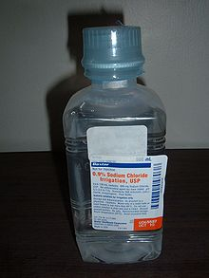
Isotonic saline 0.9%
Contains 154 mmol of NaCI, equivalent to 9 g of salt or 3.6 g of sodium.
The sodium concentration of isotonic saline is equivalent to the normal sodium concentration of plasma water.

Slide 12
Group 3

Slide 13
Group 3

Slide 14
Group 3
Isotonic Saline (0.9%)
1 liter
Volume of E.C.F. Osmolality same (as isotonic saline)
Stretch on right atrium (volume receptors in right atrium)
ANP (Atrial Natriuretic peptide)
Na excretion by Kidneys

Slide 15
Group 4(Osmotic Diuresis)
Emptied their bladder at 8:00 am and discarded the urine.
At 10:00 am emptied their bladder again, but this time they measured its volume and provided a sample for analysis. This sample will be pre-experimental sample.
Swallowed a Lasix (Furosemide) tablet 40 mg with the help of 25 ml of water immediately after providing the pre-experimental sample.
Were then asked to empty their bladders and provide post-experimental samples every hour after taking Lasix until 12:00 noon and then every half an hour until 3:00 pm.

Slide 16
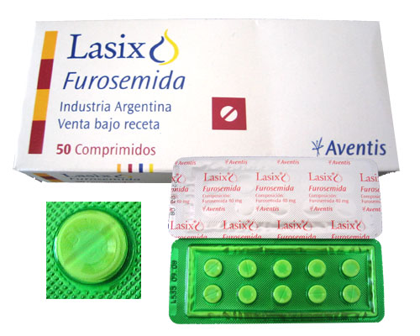
What is Lasix?
Furosemide is a loop diuretic
used in the treatment of
hypertension, congestive
heart failure and edema.
It inhibits the sodium-potassium-chloride co-transport system located within the ascending limb of the Loop of Henle.

Slide 17
Group 4

Slide 18
Group 4

Slide 19
Group 4
1 tab of Lasix (furosemide) (40mg)
with 25ml of water
Action starts 1-2 hours and lasts for 4-6 hours
(1/2 life of furosemide is 6hr)
Acts on thick ascending limb of loop of Henle and blocks the Na-K-2Cl co-transport (called loop diuretic)
Na excretion in urine and water excretion (osmotic drug)

Slide 22
Urine samples examination
Volume (measuring cylinder)
Sodium and potassium concentration (flame photometry)
PH (PH meter)
Osmolality (Osmometer)

Slide 23
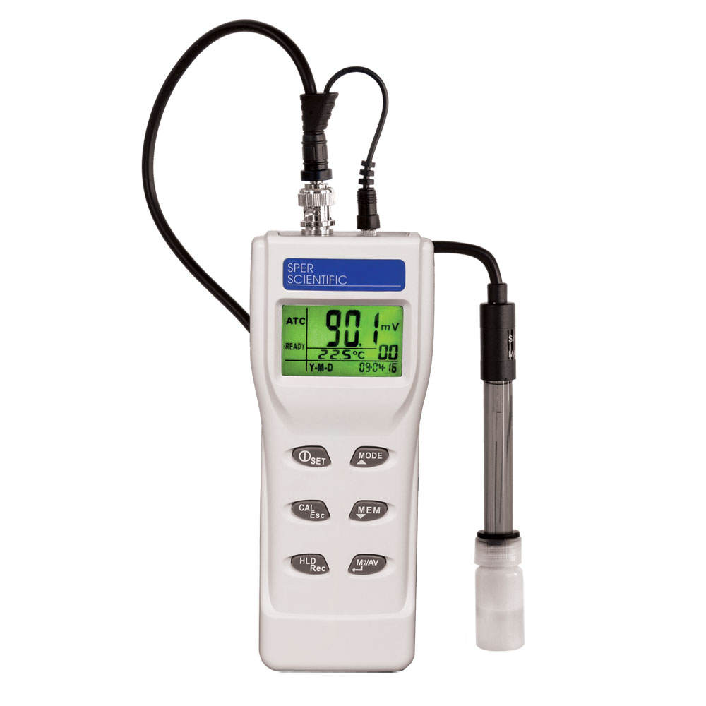
Measuring cylinder
PH meter

Slide 24
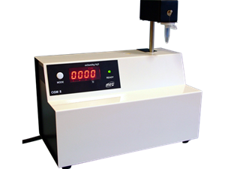
Flame photometry
Osmometer

Slide 25
The table that we fill out during these experiments

Slide 26
Calculation
Total sodium excretion is obtained by applying following equation:
Sodium excretion rate is obtained by applying the following equation:

Slide 27
Group 2

Slide 28
Group 3

Slide 29
Group 4

Slide 30
Group 4

Slide 31
GFR (Glomerular Filtration Rate)
Definition:
Is the volume of fluid filtered from the renal glomerular capillaries into the Bowman's capsule per unit time.
Urine Concentration X Urine Flow
GFR = Plasma Concentration
According to the National Kidney Foundation, normal results range from 90 - 120 ml/min/1.73 m².

Slide 32
Abnormal Results of GFR
A GFR < 60 mL/min/1.73 m² for 3 or more months
chronic kidney disease.
A GFR < 15 mL/min/1.73 m² kidney failure.

Slide 33
GFR (Glomerular Filtration Rate)
The test is recommended in:
Diabetes
Family history of kidney disease
Frequent urinary tract infections
Heart disease
High blood pressure
Urinary blockage

Slide 34
Creatinin Clearance (C_{Cr})
Definition:
The volume of blood plasma that is cleared of creatinine per unit time.
U_{cr} X V
C_{Cr} =
P_{Cr}
(U_{Cr}) = creatinine concentration in the collected urine
sample
(V) = urine flow rate
(P_{Cr}) = plasma concentration

Slide 35
Creatinin Clearance (C_{Cr})
Example:
A person has a plasma creatinine concentration of 0.01 mg/ml and in 1 hour produces 60ml of urine with a creatinine concentration of 1.25 mg/mL.
Normal values
Male: 97 to 137 ml/min.
Female: 88 to 128 ml/min.

Slide 36
Abnormal results for C_{Cr}
Abnormal results may indicate:
Acute tubular necrosis
Bladder outlet obstruction
Congestive heart failure
Dehydration
End-stage kidney disease
Glomerulonephritis
Kidney failure
Renal ischemia
Renal outflow obstruction
Shock

Slide 37
Thank You

