Slide 1
Transplantation
Immunology Unit
College of Medicine
King Saud University

Slide 2
Objectives
To understand the diversity among human leukocyte antigens (HLA) or major histo-compatibility complex (MHC)
To know the role of HLA antigens in transplant rejection
To be familiar with types of immune responses mediating transplant rejections and importance of tissue matching
To understand the principles of management after transplantation

Slide 3
Major Histocompatibility Complex and Transplantation
Major histocompatibility complex (MHC) proteins were discovered for the first time with the advent of tissue transplantation
The success of tissue and organ transplantation depends upon the donor’s and recipient’s “human leukocyte antigens” (HLA) encoded by HLA genes
These proteins are allo-antigens

Slide 4
MHC Class I and II Proteins
MHC Class I are glycoproteins found on surface of virtually all the nucleated cells
Cytotoxic T cell kills virus infected cells in association with class I MHC proteins
MHC Class II glycoproteins are normally found on the surface of antigen presenting cells (marophages, B cells, dendritic cells and Langerhans cells)
Helper T cell recognize antigen in association with class II MHC proteins

Slide 5
Major Histocompatibility Complex and Transplantation
Genes for HLA proteins are clustered in the MHC complex located on the short arm of chromosome 6
Three genes HLA-A, HLA-B and HLA-C code for Class I MHC proteins
HLA-D loci encode for Class II MHC proteins ie, DP, DQ and DR

Slide 6
Major Histocompatibility Complex and Transplantation
Each individual has two “haplotypes” i.e, two sets of these genes one paternal and one maternal
MHC class | I |  |  | II |  |  | III
Region | A | B | C | DP | DQ | DR | C4, C2, BF
Gene products | HLA-A | HLA-B | HLA-C | DP | DQ | DR | C' proteins | TNF-α TNF-β
Polymorphisms | 47 | 88 | 29 | More than 300 HLA-D

Slide 7
Minor HLA genes and Transplantation
Minor HLA genes – unknown
They mount a weak immune response
Play role in chronic rejection of a graft
There are no laboratory tests to detect minor antigens

Slide 8
Transplantation antigens

Slide 9
Transplantation
Types of transplants:
Autografts, Autologous grafts
Donor and recipient are same individual
Common in skin grafting; bone marrow
Syngeneic grafts or (isograft)
Donor and recipient are genetically identical
Animal models; identical twins

Slide 10
Transplantation
Types of transplants:
Allogeneic grafts
Donor and recipient are same species, but genetically unrelated
Common heart, lung, kidney, liver graft
Xenogeneic grafts
Donor and recipient are different species
Artificial grafts

Slide 11
Transplantation (Rejection)
Major Barrier to transplantation is the immune response
T cells play primary role
B cells can/do play a role
Classic adaptive/acquired immune response
Memory
Specificity

Slide 12
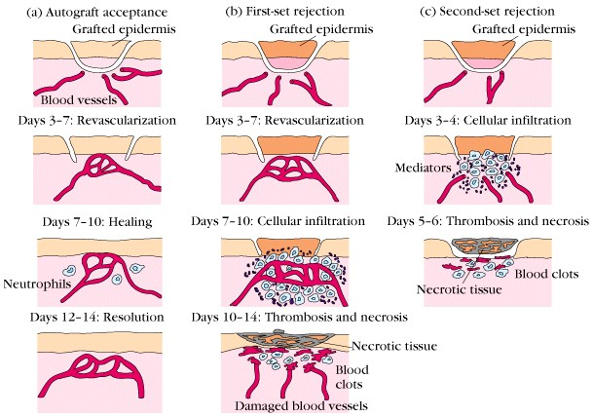
1st set versus 2nd set reactions

Slide 13
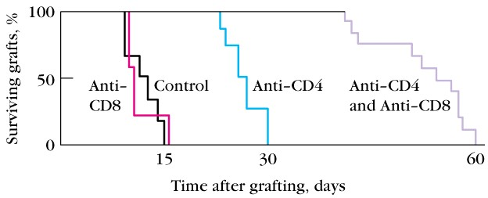
Role of CD4⁺ versus CD8 T⁺ cells
Injecting recipient mice with monoclonal antibodies to deplete one or both types of T cells

Slide 14
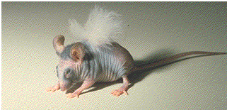
Transplantation
T cells play primary role in 1st and 2nd set rejection reactions
Nude mice accept allografts (no T cells due to genetic modification resulting in absent thymus)
B cell deficient mice reject allografts
Nude mouse has a transplant of rabbit skin

Slide 15
Mechanisms involved in Graft Rejection
Direct Pathway
Indirect Pathway

Slide 16
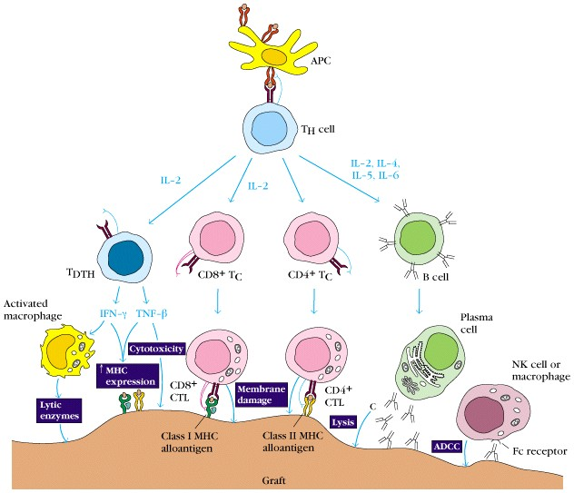
Rejection Response

Slide 17
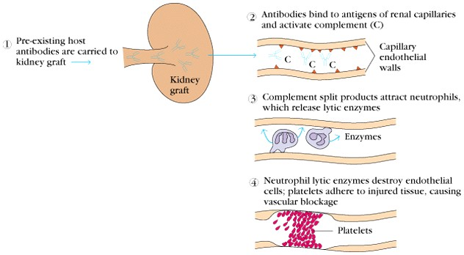
Clinical manifestations of graft rejection
Hyperacute rejection: very quick
II. Acute rejection: about 10 days (cell mediated)
III. Chronic rejection: months-years (both)

Slide 18
Chronic Rejection
This occurs months to years after engraftment
Main pathologic finding in chronic rejection is atherosclerosis of the vascular endothelium
Main cause of chronic rejection is not known
Minor histo-compatibility antigen miss match

Slide 19
Graft-versus-Host (GVH) Reaction
Occurs in about two thirds of bone marrow transplants
Occurs because grafted immunocompetent T cells proliferate in the irradiated immunocompromised host and reject cells with foreign proteins resulting in sever organ dysfunction
Donor’s Tc cells play a major role in destroying the recipient’s cells
Symptoms are: maculopapular rash, jaundice, hepatosplenomegaly and diarrhea
GVH reactions usually end in infections and death

Slide 20
HLA Typing in the Laboratory
Prior to transplantation laboratory test commonly called as HLA typing or tissue typing to determine the closest MHC match between the donor and recipient is performed
Methods
DNA sequencing by Polymerase Chain Reaction (PCR)
Serologic Assays
Mixed Lymphocyte Reaction (MLR)
Crossmatching – (Donor) lymphocytes +(Recipient) serum + complement.

Slide 21
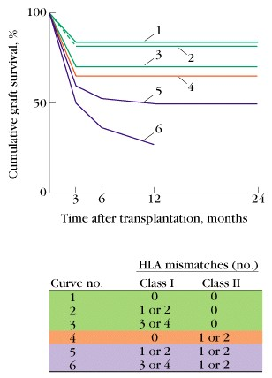
Tissue Matching
Effect of HLA class I & II matching on survival of kidney grafts

Slide 22
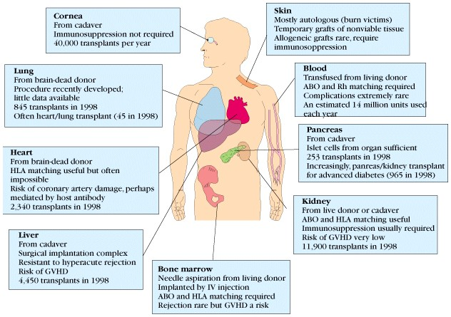
Tissue Matching

Slide 23
General Immunosuppression Therapy
Mitotic inhibitor: azathioprine (pre & post)
Corticosteroids
Cyclosporin
Total lymphoid irradiation

Slide 24
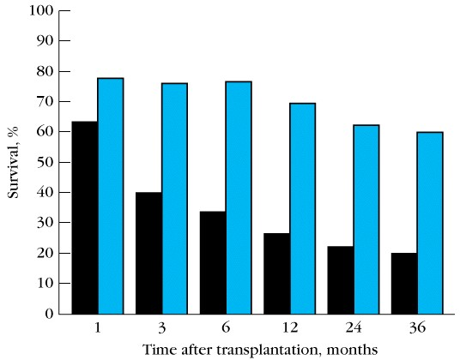
Immunosuppresive Therapy

Slide 25
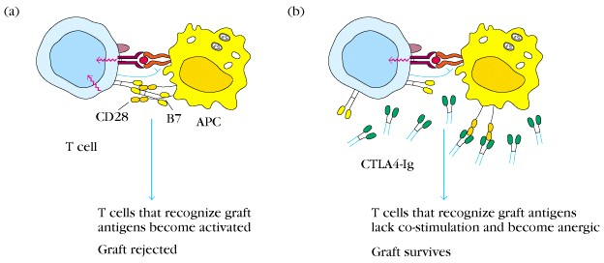
Specific Immuno-suppression therapy
Monoclonal antibodies against T cell components or cytokines
Agents blocking co-stimulatory signal

Slide 26
Immuno-suppresive Therapy
Downsides
Must be maintained for life
Toxicity
Susceptibility to infections
Susceptibility to tumors

Slide 27
Take home message
HLA or MHC molecule miss-match can stimulate humoral and cell mediated immunity which is the main cause of rejection of transplants
Cell mediated immune responses play a major role in transplant rejection
Tissue matching particularly for HLA-D antigens is important for successful transplantation
Immuno-suppresive therapy is usually required after transplantation

Slide 28
Thank you

