Slide 1
Pathology of pyelonephritis, Nephrolithiasis and Cystitis
DR. TARIQ ALJOHANI

Slide 2
Objectives
Recognize the predisposing factors for infections of the kidney and urinary tract.
Describe the different types of infections in the kidney and urinary tract.
Recognize the clinicopathological features of acute and chronic pyelonephritis.
Describe the causes of urinary tract obstruction.
Recognize drug induced nephritis

Slide 3
Infections of Urinary Tract
Upper Urinary tract
Pyelonephritis-
Acute
Chronic
Lower Urinary tract
ureteritis
cystitis
urethritis

Slide 4
definition
Pyelonephritis: one of the most common diseases of the kidney and is defined as inflammation affecting the tubules, interstitium, and renal pelvis.

Slide 5
Route of infection
Ascending infection
More than 85% of cases of urinary tract infection are caused by the gram-negative bacilli that are normal inhabitants of the intestinal tract.
This is the most common route of infection
Hematogenous infection

Slide 6
Predisposing conditions- acute pyelonephritis
Urinary tract obstruction, either congenital or acquired
Instrumentation of the urinary tract
Vesicoureteral reflux
Pregnancy..
Gender and age..
Preexisting renal lesions, causing intrarenal scarring and obstruction
Diabetes mellitus
Immunosuppression and immunodeficiency
Notes:
After the first year of life (when congenital anomalies in males commonly become evident) and up to around age 40 years, infections are much more frequent in females. With increasing age the incidence in males rises as a result of prostatic hypertrophy and instrumentation

Slide 7
Complications -acute pyelonephritis
1 Papillary necrosis
2 Pyonephrosis
3 Perinephric abscess
Notes:
Seen mainly in diabetics and in those with urinary tract obstruction.
Usually bilateral but may be unilateral.
One or all of the pyramids of the affected kidney may be involved.
On cut section, the tips or distal two thirds of the pyramids have areas of gray-white to yellow necrosis
On microscopic examination the necrotic tissue shows characteristic coagulative necrosis, with preservation of outlines of tubules.
The leukocytic response is limited to the junctions between preserved and destroyed tissue

Slide 8
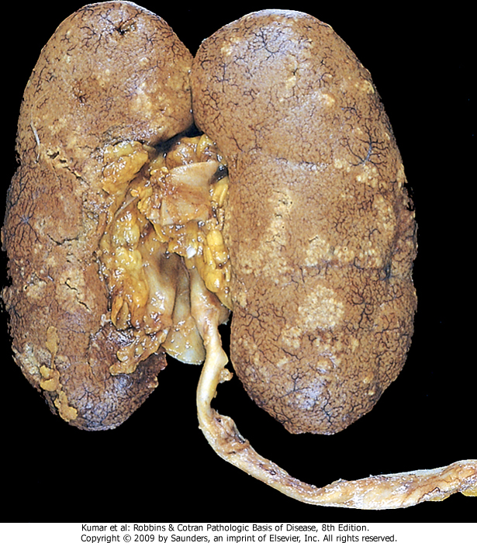
.
Acute pyelonephritis. Cortical surface shows grayish white areas of inflammation and abscess formation

Slide 9
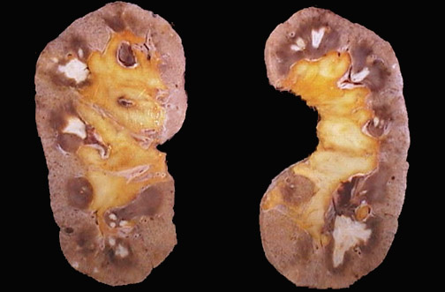
The pale white areas involving some or all of many renal papillae are areas of papillary necrosis
Notes:
This is an uncommon but severe complication of acute pyelonephritis, particularly in persons with diabetes mellitus. Papillary necrosis may also accompany analgesic nephropathy

Slide 10
Acute on chronic pyelonephritis with numerous septic foci present in an already scarred kidney.

Slide 11
Acute pyelonephritis. There is a diffuse interstitial infiltrate with polymorphonuclear leukocytes.

Slide 12
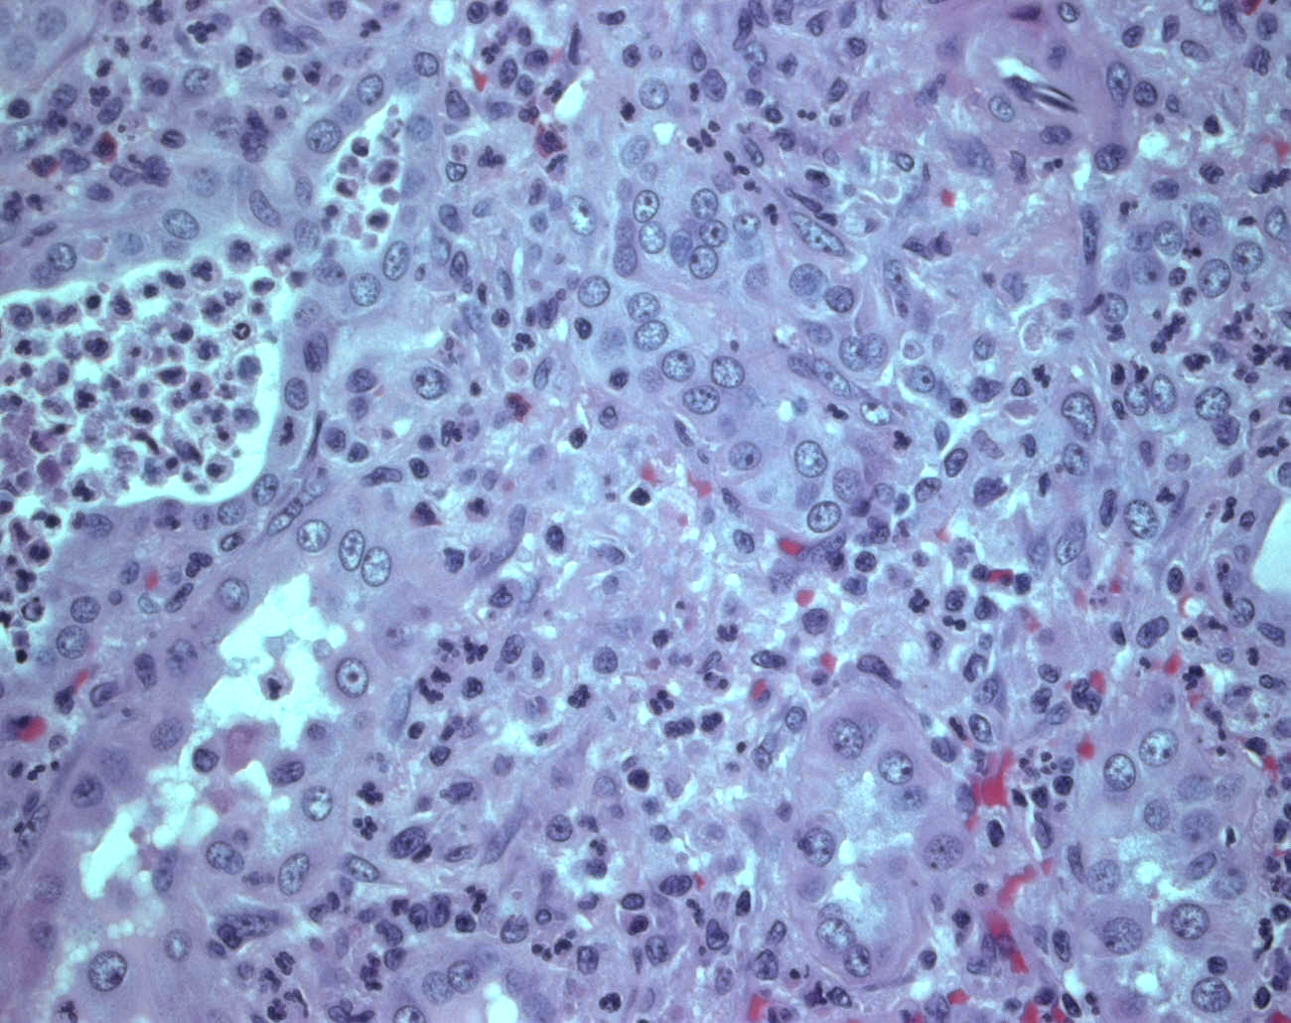

Slide 13
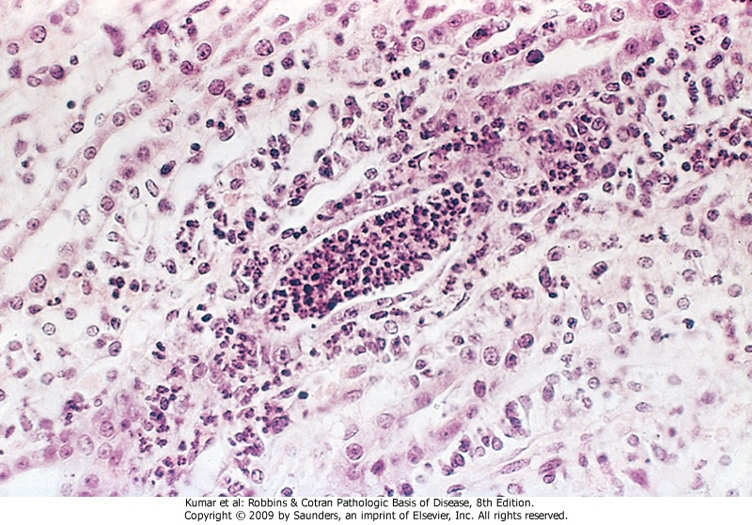
Acute pyelonephritis marked by an acute neutrophilic exudate within tubules and interstitium inflammation

Slide 14
Chronic pyelonephritis and reflux nephropathy
Chronic pyelonephritis is a disorder in which chronic tubulointerstitial inflammation and scarring involve the calyces and pelvis
1- Reflux nephropathy
2- Obstructive

Slide 15
Chronic Pyelonephritis-gross
The kidneys usually are irregularly scarred; if bilateral, the involvement is asymmetric.
The hallmarks of chronic pyelonephritis are coarse, discrete, corticomedullary scars overlying dilated, blunted, or deformed calyces, and flattening of the papillae .
Notes:
This contrasts with chronic glomerulonephritis, in which both kidneys are diffusely and symmetrically scarred.

Slide 16
Renal tuberculosis secondary to hematogenous spread of tubercle bacilli.

Slide 17
Staghorn calculus in pelviureteric junction.

Slide 18
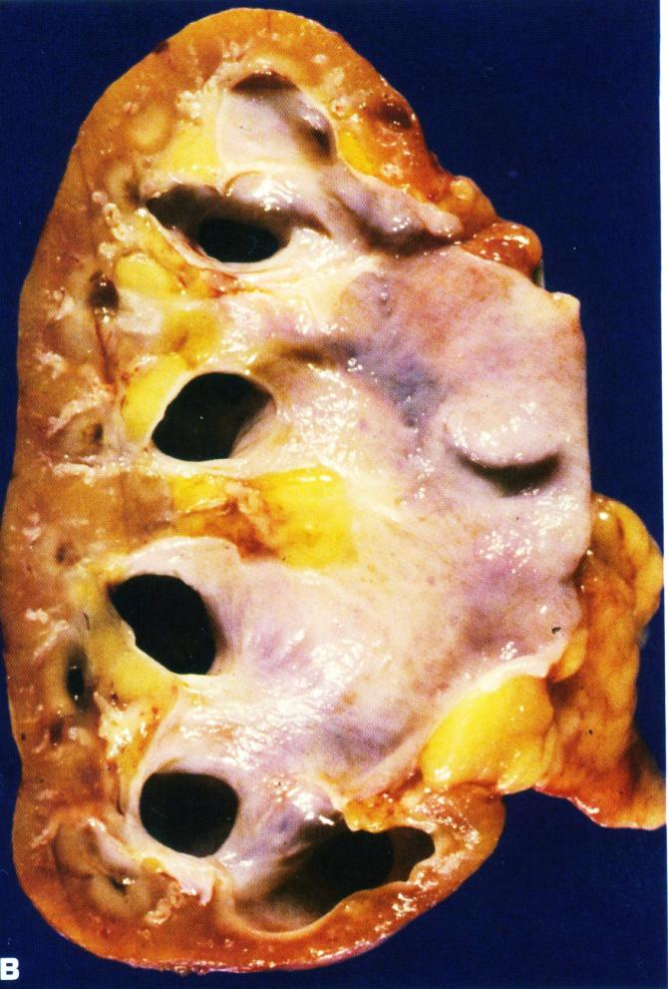
A. Bilateral hydronephrosis with acute on chronic pyelonephritis in a child due to urinary tract obstruction.
B. Hydronephrosis with thinned renal parenchyma in an adult kidney.

Slide 19
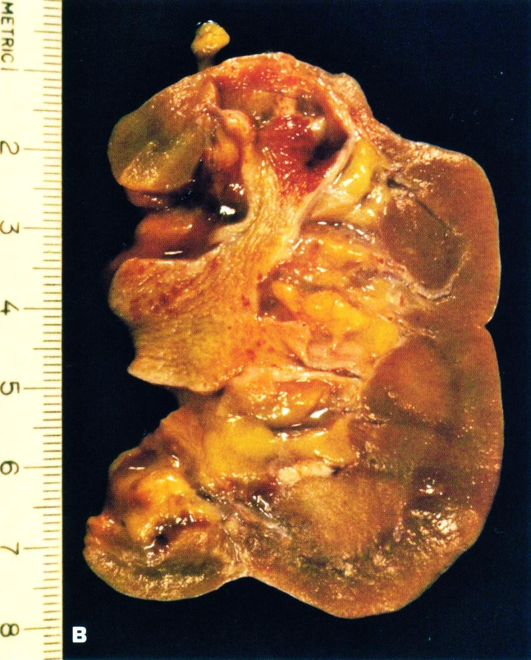
A. unshaped scar of healed pyelonephritis
B. Healed pyelonephritis associated with vesicoureteral reflux has produced scarring of both poles of the kidney with calyceal distortion due to infection of the peripheral compound papillae.

Slide 20
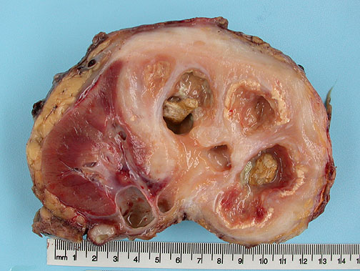
Notes:
Destruction of approximately 70% of the kidney. Numerous dilated calyces with yellow-brown calculi. The central necrotic areas are surrounded by dense fibrosis

Slide 21
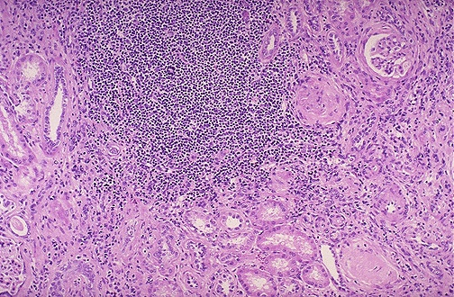
Chronic pyelonephritis: collection of chronic inflammatory cells here is in a patient with a history of multiple recurrent urinary tract infections.
Notes:
Both lymphocytes and plasma cells are seen in this case of chronic pyelonephritis. However, the plasma cells are most characteristic for chronic pyelonephritis.

Slide 22
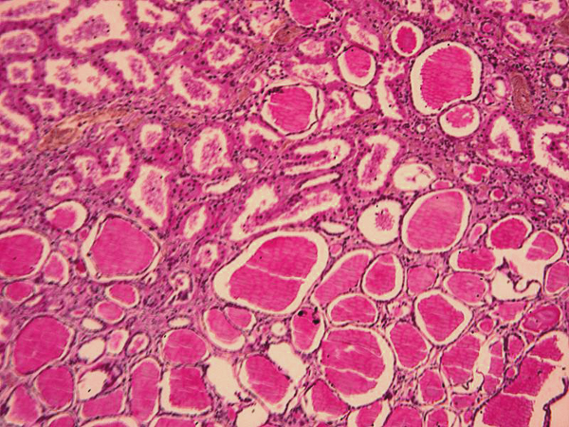

Slide 23
Urolithiasias
Types of stones in urinary tract
CALCIUM OXALATE and PHOSPHATE (70% )
Magnesium ammonium phosphate (15-20%)
(Struvite stone)
URIC ACID & URATE (5-10%)
CYSTINE (1-2%)

Slide 24
Tubulointerstitial Nephritis
Tubulointerstitial Nephritis
This group of renal diseases involves inflammatory injuries of the tubules and interstitium that are often insidious in onset and are principally manifest by azotemia

Slide 25
The mononuclear infiltrate is accompanying by abundant eosinophils and may have a granulomatous appearance.

Slide 26
Higher power of tubulitis demonstrating interstitial edema and invasion of the tubular epithelium by lymphocytes.

Slide 27
Definition-UTI
UTI: the finding of microorganisms in bladder urine with or without clinical symptoms and with or without renal disease
Significant bacteriuria: the number of bacteria in the voided urine exceeds the number that can be expected from contamination (i.e. ≥ 10⁵ cfu/ml)

Slide 28
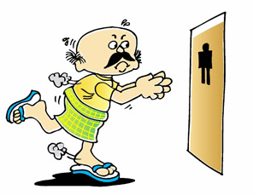
Clinical features of UTI
Cystitis
Frequency
Urgency
Dysuria – painful voiding
Suprapubic Pain
Cloudy or foul-smelling urine

Slide 29
Symptoms urolithiasis
Pain in the lower back part or in the lower abdomen, which might move to the groin. Pain may last from hours to minutes.
Nausea, vomiting
Blood in urine
Burning during urination, foul smell in urine, chills, weakness and fevers for urinary tract infection.

Slide 30
Acute and Chronic Cystitis: Etiology
Women are more likely to develop cystitis
Tuberculous cystitis is always a sequel to renal TB
Candida albicans
Schistosomiasis (Schistosoma haematobium)),
Chlamydia, and Mycoplasma may also cause cystitis.
Predisposing factors include bladder calculi, urinary obstruction, diabetes mellitus, instrumentation, and immune deficiency.
Finally, irradiation of the bladder region gives rise to radiation cystitis.

Slide 31
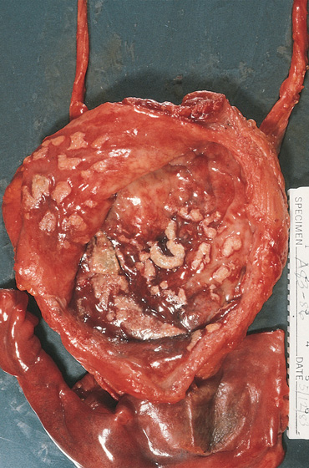
Cystitis with malakoplakia
Peculiar inflammatory reaction
characterized by
soft, yellow,
plaques 3-4 cm in diameter
and histologically
by foamy
macrophages
Slide 22.6

Slide 32
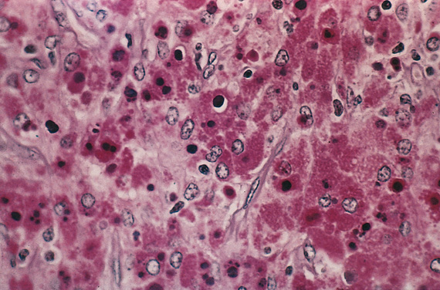
Cystitis with malakoplakia: Michaelis Gutman bodies
Slide 22.7

Slide 33
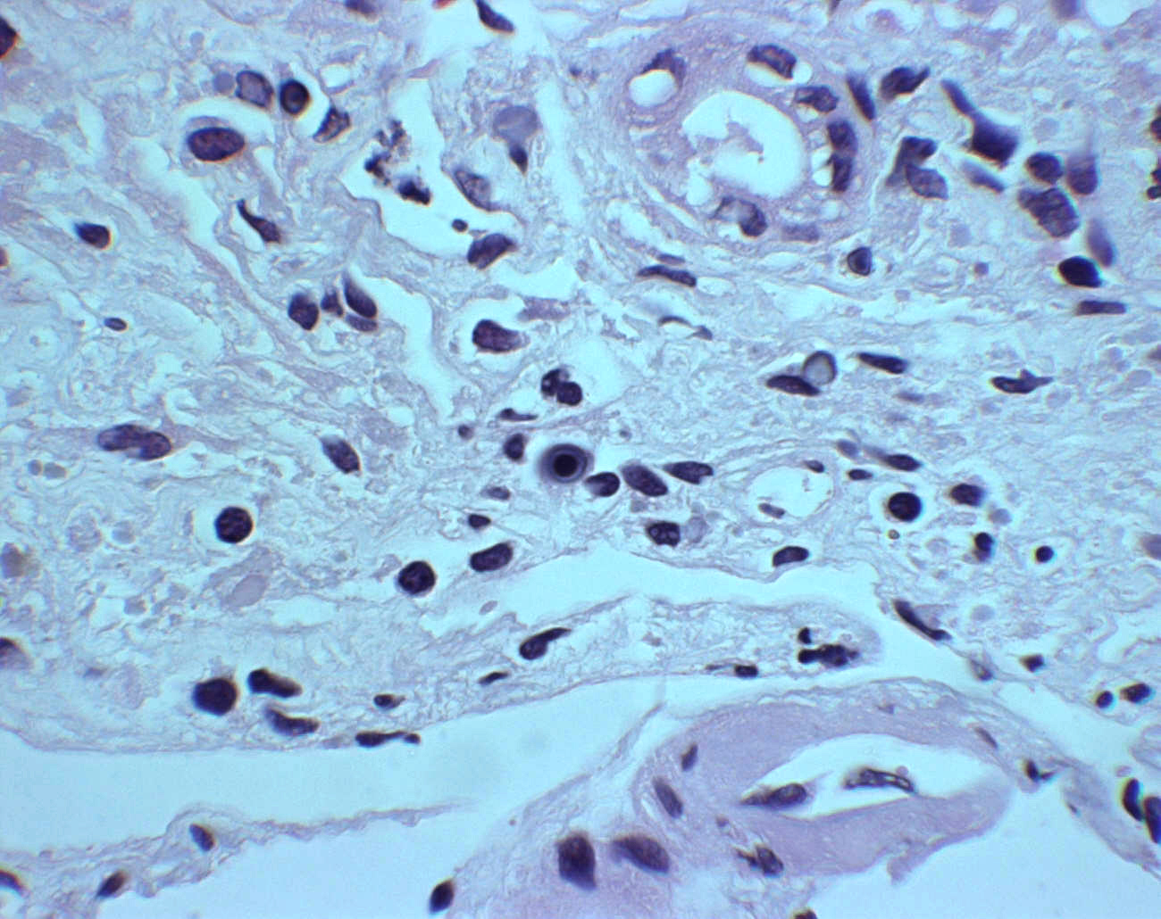
Notes:
MLKP

Slide 34
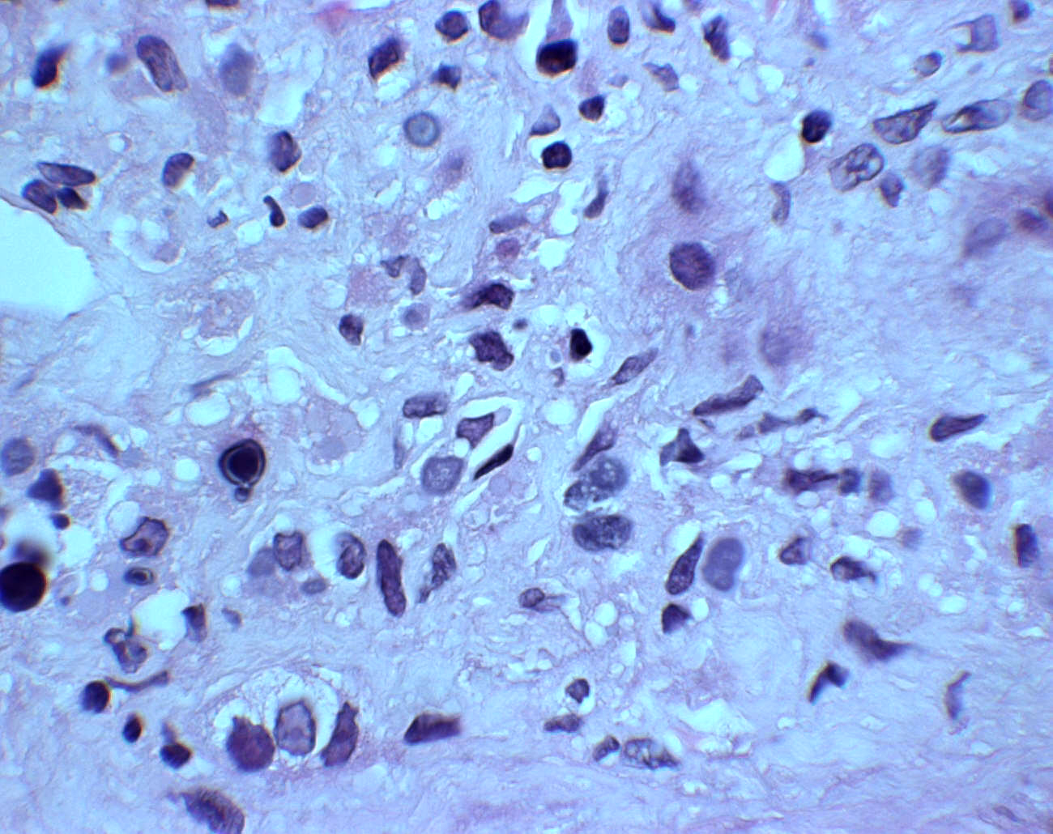
Notes:
MLKP

Slide 35
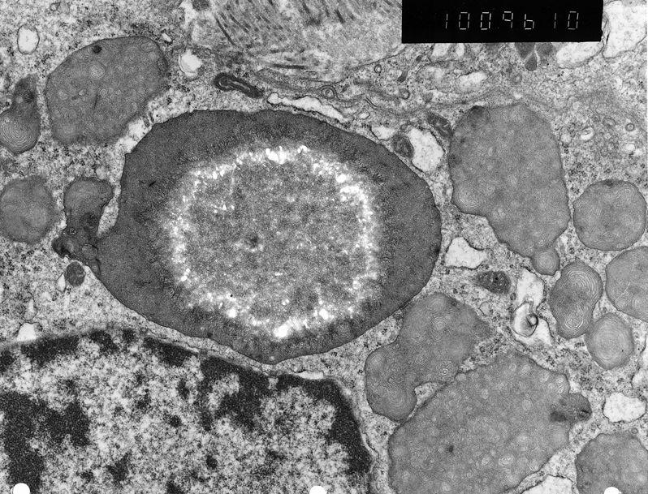
Notes:
MLKP

Slide 36
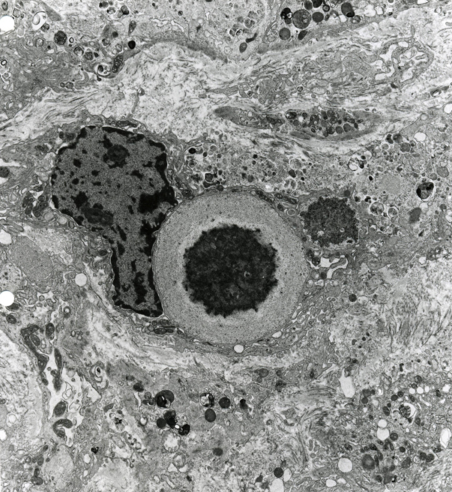

Slide 37
Acute inflammation of the urinary bladder.

Slide 38
.
Homework :
Specify what are the radiopaque and what are the radiolucent calculi.
Notes:
Multiple acquired diverticula (arrows) lie between hypertrophied muscular bundles in a hypertrophied bladder of the patient who had severe prostatic hyperplasia

