Slide 1
Pathology of Renal Transplantation DR. TARIQ ALJOHANI

Slide 2
Objectives:
Recognize the concept of renal allograft.
Describe the pathology of rejection
Differentiate between acute and chronic rejection.
Recognize the principal infections inherent to renal transplantation.
Recognize acute and chronic drug toxicity.

Slide 3
Renal transplantation
Note the two end-stage native kidneys in normal position, the atrophic first donor kidney (lower left), and the larger second donor kidney (lower right).

Slide 4
The Banff classification:diagnostic categories
Normal
Hyperacute Rejection
Borderline changes(“very mild acute rejection”)
Acute Rejection( Tcell, Antibody-mediated)
Chronic Rejection
Others
Notes:
Others= changes not considered to be related to rejection.
Hyperacute rejection is an antibody mediated endothelial damage.

Slide 5
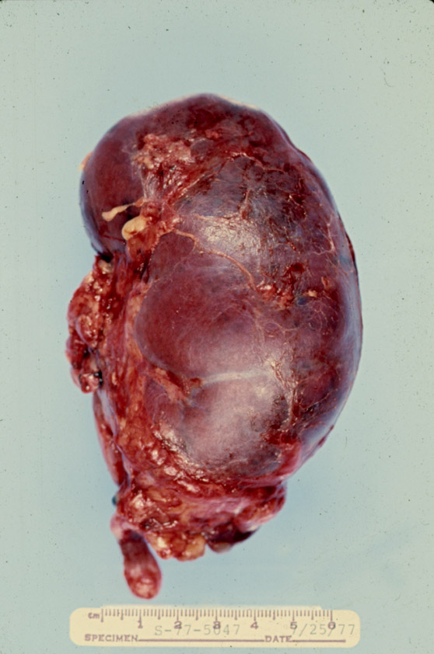
Notes:
Hyperacute rejection

Slide 6
Subtotal renal infarction due to hyperacute (antibody-mediated) rejection.

Slide 7
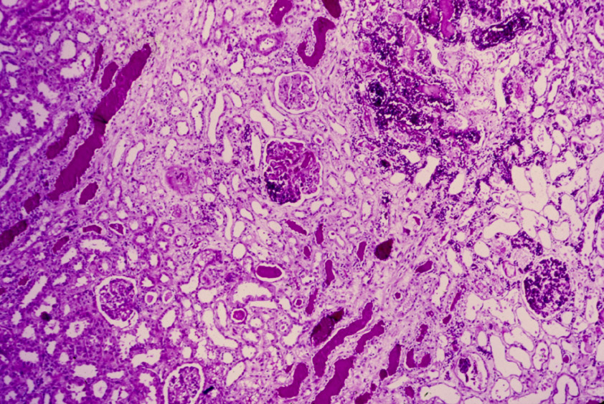
Notes:
Infartion in hyperacute rejection.

Slide 8
Severe acute rejection of donor kidney. Focal infarcts are present.

Slide 9
The Banff classification
Borderline changes(Suspicious for Acute
Rejection)
Notes:
No intimal arteritis
Mild tubulitis (1-4/tubular cross section).

Slide 10
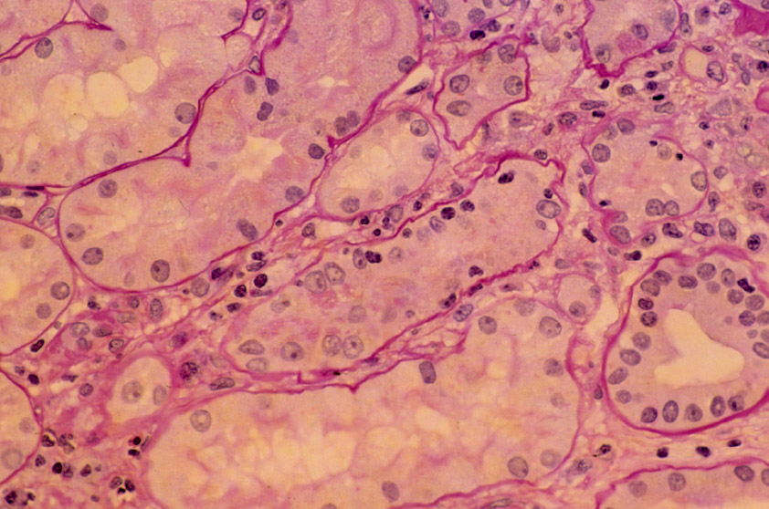
Notes:
Suspicious.

Slide 11
The Banff classification
Grade I A :→Mononuclear interstitial inflammation(>25%).
→+ Moderate tubulitis.(5 to 10)
Grade I B :→Mononuclear interstitial inflammation(>25%)
→+Severe tubulitis(>10)

Slide 12
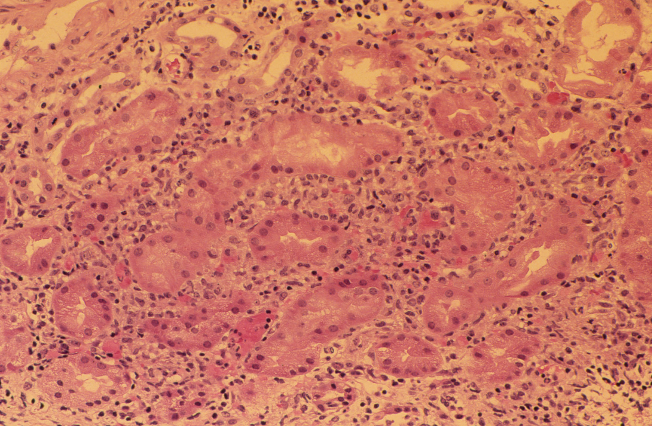
Notes:
Acute cellular rejection

Slide 13
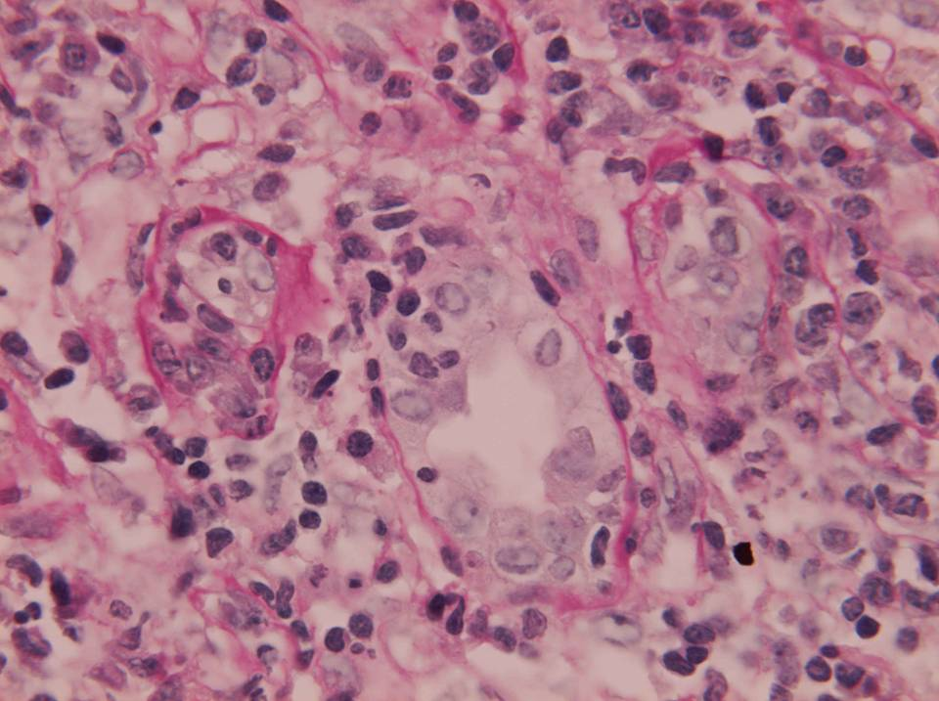

Slide 14
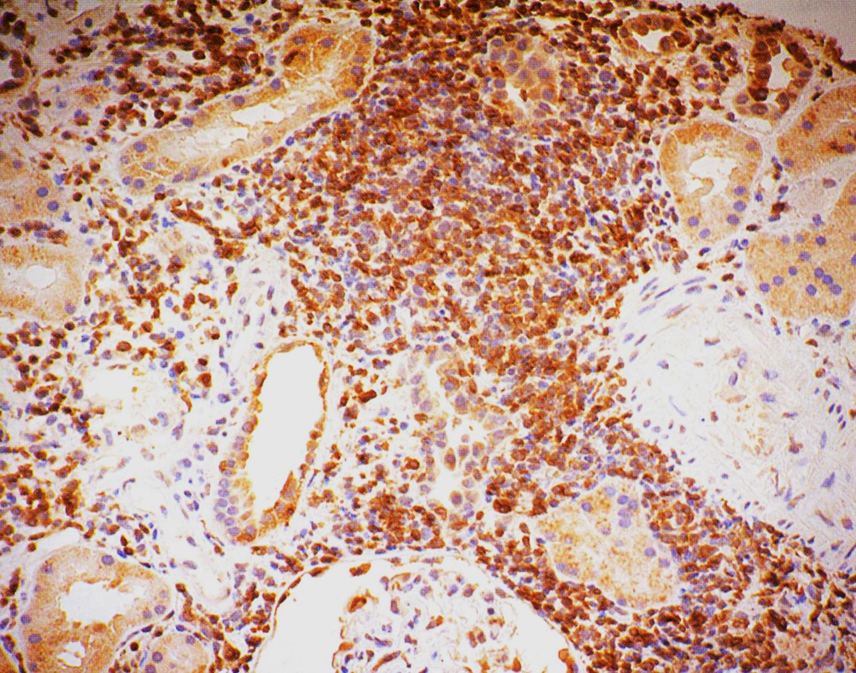
Acute rejection. The interstitial infiltrate consists of T cells mainly.

Slide 15
The Banff classification
Grade II A
Mild to Moderate intimal arteritis :
Grade II B
Severe intimal arteritis

Slide 16
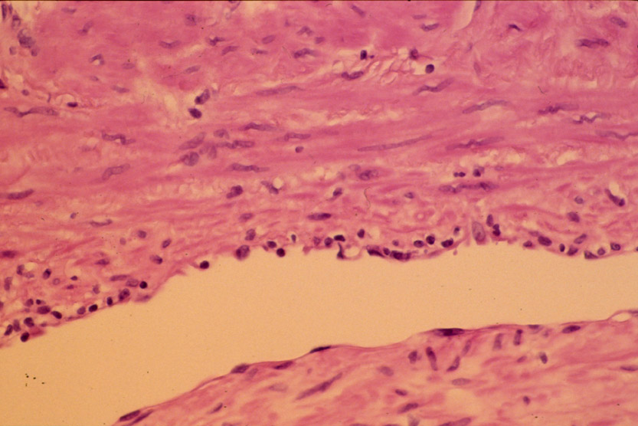
Notes:
Mild areteritis.

Slide 17
The Banff classification
Grade III →Transmural arteritis and/or fibrinoid necrosis.

Slide 18
The Banff classification
Chronic Allograft Nephropathy:
Grade I (Mild)
Grade II (Moderate)
Grade III (Severe)
Notes:
All is based on the tubular atrophy and interstitial fibrosis.as well as on the transplant glomerulopathy(double contour).
Chronic allograft damage index.Vascular :0 <25,>25,to 50,>50.mesangial matrix increase tubular atrophy,interstitial fibrosis.

Slide 19
Severe chronic rejection. (graft arteriopathy). Note the severe parenchymal atrophy and the thick-walled arteries.

Slide 20
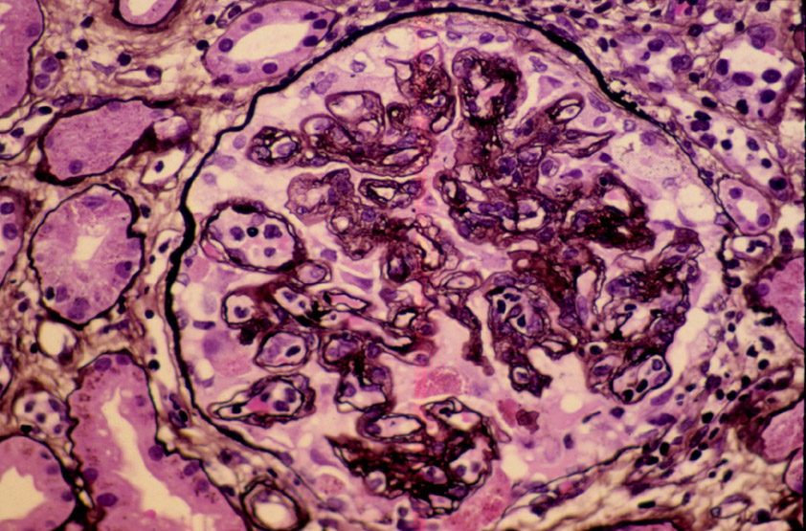
Notes:
Transplant glomerulopathy.

Slide 21
Chronic/ sclerosing allograft nephropathy. An example of Grade II-III is characterized by a diffuse increase in interstitial tissue and marked tubular atrophy as seen on this trichrome stain.

Slide 22
Chronic/ sclerosing allograft nephropathy. The classical lesion of chronic transplant vasculopathy is a circumferential proliferation of myointimal cells with an intact internal elastic lamina.

Slide 23
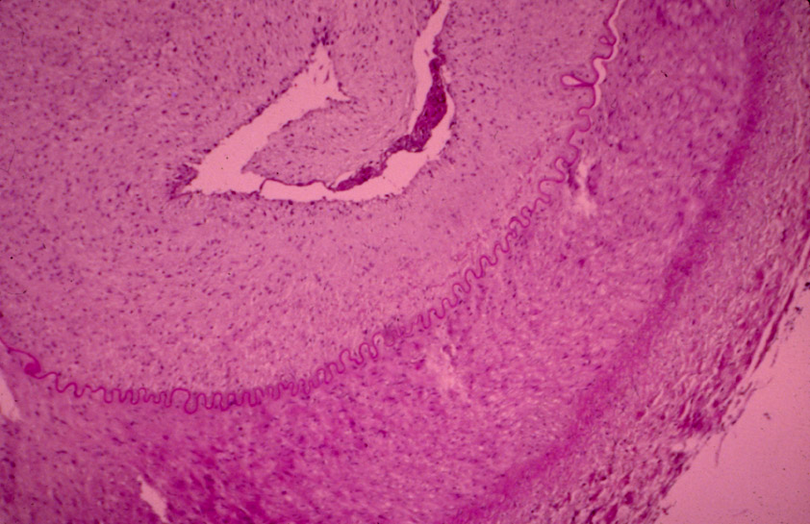
Notes:
Severe rejection

Slide 24
The Banff classification
Normal, Suspicious
Grade I
Grade II
Grade III
Cyclosporine toxicity
Acute Tubular Necrosis
Chronic rejection
No Treatment
Treat if clinical signs+
Treat
Treat or Abandon
Reduce Cyclosporine
Await recovery or treat
Temporize
Notes:
Treat grade II with steroids and consider ALG/OKT3.

Slide 25
Infections
Recurrent or De Novo GN

Slide 26
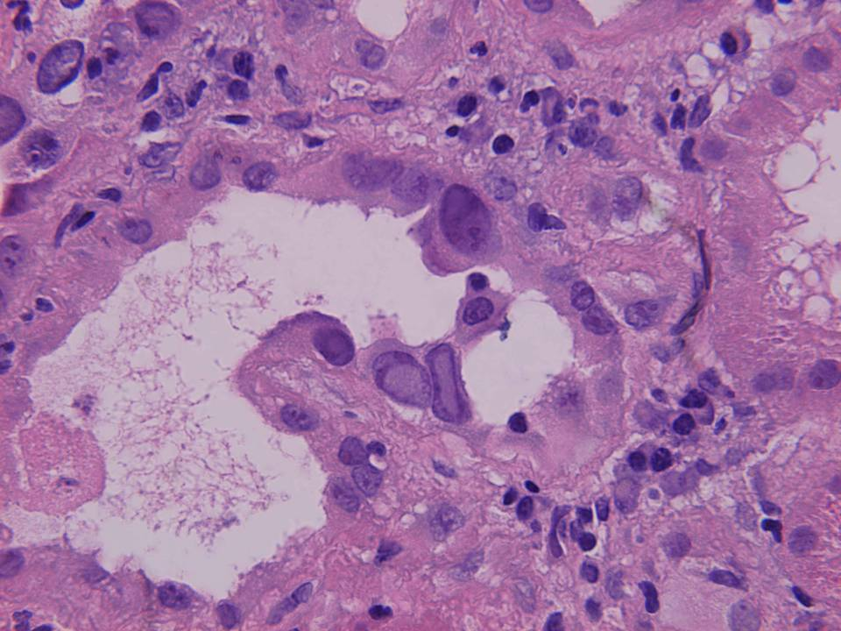
Notes:
Intranuclear viral inclusion. Ground glass.

Slide 27
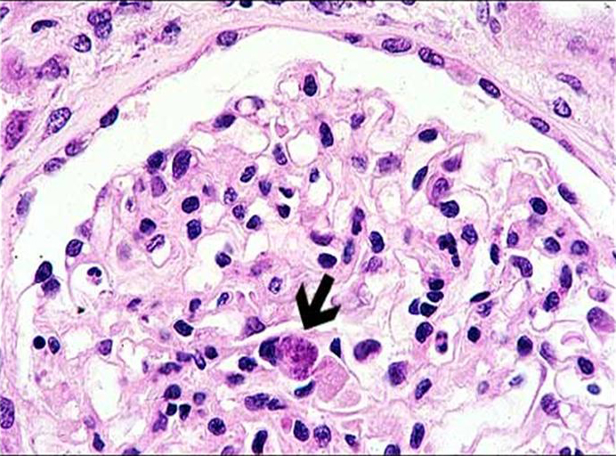

Slide 28
DRUG TOXICITY

Slide 29
Notes:
Acute Cyclosporine Toxicity: Isometric vacuolisation

Slide 30
Notes:
Acute Cyclo toxicity

Slide 31
The Banff classification
Conclusion
The Banff classification has proposed a schema for interpretation and gradation of the histological findings in renal allograft biopsies that can be used as an indication for therapeutic consequences and expected graft survival.

Slide 32
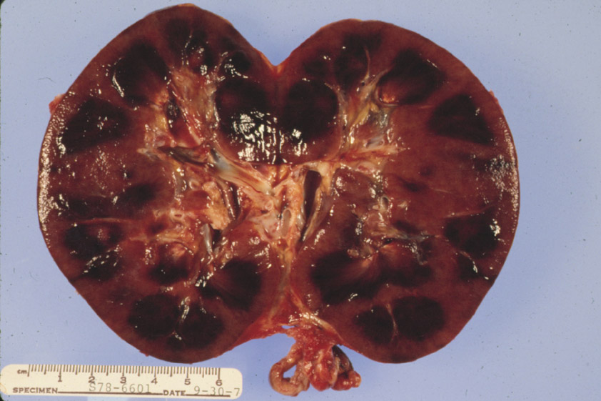
Notes:
Acute Rejection with multiple infarcts.

