Slide 1
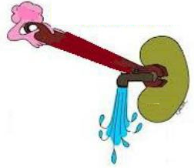
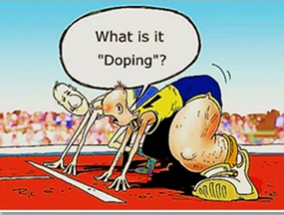
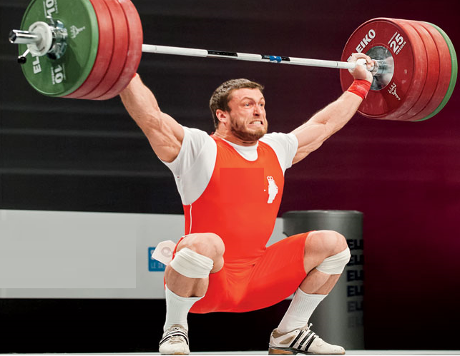
The Bulgarian Weightlifting Federation was sanctioned and suspended from participation in the 2000 Olimpic Summer Games in Sydney
To lose weight quickly in order to compete in lower weight classes e.g. wrestling, boxing, and weightlifting
Diuretic doping
“Masking” drugs to speed the elimination of banned substances e.g. steroids
Drug testing revealed the presence of furosemide

Slide 2
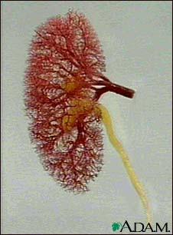
diuretics
ilos
Define and classify diuretics
Identify the site of action of each class of diuretics in the nephron
Describe the mechanisms of action of diuretics

Slide 3
diuretics
ilos
Detail on the pharmacodynamic actions and pharmacokinetic aspects of diuretics
List ADRS, therapeutic uses, contraindications and drug- drug interactions of diuretics

Slide 4
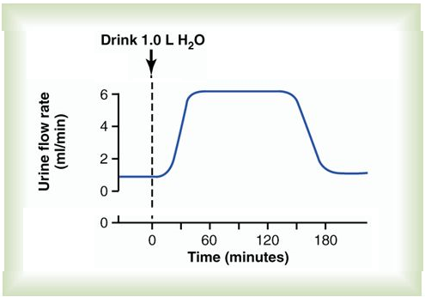
diuretics
Drugs used to increase renal flow rate
Water diuresis
They act by ↑the quantity of sodium in urine ( natriuretic diuretics)
Used to remove excess extracellular fluid (oedema)

Slide 5
Diuretics
The main
indications
Edema of
any origin
Congestive
heart failure
Hypertension
Elimination of toxins

Slide 6
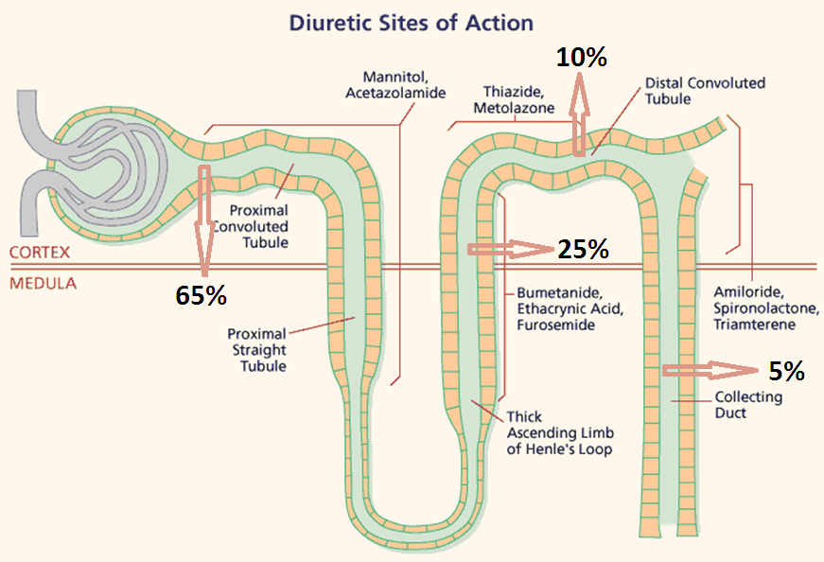
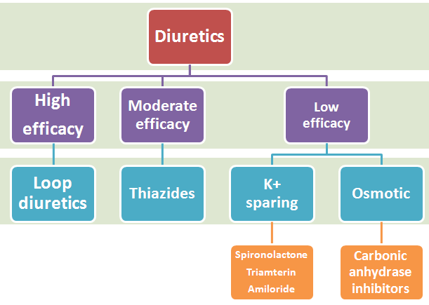
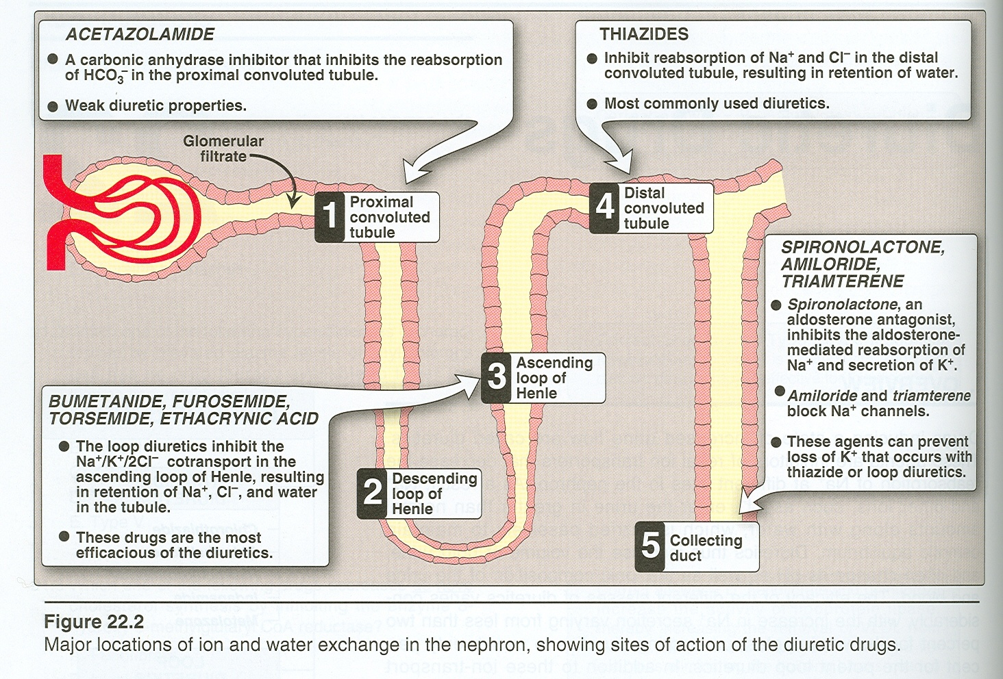
diuretics
classification
Action
Mechanism of action
Efficacy
Site of action

Slide 7
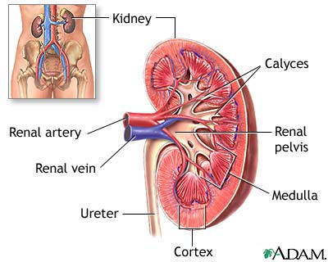
Diuretics i
Carbonic anhydrase inhibitors
Osmotic diuretics

Slide 8
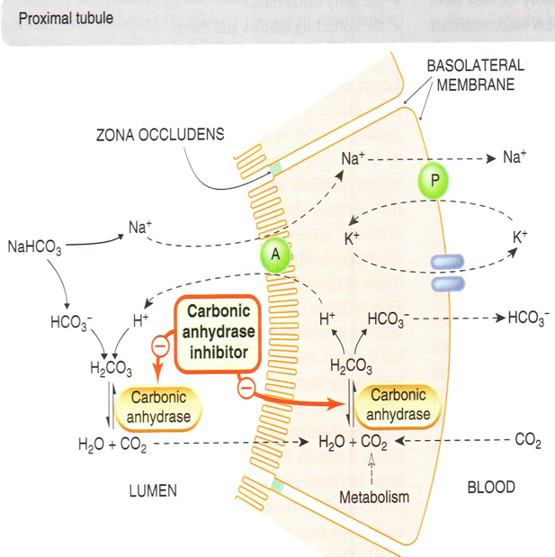
Diuretics I
Carbonic anhydrase inhibitors
Carbonic anhydrase accelerates the attainment of equilibrium in the reaction
CO2 + H2O↔H2CO3
Acetazolamide is a potent specific inhibitor of carbonic anhydrase, enzyme inhibition is non competitive

Slide 9
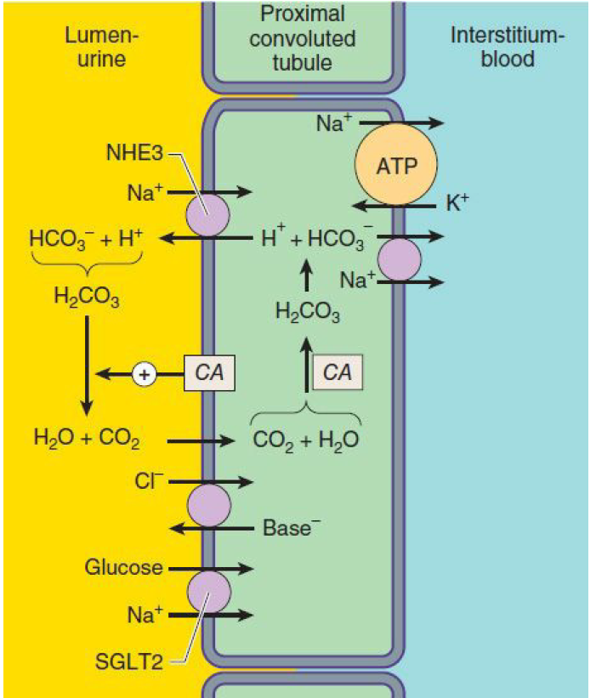
Carbonic anhydrase inhibitors
It ↓ reabsorption of bicarbonate in the proximal tubule & prevent the acidification of urine in the distal tubule
Promotes K+ excretion by ↑the load of Na+ delivered to the distal tubules
With repeated dosage the diuretic action is lost →loss of HCO3- & development of acidosis
Self- limiting action of acetazolamide restrict its use to mild oedema .

Slide 10
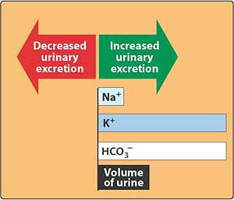
Carbonic anhydrase inhibitors
pharmacokinetics
acetazolamide
Given orally once a day
Onset of action is rapid (30 min)
t½ 6-9h
Excreted by active secretion in proximal convoluted tubules

Slide 11
Carbonic anhydrase inhibitors
dorzolamide
Is a carbonic anhydrase inhibitor
Used topically for treatment of increased intraocular pressure in open-angle glaucoma
No diuretic or systemic side effects (Why?).

Slide 12
Carbonic anhydrase inhibitors
adrs
Drowsiness
Numbness
Tingling sensation of the face & extremities
Disturbance of vision
Contraindicated in patients with liver cirrhosis (alkaline urine ↓excretion of NH4→ hyperammonemia & hepatic encephalopathy)

Slide 13
Carbonic anhydrase inhibitors
Clinical indications
1-Glaucoma:- aqueous humour contains a high concentration of bicarbonates. ↓of carbonic anhydrase↓rate of aqueous humour formation→ ↓intraocular pressure (tolerance does not develop to this effect)
2-Urine alkalinization:- uric acid, cysteine & methotrexate are relatively insoluble in acid urine. Renal excretion can be ↑by ↑ urinary bicarbonate excretion. Effect is short lived & require bicarbonate infusion.

Slide 14
Carbonic anhydrase inhibitors
Clinical indications
3-↓Formation of CSF:- ↓of carbonic anhydrase in the chorioid plexus →↓formation of CSF. Useful in management of benign intracranial hypertension.
4-Useful for correcting a metabolic alkalosis, especially an alkalosis caused by diuretic-induced increases in H⁺ excretion & metabolic alkalosis of heart failure.

Slide 15
Carbonic anhydrase inhibitors
Clinical indications
5-Mountain sickness prophylaxis:- given nightly 5 days before the ascent
↓ weakness, breathlessness , dizziness, nausea , cerebral & pulmonary oedema
6-Adjunct for treatment of epilepsy:- glial cells contain carbonic anhydrase. Nerves are highly responsive to rise in pH. ↑7.4→ 7.8 causes convulsions ↓of neuronal carbonic anhydrase →↓ pH in the vicinity of neurons→↓ convulsions .

Slide 16
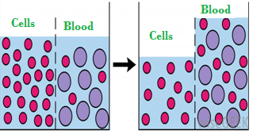
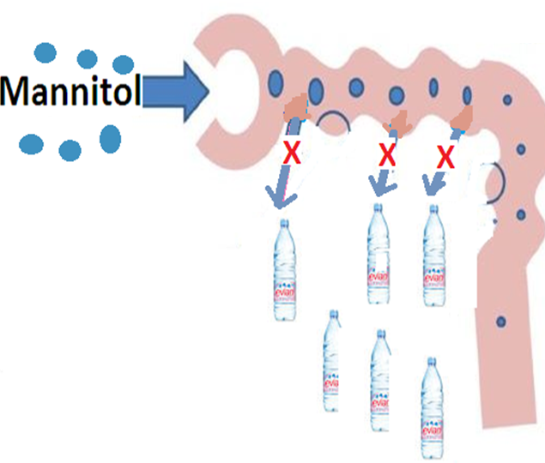
Osmotic diuretics (Aquaretics)
mannitol
Mannitol increases urine output by osmosis, drawing water out of cells and into the bloodstream
IV administration of any solute filtered by glomeruli may produce osmotic diuresis when the amount delivered to tubules exceeds their absorptive capacity
The dissolved compound exert an osmotic pressure →↓water & Na+ reabsorption
Expand the extracellular fluid volume, decrease blood viscosity, and inhibit renin release,↑renal blood flow

Slide 17
mannitol
pharmacokinetics
Mannitol, IV, not absorbed from the GIT, ↑water excretion with relatively less effect on Na+
If given orally osmotic diarrhea
Little metabolized
Mainly excreted unchanged in urine
Excreted by glomerular filteration
t½0.25-1.7h, prolonged in renal failure to 36h

Slide 18
mannitol
Clinical uses
1-To eliminate drugs that are reabsorbed from the renal tubules in acute poisoning e.g. salicylates, bromides, barbiturates
2-To prevent acute renal necrosis after severe injury , haemorrhage, hypovolaemia, →↓ GFR, absorption of water & salts is complete , distal part dries up→ irreversible damage

Slide 19
mannitol
Clinical uses
3-To↓ intracranial & intraocular pressure before ophthalmic or brain procedures
4-To maintain urine volume & to prevent anuria resulting from large pigmentation load to the kidney e.g. haemolysis, rhabdomyolysis

Slide 20
manitol
adrs
Headache, nausea, vomiting→ hyponatremia
Extracellular volume expansion, complicates heart failure & pulmonary oedema
Excessive use→ dehydration & hypernatraemia, (Adequate water replacement is required).

Slide 21
mannitol
contraindications
Chronic heart failure
Anuric patients or patients not responding to a test dose of mannitol

