Slide 1
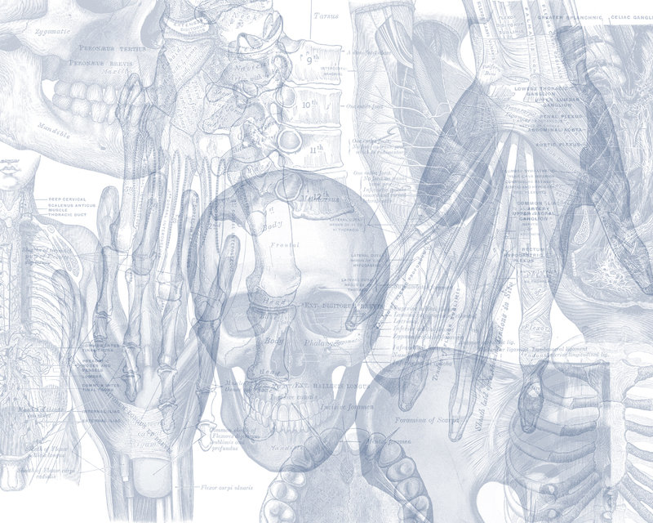
OSPE RENAL BLOCK
Color Code
Nerves
Arteries
Veins
Muscles
Lymphatics

Slide 2
اللهم لا سهل إلا ما جعلته سهل وأنت تجعل الحزن إذا شئت سهل
Important Points
Read the questions carefully.
Make sure your write the FULL name of the structures with the correct spelling.
Example: SVC ✕→ Superior Vena Cava ✓
Thoracic aorta ✕→ Descending thoracic aorta ✓
3. There is NO guarantee whether or not the exam will go out of this file.
Good luck!

Slide 3
Q 1
3
Identify the muscles:
1- Psoas major
2- Quadratus lumborum
3- Diaphragm
2
1

Slide 4
Note: These muscles are part of the posterior abdominal wall and are posterior relations of the kidney.

Slide 5
Q 2
1- The renal artery arises from abdominal aorta.
2- The level of the renal artery is L2.
3- The renal veins drain into inferior vena cava.
4- The right renal vein is shorter than the left renal vein
Identify two veins that drain into the left renal vein:
1- Left suprarenal vein
2- Left gonadal vein

Slide 6
Left

Slide 8
Sites of Constrictions in the ureter:
At ureteropelvic junction
At pelvic inlet (site of crossing of common iliac artery)
At site of entrance to bladder

Slide 9
Q 3
B
A
Identify :
A- Right adrenal (or suprarenal) gland
B- Diaphragm
C- Psoas major
D- Quadratus lumborum
E- Transverse abdominis
F- Urinary bladder
E
C
D
F

Slide 10
Q 4
Identify the structures related to the marked areas:
1- Psoas Major
2- Quadratus lumborum
3- Transversus abdominis
3
2
1

Slide 11
Q 5
7
8
Identify the structures:
1- Psoas major muscle
2- Quadratus lumborum muscle
3- Perirenal fat
4- Pararenal fat
5- Inferior vena cava
6- Renal fascia
7- Peritoneum
8- Abdominal aorta
9- Erector Spinea
5
3
6
Perirenal fat → Inside
1
4
2
9

Slide 12
Q 6
1
The ureter is supplied by:
1- Renal artery
2- Gonadal artery
3- Common iliac artery
4- Internal iliac artey
2
3
The urinary bladder is supplied by:
Internal iliac artey
4

Slide 13
Q 7
Identify the labeled areas:
1- Ureteric orifice
2- Trigone
3- Internal urethral orifice
4- Urethra
1
1
2
3
4
Note: Trigone is smooth and formed by 2 ureteric orifice and 1 urethral orifice

Slide 14
Identify:
A- Trigone
B- Prostate
C- Prostatic urethra
D- Membranous urethra
E- Penile urethra
F- External urethral orifice
G- Fossa navicularis
Identify:
A- Mucosal folds
B- Ureter
C- Trigone
D- Urethra
E- Ureteric orifice
Female
Male

Slide 15
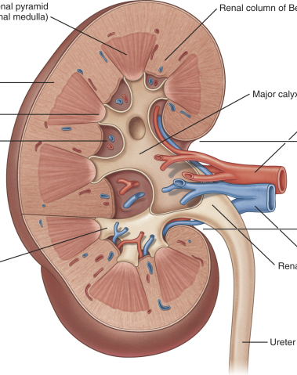
Q 8
Identify the labeled areas:
1- Renal Column
2- Renal Pyramid
3- Renal Papilla
4- Minor Calyx
5- Cortex
6- Renal Sinus
7- Renal Pelvis
8- Major Calyx
2
1
5
4
7
6
3
8

Slide 17
Q 9
Name the structures anteriorly related to the marked areas on the kidney:
A- Stomach
B- Pancreas
C- Descending colon
D- Small intestine (loop of jejunum)
E- Spleen
With Peritoneum
Without Peritoneum
This is the left kidney because it’s closer to the aorta + longer renal vein

Slide 18
Q 10
Name the structures anteriorly related to the marked areas on the kidney:
A- Liver
B- Duodenum (2nd Part)
C- Right colic flexure
D- Small intestine
With Peritoneum
Without Peritoneum
This is the right kidney because it’s closer to the inferior vena cava

Slide 19
Anterior Relations of the Kidney:
Right suprarenal gland
Liver
Descending part of duodenum
Right colic flexure
Small intestines
Left suprarenal gland
Stomach
Spleen
Pancreas
Left colic flexure
Descending colon
Jejunum
Right Kidney
With Peritoneum
Without Peritoneum
Left Kidney

Slide 20
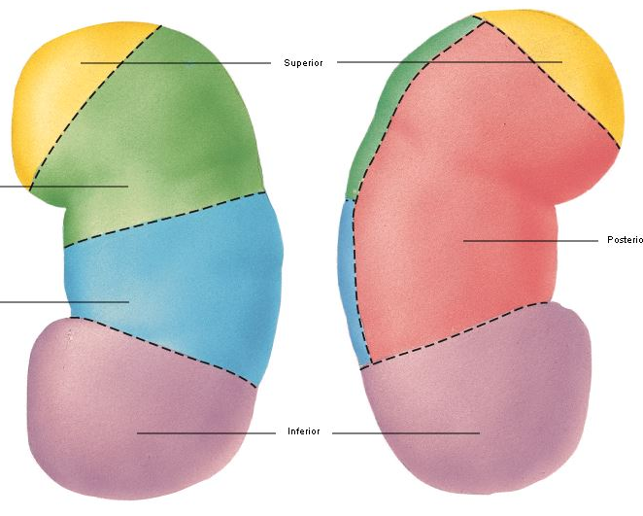
Q 11
Name the structures related to the marked areas:
1- Apical segment
2- Caudal segment
3- Anterior superior segment
4- Anterior inferior segment
5- Posterior segment
1
3
5
4
2

Slide 21
Done by:
Mohammed Ghandour
Mohammed Alyousef
Khalid Aleedan
Jawaher Abanumy
Special Thanks to TEAM 435
anatomyteam436@gmail.com
@anatomy436

