Slide 1
Biochemistry
Practical
URINALYSIS
To know what have we changed check our Editing file
Your body hears everything your mind says ..
Stay Positive
Important.
Doctors slides

Slide 2
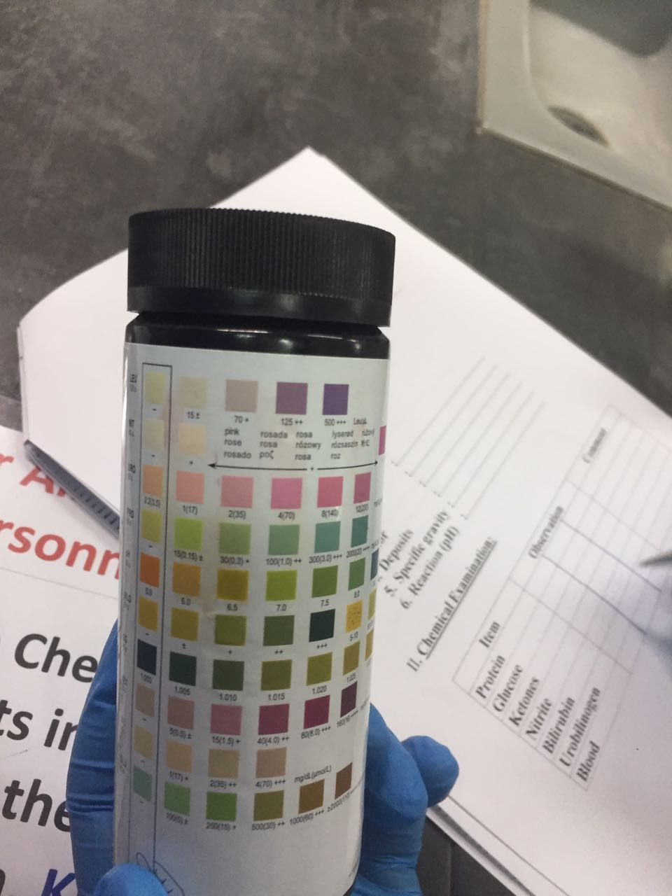
Notes about the exam :
This work is not by any means a reference .
As the doctor said the exam will consist of a urinalysis case, and it will be similar to the sample you did in the lab, but instead of finding the features some of it will be given, and there will be a question on the diagnosis of the case ..
Do your best and it will be so easy ☺

Slide 3
U R I N E :
What is “urine”?
Urine is a fluid excreted by most of mammals including humans .
It is formed in :
the kidneys (renal glomeruli) .
Urine Excretion :
The fluid undergoes chemical changes before it is excreted as urine.
Normal urine excretion by a healthy person is about 1.5 L per day .

Slide 4
Physical Properties Of Urine
IMPORTANT
PARAMETER | NORMAL | ABNORMAL | POSSIBLE CAUSES
Volume | 0.4-2.0 L/day | Polyuria | Diabetes , chronic renal failure
 |  | Oliguria | Dehydration , Acute renal failure
Appearance | Clear | Cloudy | Presence of pus cells , bacteria , salt or epithelial cells
Color | Pale Yellow | Colorless | Excessive fluid intake , uncontrolled DM* , DI** , chronic renal failure
 |  | Orange | Dehydration , carotenoid ingestion
 |  | Yellow-Green | Jaundice
 |  | Red | Blood , drugs etc.
 |  | Dark brown-black | Methemoglobin , alkaptonuria , melanoma , black water fever
 |  | smoky | glomerulonephritis
Odor (Smell) | Urineferous | Fruity | Diabetic ketoacidosis
 |  | Ammoniacal | Contaminated and long standing exposed urine
 |  | Mousy | Phenylketonuria
 |  | Burnt sugar | Maple syrup urine disease
Deposits | None | Crystals, salts or cells | Blood clots , necrotic tissues and urinary stones
Reaction (pH) | 4.6 - 7.0 | Acidic | ketosis (diabetes mellitus & starvation) , severe diarrhea , metabolic and respiratory acidosis , excessive ingestion of meat and certain fruits
 |  | Alkaline | Respiratory and metabolic alkalosis , Urinary tract infection , Vegetarians
*Diabetes Mellitus
**Diabetes insipidus

Slide 5
Chemical Properties of urine
IMPORTANT
PARAMETER | NORMAL | ABNORMAL | POSSIBLE CAUSES
Protein | < 200mg/day | Proteinuria | Nephrotic syndrome , glomerulonephritis , multiple myeloma , lower UTI , tumors or stones
Glucose | None | Glucosuria | Uncontrolled DM , gestational diabetes , Fanconi’s syndrome
Ketones | None | Ketonuria | Diabetic ketoacidosis , Glycogen storage disease, starvation , Prolonged vomiting , Unbalanced diet: high fat & Low CHO diet
Nitrite | None | Detected | UTI
Bilirubin | None | Detected | Hepatic and post-hepatic jaundice
Urobilinogen | Normal Trace (1mg/dl) | > 2 mg/dl | Jaundice
Blood | None | Hematuria | Acute & chronic glomerulonephritis , Trauma , cystitis , renal calculi and tumors , Bleeding disorders (Hemophilia).
 |  | Hemoglobinuria | Hemoglobinopathies , Malaria , Transfusion reaction (Blood Incompatibility)

Slide 6
PROTEINS
Nephrotic syndrome
“
“
Normally less than 200 mg protein is excreted in the urine daily
“
Large amounts of protein are lost in the urine and hypoproteinemia develops.
“
More than this level leads to a condition called (Proteinuria).
Increase protein excretion in urine can be one of the following two types:
A: High Molecular Weight Protein Excretion:
Glomerular Proteinuria
It is due to
Filtration of high molecular weight proteins ( e.g. glomerulonephritis)
↑ glomerular permeability
Glomerular proteinuria due to increase glomerular permeability leading to filtration of high molecular weight proteins
B: Low Molecular Weight Protein Excretion:
Tubular proteinuria
It is due to
↓ Tubular reabsorption with normal glomerular permeability
excretion of low molecular weight proteins (e.g. chronic nephritis)
Tubular proteinuria due to decrease reabsorption with normal glomerular permeability

Slide 7
Urinalysis (using dipstick):
Principle:
Dipsticks are plastic strips impregnated with chemical reagents which react with specific substances in the urine to produce color-coded visual results.
They provide quick determination of pH, protein, glucose, ketones, urobilinogen, bilirubin, blood, hemoglobin, nitrite, and specific gravity. The depth of color produced relates to the concentration of the substance in urine.
Color controls are provided against which the actual color produced by the urine sample can be compared .The reaction times of the impregnated chemicals are standardized.
Procedure:
Dip the strip in the urine sample provided then remove it immediately.
Remove the excess urine and keep the strip in a horizontal position.
Read the color produced within 30-60 seconds (Color changes after more than 2 minutes are of no significance).
Match the color changes to the color scale provided.
Give a full report about:
- Physical examination
- Chemical examination

Slide 8
CASE I
Usually under 25 years patient
with type I diabetes When there
is no enough Insulin, the
patient
can not use the glucose as a fuel
so the body breaks down fat
instead, lead to acid (ketones) build up.
A 12-year-old girl, a known patient with T1DM, presented to Emergency drowsy with short history of vomiting and abdominal pain. On examination:
- Tachycardia
- Tachypnea with a fruity smell of breath.
- BP: 85/50 mmHg (Ref range: 100/66-135/85 mmHg)
- Blood sugar: 26.7 mmol/L (Ref range: 3.9-5.6 mmol/L)
- HbA1C: 9.9% (Ref range: 5.7-6.4%)
- Blood pH: 7.1 (Ref range: 7.35–7.45)
- Circulating Ketone bodies: positive
A mid stream Urine sample was collected for complete urinalysis.
Diagnosis is very important
Diabetic with ketonuria (diabetic ketoacidosis)
Important characteristics:
What are the Physical Properties of Urine.?
Polyuria, Fruity Odor, Acidic PH, colorless (usually the rest are normal)
What are the Chemical Properties of urine?
Ketonuria, Glucosuria
elevated amount of keton and glucose in urine .
(usually the rest are normal)

Slide 9
CASE II
UTI patients usually have:
1- Pain or burning feeling during urination.
2- feeling of urgency.
3- feeling the need to urinate frequently.
4- altered appearance of the urine, either
bloody (red) or cloudy.
5- pain or pressure in the rectum.
A 49-old woman with history of DM came to hospital with fever, weakness and dysuria (pain during urination) for the last three days.
The results of her laboratory tests were as the table below.
A mid stream Urine sample was collected for complete urinalysis.
Microscopic examination of urine showed:-
WBCs: over 100/HPF (Ref range: 2-3/HPF)
RBCs: 10 /HPF (Ref range: 0-2/HPF)
Diagnosis is very important
Urinary tract infection
Test | Result | Reference range
Fasting blood glucose | 7.5 | 3.9-5.8 mmol/L
Creatinine | 75 | 55-120 mmol/L
Urea | 3.7 | 2.5-6.4 mmol/L
Sodium | 140 | 135-145 mmol/L
Potassium | 3.9 | 3.5-5.1 mmol/L
Important characteristics:
What are the Physical Properties of Urine?
(Alklaine, cloudy) (usually the rest are normal)
What are the Chemical Properties of urine?
(Proteinuria, Hematuria, Nitrite detected)
(usually the rest are normal)

Slide 10
CASE III
Nephrotic Syndrome Is A Kidney Disease With:
Proteinuria
Hypoalbuminemia
Edema
Hyperlipidemia
Hypercholesterolemia
A 6-year-old boy, developed marked edema over a period of few days. His mother had noted puffiness around the eyes, characteristically in the morning. She also noted that his urine had become frothy
His general practitioner ordered the following investigations (in the table below):
A BLOOD sample was collected to show the following
Diagnosis is very important
Test | Result | Reference range
creatinine | 58 | 55-120 mmol/L
Urea | 3.4 | 2.5-6.4 mmol/L
Sodium | 136 | 135-145 mmol/L
Potassium | 4.0 | 3.5-5.1 mmol/L
Total Protein | 34 | 60-80 g/L
Albumin | 14 | 35-50 gmL
Cholesterol | 11 | 3.2-5.2 mmol/L
Triglycerides | 1.5 | 0.5-2.27 mmol/L
Nephrotic Syndrome
The blood sample shows hypoalbuminemia and hyperlipidemia = Nephrotic
Important characteristics:
What are the physical properties of urine?
Frothy urine.
(usually the rest are normal)
What are the Chemical Properties of urine?
Heavy proteinuria.
(usually the rest are normal)
Urine dipstick must show proteinuria
SYMPTOMS:
Frothy urine
Puffiness around the eye
Edema

Slide 11
THANK YOU
FOR CHECKING OUR WORK
Done By:
MUHANNED ALZAHRANI

