Slide 1
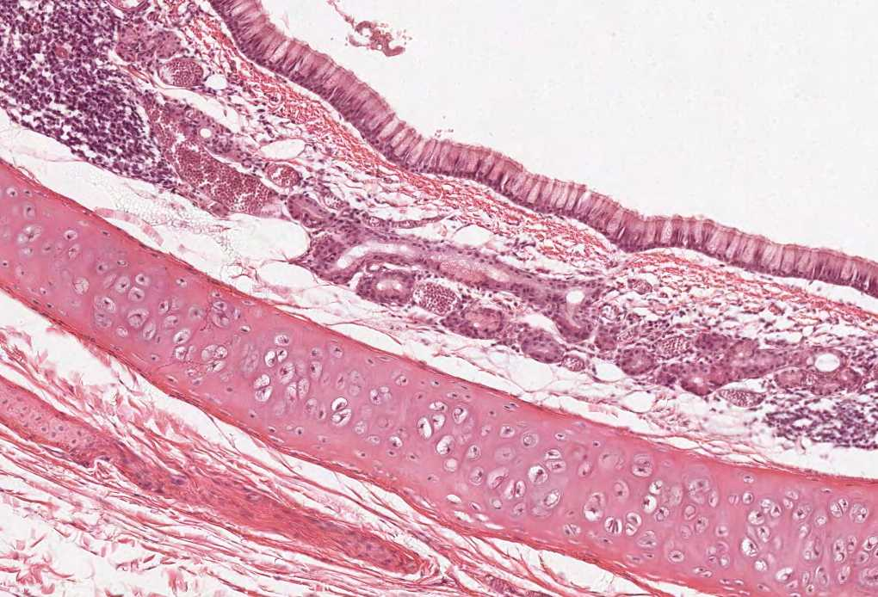
Practical Histology
Renal block

Slide 2
Things you need to know before the exam :
The pictures in the exam will be the same as the ones included in the slides.
Don’t try to take short cuts during the exam so avoid using abbreviations so you don’t lose marks.
Please keep in mind that this work is done by students , so if there are any mistakes please inform us .
This work is not by any means a reference.
Please study hard and don’t worry the exam will be easy!!

Slide 3
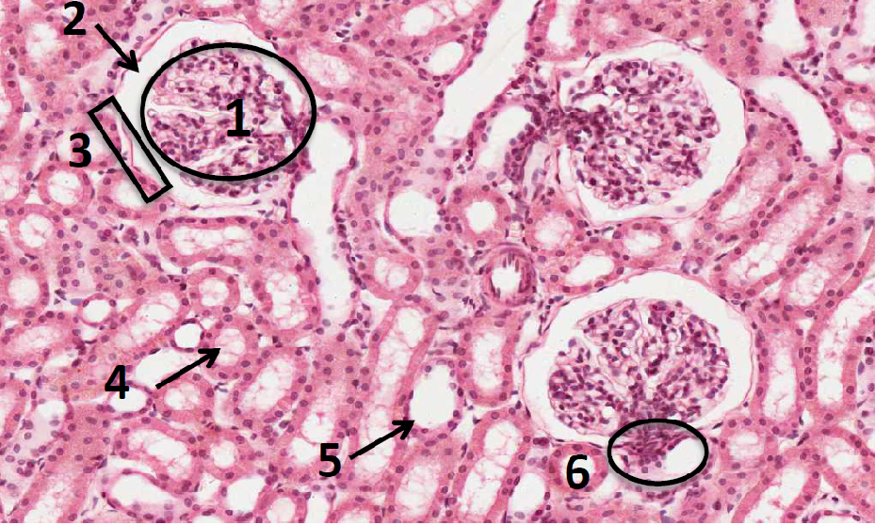
Cortex of the Kidney
Structures:
Glomerulus of renal corpuscle.
Urinary space (or capsular space).
Parietal layer of Bowman’s capsule.
Proximal convoluted tubules with brush border.
Distal convoluted tubules.
Juxta-glomerular apparatus.
How to differentiate between the proximal and distal convoluted tubules ?
PCV: Has an ill defined lumen because it is filled with brush border (microvilli)
من جوا لونها زهري.
DCV: Has a well demarcated and clear lumen.
من جوا لونها أبيض.

Slide 4
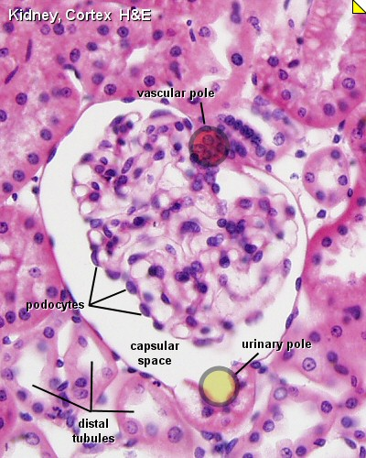
Juxtaglomerular apparatus
Formed of:
The macula densa of distal tubule (tall columnar cells)
تكون جهة ال Distal tubule
Juxtaglomerular cells of afferent glomerular arteriole (they secrete renin)
تكون جهة ال afferent arteriole
The extraglomerular mesangial cells

Slide 5
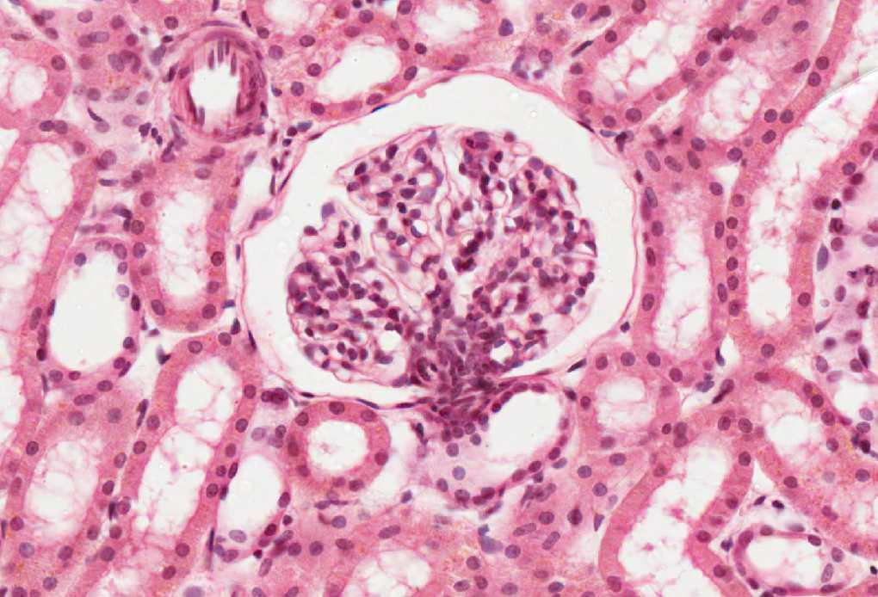
Renal Corpuscle
Structures:
Glomerulus which contains fenestrated capillaries "without diaphragm”
Bowman’s capsule: Parietal layer, urinary space, and podocytes (visceral layer)
Mesangial cells: Intra-glomerular cells
Cells:
Mesangial cells
Glomerular endothelial cells
Podocytes (epithelial cells)
DCT
DCT
PCT
Podocytes have processes, and these processes have filtration slits with diaphragms.
PCT
DCT

Slide 6
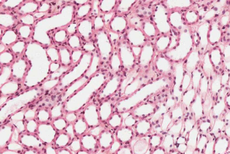
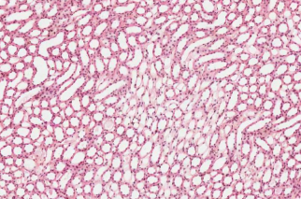
Kidney (Medulla)
Features :
Contains tubular structures:
loop of Henle: simple squamous epithelium
collecting tubules and ducts: simple cuboidal epithelium
Papillary ducts (ducts of Bellini):Simple Columnar epithelium

Slide 7
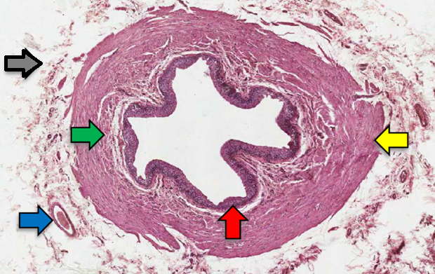
Ureter
Features:
Transitional epithelium
Inner longitudinal layer
Outer circular
Blood vessels
Adventitia
Layers:
Adventitia | Muscularis | Mucosa
NO Serosa | Muscularis“Muscle coat” Upper 2/3: - Inner Longitudinal - Outer Circular Lower 1/3: - Inner Longitudinal - Middle Circular - Outer Longitudinal | Transitional Epithelium Lamina Propria

Slide 8
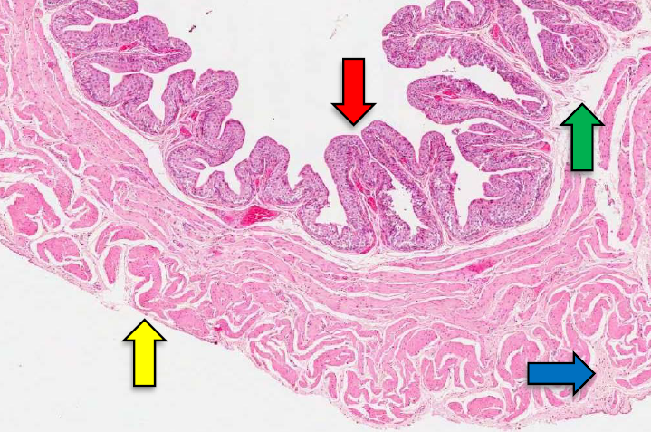
Urinary Bladder
Features:
Transitional epithelium
Lamina propria
Connective tissue
Mesothelium
Layers:
Adventitia | Muscularis | Mucosa
Serosa | 3 layers of smooth muscle coat” Inner Longitudinal Middle Circular Outer Longitudinal | Transitional Epithelium Lamina Propria
It is a continuation of the lower third of the ureter, has the same structure except that it has serosa.

Slide 9
Thank you & good luck
- Histology team
Done by :
Rana Barasain
Faisal Alrabaii
Omar Turkistani
Team leaders:
Rana Barasain
Faisal Alrabaii
Please if you need anything or even further explanation contact us on :
HistologyTeam436@gmail.com
@histology436

