Slide 1
Please Read This Notes!
This file contains 1st lecture only
This work is not by any means a reference.
Please keep in mind that this work is done by students , so if there are any mistakes please inform us .
Some slides have notes and extra explanation that will help you to understand the contents, please see it.
The lecture may has different contents between males and females.
You may find notes in some slides , it’s just to clarify how the question may come but EVERY THING IS IMPORTANT
DO NOT forget to write the formula in calculation questions.
Please study hard and don’t worry the exam will be easy !
GOLDEN ADVICE >>> STUDY SMART <<<

Slide 2
Diuresis
Physiology lab Team 436 – Renal block
This work include Boy’s + girl’s slides + girl’s handout
Objectives :
To measure the volumes and determine the compositions of urine excreted by 4 groups: ( fasting / drunk 1 L water/ drunk 1L saline / took 1 tab of lasix).
To be able to discuss the mechanisms by which the body maintain the water and sodium homeostasis in the 4 different conditions.
Definition and clinical applications of: - GFR ( Glomerular Filtration Rate). - C_{Cr} ( Creatinine Clearance )
Made by :
Hassan Alshammari - Leena Alwakeel - Mohammad Nasr - Ruba Ali
Contact us: Physiology436@gmail.com @Physiology436

Slide 3
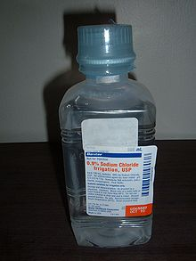
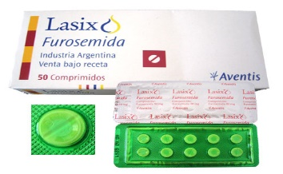
At This File , We Have 4 Cases To Discuss :
You have to know what will happen in each case
Several students have volunteered to take an active part in this practical class :
Case 1 :
Students who didn’t drink water and any other solution ( Deprived from water ).
Case 2 :
Students who drink 1 liter of water ( Water Diuresis ).
Case 3 :
Students who drink 1 liter of 0.9% saline ( Isotonic Saline ).
Case 4 :
Students who swallowed a Lasix (Furosemide) tablet 40 mg with the help of 25 ml of water
( Osmotic Diuresis ).

Slide 4
Case 1
Steps :
Patients Emptied their bladders at 8:00 am and discarded the urine.
From 8:00 they are restricted to take any fluids
They are asked to provide various urine samples for analysis at:
10:00 am, 12:00 noon, 2:00 pm and 3:00 pm.
What will happen to them ?
Subsequent urine sample is :
lesser in volume
darker yellow in color ( more concentrated )
that shows the kidneys try to conserve water in fasting state.
The next slide will explain why that happened .

Slide 5
Case 1 : Compensatory mechanism
Experiment :
Deprivation of H2O
‪كيف ممكن‬ يجي السؤال على Compensatory mechanism
Body response
Hormones (if there was)
results
Result of the experiment :
↑ Plasma Osmolarity
Compensatory mechanism :
Stimulation of Osmoreceptors in Anterior Hypothalamus
↑ Feeling Thirsty
↑ ADH secretion from posterior pituitary
↑ H2O Drinking
↑ H2O permeability in late distal tubule and collecting duct
H2O reabsorption
↓ Plasma Osmolarity Toward Normal
Result :
- ↑ Urine osmolarity
- ↓ urine volume
Remember : The aim of the compensatory mechanism is to restore the plasma osmolarity and volume towards normal level.

Slide 6
Case 2
Case 2 ( WATER DIURESIS )
Steps :
Patients emptied their bladder at 10:00 am and discarded the urine.
At 12:00 am emptied their bladder again, but this time they measured its volume and provided a sample for analysis. This sample will be : pre-experimental sample.
They drank 1 liter of water immediately after providing the pre-experimental sample.
Were then asked to empty their bladders and provide post-experimental samples every half an hour after drinking water until 3:00 pm.
What will happen to them ?
Subsequent urine samples up to 3:00 pm are :
larger in volume.
more watery in color( less concentrated ).
that shows the kidneys try to excrete this extra 1 liter of water as quickly as possible.
The next slide will explain the why that happened .

Slide 7
Case 2 : Compensatory mechanism
Opposite of the first group
Experiment :
Drinking 1 liter of H2O
Result of the experiment :
↓ Plasma Osmolarity
Compensatory mechanism :
Inhibition of osmoreceptors in Anterior Hypothalamus
↓ Feeling Thirsty
↓ ADH secretion from posterior pituitary
↓ H2O Drinking
↓ H2O permeability in late distal tubule and collecting duct
↑ Plasma Osmolarity Toward Normal
↓ H2O reabsorption and ↑ H2O excretion
↓ Urine osmolarity
↑ urine volume
Remember : The aim of the compensatory mechanism is to restore the plasma osmolarity and volume towards normal level.

Slide 8
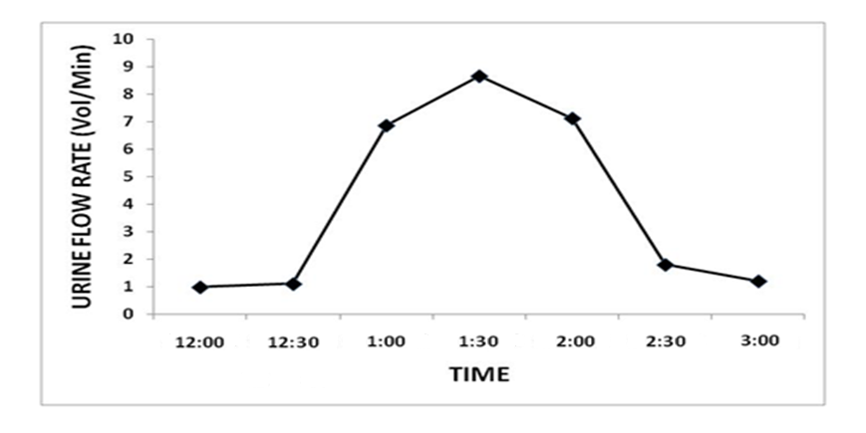
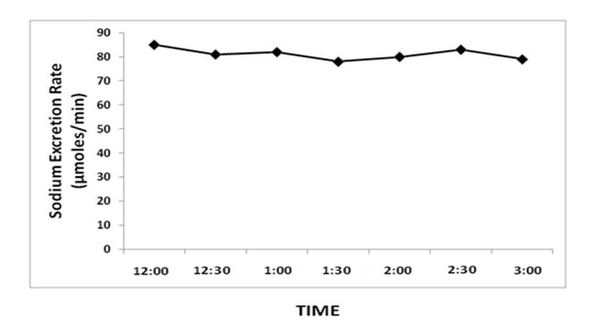
Case 2 Graphs
كيف ممكن يجي السؤال : بيجيبون لكم الرسمة ويسألوكم :
١- هذي الرسمة تتبع اي حالة : ‪(ممكن يعطوك رسمة وحدة أو الرسمتين )‬
مثلا هنا urine flow rate increase dramatically then return to same point ‪—> it is the second case ‬
٢- الوقت مهم : مثال هنا kidneys get rid of this 1 liter of water ingested by these volunteers in 3 hours
٣- تقول اذا هي WATER DIURESIS للحالة الثانية او OSMOTIC DIURESIS للحالة الرابعة
Urine flow rate
sodium excretion rate
(from 435) Thanks to them :
Urine volume
1st : will be about the same in the first post- experimental sample as of the pre- experimental sample,
2nd : will increase dramatically in the subsequent samples
3rd : and will again decrease back to the level of pre- experimental sample in the last samples.
Duration : healthy kidneys get rid of this 1 liter of water ingested by these volunteers in 3 hours and the mechanism starts after 30 minutes, as shown by the graph.
Sodium concentration will remain constant. because low level of ADH :
1- will increase the excretion of water
2- while NA are constant (won’t be affected )
Conclusion : The increase in the urine volume WAS NOT accompanied by simultaneous increase in sodium excretion in those subjects , so the diuresis that occurred in those subjects who drank water is called WATER DIURESIS. (belongs to 2nd case)

Slide 9
Case 3
Case 3
Step :
Patients emptied their bladder at 7:00 am and discarded the urine.
At 9:00 am emptied their bladder again, but this time they measured its volume and provided a sample for analysis. This sample will be pre-experimental sample.
Drank 1 liter of 0.9% saline (isotonic saline) immediately after providing the pre-experimental sample.
Then asked to empty their bladders and provide post-experimental samples every hour after drinking saline until 3:00 pm.
What will happen to them ?
Subsequent urine samples up to next 24 hours are :
Slightly larger in volume.
No change in the color
that shows the kidneys try to excrete this extra 1 liter of isotonic saline slowly but steadily.
The next slide will explain the why that happened .

Slide 10
Case 3 : Compensatory mechanism
Drinking 1 liter of 0.9% saline (isotonic)
What is Isotonic saline 0.9% ?
Contains 154 mmol of NaCl , equivalent to 9g of salt or 3.6g of Na+
The Na+ concentration of isotonic saline is EQUIVALENT to the normal Na+ concentration of plasma water. (that’s why osmolality will not change )
What is the effect of ANP ?
Increase in Blood flow to kidneys (due to relaxation of smooth muscles in blood vessels) → ↑ in GFR → ↑ in Na loss in urine.
Decrease Aldosterone → ↓ Na reabsorption in DCT → ↑ Na loss in urine.
↑ Volume in E.C.F
↑ In total volume and solute amount
No change in osmolality (cause it is isotonic)
↑ Stretch on right atrium
(volume receptors in right atrium)
↑ ANP (atrial natriuretic peptides)
↑ Na excretion by kidneys

Slide 11
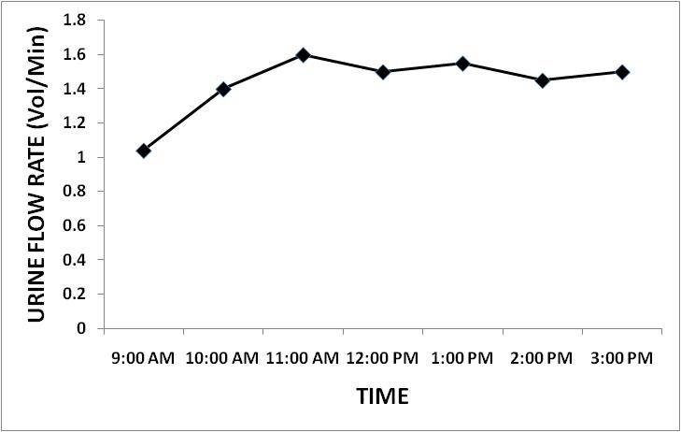
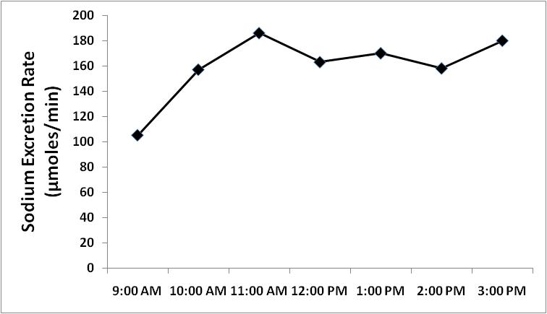
Case 3 Graphs
Urine flow rate
sodium excretion rate
(from 435) Thanks to them :
We will find in these subjects that urine volume will remain slightly increased in the post-experimental samples as compared to pre-experimental samples.
Duration : As a matter of fact, it will take 24 hours (to return back to the level of pre- experimental sample ) to excrete 1 liter of isotonic saline ingested by them.
Increased in sodium excretion with time. because at this situation , ANP will inhibit the aldosterone → ↓ Na reabsorption in DCT → ↑ Na loss in urine.
It means that the kidneys are trying to get rid of this extra sodium chloride and water that has been ingested by these volunteers, but slowly.

Slide 12
Case 4
Case 4 (Osmotic Diuresis)
.
Steps :
Patients emptied their bladder at 8:00 am and discarded the urine.
At 10:00 am emptied their bladder again, but this time they measured its volume and provided a sample for analysis. This sample will be pre-experimental sample.
Swallowed a Lasix (Furosemide) tablet 40 mg with the help of 25 ml of water immediately after providing the pre-experimental sample.
Were then asked to empty their bladders and provide post-experimental samples every hour after taking Lasix until 12:00 noon and then every half an hour until 3:00 pm.
What will happen to them ?
Subsequent urine samples up to next 4-6 hours are :
Larger in volume.
No change in the color
that shows the kidneys cant reabsorb sodium, so water will follow sodium in the urine.
The next slide will explain why that happened .
ممكن يجي سؤال على الميكانيزم
What is Lasix?
Furosemide is a loop diuretic used in the treatment of hypertension, congestive heart failure and edema.
Mechanism : It inhibits the sodium-potassium-chloride co-transport system located within the ascending limb of the Loop of Henle.

Slide 13
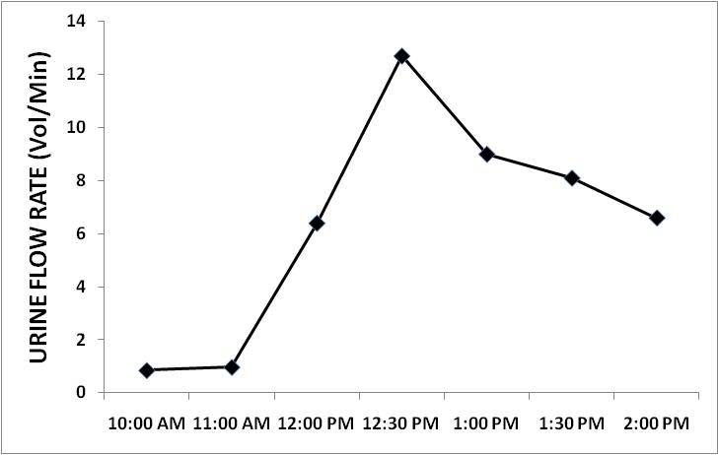
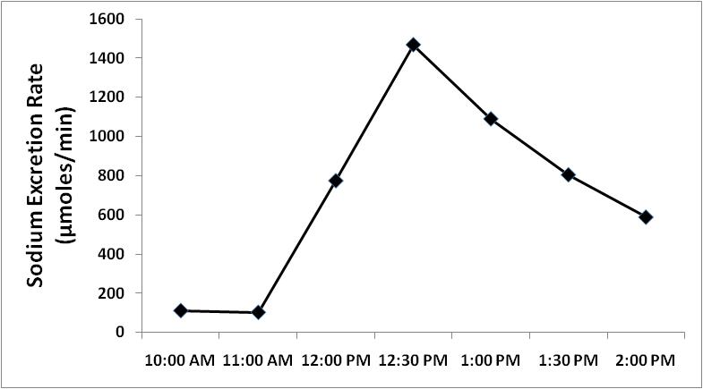
Case 4 Graphs
Case 4 : Compensatory mechanism
1 tablet of Lasix (furosemide) (40mg) with 25ml of water
Urine flow rate
sodium excretion rate
Action starts 1-2 hours and lasts for 4-6 hours (1/2 life of furosemide is 6hr)
Acts on thick ascending limb of loop of Henle and blocks the Na-K-2Cl co-transport (called loop diuretic)
We will find in these subjects that urine flow rate and sodium excretion rate are dramatically increased after 1 hour of taking Lasix tablet and remained increased for further duration of experiment.
why do we provide samples every hour after taking Lasix for 2 hours long then every half an hour ?? : effect of Lasix usually starts 1-2 hours after ingesting it and lasts for 4-6 hours
↑ Na excretion in urine
↑ Water excretion in urine
Because in this experiment both urine volume and sodium excretion rate will increase, this type of dieresis is called OSMOTIC DIURESIS,
Remember : group 2 was WATER DIURESIS , increase in the urine volume WAS NOT accompanied by simultaneous increase in urine osmolality in those subjects.

Slide 14
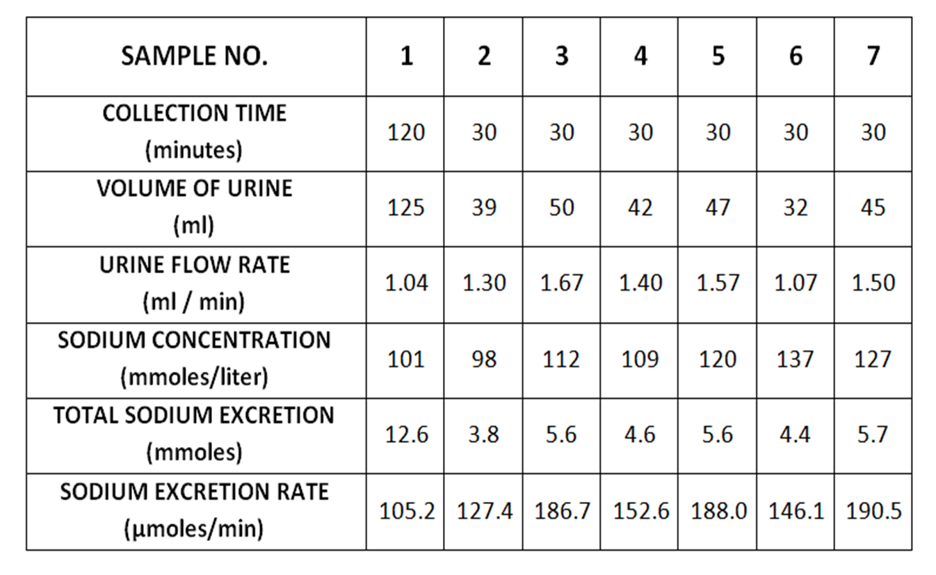
How to know these tables belong to which case ?
Example :
According to the tables below , determine the type of the experiments in each one :
Table 1
Table 2
Usually we see 2 things in the chart : Urine flow rate & NA excretion rate.
Urine Flow Rate :
From sample no. 1 to 2 : will increase a little bit , then will increase dramatically then decrease back (near) to the level of pre- experimental sample (sample no.1) (which is okay )
NA excretion rate :
Sodium excretion rates are almost constant .
So… This table express the second case ( Water Diuresis )
Usually we see 2 things in the chart : Urine flow rate & NA excretion rate.
Urine Flow Rate :
There is very slow increase in the urine flow rate which we can’t even detect it.
NA excretion rate :
Sodium excretion rates are increased slowly .
So… This table express the third case ( Isotonic Saline ).

Slide 15
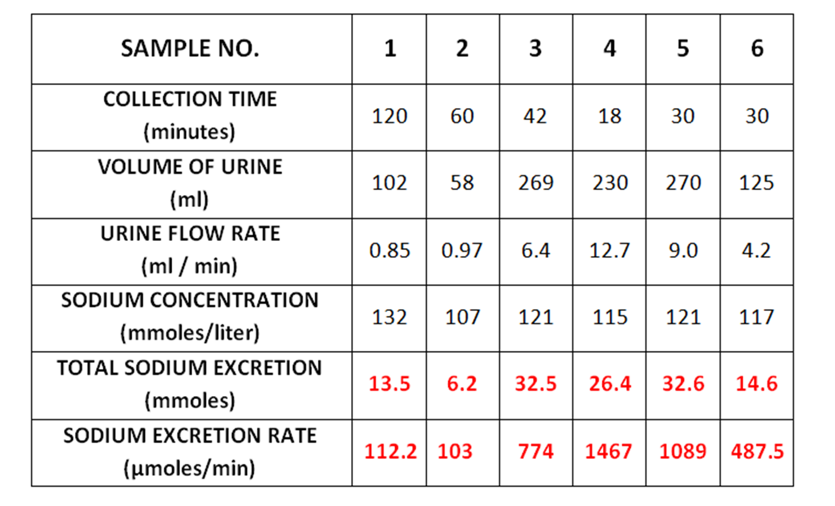
How to know this table belong to which case ?
Table 3
Comparing it to the graph
Usually we see 2 things in the chart : Urine flow rate & NA excretion rate.
Urine Flow Rate :
urine flow rates are dramatically increased for further duration of experiment.
NA excretion rate :
Sodium excretion rates are also dramatically increased for further duration of experiment.
So… This table express the 4th case because both urine flow rate and sodium excretion rate increased , this type of dieresis is called (OSMOTIC DIURESIS)

Slide 16
Summary of The Mechanisms *Important*
CASE 4 (Osmotic Diuresis) | CASE 3 | CASE 2 ( Water Diuresis ) | CASE 1
Swallowed a Lasix ( Furosemide ) tablet 40 mg with the help of 25 ml of water | Drink 1 liter of 0.9% saline ( isotonic saline ) | Drink 1 liter of water ( Water Diuresis ) | Fasting | Causes
↑ Urine ( sharp increase ) - No change in color | ↑ Urine ( gradual increase ) - No change in color | - ↑ volume of urine - Light color | - ↓ volume of urine - darker yellow in color (kidney try to conserve water) | Urine result
No change in osmolality | No change in osmolality | ↓ Plasma osmolarity | ↑ Plasma osmolarity | Osmolarity (Before compensation )
Mechanism of Drug : Acts on thick ascending limb of loop of Henle and blocks the Na-K-2Cl co-transport | - Increase Stretch on right atrium (volume receptor) - Stimulates ANP | Inhibits osmoreceptors ↓ ADH | Stimulates osmoreceptors ↑ ADH | Compensatory mechanism
Urine volume is higher than pre experimental level | Urine volume is higher than pre experimental level ( return to pre experimental after 24 hours ) | Urine volume return to pre experimental level | - | After 4 hours

Slide 17
Summery of The Whole Graphs if you understand it from the previous slides, skip it

Slide 18
Urine Samples Examination
When we get the sample we should look at :
Urine volume by → Measuring cylinder
Na+ and k+ concentration in the blood by → Flame Photometry
PH by → PH meter
Osmolality by → Osmometer
Volume (measuring cylinder)
PH (PH meter)
Sodium and potassium concentration (flame photometry)
Osmolality (Osmometer)

Slide 19
Calculation
السؤال الوحيد اللي متأكدين انه بيجي بإذن الله
DON’T FORGET TO WRITE THE FORMULA IN THE EXAM
Total sodium excretion is obtained by applying following equation:
Sodium excretion rate is obtained by applying the following equation:
كيف يجي السؤال : بيجيبون لكم الجدول فيه فراغ عند عينة معينة (رقم ٢ مثلا ) يا عند total Na excretion or Na excretion rate اللي عليكم :
١- تكتبوا القااااااااانوووووون اللي طالبينه منكم
٢- تعوضوا بالقانون من نفس العامود مثلا : هم طالبين من عينة ٢ المعلومات كلها تاخذوها من عينة ٢
٣- لا تنسون الوحدات
Example : determine the total sodium excretion and sodium excretion rate if : from the table? (note : we always make the calculation on post-experimental samples)
Solution : (let’s take sample no.2 for example )
Total NA excretion = 107 x 58 / 1000 → NA excretion = 6.2 mmol (You can check if it’s correct from the table )
Na excretion rate = 107 x 58 / 60 → NA excretion rate = 103.43 micro mole / min
DR.OLA : PLEASE Remember : ALWAYS WRITE THE FORMULA in the exam so if any thing went wrong (لا سمح الله ) at least you take a a mark on the formula .

Slide 20
GFR (Glomerular Filtration Rate)
DON’T FORGET TO WRITE THE FORMULA IN THE EXAM
Definition:
Is the volume of fluid filtered from the renal glomerular capillaries into the Bowman's capsule per unit time.
GFR =
According to the National Kidney Foundation, normal results range from 90 - 120 ml/min/1.73 m2. (unit)
Abnormal Results of GFR
A GFR < 60 mL/min/1.73 m2 for 3 or more months → chronic kidney disease.
A GFR < 15 mL/min/1.73 m2 → kidney failure.
The test is recommended in:
Diabetes
Family history of kidney disease
Frequent urinary tract infections
Heart disease , High blood pressure
Urinary blockage
DR.OLA : PLEASE Remember : ALWAYS WRITE THE FORMULA ON the exam so if any thing went wrong (لا سمح الله ) at least you take a a mark on the formula .

Slide 21
Creatinine Clearance (CCr)
DON’T FORGET TO WRITE THE FORMULA IN THE EXAM
Definition: The volume of blood plasma that is cleared of creatinine per unit time.
Abnormal results for CCr :
Acute tubular necrosis
Bladder outlet obstruction
Congestive heart failure
Dehydration
End-stage kidney disease
Glomerulonephritis
Kidney failure
Renal ischemia
Renal outflow obstruction
Shock
Normal values
Male: 97 to 137 ml/min.
Female: 88 to 128 ml/min
(UCr) = creatinine concentration in the collected urine sample
(V) = urine flow rate flow(mL) / time(min)
(PCr) = plasma concentration
Example:
A person has a plasma creatinine concentration of 0.01 mg/ml and in 1 hour produces 60ml of urine with a creatinine concentration of 1.25 mg/mL.
v
" قد جعل الله لِكُل شيءٍ قَدْرا".
❤‏‏مهما كان ثقيلًا ما تمُر به لا تقلق؛ لكِل شيءٍ مُنتهى
YEAR ONE IS DONE ✔✔✔✔✔✔

