Slide 1
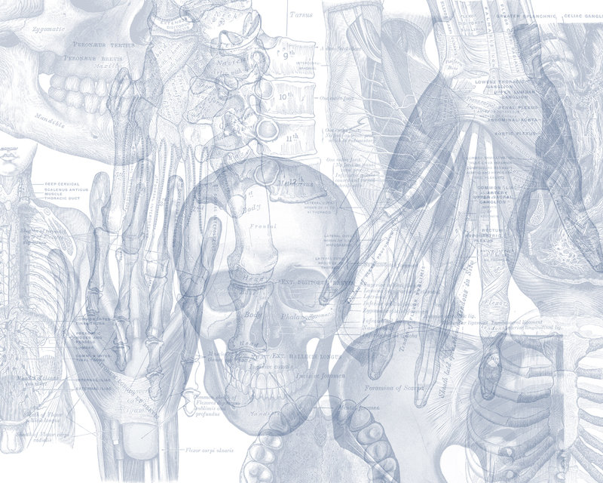
Anatomy of the Kidney
Color Code
Important
Doctors Notes
Notes/Extra explanation
Please view our Editing File before studying this lecture to check for any changes.

Slide 2
Objectives
By the end of this lecture you should be able to discuss the KIDNEY:
Shape & Position.
Surface Anatomy.
External Features.
Hilum And Its Contents.
Relations.
Internal Structure.
Blood Supply
Lymph Drainage.
Nerve Supply.

Slide 3
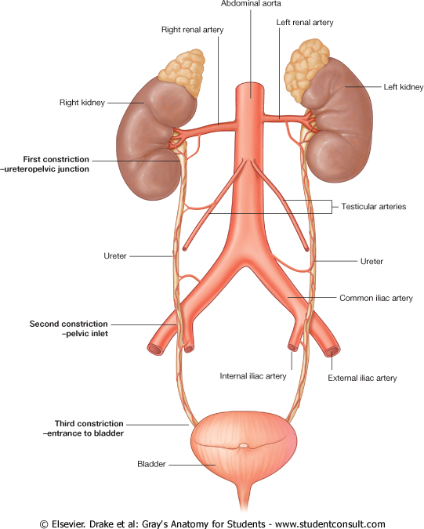
Introduction
Every day, each kidney filters liters of fluid from the bloodstream.
Although the lungs and the skin also play roles in excretion, the kidneys bear the major responsibility for eliminating nitrogenous (nitrogen-containing) wastes, toxins, and drugs from the body.
Functions of the kidney
Excretes most of the waste products of metabolism.
Controls water & electrolyte balance of the body.
Maintain acid-base balance of the blood.
Stimulate bone marrow for RBCs formation by Erythropoietin hormone.
Regulates blood pressure by Rennin enzyme.
Converts vitamin D to its active form.

Slide 4
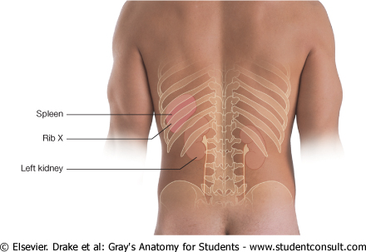
Kidney
Extra
Kidneys are reddish brown in color.
Lie behind the peritoneum (retroperitoneal*), on either side of the vertebral column on the posterior abdominal wall.
They are largely under cover of the costal margin.
The right kidney lies slightly lower than the left due to the large size of the right lobe of the liver.
The upper border of the right kidney is at the level of 11th intercostal space.
The upper border of the left kidney is a the level of the 11th rib.
*retroperitoneal: only the front of the kidney is covered by peritoneum.
Extra

Slide 5
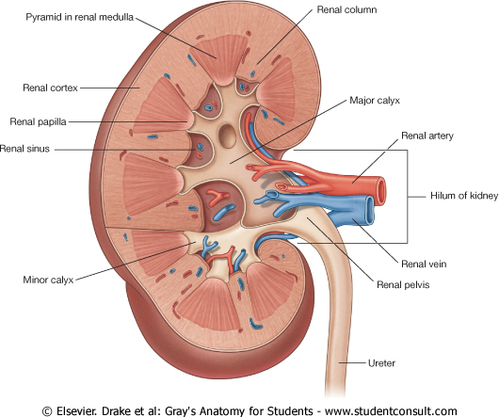
Kidney
With contraction of the diaphragm (inspiration) the kidney moves downward as much as 2.5 cm.
The lateral border is convex, while the medial border is convex at both ends but its middle part shows a vertical slit called the hilum.
The hilum extends into a large cavity called the renal sinus.
The hilum transmits (from anterior to posterior) the renal vein, two branches of renal artery, ureter, and the third branch of renal artery from the front backward (V.A.U.A.)
Lateral
Medial

Slide 6
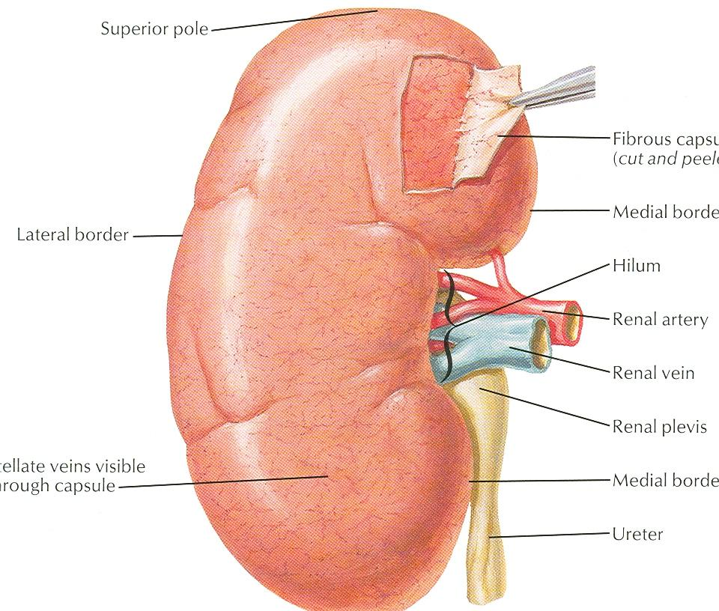
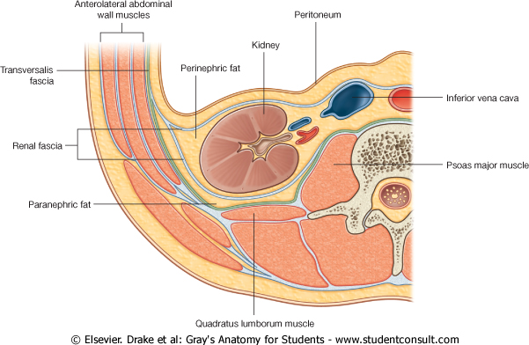
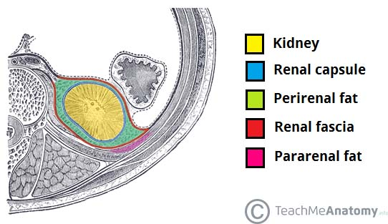
Kidney Covering
From inward to outward:
1- Fibrous capsule: It is adherent to (surrounds) the kidney.
2- Perirenal fat : It covers the fibrous capsule.
3- Renal fascia: it encloses the kidneys and suprarenal glands (but in different compartments).
4- Pararenal fat : it lies external to the renal fascia, and forms part of the retroperitoneal fat.
N.B. The last 3 structures support the kidney in position.
Perirenal fat → Inside
**في حالة الأشخاص اللي يسوون رجيم قاسي راح يتأثر عندهم الـ pararenal fat و بيصير بسببها الـ floating kidneys فلذلك راح يكون عندهم الم في أسفل الظهر بعد الهرولة أو الركض بسبب عدم ثبات الكليتين في مكانهم الطبيعي
Extra

Slide 7
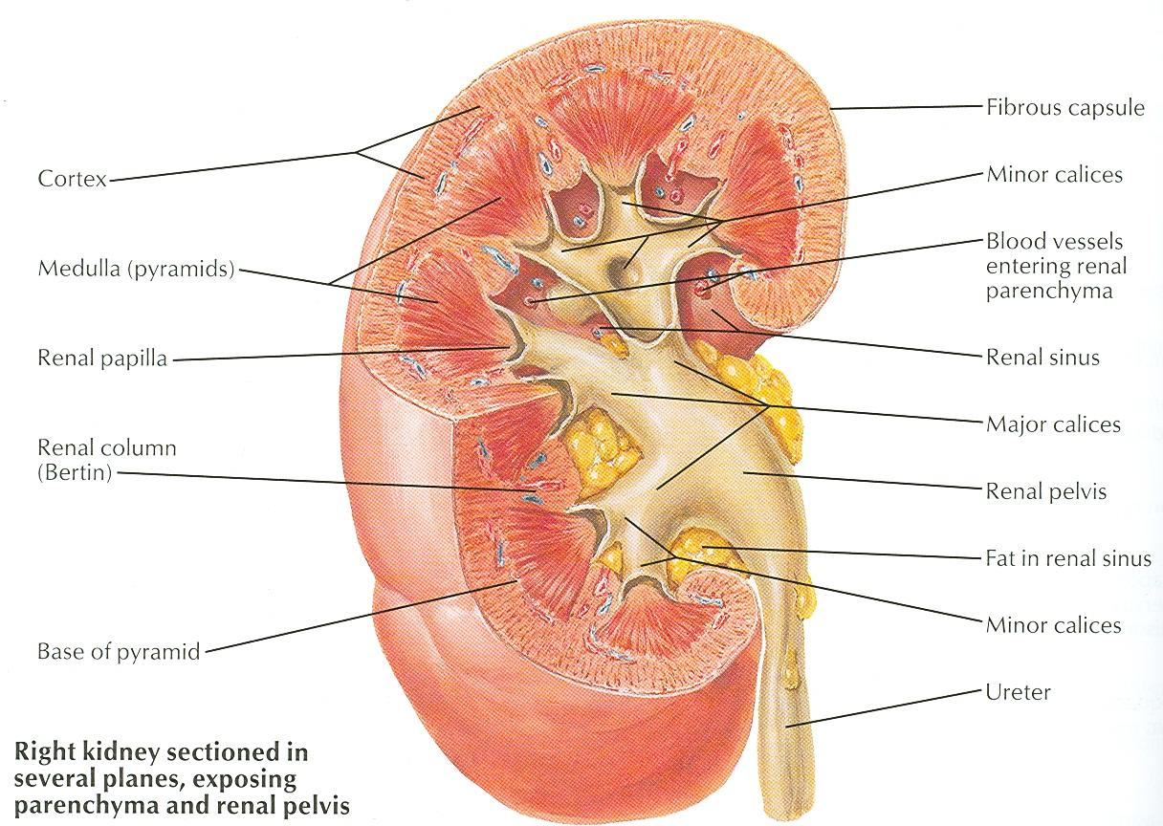
Kidney Structure
Each kidney has an outer cortex and an inner medulla.
Medulla is composed of about 12 renal pyramids.
The base of each pyramid is directed toward the cortex & its apex (the renal papilla) is projecting medially.
The cortex extends into the medulla between adjacent pyramids as the renal column.
Extending from the bases of the renal pyramids into the cortex are striations known as medullary rays.
The renal sinus within the hilum, contains the upper expanded end of the ureter: the renal pelvis.
Renal pelvis divides into two or three major calyces, which divides into two or three minor calyces.

Slide 8
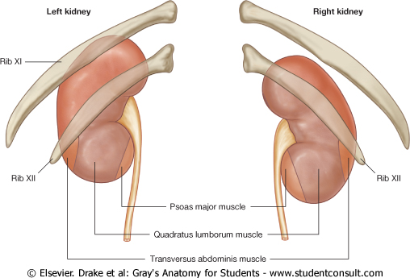
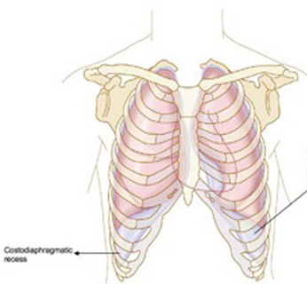
Kidney Posterior Relations
Structures :
Last intercostal space (11th)
Costodiaphragmatic pleural recess
Twelfth rib (The left kidney reaches up to the 11th rib )
4 Muscles median to lateral :
Diaphragm
Psoas major muscle
Quadratus lamborum
Transversus abdominis
3 Nerves :
Subcostal nerve (T12)
Iliohypogastric (L1)
Ilioinguinal (L1)
Extra

Slide 9
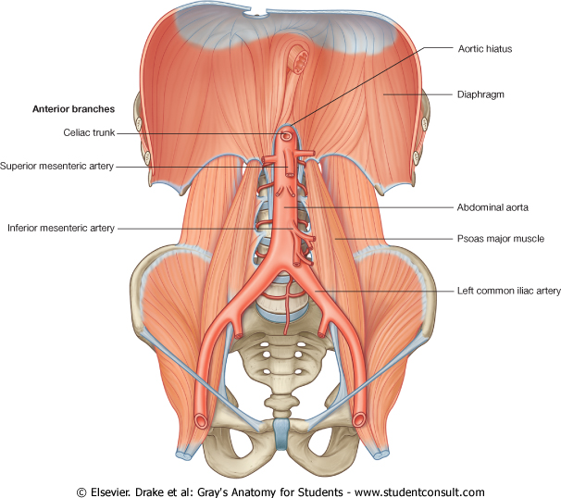
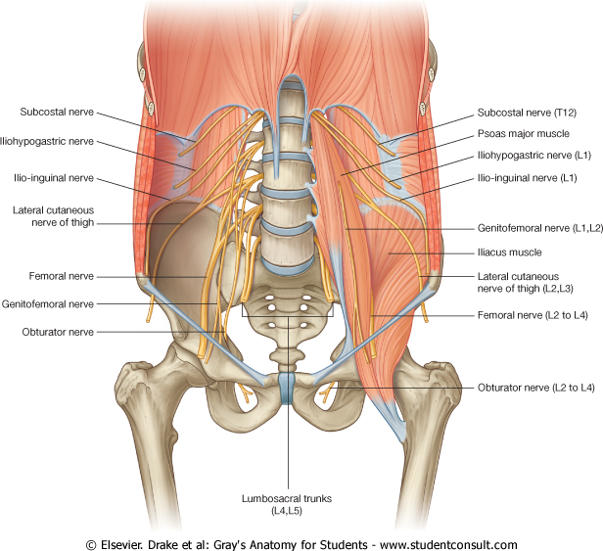
Kidney Posterior Relations
Quadratus lumborum
**You should know the location of each nerve and muscle
**It’s also important to know the normal location of the kidneys and the vessels, structures that surround it

Slide 10
Kidney Anterior Relations
IMPORTANT!
Peritoneum*
Right kidney:
1- Right suprarenal gland
2- Liver
3- Descending (second) part of duodenum
4- Right colic flexure
5- Coils of small intestine
Left kidney:
1- Left suprarenal gland 6-Descending colon
2- Stomach 7-colis of jejunum
3- Spleen
4- Pancreas
5- Left colic flexure
* The peritoneum is a continuous transparent membrane which lines the abdominal cavity and covers the abdominal organs. The anterior relations of the kidney are either directly on the kidney or lie on the peritoneum. The ones in bold are separated from the kidney by the peritoneum.

Slide 11
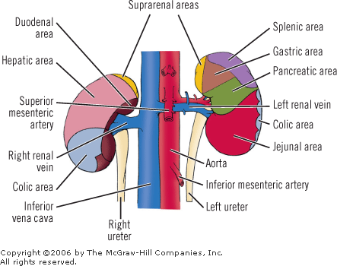
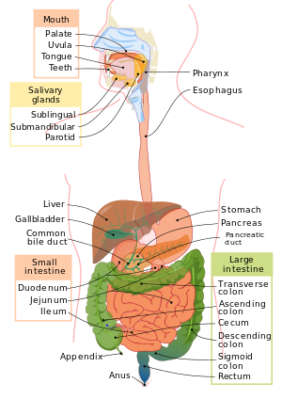
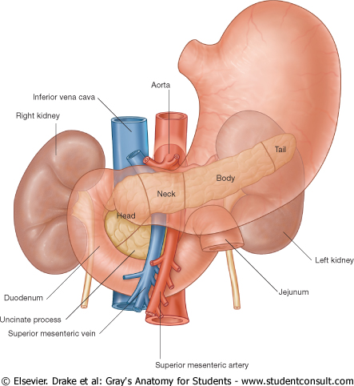
Extra Explanation
The course of the digestive tract:
Oral cavity → Pharynx → Esophagus → Stomach → Small intestines → Large intestines → Anus
The small intestines is divided into 3 parts:
Duodenum (the C-shaped part),
Jejunum (the coiled midsection),
Ileum (the last section)
The large intestines is also divided into 3 parts:
Cecum
Colon (ascending, transverse, descending)
Rectum.
The part where the ascending colon curves to form the transvers colon is called the right colic flexure, and the part where the transverse colon curves to form the descending colon is called the left colic flexure.
Extra
Extra

Slide 12
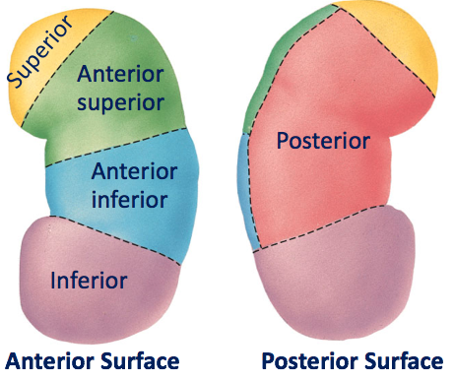
Kidney Segments
Only on the boys’ slides
Each kidney consists of 5 segments each having its own blood supply (4 anterior and 1 posterior):
1. Superior or Apical.
2. Anterior Superior.
3. Anterior Inferior.
4. Inferior or Basal.
5. Posterior or Caudal

Slide 13
Kidney Blood Supply
Renal artery
Divides to:
segmental arteries
Continues as:
Lobar arteries
Divides to:
Interlobar arteries
Divides to:
Arcuate arteries
Divides to:
Interlobular arteries
gives:
Afferent glomerular
arterioles

Slide 14
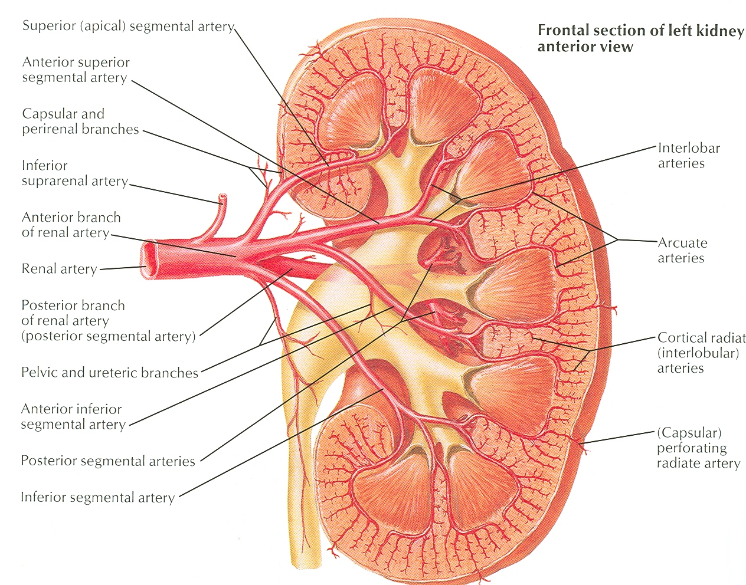
Kidney Blood Supply
Renal artery
The renal artery arises from the Aorta (abdominal Aorta) at the level of the second lumbar vertebra.
Segmental arteries
Each renal artery divides into five segmental arteries that enter the hilum of the kidney, four in front and one behind the renal pelvis.
They are distributed to different segments of the kidney, branches :
1-Apical segmental artery.
2-Anterior superior segmental artery.
3- Anterior inferior segmental artery.
4-Caudal segmental artery.
5-Posterior segmental artery.
Apical segmental artery
Anterior superior segmental artery.
renal artery
Anterior inferior segmental artery
Posterior segmental artery
Caudal segmental artery

Slide 15
Kidney Blood Supply
Lobar artery
Lobar artery arise from each segmental artery, one for each renal pyramid.
Inerlobar artery
Arcuate arteries
Each lobar artery gives off 2 or 3 interlobar arteries.
interlobar arteries
The interlobar arteries run toward the cortex on each side of the renal pyramid.
Interlobar arteries give off the arcuate arteries at the junction of the cortex and medulla.
arcuate arteries
The arcuate arteries give off several interlobular arteries.
Interlobular arteries
Interlobular arteries
Interlobular arteries give afferent glomerular arterioles.
Note: There is interLOBAR and interLOBULAR

Slide 16
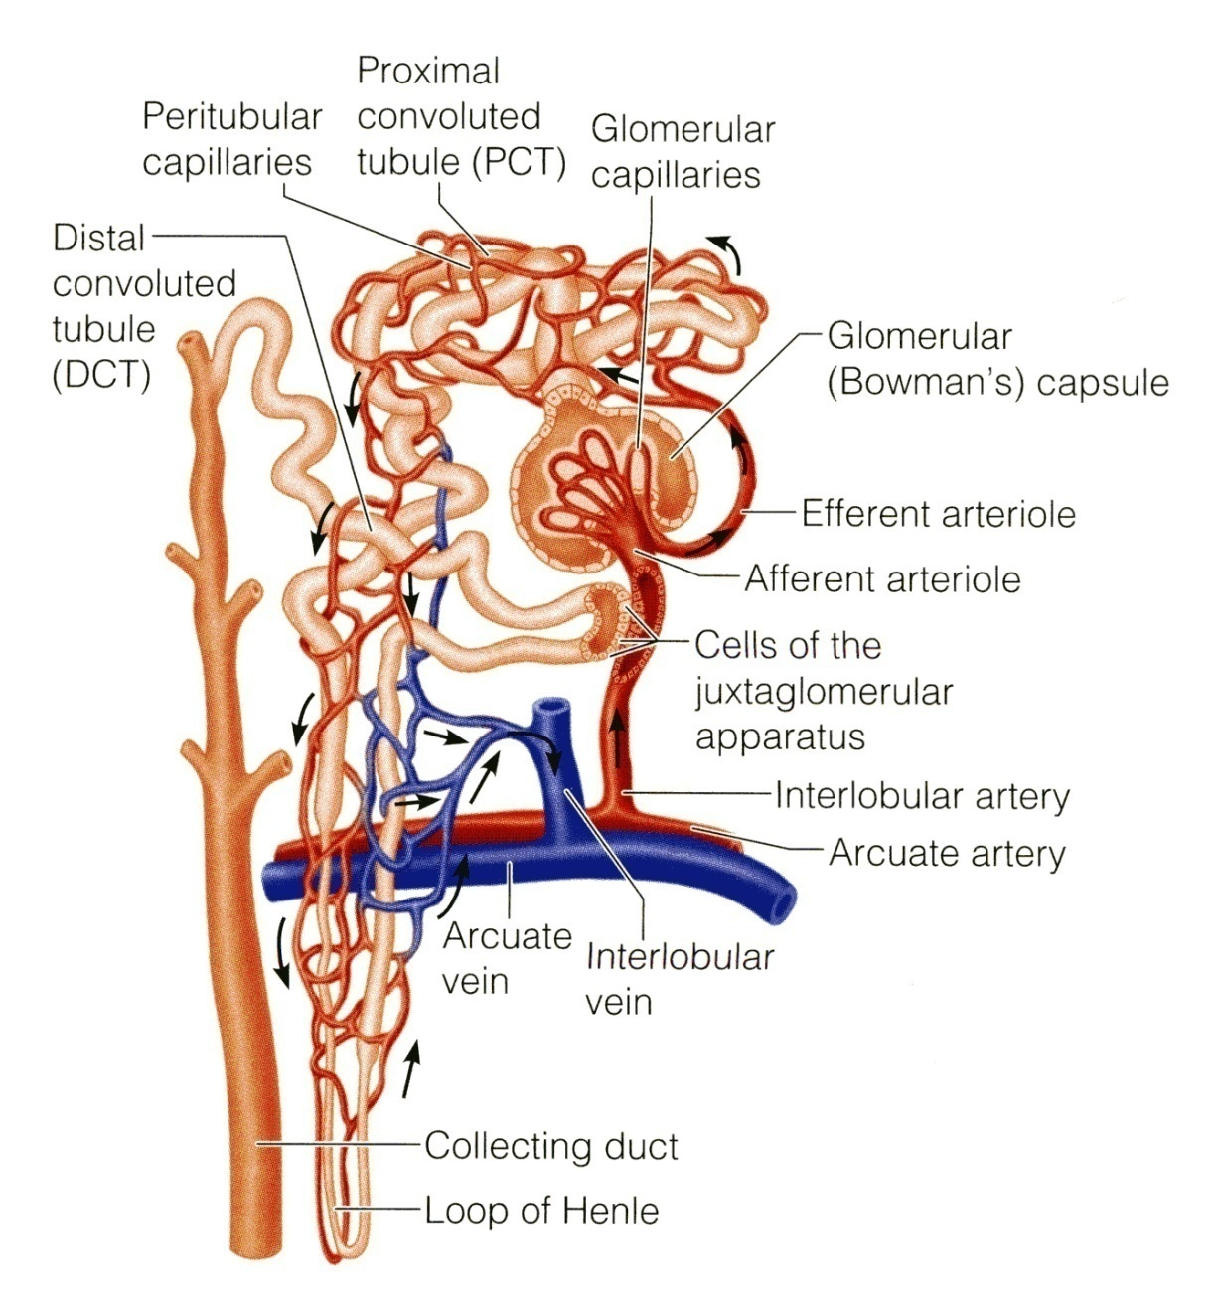
Kidney Blood Supply
Each Nephron is associated with two capillary beds:
The glomerulus
The peritubular capillary bed
The glomerulus is both fed and drained by arterioles.
The afferent arteriole, which arises from an interlobular artery, is the "feeder vessel“.
The efferent arteriole receives blood that has passed through the glomerulus.

Slide 17
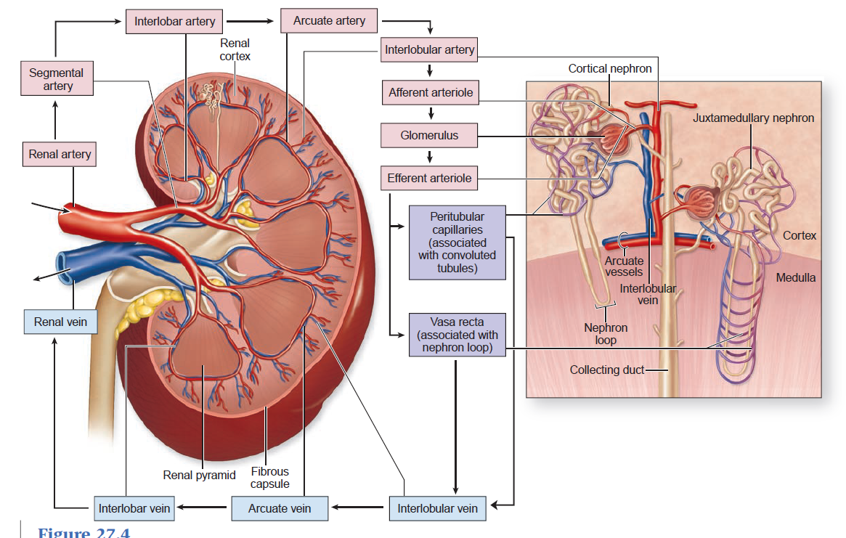

Slide 18
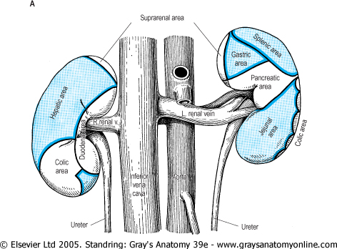
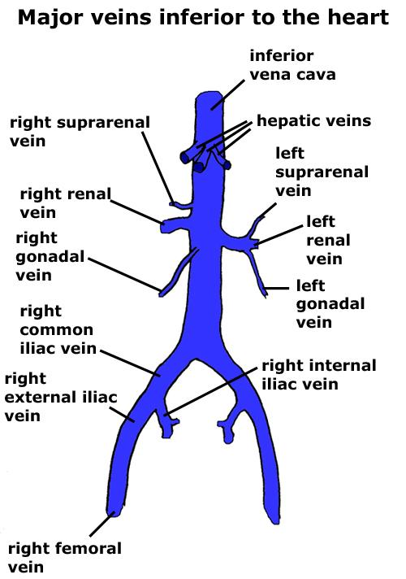
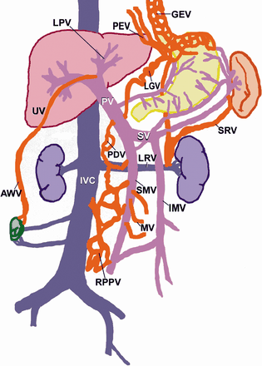
Kidney Venous Drainage
Both renal veins drain to the inferior vena cava in front of renal artery.
The left is three times longer than the right (7.5 cm and 2.5 cm). So, for this reason the left kidney is the preferred side for live donor nephrectomy (when a living person donates a kidney).
It runs from its origin in the renal hilum, posterior to the splenic vein and the body of pancreas, and then across the anterior aspect of the aorta, just below the origin of the superior mesenteric artery.
The left gonadal vein enters the left renal vein from below, while the left suprarenal vein enters it from above but nearer to the midline. (the right gonadal and suprarenal veins drain directly into the IVC)
The left renal vein enters the inferior vena cava a little above the right renal vein.
The right renal vein is behind the 2nd part of the duodenum and sometimes the lateral part of the head of the pancreas.

Slide 19
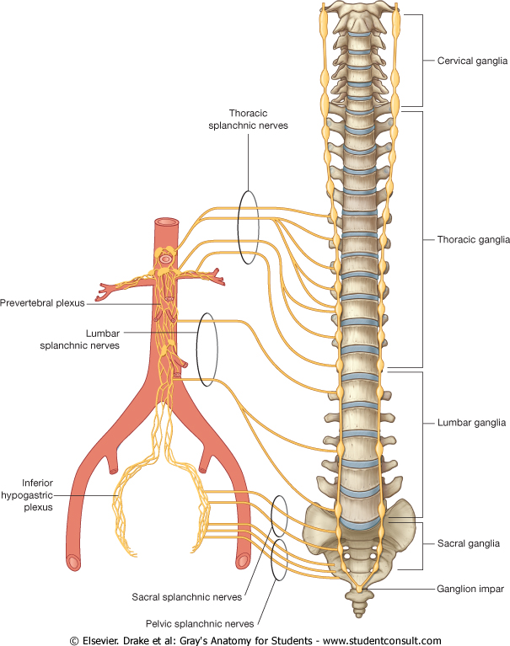
Kidney Supply
Lymph Drainage:
Lateral aortic lymph nodes around the origin of the renal artery.
(Also called: para-aortic or lumbar lymph nodes)
Nerve Supply:
Renal sympathetic plexus. (no parasympathetic)
The afferent fibers that travel through the renal plexus enter the spinal cord in the:
10th, 11th, and 12th Thoracic nerves.

Slide 20
MCQs
1- Which one of the following coverings does not play a role in supporting the kidney in position ?
fibrous capsule
renal facia
pararenal fat
perirenal fat
Answer: A
2- The …………………… contains the upper expanded end of the ureter, the renal pelvis.
Cortex.
Medulla.
Renal column.
Renal sinus.
Answer : D
3- At which level does the renal artery arise ?
1st Thoracic vertebra
2nd lumbar vertebra
1st lumbar vertebra
3rd lumbar vertebra
Answer : B
4- Which one of the following gives afferent glomerular arteries ?
Interlobar arteries
Interlobular arteries
Arcuate arteries
segmental arteries
Answer : B
5- Left renal vein runs behind which of the following veins?
Gonadal vein
Suprarenal vein
Splenic vein
Inferior vena cava
Answer : C
6. Which of the following is related to the left kidney anteriorly with peritoneum?
Left suprarenal gland
Spleen
Pancreas
Descending colon
Answer: B

Slide 21
SAQs
An obese person is undergoing a vigorous diet which one of his kidney coverings will be affected most and which condition will be apparent ?
Answer : Pararenal fat will be affected most , (floating kidney)
What are the capillary beds associated with Nephrons?
Answer: Glomerulus and Peritubular capillary bed

Slide 22
Leaders:
Nawaf AlKhudairy
Jawaher Abanumy
Members:
Yazeed Alsuhaibani
Hamad alkhudairy
Talal alhuqail
Abdulmohsen alghannam
Mohammed habib
Khaled aldakheel
Abdulaziz alsalman
Essam alshahrania
anatomyteam436@gmail.com
@anatomy436

