Slide 1
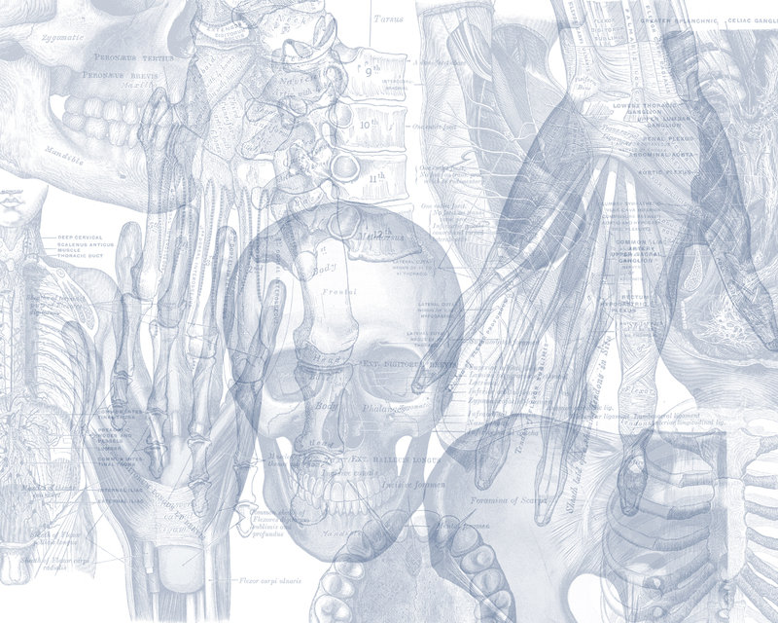
Ureters, Urinary Bladder, Urethra
Color Code
Important
Doctors Notes
Notes/Extra explanation
Please view our Editing File before studying this lecture to check for any changes.

Slide 2
Objectives
At the end of the lecture, students should be able to:
Describe the course of ureter & identify the site of ureteric constrictions.
Describe the important relations & identify certain areas (trigone, uvula vesicae) in the base of urinary bladder.
List the blood supply, lymphatic drainage & nerve supply of urinary bladder
Differentiate between male & female urethra regarding length, structure, course & function.

Slide 3
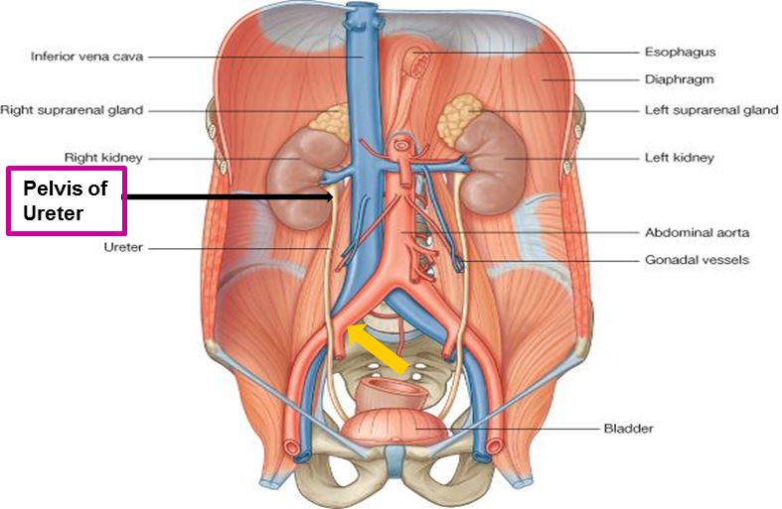
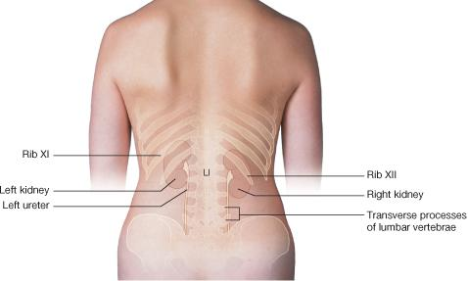
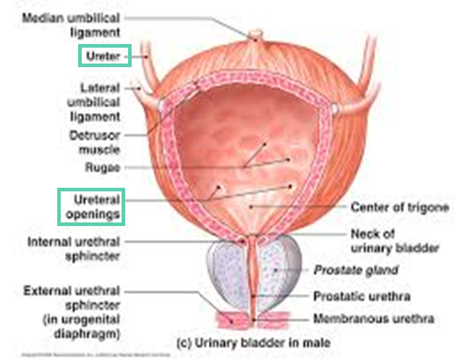
Ureter
DEFINITION: It is a muscular tube transporting urine from kidney to urinary bladder.
LENGTH: 25 – 30 cm
BEGINNING:
It begins as a continuation of renal pelvis (or pelvis of ureter).
COURSE IN ABDOMEN: Important
It descends anterior to psoas major muscle (opposite the tips of lumbar transverse processes).
It crosses anterior to the end (bifurcation) of common iliac artery to enter the pelvis.
COURSE IN PELVIS & TERMINATION:
It runs downward & backward to the level of ischial spine.
It curves forward to open in upper (superior) lateral angles of the base (posterior surface) of urinary bladder.
It runs obliquely for ¾ inch in wall of bladder before opening (this part acts like a valve which prevents urine from going back).

Slide 4
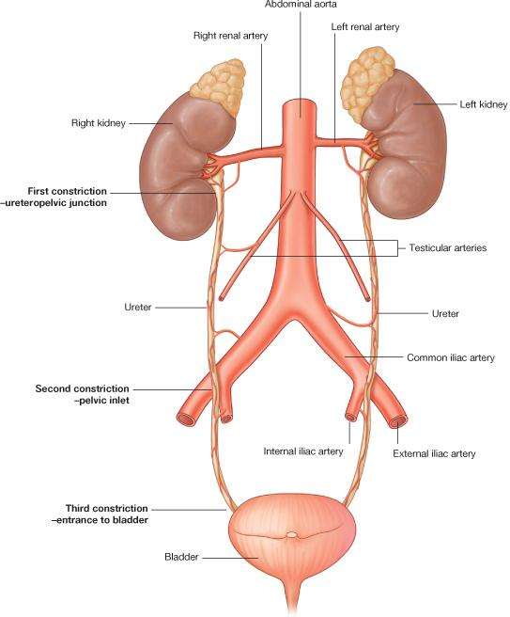
Ureter
Sites of Constrictions (Obstruction-stone* Impaction): Important!
At ureteropelvic** junction
At pelvic inlet
(site of crossing of common iliac artery)
At site of entrance to bladder
* sites were stones most commonly get stuck and cause obstruction
** between renal pelvis and ureter
Arterial Supply:
Renal artery
Gonadal artery
Common iliac artery
Internal iliac artery

Slide 5
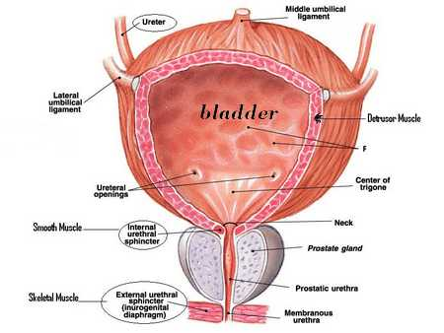
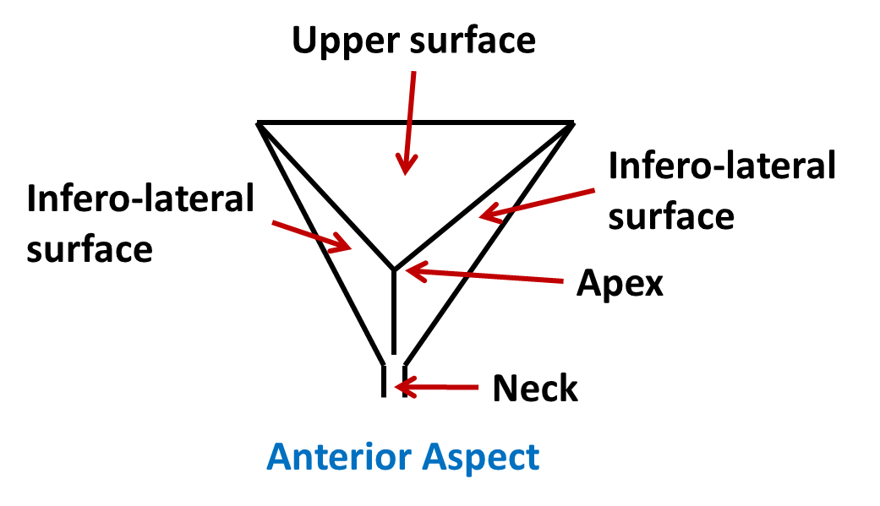
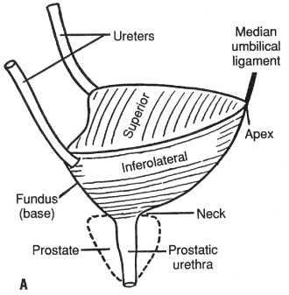
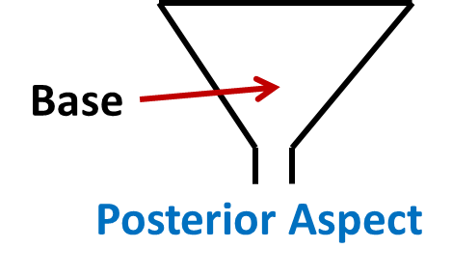
Urinary Bladder Shape
It is pelvic organ.
It has the shape of three-sided pyramid placed on one of its angle (NECK)*.
It has:
An apex: directed anteriorly
A base: directed posteriorly
A superior surface
Two infero-lateral surfaces
*Since the bladder is shaped like a pyramid that means it has an apex, a base, 3 surfaces (1 superior and 2 infero-lateral), and 3 angles. The angle it is resting on or sitting on is called the neck which is continuous with the urethra.
Extra

Slide 6
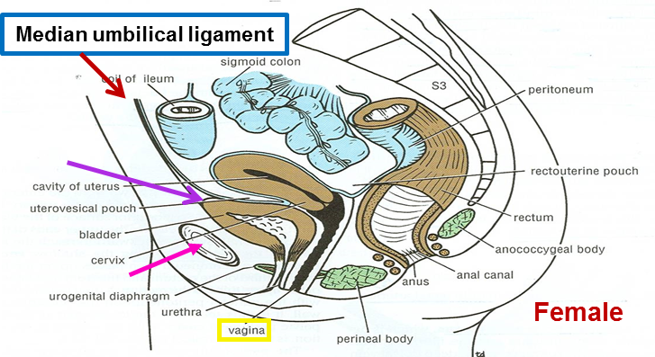
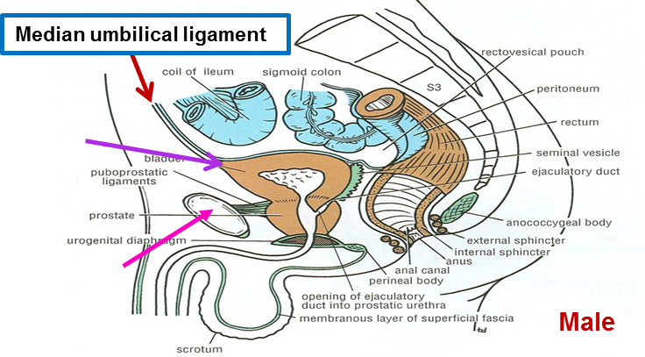
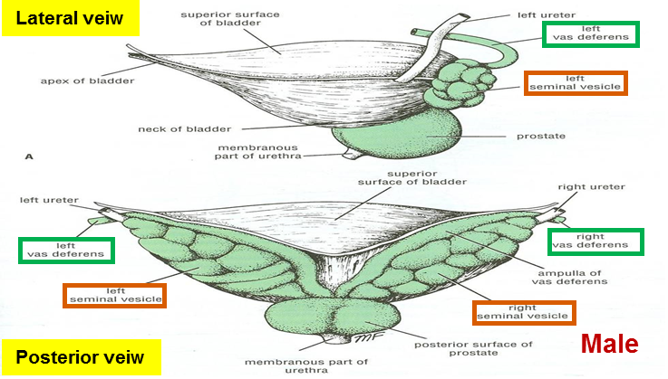
Urinary Bladder 1- Apex
The apex is directed forward.
It is related to (lies behind) upper border of symphysis pubis (in both male and female).
It is connected to umbilicus* by the median umbilical ligament (remnant of urachus in embryo).
* سرة البطن
2- Base
Is directed backward.
IN MALE: Is related to vas deferens & seminal vesicle of both sides.
IN FEMALE: Is related to vagina

Slide 7
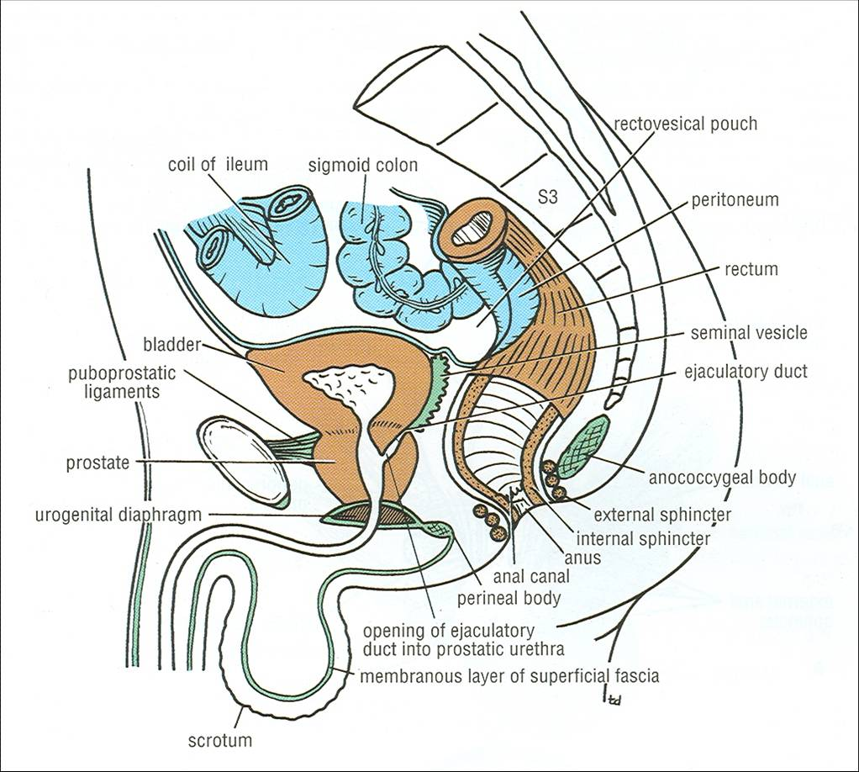
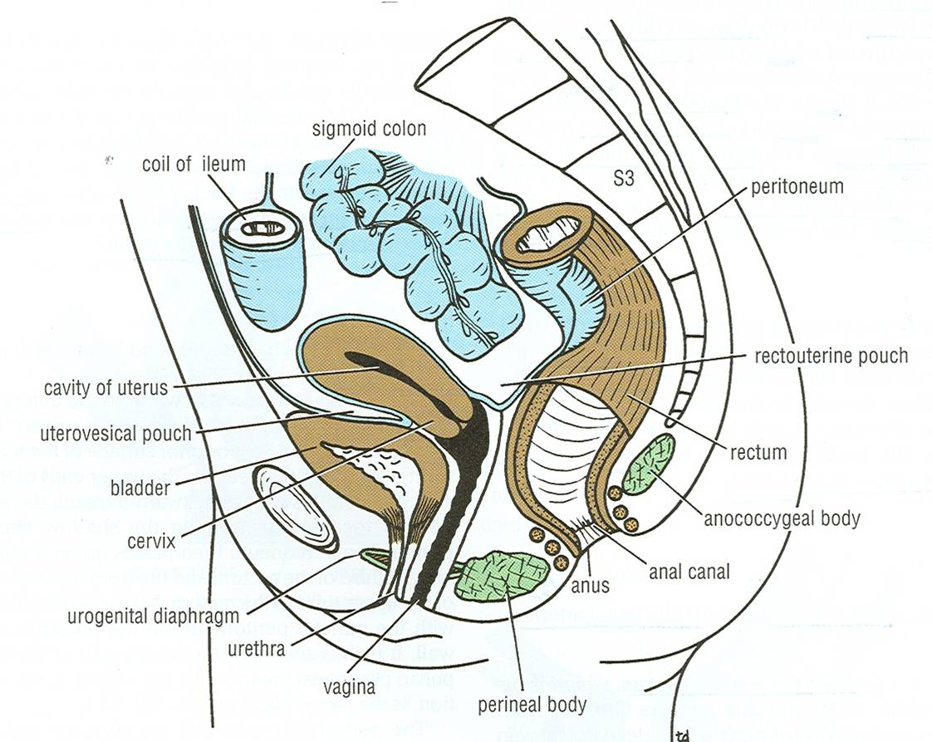
Urinary Bladder 3- Superior Surface
IN MALE:
Is related to coils of ileum & sigmoid colon.
IN FEMALE:
Is related to the uterus.
4- Infero-Lateral Surface
Male
Are related to retropubic fat separating them from pubic bones (in both male and female)
Retropubic fat
Accommodates distention* of bladder when full.
Continuous upward with anterior abdominal wall. Rupture of bladder → escape of urine to anterior abdominal wall
* انتفاخ
Female

Slide 8
Urinary Bladder Neck
The neck is the lowest & most fixed part of the urinary bladder.
It is continuous with urethra.
It is related to (lies behind) lower border of symphysis pubis* (in both male and female).
IN MALE:
It is related to upper surface of prostate gland (or we can say inferiorly, it rests on the base of prostate).
* unlike the apex which was related to the upper border of symphysis pubis
Male
Female

Slide 9
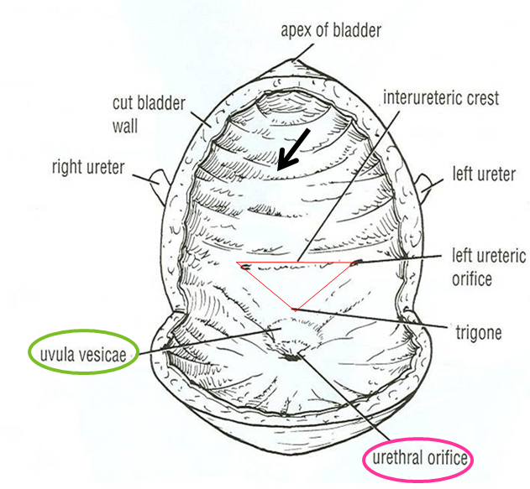
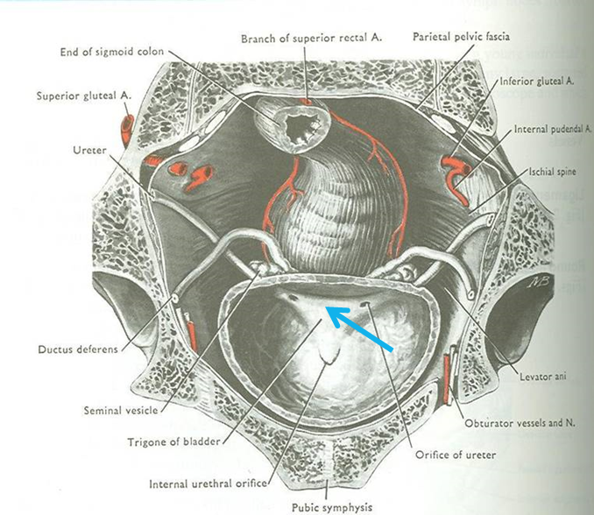
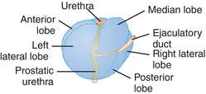
Urinary Bladder Interior
The interior of the urinary bladder is contains a mucous membrane that is folded (except at trigon).
There is an elevation behind the internal urethral orifice called uvula vesicae: it is produced by the median lobe of the prostate gland (so its only present in males)
Trigone: a triangular area in base of bladder.
Bounded by the 2 ureteric orifices (from the ureter) and internal urethral orifice (going to the urethera).
Its mucous membryane is elastic (not folded).
It is present in both male and female.
When the prostate undergoes hyperplasia the median lobe grows anteriorly and blocks or constricts the internal urethral orifice which leads to urinary symptoms (like decreased urination).
Extra

Slide 10
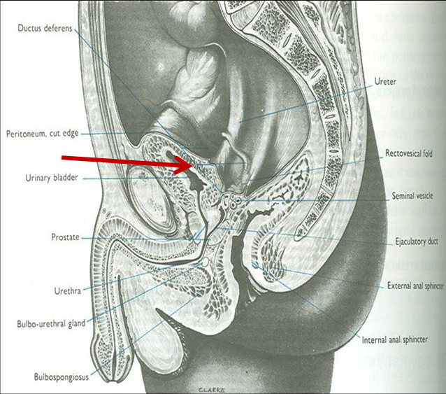
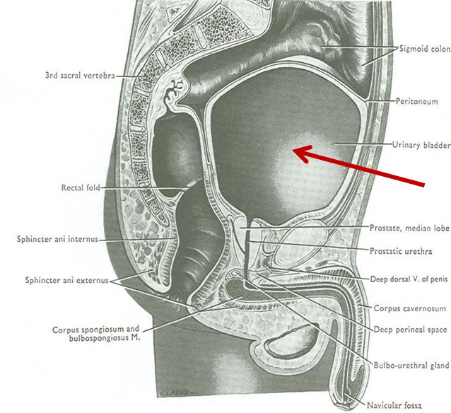
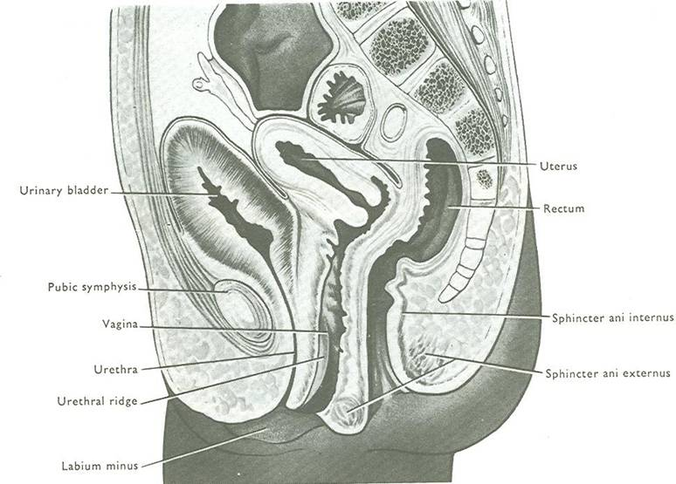
Urinary Bladder Capacity
Empty
Distended
EMPTY
Empty bladder is a pelvic organ.
Accommodates from 300 – 500 ml of urine.
DISTENDED
Is circular in shape,
Bulges into abdominal cavity.
Position (only on the boys’ slides)
Is found in abdomen until age of 6 years.
Begins to enter the enlarging pelvis from age of 6 years onward.
Is found entirely in pelvis at puberty.
A median sagittal section of
a newborn female child

Slide 11
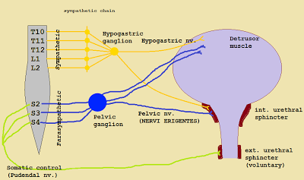
Urinary Bladder Supply
ARTERIES: from internal iliac artery
VEINS: into internal iliac vein
LYMPH: into internal iliac lymph nodes
NERVES:
Parasympathetic: through pelvic splanchnic nerves from S2, 3, 4.
Sympathetic: from L1,2 through hypogastric nerves.
Sensory: transmitting pain due to over distention of bladder (via general visceral afferent fibres from bladder to CNS).
Important!
Autonomic Regulation of the Bladder
urination involves coordination between the central, autonomic, and somatic (pudendal nerve) nervous systems.

Slide 12
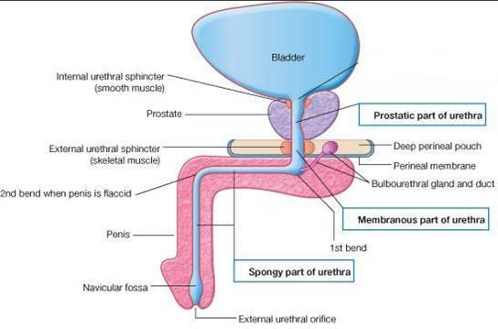
Urethra
Male
LENGTH: 20 CM.
Has 2 functions: urinary and genital and is divided into 3 parts:
PROSTATIC URETHRA (Length=3 cm):
Widest & most dilatable
Extends from neck of bladder inside prostate gland
Structures openings into prostatic urethra: Important
Ejaculatory ducts: containing sperms & secretion of seminal vesicles
Ducts of prostate gland
MEMBRANOUS URETHRA (Length=1 cm):
Surrounded by external urethral sphincter
PENILE (SPONGY) URETHRA (Length=16 cm):
Extends inside penis & opens externally through external urethral orifice (narrowest part of whole urethra)
Ejaculatory duct

Slide 13
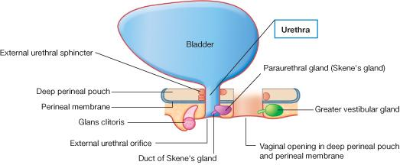
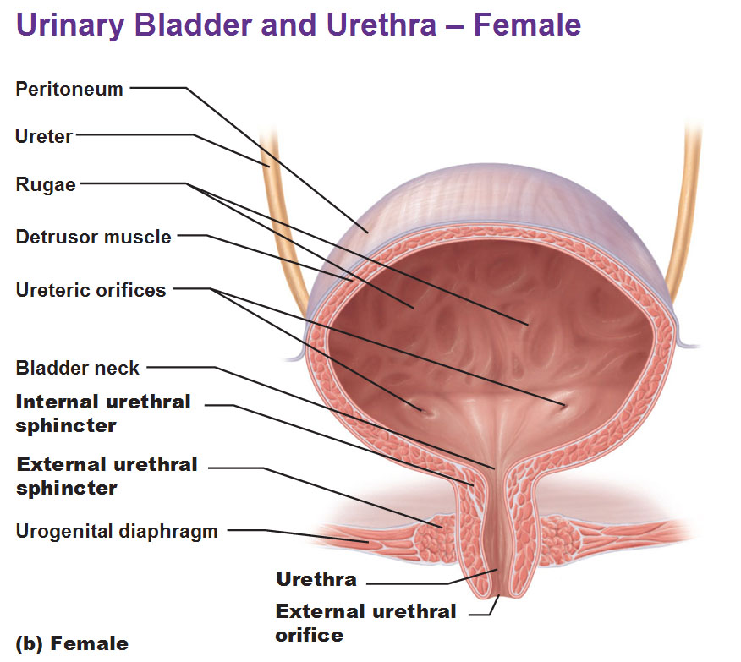
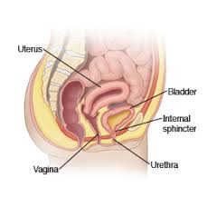
Urethra
Female
LENGTH: 4 CM
Has only urinary function.
Extends from neck of urinary bladder to open externally through the external urethral orifice (anterior to the vaginal opening).

Slide 14
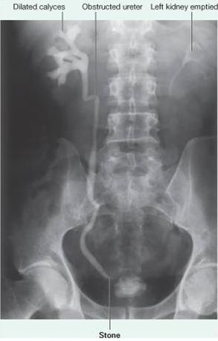
Intravenous Urogram
(IVU,IVP)
A urogram (Post micturation): demonstrates a bladder stone. Or any obstruction in the urinary system.
We use contrast media to determine the site of a stone in the urinary tract.
IVP: IntraVenous Pyelogram
Urogram: an imaging exam used to evaluate the urinary tract
Post micturition: after urination
In this image we can see that the left kidney was able to excrete the urine with the dye, while the right kidney was not able to due to an obstruction.

Slide 15
Summary
URETER | Beginning | Course | Termination | Sites of constriction | Arterial supply
 | continuation of renal pelvis | descends anterior to: psoas major & ends at (bifurcation) of common iliac artery. | opens at upper lateral angle of base of urinary bladder | at uteropelvic junction, at pelvic inlet, at site of entrance of bladder | renal, gonadal, common & internal iliac arteries
 | Function | Length | Course
MALE URETHRA | both urinary & genital | 20 cm, divided into prostatic (3 cm), membranous (1 cm) & penile ( 16 cm) | Extends from neck of bladder to open externally through external urethral orifice (narrowest part of whole urethra)
FEMALE URETHRA | urinary only | 4 cm | Extends from neck of bladder to external urethral orifice (anterior to vaginal opening)
URINARY BLADDER | Apex | Base | Superior surface | Inferolate-ral surfaces | Neck | Trigone | Uvula vesicae | Supply | Nerves
 | related to symphysis pubis, continuous with median umbilical ligament | related to vas deferens & seminal vesicle (in male) & to vagina (in female) | related to coils of ileum & sigmoid colon (in male) & to uterus (in female) | related to retropubic fat | continuous with urethra, related to upper surface of prostate gland (in male) | lies in the base of bladder, bounded by ureteric orifices & internal urethral orifice, its mucous membrane is elastic | dilatation behind internal urethral orifice, produced by the median lobe of the prostate gland | internal iliac (artery, vein, lymph nodes) | parasympathetic (S2,3,4), sympathetic (L1,2)
 | A slight projection into the cavity of the bladder just behind the urethral opening, marking the location of the middle lobe of the prostate gland.

Slide 16
MCQs
1. The ureter is a continuation of:
A- the renal cortex
B- the renal medulla
C- the renal pelvis
D- the nephron
Answer: C
2. Which one of these arteries is NOT supplying the ureter:
A- external iliac artery
B- internal iliac artery
C- gonadal artery
D- common iliac artery
Answer: A
3. The apex of the bladder is directed:
A- anterior
B- posterior
C- lateral
D- internal
Answer: A
4. The base of the bladder in female is related to:
A- uterus
B- vagina
C- the colic of ileum
D- vas deferens & seminal vesicle
Answer: B
5. The uvula vesicae is found in :
A- female
B- male
C- both male and female
D- none of the above
Answer: B
6. The triangular area inside the urinary bladder is called:
A- uvula vesicae
B- the base
C- the apex
D- trigone
Answer: D
7. The Parasympathetic supply of the bladder originates from:
A- S1, S2, S3
B- L1, L2
C- S2, S3, S4
D- hypogastric nerves.
Answer: C
8. If there is rupture in the urinary bladder the urine will go to:
A- anterior of the abdominal wall
B- posterior of the abdominal wall
C- the neck
D- the liver
Answer: A

Slide 17
SAQs
1. What are the constriction areas in the ureter ?
1. At ureteropelvic junction
2. At pelvic inlet
3. At site of entrance to bladder
2. What are the regions of the urethra in male ? And identify 2 structure opening in one of these regions?
The regions:
1- the prostatic region
2- the membranous region
3- the penile (spongy) region
The opening:
At the prostatic region there are 2 ducts:
1- ducts of prostatic gland
2- the ejaculatory duct
3. What are related to the superior surface of the bladder in male and female ?
male | female
coils of ileum & sigmoid colon | the uterus

Slide 18
Leaders:
Nawaf AlKhudairy
Jawaher Abanumy
Members:
Allulu Alsulayhim
Lama Alfawzan
Safa Al-Osaimi
Wejdan Alzaid
anatomyteam436@gmail.com
@anatomy436

