Slide 1
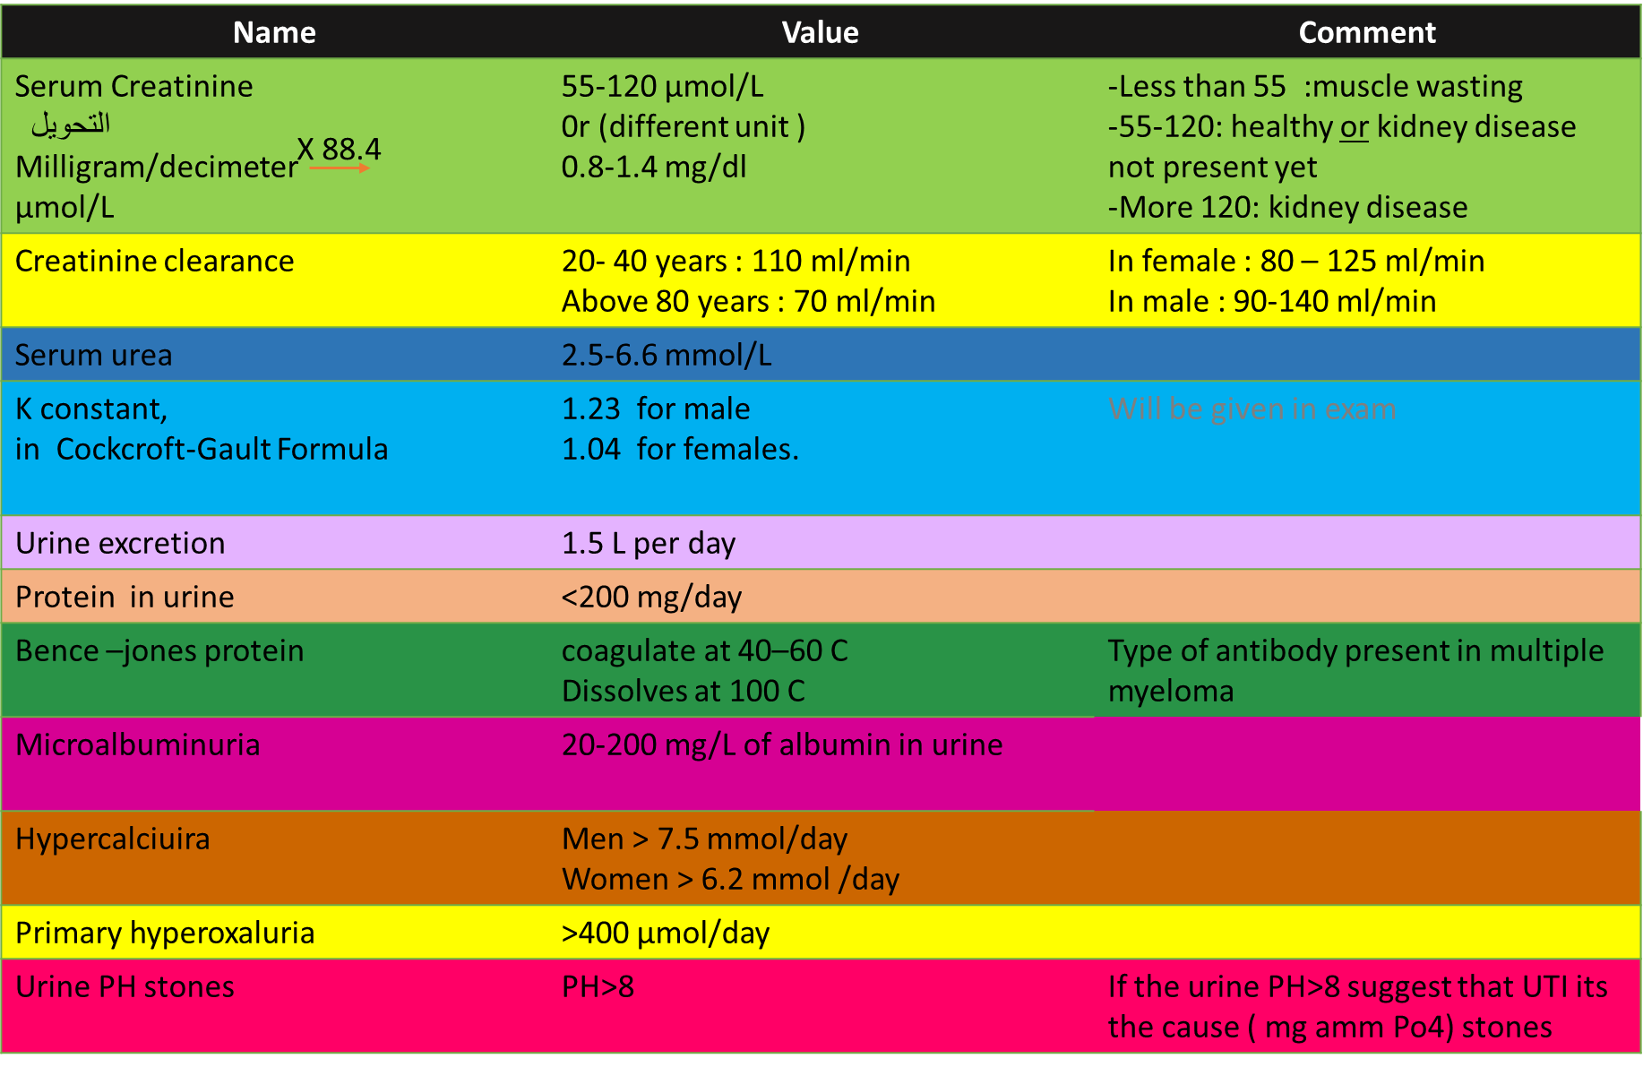
Values

Slide 2
Name | Value
SODIUM | 135 to 145 mEq/L
POTASSIUM | 3.5 to 5.5 mEq/L
CHLORIDES | 100 to 110 mEq/L
BICARBONATE | 24 to 26 mEq/L
CALCIUM | 8.6 to 10 mg/dl
MAGNESIUM | 1.6 to 2.4 mg/dl
PHOSPHORUS | 3.0 to 5.0 mg/dl
URIC ACID | 2.5 to 6.0 mg/dl
pH | 7.4
CREATININE | 0.8 to 1.4 mg/dl
BUN (Blood Urea Nitrogen) | 15 to 20 mg/dl
Done By :
Haifa alwael

