Slide 1
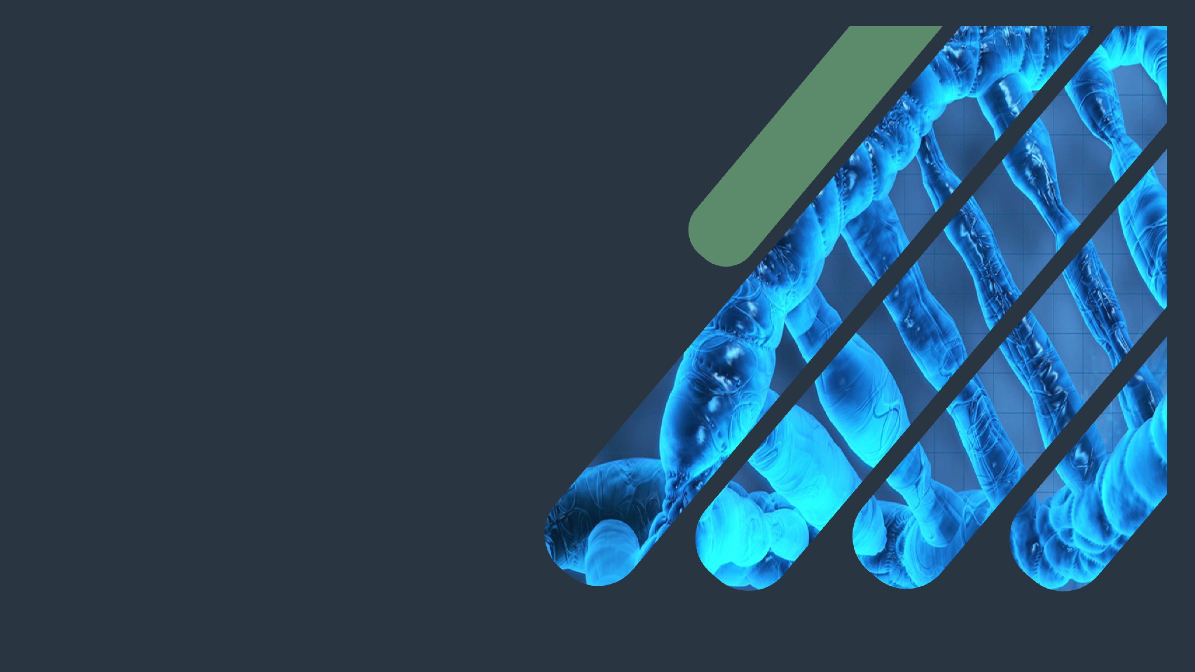
Biochemistry
Kidney Function Test
Worrying doesn’t take away tomorrow’s troubles ..
It takes away today’s peace .
Important.
Extra Explanation.
Doctors slides.
Doctors notes.

Slide 2
OBJECTIVES:
By the end of this lecture you will be able to:
know the physiological functions of the kidney.
describe the structure and function of the nephron.
identify the biochemical kidney function tests with special emphasis on when to ask for the test, the indications and limitations of each kidney function tests.
interpret the kidney function tests properly.

Slide 3
What are Nephrons
The nephron and its blood supply
The nephron is the functional unit of the kidney.
Each kidney contains about 1,000,000 to 1,300,000 nephrons.
The nephron is composed of glomerulus and renal tubules.
The nephron performs its homeostatic function by ultra filtration at glomerulus and secretion and reabsorption at renal tubules.
Laboratory and radiology tests complete each other in diagnosis especially kidney diseases .

Slide 4
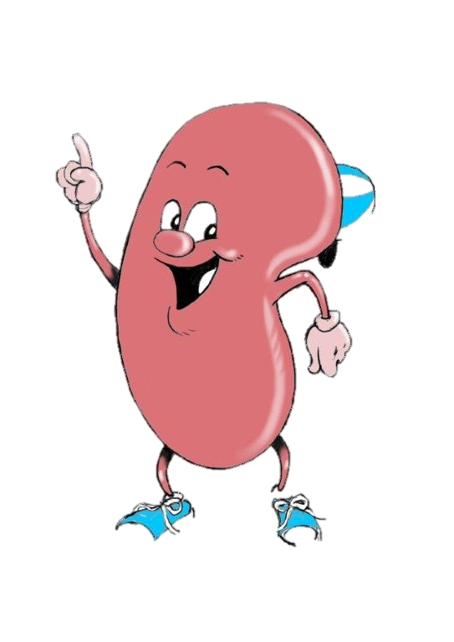
Kidney functions
IMPORTANT
Regulation of the following :
water and electrolyte balance.
acid base balance.
arterial blood pressure.
Excretion of metabolic waste products and foreign chemicals.
3. Hormonal Function : Secretion of erythropoietin & activation of vitamin D and activation of angiotensinogen by renin .
4. Metabolic Function : site for gluconeogenesis .
These metabolic wastes will be converted to intoxic (inactive) metabolites in the liver (catabolism reaction), then excreted in the urine by the kidney .
Formation of glucose from non carbohydrate precursors.

Slide 5
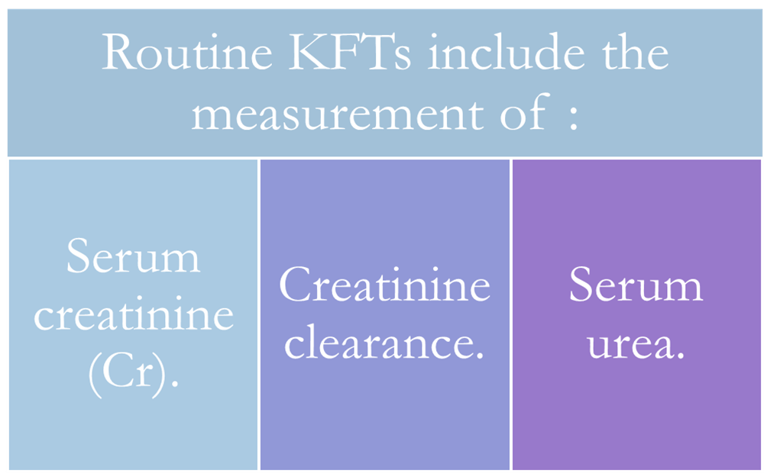
Why to test renal functions ?
Kidney function test
KFT divided into routine and special tests ..
1. Many diseases affect renal functions . ( In some, several functions are affected . In others, there is selective impairment of glomerular function or one or more of tubular functions .)
They are arranged from the most to the less important
2. Most types of renal diseases cause destruction of complete nephron. This happens when it becomes a chronic disease and lead to renal failure .
Both serum Cr and creatinine clearance are used as kidney function tests to :
To check for the response of the treatment before and after dialysis
We use it as a general management and indication to the body functions ..
Important

Slide 6
Serum Creatinine
ضروري نقيسه لانه يقيس لك مقدار الفيلتريشن
Serum Creatinine
Normally (55-120 µmol/L in adult):
Creatinine is the end product of creatine catabolism.
98% of the body creatine is present in the muscles where it functions as store of high energy in the form of creatine phosphate.
About 1-2 % of total muscle creatine or creatine phosphate pool is converted daily to creatinine through the spontaneous, non enzymatic loss of water or phosphate.
Doctor told that you must know how to convert
mg/dl to µmol/L
and vise versa
So to convert
mg/dl to µmol/L
Multiply the value by 88.4 .
Males & people with sedentary life style & vegetarians have lower creatinine levels, Usually each person (Male or Female) or (Athlete or non athlete) have their own different Creatinine levels.
بما أن عملية التحويل من كرياتين إلى كرياتينين تحدث بدون إنزيمات بكذا نقدر نتأكد أن المشكلة مو من العضلة فهي من الكلية نفسها .
X 88.4
In some cases there may be renal impairment with out increase in creatinine levels (usually in early stages)
milligram\deciliter
µmol/L
Divide over 88.4

Slide 7
Serum Creatinine
That means if we eat meat
It won’t rise creatinine in
our plasma, because it will
be degraded and may be
excreted in feces.
Serum Creatinine
not reabsorbed by the renal tubules.
endogenous substance not affected by diet.
filtered freely at the glomerulus and secreted by renal tubules ( 10 % of urinary creatinine )
In the plasma it remains fairly constant throughout the life.
That means the serum creatinine test is
better than creatinine clearance.
إذا افترضنا أن الشخص شرب الكثير من الماء، راح يزيد معدل التبول عنده وبالتالي يقل تركيز الكرياتينين في
البول ، لكن إذا قلت نسبة شرب الماء راح تقل نسبة التبول لأن السوائل قلت ، وبالتالي راح يزيد تركيز الكرياتينين في البول، ومن هذا نستنتج أن هذا الاختبارغير ثابت مقارنة بالسيرم الذي يكون ثابت طول حياة الفرد
Afferent arteriole is more dilated → it has higher pressure →the filtration takes place (not passive nor active transport)
* for example: if we have 100 µmol/L creatinine in blood, it will be 110 µmol/L in urine due to the secretion of 10%. So we have more creatinine in urine than blood.

Slide 8
Serum Creatinine
The amount of creatinine in the blood depends on the amount of muscle tissue .
Men tend to have higher creatinine level than women .
Spontaneous and non enzymatic to accurately indicate renal function .
Creatine is converted to creatinine by the loss of water .
Creatine phosphate is converted to creatinine by the loss
of phosphate group .
High serum creatinine > the kidney is not working as it should .
A- Scr less than 55 : muscle wasting disease.
B- Between 55-120 :
1) normal healthy individual
2) there is kidney problem but it’s not obvious yet.
*if it is 50 it is considered to be normal but the
person is not taking enough protein.
C- More than 120 :renal impairment

Slide 9
Creatinine clearance
نشوف كمية السيرم او البلازما الي صار له فيلتريشن ونظف من الويست الي موجودة فيه
The glomerular filtration rate (GFR) provides a useful index of the number of functioning glomeruli.
It gives an estimation of the degree of renal impairment by disease.
Accurate measurement of GRF by clearance tests requires determination of the concentration in plasma and urine of a substance that is:
The test is done on both a blood sample and on a sample of urine collected over 24 hours
This is not the case for creatinine but not necessary to have all these features so Creatinine meets most of the criteria.
مو كل المواد ينفع نستخدمها لقياس ال GFR
لأن بعضها يعاد امتصاصه أو تفرز زيادة أو تتأثر بعوامل كثيرة ما تخليها مقياس دقيق للاستخدام وبكذا كل ما تطابقت مواصفات المادة مع النقاط هذي بتصير أدق ..

Slide 10
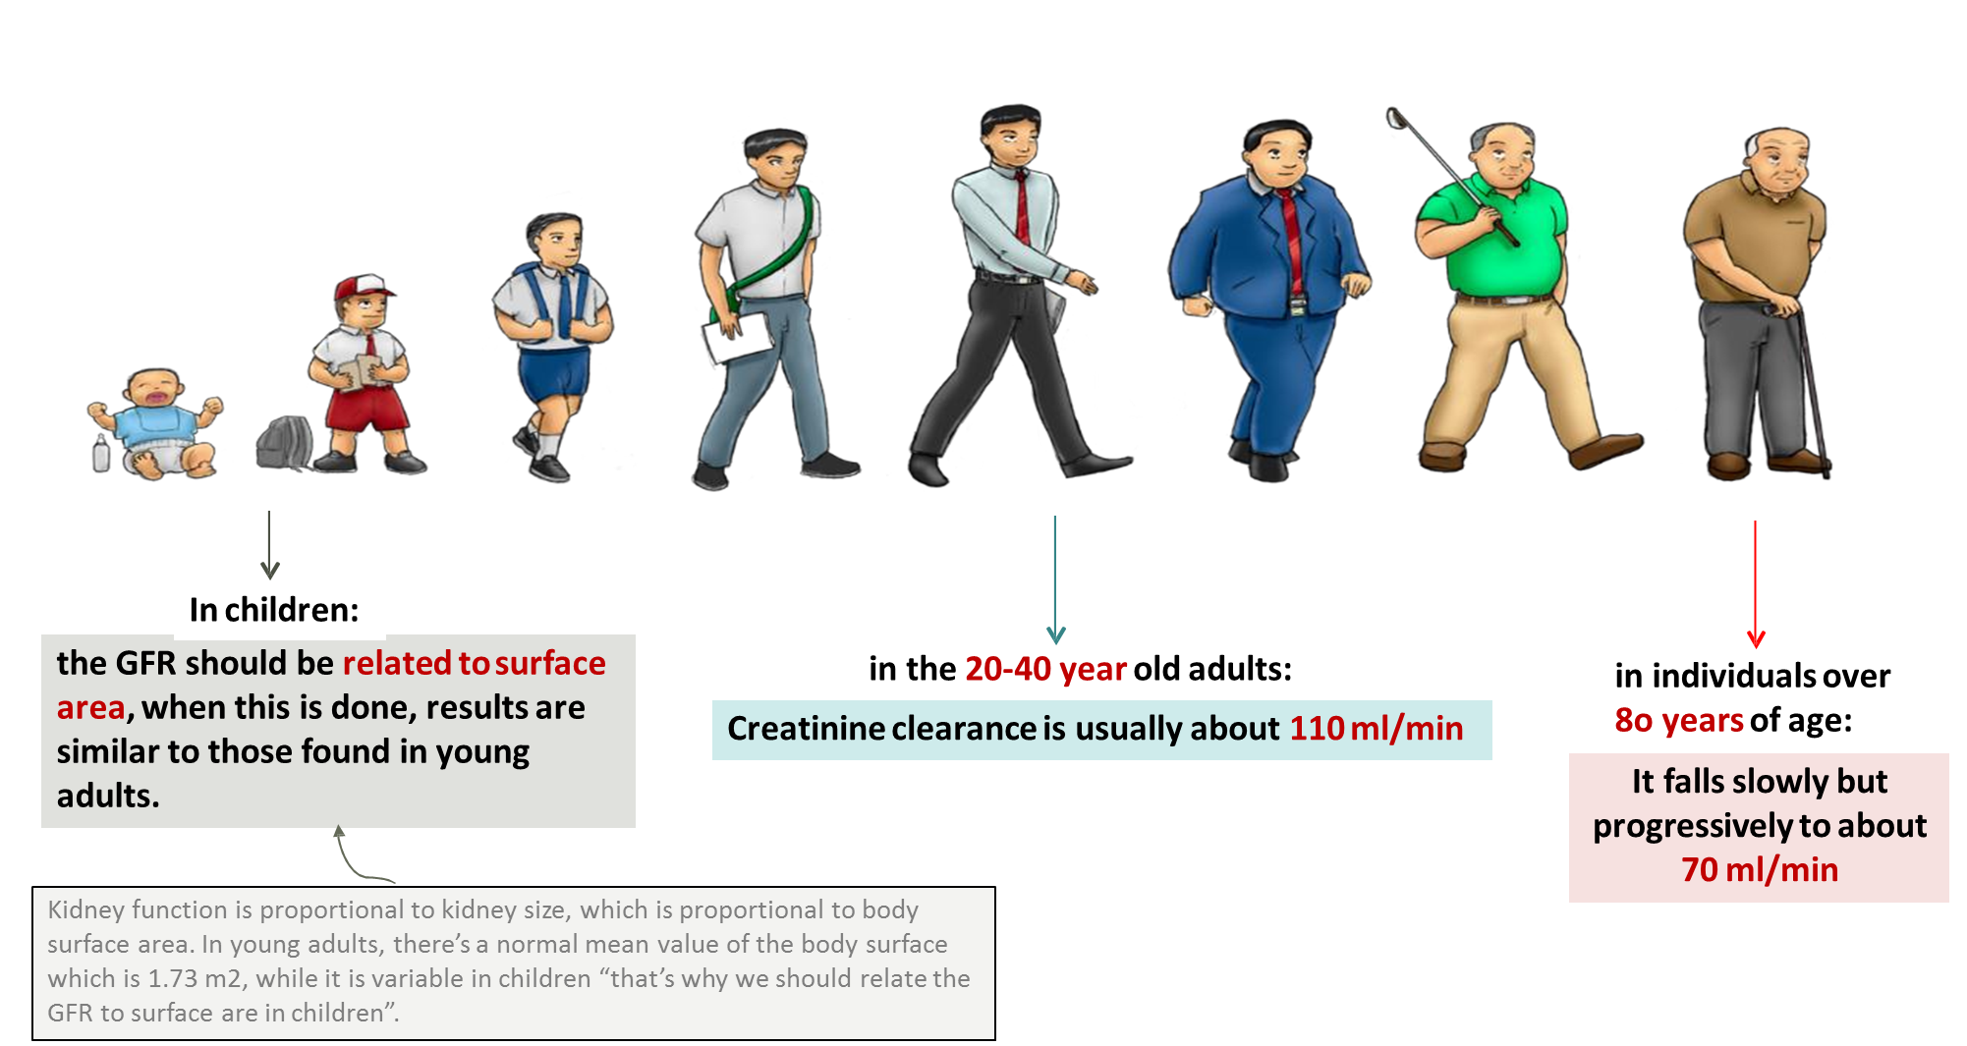
Creatinine clearance
435
Creatinine clearance represents a rate unlike serum creatinine thus its unit must be per unit time > minute

Slide 11
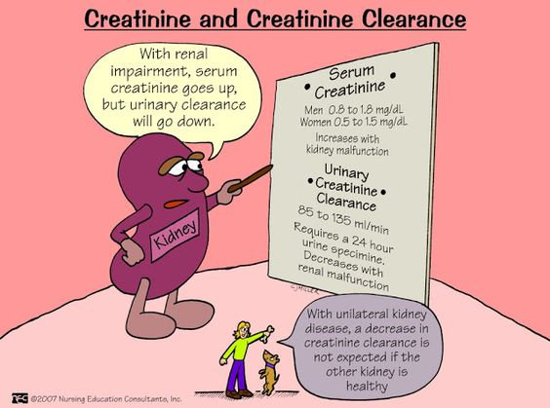
Creatinine clearance
Clearance is the volume of plasma cleared from the substance excreted in urine per minute.
It could be calculated from the following equation:
U = Concentration of creatinine in urine μmol/l
V = Volume of urine per min
P = Concentration of creatinine in serum μmol/l
Clearance (ml/min) = U × V
P
In the exam don’t forget to make sure that it has the correct units ..
ليست دقيقة بسبب أن المريض ممكن ما يطلع معه الناتج الصحيح لأنه بيقعد يجمع يورين لوقت طويل .. بسببها أوجدوا معادلة
Cockcroft-Gault Formula

Slide 12
Cockcroft-Gault Formula for Estimating GFR
(for example when some patients hang out without their container and they go to bathroom, so they didn’t urinate in the container so there will be error in the final urine volume. Also some patients may add water to the container which damages the sample).
As indicated above, the creatinine clearance is measured by using a 24-hour urine collection, but this does introduce the potential for errors in terms of completion of the collection.
فمن هالمنطلق اخترعوا معادلة بسيطة تغنيهم إلى حد ما عن تجميع اليورين .
This formula is good because we excluded urine and replaced it by easier parameters
(because we need to measure the urine volume, and once we give the patient the urine container we take a blood sample from him at the same time to measure the creatinine in the blood),

Slide 13
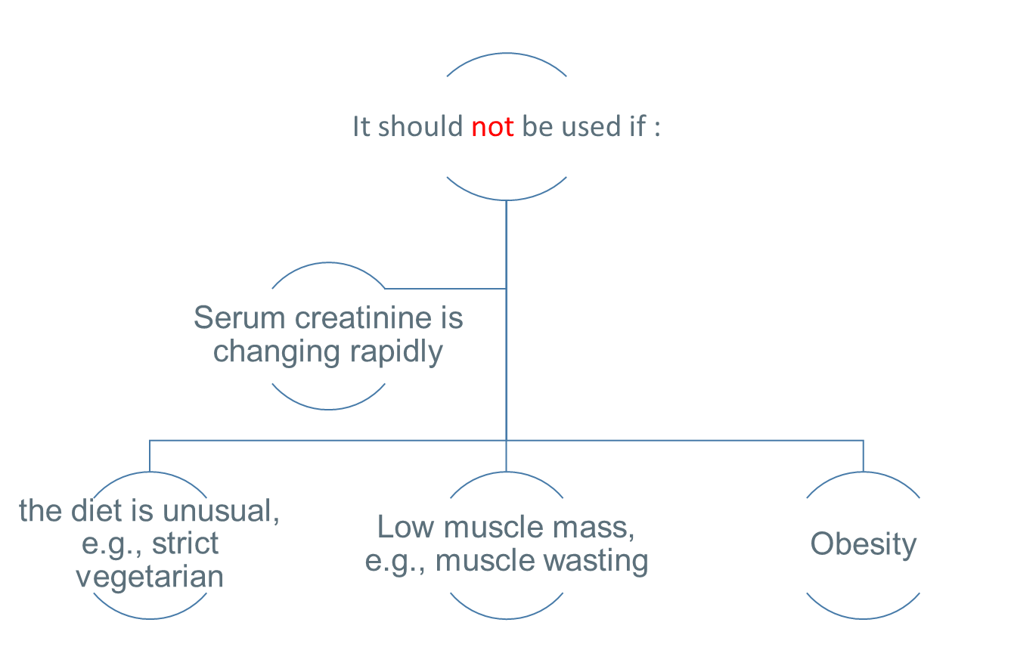
Cockcroft-Gault Formula for Estimating GFR
Cockcroft-Gault Formula:
VERY IMPORTANT
Constant values are given in the exam
where K is a constant that varies with gender:
1.23 for male
1.04 for females.
The constant K is used as females have a relatively lower muscle mass.
(because of lower muscle mass).
So Serum creatinine is inversely proportional to GFR
(lack of proteins which will decrease muscle mass) ..
Obesity will give a normal GFR even if creatinine serum is high.

Slide 14
1. Serum creatinine is more accurate.
2. Serum creatinine level is constant throughout adult life.
Serum Cr is a better KFT than creatinine clearance because:
Creatinine
(accurate because it measures one variable only which will decrease the chances of errors) ..
Creatinine clearance is only recommended in the following conditions:
we use creatinine clearance
for early renal disease due
to its tight range. as for
creatinine serum its range is
wide and therefore it won’t
indicate impaired renal
function unless its highly raised.

Slide 15
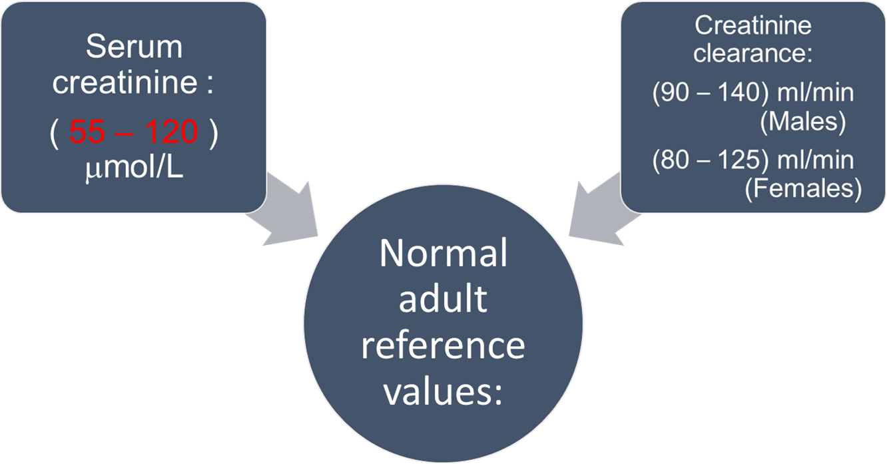
Creatinine Normal values
Urinary excretion of creatinine is 0.5 - 2.0 g per 24 hours in a normal adult, varying according to muscular weight.
A raised serum creatinine is a good indicator of impaired renal function
But normal serum creatinine does not necessarily indicate normal renal function as serum creatinine may not be elevated until GFR has fallen by as much as 50%

Slide 16
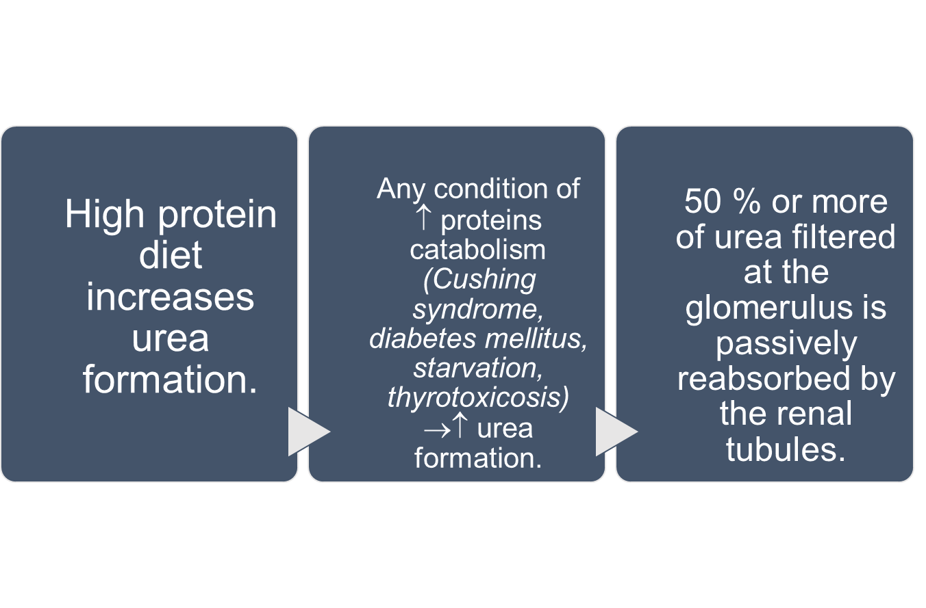
Serum Urea
Recall : urea is formed from ammonia as an detoxification reaction.
(2.5-6.6 mmol/L) in adult
Urea is formed in the liver from ammonia released from deamination of amino acids.
يعني الترتيب من حيث الأهمية :
serum creatinine.
creatinine clearance.
serum urea.
Urea is not endogenous it is affected by diet
Urea is a waste product made when protein is broken down in your body.
Urea is made in the liver and passed out of your body in the urine.
لهذا السبب أي شي يزيد هدم البروتين بيزيد تكوين اليوريا

Slide 17
Normal values of Internal Chemical
Environment controlled by the Kidneys:
SODIUM | 135 to 145 mEq/L
POTASSIUM | 3.5 to 5.5 mEq/L
CHLORIDES | 100 to 110 mEq/L
BICARBONATE | 24 to 26 mEq/L
CALCIUM | 8.6 to 10 mg/dl
MAGNESIUM | 1.6 to 2.4 mg/dl
PHOSPHORUS | 3.0 to 5.0 mg/dl
URIC ACID | 2.5 to 6.0 mg/dl
pH | 7.4
CREATININE | 0.8 to 1.4 mg/dl
BUN (Blood Urea Nitrogen) | 15 to 20 mg/dl

Slide 18
TEAM
MEMBERS
هيفاء الوعيل
ريما الشايع
أمل القرني
بشرى قوقندي
حنين باشيخ
نورة الشبيب
مهند الزهراني
طلال الطخيم
سعود الشنيفي
محمد العسيري
TEAM LEADERS
Rania Alessa
Mohammad Almutlaq

Slide 19
Review the notes ( with help of 435 team )
Lippincott's Illustrated Reviews: Biochemistry, 6th E
THANK YOU
PLEASE CONTACT US IF YOU HAVE ANY ISSUE
@436Biochemteam
Biochemistryteam436@gmail.com

