Slide 1
Biochemistry
Chemical examination of urine
قال صلى الله عليه وسلم:
«احب الناس إلى الله انفعهم للناس»
-احتسبوا الاجر وادرسوا كويس.
Important.
Doctors notes.
Doctors slides.
Extra info .

Slide 2
By the end of this lecture the students will be able to:
1. To understand the normal and abnormal chemical composition of urine in relation to renal diseases and conditions 2. To differentiate between pre-renal, renal and post- renal proteinuria with clinical examples of each 3. To acquire knowledge on the types of Glycosuria, hematuria and hemoglobinuria
OBJECTIVES:

Slide 3
“Extra” Notes:
-Diabetic patient have high level of glucose and low level of insulin ,and insulin function is to make glucose inter the cell , so when there is low insulin the cells cant utilize glucose as source of energy for its metabolic needs and enzymatic reaction ,so they will shift to fat lipolysis( fatty acid catabolism) , then fatty acid will be converted into ketone body . And ketone body will accumulate leading to acidosis .
In ER the patient might faint because of acidosis and the doctor will do breath test ,and the patient breath will smell like acetone ! Then the doctor will know that the patient is diabetic with ketone acidosis .
Treatment:
( Saline + insulin )
There is a national program that requires a test which is done for all new born as soon as they are born within 24 Hours , to check for 19 disease and phenylketonuria is on of them.
After drinking milk for 5 time ( to give time for phenyl to accumulate ) Then a blood sample will be taken by prick In the babies foot , and then the sample is examined by filter paper to see in there is an accumulation.
Treatment : restriction of phenylalanine by using special milk formula .

Slide 4
What’s Urine ?
Blood & Urine give a broad investigations about body status
Urine is a fluid excreted by most animals including humans .
It is formed in the kidneys (renal glomeruli)
The fluid undergoes chemical changes before it is excreted as urine
Normal urine excretion by a healthy person is about 1.5 L per day
Composition of urine:
Normal
Inorganic
Organic
Abnormal
Proteins
sodium
potassium
chlorides
Small amounts of Ca, Mg, S and phosphates
Traces of Fe, Cu, Zn and I2
Non- protein nitrogen (NPN) compounds
Organic acids
Sugars
Traces of proteins, vitamins, hormones, and pigments

Slide 5
Abnormal Composition of urine:
Proteins: Normal urine contains very little protein (< 200 mg/day)
More than this level leads to a condition called : Proteinuria
The causes of proteinuria are
Renal
Post-renal
Pre-renal
In pre-renal and postrenal, the kidney is totally clean

Slide 6
1-Prerenal proteinuria:
Multiple Myeloma is the best example
Some abnormal conditions increase plasma protein levels before reaching the kidneys .
Causes increased filtration of these proteins in the kidneys .
This exceeds the normal re-absorptive capacity of renal tubules Results in overflow of proteins in the urine .
(because they haven’t been reabsorbed due to their high concentration so they will be excreted with urine)

Slide 7
Example of pre-renal proteinuria:
Multiple myeloma*causes pre-renal proteinuria .
A proliferative disorder of the immunoglobulin-producing plasma cells
The serum contains elevated levels of monoclonal one type antibodies light chains antibodies (Bence-Jones protein)
Bence-Jones protein is filtered in kidneys in high amounts
Exceeding the tubular reabsorption capacity
Hence excreted in the urine
IMPORTANT
* It’s cancer of the plasma cells that produce antibodies
Proliferative: to grow or produce by multiplication of parts ..
the more plasma cells the more antibodies

Slide 8
Example of pre-renal proteinuria:
Dissolves at
100 C º
which is unusual to all other proteins
IMPORTANT
The Bence-Jones protein coagulate at 40–60 C º
Multiple myeloma cases are diagnosed by using :
Serum electrophoresis
Immuno-electrophoresis

Slide 9
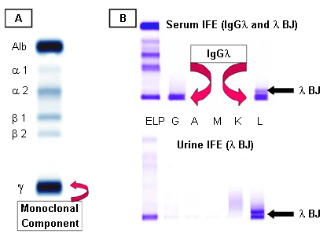
Multiple myeloma:
This method isn’t used anymore, you don’t need to memorize it just take an idea about it.
Very dense Gama in in immuno-electrophoresis
A: serum protein electrophoresis demonstrating the M component .
B: serum and urine immuno-fixation electrophoresis .
Most of our proteins are albumin and the others are immunoglobulin .

Slide 10
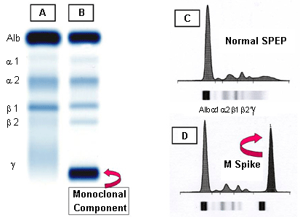
Multiple myeloma:
This method isn’t used anymore, you don’t need to memorize it just take an idea about it.
A: normal serum.
B: multiple myeloma showing Monoclonal component in the gamma region.
C: densitometry tracing of A showing the 5 zones of the high resolution agarose electrophoresis.
D: densitometry of the M component of B, termed the M Spike.
M spike is always smaller than albumins spike

Slide 11
2-Renal proteinuria:
تقسم الى حالات مرضية وغيرمرضية
Associated with renal diseases:
Glomerular proteinuria
Tubular proteinuria
normal glomerular permeability
High glomerular permeability
Causes filtration of high molecular weight proteins
can secrete low & high molecular weights
e.g. glomerulonephritis
Low tubular reabsorption with normal glomerular permeability
Causes excretion of low molecular weight proteins
e.g.
Chronic nephritis
e.g (albumen) which have low molecular weight
(low and high molecular weight proteins are filtered as in nephrotic syndrome)

Slide 12
Orthostatic (Postural) Proteinuria:
ارتفاع بمقدار البروتين بشكل طبيعي
IMPORTANT
Persistent benign proteinuria .
Occurs frequently in young adults due to periods spent in a vertical posture like standing, playing football.
Increased pressure on the renal vein in the vertical position causes orthostatic proteinuria
Disappears in horizontal posture like laying or supine position.
How do they diagnose it?
By taking urine sample after overnight sleeping

Slide 13
Microalbuminuria:
Presence of small amounts of albumin in the urine (20– 200 mg/L)
Cannot be detected by ordinary urine testing
Needs special tests for detection
Early indicator of glomerular dysfunction due to uncontrolled diabetes mellitus or hypertension .
Extra :
Electrophoresis can not detect it .
So we use other tests such as nephrometry or tergotometer .

Slide 14
3 - Post renal proteinuria:
Proteins added to the urine as it passes through the structures of the lower urinary tract (ureters, bladder , urethra, prostate and vagina)
Due to Lower urinary tract infection, trauma, tumors and stones
And also parasites can cause a damage for the ureters ( bilharzia )

Slide 15
Post renal proteinuria diseases
Post renal proteinuria
1-Glycosuria
2-Ketonuria
3-choluria
A) Glucosuria
A) Bilirubin\ Bile salts
4-Nitrate
5-Blood
A) Hematuria
B) Hemoglobinuria
B) Fructouria
C) Galactosuria
B) urobilinogen

Slide 16
1-Glycosuria: presence of sugar in urine
A - Glucosuria: Presence of detectable amount of glucose in urine .
Uncontrolled DM : The concentration of glucose in the plasma exceeds the renal threshold .
Renal glucosuria : Normal plasma glucose concentration with proximal tubular .
malfunction → ↓ renal threshold (gestational diabetes and Fanconi’s syndrome) .
Normally, when glucose level in blood is between (4-6 mmol/l), there shouldn’t be glucose in urine.
Glycosuria occurs if:
The glucose level is elevated (<6mmol/l). This is due to the tubules threshold (physiology)
OR
2. The renal threshold is decreased, although normal glucose level in blood.
Pregnant women may not have elevated blood sugar level but there may be an impairment in proximal tubule function which will results in presence of sugar in urine although she has normal plasma sugar level (سكري الحمل)
and usually it disappears after delivery, and for some women it will continue even after delivery.
Fanconi’s syndrome, genetic or acquired disease due to lead toxicity.
These patient will not be able to absorb amino acids, carbohydrates or glucose.

Slide 17
1-Glycosuria: presence of sugar in urine cont.
B - Fructosuria: Monosaccharide, Comes from fruits and honey .
(Presence of fructose in urine)
- Alimentary causes : High fructose intake .
Metabolic : Low fructokinase or aldolase B in the liver .
C – Galactosuria: Monosaccharide, Comes from milk .
(Presence of galactose in urine)
- Alimentary : High galactose intake
- Metabolic : Low galactokinase or galactose -1-phosphateuridyl transferase in the liver .

Slide 18
2-Ketonuria :
Due to Fat degradation
(( Presence of ketones, acetone, acetoacetic acid & β -hydroxybutyric acid in urine ))
1. Diabetic ketoacidosis .
2. Starvation .
3. Prolonged vomiting .
4. Unbalanced diet: high fat & Low CHO diet* .
5. Phenylketonuria (inborn error of amino acid metabolism .
IMPORTANT
* Like Atkins diet which is type of diet where there is zero carbohydrates and high protein and fat intake Very dangerous it may lead to ketone acidosis .
No glucose so, body will shift to lipolysis.
How are ketone bodies formed?
Insulin get glucose into the cell so the cell can utilize it, but Diabetic patient has little insulin, So the excess glucose will be freely moving in circulation without benefit, And when cells need food, they’ll take it from lipids by lipolysis which result in ketone bodies formation.

Slide 19
3-Choluria :
Presence of bile, bilirubin and bile salts in urine
Normally no bilirubin is detected in urine
It is detected in:
Hepatocellular damage
Obstruction of bile duct due to stones (extrahepatic) and hepatic tumors (intrahepatic) or tumor in pancreas apex .
Bilirubin
Normally present in trace amounts
High urobilinogen is found in:
Hemolytic anemia
Hepatocellular damage
Urobilinogen
Positive nitrite test indicates bacteria in urine
Nitrites:

Slide 20
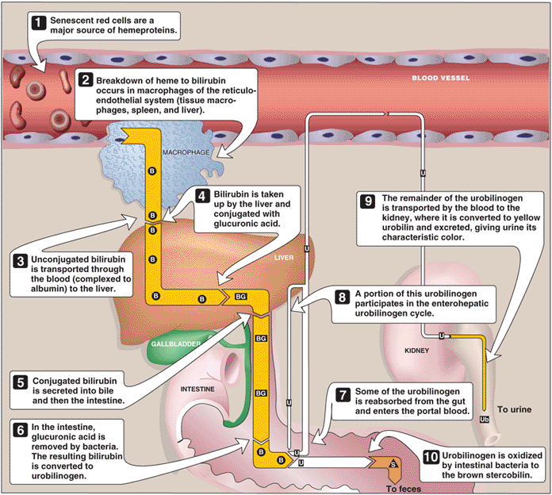
Notes:
(doctor said For your information.)
Catabolism of heme B = bilirubin; BG = bilirubin diglucuronide;
U= urobilinogen; Ub = urobilin; S = stercobilin.

Slide 21
4-Blood :
Causes
Acute / chronic glomerulonephritis
Local disorders of kidney and genito-urinary tract
Bleeding disorders
Trauma, cystitis, renal calculi, tumors
Hemophilia
Hematuria : Presence of detectable amount of blood in urine
Full RBC’s present in the blood .

Slide 22
4-Blood :
Hemoglobinuria:
Presence of hemolysed blood in urine
Difference between haematuria and haemoglobinuria:
- Haematuria : RBC’s are intact , no rupture.
- Hemoglobinuria: RBC’s lost there shape , ruptured .
A)Hemoglobinopathies
1. Sickle cell anemia
2. Thalassemia
B) Malaria (P. falciparum)
C) Transfusion reaction
- Blood group incompatibility
Due to

Slide 23
TEAM
MEMBERS
Amal AlQarni
Bushra quqandy
Reema alshea
Haifa alwael
Haneen bashaikh
Leen altamimi
Reem alsarjani
TEAM LEADERS
Rania Alessa
Mohammad Almutlaq

Slide 24
Review the notes
Lippincott's Illustrated Reviews: Biochemistry, 6th E
THANK YOU
PLEASE CONTACT US IF YOU HAVE ANY ISSUE
@436Biochemteam
Biochemistryteam436@gmail.com

