Slide 1
Biochemistry
Kidney Stones
When life puts you in tough situations, don’t say WHY ME
Say TRY ME ..
Important.
Doctors notes.
Doctors slides.

Slide 2
OBJECTIVES:
By the end of this lecture the students will be able to:
• Discuss the general physiological and pathological factors that favor kidney stones formation.
List the types of kidney stones, their chemical constituents and characteristics.
Identify the etiological causes of each type of kidney stone.
Discuss the diagnosis, treatment and prevention of kidney stones

Slide 3
These products are in high concentration
Near or above maximum solubility.
Renal calculi (kidney stones) are formed in renal tubules, ureter or bladder.
Composed of metabolic products present in glomerular filtrate.
Kidney Stones
What are kidney stones ?
الـماكسيموم سوليبيلتي ممكن نشبهها بكأس الماء إذا ذوبنا فيه كمية كبيرة من الملح، بحيث الملح راح يذوب
حتى يوصل درجة معينة يصير فيها يتراكم ولا يذوب ، لأن الماء تشبع منه .
3. Urinary stagnation (stasis)
1. High concentration of metabolic products in glomerular filtrate.
2. Changes in urine pH.
4. Deficiency of stone-forming inhibitors in urine.
In which conditions do they form ?
Some drugs and bacteria causes the changes in urine PH ..
If we have a glass of water and we kept adding salt (sodium) to it. The water will reach a limit which cannot accept any salt and accumulate at the bottom of the glass.

Slide 4
Conditions Causing Kidney Stone Formation
1. High concentration of metabolic products in glomerular filtrate is due to
2. Changes in urine pH due to
3. Urinary stagnation is due to
Low urinary volume (with normal renal function) due to restricted fluid intake
Increased fluid loss from the body due to excessive sweating or diuretics
Increased excretion of metabolic products forming stones. (urinary system is exposed to more metabolites)
Bacterial infection It could be acid or base depending on the type of bacteria
Obstruction of urinary flow.
If urine PH has changed, some substances become insoluble because certain substances are soluble at certain Ph.
We should determine the Ph of the urine for treatment:
Acidification
alkalization
Precipitation of salts at different pH.
High plasma volume (high filtrate level) Filtration increases thus metabolite amount in filtrate increase too .
Low tubular reabsorption from filtrate .
(urine will more concentrated)

Slide 5
Conditions Causing Kidney Stone Formation
4. Deficiency of stone-forming inhibitors
Urine contains substances that function to protect the possibility of pathological calcification in tubular fluid and urine
Citrate, pyrophosphate, glycoproteins inhibit growth of calcium phosphate and calcium oxalate crystals .
In type I renal tubular acidosis, hypocitraturia leads to renal stones.
hypocitraturia is citrate excretion of less than a certain amount per day..

Slide 6
Types Of Kidney Stones
Kidney stones
Uric acid
Mg ammonium PO₄
Calcium salts
Cystine
Other (xanthine, etc.)
TYPE | PH level at which stones are formed | Appearance on X-ray
Calcium salts | Alkaline urine | radio-opaque
Uric acid | Acidic urine | Radio-lucent
Mg Ammonium Po4 | Alkaline urine | Faint radio-opaque
Cystine | Acidic urine | Faint radio-opaque
Xanthine | Acidic urine | Radio-lucent
Need high pH to form stones
Need low pH to form stones
Need high pH to form stones
Need low pH to form stones
Need low pH to form stones

Slide 7
Calcium Salt Stones
80% of kidney stones contain calcium
The type of salt depends on:
Urine PH
Availability of oxalate
- Most common type.
- Ca is a cation, so it combines with an
anion (e.g. oxalate, phosphate) to form
salts.
White, hard, radio-opaque
Calcium phosphate (PO4)
Calcium Oxalate
Calcium Salt Stones
Most common
present in ureter (small)
Less often
staghorn in renal pelvis (large)

Slide 8
Calcium Salt Stones
435
but they are commonly found together
Secondary is exogenous:
from diet

Slide 9
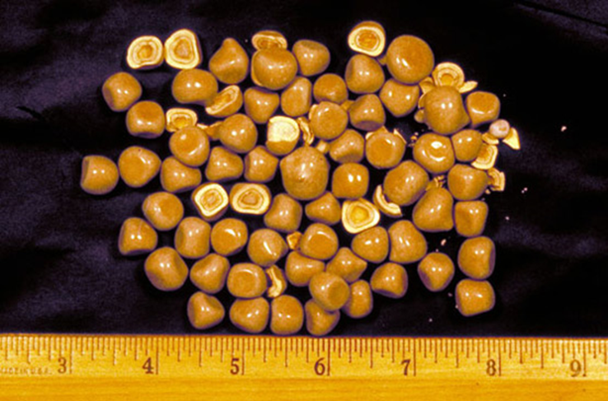
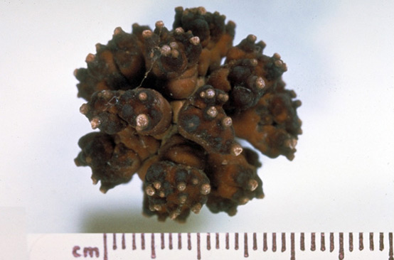
Treatment
Treatment of primary causes
Oxalate-restricted diet
Increased fluid intake
Acidification of urine (by dietary changes)
Calcium Salt Stones
Calcium salt stones are formed in alkaline urine
such as infection, hypercalcemia, hyperoxaluria
Because it’s not
recommended to
reduce Ca in the diet
First we must check his glomerular function ..
(to prevent overload)
Staghorn قرن الأيل

Slide 10
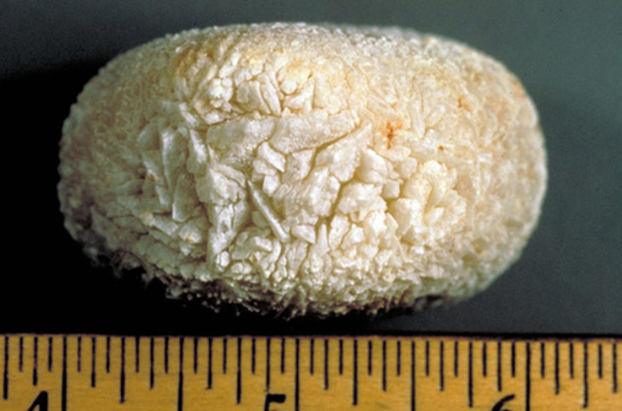
Uric Acid Stones
Represent about 8% of renal stones contain uric acid
May be associated with hyperuricemia (with or without clinical gout)
Form in acidic urine (Unlike calcium stones)
Because it’s the origin of Uric acid

Slide 11
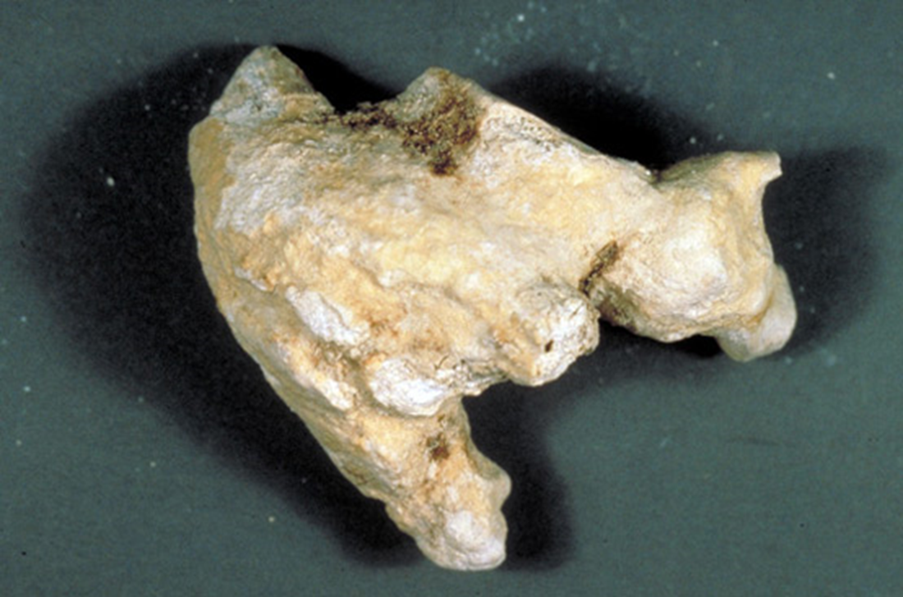
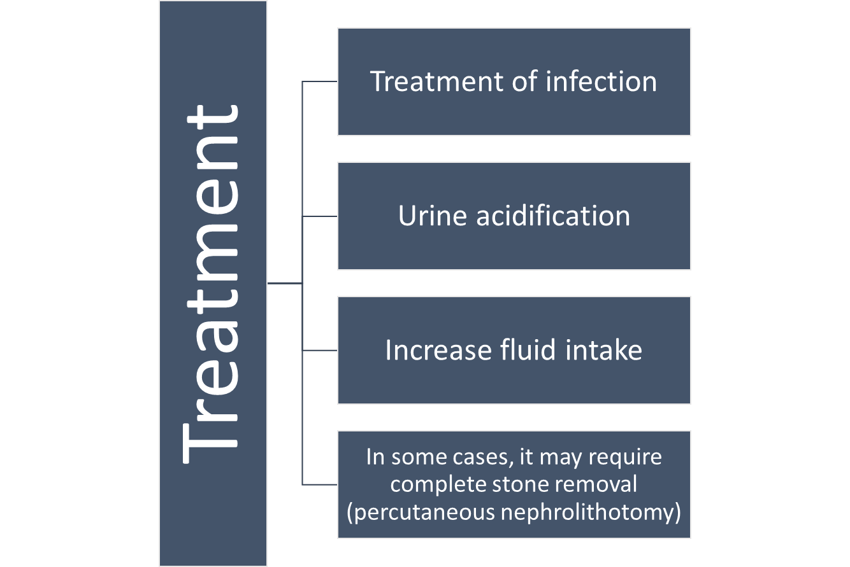
Mg Ammonium PO4 Stones
Represent about 10% of all renal stones contain Mg amm. PO4
Also called struvite kidney stones
75% of staghorn stones are of struvite type
Commonly associated with chronic and upper urinary tract infection and staghorn calculi .
Mg ammonium PO4 is kind of mineral that naturally found in the earth. Its geological name is “struvite”
Chronic urinary tract infection
Caused by Microorganisms (such as from Proteus genus) that has urase activity which metabolizes urea into ammonia.
Causing urine pH to become alkaline leading to stone formation
Infection is prime factor to struvite stones
Bacterial infection leads to 2 things:
Urease activity
Change to alkaline pH
These two are the factors leading to Mg stone formations.

Slide 12
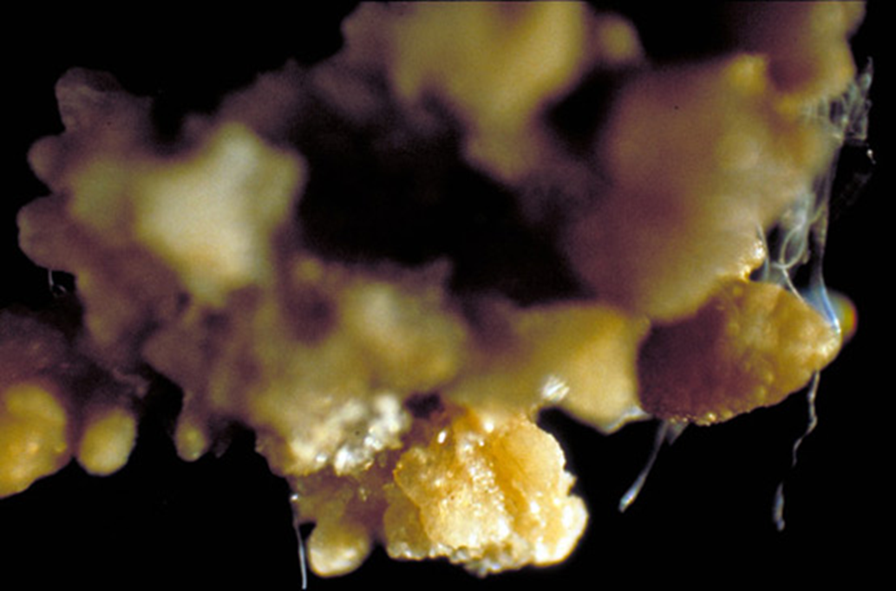
Cystine Stones
A rare type of kidney stone.
Due to homozygous cystinuria.
(Inborn error of amino acid metabolism; It might be genetic)
Form in acidic urine.
Soluble in alkaline urine.
Faint radio-opaque.
Treatment
Increased fluid intake
Alkalization of urine (by dietary changes)
Penicillamine (binds to cysteine to form a compound more soluble than cystine)
Cystine doesn't exist normally in our body, it is formed due to oxidization of two cysteine (amino acid) molecules leading to formation of the insoluble cystine molecules which will eventually lead to cystine stones formation (important to understand treatment only)

Slide 13
Laboratory Investigations Of Kidney Stones
435

Slide 14
Laboratory Investigations Of Kidney Stones
435

Slide 15
TEAM
MEMBERS
TEAM LEADERS
مهند الزهراني
صالح التويجري
Rania Alessa
Mohammad Almutlaq

Slide 16
Review the notes
Lippincott's Illustrated Reviews: Biochemistry, 6th E
THANK YOU
PLEASE CONTACT US IF YOU HAVE ANY ISSUE
@436Biochemteam
Biochemistryteam436@gmail.com

