Slide 1
Biochemistry
Inborn Errors of amino acid Metabolism
One day or day one you decide ..
Important.
Extra Information.
Doctors slides
436 Biochemistry team

Slide 2
By the end of this lecture the students will be able to:
• Identify the amino acid degradation and synthesis of non-essential amino acids.
• Recognize the metabolic defects in amino acids metabolism that lead to
genetic diseases.
OBJECTIVES:

Slide 3
Inborn Errors
EXTRA SLIDE
Inborn errors are divided into :
Amino acids inborn errors .
Carbohydrate inborn errors .
Organic acids inborn errors .
Lysosomal storage inborn errors .
Recall
We have 20 amino acids and divided into essential and non essential depending on the ability of human body to synthesize it.

Slide 4
Inborn Errors of amino acid Metabolism
Caused by enzyme or co-factor loss or deficiency due to gene mutation .
Types:
Phenylketonuria.
Maple syrup Urine disease.
Albinism.
Homocystinuria.
Alkaptonuria.
يعني لما المريض يكون عنده نقص في الانزايمز بيصيرعنده فائض في المتفاعلات ونقص في النواتج .
Co-factor
Substrate + enzyme Product
In case of defect enzyme substrate will not react sufficiently thus it might accumulate in the tissues
Enzyme
Substrate
Product
Cofactors
Defect
Yet, no complete loss of activity
Excess
Deficient
(unless there is another source that you can obtain this product from)

Slide 5
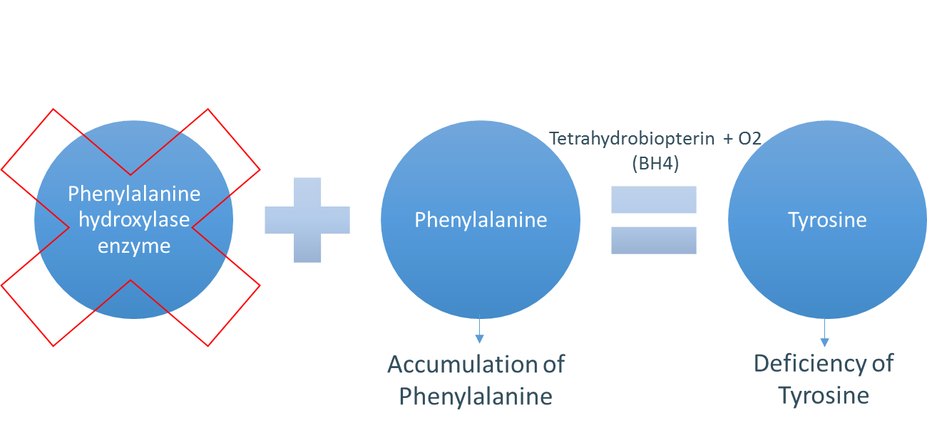
Phenylketonuria (PKU)
The most common disease of amino acid metabolism.
(incidence: 1 in 50,000)
Due to deficiency of phenylalanine hydroxylase (PAH) enzyme “classic PKU”.
Results in hyper-phenylalaninemia
and tyrosine deficiency. (normally tyrosine is not an essential amino acid but in the case of PKU it becomes essential. Therefore tyrosine supplements are given to the patient)
Pathway of phenylalanine degradation:
(High blood phenylalanine resulting from its accumulation)
Defect
Phenylalanine will not be converted to tyrosine if one of these two factors is not available : 1) PAH. 2) BH4

Slide 6
Phenylketonuria (PKU) Cont.
Other Reason for hyperphenylalaninemia:
Deficiency in Tetrahydrobiopterin (BH4)
Conversion of Phenylalanine to Tyrosine requires BH4, so even though phenylalanine hydroxylase level is normal, the enzyme will not function without it.
Hence Phenylalanine accumulates.
This Deficiency of BH4 Caused by deficiency of:
1- Dihydropteridine reductase.
2- Dihydrobiopterine synthetase .
3- Carbinolamine dehydratase.
Leading to atypical PKU
“Atypical hyperphenylalaninemia”: Deficiency in dihydropteridine reductase, dihydrobiopterin synthetase enzymes and Carbinolamin dehyratase. (which recycles BH4 -> when deficient ->BH4 can’t be recycled back -> deficiency in BH4 -> No Tyrosine formation in the body)
Classic PKU : PAH deficiency
Atypical : BH4 deficiency

Slide 7
Characteristics of PKU
In the absence of BH4:
Phenylalanine will not be converted to Tyrosine, and Tyrosine is required for the synthesis of Melanin by the enzyme Tyrosinase.
Tyrosine will not be converted to catecholamine
And Tryptophan will not be converted to serotonin as they require BH₄
Catecholamines and serotonin are neurotransmitters. (Look at the picture in slide 8)
Phenylalanine is degraded to phenyllactate, phenylacetate and phenylpyruvate.
Elevation of Phenylalanine in tissues, plasma, and urine
So deficiency in Tyrosinase leads to light skin and blue eyes (similar to albinism yet not as severe)
Gives urine a mousy (musty) odor (smell).
Melanin
CNS symptoms: Mental retardation, failure to walk or talk, seizures, microcephaly, etc..
Hypopigmentation : fair hair, light skin color and blue eyes.
Hypopigmentation because tyrosine which makes melanin became essential amino acid for the body and the only source is diet, since the body can’t form it due to defect Co-factor

Slide 8
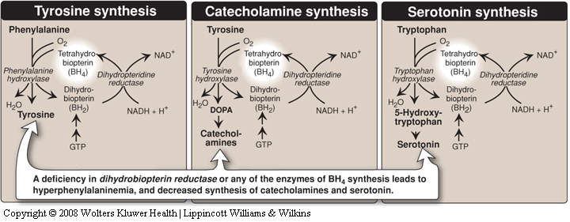
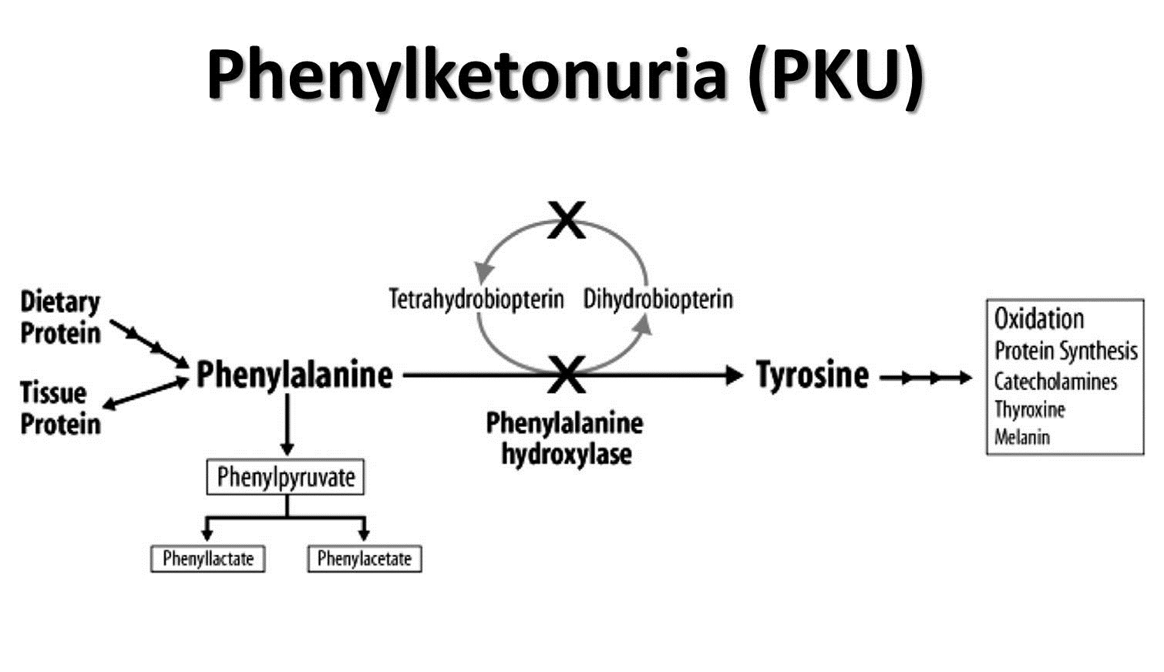
Amino acids and Tetrahydrobiopterin
Tyrosine pathways (focus on the key steps only)
Extra picture that sums up PKU

Slide 9
Diagnosis and treatment of PKU
Diagnosis:
Prenatal diagnosis is done by detecting gene mutation in fetus.
Neonatal diagnosis in infants is done by measuring levels of blood Phenylalanine.
(24-48 hours after birth, phenylalanine levels are measured to check for any deficiencies)
Treatment: Life long Phenylalanine-restricted diet and Tyrosine supplementation. (technically you can’t put the patient on phenylalanine free diet since it’s found in almost every food, plus the patient would suffer from malnutrition. As an alternative we restrict phenylalanine and supply the patient with tyrosine)
PKU Treatment story ☺
For treating PKU without the hard restricted diet system the scientists thought about forming an enzyme which is similar to PAH but with better features. They made that enzyme, and the good thing that it doesn’t require a co-factor . But they found that the immune system responses against this enzyme hence, it can’t be delivered to the cells . And while they were trying to fix this problem the discovered
( LAAN ) which is an amino acid chain based on nitrogen .. The benefit of it, that it competes phenylalanine on PAH making it not able to accumulate . The second way is to use Geno therapy ( still not effective on humans )

Slide 10
Maple syrup Urine disease
Due to deficiency of branched chain α-ketoacid dehydrogenase (BCKD).
This enzyme decarboxylates leucine, isoleucine and valine. When BCKD is deficient, these amino acids and their keto-acids accumulate in blood.
Symptoms: mental retardation, physical disability, metabolic acidosis, etc..
Maple syrup odor (smell) of urine.
Treatment: Limited intake of leucine, isoleucine and valine causes no toxic effects. (Restrict intake causing less accumulation)
MSUD is mainly due to enzyme deficiency .
it’s too rare to have abnormal Co-factor (thiamine)
Types
Classic type: The most common, due to little or no activity of branched α-ketoacid dehydrogenase.
Intermediate and intermittent forms: Higher enzyme activity, symptoms are milder.
Thiamine-responsive form: High doses of thiamine increases α-ketoacid dehydrogenase activity.
(it’s the intermediate form yet the only difference is that the patient here respond very well and thus treated with thiamine)

Slide 11
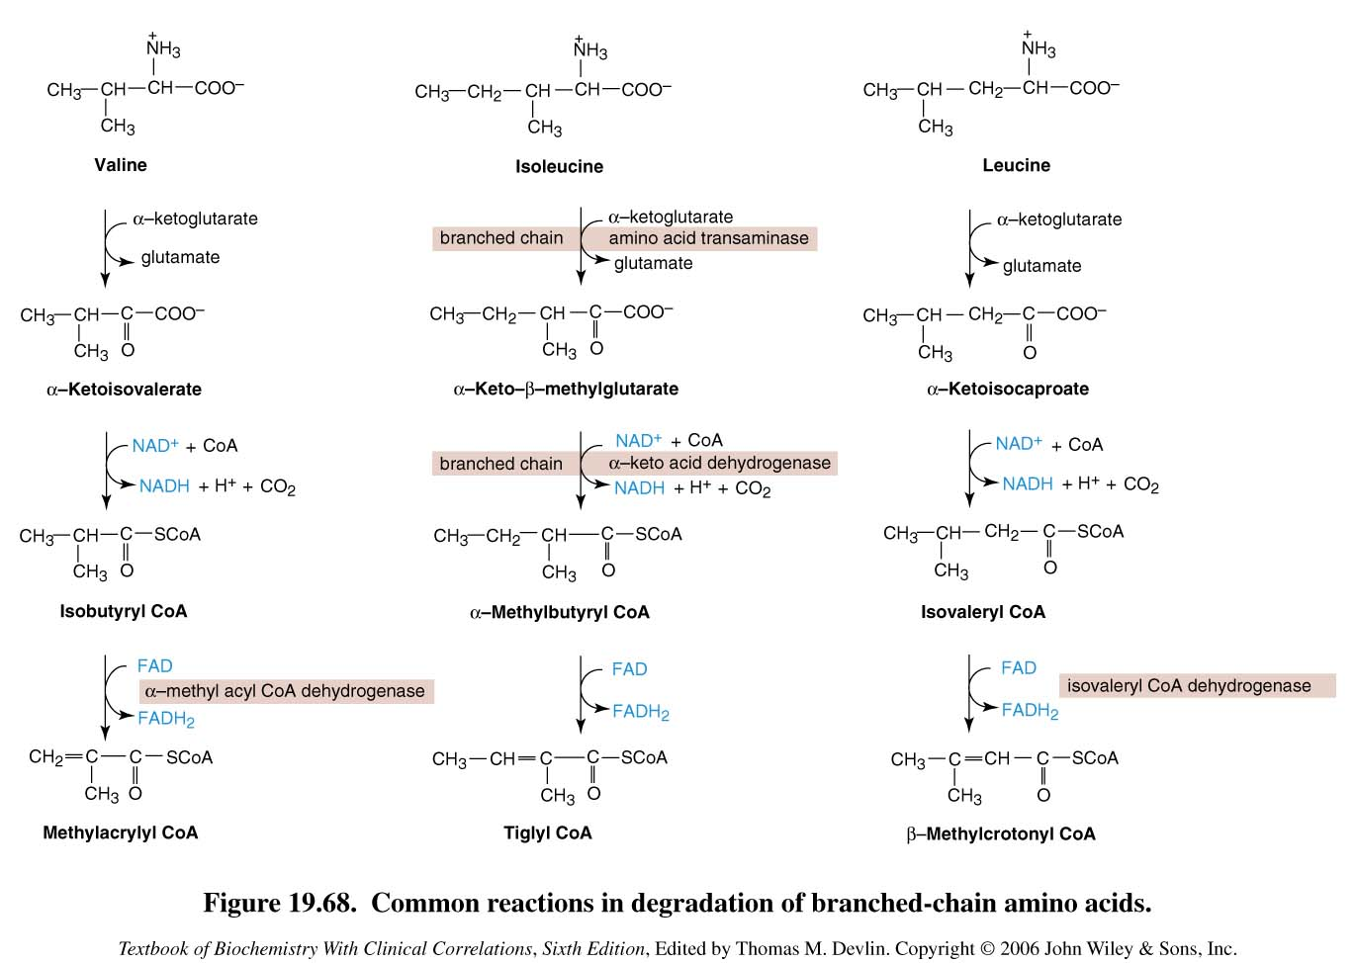
Maple syrup Urine disease
Valine, Isoleucine,
Leucine and their
keto acids
Accumulated
NO STRUCTURE MEMORIZA-TION
Degradation of branched-chain amino acids: valine, isoleucine and leucine. Deficiency of branched chain α-keto acid dehydrogenase leads to MSUD.

Slide 12
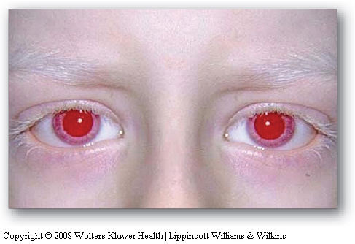
Albinism
Tyrosine is synthesized here unlike PKU
First: What is albinism?
It is a disease of Tyrosine metabolism, and Tyrosine is involved in melanin production .
Second: What is Melanin?
Melanin is a pigment of hair, skin and eyes .
Third: Why does it happen?
It happens due to Tyrosinase deficiency, which causes Melanin deficiency.
Melanin is absent in Albino patients, so the hair, and skin appear white. Eyes are red along with vision defects and photophobia .
Tyrosinase
Melanin
Leads to accumulation of Tyrosine and DOPA

Slide 13
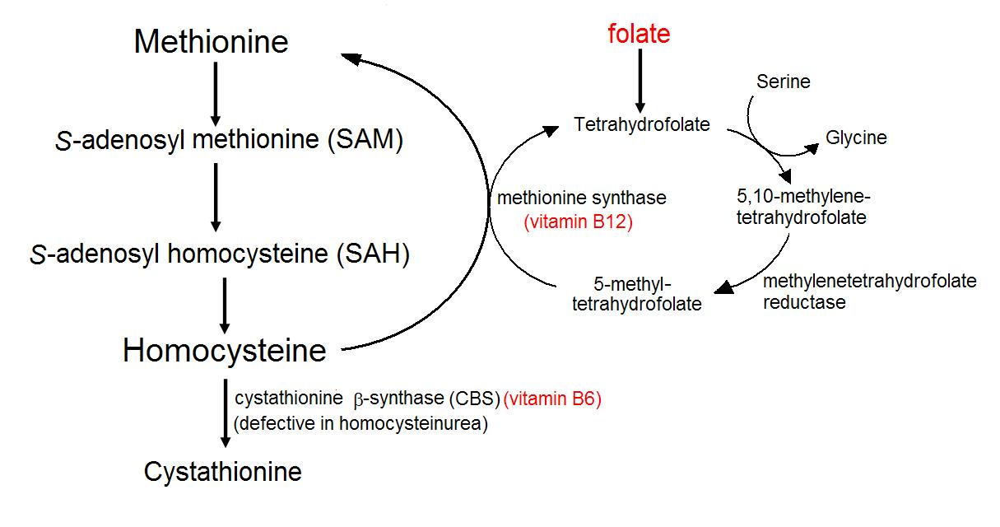
Homocystinuria
Due to deficiency of cystathionine β-synthase which leads to defects in homocysteine metabolism.
Converts homocysteine to cystathionine. (cysteine is a non-essential amino acid. The enzyme cystathionine beta-synthase is required for the early synthesis of cysteine; when deficient cysteine becomes essential amino-acid)
High plasma and urine levels of homocysteine and methionine and low levels of cysteine.
High levels of homocysteine is a risk factor for atherosclerosis and heart diseases.
Skeletal abnormalities , osteoporosis, mental retardation, displacement of eye lens.
Initially it accumulate in the blood but after reaching renal threshold it goes into urine .
-Cystathione beta-synthase requires vitamine B6 for its activity
-Methionine synthase requires vitamine B12 for its activity
-for the conversion of homocysteine to methionine the enzyme tetrahydrofolate THF (functional form of folic acid) is required
cysteine

Slide 14
Homocystinuria
Hyperhomocysteinemia is also associated with:
Neural tube defect (spina bifida)
Vascular disease (atherosclerosis)
A risk factor of heart diseases.
Spina bifida is a defect where there is incomplete closing of the backbone and membranes around the spinal cord.
Treatment
Oral administration of Vitamin B12, B6
Oral administration of folate
methionine-restricted diet

Slide 15
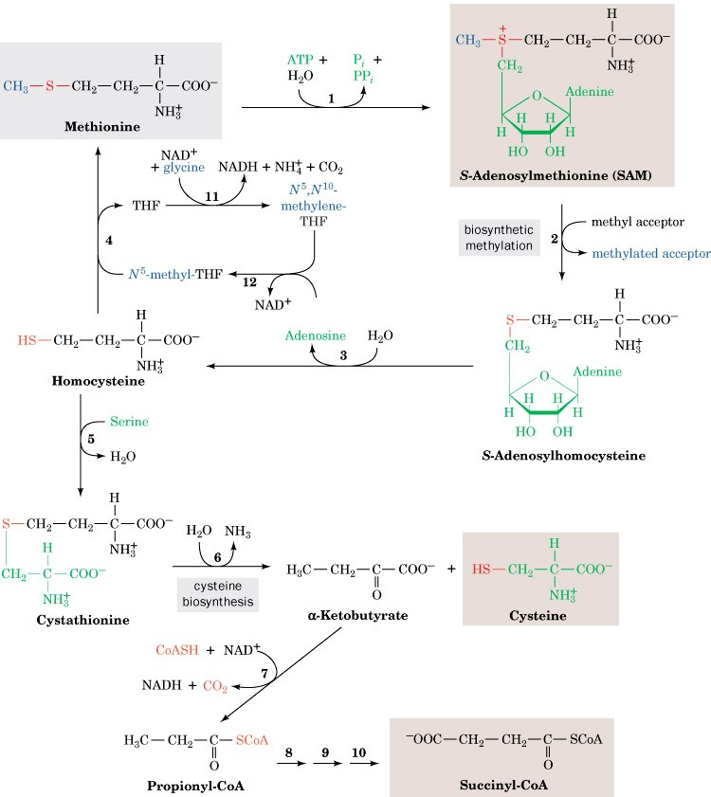
Homocystinuria
Methionine and its metabolites are accumulated
Cystathione b-synthase
Cysteine becomes
deficient
Methionine degradation pathway: Deficiency of cystathione b-synthase leads to homocystinuria / homocysteinemia

Slide 16
Alkaptonuria
A rare disease of Tyrosine degradation.
Due to deficiency of homogentisic acid oxidase. Lead to accumulation of homogentisic acid (molecule produced in the tyrosine degradation pathway)
This disorder associated with dark urine
Tyrosine
Catecholamine
P-Hydroxyphenylpyruvate
Melanin
Challenge : Do you remember how many disorders associated with Tyrosine abnormality in this lecture ?? 😏😏
Homogentisic acid
Homogentisic acid oxidase
Fumarate
TCA (tricarboxilc acid) cycle

Slide 17
Characteristics of Alkaptonuria
Homogentisic aciduria: elevated homogentisic acid in urine which is oxidized to dark pigment over time. (only symptom during childhood)
Arthritis and black pigmentation of cartilage and tissues. (appears later on time; around 40s)
Usually asymptomatic until adulthood.
Treatment: Restricted intake of Tyrosine and Phenylalanine reduces homogentisic acid and dark pigmentation.

Slide 18
Summary
 | Disease | Enzyme | Amino acids involved
1. | Phenylketonuria | Phenylalanine hydroxylase | Phenylalanine
2. | Maple syrup Urine disease | α-ketoacid dehydrogenase | Isoleucine, leucine and valine
3. | Albinism | Tyrosinase | Tyrosine
4. | Homocystinuria | Cystathionine β-synthase | Methionine
5. | Alkaptonuria | Homogentisic acid oxidase | Tyrosine and phenylalanine

Slide 19
TEAM
MEMBERS
هبه الناصر
TEAM LEADERS
.Rania Alessa
.Mohammad
Almutlaq

Slide 20
Review the notes
Lippincott's Illustrated Reviews: Biochemistry, 6th E
THANK YOU
PLEASE CONTACT US IF YOU HAVE ANY ISSUE
@436Biochemteam
Biochemistryteam436@gmail.com

