Slide 1
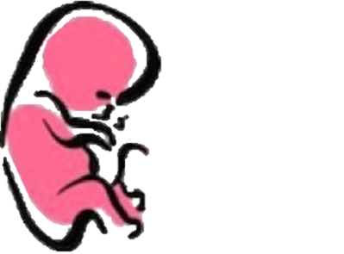
DEVELOPMENT OF THE KIDNEYS
﴿ إِنَّا خَلَقْنَا الإنسان مِنْ نُطْفَةٍ أَمْشَاجٍ نَبْتَلِيهِ فَجَعَلْنَاهُ سَمِيعًا بَصِيرًا ﴾ [الإنسان: 2].
Embryology
436
Important
Dr. notes Explanation
M E D I C I N E
KING SAUD UNIVERSITY
- We recommend you to study anatomy of the kidney lecture first.

Slide 2
O B J E C T I V E
Identify the embryological origin of kidneys & ureters .
Differentiate between the 3 systems of kidneys during development.
Describe the development of collecting & excretory parts of permanent kidney.
Describe the fetal kidney & identify the pre- and postnatal changes that occur in the kidney.
Enumerate the most common anomalies of kidneys & ureters.

Slide 3
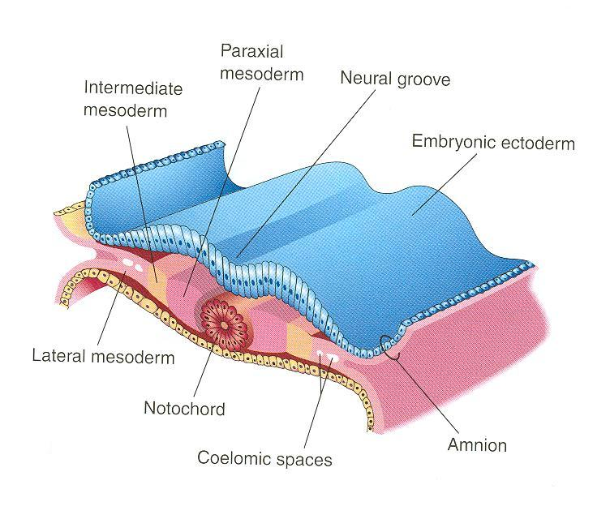
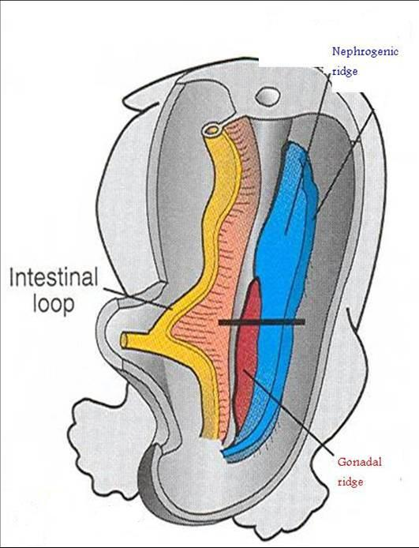
Embryological Origin
- There are three layers of mesoderm which are parietal ,lateral and intermediate mesoderm .However, just one of them contains the kidney and ureter which is intermediate mesoderm.
- Embryological origin of kidney and ureter is from intermediate mesoderm
- intermediate mesoderm differentiates into: ( two elevation).
1. Nephrogenic ridge (cord) (lateral) :
forms kidneys and ureters.
2. Gonadal ridge (medial):
forms gonads (testes or ovaries).
Nephrogenic ridge
Gonadal ridge
video for extra explanation

Slide 4
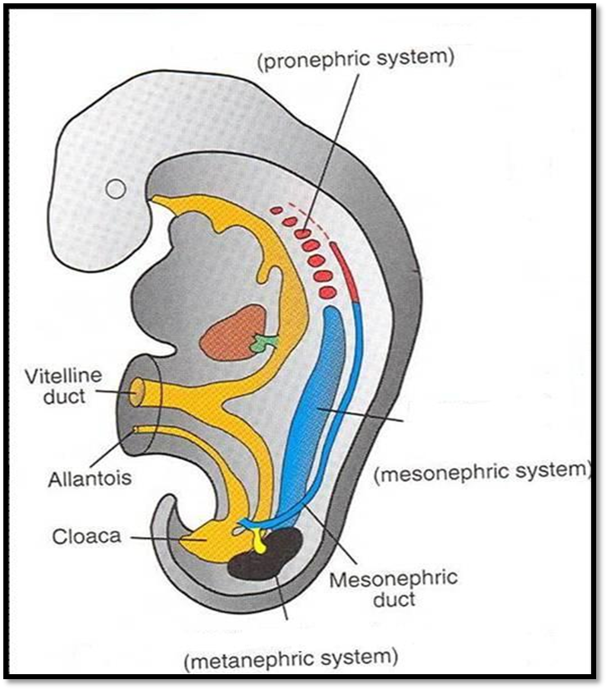
Development Of Kidney
Three Systems The Kidneys Develop:
3. Metanephric system: | 2. Mesonephric system: | 1. Pronephric system:
appears at 5th week in pelvis starts to function at 9th week * Very important * | appears at end of 4th week in thoracic and abdominal regions analogous to kidney of amphibians تشبه شكل كلية الزواحف formed of tubules and a duct Function but temporarily The duct: In male: forms genital duct genital duct transfer the sperm from testes to urethra In both sexes: forms ureteric bud In males the mesonephric duct will be part of the genital system , while in female it will disappear except the most lower part it will form ureteric bud, so in both sexes the lower part will form ureteric bud | appears at beginning of 4th week in cervical region (upper part of nephrogenic pool) analogous to kidney of fish تشبه شكل كلية الأسماك formed of tubulesتبدأ بـ and a duct وتنتهي بـ not functional in human disappears (temporal) Only tubules will disappear.(duct is available).
This system will give the permanent kidney
. الكدني تكون موجودة في ال سيرفيكال ريجون فتتتشكل في بداية الأسبوع الرابع
Upper part of nephrogenic pool
وهي عبارة عن
Tubules open in duct
Videos for extra explanation:
Pronephros
Mesonephros
metanephros

Slide 5
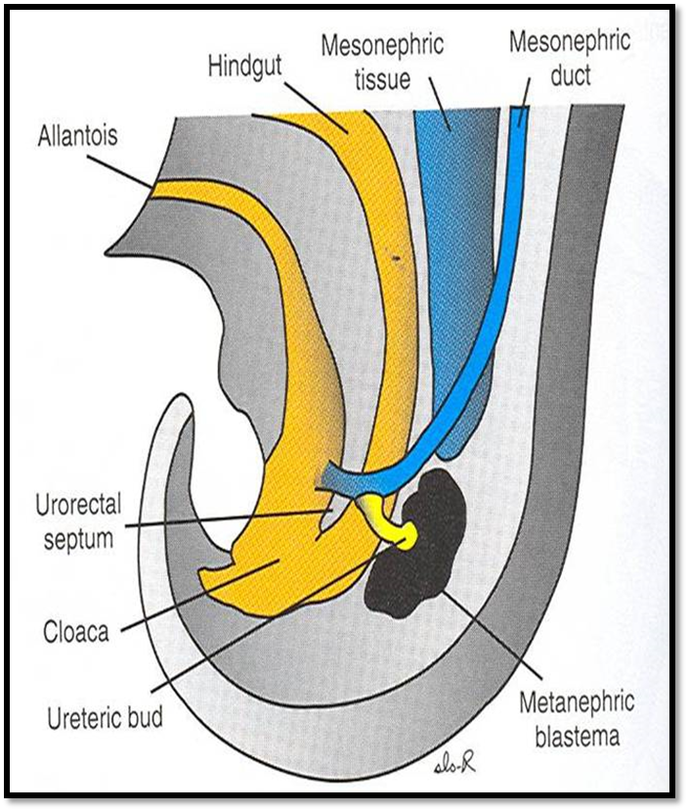
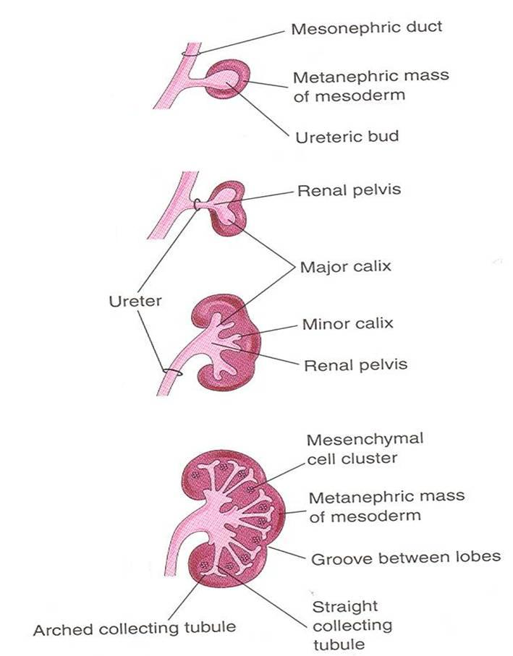
Metanephros (Permanent Kidney)
Metanephros: is permanent kidney.
Formed of 2 origins:
1- Ureteric bud (derived from distal end of mesonephric duct) : يجمع البول ))
gives collecting part of kidney.
2- Metanephric blastema (mass): (from most lower part of nephrogenic cord).
gives excretory part of kidney. الجزء الي يستخلص وينقي الدم ))
( COLLECTING PART )
A
A- Ureteric bud elongates and penetrates metanephric mass.
زي عنق وبعدين يبدا اليوريترك بد والعنق يصيروا أطول ) (stalk(ميسونفرك دكت يخرج منها يوريترك بد صغير يوصل بينهم (
B
B- Stalk of ureteric bud forms ureter and cranial end forms renal pelvis.
C- Branching of renal pelvis gives 3 major calices. Branching of major calyces gives minor calyces.
C
(بعدين اليوريترك بد تدخل داخل الميتانفرك ماس وتبدا تتفرع ويعطينا 3ميجور كاليسز وتتفرع اصغر وتعطينا 3 ماينور كاليسز).
D- Continuous branching gives straight then arched collecting tubules.
D
مع استمرار التفرع يعطينا استريت تيبيولز ونهايتها في ارش
وكل هذا داخل ميتانفرك ماس وبعدين هيصير تغيرات فيها عشان تعطيني Excretory part

Slide 6
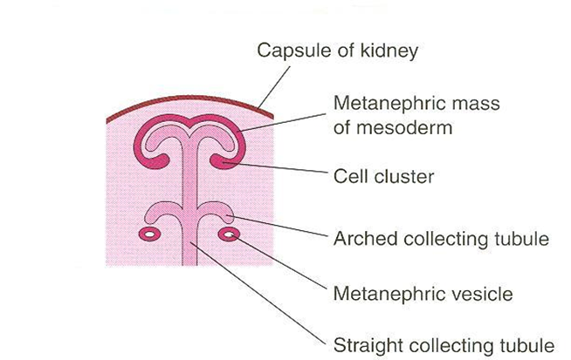
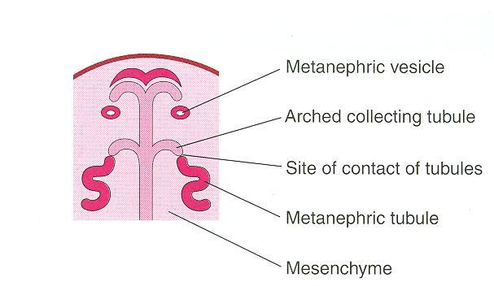
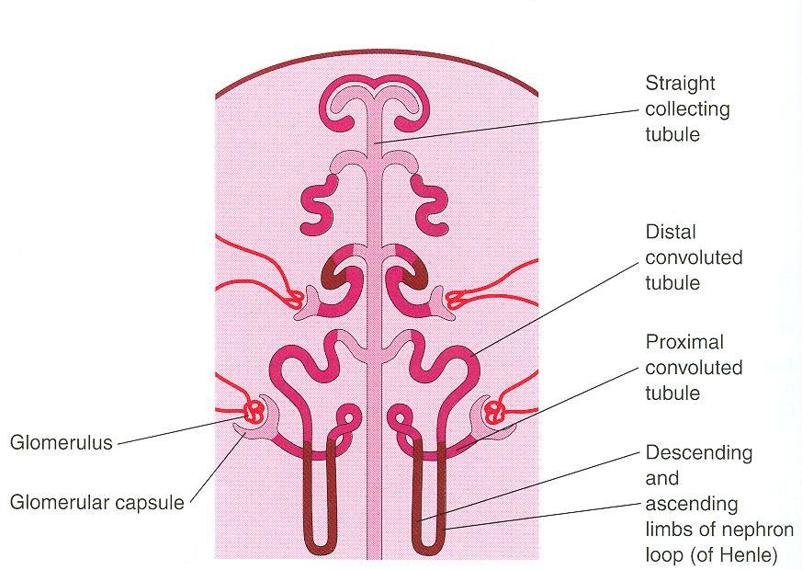
Excretory Part
- Each arched collecting tubule is surrounded by a cap of metanephric mass.
- The metanephric cap forms the metanephric vesicle.
ميتانفرك ماس عبارة عن قطعة وحدة تحيط بكرينيال اند اوف يريترك بد
يوريترك بد يبدا يتفرع ويقسمها لقطع وكل قطعة تحيط ب ارش كوليكتنق تبيولز
(Metanephric vesicleفي هذه الحالة نسمي القطعة (
- The metanephric vesicle elongates to form an S-shaped metanephric tubule.
“EXCRETORY PART (CONT).”
- The end of each tubule forms glomerular (Bowman’s) capsule.
(S-shape tubules become more longer form cup shape called (bowman’s capsule)
- Each glomerular capsule is invaginated by capillaries (glomerulus).
- The tubule lengthens to form: proximal and distal convoluted tubules + loop of Henle.
الاس شيب تيبيولز تطول اكثر وتنطوي وتعطينا
: proximal and distal convoluted tubules + loop of Henle

Slide 7
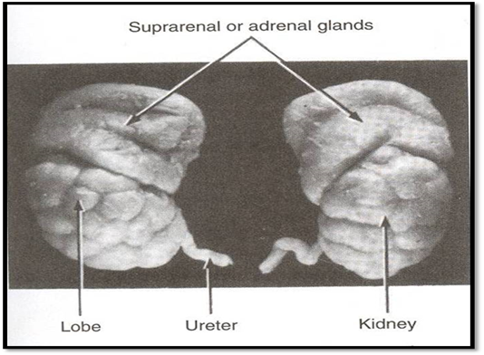
The Nephron
- The nephron: functional unit of kidney.
- The nephron is formed by fusion of: (collecting part +excretory tubules)
1.Excretory tubule formed of metanephric mass (cap).
2. Arched collecting tubule formed of ureteric bud.
Each kidney contains: 800000 – 1000000 nephrons.
No more nephrons formed after birth
CRITERIA OF THE FETAL KIDNEY :
Kidney is subdivided into lobes that are visible externally.
Lobulation diminishes at the end of fetal period.
Nephron formation is complete at birth .
No more nephron is formed after birth .
- The difference between kidney in adult and fetal:
fetal : small size , has lobes that can see with eye and disappear at the end of the fetal.
Adult: large size , has no lobes (if it has lobes (abnormal)) .

Slide 8
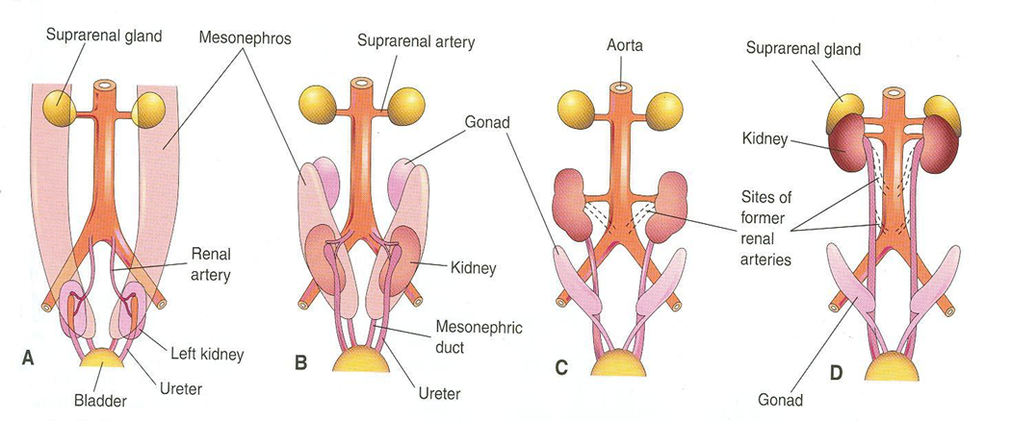
Changes Of Kidney Before Birth
- Changes during development:(by 9th week).
1. Change in position: The kidney ascends from pelvis to abdomen and attains its adult position, caudal to suprarenal gland. صار أطول لما توصل ل سبرارينال قلاند ف يوقفها من انها تطلع اكثر) Body trunk(تطلع لفوق بسبب ان
2.Change in blood supply: As the kidney ascends, its blood supply changes from renal branches of common iliac arteries (pelvis) into renal branches of (abdominal aorta) (abdomen).
3.Rotation: Initially, hilum (site of entry and exit of vessels and nerves) is ventral then rotates medially about 90° and becomes medial.
Common iliac artery
Video for explanation

Slide 9
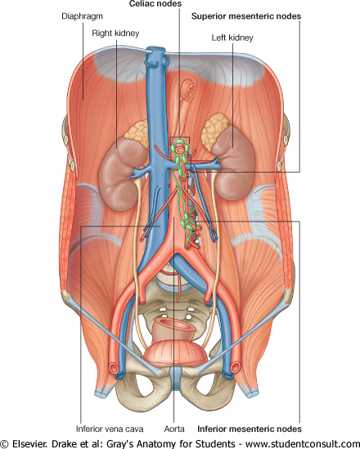
The Fetal Kidney
- What happens at the 9th week ?! (This week is very important for the kidney).
- beginning of glomerular filtration (start of function).
- The kidney attains its adult position at the level of L2 and receives its supply from renal artery(abdominal aorta).
The hilum is rotated medially.
- Kidney is subdivided into lobes that are visible externally. Lobulation diminishes at the end of fetal period.
- Changes of kidney after birth:
- Increase in size: due to elongation of tubules and increase in connective tissue between tubules (not due to increase in number of nephrons*).
*مهم جدا نعرف ان الكدني بعد الولادة ماتزيد في عدد النيفرونز.
- Disappearance of kidney lobulation.
يبدا ال (لوبس)بالاختفاء في فترة ماقبل الولادة ويختفي تماما بعد الولادة

Slide 10
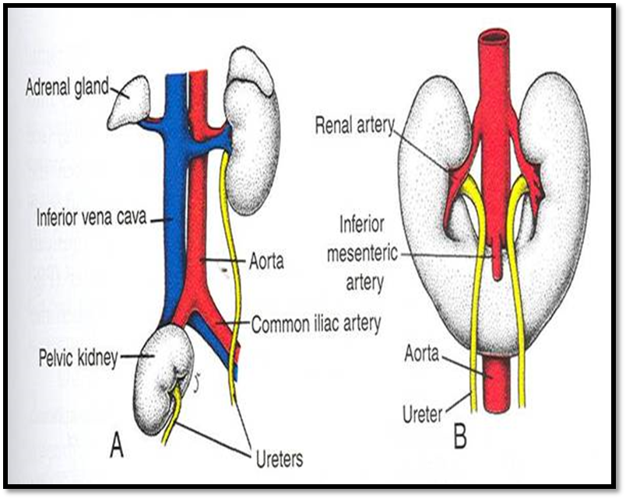
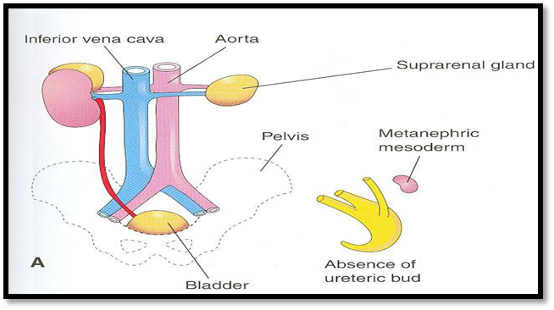
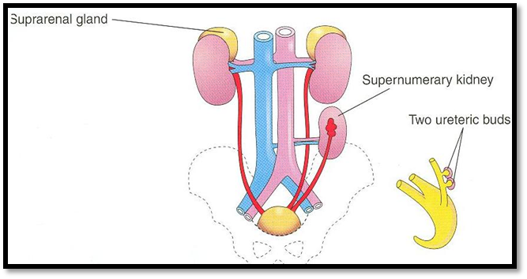
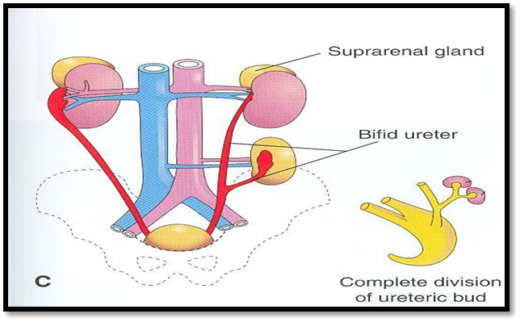
Congenital Anomalies
A- Pelvic kidney: failure of ascent of one kidney (ureter is short)
الكدني هتكون في البيلفك وهي المفروض تكون في الابدومن وبالتالي اليوريتر يكون قصير)).
B-Horseshoe kidneyعلى شكل حذوة الحصان ):)(very common): the poles of both kidneys (usually the lower poles) fuse: the kidneys have a lower position than normal but have normal function.
ايش خطورته ؟!
The fusion will cause compression of inferior mesenteric artery which originate from abdominal aorta , and supplies large intestine(transverse colon,left desceniging colon and rectum ) so all these areas will be affected.
A- Unilateral renal agenesis: due to absence of one ureteric bud.
There will be one kidney.
(جهة هيكون فيها يوريترك بد وتكونت من خلالها الكدني وحدة و وجهة الأخرى مافيها يوريترك بد بالتالي ما هيكون عندي كدني ).
B- Supernumerary kidney: due to development of 2 ureteric buds(in one side).
خاص فيهاureterهيكون عندي اكثر من يوريترك بد في جهة وحدة بالتالي اكثر من كدني هتتكون كل وحدة عندها
C- Right side: malrotation of kidney .(No rotation )
Left side: bifid ureter (one ureter will divide to two) and supernumerary kidney.
So there will be two kidneys with one ureter.
جهة اليمين helium of kidney will be in lateral side
جهة اليسار هيكون فيه اكثر من كدني مشتركة في one ureter
B
Picture ( c) : has 2 anomalies

Slide 11
Summary
Date | Event
Beginning of 4th week | Pronephric system appears
End of 4th week | Mesonephric system appears
At 5th week | Metanephric system appears(in pelvis)
9th week (very very important)☺ | Metanephric system starts working
 | Glomerular filtration starts
 | The kidney reaches its adult position and receives new blood supply(abdominal aorta)
 | Hilum rotates medially
End of fetal period | Disappearance of lobulation
At birth | Nephron formation is complete
Congenital anomalies
Pelvic kidney | Failure of ascent of one kidney(short ureter)
Horseshoe kidney | Fusion of kidney lobe (normal function)
Unilateral renal genesis | Absence of one ureteric bud
Suprenumerary kidney | Development of 2 ureteric buds(in one side)
Malrotation of kidney | Ventral hilum (facing front)
Bifid ureter and supernumaray kidney | The ureter itself splits into two ureters

Slide 12
Questions
1-Which one of the following systems forms ureteric buds:
a- Mesonephric system b-metanephric system c-pronephric system d-nephrogenic cord.
2-what is the cause of enlargment of kidneys after birth:
a-increased number of nephrons b-increased blood supply c-elongation of tubules d- disapearance of lobes.
3- Ureteric bud gives which part of the kidney:
a-collecting part b-excretory part .
4-nephron formation is complete at:
a-4thweek b-5thweek c-9thweek d-at birth.
5-glomerular filtration starts at:
a-4thweek b-5thweek c-9thweek d-at birth.
6-the kidneys change it’s arterial supply to renal branch of aorta from:
a-superior mesenteric arteries b- suprarenal arteries c-common iliac arteries d-splenic artery.
1-a
2-c
3-a
4-d
5-c
6-c

Slide 13
ANY SUGGESTION OR ISSUE
USEFUL VIDEOS
https://youtu.be/yigznAyhnGo?t=19
https://www.youtube.com/watch?v=W76SYjJDHwA
Embryology
436
@Embryology436
Editing file
Embryology436@gmail.com

Slide 14
TEAM MEMBERS
TEAM LEADERS :
B O Y S :
SAAD ALRUSHOUD
Abdulrahman Alharbi
Abdulrahman Alrasheed
Rayan Alqarni
Abdulkarim Alharbi
NEHAL BEYARI
G I R L S :
Razan Alotaibi
Thikrayat Omar
Do’aa Walid
Ohood Abdullah
Nouf Aloqili
EDITING By:
MUHANNED ALZAHRANI

