Slide 1
Development of The Urinary Bladder And Urethra
﴿ إِنَّا خَلَقْنَا الإنسان مِنْ نُطْفَةٍ أَمْشَاجٍ نَبْتَلِيهِ فَجَعَلْنَاهُ سَمِيعًا بَصِيرًا ﴾ [الإنسان: 2].
Embryology
436
Important
Dr. notes Explanation
M E D I C I N E
KING SAUD UNIVERSITY
- We recommend you to study anatomy of the Bladder and urethra .

Slide 2
O B J E C T I V E
Describe the cloaca and the formation of the urogenital sinus.
Discuss the division of the urogenital sinus into various pats and name the adult organs that are derived from each part.
Describe how the caudal parts of the mesonephric ducts are absorbed into the urogenital sinus and the significance of this embryonic events.
Discuss the position of the urachus and its significance and fate.
Describe the various anomalies concerned with the urinary bladder and urethra.

Slide 3
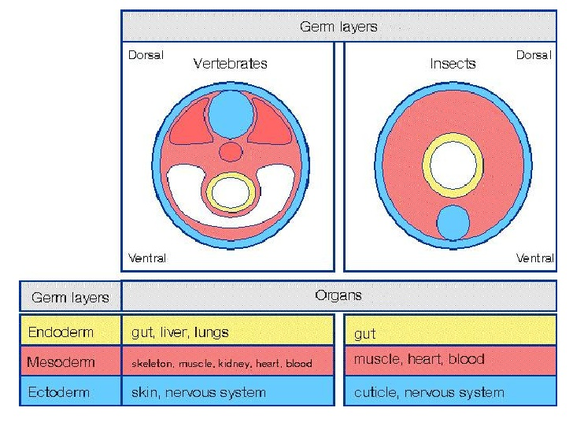
Introduction
.
* Just More explanation for the whole idea:
First the embryo was 2 layers (endoderm , ectoderm), later it become 3 layers (endoderm , mesoderm , ectoderm). These layers folded together in growth space, than it give:( head fold , tall fold, two lateral fold.)
The Tall fold gives the “hind gut”
The last part of “hind gut” dilated and it’s call Cloaca
Than the Cloaca divided by sptum into ventral part and dorsal part.

Slide 4
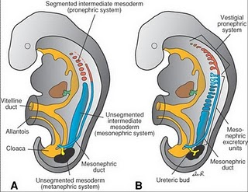
Cloaca
- It is the dilated terminal part of the hind gut.
It receives 1- the allantois and 2- the mesonephric ducts.
Its floor is closed by the cloacal membrane.
- A mesodermal urorectal septum divides the cloaca and cloacal membrane into: (2parts)
1- Ventral part: (from its name it will give part to urinary system and part to GIT)(this part that we need to know it in this lecture ): the primitive urogenital sinus that communicates with the allantois”anterior” and the mesonephric ducts”two lateral”.
Its floor is the urogenital membrane.
2- Dorsal):at the end of GIT and will give “rectum”.في هذه المحاضرة ما يهمنا هذا الجزء ): the anorectal canal that forms the rectum and upper part of anal canal.
Its floor is the anal membrane.
*the two parts(ventral and dorsal) will be separated completely from each other by the mesodermal urorectal septum. بعد ما انفصلوا تماما كل واحد يصير له ممبرين خاص فيه))
Cloacal Membrane

Slide 5
Primitive Urogenital Sinus
- this slide is very important ☺
- Primitive urogenital sinus: (Its divided into three parts):
1- A cranial (vesical*) part: forms most of the bladder (except the posterior surface or the trigone in both genders) and continuous with the allantois.
2- A middle (pelvic) part: forms main part of male urethra (there is a small part in the end of the penis is ectodermal in origin like the skin) and entire female urethra(forms all female urethra).
3- A caudal (phallic**) part: grows towards genital tubercle(shares in formation of male urethra).
*relating to the urinary bladder
**relating to penis

Slide 6
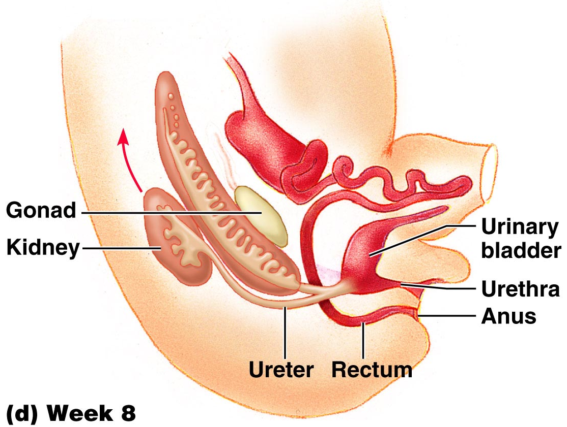
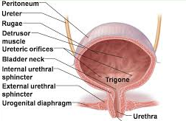
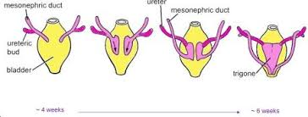
Urinary Bladder
Bladder develops mainly from the vesical part (see the previous slide) of the urogenital sinus.
The trigone is derived from the absorbed caudal ends (distal parts)of the mesonephric ducts. the end part of both 2 mesonephric ducts will be absorbed by urogenital sinus (يندمجوا مع بعض ).
The epithelium of bladder is endodermal in origin. (the most inner layer originate from endoderm)
The other layers of bladder are derived from the splanchinic mesoderm.
The allantois is at first : 1- continues with the bladder, 2- then it becomes a thick fibrous cord urachus (الحبل السري) which extends from the apex (from proximal part of urachus) of the bladder to the umbilicus. (Allantois connect apex with umbilicusاختصار: )
At birth,it is represented by the median umbilical ligament (from distal part of urachus).
-(عند الولادة الديستال بارت اوف يوريكس يتحول الىmedian umbilical ligament )
After absorption of the mesonephric ducts to form the trigone, the ureters open separately in the bladder.
الالانتويس انبوب سميك يربط السرة بقمة المثانة،. في مرحلة معينة حيكون الحبل السري و بعد الولادة لما ينقطع حيبقى من جوا ما يُسمى median umbilical ligament.
Trigone “ extra picture”
In infants and children, the bladder is an abdominal organ, then it starts to enter the greater pelvis or false pelvis ( between the 2 iliac bones) at about 6 years and becomes a pelvic (true pelvis) organ until after puberty at age 14 to 15.
So the urinary bladder mainly developed from 1- the vesical part of urogenital sinus and 2-absorbed part of mesonephric duct

Slide 7
Urethra
Indifferent stages: (the urethra in this stage is the same for both genders) في هذه المرحلة مانقدر نميز جنس الجنين)).
The genital tubercle (mesenchymal elevation) develops at the cranial end of the cloacal membrane.
هنا للحين اسمها كولوكال ممبرين عشان ما صار عندي انفصال تام) )
Two urethral folds, develop on either side of the urogenital membrane.
عند الانفصال يتكون عندي يوروجينال ممبريين) )
Laterally two labioscortal folds develop on either sides of the urethral folds.
2 urethral folds in male fuse with each other to close the penile urethra.
2 urethral folds in female remain separate to form labia minora.
(After separation)
(Labioscrotal folds)
Urogenital membrane
Extra: هذا النتوء من الامام مقسوم نصين طولية زي الصورة الثانية ، في البداية كان اسمه كولكال ممبرين بعد الانفصال الجزء العلوي حيصير يوروجينتال فولد على الاطراف و يوروجينتال ممبرين في المنتصف، في الانثى راح يضل الفولد زي ما هو و يكون الشفرين الصغيرين بينما في الذكر حيتحدوا الفولدين مع بعض و يكونوا الاحليل اللي راح يمتد على طول القضيب.

Slide 8
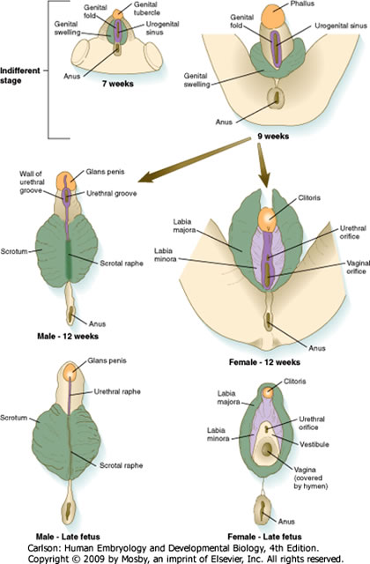
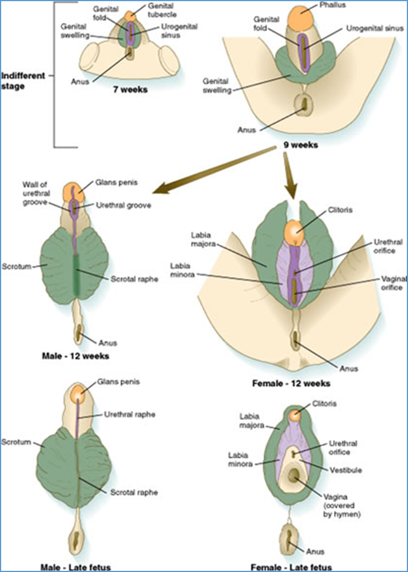
Female Urethra
-The entire female urethra is derived from endoderm of the pelvic (middle) part of the urogenital sinus.
- The external urethral orifice opens dorsal to the glans clitoris.
The genital tubercle will form female clitoris which is ventricle in position to the external urethral orifice.
بالعربي: فتحة الاحليل الخارجية تكون خلف الكلايتوريس يعني دورسال لها
Male Urethra
- The genital tubercle elongates forming the phallus, which the precursor of the penis. Remember it forms the female clitoris.
- Most of the male urethra (prostatic, membranous and spongy part) are derived from endoderm of the pelvic (middle) part of the urogenital sinus.
- The distal part of male penile urethra in glans penis starts as ectodermal solid cord that grows towards the root of penis to meet the spongy urethra, later it canalizes.
- So the terminal part of male ureathra is ectoderm, while the rest of it are endoderm from pelvic and phallic part of urogenital sinus.

Slide 9
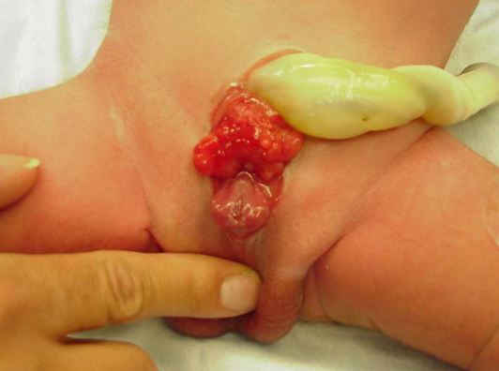
Anomalies
- There are 3 anomalies : (1- extrophy of bladder 2- urachal anomalies 3- Urethral anomalies ). And they are in male only.
- This slide is very important ☺
Extrophy of the bladder (ectopia vesicae):
It is an abnormal exposure of the posterior wall of the bladder (trigone or base of bladder) due to a defect in the anterior abdominal wall and anterior wall of the bladder. very rare
يعني اقدر اشوف بعيني البوستيريور وول لانه ماتكونت عن الانتيريور وول للبلادر او للابدومن))
Urachal (remember! it is the cord extends from the urinary bladder to the umbilical and eventually form the medial umbilical ligament) anomalies:
A. Urachal fistula(no fibrosis): the entire urachus remains patent and allows urine to escape from the umbilicus. Open way between the urinary bladder and the umbilical which is supposed to be closed ( after fibrosis ). يتبولوا من سرتهمم
B. Urachal sinus(fibrosis just in terminal part): discharge serous fluid from the umbilicus. فقط إفرازات بسيطة تخرج من السرة
C. Urachal cyst (fibrosis just in the cranial and caudal part): persistence or remnant of epithelial lining of urachus. (Contain serous fluid in side cyst ).
Video for extra explanation

Slide 10
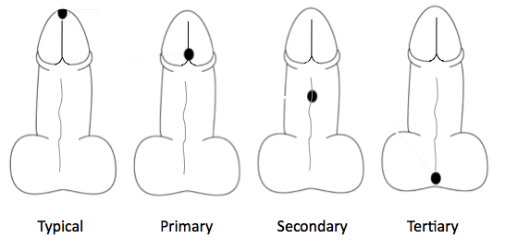
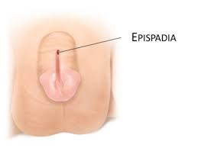
Cont.. Anomalies
- This slide is very important ☺
External urethral orifice
3- Urethral anomalies:
A. Hypospadius: it’s the most common anomaly, with incomplete fusion of the urethral folds the complete fusion described in slide 7! , and abnormal opening of the urethra يعني جزء ما انقفل occur along the ventral (inferior) aspect of the penis.
B. Epispadius: is a rare anomaly , in which the urethral meatus is found in the dorsal superior surface of penis, it is most often associated with extrophy of the bladder.
يعني عادة ماتصير لحالها يكون معها اول انوملي تكلمنا عنها
In normal male the penile urethra must open in the external urethral orifice.
Penile urethra
- See You Our Doctors Next Year ♥..

Slide 11
SUMMARY
Urinary Bladder
In infants and children the bladder is an abdominal organ. It starts to enter the greater pelvis at about 6 years and become a pelvic organ until after puberty
Primitive urogenital sinus divided into three part:
3- caudal (phallic part) | 2- middle (pelvic part) | 1- cranial (vesical part)
grows towards genital tubercle. | forms main part of male urethra and entire female urethra | forms most of the bladder and continuous with the allantois
Anomalies
3- Urethral Anomalies: |  | 2- Urachal anomalies: |  |  | 1- Exstrophy of the bladder (Ectopiae vesica)
2- Epispadius *rare* | 1- Hypospadius *common* | 3- Urachal fistula | 2- Urachal sinus | 1- Urachal cyst | (exposure of the posterior wall of the bladder due to a defect in the anterior abdominal wall and anterior wall of the bladder)
(associated with exstrophy of the bladder ) | (incomplete fusion of urethra) | ( entire urachus remains patent with urine escape from umbilicus). (discharging | (discharging serous fluid from the umbilicus) | (remnant of epithelium)

Slide 12
MCQ’s
1- The cloaca is the dilated terminal part of the hind gut, however witch of the following ducts does It receives.
A- Allantois duct. B- mesonephric duct. C- Both of them D- None of them
2- The Primitive urogenital sinus is divided into three parts, witch of the following is the correct order for them from up down.
A- vesical part, phallic part, pelvic part. B- vesical part, pelvic part , phallic part.
C- pelvic part, vesical part, phallic part. D- phallic part, vesical part, pelvic part.
3- Witch of the following forms most of the bladder and continuous with the allantois.
A- The vesical part of the primitive urogenital sinus. B- The pelvic part of the primitive urogenital sinus.
C- The phallic part of the primitive urogenital sinus. D- None of them
4- Witch of the following forms the female urethra?
A- The vesical part of the primitive urogenital sinus. B- The pelvic part of the primitive urogenital sinus.
C- The phallic part of the primitive urogenital sinus. D- None of them .
5- A mother of 7 weeks old child came to the pediatric clinic complaining of discharge
serous fluid from the baby belly button, witch of the following is most likely be the cause.
A- Urachal cyst B- Urachal sinus C- Urachal fistula D- Epispadius
6- Hypospadius.Witch of the following best describe:
A- incomplete fusion ofthe urethral folds, and abnormal openings of the
urethra occur along the ventral (inferior) aspect of the penis.
B- is a rare abnormality, in which the urethral meatus is found on
the dorsum of penis, it is most often associated with exstrophy of the bladder.
C- the entire urachus remains patent and allows urine to escape from the umbilicus.
1-C
2-B
3-A
4-B
5-B
6-A

Slide 13
ANY SUGGESTION OR ISSUE
USEFUL VIDEOS
https://youtu.be/v3Tv86bITZ4?t=249
Embryology
@Embryology436
436
Editing file
Embryology436@gmail.com

Slide 14
TEAM MEMBERS
TEAM LEADERS :
B O Y S :
SAAD ALRUSHOUD
Abdulrahman Alharbi
Abdulrahman Alrasheed
Rayan Alqarni
Abdulkarim Alharbi
NEHAL BEYARI
G I R L S :
Razan Alotaibi
Thikrayat Omar
Do’aa Walid
Ohood Abdullah
Nouf Aloqili
- Special Thanks To Team 435 ♥
EDITING By:
MUHANNED ALZAHRANI

