Slide 1
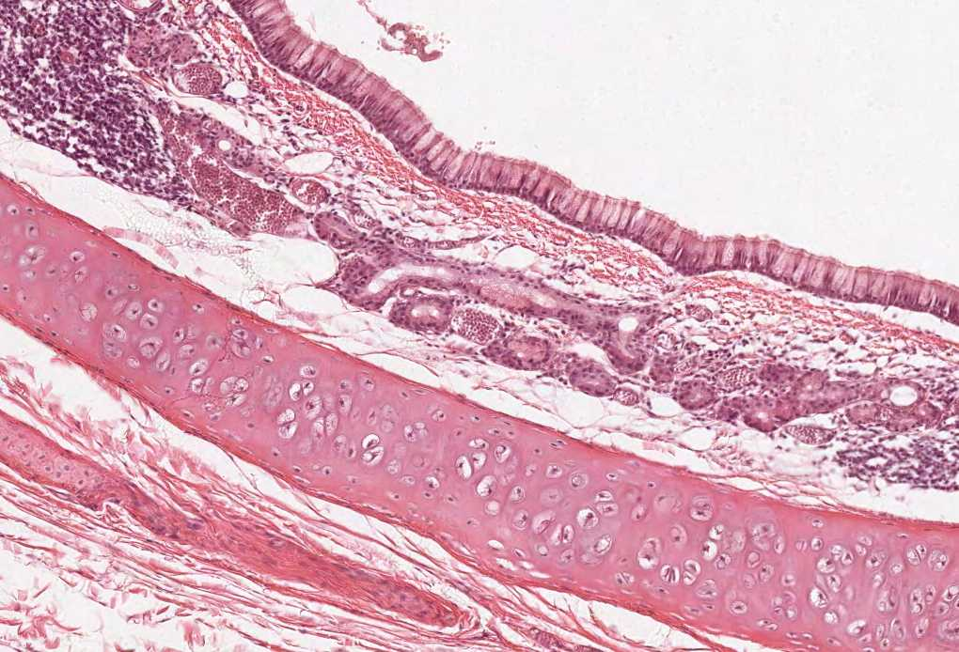



HISTOLOGY OF THE
KIDNEY AND
URINARY PASSAGE
(Lectures 1 & 2)
Color index:
Slides.. Important ..Notes ..Extra..

Slide 2
Objectives:
By the end of this lecture, the student should be able to describe:
The microscopic structure of the renal cortex and medulla.
The histology of renal corpuscle, proximal and distal tubules, loop of Henle, and collecting tubules & ducts.
The histological structure of juxtaglomerular apparatus.
The functional structures of the different parts of the kidney.
The microscopic structure of the Renal pelvis and ureter.
The microscopic structure of the urinary bladder and male and female urethra

Slide 3

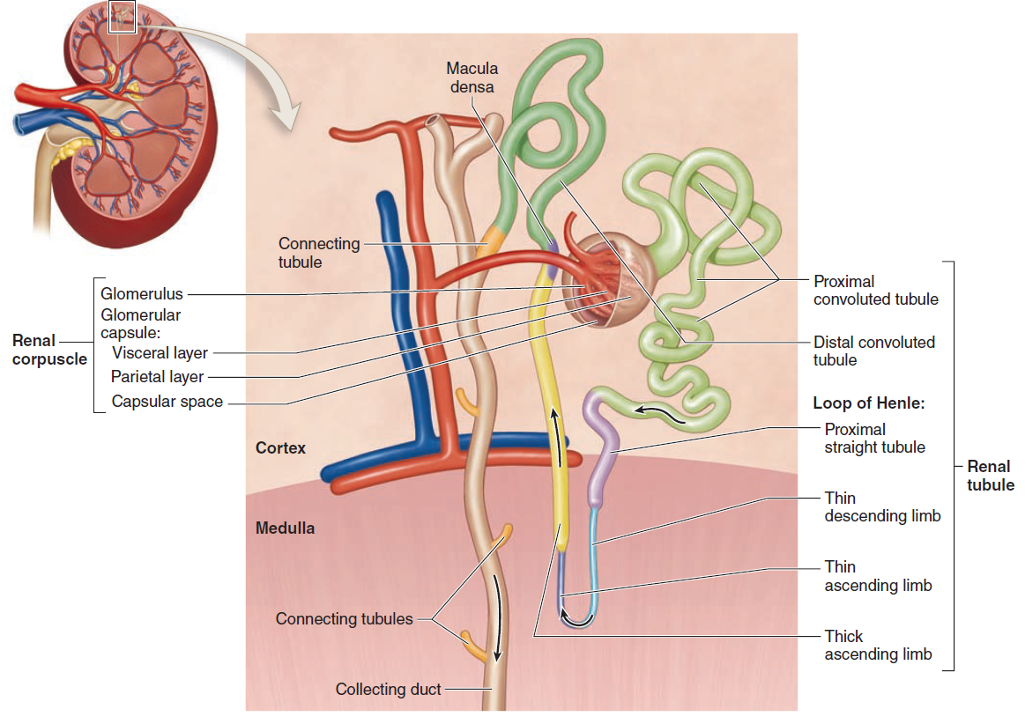
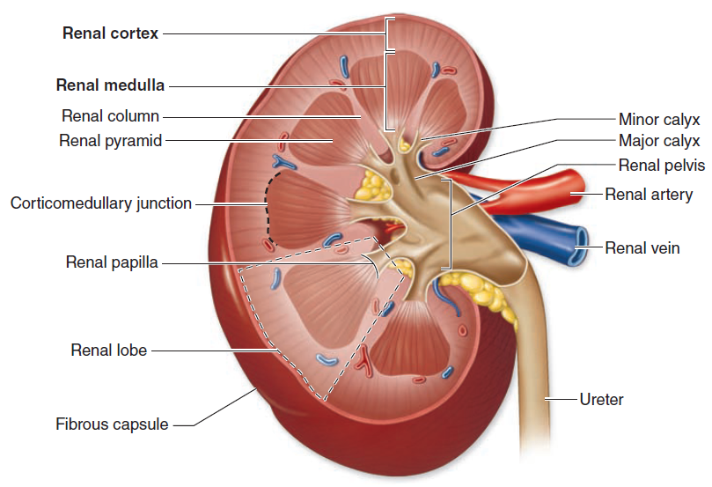
KIDENY
Kidney
Cortex
Medulla
‘’formed of 6-12 renal pyramids’’
it’s the functional unit of the kidney
There are two typres of nephrons:
cortical
juxtamedullary
Uriniferous tubule
Nephron
Collecting tubule
Renal corpuscle
Proximal tubule
Thin limps of Henle’s loop
Distal tubule
The tubules are densely packed.
The tubules are separated by
thin stroma and basal lamina.
Dark brown and granular.
The base of pyramid is toward the cortex
(cortico-medullary border)
The apex (renal papilla) toward the hilum, it is perforated by 12 openings of the ducts of Bellini in region called area cribrosa .
The apex is surrounded by a minor calyx.
3 or 4 minor calyces join to form 3 or 4 major calyces that form renal pelvis.
Pyramids are separated by cortical columns of Bertin.

Slide 4
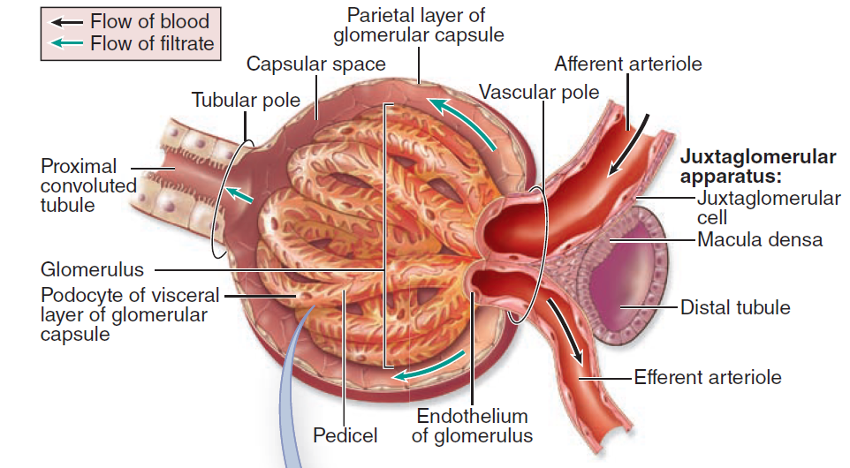
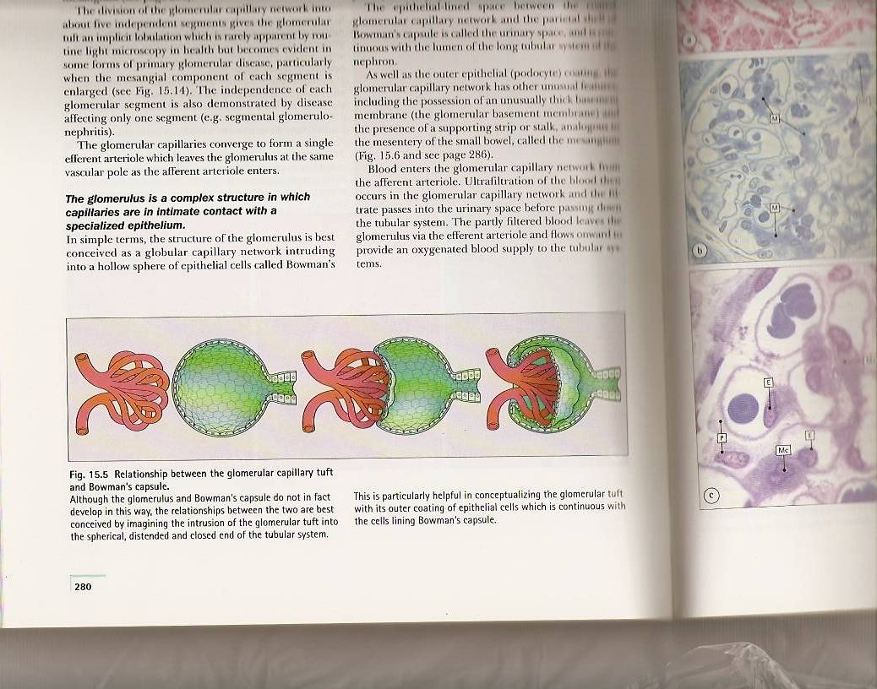

Renal Corpuscle
Renal Corpuscle
Contains:
Glomerulus : tuft (collection) of fenestrated capillaries "without diaphragm”. Partially covered by visceral layer of Bowman’s capsule.
Bowman’s capsule : (Parietal layer, urinary space ,and visceral layer or podocytes). Visceral layer: near to glomerulus and cover some parts of it. Parietal layer: layer which is far from glomerulus.
Mesangial cells : (intra-glomerular cells). Mesangial cells with its matrix called mesangium which support the glomerulus

Slide 5
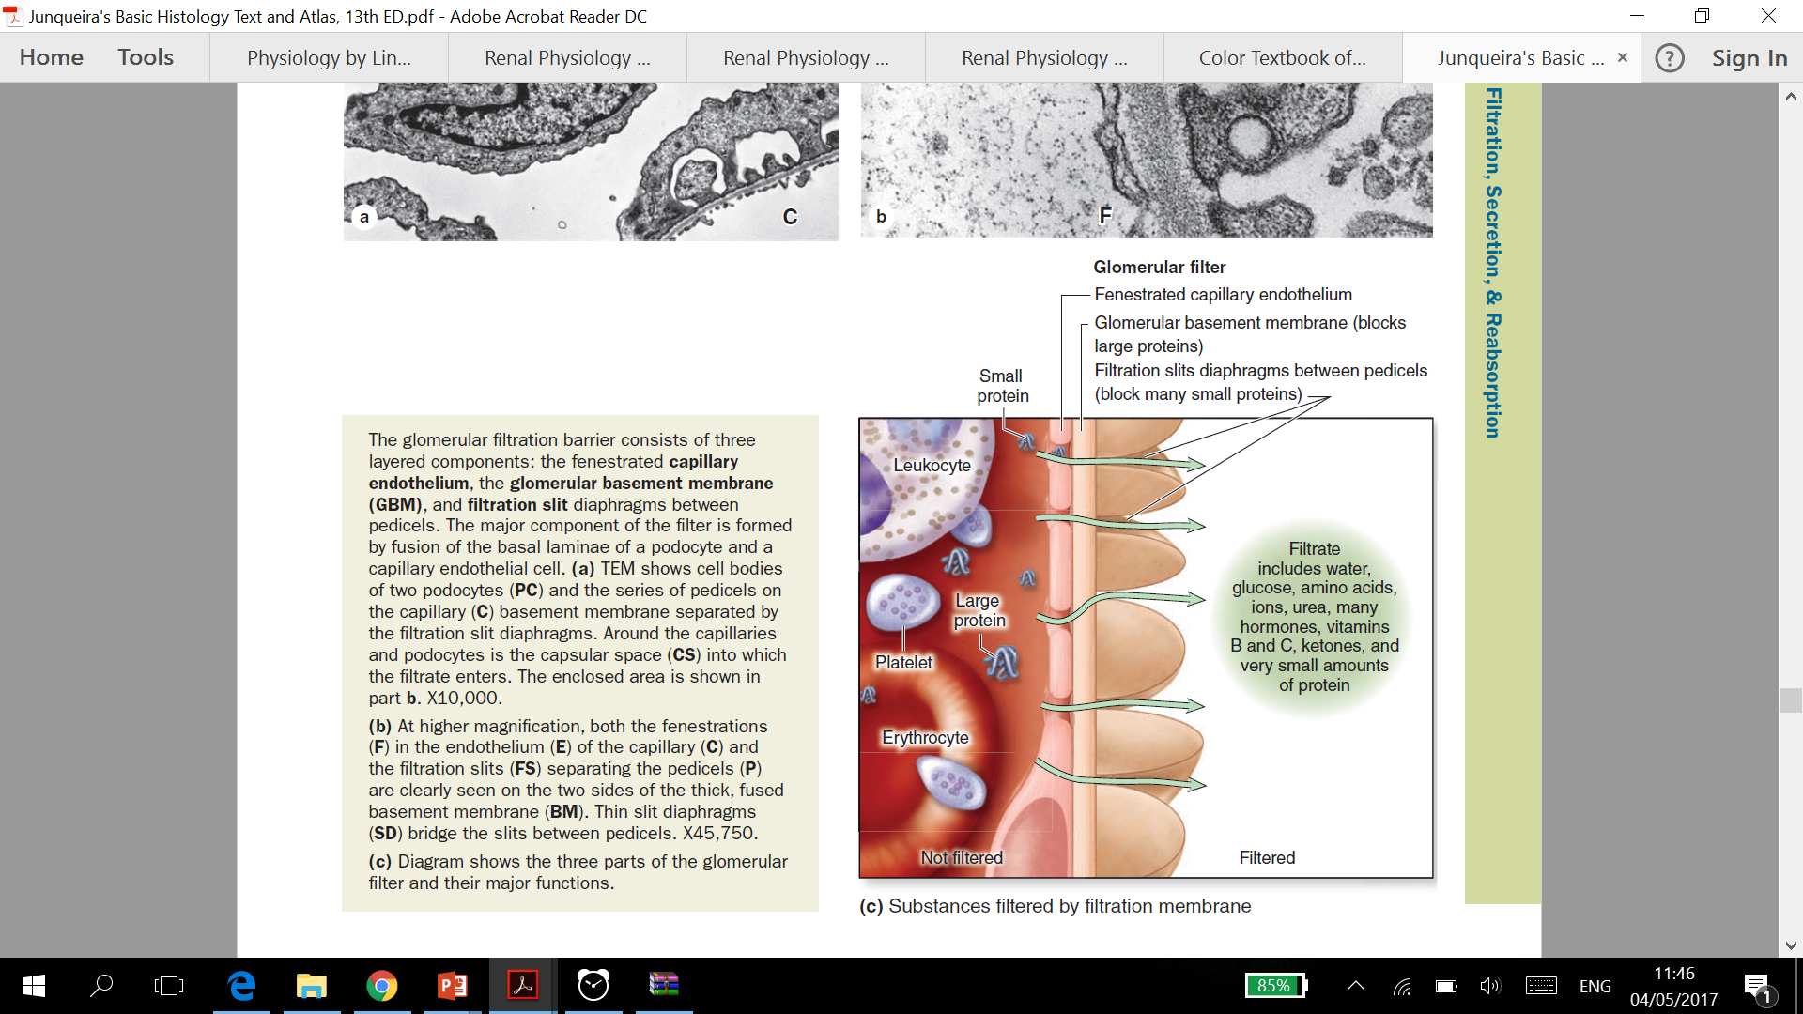
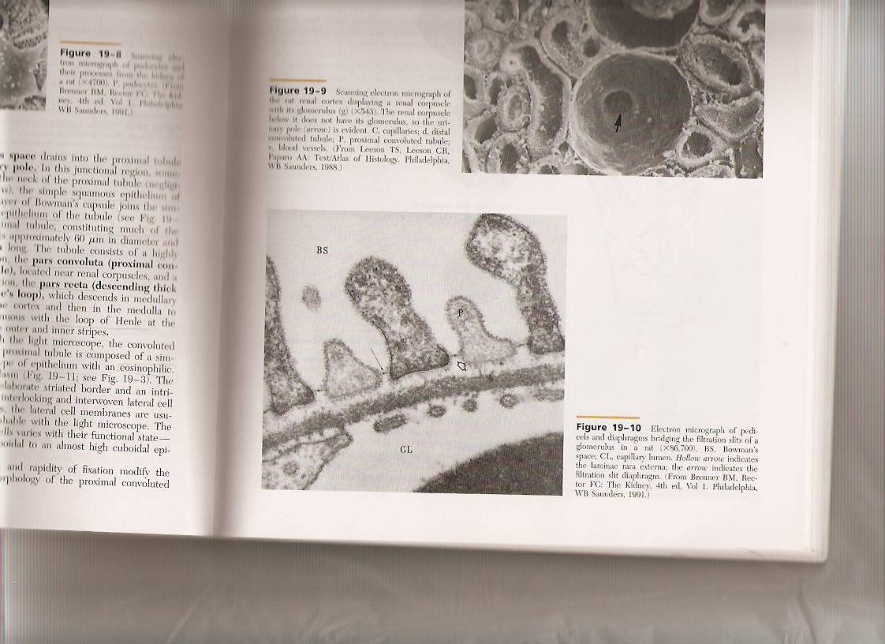
Glomerular Filtration Barrier
Glomerular Filtration Barrier
Composed of: | More Information:
1- Endothelial wall of the glomerular capillaries. | Also called glomerular endothelium.
2- The glomerular basal lamina (inner and outer laminae rarae and middle lamina densa). | Mainly composed of podocytes and partially composed of Glomerular Endothelium.
3- Visceral layer of Bowman’s capsule (podocytes). | Glomerular Epithelium. Podocytes have primary (major) processes and secondary (minor) processes (pedicles). Between pedicles (on the surface of capillaries) there are filtration slits that have filtration slit diaphragms.
podocytes
filtration slits

Slide 6
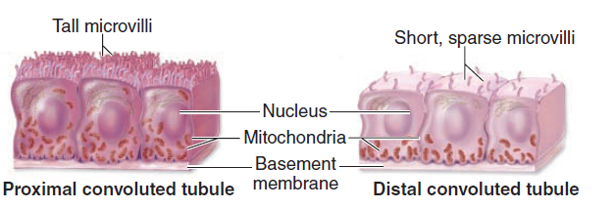
Renal Tubules
Proximal convoluted tubule
Thin limp of Henle’s loop
Distal Convoluted tubule
Composed of simple cuboidal epithelium
Acidophilic cytoplasm
Have brush borders
(microvilli) and
lateral interdigitations
Well-defined basal lamina
Composed of simple squamous epithelium
It has 3 regions:
Descending thin limp
Crest of Henle’s loop
Ascending thin limp
Formed of low cuboidal epithelium
Drains into the collecting tubules
Starts at the macula densa
- Most of tubules are in the cortex
- Loop of henle and tubules extend to medulla
It’s longer in Juxta-medullary nephron than in cortical nephron
Because distal convoluted tubules are much shorter than proximal convoluted tubules, any section of renal cortex presents many more sections of proximal convoluted tubules.
Proximal convoluted tubules
It’s full with Microvilli because it is the place where most of the reabsorption process take place
Distal convoluted tubules
The macula densa is a group of tall columnar narrow cells in the juxtaglomerular apparatus –of the distal tubule- (close to the afferent arteriole)
- Proximal is the longest one that’s why its convoluted.
- Proximal is more than distal in the cortex.
Collecting duct
Loop of Henle’s

Slide 7
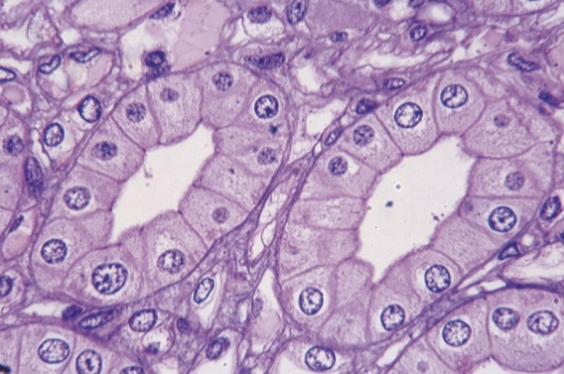
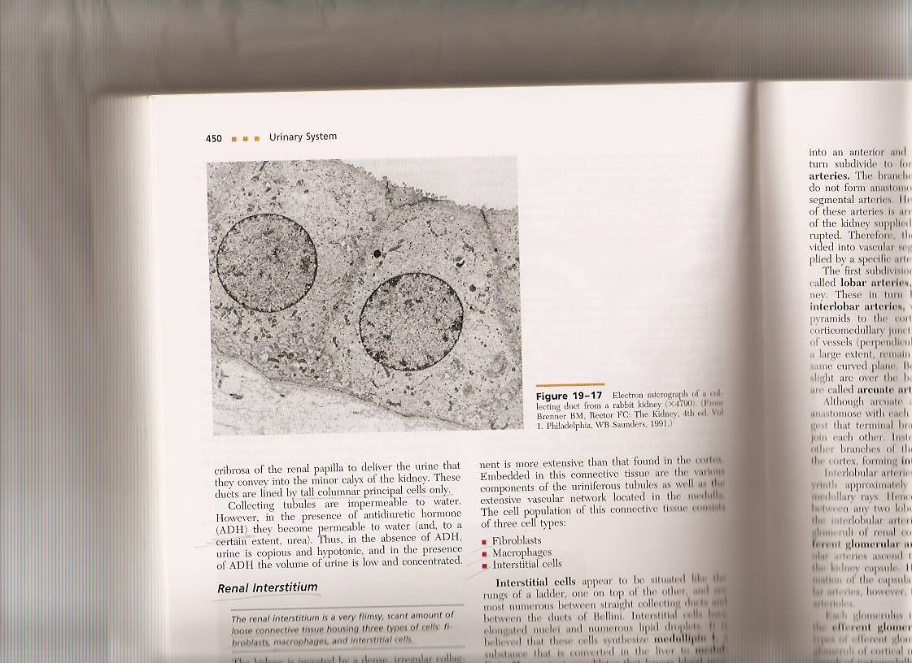
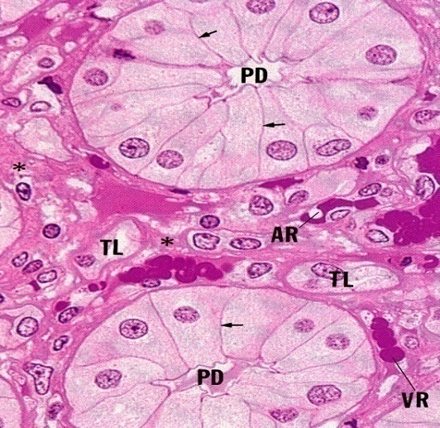
Collecting tubules
Renal interstitium
Are composed of Simple Cuboidal Epithelium.
The lateral border is well defined because there isn’t lateral interdigitation.
All parts of the collecting tubules ( Cortex & medulla) excepts the last part
(papillary ducts) are laying with simple cuboidal epithelium.
They have 3 regions:
Cortical: simple cuboidal epithelium
Medullary: simple cuboidal epithelium
Papillary ducts (ducts of Bellini):Simple Columnar Epith. (it must be lays with S. Columnar Epith because it’s the biggest part)
They aren’t part of nephron.
They open in area cribrosa. (لأنها مخرمه )
They are impermeable to water except in presence of ADH.
It is a very flimsy, scant amount of loose CT that contains:
1-Fibroblasts.
2-Macrophages.
3-Interstitial cells:
They secrete medullipin I, which is converted in the liver into medullipin II, that lowers blood pressure.

Slide 8
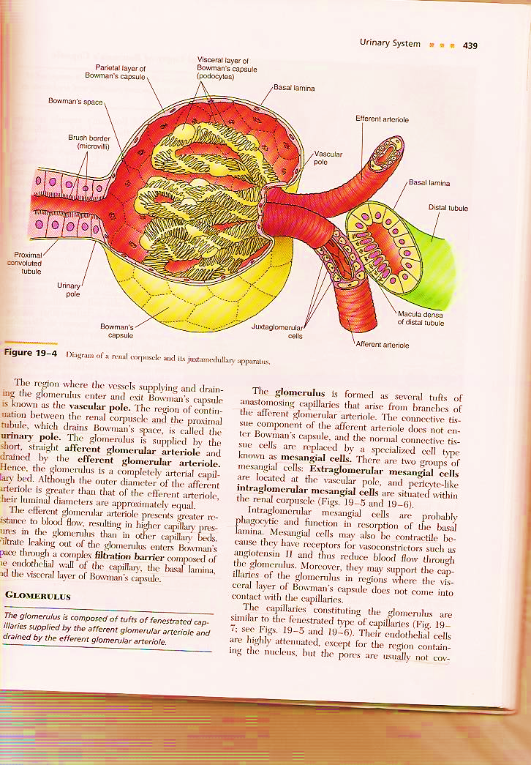
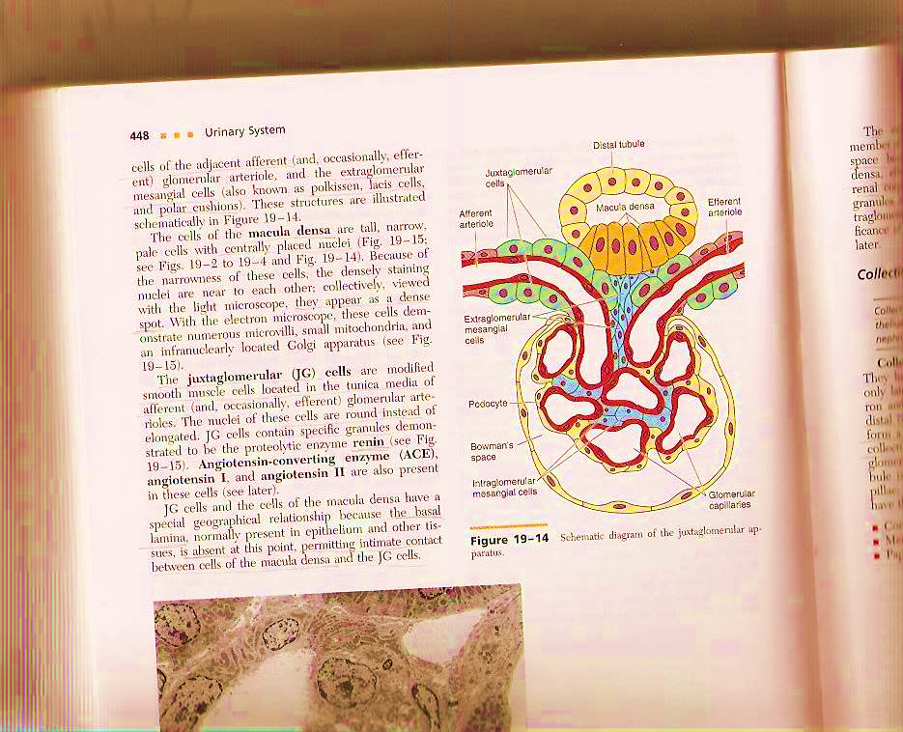
DR Raeesa’s Explanation:
The renal corpuscle has two poles
1- vascular pole
2- urinary pole for the passage of what will give me urine later.
The vascular pole is for the blood entry and excitation of arterioles:
(Afferent + Efferent)
The blood enters the afferent arteriole and goes out when its filtered through efferent arteriole.
In the space between the two arterioles there is distal tubule, part of it is adherent to the arterioles.
So the triangle of Juxtaglomerular apparatus is formed of 3 things::
part of afferent, part of efferent, part of distal tubule and in between there is extra mesangial cells.
There are changes only in the cells of distal tubule adherent to the afferent arterioles:
The changes:
1- Columnar epithelium with oval nuclei
2- The number of cells increase
3- There is macula dense
There are changes in the arterioles in the part adherent to the distal tubule.
the changes:
1- Modification in the tunica media (smooth muscle), so instead of spindle shaped cell it will be cuboidal cell. After modification it called Juxtaglomerular cells which is responsible for renin secretion.

Slide 9
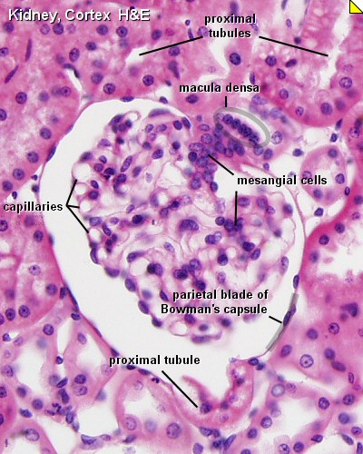
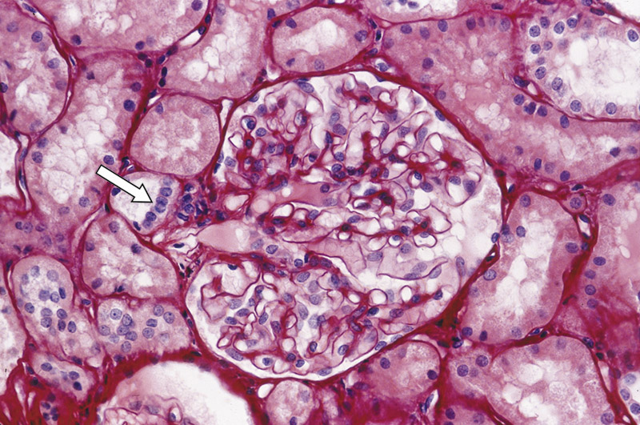
Juxtaglomerular Apparatus
It has 3 components:
A- The macula densa of distal tubule
Tall cells
B- Juxtaglomerular cells of afferent glomerular arteriole
modified smooth muscle of tunica media.
C- The extraglomerular mesangial cells
centrally-placed nuclei
They secrete renin.
Nuclei are round with granular cytoplasm.

Slide 10
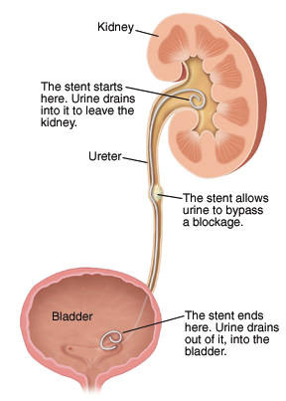
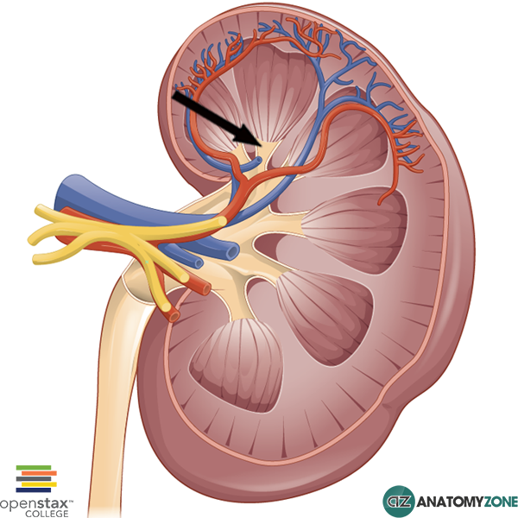
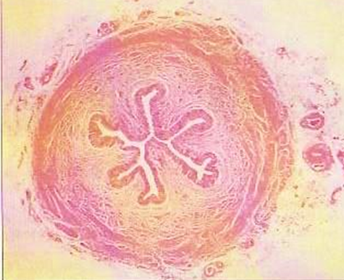
Renal Calyces
Ureter
Each papilla has minor Calyces in region called area cribrosa and the urine drop from here to major Calyces.
  Each calyx accepts urine from the renal papilla of a renal pyramid.
  They are lined with:
  1- Transitional epithelium
  2- Lamina propria
  3- Smooth muscle
  The urinary track stars from minor calyces
  Minor calyces merge to form major calyces (with same lining tissue as minor calyces).
  Major calyces open into the renal pelvis.
  Composed of three layers:
  1- Mucosa:
  Is formed of transitional epithelium
  and lamina propria.
  2- Muscularis (muscular coat):
  Is formed of 2 layers of smooth muscle in the upper 2/3:
  A- Inner longitudinal.
  B- Outer circular.
  2 layer like pelvis as it’s continuation of it.
  Is formed of 3 layers of smooth muscle in the lower 1/3:
  A- Inner longitudinal .
  B- Middle circular.
  C- Outer longitudinal.
  3 layer like urinary bladder as it’s continuation of it.
  3- Adventitia:
  Fibrous C.T. covering.
  N.B. No serosa because the ureter isn’t covered by peritoneum as we take in anatomy.

Slide 11
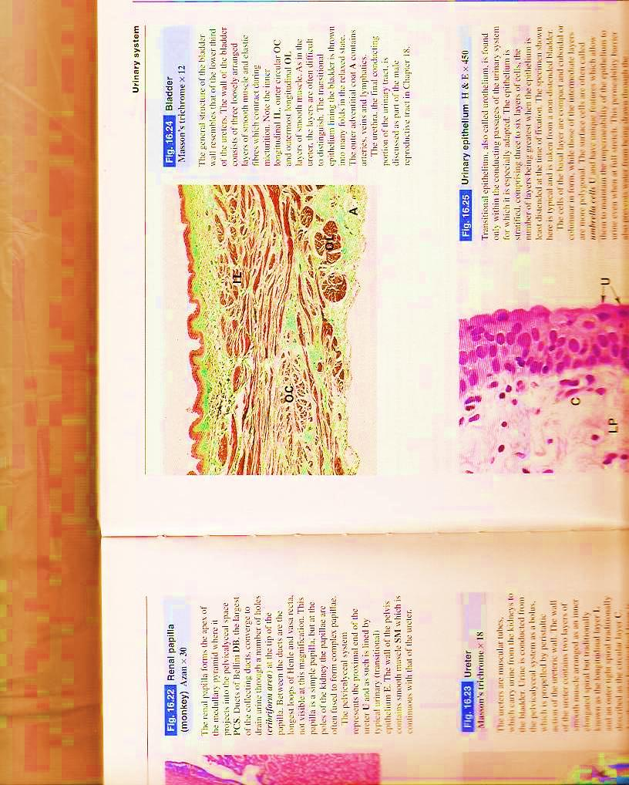
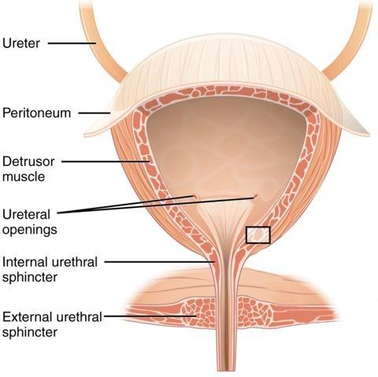
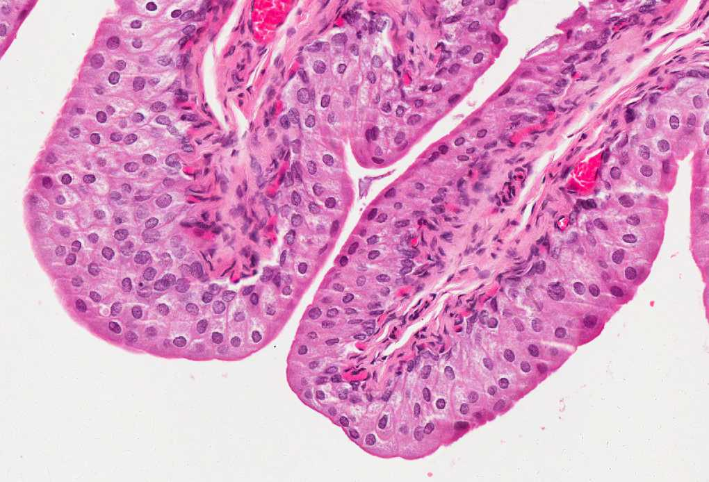
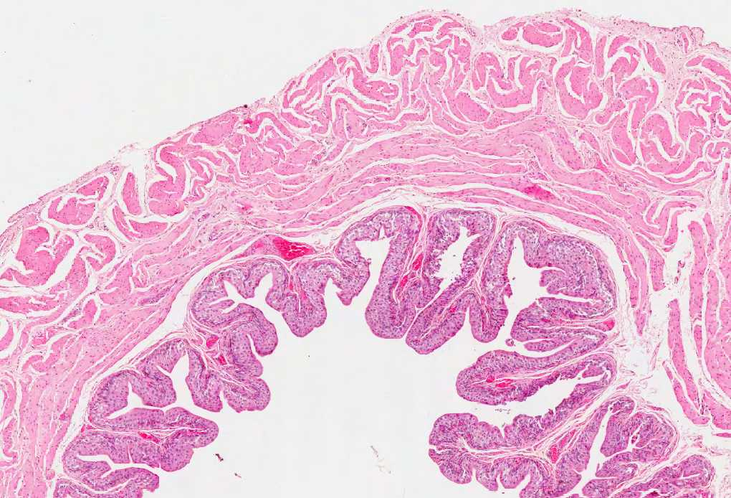
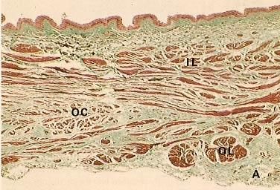
Urinary Bladder
It has the same structure as the lower third of ureter.
1- Mucosa:
Superficial layer of transitional epithelium has
dome-shaped cells (in empty bladder).
2- Muscularis (muscular coat):
It has 3 layers of smooth muscle:
inner and outer longitudinal (thin)
and middle circular (thick) layers.
3- Adventitia:
Its outer covering is adventitia or serosa.
It is similar the lower 1/3 of the ureter except that it has serosa

Slide 12
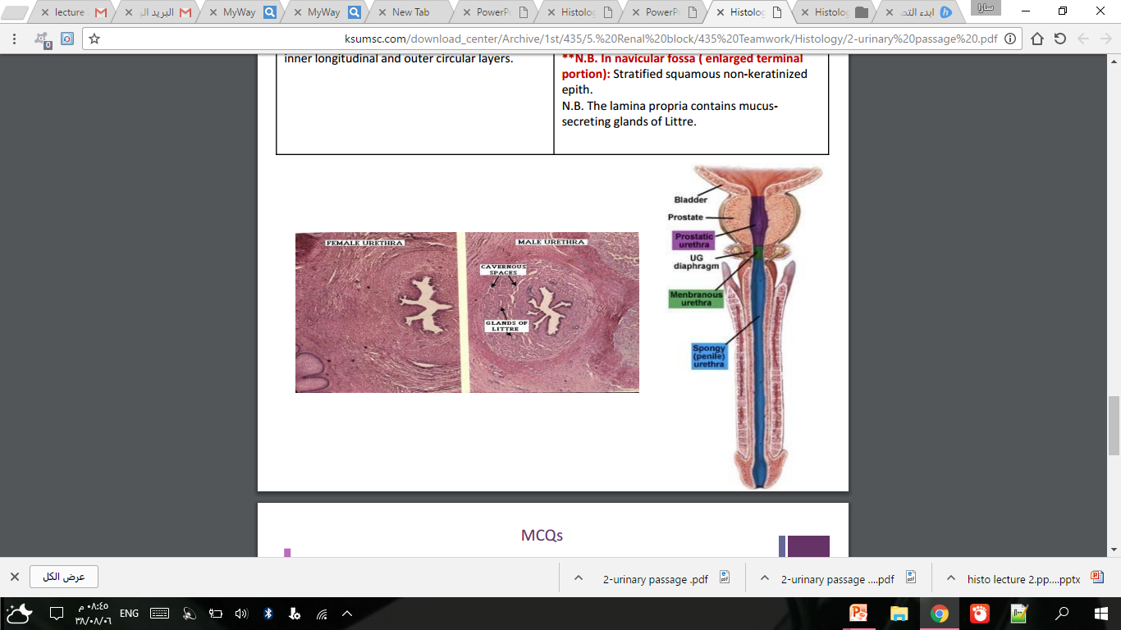
EXTRA pictures:
Male Urethra | Female Urethra
It is long and is divided into 3 regions: 1- Prostatic urethra: is lined with transitional epithelium. 2- Membranous urethra and 3- Penile (spongy) urethra (the longest part): are both lined with Stratified columnar epithelium With patches of pseudostratified columnar epithelium. N.B. In navicular fossa (enlarged terminal portion): Stratified squamous non-keratinized epithelium. N.B. The lamina propria contains mucus secreting glands of Littre. | Female urethra is short & lined by: A- Epithelium: 1- Transitional epithelium near the bladder. 2- Pseudostratified columnar epithelium. 3- Stratified squamous non-keratinized epith. Before the opining, But in the opining it will be keratinized like skin B- Sub-epithelial fibroelastic CT that contains glands of Littre (mucus-secreting glands). C- Smooth muscle: inner longitudinal and outer circular layers. Very thin and ill-defined يعني تناتيف وشيء بسيط مو طبقة محترمة زي اليوريتر
In both male and female there are glands of Littre in lamina propria
Its secretary gland that secret mucus to maintain the epithelium wet.

Slide 13
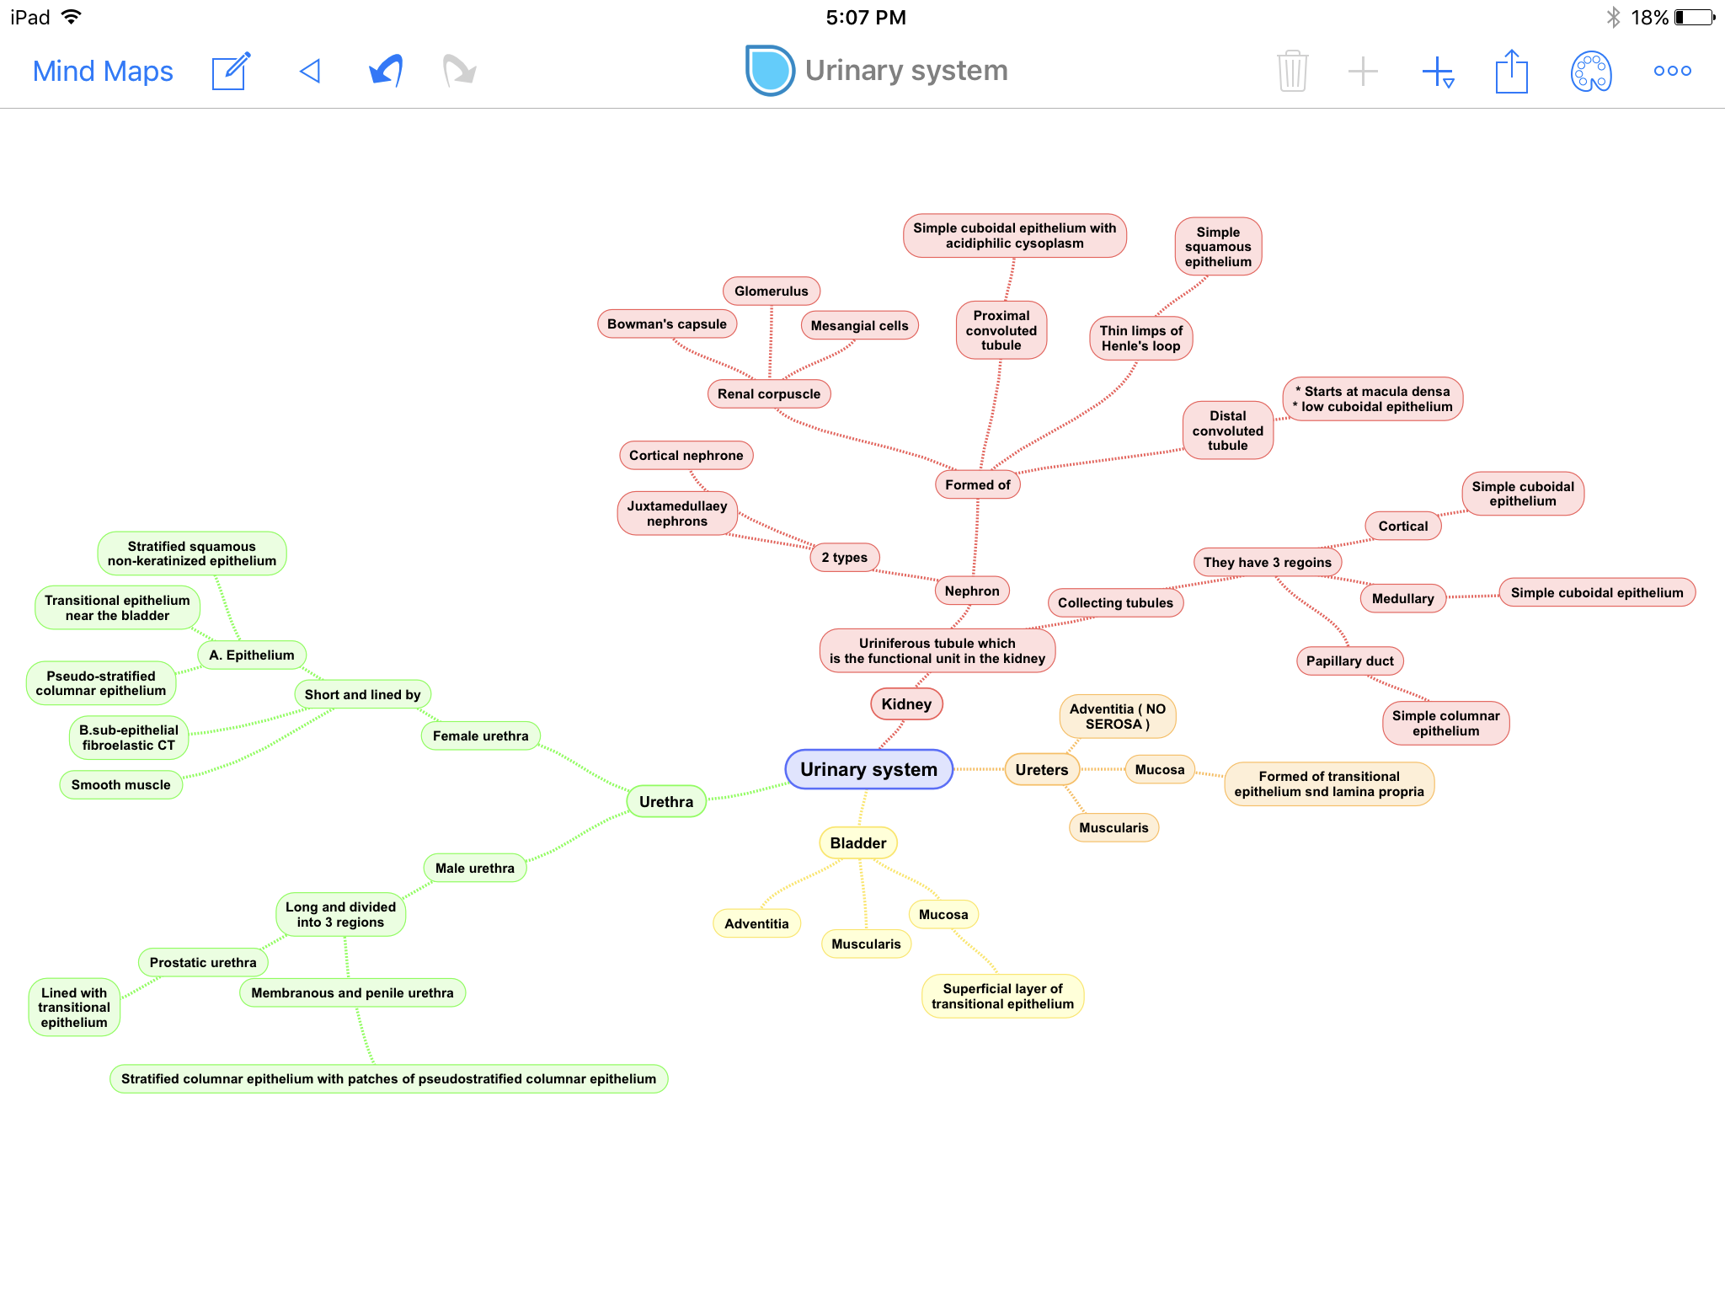

Slide 14

MCQ’s
Which of the following is a feature of urinary bladder?
The adventitia has no serosa
The adventitia has serosa
The structure is the same as upper third of ureter
The inner and outer longitudinal muscle layers are thick
Which part of the renal system secretes renin?
Juxtaglomerular cells of afferent glomerular arteriole
Juxtaglomerular cells of efferent glomerular arteriole
Mesangial cells
Macula densa
What is the correct passage of urine out of these sequences?
Renal pyramid > major calyces > minor calyces > renal pelvis
Major calyces > minor calyces > renal pyramid > renal pelvis
Renal pyramid > minor calyces > major calyces > renal pelvis
Renal pelvis > major calcxes > minor calyces > renal pyramid
What are the layers of muscles found in the ureter?
2 layers; Inner longitudinal and Outer circular.
3 layers; inner and outer longitudinal, middle circular
Both types, upper has 2 layers and lower has 3 layers
Ureter has no smooth muscles
5. What are the type of cells found in macula densa?
Simple squamous cells
Simple cuboidal cells
Tall columnar cells
Transitional epithelium
Which part of the male urethra has NO patches of pseudostratified columnar epithelium?
Membranous urethra
Penile urethra
Prostatic urethra
All of them have the patches
What is the main lining epithelium found in the urethra ?
Simple squamous cells
Simple cuboidal cells
Tall columnar cells
Transitional epithelium
1-B
2-A
3-C
4-C
5-C
6-C
7-D

Slide 15
MCQ’s
9. Which one of the following is a compartment of renal corpuscle?
A- Glomerulus B- Bowman’s capsule
C- Mesangial cells D- All the above
10. Which one is considered as a layer from glomerular filtration barrier?
A- Parietal layer of bowman’s capsule B- Mesangial cells
C- Podocytes D- Henle’s loop
11. If we take section of renal cortex which one will be most prominent?
A- Distal convoluted tubule B- Proximal convoluted tubule
C- nether A nor B D- Both A and B
12. which one of the following contain simple columnar epithelium?
A- Ducts of Bellini B- Cortical of collecting tubules
C- Proximal convoluted D- Medullary of collecting tubules
13. Thin limbs of Henle’s loop is longer in which of the following?
A- Cortical nephron B- juxta medullary nephron
C- Renal corpuscle D- All the above
9-D
10-C
11-B
12-A
13-B

Slide 16


Thank you & good luck
- Histology team
Done by:
We’am Babaier
Reema AlBarrak
Shahad Al Anzan
Amal AlQarni
Do’aa Walid
Ahmed Badahdah
Mutasem Alhasani
Omar Turkistani
Nawaf Aldarweesh
Mohammed Khojah
Team leaders:
Rana Barasain
Faisal Alrabaii
Please if you need anything or even further explanation contact us on:
HistologyTeam436@gmail.com
@histology436

