Slide 1
Lecture : pyelonephritis
important
Extra notes
Doctors notes
"لا حول ولا قوة إلا بالله العلي العظيم" وتقال هذه الجملة إذا داهم الإنسان أمر عظيم لا يستطيعه ، أو يصعب عليه القيام به .

Slide 2
Objectives:
Introduction
Epidemiology
Definition
Etiology
Pathogenesis
Pathology
Clinical presentations
Diagnosis
Treatment and prevention

Slide 3
Only in male’s slides
Introduction:
It is very serious condition that lead to renal scarring, nephric, perinephric abscess formation, sepsis
Clinical presentation is atypical in some patients
Update on the management
Pyelonephritis may be acute or chronic
UTI Terminology:
Uncomplicated: infection of urinary bladder in host w/out underlying renal or neurologic disease
Complicated: infection in setting of underlying structural, medical or neurologic disease
Recurrent: > 2 symptomatic UTIs within 12 months. following clinical resolution of each previous UTI after therapy
Reinfection: recurrent UTI caused by different pathogen at any time or original infecting strain >13 days after therapy of original UTI
Relapse: recurrent UTI caused by same species causing original UTI within 2 weeks after therapy

Slide 4
Definition:
It is a bacterial of the renal pelvis, tubules and interstitial tissue of one or both kidneys.
potentially organ- and/or life-threatening infection that characteristically causes some scarring of the kidney with each infection and may lead to significant damage to the kidney that may lead to hypertension (only in female’s slides)
Prevalence of bacteriuria in Different age Groups:
*Women are more prawn to develop bacteriuria due to some factors such as being pregnant, Postmenopausal or an Elderly
Renal pelvis: pyelitis.
Bladder: cystitis
Urethra: Urethritis.
Renal parenchyma: pyelonephritis.

Slide 5
Etiology:
Ascending bacterial infection | Hematogenous spread | Hospital-acquired infections
1- Escherichia Coli (most bacterial causes bowel organism eg Ecoli) accounts 70-90% of uncomplicated UTI and 21-54% of Complicated UTI. The uropathogenic E. coli (UPEC) derives from the phylogenetic groups B2 and D, which expresses H,O and K antigens. UPEC genes encode several postulated Virulence factors including adhesives P Fimbraie pap+genotype family , protectins , siderophores and toxins. | staph aureus (is rare Except in neonates) | coliforms
Enterobacter species | mycobacterial tuberculosis (can cause infection every where)
Klebsiella pneumoniae / Proteus mirabilis |  | enterococci
Staphylococcus saprophyticus (normal flora of vagina)
Pseudomonas aeruginosa (hospital acquired)
Other etiology | Candida (immunecompromised) | Brucella (can cause infection every where)
 | Viruses (Adenovirus) | Host factor

Slide 6
Risk Factors:
Mechanical: | Constitutional:
Structural abnormalities to the kidneys and the urinary tract such as : (urethral strictures)¹ vesicoureteral reflux (VUR) especially in young children urinary tract catheterization (Catheterized patients) nephrostomy² Pregnancy (half of asymptomatic will develop pyelonephritis if not treated) neurogenic bladder (e.g. due to spinal cord damage, spina bifida or multiple sclerosis) and Obstruction : prostate disease (e.g. benign prostatic hyperplasia) in eldery men bladder tumors calculi (stones) 1: narrowing of the urethra 2: artificial opening created between the kidney and the skin drains urine from your kidney into a collecting bag | diabetes mellitus (10 time more admission)
 | immunocompromised states
Pathology:
Frequently due to ureterovesical reflux
Kidneys enlarged.
Interstitial infiltration of inflammatory cells.
Abscesses on the capsule and at corticomedullary junction
Result in destruction of tubules and the glomeruli.
When chronic, kidneys become scarred, contracted and nonfunctioning.

Slide 7
Pathogenesis:
Only in male’s slides
Ascending bacterial infection.
Hematogenous spread to kidney is rare. Eg; Staph aureus and mycobacterial tuberculosis Exception: neonates with Staph aureus
For optimal host defense function, intermittent & complete emptying of bladder must occur.
Urine is excellent culture medium
Bactericidal secretion from uroepithelial cells and glycoproteins inhibit bacterial adherence
Renal parenchyma infections result in inflammatory response to contain infection but contributes to potential scarring.
Pathogenesis:
Only in female’s slides
Rectal and/or vaginal reservoirs
Colonization of perianal area
Bacterial migration to peri-vaginal area
Bacteria ascend through urethra to bladder
Intercourse may contribute urethral colonization and ascending infection
ASB [asymptomatic bacteriuria] in 1st trimester of pregnancy may cause pyelonephritis in 3rd trimester
Frequently due to ureterovesical reflux

Slide 8
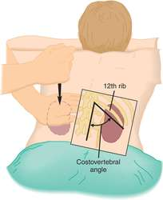
Symptoms and Signs
Acute Pyelonephritis
Chronic Pyelonephritis (causes renal failure)
Symptoms develop rapidly (<24 hours) and may include:
May be unilateral or bilateral.
Acutely ill
Renal angle tenderness
Flank pain or tenderness or both, fever>38 c and chill .
Lower urinary tract symptoms: (urgency,dysuria and frequency)
Azotemia can occur
non infectious causes of these symptoms is Renal infarct and caliculi
Confusion in elderly
Leukocytosis
Pyuria
Bacteriuria
Nausea and vomiting
Unremarkable symptoms:
Nausea and general malaise.
Systemic signs:
Elevated BP, vomiting, diarrhea.
Flank pain: pain in the costovertebral angle.

Slide 9
Differential Diagnosis:
Complications:
1/5 of the patients.
Acute pelvic inflammatory disease.
Ectopic pregnancy.
Diverticulitis.
Renal calculi.
Hypertension → septic shock → multi organs failure → death.
Renal or perinephric abscesses.
Metastatic infection.
Papillary necrosis.
Acute renal failure.
Emphysematous pyelonephritis.
Renal gangrene.
Localized or generalized atrophy/permanent loss of function
Diagnosis :
Only in females slides
Is not always straightforward
A number of studies using immunochemical markers have shown that many women, who initially present with lower tract symptoms, actually have pyelonephritis
The extremes of age, the presentation may be so atypicalin the very young (feeding difficulty or fever)
In the elderly presentation may be mental status change like confusion or fever

Slide 10
Diagnosis
Urine culture | In BAP (blood agar plate) and selective media | Identify the organism | Assess sensitivity and Find the best antimicrobial therapy
Confirmed by : | Bacteria (10⁸/l or 10⁵/ml) in number | Pus > or = 10/HPF (90%), Positive nitrate dipstick test result for | RBCs 20-40% in urine and leukocytosis | Leukocyte esterase (An enzyme produced by leukocytes) (indicate presence of pus cells)
urinalysis | (10 WBC/hpf ) is the usual upper limit of normal Positive result on leukocyte esterase dipstick test correlates well for detecting >10 WBC/hpf, with a specificity of 65%–95%, and sensitivity of 75%–95% Positive nitrate dipstick test result for bacteriuria[ bacteria reduce nitrate to nitrite is only moderately reliable; false-negative results are common
Blood culture 15-30% | To investigate if there is bacteremia / important as this is a systemic infection
Ultrasound | These indicate Kidneys and urinary tract abnormalities in chronic Pyelonephritis. Also indicates if there are abscesses in the kidney (important because the Antibiotics can not enter the abcess)
CT scan
IVP (intravenous pyelogram) | Identify the presence of obstruction or degenerative changes caused by the infection process
BUN and CR | Blood urea nitrogen and Creatinine levels of the blood and urine may be used to monitor kidney function
Other diagnose approach : Radionucleotide imaging with gallium citrate and indium-111-labeled WBCs
IMPORTANT NOTE: the sample for the urinalysis and urine culture should be : (Clean Catch urine sample)
extra: What Is a Clean Catch Urine Sample?
A clean catch urine sample or specimen is one of the least invasive procedures for a urine culture or urinalysis. The clean catch method aims to prevent bacteria from the skin of the penis or vagina from contaminating the urine specimen. It’s important to follow the clean catch process to have accurate results from an uncontaminated sample.

Slide 11
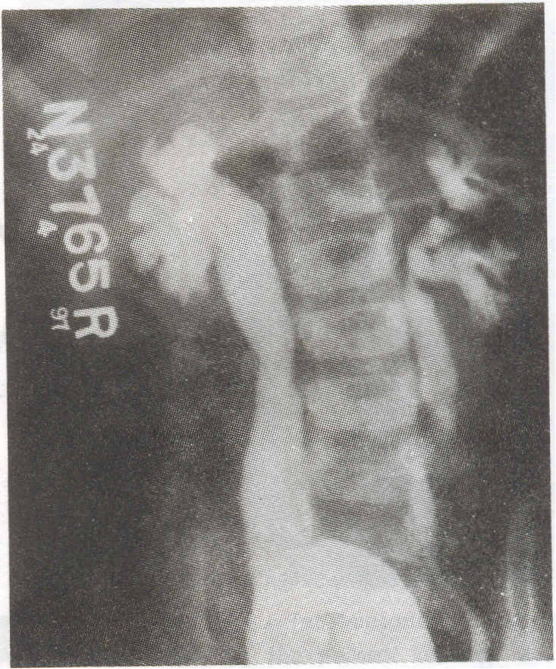
Micturiting cystourethrogram (MCW showing bilateral VUR, grade IV on right and grade III on left-side. There is bilateral ureteral and pelvic dilation with blunting of fornices in the right kidney.
Bilateral reflux extending into the pelvicalyceal systems of the kidney without dilatation of the calyces or ureters. (Note catheter in bladder)

Slide 12
Management
mild signs and symptoms :Patients may be treated on an outpatient basis with antibiotics for 7-14 days
sever cases :Hospitalization
Ampicillin with aminoglycoside or third generation cephalosporin, piperacillin or carbapenems in sever cases
Empirical treatment is TMP-SMX (trimethoprim-sulfamethoxazole COMBINATION but the Resistance is around 50%) SO fluoroquinolones is alternative . the Empirical treatment is used in the ER when you need to treat the patient quickly (in severe cases)
Antibiotics are selected according to results of urinalysis culture and sensitivity and may include broad-spectrum medications
Treated as outpatients if there is no nausea, vomiting or dehydration and other signs and symptoms of sepsis
Very ill patients and all pregnant women are hospitalized at least for 2 to 3 days for parenteral therapy
2 weeks course
Bactrim
Ciprofloxacin
Gentamicin with or without amoxicillin
Male’s slides
Female’s slides

Slide 13
Prevention:
Only in male’s slides
Antimicrobial prophylaxis
TMP-SMX or fluoroquinolones 3/week or nitrofurantoin daily
Intravaginal estradiol
300 ml of cranberry juice
Removal the urinary catheter as soon as possible or use condom catheter
Prognosis:
Only in male’s slides
Prognosis is dependent upon early detection and successful treatment
Baseline assessment for every patient must include urinary assessment because pyelonephritis may occur as a primary or secondary disorder
Problem:
Only in female’s slides
Chronic or recurring symptomless infection persisting for months or years
Another 6 weeks course if relapse
Follow up urine culture 2 weeks after completion of therapy

Slide 14
Only in female’s slides
Chronic Pyelonephritis:
Repeated bouts of acute pyelonephritis may lead to chronic pyelonephritis that may lead to kidney damage and hypertension
Clinical manifestations:
Complications:
ESRD=end stage renal disease
Hypertension
Kidney stones
Medical management:
According to C&S result Drugs carefully titrated if renal function is impaired
No symptoms of infection unless an acute exacerbation occurs
Fatigue
Head ache
Poor appetite
Polyuria
Excessive thirst
Weight loss
Progressive scarring → renal failure
Assessment and diagnostic findings:
IVP
Serum creatinine
Blood urea
Culture and sensitivity

Slide 15
Only in females slides
Nursing management
Fluid balance – I / O chart Fluids encouraged unless contraindicated 4th hourly temp Antibiotics Bed rest Teach how to prevent recurrent infections : adequate fluids, emptying the bladder regularly and performing recommended perineal hygiene taking antibiotics as prescribed

Slide 16
Only in females slides
Treatment of Acute Uncomplicated Pyelonephritis
Mild or moderate symptoms | Hospitalized patients | Ambulatory patients
Outpatient treatment (total of 7–14 days) oral treatment: Fluoroquinolone TMP/SMX, if uropathogen is known to be susceptible. If Gram-positive pathogen: amoxicillin or amoxicillin-clavulanate | IV antibiotic first 48–72 hours followed by 7 days of oral antibiotic therapy Fluoroquinolone IV, then PO Aminoglycoside ± ampicillin IV, then TMP/SMX PO Third-generation cephalosporin IV, then TMP/SMX PO | 7–14 days of oral therapy with one of the antimicrobials mentioned in the table .
Eradicate pathogens in kidney and urothelium, and treat/prevent bacteremia

Slide 17
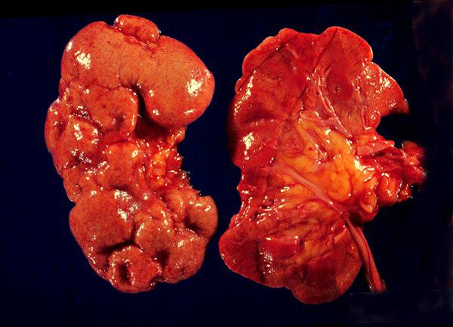
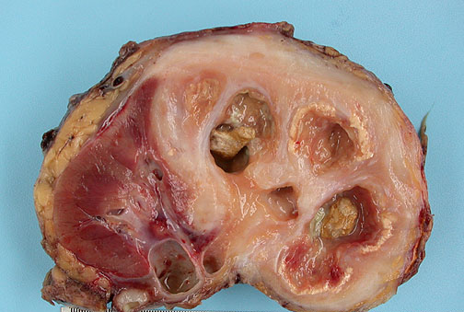
Only in females slides
Destruction of approximately 70% of the kidney. Numerous dilated calyces with yellow-brown calculi. The central necrotic areas are surrounded by dense fibrosis.
Scarred and contorted kidneys

Slide 18
Summary (doctor’s notes)
important
-Pyelonephritis : usually upper UTI and complicated.
It is acquired usually by 1-Ascending Infection 2- Hematogenous Spread
Diagnosis: Bacteria 10⁵CFU/ml , blood culture
Symptoms': flank pain , vomiting , fever , diarrhea
Local complication : renal abscess , scarring, ischemia
Distal complications : bacteria will spread to other organs
Risk factors : obstruction , catheterized patients , diabetic, pregnancy (could lead to abortion)
Most common organisms : E.coli , staph saprophyticus , klebsiella , proteus mirabilis , enterococci, staphylococcus aureus , pseudomonas aeruginosa , Enterobacter.
Prophylaxis : Nitrofurantoin , TMP- SMX , Fluoroquinolones.
Treatment: Ampicillin, Aminoglycosides , 3rd generations cephalosporin's , piperacillin , carbapenems.
anti-pseudomonas: aminoglycosides , ciproflaxcin , carbapenam, pipracillin.
Anti-entrococcus : vancomysin , nitrofurantoin
Anti- E-coli : Ampicillin , gentamycin , nitrofurantoin , TMS , Ciproflaxcin, (cepha 2nd , 3rd)

Slide 19
Risk Factors: | Etiology and Pathophysiology:
Pregnancy –Diabetes –Immunosuppression-Obstruction-Catheterized patients-vesicoureteral reflux-calculi . | most bacterial causes Escherichia coli Hospital-acquired infections may be due to coliforms and enterococci. Haematogenous spread is rare eg Staph aureusand mycobacterial tuberculosis Frequently due to ureterovesical reflux .
Treatment: | Pathogenesis:
Patients with mild signs and symptoms may be treated on an outpatient basis with antibiotics for 7-14 day Hospitalization in sever cases Empirical treatment is TMP-SMX (Resistance around 50%), fluoroquinolones is alternative Ampicillin with aminoglycoside or third generation cephalosporins, pipracillin or carbapenems in sever case Antibiotics are selected according to results of urinalysis culture and sensitivity and may include broad-spectrum medications. | Rectal and/or vaginal reservoirs Colonization of perianal area Bacterial migration to perivaginal area Bacteria ascend through urethra to bladder Intercourse may contribute urethral colonization and ascending infection ASB[asymtomatic bacteruria] in 1st trimester of pregnancy may cause pyelonephritis in 3rd trimester
Clinical Manifestations of acute pyelonephritis: | Diagnosis:
Chills-Fever -Flank pain | Blood culture-BUN and Creatinine levels-Ultrasound or CT scan Complications: ESRD=end stage renal disease-Hypertension -Kidney stones
Summary

Slide 20
SAQ:
A 70 year old female visits your clinic , she has fever , flank pain and azotemia and after some test you find her kidneys are enlarged with Abscess formation and there is destruction of Tubules . you diagnose her of having Pyelonephritis . Answer the following based on the information:
1-Based on the information what is the most likely common organism that have infected her ?
ANS: E.coli
2- What is the treatment needed?
ANS: Ampicillin , Nitrofurontoin TMS, Ciproflaxcin and other
3-what antibiotics could you use to prevent a relapse (prophylaxis)?
ANS: Nitrofurantoin , TMP- SMX , Fluoroquinolones
4- in general how do you confirm diagnosis of Pyelonephritis
ANS: Blood culture , 10⁵CFU/ml
5- what complications could occur duo to Pyelonephritis?
ANS: multi organ failure , septic shock , metastatic infection , papillary necrosis , Acute renal failure , renal gangrene , ,atrophy , emphysematous pyelonephritis.

Slide 21
MCQ:
1-For ambulatory patients we use antibiotics for:
A- (3-4wks) B- (7-14wks) C- (7-14days)
2- x-ray is used for pyelonephritis diagnosis
A- T B-F
3- Ascending bacterial infection include:
A- candida B- E-coli C- coliforms
4- Hyperlipidemia is a risk factor to pyelonephritis
A- T B-F
5- A patient is said to have pyuria when pus cells are greater than 10cmm
A-T B-F
6- Which of the following is the organism most likely to be grown and isolated in pyelonephritis?
a)Escherichia coli b)Staphylococcus saprophyticus
c)Proteus organisms d)Klebsiella organisms
7- pyelonephritis It is Bacterial infection of the following except:
A) vaginitis. B) cystitis.
C) pyelitis D) urethritis.
8- If patient Resist TMP-SMX we use:
A)Penicillin B) fluoroquinolones c) macrolides
1-C 2-B 3-B 4-B 5-A 6-A 7-A 8- B

Slide 22
MICROBIOLOGY TEAM:
Hamad Alkhudhairy (leader)
Talal Alhuqayl
Yousef Aljebrin
Basel Almeflh
Anwar Al souan
Majed Alzain
Ibraheem Aldeeri
Ibrahim Fetyani
Abdulmalik Alghanam
Nasir Aldosari
Shrooq Alsomali (leader)
Lama Altamimi
Jawaher Alkhayyal
Ohoud Abdullah
Lama Al-musallam
وخلصنا سنة أولى طب !
We are waiting for your feedback
@microbio436
The Editing File
436microbiologyteam@gmail.com

