Slide 1

Renal excretion of drugs
Objectives:
Identify main and minor routes of excretion including renal elimination and biliary excretion.
Describe its consequences on duration of drugs.
Identify the different factors controlling renal excretion of drugs.
Know the meaning of urinary ion trapping.
Know how we can prescribe drugs in patients with renal impairment.
هناك فرق بين العلاج والشفاء.. نحن نكتب العلاج، لكن الشافي هو الله

Slide 2
Renal excretion of drugs
1.Brief anatomy & physiology of the kidney.
3.factors affecting renal excretion of drugs:
4.Urinary pH trapping + examples.
5.Creatinine clearance and drug excretion.
6.examples of drugs excreted mainly by the kidney.
7.risk factors for NSAIDS-associated acute renal failure.
8.orders of drug elimination:
2.renal excretion of drugs.
active tubular secretion
tubular reabsorption
Glomerular filtration
Glomerular filtration of drugs
GFR
characters of active tubular secretion
types of transporters
competitive tubular secretion of drugs
passive tubular reabsorption of drugs
active tubular reabsorption of drugs
renal blood flow
physiochemical properties
biological factors
pH of urine
disease state
Molecular weight
Lipid solubility
Volume of distribution
Binding characteristics of drugs
Zero order
First order
Extra slide: outline of the lecture

Slide 3
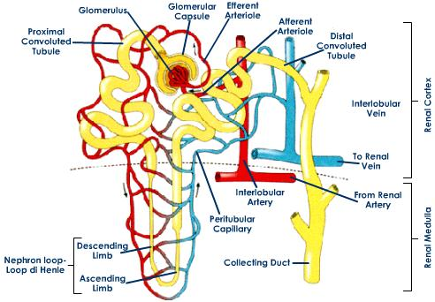
just for you understanding
just for you understanding
Structure of the kidney:
The structural unit of the kidney is the NEPHRON which consists of:
Glomerulus.
Proximal convoluted tubule.
Loop of Henle that is divided to:
  Descending loop of Henle.
  Ascending loop of Henle.
Distal convoluted tubule.
Collecting duct.
Routes of excretion
Minor
Pulmonary excretion
Salivary excretion
Major
Renal excretion
Biliary excretion
Mammary excretion
Skin excretion via sweating
Kidneys are the most important organ for drug excretion.

Slide 4
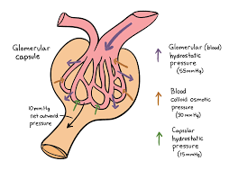
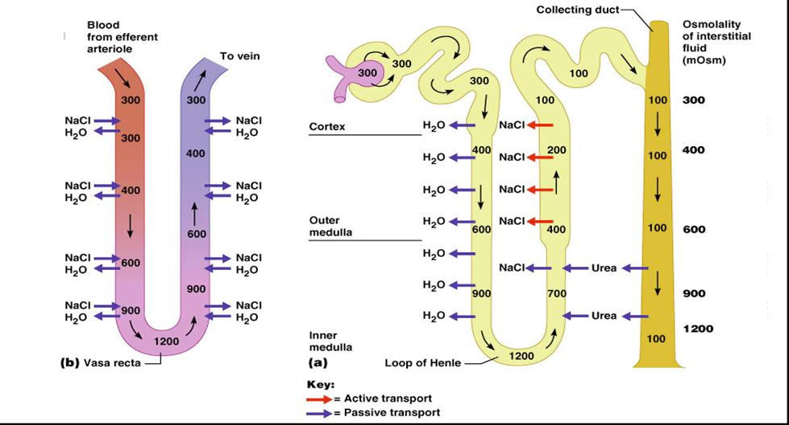
just for you understanding
Glomerular filtration:
  Blood is filtered across a semi-permeable membrane into the Bowman’s capsule.
  Driving forces for Glomerular Filtration is hydrostatic pressure of blood flowing in the capillaries.
  Filtrate contains Water, Glucose, Amino Acids, Sodium Bicarbonates, organic solutes and electrolytes such as Sodium, Potassium and Chloride.
  Blood cells, platelets and plasma proteins are retained in the blood and NOT filtered.
Glomerular filtration of drugs:
  Glomerular filtration of drugs occurs to:
    Drugs with low molecular weight.
    Water soluble (polar = ionized) drugs such as Aminoglycosides and Tubocurarine.
    Plasma free drugs. (not bound to plasma proteins).
    Drugs with low volume of distribution. (Higher the volume less the excretion. Because the amount available for excretion will be less.) In other words, If a drug is highly distributed, it won’t be present in the blood to be filtered. Suppose a drug has low volume of distribution? It will be present in the blood then after filtration about 90% of the drug is filtered, thus the excretion will be high.
Glomerular Filtration Rate (GFR):
  It’s the amount of blood filtered by the glomeruli in a given time.
    Normal glomerular filtration rate (GFR) = 125 ml/min.
    GFR is used as an indicator for kidney function.
    GFR is determined by Creatinine and Inulin which is easily filtered by the kidney and NOT reabsorbed.
  Creatinine clearance (CrCl) is used as a marker instead of GFR.
Normal function of the kidney
Regulation of electrolytes (aldosterone).
Regulation of water balance (anti-diuretic hormone).
Excretion of wastes and drugs metabolites such as:
  Urea.
  Uric acid.
  Creatinine.
Renal excretion of drugs Very important
Urinary excretion of drugs occurs through three processes:
Glomerular filtration.
Active tubular secretion.
Tubular reabsorption.

Slide 5
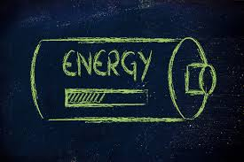
Active tubular secretion: active =need of energy
  Occurs mainly in the Proximal Convoluted Tubules.
  It increases drug concentration in the filtrate.
  Drugs undergo active secretion have excretion rate greater than normal GFR.
  Mainly secretion of ionized drugs into the lumen such as PENICILLIN G.
Characters of active tubular secretion:
  Needs energy.
  Transports drugs against concentration gradients between blood filtrate.
  Requires carries (transporters).
  Can be fully saturated.
  Not specific (competition may happen).
Types of transporters:
  Transporters for organic acids such as Penicillin, Aspirin, Sulfonamides, uric acid and Probenecid.
  Transporters for organic bases such as Morphine, Catecholamines, Atropine, and Quinine.
Probenecid can inhibit active tubular secretion of acidic drugs.
Two drugs can compete for the same carries for example:
  Probenecid with Penicillin.
  Probenecid with Nitrofurantoin.
Competitive active tubular secretion of drugs:
  Two structurally similar drugs having similar ionic charge and employing the same carrier-mediated process for excretion enter into competition.
  The drug with greater rate of excretion will retard the excretion of other drug with which it competes.
  The half life of both drugs is increased since the total sites for active secretion are limited.
Combination of drugs
Beneficial combination
Harmful combination
Probenecid and Penicillin G.
Both require the same carrier for renal excretion.
Probenecid competes with or retards renal tubular secretion of Penicillin G, thus, less amount of Penicillin G will be excreted which leads to prolongation of duration of action of Penicillin G, thus, increases its antibacterial effect.
Probenecid and Nitofurantoin.
Probenecid inhibits renal tubular secretion of Nitrofurantoin thus decreases its efficacy in Urinary Tract Infections (UTIs).
(الدواء يحتاج انه يكون في المثانة عشان يشتغل)

Slide 6
Tubular reabsorptions:
  After glomerular filtration, drugs may be reabsorbed back from tubular lumen into systemic blood circulation.
  It takes place along all the renal tubules.
  Reabsorption increases half life of a drug.
  Reabsorption may be Passive or Active.
Passive tubular reabsorption of drugs:
  In distal convoluted tubules and collecting ducts.
  Only lipid soluble drugs (Non-ionized) undergo passive tubular reabsorption from tubular lumen back into blood (not excreted in the urine, urinary excretion will be low).
  Ionized drugs (water soluble) are poorly reabsorbed, excreted easily in the urine, and urinary excretion will be high.
Active tubular reabsorption of drugs:
  It occurs with endogenous substances or nutrients that the body needs to conserve. Ex : Amino acids , Glucose , uric acid and electrolytes .
  Probenecid acts as a uricosuric agent in the treatment of gout.
  Probenecid inhibits active tubular reabsorption of uric acid, So, It increases excretion of uric acid in urine.
Factors affecting renal excretion of drugs
Factor | relation
Blood flow to the kidney. | Directly proportional
Molecular weight. | inversely proportional
Lipid solubility. | inversely proportional
Degree of ionization. | directly proportional
Volume of distribution. | inversely proportional
Binding character. | inversely proportional
Biological factors such as age. | in neonates & elderly
Disease state of the patient.
Urine pH.
Renal blood flow:
  Adequate renal function depends upon renal blood flow.
  Decline in renal blood flow can decrease excretion of drugs.
  Non-Steroidal Anti-Inflammatory Drugs (NSAIDs) e.g. Aspirin and Ibuprofen inhibit the production of prostaglandins and therefore reduces renal perfusion and GFR.

Slide 7
Molecular weight
Large molecular weight drugs are difficult to be excreted than small molecular weight especially by glomerular filtration.
Lipid solubility
Urinary excretion is inversely related to lipophilicity.
Degree of ionization
Increased ionization of drug increases its water solubility and thus enhances its renal excretion.
Volume of distribution
Increase lipid solubility increases volume of distribution of a drug and decreases renal excretion.
Polar or water soluble drugs such as Aminoglycosides and Tubocurarine are easily filtered.
Binding characteristics of drugs
Renal clearance is inversely related to volume of distribution of drugs.
Drugs with large volume of distribution are poorly excreted in urine.
Drugs restricted to blood (low volume of distribution) have higher renal excretion rates.
Drugs that are bound to plasma proteins behave as macromolecules and cannot be filtered through glomerulus.
Only unbound form of drug (free form) appears in glomerular filtrate.
Protein bound drugs have longer half lives.
2. Physiochemical properties:
Biological factors:
  Age can affect renal clearance.
  Renal clearance is reduced in neonates and elderly due to pharmacokinetics changes.
  Dose reduction is advisable in neonates and elderly otherwise, toxicity may occur.
Disease state:
  Impaired renal clearance and increases of half lives of drugs may occur due to:
    Reduced renal blood flow that may be caused by:
      Congestive heart failure.
      Hemorrhage.
      Cardiogenic shock.
    Decrease renal excretion that may be cause by:
      Renal diseases such as glomerulonephritis.

Slide 8
Examples of ion trapping :
Consider a Barbiturate which is a weak acidic drug over dose.
  Well, normally most acidic drugs will be reabsorbed back into the blood stream.
Renal excretion of drugs and pH of urine:
  Normal urine pH is 5.3 (slightly acidic).
  Urine pH varies from 4.5 to 8 depending upon the diet for example:
    Meat causes more acidic urine.
    Carbohydrates rich foods may increase urinary pH.
  Most drugs are weak acids or weak bases.
  Normal urine acidity favors excretion of basic drugs.
  Most acidic drugs will be reabsorbed back into body.
  Changing the pH of urine can inhibit or enhance the passive tubular reabsorption of drugs.
Urine
pH=5.3
Less amount is excreted
High amount is reabsorbed
Blood
pH=7.4
Weak acidic urine will cause less ionized portion of the drug and most of it will be reabsorbed back into the blood stream.
weak acidic drugs will be reabsorbed back into the blood stream because the blood is slightly basic.
Urinary pH trapping (ion trapping)
It is used to enhance renal clearance of drugs during toxicity.
Urine acidification by ammonium chloride (NH4Cl) increases excretion of basic drugs such as Amphetamine and Gentamycin.
Urine alkalization by sodium bicarbonate (NaHCO3) increases excretion of acidic drugs such as aspirin.
  So, We need to alkalize the urine by sodium bicarbonate so that the drug can be ionized into more water soluble form and then easily excreted and weakly reabsorbed.
Urine
pH=8.0
High amount is excreted
Less amount is reabsorbed
Blood
pH=7.4
Slightly higher basic urine will cause higher portion of the drug to be ionized to more water soluble form so it can be easily excreted.
weak acidic drugs will be reabsorbed back into the blood stream because the blood is slightly basic.

Slide 9
Creatinine clearance and drugs excretion:
  Creatinine clearance rate (CrCl):
  Is the unit volume (ml) of plasma cleared by the kidney per unit time.
Creatinine clearance is used to estimate glomerular filtration rate (GFR) because creatinine is produced from muscles and freely filtered because it is water soluble with least protein bound portion and it’s water soluble as well.
Estimation of creatinine clearance
The Cockcroft-Gault equation for estimation of creatinine clearance:
(Not important)
Female CrCl = 0.85 (140 – age) x body weight.
              Serum creatinine x 72
Male CrCl = (140 - age) x body weight
            Serum creatinine x 72
Renal clearance
CL_{r} (ml/min) = excretion rate (C_{u}V_{u})
            Plasma concentration (Cp)
CL_{r} : Renal clearance.
Cu: Drug concentration in the urine.
Vu: Volume of urine in 24 hours.
Cp: Drug concentration in the blood.
Renal clearance of drugs:
If renal clearance is impaired, this may increase t ½ of drugs and may lead to drug toxicity.
Drug renal clearance is especially important for some drugs which are:
  Mainly excreted by the kidney.
  Have narrow therapeutic index such as Lithium, Digoxin and Warfarin.

Slide 10
Drugs excreted mainly by the kidney includes: (Important)
Antibiotics such as:
  Penicillin, Cephalosporin.
  Aminoglycosides (gentamycin).
  Sulfonamide.
Non-Steroidal Anti-Inflammatory Drugs (NSAIDs) such as:
  Aspirin.
  Paracetamol.
  Coxibs.
Lithium.
Digoxin.
Immunosuppressant drugs such as Cyclosporine.
Anticancer drugs such as Cisplatin.
Imipinem
So what should we do in renal impairment?
  Drugs that primarily excreted by the kidney need dose adjustment when creatinine clearance is below 60 ml/min.
Dose adjustment divided into:
  Mino dose adjustment if CrCl = 30-6- ml/min.
  Major dose adjustment if CrCl < 15 ml/min.
  Monitor blood levels of drug (therapeutic drug monitoring)
  keep the usual dose but prolong the dosing intervals (e.g. gentamicin) or decrease the dose without changing dosing intervals (e.g. digoxin)
You need to be careful upon prescribing those drugs in:
  Patients with renal failure.
  Elderly patients.
When dose reduction is not required in renal impairment?
  Few drugs e.g. Ceftriaxone, Doxycycline that are mainly excreted into feces (biliary excretion).
Risk factor for NSAIDs-associated acute renal failure
  Prostaglandins (PGs) have major role in the preservation of renal function, when pathologic state compromise physiologic kidney processes.
  PGI₂ and PGE₂ antagonize the local effects of circulating angiotensin II, Endothelin, Vasopressin and Catecholamines that reduce renal circulation.
  Prostaglandins preserve GFR by antagonizing arteriolar vasoconstriction.
  A significant reduction in GFR can occur following administration of a NSAIDs to a patient with any underlying disease state (because NSAIDs inhibit production of PGs)

Slide 11
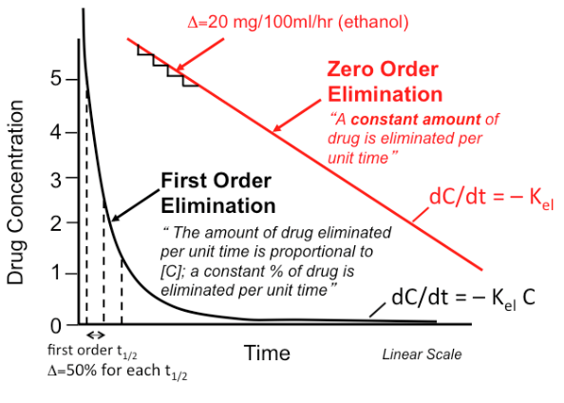
Orders of drug elimination
First-order kinetics
Zero-order kinetics
For first-order drug elimination, a constant percentage is lost per unit time.
Most drugs follow the first order kinetic of excretion e.g. penicillin, aminoglycosides and quinolones.
In first order kinetic the rate of excretion is increased if the concentration of drug is increased in the plasma.
For zero-order drug elimination, a constant amount is lost per unit time.
Examples: Alcohol, Phenytoin, Aspirin.
In zero-order the rate of excretion is independent of the concentration of drug in plasma.
If a drug with a 2-hours half life is given with an initial dose of 8mg/ml, assuming first-order kinetics, how much drug will be left after 6 hours?
6 mg/ml.
4 mg/ml.
2 mg/ml
1 mg/ml
Remember 50% is lost every 2 hours
Answer is D
Because 50% is lost every 2 hours the
After 2 hours 4 mg/ml is left.
After 4 hours 2 mg/ml is left.
After 6 hours 1 mg/ml is left.

Slide 12
Summary
Polar drugs are readily excreted and poorly reabsorbed.
Lipid soluble drugs are reabsorbed back and excretion will be low.
Acidic drugs are best excreted in alkaline urine (sodium bicarbonate).
Basic drugs are best excreted in acidic urine (ammonium chloride).
Enterohepatic circulation prolongs half life of the drug.
Inulin and creatinine are used to assess renal function.
Competition for active secretion prolongs half life of some drugs e.g penicillin and probenicid.
Protein binding of drugs inhibits renal excretion of drugs except those that are actively secreted.
NSAIDS e.g aspirin and ibuprofen inhibits the production of PGs and therfore reduces renal perfusion and GFR.
Irrespective of the mechanism of excretion renal of drugs , decreased renal blood flow decrease excretion of drugs.

Slide 13
MCQ
Which of the following is/are a major routes of drugs excretion?
  Renal excretion.
  Salivary excretion.
  Mammary excretion.
  A & B.
Which of the following is the first step in renal excretion of drugs?
  Tubular excretion.
  Active tubular reabsorption.
  Glomerular filtration.
  Renal blood flow.
Which one of the following is physiochemical properties of a drug?
  Lipid solubility.
  Self biological factors.
  Urinary pH.
  Renal blood flow.
Adequate renal function depends upon:
  Disease state of the patient.
  Degree of drug ionization.
  Renal blood flow.
  Volume of drug distribution.
Which of the following is true about ion trapping?
  Barbiturate is used for alkalization of urine.
  Sodium bicarbonate is used for acidification of urine.
  It is used to enhance renal excretion of drugs.
  None of the above.
Renal clearance is inversely proportional to:
  Plasma drug concentration
  Renal drug concentration.
  Volume of urine.
  Renal blood flow.
Which of the following drugs is excreted in feces
  Ceftriaxone.
  Digoxin.
  Cephalosporin.
  Cyclosporine.
In which of the following cases we need a major dose adjustment?
  If the renal clearance is less than 60 ml/min.
  If the used drug has a narrow therapeutic index.
  If renal clearance is less than 60 ml/min but more tan 30 ml/min.
  If renal clearance is less than 15 ml/min.
What is the mechanism of action of NSAIDs that may lead to significant reduction of the GFR?
  Inhibition of PGs.
  Blockage of COX pathway.
  Anti-inflammatory effect.
  Only aspirin can cause that.
Most of anti-cancer drugs are mainly excreted by:
  Biliary excretion.
  Renal excretion.
  Mammary excretion in females.
  Pulmonary excretion.
Answers:
A
C
A
C
C
A
A
D
A
B

Slide 14
SAQ
A inpatient 56-year-old male who takes DIGOXIN for his heart failure, 4 days after administration he developed pneumonia, the doctor decided to start using PENICILLIN to treat his infection.
When should we adjust the dose for both drugs and why?
  Digoxin has a narrow therapeutic index so we should monitor blood levels even if the renal system is fine for this patient.
  Penicillin needs to be adjusted if the there renal impairment or if the renal clearance is less than 60 ml/min.
What is the order of elimination of penicillin?
  First order kinetics.
Describe first and zero order elimination kinetics.
  First order: same PRECENTAGE is lost after each half-life cycle and it is dose dependent.
  Zero order: same AMOUNT is lost each half life cycle and it is dose independent.

Slide 15
Editing file

