Slide 1
Diuretics
OBJECTIVES:
Define and classify diuretics.
Describe the mechanisms of action of diuretics.
Identify the site of action of each class of diuretics in the nephron.
Detail on the pharmacodynamic actions and pharmacokinetic aspects of diuretics.
List ADRS, therapeutic uses, contraindications and drug-drug interactions of diuretics.

Slide 2
Diuretics
Diuretics
Are drugs that increase renal excretion of sodium and water resulting in increase in urine volume
Diuresis
Diuresis: is the process of excretion of water in the urine.
Natriuresis
is the process of excretion of sodium in the urine.
Drugs used to increase renal flow rate
Water diuresis
They act by ↑the quantity of sodium in urine ( natriuretic diuretics)
Used to remove excess extracellular fluid (oedema)

Slide 3
Nephron Segment | Diuretics | Transporter mostly Na⁺ | Function | Filtered Na⁺ re-absorbed
Proximal convoluted tubules | Carbonic anhydrase inhibitors | Na⁺/H⁺ transporter Carbonic anhydrase enzyme | Re-absorption of 100% glucose and amino acids, 66% Na, K, Ca, Mg; 85% NaHCO3 | 85 % Na , HCO3 65 % As NaHCO3
Proximal Straight Tubules | - | Acid & base transporter | Secretion and re-absorption of organic acids and bases | -
Ascending Loop of Henle | Loop diuretics | Na⁺/K⁺/2Cl⁻ co-transporter | Active reabsorption 25% Na, K, Cl Secondary re-absorption Ca, Mg | 20-30% Active reabsorption Na, K, Cl Ca and Mag
Distal convoluted tubules | Thiazide diuretics | Na⁺/Cl⁻ co-transporter | Active tubular reabsorption of 5%Na, Cl, Ca | 5-10% Active reabsorption Na, Cl
Cortical Collecting Tubules | K-sparing diuretics | Na⁺ channel K & H transporter Aldosterone Antidiuretic hormone | Na reabsorption K & H secretion | 5% Na reabsorption K & H secretion
ذا جاء يزيد (Thiazide) وهو أصلا جاي متأخر (Distal convoluted tubule)

Slide 4
Classification of diuretics
Carbonic anhydrase inhibitors
Osmotic diuretics
Loop diuretics
Thiazide diuretics
Potassium-sparing diuretics
Mechanism of actions of diuretics
Most diuretics act by interfering with the normal sodium reabsorption by the
renal tubules resulting into sodium and water excretion.
Sites of action for diuretics
How diuretics produce their effects?
Diuretics affect carriers or transporters in luminal membrane of renal tubular cells required
for tubular reabsorption of sodium from filtrate back into blood.
https://www.youtube.com/watch?v=_7B8zIm8RBM
(7:23) Check this video اذا مالك خلق تحفظ

Slide 5
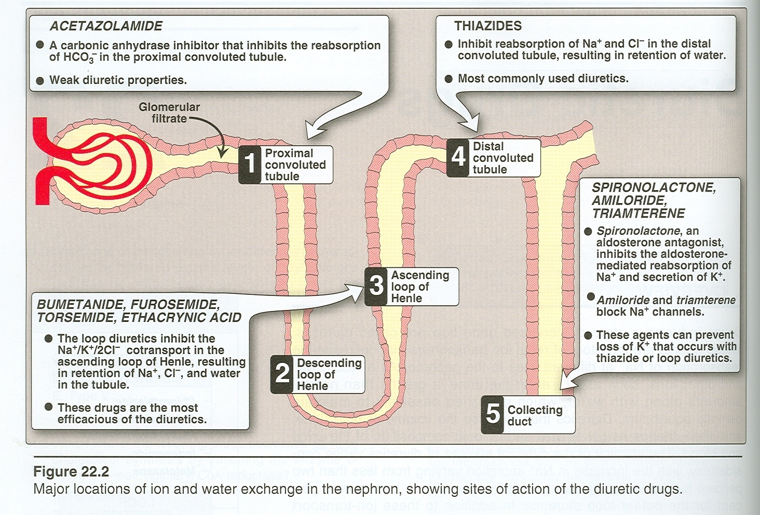
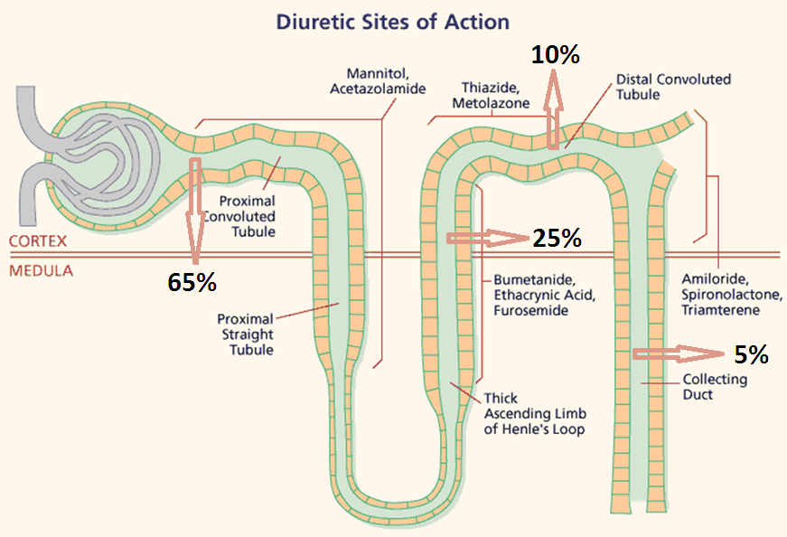
2
5
4
1
3
Mannitol
Acetazolamide
Loop diuretics
Thiazide
K sparing diuretics

Slide 6
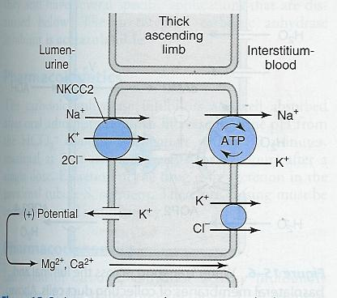
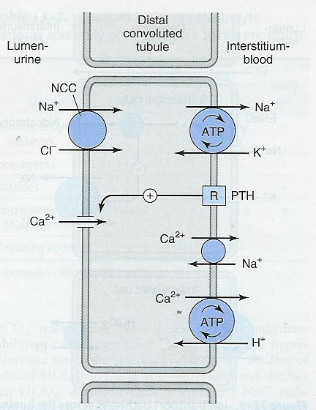
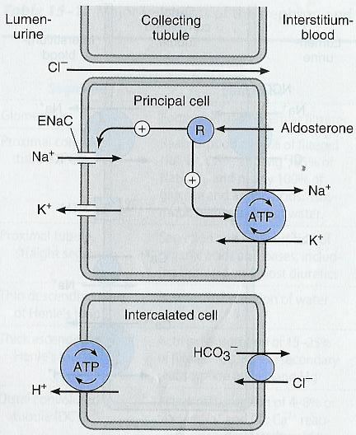
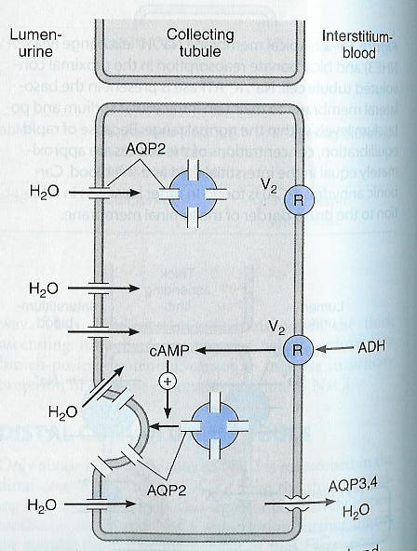
ASCENDING LOOP OF HENLE
Distal convoluted tubules (DCT)
COLLECTING TUBULES (CT)
COLLECTING TUBULES (CT)

Slide 7
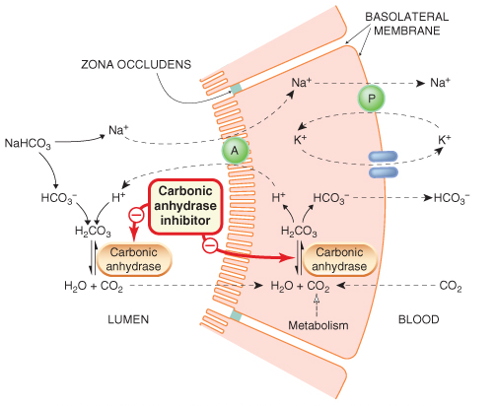
Inhibitors = Zola
Carbonic Anhydrase Inhibitors | Drug | Acetazolamide – dorzolamide Acetazolamide is a potent specific inhibitor of carbonic anhydrase, enzyme inhibition is non competitive
 | Mechanism of action | Site of action: proximal convoluted tubules. Inhibits carbonic anhydrase (CA) enzyme in proximal convoluted tubules thus interferes with NaHCO3 re-absorption and causes diuresis.
 | Pharmacokinetics | given orally once a day. Onset of action is rapid (30 min). t½ 6-9h Duration of action (12 h). Excreted by active secretion in proximal convoluted tubules. Produces alkaline urine Because of the aldosterone effect there will be an exchange between K and Na (K out Na in)
 | Pharmacodynamics | -↑ urine volume mildly acts on HCO₃ It ↓ reabsorption of bicarbonate in the proximal tubule & prevent the acidification of urine in the distal tubule -↑ urinary excretion of sodium, potassium , bicarbonate (alkaline urine). -With repeated dosage the diuretic action is lost →loss of HCO3- & development of Metabolic acidosis. Self- limiting action of acetazolamide restrict its use to mild edema. -↑ Urinary phosphate excretion. Because phosphate prefer alkaline urine -Promotes K+ excretion by ↑the load of Na+ delivered to the distal tubules.
Acetazolamide ممكن نقرأ اسم الدرق بالمقلوب “مدي الزوليه يا ستي” أو “يا ستي الزوليه مدي”
Dorzolamide ممكن نقرأ اسم الدرق “درسوا للميد”
Blood
Lumen
Basolateral membrane
Luminal membrane
“ ملفوفه من الأول” proximal Convoluted = Zola “زوليه”
Proximal tubules
alkaline urine (Zola) “رحت بيت الخال يوريني الزوليه”
CA is required for reversible reaction,
in which CO2 +H2O H2CO3
H⁺ HCO3⁻
Metabolic acidosis(Zola) “متى أسدد لك دين الزوليه”

Slide 8
Carbonic Anhydrase Inhibitors | Therapeutic uses | Open angle glaucoma. carbonic anhydrase inhibitors cause ↓ Intraocular pressure (IOP) by reducing aqueous humor formation in ciliary body of eye. (tolerance does not develop to this effect) which drug? The one taken as topically which is Dorzolamide ↓ Cerebrospinal fluid (CSF) of brain. ↓of carbonic anhydrase in the choroid plexus →↓formation of CSF. Useful in management of benign intracranial hypertension. As prophylactic therapy, in acute mountain sickness. given nightly 5 days before the ascent ↓ weakness, breathlessness , dizziness, nausea, cerebral & pulmonary edema. Epilepsy (decrease cerebrospinal fluid, CSF). glial cells contain carbonic anhydrase. Nerves are highly responsive to rise in pH. ↑7.4→ 7.8 causes convulsions ↓of neuronal carbonic anhydrase →↓ pH in the vicinity of neurons→↓ convulsions . Metabolic alkalosis. especially an alkalosis caused by diuretic-induced increases in H⁺ excretion & metabolic alkalosis of heart failure Urinary alkalinization to enhance renal excretion of acidic substances (cysteine in cystinuria). Hyperphosphatemia
 | Adverse effects | Hypokalemia (potassium loss). Metabolic acidosis. Renal stone formation (calcium phosphate stones). Hypersensitivity reaction. | Drowsiness Numbness Tingling sensation of the face & extremities Disturbance of vision Contraindicated in patients with liver cirrhosis (alkaline urine ↓excretion of NH4→ hyperammonemia & hepatic encephalopathy)
ACOD azolamide causes ACIDosis

Slide 9
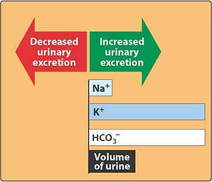
Dorzolamide
Is a carbonic anhydrase inhibitor
Used topically for treatment of open-angle glaucoma.
no diuretic or systemic side effects (Why?) it’s given as eye drops
Why do CA inhibitors have weak diuretic properties?
Diuretic properties decreases after several days as the blood bicarbonate falls.
” درسوا للميد زين وفتحوا عيونكم”

Slide 10
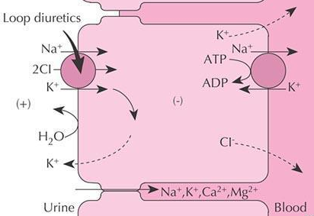
LOOP DIURETICS High Ceiling diuretics
Ascending loop of Henle
Is impermeable to water
In thick ascending loop of Henle (TAL) is responsible for active re-absorption of Na, K and Cl (25-30% Na⁺ is reabsorbed) via transport system in luminal membrane called Na⁺/ K⁺ / 2Cl⁻ co-transporter
Ca and Mg are reabsorbed and enter the interstitial fluid via paracellular pathway
The most potent diuretic , termed “high ceiling diuretic”
Efficacy: High natriuresis as 25-30% Na⁺ is reabsorbed
Induce expression of COX, PGE↓ salt transport in TAL
↓Renal vascular resistance &↑renal blood flow→ PGs
Bumetanide
Potency 40 ,t½ 0.8 h
Ethacrynic Acid
Potency 0.7, t½ 1h
Furosemide
Potency 1, t½ 1.5h
Torsemide
Potency 3, t½ 3.5h
B ume tanide ممكن نقرأ اسم الدرق “ بأمي تنادي”
Etha cry nic Acid ممكن نقرأ اسم الدرق “ إذا بكى نسى ”
Tor semide ممكن نقرأ اسم الدرق “ ثور صامد”
For Semide ممكن نقرأ اسم الدرق “ لأجل صامد”

Slide 11
LOOP DIURETICS
Mechanism | Pharmacokinetics | Pharmacological effects | Uses | Adverse effects
inhibit Na⁺ / K⁺ / 2 Cl⁻ co-transporter in the luminal membrane of the thick ascending loop of Henle (TAL). inhibit Ca⁺⁺ and Mg ⁺⁺ re-absorption. | Given orally or I. V. Have fast onset of action (suitable for emergency) Have short duration of action. Excreted by active tubular secretion of weak acids into urine. By acid carrier (avidly bound to plasma proteins). Interfere with uric acid secretion (hyperuricemia). #gout Bumetanide is the most potent | ↑urinary excretion of Na⁺ and K⁺. ↑urinary excretion Ca⁺⁺ and Mg ⁺⁺ . ↑urine volume. ↑renal blood flow. Furosemide and ethacrynic acid reduce pulmonary congestion and left ventricular filling pressures in heart failure →↑ venous capacitance | because of their rapid onset of action they are drugs of choice for emergency situations as: Severe edema associated with congestive heart failure, nephrotic syndrome. Treatment for Oliguric ARF. Treatment of hypercalcemia 3 Acutes: Acute pulmonary edema. Acute hyperkalaemia. Acute hypercalcemia. Toxicity of Br, F & I | Hypovolemia. Hyponatraemia (↓ blood Na⁺). Hypokalemia (↓ blood K⁺). Hypomagnesaemia (↓ blood Mg²⁺). Hypocalcaemia (↓ blood Ca²⁺). Metabolic alkalosis. Alkalosis because H goes in urine. Postural hypotension, first dose causes severe drop in BP. Dietary K supplementation or K-sparing diuretics should be used to avoid hypokalemia. Hyperuricemia (increase blood uric acid and gouty attack). Ototoxicity (risk increased if combined with aminoglycosides). Allergic reactions, Hypersensitivity To sulphonamides. Hyperglycemia. Anurea unresponsive to a trial dose of loop diuretic.
Oto toxicity = Loop Diuretics

Slide 12
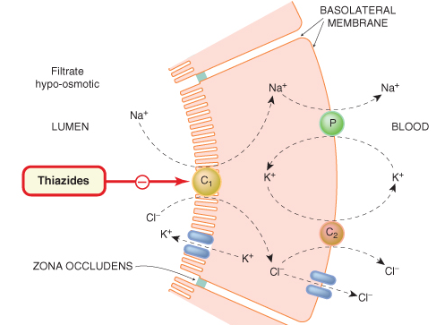
Metolazone
Potency 5, t½ 5h
Chlorthalidone
Potency 10, t½ 26h
Indapamide
Potency 20, t½ 16h
Chlorothiazide
Hydrochlorothiazide
Potency 0.1, t½ 2h
Potency 1 , t½ 3h
Thiazide Diuretics Low Ceiling diuretics
Drugs as:
most commonly used thiazide diuretic
Mechanism of action:
acts via inhibition of Na/Cl co-transporter on the luminal membrane of distal convoluted tubules.
Efficacy: Moderate natriuresis (5-10% of filtered load of sodium is reabsorbed).
الدب (dap)كل ما له ذا يزيد (thiazide)

Slide 13
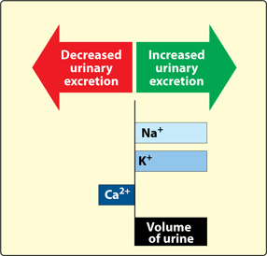
Thiazide Diuretics
Pharmacokinetics | Given orally, efficiently absorbed from the GIT. slow of onset, Lipid soluble. long duration of action (40 h) are secreted by active tubular secretory system of the kidney. Eliminated by Glomerular filtration & tubular secretion , some is reabsorbed may interfere with uric acid secretion and cause hyperuricemia. thiazide should be taken with caution in patients with gout or high levels of uric acid.
Pharmacological effects | urinary NaCl excretion. Which can result in the excretion of very hyperosmolar (concentrated) urine. urinary K excretion (Hypokalemia) urinary magnesium excretion urinary calcium excretion calcium re-absorption (Hypercalcemia) uric acid excretion Causes vasodilatation , diazoxide, non diuretic thiazide is a potent vasodilator of urine volume in case of diabetes insipidus
uses | Treatment of essential hypertension (cheap-well tolerated). Ineffective when the GFR is less than 30 to 40 ml/min, except metolazone & indapamide. Treatment of mild heart failure (to reduce extracellular volume). Calcium nephrolithiasis due to hypercalciuria (to increase calcium re-absorption and decrease renal calcium stones) Treatment for Osteoporosis Nephrogenic diabetes insipidus polyuria (decrease blood volume and GFR)
ذا يزيد (Thiazide) الطولCalcium Re-absorption (Hypercalcemia & osteoporosis )

Slide 14
Thiazide Diuretics
Adverse Effects | Fluid and electrolyte imbalance Metabolic alkalosis.
 | 4 HYPOs: Hyponatremia Hypovolemia (volume depletion) Hypokalemia Hypomagnesaemia | 4 HYPERs: HyperUricaemia (gout) HyperCalcemia HyperGlycaemia HyperLipidemia ↑LDL
HyperGLUC
Thiazide
↓ Distal tubular Na+
reabsorption
↑Urinary excretion
↓ Extracellular volume
↑Proximal Na+ & Water reabsorption
↓ Distal delivery of Na+ & water
↓ Urine volume
Mechanism of antidiuretic effect of thiazide in diabetes insipidus
This is special for abnormal conditions.

Slide 15
K+ sparing diuretics make the K+ stay (not go down in the urine) STAy
Spironolactone
Triamterene
Amiloride
Triamterene
Amiloride
Na⁺ channels inhibitors
nonsteroids
Spironolactone
Aldosteron Antagonists
Steroids
Potassium-sparing diuretics
Eplerenone
Mechanism of action
Act in collecting tubules and ducts by inhibiting Na re-absorption and K & H excretion (K-sparing effect) by either:
Inhibition of Na influx through Na channels in the luminal membrane
(triamterene – amiloride).
By antagonizing cytoplasmic aldosterone receptors
(Spironolactone)
Amil or rideممكن نقرأ اسم الدرق “أمل أو عايدة” أو “أمل أو رايد”
The K
STAys
Amal ride the car(amiloride) and said (trai metrene) , ok give me the soare key (K Sparing diuretic)
Tria mtereneممكن نقرأ اسم الدرق “ تراي مترين = يعني ترى طولي مترين ”

Slide 16
Potassium-sparing diuretics
Pharmacodynamics | ↑ urinary Na⁺ excretion ↓ urinary K⁺ excretion Hyperkalemia ↓ H⁺ excretion (acidosis)
Therapeutic uses | Drug of choice for patients with hepatic cirrhosis Secondary hyperaldosteronism. hyperaldosteronism is divided into primary and secondary secondary is a result of a disease like hepatic cirrhosis due to hyperalbunimia which decreases blood volume which stimulates RAAS and results in hyperaldosternism. (CHF, hepatic cirrhosis, nephrotic syndrome). Treatment of hypertension (combined with thiazide or loop diuretics to correct for hypokalemia). to prevent loss if supplements didn’t work
Adverse Effects | Hyperkalaemia. Metabolic acidosis. Gynaecomastia. only in spironolactone because it blocks testostrone and aldosterone leading to a decrease in sexaul desire GIT upset and peptic ulcer
Contraindications | Hyperkalaemia: as in chronic renal failure, K+ supplementation, β-blockers or ACE inhibitors. liver disease (dose adjustment is needed).
سوبر( Spiro) مان بلا(no) كلام (kalaemia) كبير (Hyper)

Slide 17
Only in males slides
Aldosterone Antagonists
Aldosterone antagonists are competitive antagonist at the collecting duct→↑ Excretion of Na+,Cl-&↓Excretion of K+,H+,NH4 Actions depend on renal PGs production
 | spironolactone |  |  |  | Eplerenone 100x more specific than spironolactone at clinical dose
pharmacokinetics | Well absorbed from the GIT ,t½=1.6h. Highly protein- bound Undergoes enterohepatic recycling. Delayed onset of action (nuclear receptor), maximum diuretic action 4 days. Converted in gut & liver to canrenone [active metabolite, t½=16h]. |  |  |  | Eliminated by metabolism(CYP3A4),t½ 5h. Low affinity for progesterone and androgen receptors
 | Both ineffective in adrenalectomized patients
Therapeutic uses | Enhances Natriuresis caused by Other Diuretics. Prevents Hypokalemia. Thus, Used in Combination with Loop & Thiazide Diuretics Primary Hyper-aldosteronism called Conn’s syndrome. Secondary hyperaldosteronism caused by nephrotic syndrome, heart failure and liver cirrhosis. |  |  | Edema of Liver Cirrhosis. resistant Hypertension. Nephrotic syndrome. Heart Failure, Improve survival.
ADRS | Hyperkalemia Metabolic Acidosis in cirrhotic patients CNS Side Effects Impotence Gynecomastia | Menstrual Irregularities Hirsutism Deepening of Voice Peptic Ulcers Gastritis
contraindications | Hyperkalemia Renal failure Other K+ sparing diuretics |  | ACE-I K+ suplement

Slide 18
Only in males slides
Sodium channel inhibitors
 | Triamterene 0.1, t½ 4.2 h, elimination by metabolism | Amiloride Potency 1, t½ 21h, Renal elimination
Therapeutic uses | Enhances Natriuresis caused by Other Diuretics Prevents Hypokalemia Thus, Used in Combination with Loop & Thiazide Diuretics Liddle’s Syndrome genetic disorder characterized by hyperactivity of Na channels in collecting ducts Lithium-Induced Diabetes Insipidus
ADRS | Hyperkalemia Renal Stones Interstitial Nephritis Megaloblastosis in cirrhotic patients caused by block to folate “folic acid” | Hyperkalemia
contraindications | Hyperkalemia Renal failure Other K+ sparing diuretics ACE-I & ARBs K+ suplement Aliskiren

Slide 19
Osmotic diuretics
Drug | Mannitol
Pharmacokinetics | Poorly absorbed, If given orally osmotic diarrhea Given intravenously Not metabolized Excreted by glomerular filtration without being re-absorbed or secreted within 30-60 min. t½0.25-1.7h, prolonged in renal failure to 36h
Pharmacological actions | Mannitol increases urine output by osmosis, drawing water out of cells and into the bloodstream Acts in proximal tubules & descending loop of Henle by osmotic effect. IV administration of any solute filtered by glomeruli may produce osmotic diuresis when the amount delivered to tubules exceeds their absorptive capacity ↑water excretion with relatively less effect on Na+ (water diuresis). Expand the extracellular fluid volume (initially), decrease blood viscosity, and inhibit renin release, ↑renal blood flow.
Therapeutic uses | Acute renal failure due to shock or trauma (maintain urine flow- preserve kidney function). severe injury , haemorrhage, hypovolaemia, →↓ GFR, absorption of water & salts is complete , distal part dries up→ irreversible damage In acute drug poisoning: To eliminate drugs that are reabsorbed from the renal tubules e.g. salicylates, barbiturates, bromides . To ↓ intracranial & intraocular pressure before ophthalmic or brain procedures (cerebral edema). To maintain urine volume & to prevent anuria resulting from large pigmentation load to the kidney e.g. haemolysis, rhabdomyolysis. But contraindicated in Anuric patients or patients not responding to a test dose of mannitol
Adverse effects | Headache, nausea, vomiting → hyponatremia Extracellular volume expansion, complicates heart failure & pulmonary oedema. Contraindicated in chronic heart failure Excessive use→ dehydration & *hypernatraemia (Adequate water replacement is required). The only drug with this effect
ممكن نقرأ اسم الدرق ماني طويل
Osmotic diuretics= Mannitol (Suger) اسمها د.منان تجنن مثل السكر
Mannitol
Urine
منان(Mannitol) ما تأخذ وتعطي (not Reabsorbed or secreted ) مع أي أحد
ماني(Mannitol) ماخذ ومعطي (not Reabsorbed or secreted ) معك
د.منان تعرف تجذب البنات بشرحها (drag water out of the cell) وتخلي المحاضرة زي المويه سهله (only drag the water)

Slide 20
Only in males slides
Drug – Drug interactions
K-Sparing diuretics
A) Sodium Channel blockers:
ACE Inhibitors
Beta-Blockers
K Supplements
K-Sparing
Diuretics
Aliskiren
Tbiazide diuretics
Thiazides Diminish effect → Uricosurics Sulphonylurea
Thiazides Increase effect → Digitalis Diazoxide
NSAIDs → Reduce Thiazide efficacy
Loop diuretics
NSAIDS Probenecid → ↓Diuretic Response
Digitalis → Arrhythmias
Aminoglycosides → ↑ Ototoxicity of Loop Diuretic
→
↑Hyperkalemia induced by K-Sparing diuretics
B) Aldosterone antagonists
Salicylates
Spironolactone
alters clearance
Aldosterone antagonist depends on PG so NSAIDS block their effect
→
↓Secretion of canrenone
↓Efficacy of Spironolactone
Digitalis
→

Slide 21
Treatment of hypertension:
Thiazide diuretics
used alone or in combination with beta-blockers at low-dose (fewer side effects)
In presence of renal failure, loop diuretic is used.
Edema States
Thiazide diuretic is used in mild edema with normal renal function
Loop diuretics are used in cases with impaired renal function.
Congestive Heart failure
Thiazides may be used in only mild cases with well-preserved renal function
Loop diuretics are much preferred in severe cases especially when GF is lowered
In life-threatening acute pulmonary edema, furosemide is given IV.
Renal failure
Thiazides are used till GFR ≥ 40-50 ml/min
Loop diuretic are used below given values.
Diabetes inspidus
Large volume(>10 L/day) of dilute urine
thiazide diuretics reduces urine volume
Hepatic cirrhosis with ascites
Spironolactone is of choice.
Therapeutic applications of diuretics
Treatment of hypertension:
Renal failure
Diabetes inspidus
Hepatic cirrhosis with ascites
Edema States
Congestive Heart failure
Elimination of toxins

Slide 22
SUMMARY
Side effects | Uses | Effects | Mechanism of action | Diuretics
Metabolic acidosis , Urinary alkalosis Hypokalemia | Glaucoma, epilepsy Mountain sickness Alkalosis Phosphatemia | Urinary Na HCO3, K Urinary alkalosis Metabolic acidosis | Inhibition of NaHCO3 reabsorption in PCT | CA inhibitors Acetohexamide Dorzolamide
Hypokalemia, hypovolemia, hyponatremia, hypomagnesemia, hypocalcemia Precipitate gout, alkalosis | Acute pulmonary edema (Drug of choice) Heart failure Hyperkalemia, Hypercalcemia | Urinary Na, K, Ca, Mg | Na/K/2Cl transporter in TAL the most effective | Loop diuretics Furosemide
Hypokalemia, hyponatremia, hypovolemia,hypomagnesemia, hypercalcemia Metabolic Alkalosis, precipitate gout Hyperlipidemia, hyperglycemia | Commonly used Hypertension, mild heart failure, nephrolithiasis, diabetes inspidus | Urinary Na, K, Mg BUT↓ urinary Ca (hypercalcemia) Metabolic alkalosis | Na and Cl cotransporter in DCT | Thiazide diuretics hydrochlorothiazide
Gynaecomastia Hyperkalaemia, Metabolic acidosis. GIT upset and peptic ulcer | Hepatic cirrhosis (Drug of choice) | ↑ Urinary Na ↓ K, H secretion Metabolic acidosis | competitive antagonist of aldosterone in CCT | K-sparing diuretic Spironolactone.
Extracellular water expansion Dehydration Hypernatremia | Cerebral edema, glaucoma Acute renal failure, drug toxicities | Urine excretion Little Na | Osmotic effect in PCT | Osmotic diuretic Mannitol

Slide 23
MCQ
A patient taking aminoglycosides was prescribed one of these diuretics, then the patient experienced hearing loss and damage to the ear. Which drug did he take?
A) Chlorothiazide . B) Furosemide. C) Acetozolamide. D) Spironolactone.
A patient came to the emergency room suffering from severe pulmonary edema, which diuretic is the best choice for his case?
A) Spironolactone. B) Dorzolamide. C) furosemide. D) Hydrochlorothiazide.
How do thiazide diuretics affect these ions?
A) Inhibits Ca, Mg, Na, K. B) Reabsorbs Ca, Mg, Na, K. C) Inhibits Ca, Mg, but reabsorbs Na, K. D) Inhibits Mg, Na, K, but reabsorbs Ca.
A diabetic patient who urinates frequently was given a thiazide diuretic, how will it fix his problem as a compensatory mechanism?
A) Decrease GFR and blood volume by reabsorbing sodium. B) Increasing GFR and blood volume by excreting more sodium. C) Decreasing GFR and increasing blood volume. D) Increasing GFR and decreasing blood volume
A patient had been taken (hydrochlorothiazide) , he came to see his doctor and on investigation the doctor noticed a decrease of K level , what is the drug that the doctor might use it in combination in this case?
Mannitol. B) Indapamide. C) Metalazone. D) Amiloride.
Which one of these diuretics is known to be (water diuresis) ?
A) Amiloride. B) Metalazone. C) Mannitol. D) hydrochlorothiazide.
Spironolactone can be characterized by which of the following properties ?
A) It binds to a transmembrane receptor. B) It inhibits aldosterone synthesis. C) it is bio transformed to an active metabolite. D) It is more potent than hydrochlorothiazide .
Which of the following is the mechanism of action of spironolactone?
A) Though osmotic effects. B) Through enzyme inhibition. C) Through interaction with hormonal receptors. D) Through inhibition of a co-transporter.
Which of the following diuretics act on specific membrane transport proteins?
A) Mannitol. B) Indapamide. C) Amiloride. D) Spironolactone.
Answers:
B
C
D
A
D
C
A
C
B

Slide 24
MCQ
A 54-year old male develops congestive heart failure after suffering his second myocardial infarction. His physician put him on a regimen of several medications, including frusemide. On follow-up, the patient is found to have hypokalemia. The addition of which medication would likely resolve the problem of hypokalemia, while helping to treat the underling condition?
A) Hydrochlorothiazide. B) Spironolactone. C) Acetazolamide. D) Ethacrynic Acid.
A 50-year- old-male with pitting edema of the ankles developed gynecomastia and erectile dysfunction while being treated with which of the following drugs?
A) Hydrochlorothiazide. B) Metolazone. C) Spironolactone. D) triamterine.
A 45-year- old female with a long history of alcohol abuse is being treated for cirrhosis- associated ascites. Her physician decided to give her amiloride, a diuretic helpful in edema caused by cirrhosis. What common side effect should be monitored in this patient?
A) Hyponatremia. B) Hypercalcemia. C) Hypermagnesemia. D) Hyperkalemia.
A 45-year- old male with history of medication- controlled hypertension presented to you with complaints of a painful swollen big toe. You suspected gout and checked his uric acid levels, which were elevated. Upon looking at the list of his medication you realized that one of them might be the cause. Which medication might that be?
A) Dorzolamide. B) Spironolactone. C) Hydrochlorothiazide. D) Mannitol.
Which of the following statements about diuretics is false?
All potassium-sparing diuretics may be taken orally.
Osmotic diuretics cause an expansion of the extracellular fluid volume.
Spironolactone and amiloride produce potassium loss by the same mechanism.
Both a & b.
A 50-year- old-man with mild hypertension treated with spironolactone complains of discomfort in his chest, he has slightly enlarged fat deposits in his breasts with prominent nipples. His physician decides to switch this patient to a drug that has the same mechanism of action but will avoid this adverse effect. Which of the following drugs would he use?
A) Amiloride. B) Torsemide. C) Chlorthalidone. D) Aldosterone.
Answers:
B
C
D
C
C
A

Slide 25
MCQ
Which drug falls under the carbonic anhydrase inhibitors class?
A) Acetazolamide. B) Bumetanide. C) Chlorothiazide. D) amiloride.
A 75-year- old woman with hypertension is being treated with a thiazide. Her blood pressure responds well and reads at 120/76mm hg. After several months on the medication, she complains of being tired and weak. an analysis of the blood indicates low values for which of the following?
A) Calcium. B) Potassium. C) Sodium. D) Uric acid.
A 57-year- old man with a history of heavy alcohol use is being admitted for a first episode of congestive heart failure, which likely resulted from untreated alcoholic cardiomyopathy. the cardiologist decides to start the patient on diuretic therapy. which class of diuretics is preferred in this case?
loop diuretics because they exert their action at the distal convoluted tubule
loop diuretics because the thick ascending limb is an area of high capacity for NaCl reabsorption
thiazide diuretics because they exert their action at the thick ascending limb of the loop of Henle
thiazide diuretics because they increase cardiac output
A 35-year- old woman presents to your office for a regular checkup. she has no complains. On examination, her blood pressure is slightly elevated at 145/85.
she is physically fit and follows al heathy diet. you decide to start her on antihypertensive therapy and prescribe hydrochlorothiazide. how does this agent work?
A) inhibits reabsorption of sodium chloride in the early DCT. B) decrease net excretion of chloride, sodium and potassium
C) increases excretion of calcium. D) inhibits reabsorption of sodium chloride in the thick ascending limb of the loop of Henle.
which of the following is an action of loop diuretics on ionic excretion?
A) increased sodium excretion. B) decrease magnesium loss. C) decreased calcium loss. D) decreased potassium loss.
when furosemide is administrated to a patient with pulmonary edema, there is often symptomatic relief within 5 minutes of starting treatment. this relief is primarily due to:
a rapid diuretic effect. B) an increase in venous capacitance. C) a direct effect on myocardial contractility D. psychological effects.
Answers:
A
B
B
A
A
B

Slide 26
A new diuretic is being studied in human volunteers. compared with placebo, the new drug increase urine volume, increases urinary Ca2+, increase plasma pH and decrease serum K+. if this new drug has a similar mechanism of action to an established diuretic, it probably :
A) block the NaCl cotransporter in the DCT. B)blocks aldosterone receptors in the CT
C) inhibits carbonic anhydrase in the PCT. D) inhibits the Na+/K+/2Cl- cotransporter in the TAL.
23. Which drug of the following diuretics is used in treatment of glaucoma?
A) Acetazolamide
B) Dorzolamide
C) Furosemide
D) Indapamide
24. Which class of diuretics work by acting on proximal tubules?
A) Loop diuretics
B) Thiazide diuretics
C) Potassium-sparing diuretics
D) Carbonic Anhydrase Inhibitors
MCQ
Answers:
22. A
23. B
24. D

Slide 27
Editing file
Trad Alwakeel

