Slide 1


Extra Notes from Reference Books
Guyton and Hall 12th Edition
Linda 5th Edition
If you do not understand a certain point in any of the lectures just read its explanation from the reference books. Good luck!
Done by:
Amal Alqarni – Najd Altheeb – Reema Alotaibi – Amal Alshaibi – Elham Alamy – Ghada Alhadlaq – Ruba Barnawi - Ghada Alskait – Leena Alwakeel – Laila Mathkour – Heba Alnasser

Slide 2
Lecture 1
Chapter 26 – page 304
Guyton corner : ‘ remember from CVS block ‘ - Regulation of arterial blood pressure : the kidneys play a dominant role in long-term regulation of arterial pressure by excreting variable amounts of sodium and water. The kidneys also contribute to short-term arterial pressure regulation by secreting hormones and vasoactive factors or substances (e.g., renin) that lead to the formation of vasoactive products (e.g., angiotensin II).
Guyton corner : ‘ remember from Foundation block ‘ - Regulation of Erythrocyte Production : The kidneys secrete erythropoietin, which stimulates the production of blood cells by hematopoietic stem cells in the bone marrow. One important stimulus for erythropoietin secretion by the kidneys is hypoxia. The kidneys normally account for almost all the erythropoietin secreted into the circulation. In people with severe kidney disease or who have had their kidneys removed and have been placed on hemodialysis, severe anemia develops as a result of decreased erythropoietin production.

Slide 3
Cont.
• Guyton corner :
remember from MSK block ‘ - Glucose synthesis : The kidneys‟ capacity to add glucose to the blood during prolonged periods of fasting rivals that of the liver.
Physiology and anatomy of kidneys
Guyton corner : ( page 304 ) - General Organization of the Kidneys and Urinary Tract The medial side of each kidney contains an indented region called the hilum through which pass the renal artery and vein, lymphatics, nerve supply, and ureter, which carries the final urine from the kidney to the bladder, where it is stored until emptied. The kidney is surrounded by a tough, fibrous capsule that protects its delicate inner structures.
Guyton corner : ( page 305 ) - The Nephron Is the Functional Unit of the Kidney: The kidney cannot regenerate new nephrons. Therefore, with renal injury, disease, or normal aging, there is a gradual decrease in nephron number. After age 40, the number of functioning nephrons usually decreases about 10 percent every 10 years; thus, at age 80, many people have 40 percent fewer functioning nephrons than they did at age 40. This loss is not life threatening because adaptive changes in the remaining nephrons allow them to excrete the proper amounts of water, electrolytes, and waste products.

Slide 4
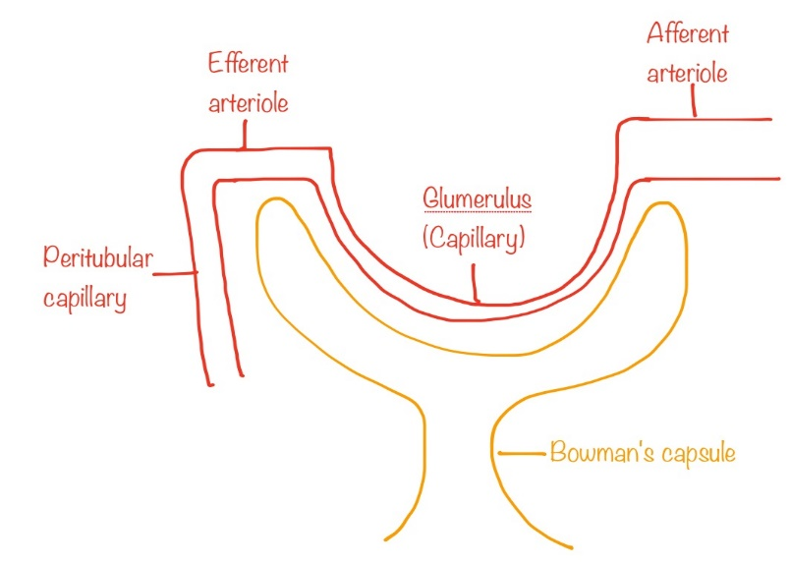
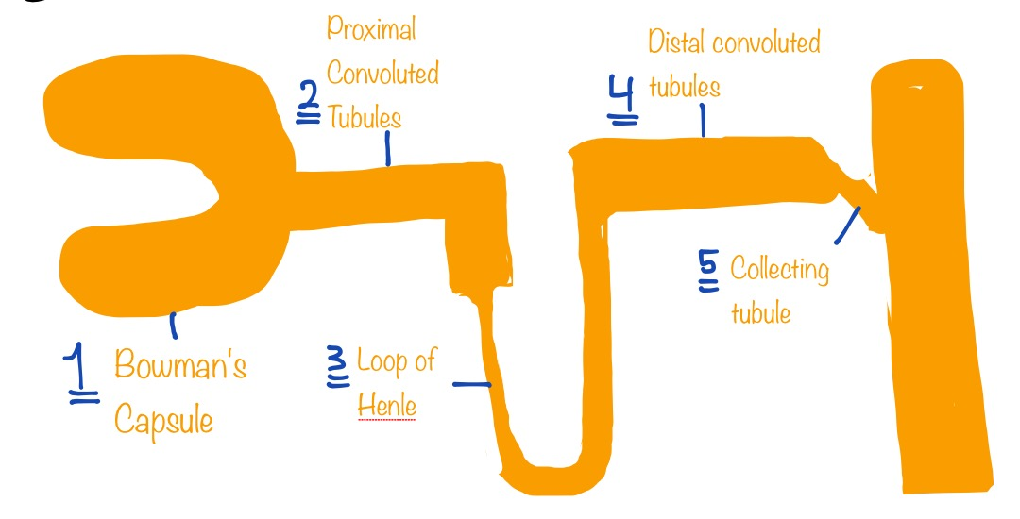
Cont.(Important Notes from 435 )
Note that the pressures along the afferent arteriole, glumerulus and efferent arteriole are high. Why? To increase filtration. • Note that the afferent arteriole is larger than the efferent arteriole
Nephrons
Vessels
Tubes (5)

Slide 5
Cont.
• Guyton corner : ( page 305 ) - The Nephron Is the Functional Unit of the Kidney: Each nephron contains (1) a tuft of glomerular capillaries called the glomerulus, through which large amounts of fluid are filtered from the blood, and (2) a long tubule in which the filtered fluid is converted into urine on its way to the pelvis of the kidney

Slide 6
Cont.(Structure of a Nephron)
Guyton corner : Each nephron has some differences from the others, depending on how deep the nephron lies within the kidney mass. Those nephrons that have glomeruli located in the outer cortex are called cortical nephrons; they have short loops of Henle that penetrate only a short distance into the medulla About 20 to 30 percent of the nephrons have glomeruli that lie deep in the renal cortex near the medulla and are called juxtamedullary nephrons. These nephrons have long loops of Henle that dip deeply into the medulla, in some cases all the way to the tips of the renal papillae. The vascular structures supplying the juxtamedullary nephrons also differ from those supplying the cortical nephrons. For the cortical nephrons, the entire tubular system is surrounded by an extensive network of peritubular capillaries. For the juxtamedullary nephrons, long efferent arterioles extend from the glomeruli down into the outer medulla and then divide into specialized peritubular capillaries called vasa recta that extend downward into the medulla, lying side by side with the loops of Henle. Like the loops of Henle, the vasa recta return toward the cortex and empty into the cortical veins. This specialized network of capillaries in the medulla plays an essential role in the formation of a concentrated urine

Slide 7
Cont.(Structure of a Nephron)
Linda corner: Bowman’s space is continuous with the first portion of the nephron. Blood is ultra filtered across the glomerular capillaries into Bowman’s space, which is the first step in urine formation. The remainder of the nephron is a tubular structure lined with epithelial cells, which serve the functions of reabsorption and secretion. The nephron or renal tubule comprises the following segments (beginning with Bowman’s space): the proximal convoluted tubule, the proximal straight tubule, the loop of Henle (which contains a thin descending limb, a thin ascending limb, and a thick ascending limb), the distal convoluted tubule, and the collecting ducts. Each segment of the nephron is functionally distinct, and the epithelial cells lining each segment have a different ultrastructure. For example, the cells of the proximal convoluted tubule are unique in having an extensive development of microvilli, called a brush border, on their luminal side. The brush border provides a large surface area for the major reabsorptive function of the proximal convoluted tubule. There are two types of nephrons, superficial cortical nephrons and juxtamedullary nephrons, which are distinguished by the location of their glomeruli. The superficial cortical nephrons have their glomeruli in the outer cortex. These nephrons have relatively short loops of Henle, which descend only into the outer medulla. The juxtamedullary nephrons have their glomeruli near the corticomedullary border. The glomeruli of the juxtamedullary nephrons are larger than those of the superficial cortical nephrons and, accordingly, have higher glomerular filtration rates. The juxtamedullary nephrons are characterized by long loops of Henle that descend deep into the inner medulla and papilla and are essential for the concentration of urine.

Slide 8
Cont.
Linda corner: Blood enters each kidney via a renal artery, which branches into interlobar arteries, arcuate arteries, and then cortical radial arteries. The smallest arteries sub- divide into the first set of arterioles, the afferent arterioles. The afferent arterioles deliver blood to the first capillary network, the glomerular capillaries, across which ultrafiltration occurs. Blood leaves the glomerular capillaries via a second set of arterioles, the efferent arterioles, which deliver blood to a second capillary network, the peritubular capillaries. The peritubular capillaries surround the nephrons. Solutes and water are reabsorbed into the peritubular capillaries, and a few solutes are secreted from the peritubular capillaries. Blood from the peritubular capillaries flows into small veins and then into the renal vein. The blood supply of superficial cortical nephrons differs from that of juxtamedullary nephrons. In the superficial nephrons, peritubular capillaries branch off the efferent arterioles and deliver nutrients to the epithelial cells. These capillaries also serve as the blood supply for reabsorption and secretion. In the juxtamedullary nephrons, the peritubular capillaries have a specialization called the vasa recta, which are long, hairpinshaped blood vessels that follow the same course as the loop of Henle. The vasa recta serve as osmotic exchangers for the production of concentrated urine

Slide 9
Cont.(Renal blood flow )
Guyton corner : -In an average 70-kilogram man, the combined blood flow percent of the cardiac output. Considering that the two kidneys constitute only about 0.4 percent of the total body weight, one can readily see that they receive an extremely high blood flow compared with other organs. As with other tissues, blood flow supplies the kidneys with nutrients and removes waste products. However, the high flow to the kidneys greatly exceeds this need. -the kidneys normally consume oxygen at twice the rate of the brain but have almost seven times the blood flow of the brain. Thus, the oxygen delivered to the kidneys far exceeds their metabolic needs, and the arterial-venous extraction of oxygen is relatively low compared with that of most other tissues. -Most of the renal vascular resistance resides in three major segments: interlobular arteries, afferent arterioles, controlled by the sympathetic nervous system, various hormones, and local internal renal control mechanisms. An increase in the resistance of any of the vascular segments of the kidneys tends to reduce the renal blood flow, whereas a decrease in vascular resistance increases renal blood flow if renal artery and renal vein pressures remain constant. -The outer part of the kidney, the renal cortex, receives most of the kidney’s blood flow. Blood flow in the renal medulla accounts for only 1 to 2 percent of the total renal blood flow. Flow to the renal medulla is supplied by a specialized portion of the peritubular capillary system called the vasa recta.
• Linda corner: As with blood flow in any organ, RBF (Q) is directly proportional to the pressure gradient (ΔP) between the renal artery and the renal vein, and it is inversely proportional to the resistance (R) of the renal vasculature. (Recall that Q = ΔP/R. Recall, also, that resistance is provided mainly by the arterioles.) The kidneys are unusual, however, in that there are two sets of arterioles, the afferent and the efferent. The major mechanism for changing blood flow is by changing arteriolar resistance. In the kidney, this can be accomplished by changing afferent arteriolar resistance and/ or efferent arteriolar resistance.

Slide 10
Cont.(Urine formation )
• Guyton corner : The rates at which different substances are excreted in the urine represent the sum of three renal processes, (1) glomerular filtration, (2) reabsorption of substances from the renal tubules into the blood, and (3) secretion of substances from the blood into the renal tubules. Expressed mathematically , Urinary Excretion Rate = Filtration Rate – Reabsorption Rate + Secretion Rate Urine formation begins when a large amount of fluid that is virtually free of protein is filtered from the glomerular capillaries into Bowman‟s capsule. Most substances in the plasma, except for proteins, are freely filtered, so their concentration in the glomerular filtrate in Bowman‟s capsule is almost the same as in the plasma. As filtered fluid leaves Bowman‟s capsule and passes through the tubules, it is modified by reabsorption of water and specific solutes back into the blood or by secretion of other substances from the peritubular capillaries into the tubules
In general, tubular reabsorption is quantitatively more important than tubular secretion in the formation of urine, but secretion plays an important role in determining the amounts of potassium and hydrogen ions and a few other substances that are excreted in the urine. Most substances that must be cleared from the blood, especially the end products of metabolism such as urea, creatinine, uric acid, and urates, are poorly reabsorbed and are therefore excreted in large amounts in the urine. Certain foreign substances and drugs are also poorly reabsorbed but, in addition, are secreted from the blood into the tubules, so their excretion rates are high. Conversely, electrolytes, such as sodium ions, chloride ions, and bicarbonate ions, are highly reabsorbed, so only small amounts appear in the urine. Certain nutritional substances, such as amino acids and glucose, are completely reabsorbed from the tubules and do not appear in the urine even though large amounts are filtered by the glomerular capillaries.

Slide 11
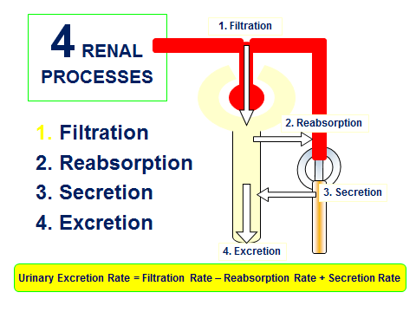
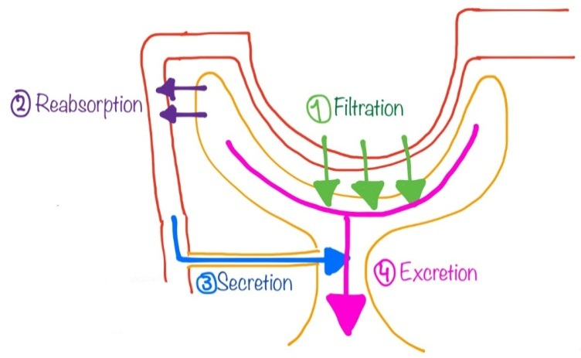
Cont.(Urine formation )

Slide 12
Cont.
Glumerular membrane is made up of: - Endothelial cells - Basement membrane - Podocytes (visceral layer of the capsule) • Passage of molecules through the membrane depends on: 1. Molecular weight 2. Electrical charge
Gluemerular filtration rate depends on: 1. Net Filtration pressure: (Which depends on) A. Hydrostatic pressure of the capillary: - Arterial blood pressure - Afferent ➢ Vasoconstriction (sympathetic stimulation) ➛ Reduced hydrostatic capillary pressure ➛ Less GFR ➢ Vasodilation (parasympathetic stimulation) ➛ More hydrostatic capillary pressure ➛ More GFR - Efferent ➢ Vasoconstriction (Angiotensin II or strong sympthetic stimulation) ➛ More hydrostatic capillary pressure ➛ More GFR ➢ Vasodilation ➛ Less hydrostatic pressure ➛ Less GFR ➢ Severe vasoconstriction ➛ More hydrostatic capillary pressure and even more oncotic capillary pressure ➛ Less GFR B. Oncotic pressure of the capillary: C. Hydrostatic pressure of the capsule (affected by obstruction): - Tumors (e.g. prostatic cancer) - Prostatic hyperplasia/hypertrophy 2 . Capillary filtration coefficient: (Which depends on) A. Filtration barrier permeability B. Surface area of the filtration barrier

Slide 13
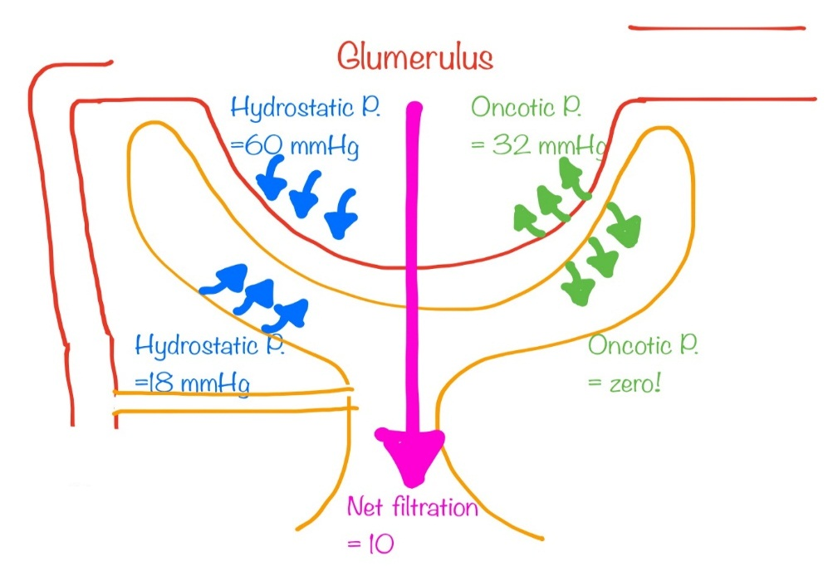
Cont.
Note that, as the afferent arteriole constricts in response to sympathetic stimulation, prostaglandins are released to cause vasodilation to prevent further damage and renal failure. This explains why NSAIDs should not be given at this point.
Why is the oncotic pressure of the capsule zero? Because usually, plasma proteins do not cross the filtration barrier. • Early in diabetes, GFR is high. It drops later due to membrane thickening. • Diabetes and hypertension thicken the membrane, reducing permeability and filtration coefficient.

Slide 14
Cont.
Guyton corner :
The glomerular capillary membrane is similar to that of other capillaries, except that it has three (instead of the usual two) major layers: (1) the endothelium of the capillary, (2) a basement membrane, and (3) a layer of epithelialcells (podocytes) surrounding the outer surface of the capillary basement membrane Together, these layers make up the filtration barrier, which, despite the three layers, filters several hundred times as much water and solutes as the usual capillary membrane. Even with this high rate of filtration, the glomerular capillary membrane normally prevents filtration of plasma proteins.
The high filtration rate across the glomerular capillary membrane is due partly to its special characteristics. The capillary endothelium is perforated by thousands of small holes called fenestrae, similar to the fenestrated capillaries found in the liver. Although the fenestrations are relatively large, endothelial cells are richly endowed
with fixed negative charges that hinder the passage of plasma proteins.
Surrounding the endothelium is the basement membrane, which consists of a meshwork of collagen and proteoglycan fibrillae that have large spaces through which large amounts of water and small solutes can filter. The basement membrane effectively prevents filtration of plasma proteins, in part because of strong negative electrical charges associated with the proteoglycans.
The final part of the glomerular membrane is a layer of epithelial cells that line the outer surface of the glomerulus. These cells are not continuous but have long footlike processes (podocytes) that encircle the outer surface of the capillaries The foot processes are separated by gaps called slit pores through which the glomerular filtrate moves. The epithelial cells, which also have negative charges, provide additional restriction to filtration of plasma proteins. Thus, all layers of the glomerular capillary wall provide a barrier to filtration of plasma proteins.

Slide 15
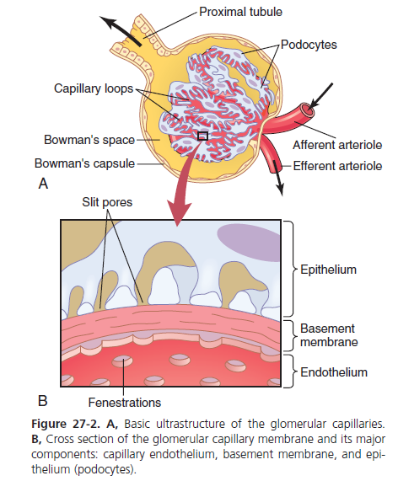
Cont.
Guyton corner :
The glomerular capillary membrane is similar to that of other capillaries, except that it has three (instead of the usual two) major layers:
(1) the endothelium of the capillary,
(2) a basement membrane, and (3) a layer of epithelial cells (podocytes) surrounding the outer surface of the capillary basement membrane. Together, these layers make up the filtration barrier, which, despite the three layers, filters several hundred times as much water and solutes as the usual capillary membrane. Even with this high rate of filtration, the glomerular capillary membrane normally prevents filtration of plasma proteins. The high filtration rate across the glomerular capillary membrane is due partly to its special characteristics. The capillary endothelium is perforated by thousands of small holes called fenestrae, similar to the fenestrated capillaries found in the liver, although smaller than the fenestrae of the liver. Although the fenestrations are relatively large, endothelial cell proteins are richly endowed with fixed negative charges that hinder the passage of plasma proteins.
Surrounding the endothelium is the basement membrane, which consists of a meshwork of collagen and proteoglycan fibrillae that have large spaces through which large amounts of water and small solutes can filter. The basement membrane effectively prevents filtration of plasma proteins, in part because of strong negative electrical charges associated with the proteoglycans. The final part of the glomerular membrane is a layer of epithelial cells that line the outer surface of the glomerulus. These cells are not continuous but have long footlike processes (podocytes) that encircle the outer surface of the capillaries .The foot processes are separated by gaps called slit pores through which the glomerular filtrate moves. The epithelial cells, which also have negative charges, provide additional restriction to filtration of plasma proteins. Thus, all layers of the glomerular capillary wall provide a barrier to filtration of plasma proteins.

Slide 16
Cont.
Linda corner: Layers of the Glomerular Capillary
ENDOTHELIUM
The endothelial cell layer has pores 70 to 100 nanometers (nm) in diameter. Because these pores are relatively large, fluid, dissolved solutes, and plasma proteins all are filtered across this layer of the glomerular capillary barrier. On the other hand, the pores are not so large that blood cells can be filtered.
BASEMENT MEMBRANE
The basement membrane has three layers. The lamina rara interna is fused to the endothelium; the lamina densa is located in the middle of the basement membrane; and the lamina rara externa is fused to the epithelial cell layer. The multilayered basement membrane does not permit filtration of plasma proteins and, therefore, constitutes the most significant barrier of the glomerular capillary.
EPITHELIUM
The epithelial cell layer consists of specialized cells called podocytes, which are attached to the basement membrane by foot processes. Between the foot processes are filtration slits, 25 to 60 nm in diameter, which are bridged by thin diaphragms. Because of the relatively small size of the filtration slits, the epithelial layer (in addition to the basement membrane)

Slide 17
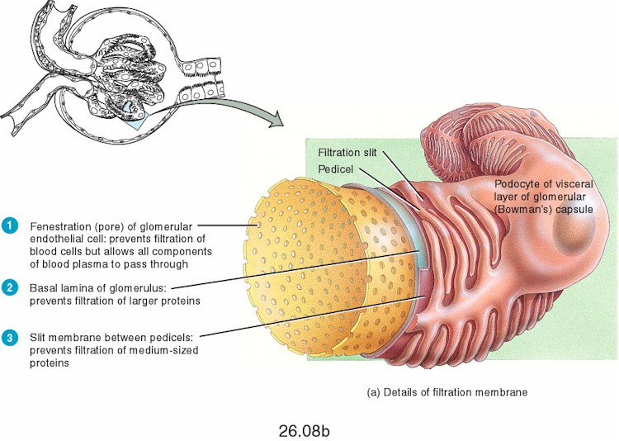
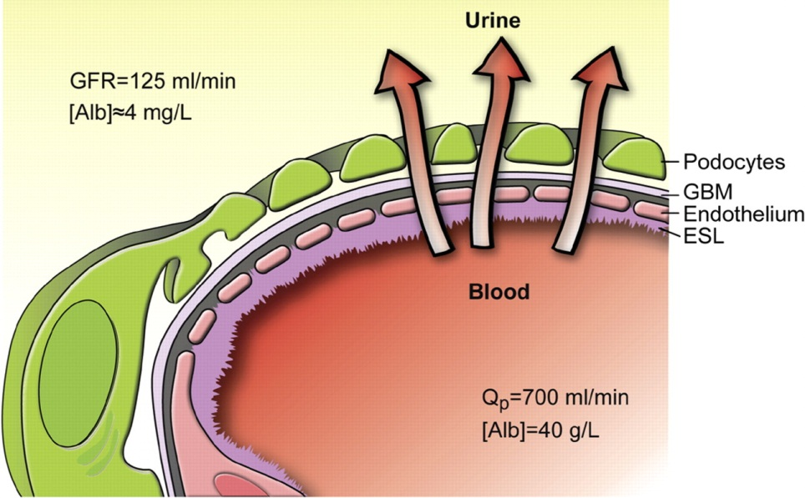
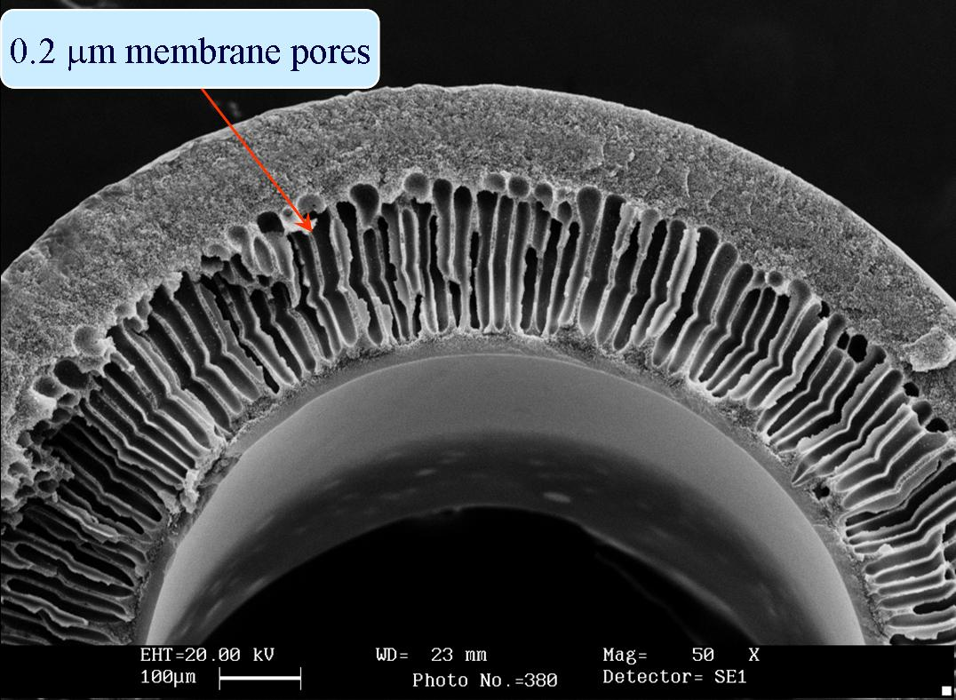
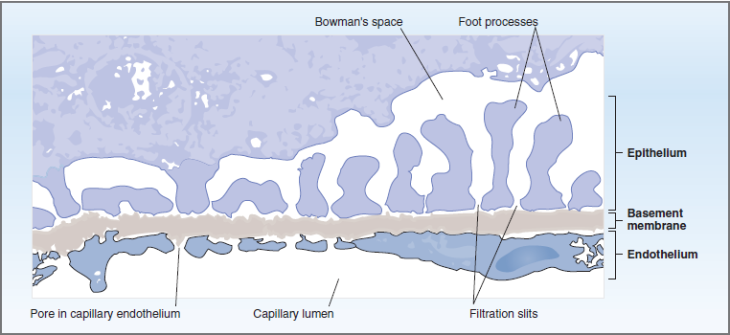
Cont.

Slide 18
Cont.(GFR)
Linda corner:
K_{f}, filtration coefficient, is the water permeability or hydraulic conductance of the glomerular capillary wall. The two factors that contribute to K_{f} are the water permeability per unit of surface area and the total surface area. K_{f} for glomerular capillaries is more than 100-fold that for systemic capillaries (e.g., skeletal muscle capillaries) because of the combination of a higher total surface area and a higher intrinsic water permeability of the barrier. The consequence of this extremely high K_{f} is that much more fluid is filtered from glomerular capillaries than from other capillaries (i.e., GFR is 180 L/day(
Guyton corner :
[ Forces favouring filtration ] :
1) Glomerular hydrostatic pressure= 60 mmHg. 2) Bowman's capsule colloid osmotic pressure = zero mmHg
[ Forces opposing filtration ] :
1) Bowman's capsule hydrostatic pressure = 18 mmHg. 2) Glomerular colloid osmotic pressure = 32 mmHg
- NFP = 60-18-32 = +10 mmHg

Slide 19
Cont.(GFR)
Linda corner:
♦ πGC, oncotic pressure in glomerular capillaries, is another force opposing filtration. πGC is determined by the protein concentration of glomerular capillary blood. πGC does not remain constant along the capillary length; rather, it progressively increases as fluid is filtered out of the capillary. πGC eventually increases to the point where net ultrafiltration pressure becomes zero and glomerular filtration stops (called filtration equilibrium).
Figure 6-10B shows the three Starling pressures at the end of the glomerular capillary. At this point, the blood has been extensively filtered and is about to leave the glomerular capillary to enter the efferent arteriole. The sum of the three Starling pressures now is zero. Because net ultrafiltration is zero, no filtration can occur, a point called filtration equilibrium.
Conveniently, filtration equilibrium normally occurs at the end of the glomerular capillary.
An important question to ask is What causes filtration equilibrium to occur? Stated differently, Which Starling pressure has changed to make the net ultrafiltration pressure zero? To answer this question, compare the Starling pressures at the beginning of the glomerular capillary with those at the end of the capillary. The only pressure that changes is πGC, the oncotic pressure of glomerular capillary blood. As fluid is filtered out of the glomerular capillary, protein is left behind and the protein concentration and πGC increase. By the end of the glomerular capillary, πGC has increased to the point where the net ultrafiltration pressure becomes zero. (A related point is that this blood leaving the glomerular capillaries will become peritubular capillary blood. The peritubular capillary blood will, therefore, have a high oncotic pressure [πc], which becomes a driving force for reabsorption in the proximal tubule of the nephron.) There is no decrease in PGC along the length of the glomerular capillaries, as occurs in systemic capillaries. The difference for glomerular capillaries is the presence of a second set of arterioles, the efferent arterioles. Constriction of efferent arterioles prevents the decline in PGC that would otherwise occur as fluid is filtered out along the length of the glomerular capillaries.

Slide 20
Cont.
This slide has questions that the doctor gave 435 as homework, have a look at them.
Q1 : Read more about Renin; where is it synthesized ?
Guyton corner :
The Renin-Angiotensin System : Its Role in Arterial Pressure Control
Aside from the capability of the kidneys to control arterial pressure through changes in extracellular fluid volume, the kidneys also have another powerful mechanism for controlling pressure. It is the renin-angiotensin system.
Renin is a protein enzyme released by the kidneys when the arterial pressure falls too low. In turn, it raises the arterial pressure in several ways, thus helping to correct the initial fall in pressure.
Renin is synthesized and stored in an inactive form called prorenin in the juxtaglomerular cells (JG cells) of the kidneys. The JG cells are modified smooth muscle cells located in the walls of the afferent arterioles immediately proximal to the glomeruli. When the arterial pressure falls, intrinsic reactions in the kidneys themselves cause many of the prorenin molecules in the JG cells to split and release renin. Most of the renin enters the renal blood and then passes out of the kidneys to circulate throughout the entire body. However, small amounts of the renin do remain in the local fluids of the kidney and initiate several intrarenal functions. Page 220

Slide 21
Cont.
Q2 : Why does GFR increase in high protein diet and hyperglycemia ?
Guyton corner : Page 321
Other Factors That Increase Renal Blood Flow and GFR: High Protein Intake and Increased Blood Glucose
Although renal blood flow and GFR are relatively stable under most conditions, there are circumstances in which these variables change significantly. For example, a high protein intake is known to increase both renal blood flow and GFR. With a chronic high-protein diet, such as one that contains large amounts of meat, the increases in GFR and renal blood flow are due partly to growth of the kidneys. However, GFR and renal blood flow increase 20 to 30 percent within 1 or 2 hours after a person eats a high-protein meal.
One likely explanation for the increased GFR is the following: A high-protein meal increases the release of amino acids into the blood, which are reabsorbed in the proximal tubule. Because amino acids and sodium are reabsorbed together by the proximal tubules, increased amino acid reabsorption also stimulates sodium reabsorption in the proximal tubules. This decreases sodium delivery to the macula densa which elicits a tubuloglomerular feedback–mediated decrease in resistance of the afferent arterioles, as discussed earlier. The decreased afferent arteriolar resistance then raises renal blood flow and GFR. This increased GFR allows sodium excretion to be maintained at a nearly normal level while increasing the excretion of the waste products of protein metabolism, such as urea.

Slide 22
Cont.
A similar mechanism may also explain the marked increases in renal blood flow and GFR that occur with large increases in blood glucose levels in uncontrolled diabetes mellitus. Because glucose, like some of the amino acids, is also reabsorbed along with sodium in the proximal tubule, increased glucose delivery to the tubules causes them to reabsorb excess sodium along with glucose. This, in turn, decreases delivery of sodium chloride to the macula densa, activating a tubuloglomerular feedback-mediated dilation of the afferent arterioles and subsequent increases in renal blood flow and GFR.
These examples demonstrate that renal blood flow and GFR per se are not the primary variables controlled by the tubuloglomerular feedback mechanism. The main purpose of this feedback is to ensure a constant delivery of sodium chloride to the distal tubule, where final processing of the urine takes place. Thus, disturbances that tend to increase reabsorption of sodium chloride at tubular sites before the macula densa tend to elicit increased renal blood flow and GFR, which helps return distal sodium chloride delivery toward normal so that normal rates of sodium and water excretion can be maintained .
An opposite sequence of events occurs when proximal tubular reabsorption is reduced. For example, when the proximal tubules are damaged (which can occur as a result of poisoning by heavy metals, such as mercury, or large doses of drugs, such as tetracyclines), their ability to reabsorb sodium chloride is decreased. As a consequence, large amounts of sodium chloride are delivered to the distal tubule and, without appropriate compensations, would quickly cause excessive volume depletion. One of the important compensatory responses appears to be a tubuloglomerular feedback–mediated renal vasoconstriction that occurs in response to the increased sodium chloride delivery to the macula densa in these circumstances. These examples again demonstrate the importance of this feedback mechanism in ensuring that the distal tubule receives the proper rate of delivery of sodium chloride, other tubular fluid solutes, and tubular fluid volume so that appropriate amounts of these substances are excreted in the urine.

Slide 23
Lecture 2
Inulin Clearance Can Be Used to Estimate GFR :
If a substance is freely filtered (filtered as freely as water) and is not reabsorbed or secreted by the renal tubules, then the rate at which that substance is excreted in the urine is equal to the filtration rate of the substance by the kidneys.
A substance that fits these criteria is inulin, a polysaccharide molecule with a molecular weight of about 5200. Inulin, which is not produced in the body, is found in the roots of certain plants and must be administered intravenously to a patient to measure GFR.
Creatinine Clearance and Plasma Creatinine Concentration Can Be Used to Estimate GFR : Creatinine is a by-product of muscle metabolism and is cleared from the body fluids almost entirely by glomerular filtration. Therefore, the clearance of creatinine can also be used to assess GFR. Because measurement of creatinine clearance does not require intravenous infusion into the patient, this method is much more widely used than inulin clearance for estimating GFR clinically. However, creatinine clearance is not a perfect marker of GFR because a small amount of it is secreted by the tubules, so the amount of creatinine excreted slightly exceeds the amount filtered. There is normally a slight error in measuring plasma creatinine that leads to an overestimate of the plasma creatinine concentration, and fortuitously, these two errors tend to cancel each other. Therefore, creatinine clearance provides a reasonable estimate of GFR

Slide 24
Cont.
Guyton corner :
Feedback mechanisms intrinsic to the kidneys normally keep the renal blood flow and GFR relatively constant, despite
marked changes in arterial blood pressure. These mechanisms still function in blood-perfused kidneys that have been removed from the body, independent of systemic influences. This relative constancy of GFR and renal blood flow is referred to as auto regulation (Figure 26-17)
The major function of auto regulation in the kidneys is to maintain a relatively constant GFR and to allow precise control of renal excretion of water and solutes. The GFR normally remains auto regulated (that is, remains relatively constant), despite considerable arterial pressure fluctuations that occur during a person's usual activities. For instance, a decrease in arterial pressure to as low as 75 mm Hg or an increase to as high as 160 mm Hg usually changes GFR less than 10 percent. In general, renal blood flow is auto regulated in parallel with GFR, but GFR is more efficiently auto regulated under certain conditions. Importance of GFR Auto regulation in Preventing Extreme Changes in Renal Excretion
Linda corner:
The only way to maintain this constancy of blood flow in the phase of changing arterial pressure is by varying the resistance of the arterioles. Thus, as renal arterial pressure increases or decreases, renal resistance must increase or decrease proportionately (recall that Q = ΔP/R).

Slide 25
Cont.
Guyton corner :
The juxtaglomerular complex consists of macula densa cells in the initial portion of the distal tubule and juxtaglomerular cells in the walls of the afferent and efferent arterioles. The macula densa is a specialized group of epithelial cells in the distal tubules that comes in close contact with the afferent and efferent arterioles. The macula densa cells contain Golgi apparatus, which are intracellular secretory organelles directed toward the arterioles, suggesting that these cells may be secreting a substance toward the arterioles.
If we are in stressful condition our blood pressure increases →the blood flow increase which result in increased hydrostatic pressure→NFP increase→GFR increase. But even though we don’t urinate, why? Because kidney has mechanism to regulate by itself (auto regulation ) within certain blood pressure range .
If the BP within 75-160 the kidney is auto regulated which mean GFR is constant . And its auto regulated by 2 mechanism THE 1ST one is myogenic mechanism : if the BP increases the renal blood flow increases which will stretch the A.A this will stimulate Ca+2 channels to open→Ca+2 influx to smooth muscle cells in the wall of A.A leading to vasoconstriction → decreased blood flow → decreased Pg→ decreased NFP→ decreased GFR .
Remember :GFR in addition to renal plasma flow are constant → due to autoregulation
At the beginning of distal convoluted tubules ( between A.A & E.A ) there are cells called macula densa cells. The cells opposite to macula densa are called juxtaglomerular cells. Macula densa is sensitive to NaCl (salt). Let’s say BP is increased, fluid going to A.A increases therefore increased GFR, and the filtrated fluid in proximal convoluted tubules increases and moves very fast which make no time for reabsorption in PCT. When this fluid reach to macula densa in DCT it will sense high sodium chloride and send signals that stimulate vasoconstriction of A.A . In addition, it prevents release of renin by juxtaglomerular cells and prevent production of Ang II, no vasoconstriction of E.A.
Low BP→ Low blood flow →low Pg →low GFR → Fluids enter the proximal convoluted tubule are low and move slowly which make them reabsorbed→Decrease delivery of NaCl to the macula densa cells→vasodilatation of Afferentarterioles→IncreaseinReninreleasefromthejuxtaglomerularcellsto→AngII→ cause vasoconstriction of EFFERNT Arteriole. Inaddition,itstimulatesjuxtaglomerularcellstoreleaserenin→produceAngII→causing vasoconstriction of E.A.

Slide 26
Cont.
Guyton corner :
Tubuloglomerular Feedback and Autoregulation of GFR
Decreased Macula Densa Sodium Chloride Causes Dilation of Afferent Arterioles and Increased Renin Release. The macula densa cells sense changes in volume delivery to the distal tubule by way of signals that are not completely understood. Experimental studies suggest that decreased GFR slows the flow rate in the loop of Henle, causing increased reabsorption of sodium and chloride ions in the ascending loop of Henle, thereby reducing the concentration of sodium chloride at the macula densa cells. This decrease in sodium chloride concentration initiates a signal from the macula densa that has two effects (Figure 26-19): (1) It decreases resistance to blood flow in the afferent arterioles, which raises glomerular hydrostatic pressure and helps return GFR toward normal, and (2) it increases renin release from the juxtaglomerular cells of the afferent and efferent arterioles, which are the major storage sites for renin. Renin released from these cells then functions as an enzyme to increase the formation of angiotensin I, which is converted to angiotensin II. Finally, the angiotensin II constricts the efferent arterioles, thereby increasing glomerular hydrostatic pressure and helping to return GFR toward normal.These two components of the tubuloglomerular feedback mechanism, operating together by way of the special anatomical structure of the juxtaglomerular apparatus, provide feedback signals to both the afferent and the efferent arterioles for efficient autoregulation of GFR during changes in arterial pressure. When both of these mechanisms are functioning together, the GFR changes only a few percentage points, even with large fluctuations in arterial pressure between the limits of 75 and 160 mm Hg.

Slide 27
Cont.
Guyton corner pg321 :
Another mechanism that contributes to the maintenance of a relatively constant renal blood flow and GFR is the
ability of individual blood vessels to resist stretching during increased arterial pressure, a phenomenon referred to as the myogenic mechanism. Studies of individual blood vessels (especially small arterioles) throughout the body have shown that they respond to increased wall tension or wall stretch by contraction of the vascular smooth muscle. Stretch of the vascular wall allows increased movement of calcium ions from the extracellular fluid into the cells, causing them to contract ,This contraction prevents excessive stretch of the vessel and at the same time, by raising vascular resistance, helps prevent excessive increases in renal blood flow and GFR when arterial pressure increases.
Although the myogenic mechanism probably operates in most arterioles throughout the body, its importance in renal blood flow and GFR autoregulation has been questioned by some physiologists because this pressure sensitive mechanism has no means of directly detecting changes in renal blood flow or GFR per se. On the other hand, this mechanism may be more important in protecting the kidney from hypertension-induced injury. In response to sudden increases in blood pressure, the myogenic constrictor response in afferent arterioles occurs within seconds and therefore attenuates transmission of increased arterial pressure to the glomerular capillaries
• Linda corner pg252:
The myogenic hypothesis states that increased arterial pressure stretches the blood vessels, which causes reflex
contraction of smooth muscle in the blood vessel walls and consequently increased resistance to blood flow The mechanism of stretch-induced contraction involves the opening of stretch-activated calcium (Ca2+) channels in the smooth muscle cell membranes. When these channels are open, more Ca2+ enters vascular smooth muscle cells, leading to more tension in the blood vessel wall. The myogenic hypothesis explains autoregulation of RBF as follows: Increases in renal arterial pressure stretch the walls of the afferent arterioles, which respond by contracting. Afferent arteriolar contraction leads to increased afferent arteriolar resistance. The increase in resistance then balances the increase in arterial pressure, and RBF is kept constant

Slide 28
Cont.
Guyton corner :
The kidneys also contribute to short-term arterial pressure regulation by secreting hormones and vasoactive factors or substances (e.g., renin) that lead to the formation of vasoactive products (e.g., angiotensin II).
Hormones that constrict afferent and efferent arterioles, causing reductions in GFR and renal blood flow, include norepinephrine and epinephrine released from the adrenal medulla. In general, blood levels of these hormones parallel the activity of the sympathetic nervous system; thus, norepinephrine and epinephrine have little influence on renal hemodynamics except under extreme conditions, such as severe hemorrhage. Several hormones and autacoids can influence GFR and renal blood flow, as summarized in Table 26-4

Slide 29
Cont.
Guyton corner :
Angiotensin II is a powerful renal vasoconstrictor, Receptors for angiotensin II are present in virtually all blood vessels of the kidneys. However, the preglomerular blood vessels, especially the afferent arterioles, appear to be relatively protected from angiotensin II–mediated constriction in most physiologic conditions.The efferent arterioles, however, are highly sensitive to angiotensin II. increased angiotensin II levels raise glomerular hydrostatic pressure while reducing renal blood flow.
Linda corner:
Angiotensin II is a potent vasocon-strictor of
both afferent and efferent arterioles.The effect of angiotensin on RBF is clear: It constricts both sets of arterioles, increases resistance, and decreases blood flow. However, efferent arterioles are more sensitive to angiotensin II than afferent arterioles, and this difference in sensitivity has con-sequences for its effect on GFR. Briefly, low levels of angiotensin II produce an increase in GFR by constricting efferent arterioles, while high levels of angiotensin II produce a decrease in GFR by constricting both afferent and efferent arterioles.

Slide 30
Cont.
Guyton corner :
Essentially all the blood vessels of the kidneys, including the afferent and the efferent arterioles, are richly innervated by sympathetic nerve fibers. Strong activation of the renal sympathetic nerves can constrict the renal arterioles and decrease renal blood flow and GFR. Moderate or mild sympathetic stimulation has little influence on renal blood flow and GFR
Linda corner:
Both afferent and efferent arterioles are innervated by sympathetic nerve fibers that produce vasoconstriction by activating α1 receptors. However, because there are far more α1 receptors on afferent arterioles, increased sympathetic nerve activity causes a decrease in both RBF and GFR.

Slide 31
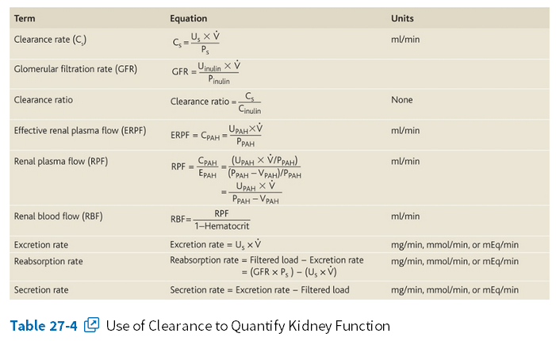

Lecture 3 (concepts of clearance)
Guyton’s corner :
C_{s} is the clearance rate of a substance s, P_{s} is the plasma concentration of the substance, U_{s} is the urine concentration of that substance, and V is the urine flow rate. Rearranging this equation, clearance can be expressed as :
Thus, renal clearance of a substance is calculated from the urinary excretion rate (U_{s} × V) of that substance divided by its plasma concentration.
Guyton corner :
The rates at which different substances are “cleared” from the plasma provide a useful way of quantitating the effectiveness with which the kidneys excrete various substances (Table 27-4). By definition, the renal clearance of a substance is the volume of plasma that is completely cleared of the substance by the kidneys per unit time.
This concept is somewhat abstract because there is no single volume of plasma that is completely cleared of a substance. However, renal clearance provides a useful way of quantifying the excretory function of the kidneys and, as discussed later, can be used to quantify the rate at which blood flows through the kidneys, as well as the basic functions of the kidneys: glomerular filtration, tubular reabsorption, and tubular secretion.
To illustrate the clearance principle, consider the following example: If the plasma passing through the kidneys contains 1 milligram of a substance in each milliliter and if 1 milligram of this substance is also excreted into the urine each minute, then 1 ml/min of the plasma is “cleared” of the substance. Thus, clearance refers to the volume of plasma that would be necessary to supply the amount of substance excreted in the urine per unit time.

Slide 32
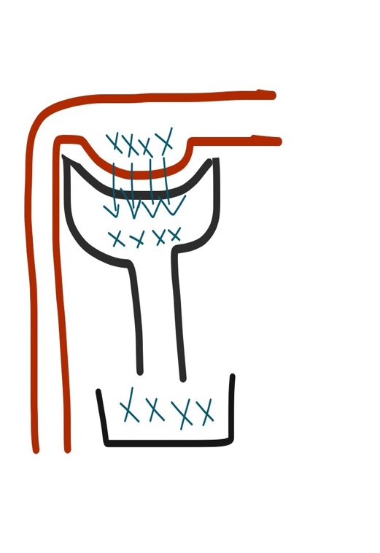
Cont.
الجسم يتعامل مع أي مادة عن طريق أربعة طرق :
clearance : 100%
amount filtered = amount excreted
0% reabsorbed
0% secreted
GFR اذا المادة ما صار لها سيكريشن ولا اكسكريشن راح تساوي
لأنها زي ما دخلت طلعت. نتكلم عن الكمية اما بالنسبة للتركيز راح يختلف. ليش؟ مثلا لو اعطينا بنت كوب موية كبير وبنت ثانية كوب موية صغير وحطينا ملعقة سكر في كل الكوبين، بيكون تركيز السكر في الصغير اعلى من الكبير. فالكمية نفسها لكن التركيز غير
example of substance that help us indicate GFR: inulin&creatinine
we cannot say that inulin is completely cleared; because there is still some amount of it that is unfiltered. We say that the “amount filtered” is completely cleared.
Steady state بما ان مادة انيولين تاخذ وقت في حساب كليرنس لاننا تحتاج حقن المريض بها وانتظار
صار كريتينين هو المادة البديلة لإنيولين لانه موجود بالجسم . صحيح انه يصير له سيكريشن ١٠٪ بس تبين لهم أنهم لما يحسبون كميته بالدم يكون تركيزه أعلى من الحقيقي بقليل فبالتالي راح يعطينا نتيجة طبيعية والسيكريشن ماراح يؤثر بالنتيجة
1

Slide 33
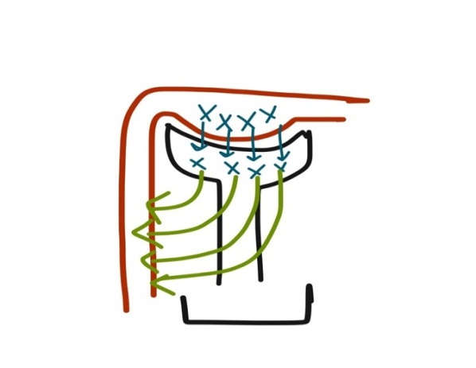
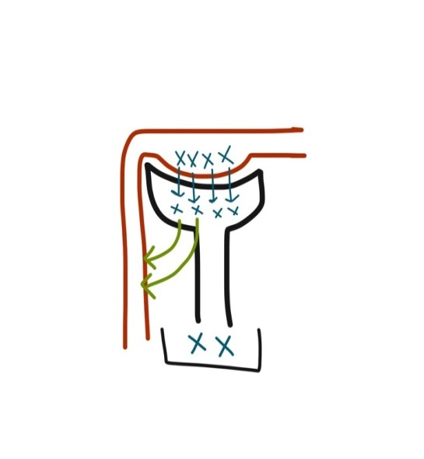
Cont.
Partially reabsorbed
Partially cleared
Example : Na+ ions , urea
2
3
100% reabsorbed
0% clearance
Example: glucose
glucose max الجلكوز له خاصية
للجلكوز excretionإذا تعداه يصير reabsorption بمعنى إنه له حد في الـ
reabsorption مثلاَ لو كان الجلكوز ١٠٠ راح يصير له كله
لكن لو وصل تركيزه ٢٠٠ هنا يبدأ الجلكوز يطلع مع البول لأنه تعدى الكمية الي ممكن تستوعبها
carriersالـ
350تستمر حتى يوصل تركيز الجلكوز لـ Reabsorption عملية الـ
هنا تتوقف العملية بشكل تام.
السبب وراء استمرارها حتى بعد ما تتعدى الـ Threshold
هو لأن كل نيفرون مختلفة عن الثانية من ناحية قدرتها على إعادة الامتصاص. بعضها توقف عند
ثم تتوقف 350 والبعض تستمر لحد 200
200 الجلكوز الطبيعي في الدم ما يتعدى

Slide 34
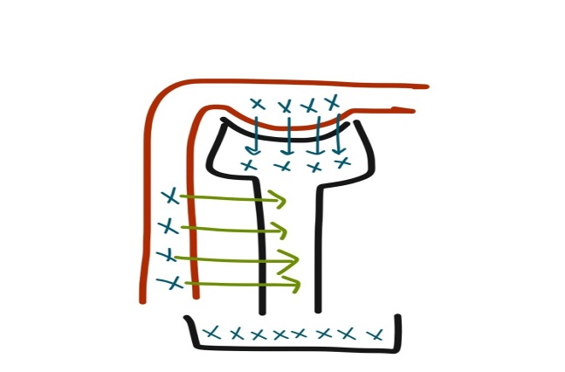
Cont.
4
clearance of substance that is completely filtered and secreted = 0% reabsorption
  Ex: para aminohippuric acid
amount entered the nephron = amount excreted + 10%
( عشان ما تأثر في النتيجة 10% تبقى في الدم ومايحصل لها سكريشن فلذلك نضيف 10% كمية قليلة من المادة (
peritubular arterioles للـ 80% من المادة المارة فيلتريشن يروح باقي الـ 20% بمعنى لما يصير للـ
ويحصله سيكريشن فيكون الدم تخلص تماماً من هذه المادة.
What can we indicate from this substance?
By measuring the clearance of the substance we know the renal plasma flow. Therefore we can calculate the whole blood flow by :
RPF (560) = 55%
RBF = 100%
RBF= 560 x 100 / 55 = 1018 ml/min

Slide 35
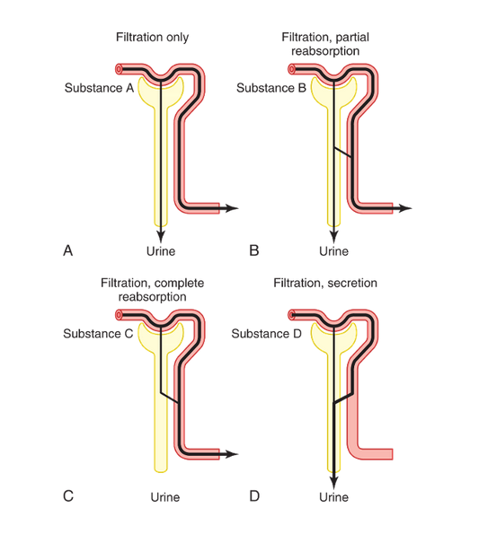
Cont.
Guyton corner :
Figure 26-10 shows the renal handling of four hypothetical substances. The substance shown in panel A is freely filtered by the glomerular capillaries but is neither reabsorbed nor secreted. Therefore, its excretion rate is equal to the rate at which it was filtered. Certain waste products in the body, such as creatinine, are handled by the kidneys in this manner, allowing excretion of essentially all that is filtered.
In panel B, the substance is freely filtered but is also partly reabsorbed from the tubules back into the blood. Therefore, the rate of urinary excretion is less than the rate of filtration at the glomerular capillaries. In this case, the excretion rate is calculated as the filtration rate minus the reabsorption rate. This is typical for many of the electrolytes of the body such as sodium and chloride ions.
In panel C, the substance is freely filtered at the glomerular capillaries but is not excreted into the urine because all the filtered substance is reabsorbed from the tubules back into the blood. This pattern occurs for some of the nutritional substances in the blood, such as amino acids and glucose, allowing them to be conserved in the body fluids.
The substance in panel D is freely filtered at the glomerular capillaries and is not reabsorbed, but additional quantities of this substance are secreted from the peritubular capillary blood into the renal tubules. This pattern often occurs for organic acids and bases, permitting them to be rapidly cleared from the blood and excreted in large amounts in the urine. The excretion rate in this case is calculated as filtration rate plus tubular secretion rate.For each substance in the plasma, a particular combination of filtration, reabsorption, and secretion occurs. The rate at which the substance is excreted in the urine depends on the relative rates of these three basic renal processes.

Slide 36
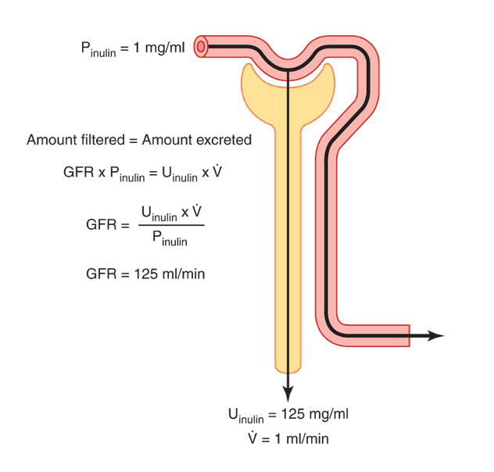
Cont.
Guyton corner :
Inulin Clearance Can Be Used to Estimate GFR
If a substance is freely filtered (filtered as freely as water) and is not reabsorbed or secreted by the renal tubules, then the rate at which that substance is excreted in the urine (U_{s} × V) is equal to the filtration rate of the substance by the kidneys (GFR × P_{s}). Thus,
The GFR, therefore, can be calculated as the clearance of the substance as follows:
A substance that fits these criteria is inulin, a polysaccharide molecule with a molecular weight of about 5200. Inulin, which is not produced in the body, is found in the roots of certain plants and must be administered intravenously to a patient to measure GFR.
Figure 27-19 shows the renal handling of inulin. In this example, the plasma concentration is 1 mg/ml, urine concentration is 125 mg/ml, and urine flow rate is 1 ml/min. Therefore, 125 mg/min of inulin passes into the urine. Then, inulin clearance is calculated as the urine excretion rate of inulin divided by the plasma concentration, which yields a value of 125 ml/min. Thus, 125 milliliters of plasma flowing through the kidneys must be filtered to deliver the inulin that appears in the urine.
Inulin is not the only substance that can be used for determining GFR. Other substances that have been used clinically to estimate GFR include radioactive iothalamate and creatinine.

Slide 37
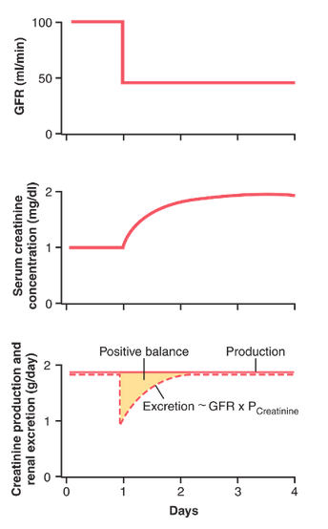
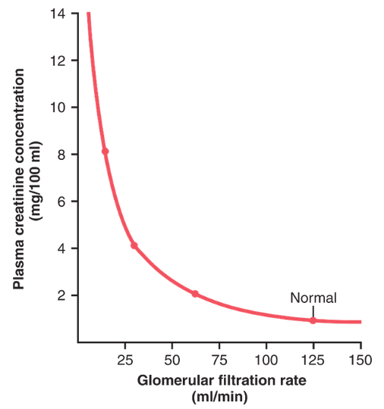
Cont.
Guyton corner :
Creatinine Clearance and Plasma Creatinine Concentration Can Be Used to Estimate GFR
Creatinine is a by-product of muscle metabolism and is cleared from the body fluids almost entirely by glomerular filtration. Therefore, the clearance of creatinine can also be used to assess GFR. Because measurement of creatinine clearance does not require intravenous infusion into the patient, this method is much more widely used than inulin clearance for estimating GFR clinically. However, creatinine clearance is not a perfect marker of GFR because a small amount of it is secreted by the tubules, so the amount of creatinine excreted slightly exceeds the amount filtered. There is normally a slight error in measuring plasma creatinine that leads to an overestimate of the plasma creatinine concentration, and fortuitously, these two errors tend to cancel each other. Therefore, creatinine clearance provides a reasonable estimate of GFR.
In some cases, it may not be practical to collect urine in a patient for measuring creatinine clearance (C_{Cr}). An approximation of changes in GFR, however, can be obtained by simply measuring plasma creatinine concentration (P_{Cr}), which is inversely proportional to GFR:
If GFR suddenly decreases by 50%, the kidneys will transiently filter and excrete only half as much creatinine, causing accumulation of creatinine in the body fluids and raising plasma concentration. Plasma concentration of creatinine will continue to rise until the filtered load of creatinine (P_{Cr} × GFR) and creatinine excretion (U_{Cr} × ) return to normal and a balance between creatinine production and creatinine excretion is re-established. This will occur when plasma creatinine increases to approximately twice normal, as shown in Figure 27-20.
Figure 27-21 Approximate relationship between glomerular filtration rate (GFR) and plasma… If GFR falls to one-fourth normal, plasma creatinine would increase to about four times normal and a decrease of GFR to one-eighth normal would raise plasma creatinine to eight times normal. Thus, under steady-state conditions, the creatinine excretion rate equals the rate of creatinine production, despite reductions in GFR. However, this normal rate of creatinine excretion occurs at the expense of elevated plasma creatinine concentration, as shown in Figure 27-21.

Slide 38
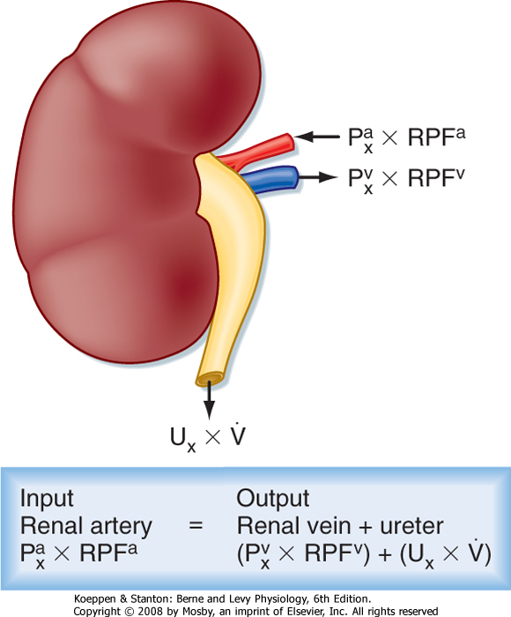
Cont.
What goes into the nephrons = What leaves the nephrons:

Slide 39
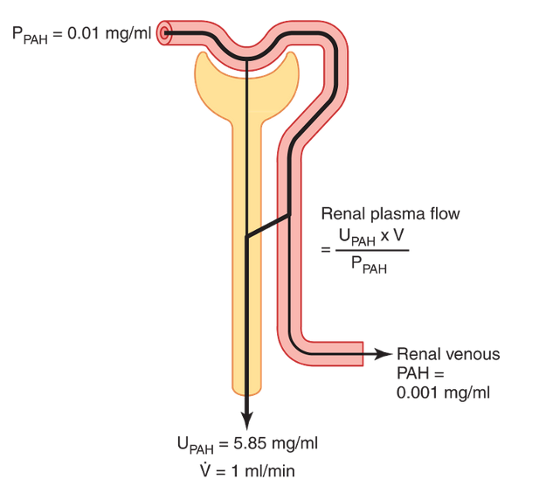



Cont.
Guyton corner :
PAH Clearance Can Be Used to Estimate Renal Plasma Flow
Theoretically, if a substance is completely cleared from the plasma, the clearance rate of that substance is equal to the total renal plasma flow. In other words, the amount of the substance delivered to the kidneys in the blood (renal plasma flow × P_{s}) would be equal to the amount excreted in the urine (U_{s} × ). Thus, renal plasma flow (RPF) could be calculated as :
Because the GFR is only about 20 percent of the total plasma flow, a substance that is completely cleared from the plasma must be excreted by tubular secretion, as well as glomerular filtration (Figure 27-22). There is no known substance that is completely cleared by the kidneys. One substance, however, PAH, is about 90 percent cleared from the plasma. Therefore, the clearance of PAH can be used as an approximation of renal plasma flow. To be more accurate, one can correct for the percentage of PAH that is still in the blood when it leaves the kidneys. The percentage of PAH removed from the blood is known as the extraction ratio of PAH and averages about 90 percent in normal kidneys. In diseased kidneys, this extraction ratio may be reduced because of inability of damaged tubules to secrete PAH into the tubular fluid.
The calculation of RPF can be demonstrated by the following example: Assume that the plasma concentration of PAH is 0.01 mg/ml, urine concentration is 5.85 mg/ml, and urine flow rate is 1 ml/min. PAH clearance can be calculated from the rate of urinary PAH excretion (5.85 mg/ml × 1 ml/min) divided by the plasma PAH concentration (0.01 mg/ml). Thus, clearance of PAH calculates to be 585 ml/min. If the extraction ratio for PAH is 90 percent, the actual renal plasma flow can be calculated by dividing 585 ml/min by 0.9, yielding a value of 650 ml/min. Thus, total renal plasma flow can be calculated as :
The extraction ratio (E_{PAH}) is calculated as the difference between the renal arterial PAH (P_{PAH}) and renal venous PAH (V_{PAH}) concentrations, divided by the renal arterial PAH concentration :
One can calculate the total blood flow through the kidneys from the total renal plasma flow and hematocrit (the percentage of red blood cells in the blood). If the hematocrit is 0.45 and the total renal plasma flow is 650 ml/min, the total blood flow through both kidneys is 650/(1 to 0.45), or 1182 ml/min.

Slide 40
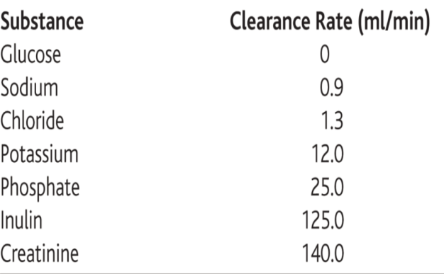
Cont.
Guyton corner :
Comparisons of Inulin Clearance with Clearances of Different Solutes
The following generalizations can be made by comparing the clearance of a substance with the clearance of inulin, a measure of GFR:
If the clearance rate of the substance equals that of inulin, the substance is only filtered and not reabsorbed or secreted
if the clearance rate of a substance is less than inulin clearance, the substance must have been reabsorbed by the nephron tubules.
if the clearance rate of a substance is greater than that of inulin, the substance must be secreted by the nephron tubules.
Listed below are the approximate clearance rates for some of the substances normally handled by the kidneys:

Slide 41
Cont.
Guyton corner :
Calculation of Tubular Reabsorption or Secretion from Renal Clearances
If the rates of glomerular filtration and renal excretion of a substance are known, one can calculate whether there is a net reabsorption or a net secretion of that substance by the renal tubules. For example, if the rate of excretion of the substance (U_{s} × ) is less than the filtered load of the substance (GFR × P_{s}), then some of the substance must have been reabsorbed from the renal tubules.
Conversely, if the excretion rate of the substance is greater than its filtered load, then the rate at which it appears in the urine represents the sum of the rate of glomerular filtration plus tubular secretion.
The following example demonstrates the calculation of tubular reabsorption. Assume the following laboratory values for a patient were obtained:
Urine flow rate = 1 ml/min
Urine concentration of sodium (U_{Na}) = 70 mEq/L = 70 μEq/ml
Plasma sodium concentration = 140 mEq/L = 140 μEq/ml
GFR (inulin clearance) = 100 ml/min
In this example, the filtered sodium load is GFR × P_{Na}, or 100ml/min × 140 μEq/ml = 14,000 μEq/min. Urinary sodium excretion (U_{Na} × urine flow rate) is 70 μEq/min. Therefore, tubular reabsorption of sodium is the difference between the filtered load and urinary excretion,
or 14,000 μEq/min - 70 μEq/min = 13,930 μEq/min.

Slide 42

Cont.
Guyton corner :
Filtration Fraction Is Calculated from GFR Divided by Renal Plasma Flow
To calculate the filtration fraction, which is the fraction of plasma that filters through the glomerular membrane, one must first know the renal plasma flow (PAH clearance) and the GFR (inulin clearance). If renal plasma flow is 650 ml/min and GFR is 125 ml/min, the filtration fraction (FF) is calculated as :

Slide 43
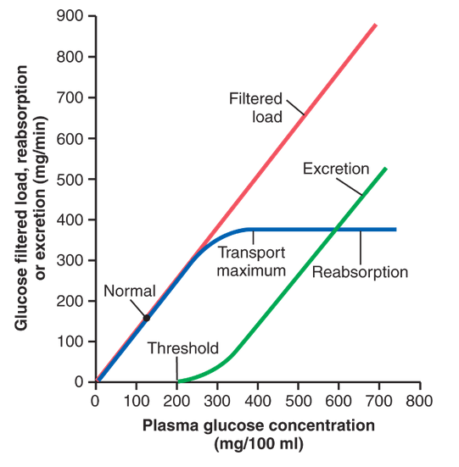
Cont.
Guyton corner :
Tubular reabsorption is highly selective. Some substances, such as glucose and amino acids, are almost completely reabsorbed from the tubules, so the urinary excretion rate is essentially zero. Many of the ions in the plasma, such as sodium, chloride, and bicarbonate, are also highly reabsorbed, but their rates of reabsorption and urinary excretion are variable, depending on the needs of the body. Waste products, such as urea and creatinine, conversely, are poorly reabsorbed from the tubules and excreted in relatively large amounts.
Relations among the filtered load of glucose, the rate of glucose reabsorption by the renal tubules, and the rate of glucose excretion in the urine. The transport maximum is the maximum rate at which glucose can be reabsorbed from the tubules. The threshold for glucose refers to the filtered load of glucose at which glucose first begins to be excreted in the urine.

Slide 44
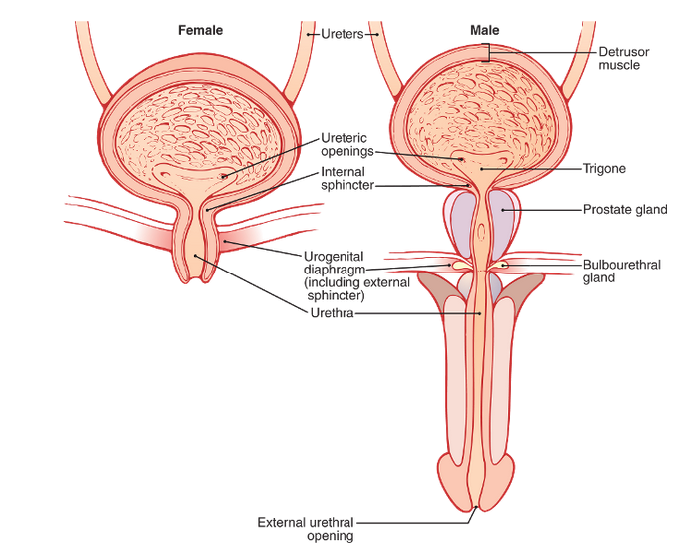
Lecture 4
Guyton:
The urinary bladder, shown in Figure, is a smooth muscle chamber composed of two main parts:
the body, which is the major part of the bladder in which urine collects.
the neck, which is a funnel-shaped extension of the body, passing inferiorly and anteriorly into the urogenital triangle and connecting with the urethra. The lower part of the bladder neck is also called the posterior urethra because of its relation to the urethra.
The smooth muscle of the bladder is called the detrusor muscle. Its muscle fibers extend in all directions and, when contracted, can increase the pressure in the bladder to 40 to 60 mm Hg. Thus, contraction of the detrusor muscle is a major step in emptying the bladder. Smooth muscle cells of the detrusor muscle fuse with one another so that low-resistance electrical pathways exist from one muscle cell to the other. Therefore, an action potential can spread throughout the detrusor muscle, from one muscle cell to the next, to cause contraction of the entire bladder at once. (IMPORTANT)
On the posterior wall of the bladder, lying immediately above the bladder neck, is a small triangular area called the trigone. At the lowermost apex of the trigone, the bladder neck opens into the posterior urethra and the two ureters enter the bladder at the uppermost angles of the trigone. The trigone can be identified by the fact that its mucosa, the inner lining of the bladder, is smooth, in contrast to the remaining bladder mucosa, which is folded to form rugae.
Each ureter, as it enters the bladder, courses obliquely through the detrusor muscle and then passes another 1 to 2 centimeters beneath the bladder mucosa before emptying into the bladder.
The bladder neck (posterior urethra) is 2 to 3 centimeters long, and its wall is composed of detrusor muscle interlaced with a large amount of elastic tissue. The muscle in this area is called the internal sphincter. Its natural tone normally keeps the bladder neck and posterior urethra empty of urine and, therefore, prevents emptying of the bladder until the pressure in the main part of the bladder rises above a critical threshold.
Beyond the posterior urethra, the urethra passes through the urogenital diaphragm, which contains a layer of muscle called the external sphincter of the bladder. This muscle is a voluntary skeletal muscle, in contrast to the muscle of the bladder body and bladder neck, which is entirely smooth muscle. The external sphincter muscle is under voluntary control of the nervous system and can be used to consciously prevent urination even when involuntary controls are attempting to empty the bladder.

Slide 45
Cont.
Guyton:
Transport of Urine from the Kidney Through the Ureters and into the Bladder :
Urine that is expelled from the bladder has essentially the same composition as fluid flowing out of the collecting ducts; there are no significant changes in the composition of urine as it flows through the renal calyces and ureters to the bladder.
Urine flowing from the collecting ducts into the renal calyces stretches the calyces and increases their inherent pacemaker activity, which in turn initiates peristaltic contractions that spread to the renal pelvis and then downward along the length of the ureter, thereby forcing urine from the renal pelvis toward the bladder. In adults, the ureters are normally 25 to 35 centimeters (10 to 14 inches) long.
The walls of the ureters contain smooth muscle and are innervated by both sympathetic and parasympathetic nerves, as well as by an intramural plexus of neurons and nerve fibers that extends along the entire length of the ureters. As with other visceral smooth muscle, peristaltic contractions in the ureter are enhanced by parasympathetic stimulation and inhibited by sympathetic stimulation.
The ureters enter the bladder through the detrusor muscle in the trigone region of the bladder.
Normally, the ureters course obliquely for several centimeters through the bladder wall. The normal tone of the detrusor muscle in the bladder wall tends to compress the ureter, thereby preventing backflow (reflux) of urine from the bladder when pressure builds up in the bladder during micturition or bladder compression. Each peristaltic wave along the ureter increases the pressure within the ureter so that the region passing through the bladder wall opens and allows urine to flow into the bladder.
In some people, the distance that the ureter courses through the bladder wall is less than normal, so contraction of the bladder during micturition does not always lead to complete occlusion of the ureter. As a result, some of the urine in the bladder is propelled backward into the ureter, a condition called vesicoureteral reflux. Such reflux can lead to enlargement of the ureters and, if severe, can increase the pressure in the renal calyces and structures of the renal medulla, causing damage to these regions.
Pain Sensation in the Ureters, and the Ureterorenal Reflex :
The ureters are well supplied with pain nerve fibers. When a ureter becomes blocked (e.g., by a ureteral stone), intense reflex constriction occurs, associated with severe pain. Also, the pain impulses cause a sympathetic reflex back to the kidney to constrict the renal arterioles, thereby decreasing urine output from the kidney. This effect is called the ureterorenal reflex and is important for preventing excessive flow of fluid into the pelvis of a kidney with a blocked ureter.

Slide 46
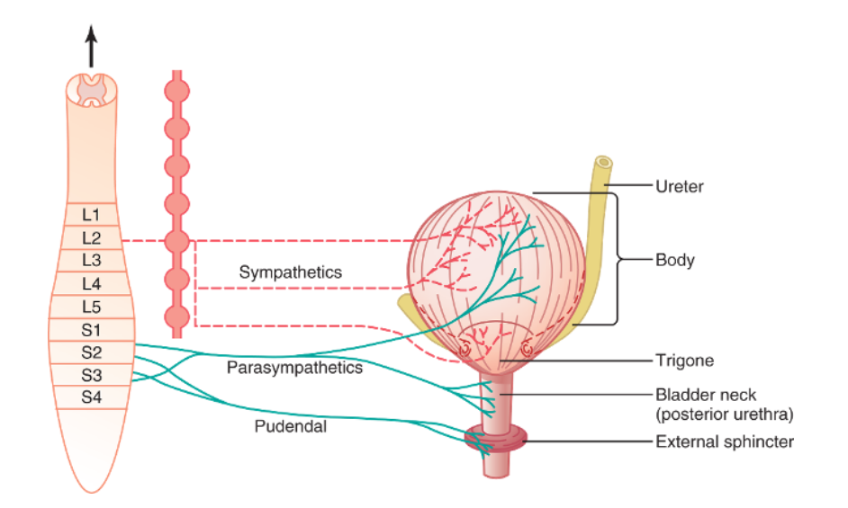
Cont.
Guyton: Important
Innervation of the Bladder :
The principal nerve supply of the bladder is by way of the pelvic nerves, which connect with the spinal cord through the sacral plexus, mainly connecting with cord segments S2 and S3 . Coursing through the pelvic nerves are both sensory nerve fibers and motor nerve fibers. The sensory fibers detect the degree of stretch in the bladder wall. Stretch signals from the posterior urethra are especially strong and are mainly responsible for initiating the reflexes that cause bladder emptying.
The motor nerves transmitted in the pelvic nerves are parasympathetic fibers. These terminate on ganglion cells located in the wall of the bladder. Short postganglionic nerves then innervate the detrusor muscle.
In addition to the pelvic nerves, two other types of innervation are important in bladder function. Most important are the skeletal motor fibers transmitted through the pudendal nerve to the external bladder sphincter. These are somatic nerve fibers that innervate and control the voluntary skeletal muscle of the sphincter. Also, the bladder receives sympathetic innervation from the sympathetic chain through the hypogastric nerves, connecting mainly with the L2 segment of the spinal cord. These sympathetic fibers stimulate mainly the blood vessels and have little to do with bladder contraction. Some sensory nerve fibers also pass by way of the sympathetic nerves and may be important in the sensation of fullness and, in some instances, pain.

Slide 47
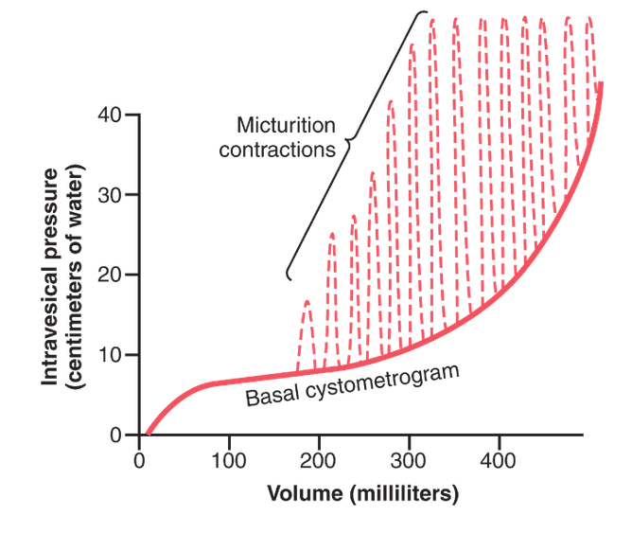
Cont.
Guyton:
Filling of the Bladder and Bladder Wall Tone; the Cystometrogram : (Extra)
Figure shows the approximate changes in intravesicular pressure as the bladder fills with urine. When there is no urine in the bladder, the intravesicular pressure is about 0, but by the time 30 to 50 milliliters of urine have collected, the pressure rises to 5 to 10 centimeters of water. Additional urine—200 to 300 milliliters—can collect with only a small additional rise in pressure; this constant level of pressure is caused by intrinsic tone of the bladder wall itself. Beyond 300 to 400 milliliters, collection of more urine in the bladder causes the pressure to rise rapidly. Superimposed on the tonic pressure changes during filling of the bladder are periodic acute increases in pressure that last from a few seconds to more than a minute. The pressure peaks may rise only a few centimeters of water or may rise to more than 100 centimeters of water. These pressure peaks are called micturition waves in the cystometrogram and are caused by the micturition reflex
Cytometrogram is a graph that studies the relation between the pressure and urine volume, in order to study these 2 factors we should first empty the bladder and then in the lab they put 2 catheters. The 1st catheter fills the bladder gradually and the other one measures the pressure , as they increase the volume of urine the pressure increases. When the volume reaches to 50 ml the pressure increases to be 5 but they noticed that when the volume contuses increasing between 100 to 200 ml the pressure remains constant this is due to the bladder has feature called “ receptive relaxation “ i.e. : as it receives more urine it dilate more and more so the pressure remains constant and this dilation is due to presence of transitional epithelium “ this called Laplace law . The pressure will remain constant within limit but when it reaches 400 ml any further increase will increase the pressure and it won’t be constant anymore.

Slide 48
Cont.
Guyton: Control of Micturition reflex
Once a micturition reflex begins, it is “self-regenerative.” That is, initial contraction of the bladder activates the stretch receptors to cause a greater increase in sensory impulses from the bladder and posterior urethra, which causes a further increase in reflex contraction of the bladder; thus, the cycle is repeated again and again until the bladder has reached a strong degree of contraction. Then, after a few seconds to more than a minute, the self-regenerative reflex begins to fatigue and the regenerative cycle of the micturition reflex ceases, permitting the bladder to relax.
Thus, the micturition reflex is a single complete cycle of (1) progressive and rapid increase of pressure, (2) a period of sustained pressure, and (3) return of the pressure to the basal tone of the bladder. Once a micturition reflex has occurred but has not succeeded in emptying the bladder, the nervous elements of this reflex usually remain in an inhibited state for a few minutes to 1 hour or more before another micturition reflex occurs. As the bladder becomes more and more filled, micturition reflexesoccur more and more often and more and more powerfully.
Once the micturition reflex becomes powerful enough, it causes another reflex, which passes through the pudendal nerves to the external sphincter to inhibit it. If this inhibition is more potent in the brain than the voluntary constrictor signals to the external sphincter, urination will occur. If not, urination will not occur until the bladder fills still further and the micturition reflex becomes more powerful.
Facilitation or Inhibition of Micturition by the Brain
The micturition reflex is an autonomic spinal cord reflex, but it can be inhibited or facilitated by centers in the brain. These centers include (1) strong facilitative and inhibitory centers in the brain stem, located mainly in the pons, and (2) several centers located in the cerebral cortex that are mainly inhibitory but can become excitatory.
The micturition reflex is the basic cause of micturition, but the higher centers normally exert final control of micturition as follows:
The higher centers keep the micturition reflex partially inhibited, except when micturition is desired.
The higher centers can prevent micturition, even if the micturition reflex occurs, by tonic contraction of the external bladder sphincter until a convenient time presents itself.
When it is time to urinate, the cortical centers can facilitate the sacral micturition centers to help initiate a micturition reflex and at the same time inhibit the external urinary sphincter so that urination can occur.
Voluntary urination is usually initiated in the following way: First, a person voluntarily contracts his or her abdominal muscles, which increases the pressure in the bladder and allows extra urine to enter the bladder neck and posterior urethra under pressure, thus stretching their walls. This stimulates the stretch receptors, which excites the micturition reflex and simultaneously inhibits the external urethral sphincter. Ordinarily, all the urine will be emptied, with rarely more than 5 to 10 milliliters left in the bladder.

Slide 49
Cont.
Guyton: Abnormalities of Micturition
Atonic Bladder and Incontinence Caused by Destruction of Sensory Nerve Fibers.
Micturition reflex contraction cannot occur if the sensory nerve fibers from the bladder to the spinal cord are destroyed, thereby preventing transmission of stretch signals from the bladder. When this happens, a person loses bladder control, despite intact efferent fibers from the cord to the bladder and despite intact neurogenic connections within the brain. Instead of emptying periodically, the bladder fills to capacity and overflows a few drops at a time through the urethra. This is called overflow incontinence.
A common cause of atonic bladder is crush injury to the sacral region of the spinal cord. Certain diseases can also cause damage to the dorsal root nerve fibers that enter the spinal cord. For example, syphilis can cause constrictive fibrosis around the dorsal root nerve fibers, destroying them. This condition is called tabes dorsalis, and the resulting bladder condition is called tabetic bladder.
Automatic Bladder Caused by Spinal Cord Damage Above the Sacral Region.
If the spinal cord is damaged above the sacral region but the sacral cord segments are still intact, typical micturition reflexes can still occur. However, they are no longer controlled by the brain. During the first few days to several weeks after the damage to the cord has occurred, the micturition reflexes are suppressed because of the state of “spinal shock” caused by the sudden loss of facilitative impulses from the brain stem and cerebrum. However, if the bladder is emptied periodically by catheterization to prevent bladder injury caused by overstretching of the bladder, the excitability of the micturition reflex gradually increases until typical micturition reflexes return; then, periodic (but unannounced) bladder emptying occurs.
Some patients can still control urination in this condition by stimulating the skin (scratching or tickling) in the genital region, which sometimes elicits a micturition reflex.
Uninhibited Neurogenic Bladder Caused by Lack of Inhibitory Signals from the Brain.
Another abnormality of micturition is the so-called uninhibited neurogenic bladder, which results in frequent and relatively uncontrolled micturition. This condition derives from partial damage in the spinal cord or the brain stem that interrupts most of the inhibitory signals. Therefore, facilitative impulses passing continually down the cord keep the sacral centers so excitable that even a small quantity of urine elicits an uncontrollable micturition reflex, thereby promoting frequent urination.

Slide 50
Cont.
Uninhibited Neurogenic Bladder Caused by Lack of Inhibitory Signals from the Brain. Therefore, facilitative impulses passing continually down the cord keep the sacral centers so excitable that even a small quantity of urine elicits an uncontrollable micturition reflex, thereby promoting frequent urination.
Essential functions and anatomy
The bladder has two functions – storage and voiding. Afferent pathways (T12–S4) respond to pressure within the bladder and sensation from the genitalia. As the bladder distends, continence is maintained by suppression of parasympathetic and reciprocal activation of sympathetic outflow. Both are under some voluntary control. Voiding takes place by parasympathetic activation of the detrusor, and relaxation of the internal sphincter (Table 21.18). Cortical awareness of bladder fullness is located in the
post-central gyrus, parasagittally, while initiation of micturition is in the pre-central gyrus. Voluntary control of micturition is located in the frontal cortex, parasagittally. Neurological disorders of micturition
Urogenital tract disease is dealt with largely by urologists. Incontinence is common and easy to recognize; neurological causes are sometimes not obvious. These are: Cortical:
Post-central lesions cause loss of sense of bladder
fullness.
Pre-central lesions cause difficulty initiating micturition.
Frontal lesions cause socially inappropriate micturition.
Spinal cord. Bilateral UMN lesions (pyramidal tracts) cause urinary frequency and incontinence. The bladder is small and hypertonic, i.e. sensitive to small changes in intravesical pressure. Frontal lesions can also cause a hypertonic bladder. LMN. Sacral lesions (conus medullaris, sacral root and pelvic nerve – bilateral) cause a flaccid, atonic bladder that overflows cauda equina, p. 1177), often unexpectedly.
Management. Assessment of both urological causes (e.g.
calculi, prostatism, gynaecological problems) and potential neurological causes of incontinence is necessary. Intermittent self-catheterization is used by many patients, with for example spinal cord lesions.
موجود في هامش سلايدات د.منان

Slide 51
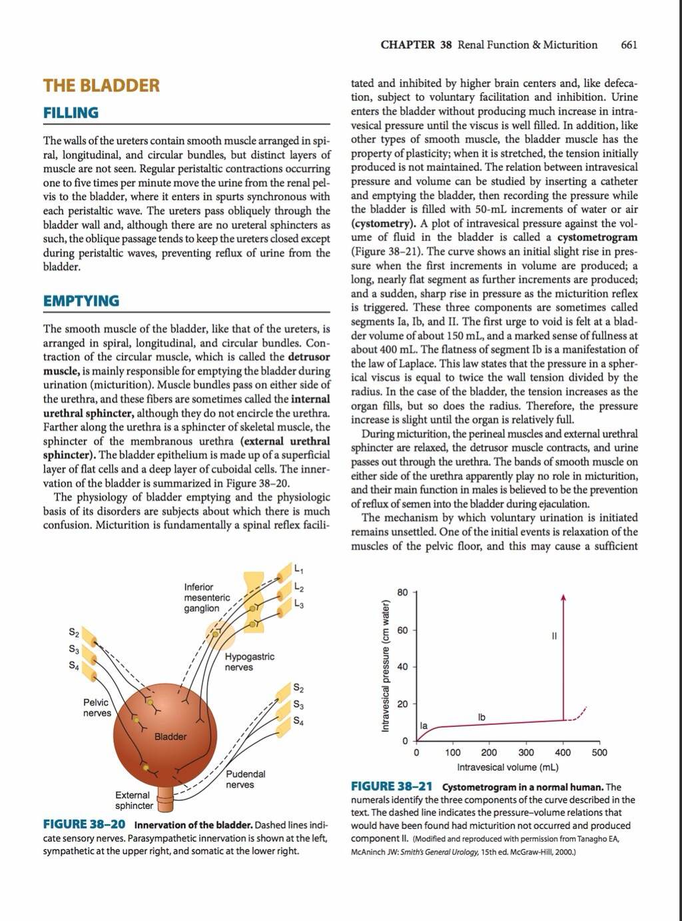
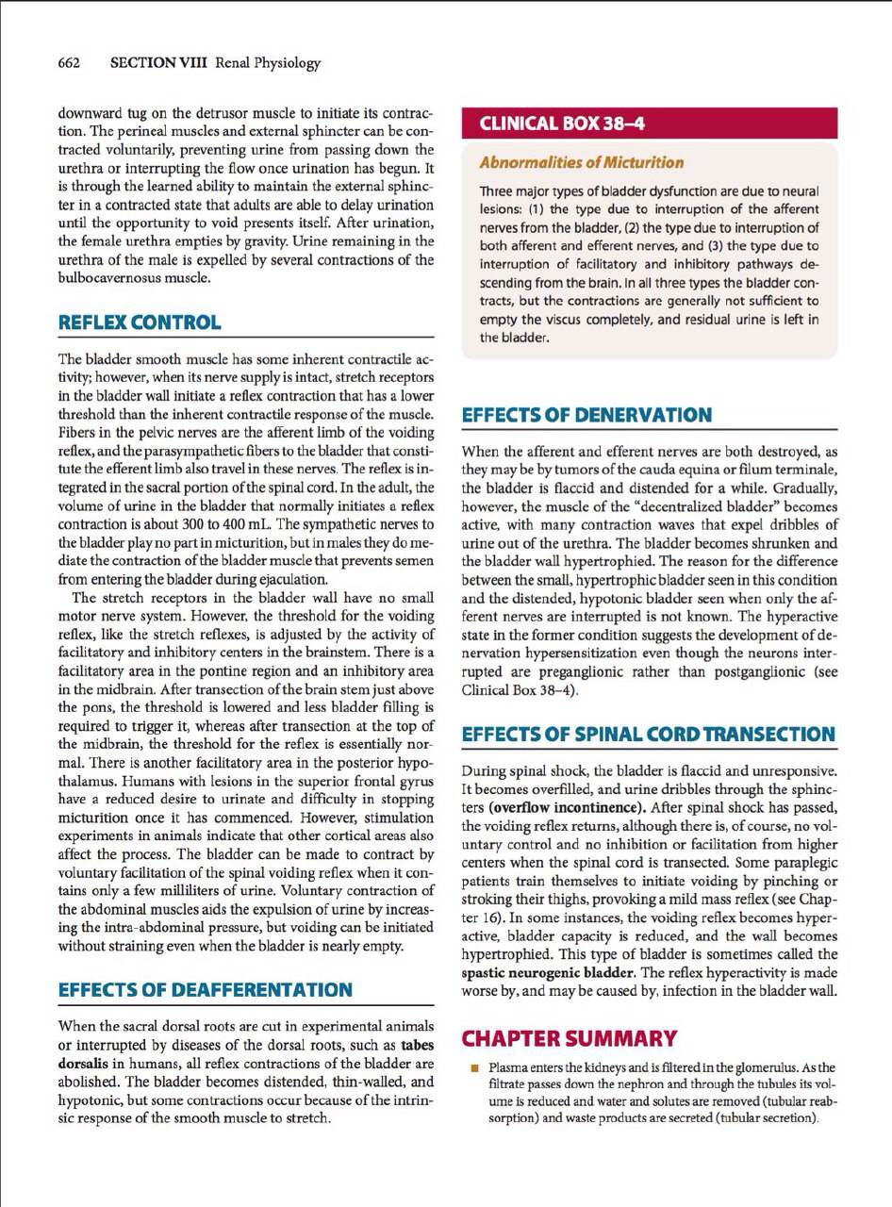
Cont.
Dr. mannan recommended reading this chapter from Ganong’s book.

Slide 52
Lecture5
Linda corner: “Tubular transport maximum of Glucose”
Glucose is filtered across glomerular capillaries and reabsorbed by the epithelial cells of the proximal con- voluted tubule. Glucose reabsorption is a two-step process involving Na+-glucose cotransport across the luminal membrane and facilitated glucose transport across the peritubular membrane. Because there are a limited number of glucose transporters, the mechanism is saturable; that is, it has a transport maximum, or Tm.
Glucosuria :At normal plasma glucose concentrations (70 to 100 mg/dL), all of the filtered glucose is reabsorbed and none is excreted. Under some circumstances, however, glucosuria (excretion or spilling of glucose in the urine) occurs. The causes of glucosuria can be understood by referring again to the glucose titration curve.
In uncontrolled diabetes mellitus, lack of insulin causes the plasma concentration of glucose to increase to abnormally high levels. In this condition, the filtered load of glucose exceeds the reabsorptive capacity (i.e., plasma glucose concentration is above the Tm), and glucose is excreted in the urine.
(2) During pregnancy, GFR is increased, which increases the fil- tered load of glucose to the extent that it may exceed the reabsorptive capacity.
(3) Several congenital ab- normalities of the Na+-glucose cotransporter are associated with decreases in Tm, causing glucose to be excreted in the urine at lower than normal plasma concentrations

Slide 53
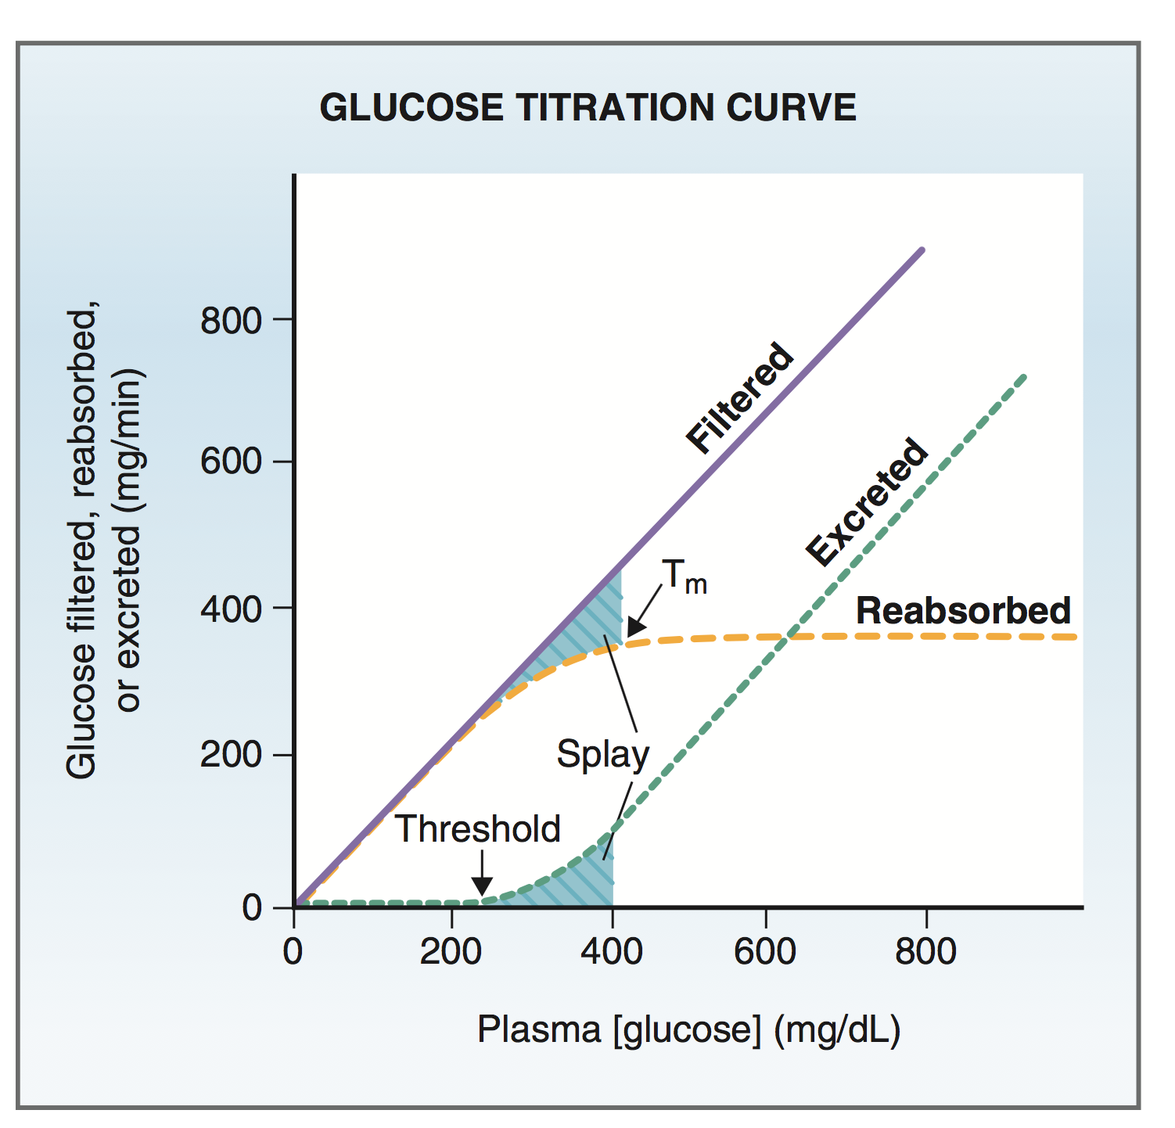
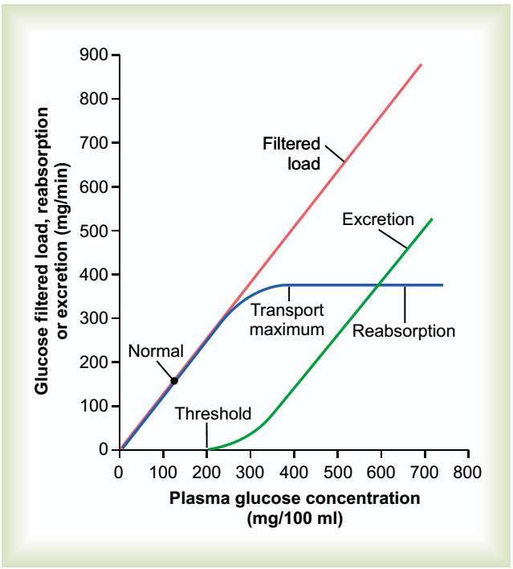
Cont.
Linda’s Corner: “Tubular transport maximum of Glucose”
At plasma glucose concentrations less than 200 mg/dL, all of the filtered glucose can be reabsorbed because Na+-glucose cotransporters are plentiful. In this range, the curve for reabsorption is identical to that for filtration; that is, reabsorption equals filtration. The number of carriers is limited, however. At plasma concentrations above 200 mg/dL, the reabsorption curve bends because some of the filtered glucose is not reabsorbed. At plasma concentrations above 350 mg/dL, the carriers are completely saturated and reabsorption levels off at its maximal value, Tm.
A glucose titration curve depicts the relationship between plasma glucose concentration and glucose reabsorption. For comparison, the filtered load of glucose and the excretion rate of glucose are plotted on the same graph. The glucose titration curve is obtained experimentally by infusing glucose and measuring its rate of reabsorption as the plasma con- centration is increased. The titration curve is best understood by examining each relationship separately and then by considering all three relationships together.

Slide 54
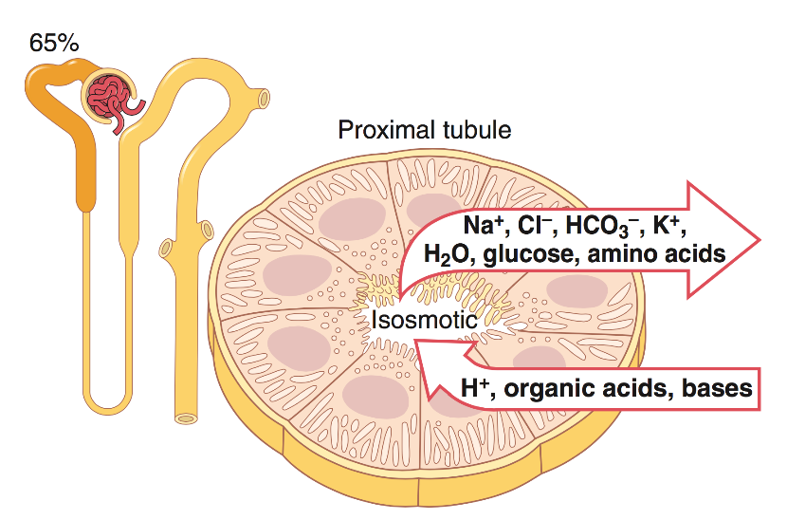
Cont.
Guyton corner: “Proximal Convoluted Tubule (PCT) Reabsorption”
The high capacity of the proximal tubule for reabsorption results from its special cellular characteristics, as shown in Figure 28-6. The proximal tubule epithelial cells are highly metabolic and have large numbers of mitochondria to support powerful active transport processes. In addition, the proximal tubular cells have an extensive brush border on the luminal (apical) side of the membrane, as well as an extensive labyrinth of intercellular and basal channels, all of which together provide an extensive membrane surface area on the luminal and basolateral sides of the epithelium for rapid transport of sodium ions and other substances.
The extensive membrane surface of the epithelial brush border is also loaded with protein carrier molecules that transport a large fraction of the sodium ions across the luminal membrane linked by way of the co-transport mechanism with multiple organic nutrients such as amino acids and glucose. Additional sodium is transported from the tubular lumen into the cell by counter-transport mechanisms that reabsorb sodium while secreting other substances into the tubular lumen, especially hydrogen ions. 13th edition, P.343

Slide 55
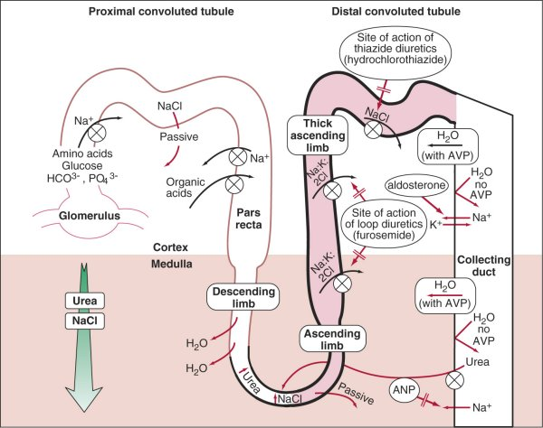
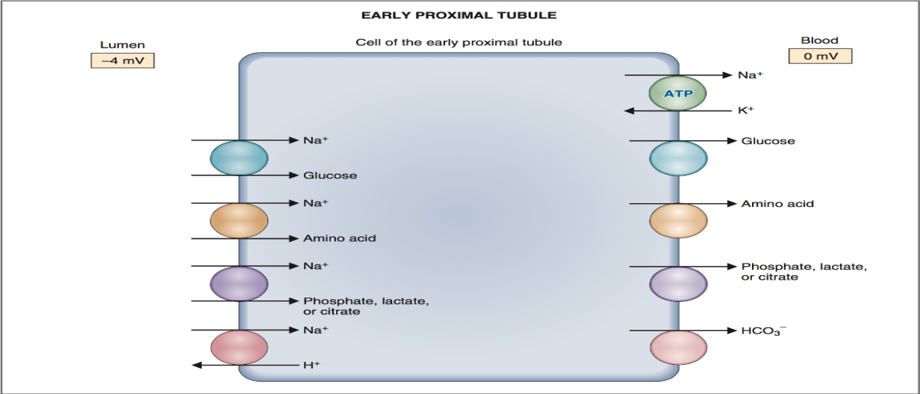
Cont.
Linda corner: “PCT Reabsorption ‘Na⁺ Reabsorption’”
The proximal convoluted tubule consists of an early proximal convoluted tubule and a late proximal convoluted tubule.
The mechanisms for Na+ reabsorption in the early and late proximal tubules are different, as reflected in the anions and other solutes that accompany Na+. In the early proximal tubule, Na+ is reabsorbed primarily with HCO3− and organic solutes such as glucose and amino acids. In the late proximal tubule, Na+ is reabsorbed primarily with Cl−, but without organic solutes. 5th edition, p.271
“PCT Reabsorption ‘Early stage’”
The cotransport mechanisms in the luminal membrane of the early proximal tubule are Na+-glucose (SGLT), Na+-amino acid, Na+-phosphate, Na+-lactate, and Na+-citrate. In each case, Na+ moves into the cell and down its electrochemical gradient coupled to glucose, amino acid, phosphate, lactate, or citrate, which move into the cell against their electrochemical gradients. 5th edition, p.272

Slide 56
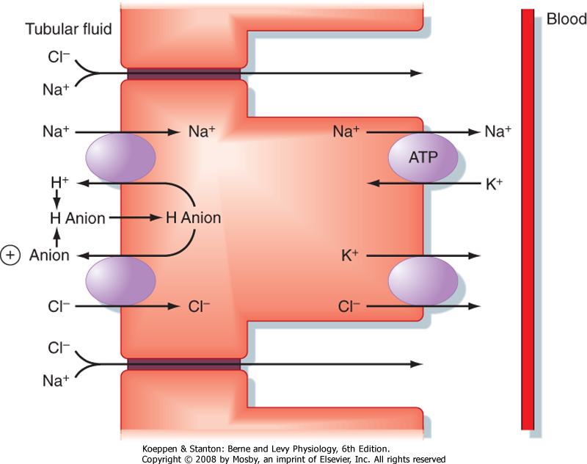
Cont.
Guyton corner: “PCT ‘Na⁺ Reabsorption’”
Renal tubular cells, like other epithelial cells, are held together by tight junctions.Lateral intercellular spaces lie behind the tight junctions and separate the epithelial cells of the tubule. Solutes can be reabsorbed or secreted across the cells through the transcellular pathway or between the cells by moving across the tight junctions and intercellular spaces by way of the paracellular pathway. Sodium is a substance that moves through both routes, although most of the sodium is transported through the transcellular pathway. In some nephron segments, especially the proximal tubule, water is also reabsorbed across the paracellular pathway, and substances dissolved in the water, especially potassium, magnesium, and chloride ions, are carried with the reabsorbed fluid between the cells.

Slide 57
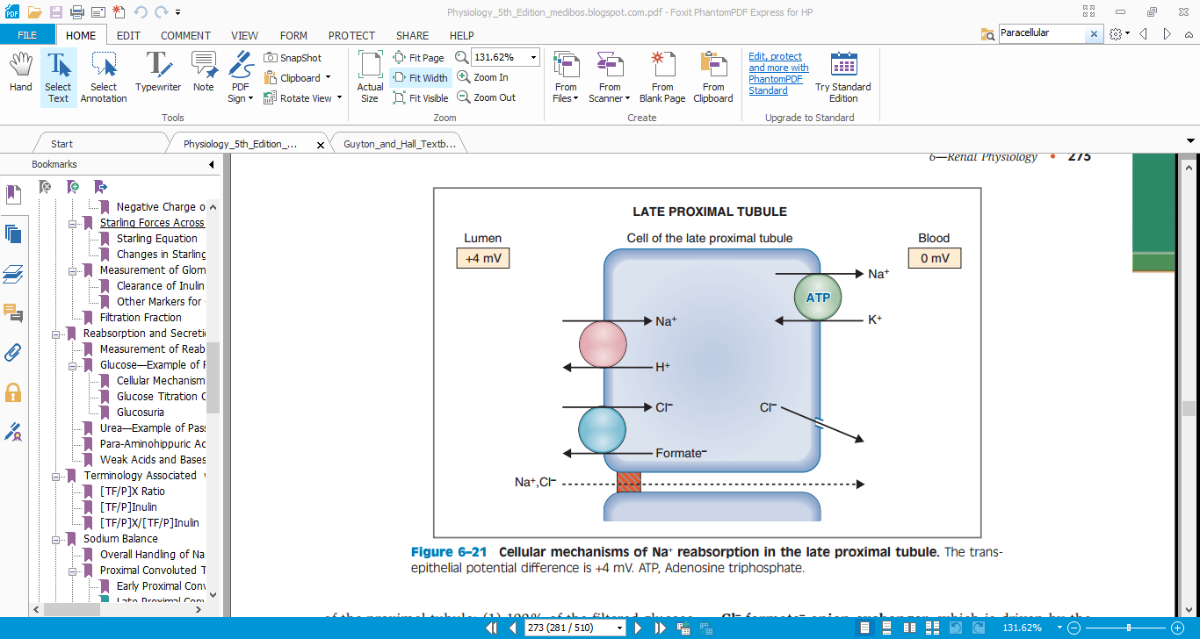
Cont.
Linda corner: “PCT‘Na⁺ Reabsorption’”
In contrast to the early proximal tubule, the late proximal tubule reabsorbs primarily NaCl (Fig. 6-21). The high tubular fluid Cl− concentration is the driving force for this reabsorption, for which there are both cellular and paracellular (between cells) components.The cellular Component of NaCl reabsorption is explained as follows: The luminal membrane of late proximal cells contains two exchange mechanisms, including the familiar Na+-H+ exchanger and a Cl−-formate−anion exchanger, which is driven by the high tubular fluid Cl − concentration. The combined function of the two exchangers is to transport NaCl from the lumen into the cell. Na+ then is extruded into blood by the Na+-K+ATPase, and Cl−moves into blood by diffusion.The paracellular component also depends on the high tubular fluid Cl−concentration. The tight junctions between cells of the proximal tubule are, in fact, not tight: They are quite permeable to small solutes, such as NaCl, and to water. Thus, the Cl − concentration gradient drives Cl− diffusion between the cells, from lumen to blood. This Cl−diffusion stablishes a Cl−diffusion potential, making the lumen positive with respect to blood. Na+reabsorption follows, driven by the lumen-positive potential difference. Like the cellular route, the net result of the paracellular route is reabsorption of NaCl.

Slide 58
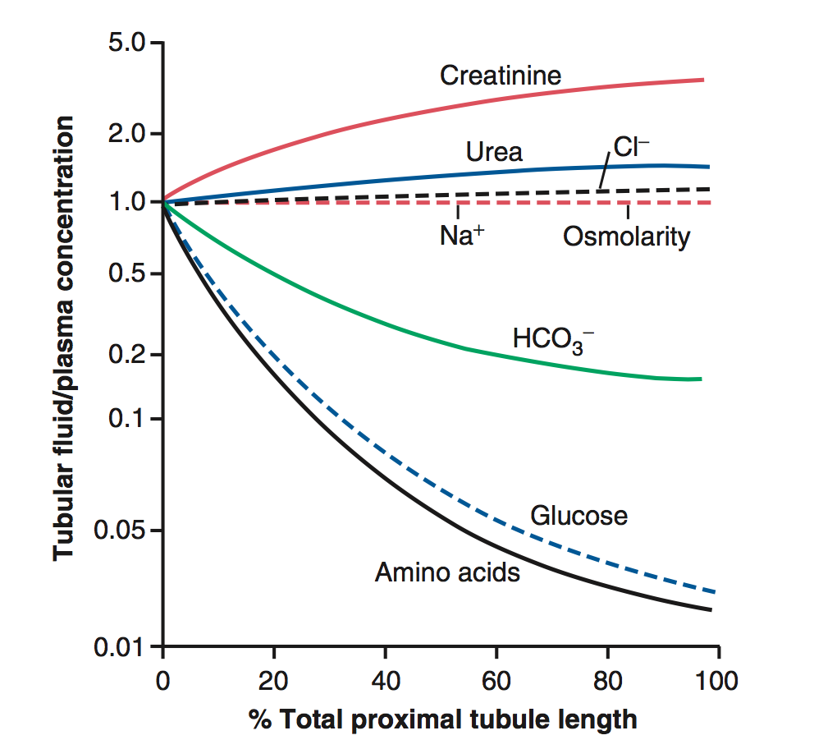
Cont.
Guyton corner: ” Glucose Reabsorption ‘Early stage’”
Figure 28-7 summarizes the changes in concentrations of various solutes along the proximal tubule. Although the amount of sodium in the tubular fluid decreases markedly along the proximal tubule, the con- centration of sodium (and the total osmolarity) remains relatively constant because water permeability of the proximal tubules is so great that water reabsorption keeps pace with sodium reabsorption. Certain organic solutes, such as glucose, amino acids, and bicarbonate, are much more avidly reabsorbed than is water, and thus their con- centrations decrease markedly along the length of the proximal tubule. Other organic solutes that are less per- meant and not actively reabsorbed, such as creatinine, increase their concentration along the proximal tubule. The total solute concentration, as reflected by osmolarity, remains essentially the same all along the proximal tubule because of the extremely high permeability of this part of the nephron to water. 13th edititon, p.354

Slide 59
Cont.
Guyton corner: “Urea Reabsorption”
Urea is also passively reabsorbed from the tubule, but to a much lesser extent than chloride ions. As water is reabsorbed from the tubules (by osmosis coupled to sodium reabsorption), urea concentration in the tubular lumen increases. This increase creates a concentration gradient favoring the reabsorption of urea.
Linda corner: “Urea Reabsorption”
Urea is freely filtered across the glomerular capillaries, and the concentration in the initial filtrate is identical to that in blood (i.e., initially, there is no concentration difference or driving force for urea reabsorption). However, as water is reabsorbed along the nephron, the urea concentration in tubular fluid increases, creating a driving force for passive urea reabsorption. Therefore, urea reabsorption generally follows the same pattern as water reabsorption—the greater the water reabsorption, the greater the urea reabsorption and the lower the urea excretion.In the proximal tubule, 50% of the filtered urea is reabsorbed by simple diffusion. As water is reabsorbed in the proximal tubule, urea lags slightly behind, causing the urea concentration in the tubular lumen to become slightly higher than the urea concentration in blood; this concentration difference then drives passive urea reabsorption. At the end of the proximal tubule, 50% of the filtered urea has been reabsorbed; thus, 50% remains in the lumen.

Slide 60
Cont.
Guyton corner: “Water reabsorption”
When solutes are transported out of the tubule by either primary or secondary active transport, their concentrations tend to decrease inside the tubule while increasing in the renal interstitium. This phenomenon creates a concentration difference that causes osmosis of water in the same direction that the solutes are transported, from the tubular lumen to the renal interstitium. Some parts of the renal tubule, especially the proximal tubule, are highly permeable to water, and water reabsorption occurs so rapidly that there is only a small concentration gradient for Solutes across the tubular membrane .A large part of the osmotic flow of water in the proximal tubules occurs through the so-called tight junctions between the epithelial cells, as well as through the cells themselves. The reason for this Situation, as already discussed, is that the junctions between the cells are not as tight as their name would imply and permit significant diffusion of water and small ions. This condition is especially true in the proximal tubules, which have a high permeability for water and a smaller but significant permeability to most ions, such as sodium, chloride, potassium, calcium, and magnesium.
Linda corner: “Water reabsorption”
Isosmotic reabsorption is a hallmark of proximal tubular function: Solute and water reabsorption are coupled and are proportional to each other. Thus, if 67% of the filtered solute is reabsorbed by the proximal tubule, then 67% of the filtered water also will be reabsorbed. What solutes are included in the general term “solute”?The major cation is Na +, with its accompanying anions HCO3−(early proximal tubule) and Cl−(late proximal tubule). Minor anions are phosphate, lactate, and citrate. Other solutes are glucose and amino acids. Quantitatively, however, most of the solute reabsorbed by the proximal tubule is NaCl and NaHCO3.

Slide 61
Cont.
Guyton corner: “Water reabsorption”
As water moves across the tight junctions by osmosis, it can also carry with it some of the solutes, a process referred to as solvent drag.
Tubular Fluid Remains Isosmotic in the Proximal Tubule:
As fluid flows through the proximal tubule, solutes and water are reabsorbed in equal proportions, so little change in osmolarity occurs; thus, the proximal tubule fluid remains isosmotic to the plasma, with an osmolarity of about 300 mOsm/L. As fluid passes down the descending loop of Henle, water is reabsorbed by osmosis and the tubular fluid reaches equilibrium with the surrounding interstitial fluid of the renal medulla, which is very hypertonic—about two to four times the osmolarity of the original glomerular filtrate. Therefore, the tubular fluid becomes more concentrated as it flows into the inner medulla.

Slide 62
Guyton corner: “Organic Ion / Cation Secretion”
The proximal tubule is also an important site for secretion of organic acids and bases such as bile salts, oxalate, urate, and catecholamines. Many of these substances are the end products of metabolism and must be rapidly removed from the body. The secretion of these substances into the proximal tubule plus filtration into the proximal tubule by the glomerular capillaries and the almost total lack of reabsorption by the tubules, all combined, contribute to rapid excretion in the urine.
In addition to the waste products of metabolism, the kidneys secrete many potentially harmful drugs or toxins directly through the tubular cells into the tubules and rapidly clear these substances from the blood. In the case of certain drugs, such as penicillin and salicylates, the rapid clearance by the kidneys creates a problem in maintaining a therapeutically effective drug concentration.

Slide 63
Cont.
H₂CO₃ Dissociates 2 times :
The First time: Is In the Tubular Fluid with the help of Extracellular C.A. Into CO₂ and H₂O.
The Second time: Is in the Tubular Cell into HCO₃⁻ & H⁺
Na - H exchanger: this process happen to reabsorb HCO3 is the following step :
1- in the cell we will find H2O & CO2 due to the passive diffusion of them. Then the enzyme CA will fuse them together to form H2CO3 which is unstable it dissolve easily into H and HCO3
2- H+ is moved inside the tubule through a counter-transport with Na actively (2ry active transport)
3- the purpose of transporting H+ inside tubule is to destroy the filtered HCO3 before it get excreted in urine. It will dissolve to form H2CO3 then into CO2 and water.
4- CO2 enter to cell to form bicarbonate and excrete it to blood with facilitated diffusion.
https://www.youtube.com/watch?v=pl_-P3rM5n8

Slide 64
Lecture 6
Guyton corner :
The glomerular filtration and tubular reabsorption and tubular secretion are regulated according to the need of the body. page (312).
For many substances, tubular reabsorption plays a much more important role than secretion in determining the final urinary excretion rate. However, tubular secretion accounts for significant amounts of potassium ions, hydrogen ions, and a few other substances that appear in the urine page (323)

Slide 65
Cont.
Guyton corner : page ( 330-331)
• Solute and Water Transport in the Loop of Henle:
-The loop of Henle consists of three functionally distinct segments: the thin descending segment, the thin ascending segment, and the thick ascending segment.
-The thin segment of the ascending limb has a much lower reabsorptive capacity than the thick segment, and the thin descending limb does not reabsorb significant amounts of any of these solutes.
An important component of solute reabsorption in the thick ascending limb is the sodium- potassium ATPase pump, the reabsorption of other solutes in the thick segment of the ascending loop of Henle is closely linked to the reabsorptive capability of the sodium- potassium ATPase pump, which maintains a low intracellular sodium concentration.The low intracellular sodium concentration in turn provides a favorable gradient for movement of sodium from the tubular fluid into the cell.
In the thick ascending loop, movement of sodium across the luminal membrane is mediated primarily by a 1-sodium, 2-chloride, 1-potassium co-transporter.
The thick ascending limb also has a sodium-hydrogen counter-transport mechanism in its luminal cell membrane.
There is also significant paracellular reabsorption of cations, such as Mg++, Ca++, Na+, and K+, in the thick ascending limb owing to the slight positive charge of the tubular lumen relative to the interstitial fluid. Although the 1-sodium, 2-chloride, 1-potassium co-transporter moves equal amounts of cations and anions into the cell

Slide 66
Cont.
Thick ascending limb
Transcellularly
Paracellularly
sodium hydrogen exchanger:
HCO3 + Na H (out)
N a + 2 Cl + K cotransporter
Few K (out)
Na+
Ca++
K+
Mg++

Slide 67
Cont.
Guyton corner : page ( 330-331)
• Solute and Water Transport in the Loop of Henle:
-The loop of Henle consists of three functionally distinct segments: the thin descending segment, the thin ascending segment, and the thick ascending segment.
-The thin segment of the ascending limb has a much lower reabsorptive capacity than the thick segment, and the thin descending limb does not reabsorb significant amounts of any of these solutes.
An important component of solute reabsorption in the thick ascending limb is the sodium- potassium ATPase pump, the reabsorption of other solutes in the thick segment of the ascending loop of Henle is closely linked to the reabsorptive capability of the sodium- potassium ATPase pump, which maintains a low intracellular sodium concentration.The low intracellular sodium concentration in turn provides a favorable gradient for movement of sodium from the tubular fluid into the cell.
In the thick ascending loop, movement of sodium across the luminal membrane is mediated primarily by a 1-sodium, 2-chloride, 1-potassium co-transporter.
The thick ascending limb also has a sodium-hydrogen counter-transport mechanism in its luminal cell membrane.
There is also significant paracellular reabsorption of cations, such as Mg++, Ca++, Na+, and K+, in the thick ascending limb owing to the slight positive charge of the tubular lumen relative to the interstitial fluid. Although the 1-sodium, 2-chloride, 1-potassium co-transporter moves equal amounts of cations and anions into the cell

Slide 68
Cont.
Linda corner:
▪ The distal tubule and collecting duct constitute the terminal nephron, and together they reabsorb
about 8% of the filtered Na+. Like the thick ascending limb, reabsorption in the terminal nephron is load-dependent, with considerable capacity to reabsorb extra Na+ that may be delivered from the proximal tubule. The mechanism of Na+ transport in the early distal tubule differs from that of the late distal tubule and collecting duct.
▪ The early distal tubule reabsorbs 5% of the filtered Na+. At the cellular level, the mechanism is an Na+- Cl− cotransporter in the luminal membrane, the energy for which derives from the Na+ gradient. There is net reabsorption of Na+ and Cl− in the early distal tubule, which is explained as follows: Both ions enter the cell on the Na+-Cl− cotransporter; Na+ then is extruded from the cell into the blood by the Na+-K+ ATPase, and Cl− diffuses out of the cell through Cl− channels in the basolateral membrane.
▪ The Na+-Cl− cotransporter of the early distal tubule differs from the Na+-K+-2Cl− cotransporter of the thick ascending limb in the following respects: It transports two ions (not three), it is electroneutral (not electro genic), and it is inhibited by a different class of diuretics, the thiazide diuretics (e.g.chlorothiazide, hydrochlorothiazide, metolazone). Like the loop diuretics, the thiazides are organic acids, which are anions at physiologic pH. Thiazide diuretics bind to the Cl− site of the Na+-Cl− cotransporter and prevent it from cycling, thus inhibiting NaCl reabsorption in the early distal tubule.
▪ The early distal tubule is impermeable to water. Thus, it reabsorbs solute but leaves water behind, which then dilutes the tubular fluid. For this reason, the early distal tubule is called the cortical diluting segment (“cortical” because distal tubules are in the kidney cortex). Recall that the tubular fluid entering the early distal tubule is already dilute (compared with blood) because of the function of the thick ascending limb; the early distal tubule further dilutes it.

Slide 69
Cont.
Terminal nephron
Early distal convoluted tubule
Late distal convoluted tubule and collecting duct
Impermeable to water
Principal cells
Intercalated cells
Na reabsorption (ENaC)
Water reabsorption (ADH)
Secrete K
Secrete H and reabsorb HCO3
Reabsorb K (K/H pump)
Reabsorbs Na and Cl
(Na/Cl cotransporter)

Slide 70
Cont.
• Guyton corner :
▪ The thick segment of the ascending limb of the loop of Henle empties into the distal tubule. The first portion of the distal tubule forms the macula densa. The next part of the distal tubule is highly convoluted and has many of the same reabsorptive characteristics of the thick segment of the ascending limb of the loop of Henle. That is, it avidly reabsorbs most of the ions, including sodium, potassium, and chloride, but is virtually impermeable to water and urea. For this reason, it is referred to as the diluting segment because it also dilutes the tubular fluid.
▪ Approximately 5 percent of the filtered load of sodium chloride is reabsorbed in the early distal tubule. The sodium-chloride co- transporter moves sodium chloride from the tubular lumen into the cell, and the sodium-potassium ATPase pump transports sodium out of the cell across the basolateral membrane. Chloride diffuses out of the cell into the renal interstitial fluid through chloride channels in the basolateral membrane.
▪ The thiazide diuretics, which are widely used to treat disorders such as hypertension and heart failure, inhibit the sodium-chloride co- transporter.
▪ The second half of the distal tubule and the subsequent cortical collecting tubule have similar functional characteristics. Anatomically, they are composed of two distinct cell types, the principal cells and intercalated cells. The principal cells reabsorb sodium and water from the lumen and secrete potassium ions into the lumen. The intercalated cells reabsorb potassium ions and secrete hydrogen ions into the tubular lumen.
▪ Principal Cells Reabsorb Sodium and Secrete Potassium. Sodium reabsorption and potassium secretion by the principal cells depend on the activity of a sodium-potassium ATPase pump in each cell’s basolateral membrane. This pump maintains a low sodium concentration inside the cell and, therefore, favors sodium diffusion into the cell through special channels.
▪ The secretion of potassium by these cells from the blood into the tubular lumen involves two steps: (1) Potassium enters the cell because of the sodium-potassium ATPase pump, which maintains a high intracellular potassium concentration, and then (2) once in the cell, potassium diffuses down its concentration gradient across the luminal membrane into the tubular fluid.
▪ Intercalated Cells Secrete Hydrogen and Reabsorb Bicarbonate and Potassium Ions. Hydrogen ion secretion by the intercalated cells is mediated by a hydrogen- ATPase transporter. Hydrogen is generated in this cell by the action of carbonic anhydrase on water and carbon dioxide to form carbonic acid, which then dissociates into hydrogen ions and bicarbonate ions. The hydrogen ions are then secreted into the tubular lumen, and for each hydrogen ion secreted, a bicarbonate ion becomes available for reabsorption across the basolateral membrane.

Slide 71
Cont.
• Linda corner:
▪ Anatomically and functionally, the late distal tubule and collecting duct are similar and can be discussed together. There are two major cell types interspersed along these segments: the principal cells and the α-intercalated cells. The principal cells are involved in Na+ reabsorption, K+ secretion, and water reabsorption; the α-intercalated cells are involved in K+ reabsorption and H+ secretion. The late distal tubule and collecting duct reabsorb only 3% of the filtered Na+. Quantitatively, this amount is small when compared with the amounts reabsorbed in the proximal tubule, the thick ascending limb, and even the early distal tubule. The late distal tubule and collecting duct, however, are the last segments of the nephron to influence the amount of Na+ that is to be excreted (i.e., they make the fine adjustments of Na+ reabsorption).
▪ Rather than the coupled trans- port mechanisms seen in other nephron segments, the luminal membrane of the principal cells contains Na+ channels (epithelial Na+ channels, or ENaC). Na+ diffuses through these channels down its electrochemical gradient, from the lumen into the cell. Na+ then is extruded from the cell via the Na+-K+ ATPase in the basolateral membrane. The anion that accompanies Na+ is mainly Cl−, although the transport mechanism for Cl− has not been elucidated.
▪ Given the critical role of the late distal tubule and collecting duct in the fine adjustments to Na+ excretion, it should not be surprising that Na+ reabsorption in these segments is hormonally regulated. Aldosterone is a steroid hormone that acts directly on the principal cells to increase Na+ reabsorption. Aldosterone is secreted by the zona glomerulosa of the adrenal cortex, is delivered to the principal cells via the circulation, and diffuses into the cells across the basolateral cell membrane. In the cell, the hormone is transferred to the nucleus, where it directs the synthesis of specific messenger RNAs (mRNAs). These mRNAs then direct the synthesis of new proteins that are involved in Na+ reabsorption by the principal cells. The aldosterone- induced proteins include the luminal membrane Na+ channel itself, the Na+-K+ ATPase, and enzymes of the citric acid cycle (e.g., citrate synthase).
▪ Na+ reabsorption by the principal cells is inhibited by the K+-sparing diuretics (e.g., amiloride, triamterene, spironolactone). Spironolactone, a steroid and aldosterone-antagonist, prevents aldosterone from entering the nucleus of the principal cells and therefore blocks the synthesis of mRNAs and new proteins. Amiloride and triamterene bind to the luminal membrane Na+ channels and inhibit the aldosterone-induced increase in Na+ reabsorption. The K+-sparing diuretics produce only mild diuresis because they inhibit such a small percentage of the total Na+ reabsorption. However, as the name suggests, their main use is in combination with other diuretics to inhibit K+ secretion by the principal cells, as discussed in the section on K+ handling.
▪ Water reabsorption by the late distal tubule and collecting duct is variable, as described later in this chapter. Water permeability of the principal cells is controlled by ADH, which is secreted by the posterior lobe of the pituitary gland according to the body’s need for water. When ADH levels are low or absent, the water permeability of the principal cells is low, and little, if any, water is reabsorbed along with NaCl. When ADH levels are high, aquaporin 2 (AQP2) channels are inserted in the luminal membranes of the principal cells, turning on their water permeability; thus, in the presence of ADH water is reabsorbed along with NaCl.

Slide 72
Cont.
• Linda corner:
▪ The maintenance of potassium (K+) balance is essential for the normal function of excitable tissues
(e.g., nerve, skeletal muscle, cardiac muscle). the K+ concentration gradient across excitable cell membranes sets the resting membrane potential. Also, that changes in resting membrane potential alter excitability by opening or closing gates on the Na+ channels, which are responsible for the upstroke of the action potential. Changes in either intracellular or extracellular K+ concentration alter the resting membrane potential and, as a consequence, alter the excitability of these tissues.
▪ Most of the total body K+ is located in the ICF: 98% of the total K+ content is in the intracellular compartment and 2% is in the extracellular compartment. A consequence of this distribution is that the intracellular K+ concentration (150 mEq/L) is much higher than the extracellular concentration (4.5 mEq/L). This large concentration gradient for K+ is maintained by the Na+- K+ ATPase that is present in all cell membranes.
▪ One challenge to maintaining the low extracellular K+ concentration is the large amount of K+ present in the intracellular compartment. A small shift of K+ into or out of the cells can produce a large change in the extracellular K+ concentration. The distribution of K+ across cell membranes is called internal K+ balance. Hormones, drugs, and various pathologic states alter this distribution and, as a consequence, can alter the extracellular K+ concentration.
▪ Another challenge to maintaining the low extracellular K+ concentration is the variation in dietary K+ intake in humans: Dietary K+ can vary from as low as 50 mEq/day to as high as 150 mEq/day. To maintain K+ balance, urinary excretion of K+ must be equal to K+ intake. Thus, on a daily basis, urinary excretion of K+ must be capable of varying from 50 to 150 mEq/day. The renal mechanisms that allow for this variability are called external K+ balance.
▪ Internal K+ balance is the distribution of K+ across cell membranes. To reemphasize, most K+ is present inside the cells and even small K+ shifts across cell membranes can cause large changes in K+ concentrations in ECF and blood. A shift of K+ out of cells produces an increase in the blood K+ con- centration called hyperkalemia. A shift of K+ into cells produces a decrease in the blood K+ concentration called hypokalemia.

Slide 73
Cont.
Guyton corner :
After ingestion of a normal meal, extracellular fluid potassium concentration would rise to a lethal level if the ingested potassium did not rapidly move into the cells. For example, absorption of 40 mEq of potassium (the amount contained in a meal rich in vegetables and fruit) into an extracellular fluid volume of 14 liters would raise plasma potassium concentration by about 2.9 mEq/L if all the potassium remained in the extracellular compartment. Fortunately, most of the ingested potassium rapidly moves into the cells until the kidneys can eliminate the excess

Slide 74
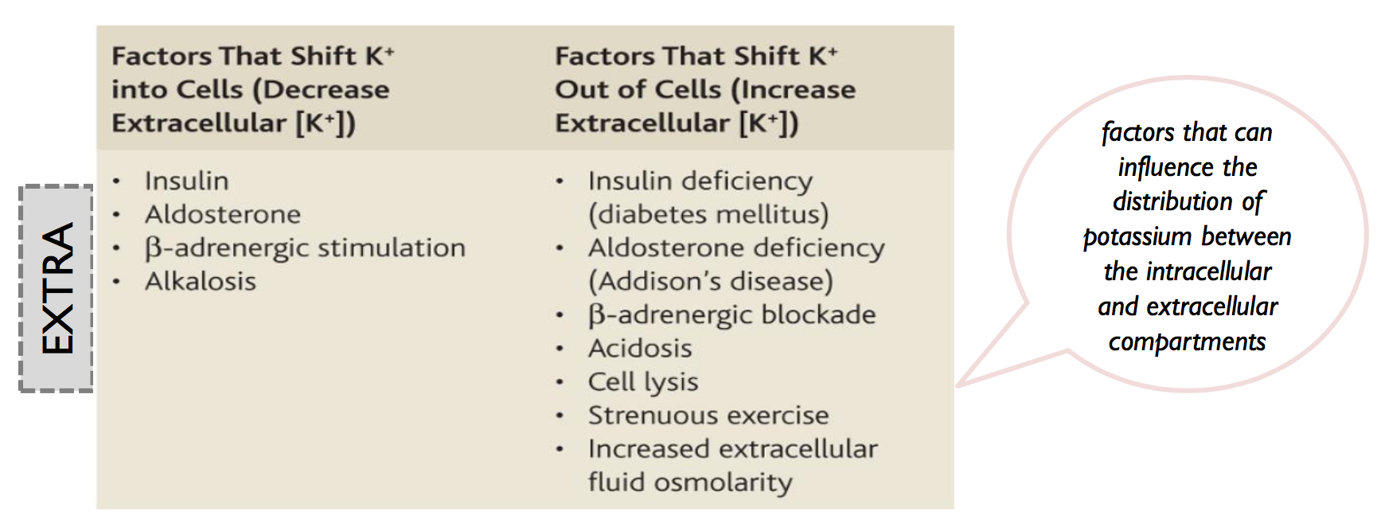
Cont.

Slide 75
Cont.
• Guyton corner : the tubular handling of potassium under normal conditions.
About 65 percent of the filtered potassium is reabsorbed in the proximal tubule. Another 25 to 30 percent of the filtered potassium is reabsorbed in the loop of Henle, especially in the thick ascending part where potassium is actively co- transported along with sodium and chloride. In both the proximal tubule and the loop of Henle, a relatively constant fraction of the filtered potassium load is reabsorbed. Changes in potassium reabsorption in these segments can influence potassium excretion, but most of the day-to-day variation of potassium excretion is not due to changes in reabsorption in the proximal tubule or loop of Henle. There is also some potassium reabsorption in the collecting tubules and collecting ducts; the amount reabsorbed in these parts of the nephron varies depending on the potassium intake.

Slide 76
Cont.
• Guyton corner : the basic cellular mechanisms of potassium secretion by the principal cells. Secretion of potassium from the blood into the tubular lumen is a two- step process, beginning with uptake from the interstitium into the cell by the sodium- potassium ATPase pump in the basolateral cell membrane; this pump moves sodium out of the cell into the interstitium and at the same time moves potassium to the interior of the cell. The second step of the process is passive diffusion of potassium from the interior of the cell into the tubular fluid. The sodium-potassium ATPase pump creates a high intracellular potassium concentration, which provides the driving force for passive diffusion of potassium from the cell into the tubular lumen. The luminal membrane of the principal cells is highly permeable to potassium because there are two types of special channels that allow potassium ions to rapidly diffuse across the membrane: (1) the renal outer medullary potassium (ROMK) channels, and (2) high conductance “big” potassium (BK) channels. Both types of potassium channels are required for efficient renal potassium excretion, and their abundance in the luminal membrane is increased during high potassium intake.

Slide 77
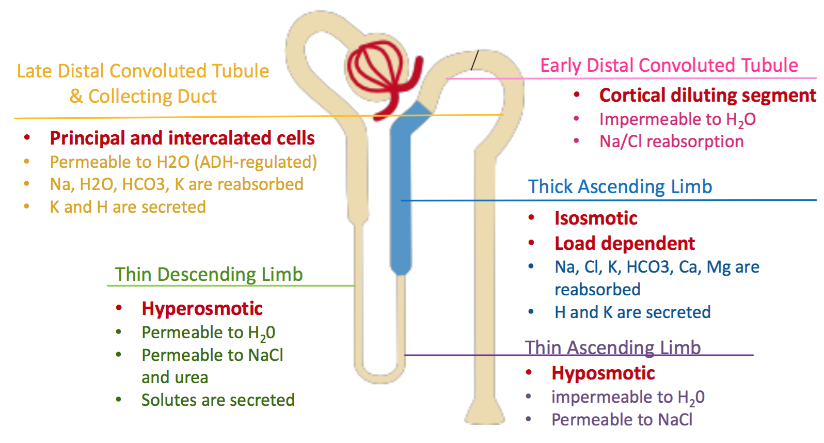
Cont.
Based on pages (276-279) of Linda S. Costanzo physiology (5th edition)

Slide 78
Lecture 7
• Guyton corner : The intracellular fluid is separated from the extracellular fluid by a cell membrane that is highly permeable to water but not to most of the electrolytes in the body. In contrast to the extracellular fluid, the intracellular fluid contains only small quantities of sodium and chloride ions and almost no calcium ions. Instead, it contains large amounts of potassium and phosphate ions plus moderate quantities of magnesium and sulfate ions, all of which have low concentrations in the extracellular fluid. Also, cells contain large amounts of protein, almost four times as much as in the plasma.

Slide 79
EXTRA
Table 25-2
Figure 25-2
Guyton corner : Comparisons of the composition of the extracellular fluid, including the plasma and interstitial fluid, and the intracellular fluid are shown in Figure 25-2 and in Table 25-2.
If you forgot the basics, go back to foundation physiology :)

Slide 80
EXTRA
ECF is composed of 2 parts interstitial fluid and plasma component .
•Balance between intake and output should be maintained and the output is regulated mainly by kidney.
Guyton corner : Body Fluid Compartments The total body fluid is distributed mainly between two compartments: the extracellular fluid and the intracellular fluid (Figure 25-1). The extracellular fluid is divided into the interstitial fluid and the blood plasma. There is another small compartment of fluid that is referred to as transcellular fluid. This compartment includes fluid in the synovial, peritoneal, pericardial, and intraocular spaces, as well as the cerebrospinal fluid; it is usually considered to be a specialized type of extracellular fluid, although in some cases its composition may differ markedly from that of the plasma or interstitial fluid. All the transcellular fluids together constitute about 1 to 2 liters. In the average 70-kilogram adult man, the total body water is about 60 percent of the body weight, or about 42 liters. This percentage can change, depending on age, gender, and degree of obesity. As a person grows older, the percentage of total body weight that is fluid gradually decreases. This is due in part to the fact that aging is usually associated with an increased percentage of the body weight being fat, which decreases the percentage of water in the body. Because women normally have more body fat than men, their total body water averages about 50 percent of the body weight. In premature and newborn babies, the total body water ranges from 70 to 75 percent of body weight. Therefore, when discussing the “average” body fluid compartments, we should realize that variations exist, depending on age, gender, and percentage of body fat.

Slide 81
EXTRA
•Guyton corner : Vascular Control by Ions and Other Chemical Factors :
1.Many different ions and other chemical factors can either dilate or constrict local blood vessels. Most of them have little function in overall regulation of the circulation, but some specific effects are:
2.An increase in calcium ion concentration causes vasoconstriction. This results from the general effect of calcium to stimulate smooth muscle contraction,.
3.An increase in potassium ion concentration, within the physiological range, causes vasodilation. This results from the ability of potassium ions to inhibit smooth muscle contraction.
4.An increase in magnesium ion concentration causes powerful vasodilation because magnesium ions inhibit smooth muscle contraction.
5.An increase in hydrogen ion concentration (decrease in pH) causes dilation of the arterioles. Conversely, slight decrease in hydrogen ion concentration causes arteriolar constriction.
6.Anions that have significant effects on blood vessels are acetate and citrate, both of which cause mild degrees of vasodilation.
7.An increase in carbon dioxide concentration causes moderate vasodilation in most tissues but marked vasodilation in the brain. Also, carbon dioxide in the blood, acting on the brain vasomotor center, has an extremely powerful indirect effect, transmitted through the sympathetic nervous vasoconstrictor system, to cause widespread vasoconstriction throughout the body.

Slide 82
EXTRA
Guyton corner : Even small increases in arterial pressure can cause marked increases in urinary excretion of sodium and water, phenomena that are referred to as pressure natriuresis and pressure diuresis. Because of the autoregulatory mechanisms increasing the arterial pressure between the limits of 75 and 160 mm Hg usually has only a small effect on renal blood flow and GFR. The slight increase in GFR that does occur contributes in part to the effect of increased arterial pressure on urine output.

Slide 83
EXTRA
•Guyton corner : Sympathetic Nervous System Activation Decreases GFR : Essentially all the blood vessels of the kidneys, including the afferent and the efferent arterioles, are richly innervated by sympathetic nerve fibers. Strong activation of the renal sympathetic nerves can constrict the renal arterioles and decrease renal blood flow and GFR. Moderate or mild sympathetic stimulation has little influence on renal blood flow and GFR. For example, reflex activation of the sympathetic nervous system resulting from moderate decreases in pressure at the carotid sinus baroreceptors or cardiopulmonary receptors has little influence on renal blood flow or GFR. The renal sympathetic nerves seem to be most important in reducing GFR during severe, acute disturbances lasting for a few minutes to a few hours, such as those elicited by the defense reaction, brain ischemia, or severe hemorrhage. In the healthy resting person, sympathetic tone appears to have little influence on renal blood flow. Angiotensin II Preferentially Constricts Efferent Arterioles in Most Physiologic Conditions : A powerful renal vasoconstrictor, angiotensin II, can be considered a circulating hormone, as well as a locally produced autacoid because it is formed in the kidneys and in the systemic circulation. Receptors for angiotensin II are present in virtually all blood vessels of the kidneys. However, the preglomerular blood vessels, especially the afferent arterioles, appear to be relatively protected from angiotensin II–mediated constriction in most physiologic conditions associated with activation of the renin-angiotensin system such as during a low-sodium diet or reduced renal perfusion pressure due to renal artery stenosis. This protection is due to release of vasodilators, especially nitric oxide and prostaglandins, which counteract the vasoconstrictor effects of angiotensin II in these blood vessels. The efferent arterioles, however, are highly sensitive to angiotensin II. Because angiotensin II preferentially constricts efferent arterioles in most physiologic conditions, increased angiotensin II levels raise glomerular hydrostatic pressure while reducing renal blood flow. It should be kept in mind that increased angiotensin II formation usually occurs in circumstances associated with decreased arterial pressure or volume depletion, which tend to decrease GFR. In these circumstances, the increased level of angiotensin II, by constricting efferent arterioles, helps prevent decreases in glomerular hydrostatic pressure and GFR; at the same time, though, the reduction in renal blood flow caused by efferent arteriolar constriction contributes to decreased flow through the peritubular capillaries, which in turn increases reabsorption of sodium and water. Thus, increased angiotensin II levels that occur with a low-sodium diet or volume depletion help maintain GFR and normal excretion of metabolic waste products such as urea and creatinine that depend on glomerular filtration for their excretion; at the same time, the angiotensin II-induced constriction of efferent arterioles increases tubular reabsorption of sodium and water, which helps restore blood volume and blood pressure.

Slide 84
EXTRA
•Guyton corner : page 346 Aldosterone Increases Sodium Reabsorption and Potassium Secretion. The most important stimuli for aldosterone are (1) increased extracellular potassium concentration and (2) increased angiotensin II levels, which typically occur in conditions associated with sodium and volume depletion or low blood pressure. The increased secretion of aldosterone associated with these conditions causes renal sodium and water retention, helping to increase extracellular fluid volume and restore blood pressure toward normal.
•Guyton corner : page 346 Angiotensin II Increases Sodium and Water Reabsorption. Angiotensin II is perhaps the body’s most powerful sodium-retaining hormone. angiotensin II formation increases in circumstances associated with low blood pressure and/or low extracellular fluid volume, such as during hemorrhage or loss of salt and water from the body fluids by excessive sweating or severe diarrhea. The increased formation of angiotensin II helps to return blood pressure and extracellular volume toward normal by increasing sodium and water reabsorption from the renal tubules through three main effects: 1.Angiotensin II stimulates aldosterone secretion, which in turn increases sodium reabsorption. 2. Angiotensin II constricts the efferent arterioles. 3. Angiotensin II directly stimulates sodium reabsorption in the proximal tubules, the loops of Henle, the distal tubules, and the collecting tubules.

Slide 85
EXTRA
•Guyton corner : page 347 ADH Increases Water Reabsorption. The most important renal action of ADH is to increase the water permeability of the distal tubule, collecting tubule, and collecting duct epithelia. This effect helps the body to conserve water in circumstances such as dehydration. In the absence of ADH, the permeability of the distal tubules and collecting ducts to water is low, causing the kidneys to excrete large amounts of dilute urine, a condition called diabetes insipidus. Thus, the actions of ADH play a key role in controlling the degree of dilution or concentration of the urine.
•Guyton corner : page 347 Atrial Natriuretic Peptide Decreases Sodium and Water Reabsorption. When specific cells of the cardiac atria are stretched because of plasma volume expansion and increased atrial blood pressure, they secrete a peptide called atrial natriuretic peptide (ANP). Increased levels of this peptide in turn directly inhibit the reabsorption of sodium and water by the renal tubules, especially in the collecting ducts. ANP also inhibits renin secretion and therefore angiotensin II formation, which in turn reduces renal tubular reabsorption. This decreased sodium and water reabsorption increases urinary excretion, which helps to return blood volume back toward normal.

Slide 86
EXTRA
•Guyton corner : ADH Synthesis in Supraoptic and Paraventricular Nuclei of the Hypothalamus and ADH Release from the Posterior Pituitary Figure 28-10 shows the neuroanatomy of the hypothalamus and the pituitary gland, where ADH is synthesized and released. The hypothalamus contains two types of magnocellular (large) neurons that synthesize ADH in the supraoptic and paraventricular nuclei of the hypothalamus, about five sixths in the supraoptic nuclei and about one sixth in the paraventricular nuclei. Both of these nuclei have axonal extensions to the posterior pituitary. Once ADH is synthesized, it is transported down the axons of the neurons to their tips, terminating in the posterior pituitary gland. When the supraoptic and paraventricular nuclei are stimulated by increased osmolarity or other factors, nerve impulses pass down these nerve endings, changing their membrane permeability and increasing calcium entry. ADH stored in the secretory granules (also called vesicles) of the nerve endings is released in response to increased calcium entry. The released ADH is then carried away in the capillary blood of the posterior pituitary into the systemic circulation.Secretion of ADH in response to an osmotic stimulus is rapid, so plasma ADH levels can increase severalfold within minutes, thereby providing a rapid means for altering renal excretion of water.A second neuronal area important in controlling osmolarity and ADH secretion is located along the anteroventral region of the third ventricle, called the AV3V region. At the upper part of this region is a structure called the subfornical organ, and at the inferior part is another structure called the organum vasculosum of the lamina terminalis. Between these two organs is the median preoptic nucleus, which has multiple nerve connections with the two organs, as well as with the supraoptic nuclei and the blood pressure control centers in the medulla of the brain. Lesions of the AV3V region cause multiple deficits in the control of ADH secretion, thirst, sodium appetite, and blood pressure. Electrical stimulation of this region or stimulation by angiotensin II can increase ADH secretion, thirst, and sodium appetite. In the vicinity of the AV3V region and the supraoptic nuclei are neuronal cells that are excited by small increases in extracellular fluid osmolarity; hence, the term osmoreceptors has been used to describe these neurons. These cells send nerve signals to the supraoptic nuclei to control their firing and secretion of ADH. It is also likely that they induce thirst in response to increased extracellular fluid osmolarity. Both the subfornical organ and the organum vasculosum of the lamina terminalis have vascular supplies that lack the typical blood-brain barrier that impedes the diffusion of most ions from the blood into the brain tissue. This makes it possible for ions and other solutes to cross between the blood and the local interstitial fluid in this region. As a result, the osmoreceptors rapidly respond to changes in osmolarity of the extracellular fluid, exerting powerful control over the secretion of ADH and over thirst.

Slide 87
EXTRA
•Guyton corner : Osmoreceptor-ADH Feedback System Figure 28-9 shows the basic components of the osmoreceptor-ADH feedback system for control of extracellular fluid sodium concentration and osmolarity. When osmolarity (plasma sodium concentration) increases above normal because of water deficit, for example, this feedback system operates as follows:
•An increase in extracellular fluid osmolarity (which in practical terms means an increase in plasma sodium concentration) causes the special nerve cells called osmoreceptor cells, located in the anterior hypothalamus near the supraoptic nuclei, to shrink.
•Shrinkage of the osmoreceptor cells causes them to fire, sending nerve signals to additional nerve cells in the supraoptic nuclei, which then relay these signals down the stalk of the pituitary gland to the posterior pituitary.
•These action potentials conducted to the posterior pituitary stimulate the release of ADH, which is stored in secretory granules (or vesicles) in the nerve endings.
•ADH enters the blood stream and is transported to the kidneys, where it increases the water permeability of the late distal tubules, cortical collecting tubules, and medullary collecting ducts.
•The increased water permeability in the distal nephron segments causes increased water reabsorption and excretion of a small volume of concentrated urine.

Slide 88
EXTRA
•Guyton corner : stimuli increase ADH secretion: (1) decreased arterial pressure and (2) decreased blood volume. Whenever blood pressure and blood volume are reduced, such as occurs during hemorrhage, increased ADH secretion causes increased fluid reabsorption by the kidneys, helping to restore blood pressure and blood volume toward normal. Low Blood Volume and Low Blood Pressure Stimulate ADH Secretion—Vasoconstrictor Effects of ADH : Low Blood Volume and Low Blood Pressure Stimulate ADH Secretion—Vasoconstrictor Effects of ADH Whereas minute concentrations of ADH cause increased water conservation by the kidneys, higher concentrations of ADH have a potent effect of constricting the arterioles throughout the body and therefore increasing the arterial pressure. For this reason, ADH has another name, vasopressin. One of the stimuli for causing intense ADH secretion is decreased blood volume. This occurs strongly when the blood volume decreases 15 to 25 percent or more; the secretory rate then sometimes rises to as high as 50 times normal. The cause of this is the following. The atria have stretch receptors that are excited by overfilling. When excited, they send signals to the brain to inhibit ADH secretion. Conversely, when the receptors are unexcited as a result of underfilling, the opposite occurs, with greatly increased ADH secretion. Decreased stretch of the baroreceptors of the carotid, aortic, and pulmonary regions also stimulates ADH secretion.

Slide 89
Lecture 8 (if you zoom in everything will be clear!)
Countercurrent System:
Guyton corner : When there is a water deficit in the body, the kidney forms concentrated urine by continuing to excrete solutes while increasing water reabsorption and decreasing the volume of urine formed. The human kidney can produce a maximal urine concentration of 1200 to 1400 mOsm/L, four to five times the osmolarity of plasma.
Countercurrent Mechanism Produces a Hyperosmotic Renal Medullary Interstitium :The osmolarity of interstitial fluid in almost all parts of the body is about 300 mOsm/L, which is similar to the plasma osmolarity. The osmolarity of the interstitial fluid in the medulla of the kidney is much higher and may increase progressively to about 1200 to 1400 mOsm/L in the pelvic tip of the medulla. This means that the renal medullary interstitium has accumulated solutes in great excess of water. Once the high solute concentration in the medulla is achieved, it is maintained by a balanced inflow and outflow of solutes and water in the medulla.The major factors that contribute to the buildup of solute concentration into the renal medulla are as follows: Active transport of sodium ions and co-transport of potassium, chloride, and other ions out of the thick portion of the ascending limb of the loop of Henle into the medullary interstitium,Active transport of ions from the collecting ducts into the medullary interstitium , Facilitated diffusion of urea from the inner medullary collecting ducts into the medullary interstitium,Diffusion of only small amounts of water from the medullary tubules into the medullary interstitium, far less than the reabsorption of solutes into the medullary interstitium
Special Characteristics of Loop of Henle That Cause Solutes to Be Trapped in the Renal Medulla.The transport characteristics of the loops of Henle are summarized in Table 28-1, along with the properties of the proximal tubules, distal tubules, cortical collecting tubules, and inner medullary collecting ducts.

Slide 90
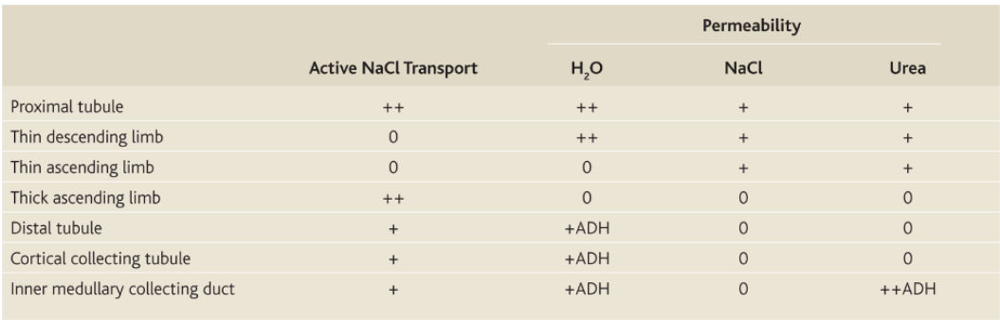
Cont.
Table 28-1
[ IMPORTANT ] The most important cause of the high medullary osmolarity is active transport of sodium and co-transport of potassium, chloride, and other ions from the thick ascending loop of Henle into the interstitium. This pump is capable of establishing about a 200-milliosmole concentration gradient between the tubular lumen and the interstitial fluid. Because the thick ascending limb is virtually impermeable to water, the solutes pumped out are not followed by osmotic flow of water into the interstitium. Thus, the active transport of sodium and other ions out of the thick ascending loop adds solutes in excess of water to the renal medullary interstitium. There is some passive reabsorption of sodium chloride from the thin ascending limb of Henle’s loop, which is also impermeable to water, adding further to the high solute concentration of the renal medullary interstitium.The descending limb of Henle’s loop, in contrast to the ascending limb, is very permeable to water, and the tubular fluid osmolarity quickly becomes equal to the renal medullary osmolarity. Therefore, water diffuses out of the descending limb of Henle’s loop into the interstitium and the tubular fluid osmolarity gradually rises as it flows toward the tip of the loop of Henle.

Slide 91
Cont.
Steps Involved in Causing Hyperosmotic Renal Medullary Interstitium.
Keeping in mind these characteristics of the loop of Henle, let us now discuss how the renal medulla becomes hyperosmotic. First, assume that the loop of Henle is filled with fluid with a concentration of 300 mOsm/L, the same as that leaving the proximal tubule (Figure 28-4, step 1). Next, the active ion pump of the thick ascending limb on the loop of Henle reduces the concentration inside the tubule and raises the interstitial concentration; this pump establishes a 200-mOsm/L concentration gradient between the tubular fluid and the interstitial fluid (step 2). The limit to the gradient is about 200 mOsm/L because paracellular diffusion of ions back into the tubule eventually counterbalances transport of ions out of the lumen when the 200-mOsm/L concentration gradient is achieved.
Step 3 is that the tubular fluid in the descending limb of the loop of Henle and the interstitial fluid quickly reach osmotic equilibrium because of osmosis of water out of the descending limb. The interstitial osmolarity is maintained at 400 mOsm/L because of continued transport of ions out of the thick ascending loop of Henle. Thus, by itself, the active transport of sodium chloride out of the thick ascending limb is capable of establishing only a 200-mOsm/L concentration gradient, much less than that achieved by the countercurrent system.
Step 4 is additional flow of fluid into the loop of Henle from the proximal tubule, which causes the hyperosmotic fluid previously formed in the descending limb to flow into the ascending limb. Once this fluid is in the ascending limb, additional ions are pumped into the interstitium, with water remaining in the tubular fluid, until a 200-mOsm/L osmotic gradient is established, with the interstitial fluid osmolarity rising to 500 mOsm/L (step 5). Then, once again, the fluid in the descending limb reaches equilibrium with the hyperosmotic medullary interstitial fluid (step 6), and as the hyperosmotic tubular fluid from the descending limb of the loop of Henle flows into the ascending limb, still more solute is continuously pumped out of the tubules and deposited into the medullary interstitium. These steps are repeated over and over, with the net effect of adding more and more solute to the medulla in excess of water; with sufficient time, this process gradually traps solutes in the medulla and multiplies the concentration gradient established by the active pumping of ions out of the thick ascending loop of Henle, eventually raising the interstitial fluid osmolarity to 1200 to 1400 mOsm/L as shown in step 7.Thus, the repetitive reabsorption of sodium chloride by the thick ascending loop of Henle and continued inflow of new sodium chloride from the proximal tubule into the loop of Henle is called the countercurrent multiplier. The sodium chloride reabsorbed from the ascending loop of Henle keeps adding to the newly arrived sodium chloride, thus “multiplying” its concentration in the medullary interstitium

Slide 92
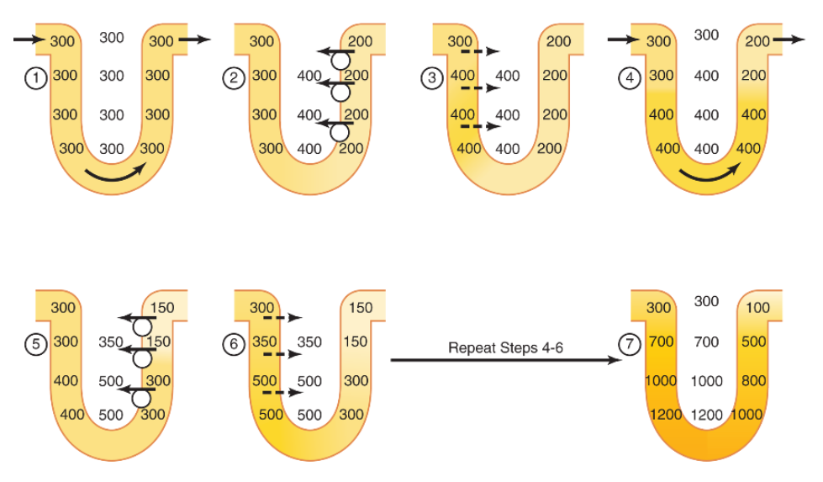
Cont.
Figure 28-4

Slide 93
Cont.
Concentrated Urine Requirements for Excreting a Concentrated Urine—High ADH Levels and Hyperosmotic Renal Medulla
The basic requirements for forming a concentrated urine are (1) a high level of ADH, which increases the permeability of the distal tubules and collecting ducts to water, thereby allowing these tubular segments to avidly reabsorb water, and (2) a high osmolarity of the renal medullary interstitial fluid, which provides the osmotic gradient necessary for water reabsorption to occur in the presence of high levels of ADH.
The renal medullary interstitium surrounding the collecting ducts is normally hyperosmotic, so when ADH levels are high, water moves through the tubular membrane by osmosis into the renal interstitium; from there it is carried away by the vasa recta back into the blood. Thus, the urine concentrating ability is limited by the level of ADH and by the degree of hyperosmolarity of the renal medulla. We discuss the factors that control ADH secretion later, but for now, what is the process by which renal medullary interstitial fluid becomes hyperosmotic? This process involves the operation of the countercurrent mechanism.
The countercurrent mechanism depends on the special anatomical arrangement of the loops of Henle and the vasa recta, the specialized peritubular capillaries of the renal medulla. In the human, about 25 percent of the nephrons are juxtamedullary nephrons, with loops of Henle and vasa recta that go deeply into the medulla before returning to the cortex. Some of the loops of Henle dip all the way to the tips of the renal papillae that project from the medulla into the renal pelvis. Paralleling the long loops of Henle are the vasa recta, which also loop down into the medulla before returning to the renal cortex. And finally, the collecting ducts, which carry urine through the hyperosmotic renal medulla before it is excreted, also play a critical role in the countercurrent mechanism.

Slide 94
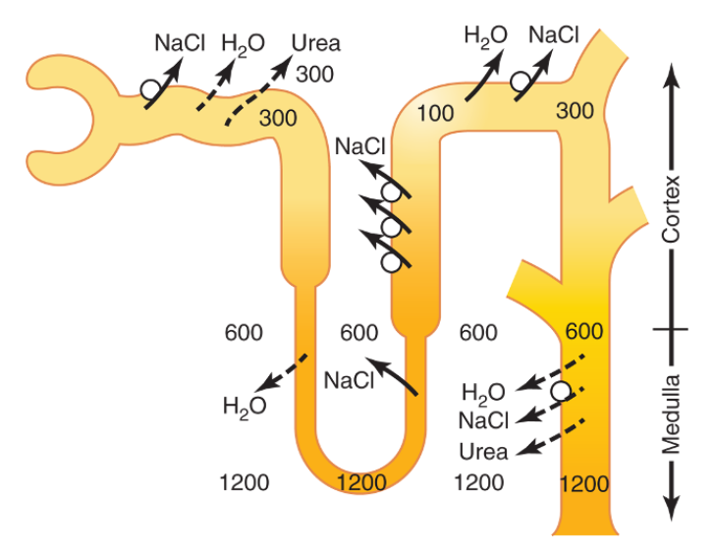
Cont.
Role of Distal Tubule and Collecting Ducts in Excreting Concentrated Urine
When the tubular fluid leaves the loop of Henle and flows into the distal convoluted tubule in the renal cortex, the fluid is dilute, with an osmolarity of only about 100 mOsm/L (Figure 28-5). The early distal tubule further dilutes the tubular fluid because this segment, like the ascending loop of Henle, actively transports sodium chloride out of the tubule but is relatively impermeable to water.
As fluid flows into the cortical collecting tubule, the amount of water reabsorbed is critically dependent on the plasma concentration of ADH. In the absence of ADH, this segment is almost impermeable to water and fails to reabsorb water but continues to reabsorb solutes and further dilutes the urine. When there is a high concentration of ADH, the cortical collecting tubule becomes highly permeable to water, so large amounts of water are now reabsorbed from the tubule into the cortex interstitium, where it is swept away by the rapidly flowing peritubular capillaries. The fact that these large amounts of water are reabsorbed into the cortex, rather than into the renal medulla, helps to preserve the high medullary interstitial fluid osmolarity.
As the tubular fluid flows along the medullary collecting ducts, there is further water reabsorption from the tubular fluid into the interstitium, but the total amount of water is relatively small compared with that added to the cortex interstitium. The reabsorbed water is quickly carried away by the vasa recta into the venous blood. When high levels of ADH are present, the collecting ducts become permeable to water, so the fluid at the end of the collecting ducts has essentially the same osmolarity as the interstitial fluid of the renal medulla—about 1200 mOsm/L (see Figure 28-4). Thus, by reabsorbing as much water as possible, the kidneys form highly concentrated urine, excreting normal amounts of solutes in the urine while adding water back to the extracellular fluid and compensating for deficits of body water.
Figure 28-5

Slide 95
Cont.
Urea Contributes to Hyperosmotic Renal Medullary Interstitium and Formation of Concentrated Urine
Thus far, we have considered only the contribution of sodium chloride to the hyperosmotic renal medullary interstitium. However, urea contributes about 40 to 50 percent of the osmolarity (500 to 600 mOsm/L) of the renal medullary interstitium when the kidney is forming a maximally concentrated urine. Unlike sodium chloride, urea is passively reabsorbed from the tubule. When there is water deficit and blood concentration of ADH is high, large amounts of urea are passively reabsorbed from the inner medullary collecting ducts into the interstitium.
The mechanism for reabsorption of urea into the renal medulla is as follows: As water flows up the ascending loop of Henle and into the distal and cortical collecting tubules, little urea is reabsorbed because these segments are impermeable to urea (see Table 28-1). In the presence of high concentrations of ADH, water is reabsorbed rapidly from the cortical collecting tubule and the urea concentration increases rapidly because urea is not very permeant in this part of the tubule.
As the tubular fluid flows into the inner medullary collecting ducts, still more water reabsorption takes place, causing an even higher concentration of urea in the fluid. This high concentration of urea in the tubular fluid of the inner medullary collecting duct causes urea to diffuse out of the tubule into the renal interstitial fluid. This diffusion is greatly facilitated by specific urea transporters, UT-A1 and UT-A3. One of these urea transporters, UT-A3, is activated by ADH, increasing transport of urea out of the inner medullary collecting duct even more when ADH levels are elevated. The simultaneous movement of water and urea out of the inner medullary collecting ducts maintains a high concentration of urea in the tubular fluid and, eventually, in the urine, even though urea is being reabsorbed.
The fundamental role of urea in contributing to urine concentrating ability is evidenced by the fact that people who ingest a high-protein diet, yielding large amounts of urea as a nitrogenous “waste” product, can concentrate their urine much better than people whose protein intake and urea production are low. Malnutrition is associated with a low urea concentration in the medullary interstitium and considerable impairment of urine concentrating ability.

Slide 96
Cont.
Recirculation of Urea from Collecting Duct to Loop of Henle Contributes to Hyperosmotic Renal Medulla.
A healthy person usually excretes about 20 to 50 percent of the filtered load of urea. In general, the rate of urea excretion is determined mainly by two factors: (1) the concentration of urea in the plasma and (2) the glomerular filtration rate (GFR). In patients with renal disease who have large reductions of GFR, the plasma urea concentration increases markedly, returning the filtered urea load and urea excretion rate to the normal level (equal to the rate of urea production), despite the reduced GFR.In the proximal tubule, 40 to 50 percent of the filtered urea is reabsorbed, but even so, the tubular fluid urea concentration increases because urea is not nearly as permeant as water. The concentration of urea continues to rise as the tubular fluid flows into the thin segments of the loop of Henle, partly because of water reabsorption out of the descending loop of Henle but also because of some secretion of urea into the thin loop of Henle from the medullary interstitium (Figure 28-6). The passive secretion of urea into the thin loops of Henle is facilitated by the urea transporter UT-A2.The thick limb of the loop of Henle, the distal tubule, and the cortical collecting tubule are all relatively impermeable to urea, and very little urea reabsorption occurs in these tubular segments. When the kidney is forming concentrated urine and high levels of ADH are present, reabsorption of water from the distal tubule and cortical collecting tubule further raises the tubular fluid concentration of urea. As this urea flows into the inner medullary collecting duct, the high tubular fluid concentration of urea and specific urea transporters cause urea to diffuse into the medullary interstitium. A moderate share of the urea that moves into the medullary interstitium eventually diffuses into the thin loop of Henle and then passes upward through the ascending loop of Henle, the distal tubule, the cortical collecting tubule, and back down into the medullary collecting duct again. In this way, urea can recirculate through these terminal parts of the tubular system several times before it is excreted. Each time around the circuit contributes to a higher concentration of urea. This urea recirculation provides an additional mechanism for forming a hyperosmotic renal medulla. Because urea is one of the most abundant waste products that must be excreted by the kidneys, this mechanism for concentrating urea before it is excreted is essential to the economy of the body fluid when water is in short supply. When there is excess water in the body, urine flow rate is usually increased and therefore the concentration of urea in the inner medullary collecting ducts is reduced, causing less diffusion of urea into the renal medullary interstitium. ADH levels are also reduced when there is excess body water and this, in turn, decreases the permeability of the inner medullary collecting ducts to both water and urea, and more urea is excreted in the urine.

Slide 97
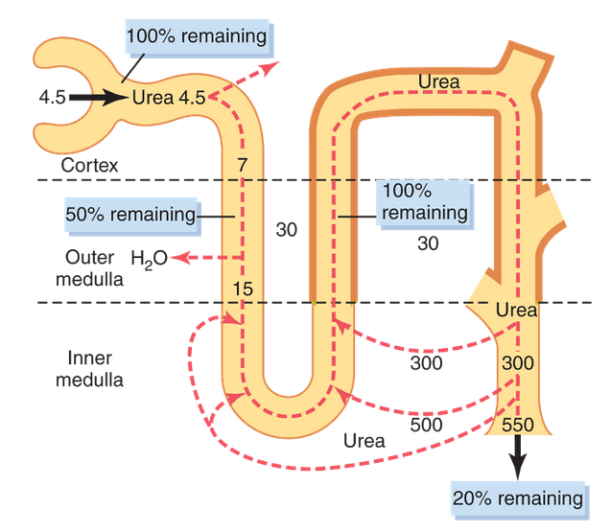
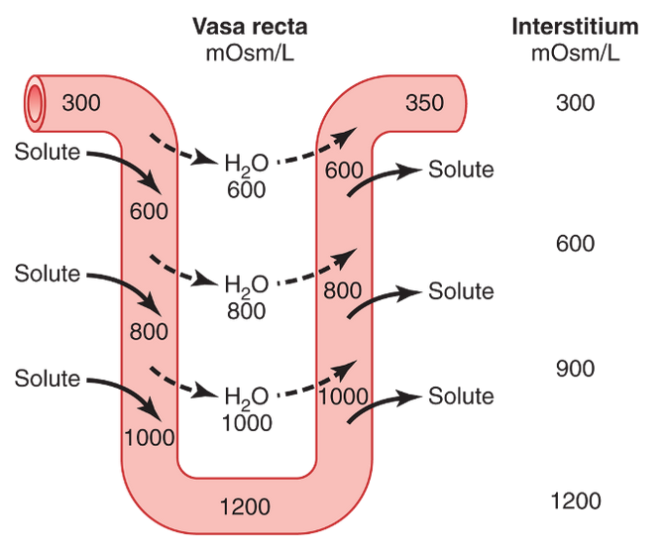
Cont.
Countercurrent Exchange in the Vasa Recta Preserves Hyperosmolarity of the Renal Medulla
Blood flow must be provided to the renal medulla to supply the metabolic needs of the cells in this part of the kidney. Without a special medullary blood flow system, the solutes pumped into the renal medulla by the countercurrent multiplier system would be rapidly dissipated.
There are two special features of the renal medullary blood flow that contribute to the preservation of the high solute concentrations:
The medullary blood flow is low, accounting for less than 5 percent of the total renal blood flow. This sluggish blood flow is sufficient to supply the metabolic needs of the tissues but helps to minimize solute loss from the medullary interstitium.
The vasa recta serve as countercurrent exchangers, minimizing washout of solutes from the medullary interstitium.
The countercurrent exchange mechanism operates as follows (Figure 28-7): Blood enters and leaves the medulla by way of the vasa recta at the boundary of the cortex and renal medulla. The vasa recta, like other capillaries, are highly permeable to solutes in the blood, except for the plasma proteins. As blood descends into the medulla toward the papillae, it becomes progressively more concentrated, partly by solute entry from the interstitium and partly by loss of water into the interstitium. By the time the blood reaches the tips of the vasa recta, it has a concentration of about 1200 mOsm/L, the same as that of the medullary interstitium. As blood ascends back toward the cortex, it becomes progressively less concentrated as solutes diffuse back out into the medullary interstitium and as water moves into the vasa recta.
Although there are large amounts of fluid and solute exchange across the vasa recta, there is little net dilution of the concentration of the interstitial fluid at each level of the renal medulla because of the U shape of the vasa recta capillaries, which act as countercurrent exchangers. Thus, the vasa recta do not create the medullary hyperosmolarity, but they do prevent it from being dissipated.
The U-shaped structure of the vessels minimizes loss of solute from the interstitium but does not prevent the bulk flow of fluid and solutes into the blood through the usual colloid osmotic and hydrostatic pressures that favor reabsorption in these capillaries. Under steady-state conditions, the vasa recta carry away only as much solute and water as is absorbed from the medullary tubules and the high concentration of solutes established by the countercurrent mechanism is preserved.
Figure 28-6
Figure 28-7

Slide 98
Cont.
Factors affecting urine concentration: Increased Medullary Blood Flow Reduces Urine Concentrating Ability.
Certain vasodilators can markedly increase renal medullary blood flow, thereby “washing out” some of the solutes from the renal medulla and reducing maximum urine concentrating ability. Large increases in arterial pressure can also increase the blood flow of the renal medulla to a greater extent than in other regions of the kidney and tend to wash out the hyperosmotic interstitium, thereby reducing urine concentrating ability. As discussed earlier, maximum concentrating ability of the kidney is determined not only by the level of ADH but also by the osmolarity of the renal medulla interstitial fluid. Even with maximal levels of ADH, urine concentrating ability will be reduced if medullary blood flow increases enough to reduce the hyperosmolarity in the renal medulla.
Disorders of Urinary Concentrating Ability
Impairment in the ability of the kidneys to concentrate or dilute the urine appropriately can occur with one or more of the following abnormalities:
Inappropriate secretion of ADH. Either too much or too little ADH secretion results in abnormal fluid handling by the kidneys.
Impairment of the countercurrent mechanism. A hyperosmotic medullary interstitium is required for maximal urine concentrating ability. No matter how much ADH is present, maximal urine concentration is limited by the degree of hyperosmolarity of the medullary interstitium.
Inability of the distal tubule, collecting tubule, and collecting ducts to respond to ADH.

Slide 99
Cont.
Failure to Produce ADH: “Central” Diabetes Insipidus.An inability to produce or release ADH from the posterior pituitary can be caused by head injuries or infections, or it can be congenital. Because the distal tubular segments cannot reabsorb water in the absence of ADH, this condition, called “central” diabetes insipidus, results in the formation of a large volume of dilute urine with urine volumes that can exceed 15 L/day. The thirst mechanisms, discussed later in this chapter, are activated when excessive water is lost from the body; therefore, as long as the person drinks enough water, large decreases in body fluid water do not occur. The primary abnormality observed clinically in people with this condition is the large volume of dilute urine. However, if water intake is restricted, as can occur in a hospital setting when fluid intake is restricted or the patient is unconscious (e.g., because of a head injury), severe dehydration can rapidly occur. The treatment for central diabetes insipidus is administration of a synthetic analog of ADH, desmopressin, which acts selectively on V2 receptors to increase water permeability in the late distal and collecting tubules. Desmopressin can be given by injection, as a nasal spray, or orally, and it rapidly restores urine output toward normal. Inability of the Kidneys to Respond to ADH: “Nephrogenic” Diabetes Insipidus.In some circumstances normal or elevated levels of ADH are present but the renal tubular segments cannot respond appropriately. This condition is referred to as “nephrogenic” diabetes insipidus because the abnormality resides in the kidneys. This abnormality can be due to either failure of the countercurrent mechanism to form a hyperosmotic renal medullary interstitium or failure of the distal and collecting tubules and collecting ducts to respond to ADH. In either case, large volumes of dilute urine are formed, which tends to cause dehydration unless fluid intake is increased by the same amount as urine volume is increased. Many types of renal diseases can impair the concentrating mechanism, especially those that damage the renal medulla. Also, impairment of the function of the loop of Henle, as occurs with diuretics that inhibit electrolyte reabsorption by this segment, such as furosemide, can compromise urine concentrating ability. And certain drugs, such as lithium (used to treat manic-depressive disorders) and tetracyclines (used as antibiotics), can impair the ability of the distal nephron segments to respond to ADH. Nephrogenic diabetes insipidus can be distinguished from central diabetes insipidus by administration of desmopressin, the synthetic analog of ADH. Lack of a prompt decrease in urine volume and an increase in urine osmolarity within 2 hours after injection of desmopressin is strongly suggestive of nephrogenic diabetes insipidus. The treatment for nephrogenic diabetes insipidus is to correct, if possible, the underlying renal disorder. The hypernatremia can also be attenuated by a low-sodium diet and administration of a diuretic that enhances renal sodium excretion, such as a thiazide diuretic.

Slide 100
Cont.
Summary of Urine Concentrating Mechanism and Changes in Osmolarity in Different Segments of the Tubules:
Proximal Tubule.About 65 percent of the filtered electrolytes is reabsorbed in the proximal tubule. However, the proximal tubular membranes are highly permeable to water, so that whenever solutes are reabsorbed, water also diffuses through the tubular membrane by osmosis. Therefore, the osmolarity of the fluid remains about the same as the glomerular filtrate, 300 mOsm/L.
Descending Loop of Henle.As fluid flows down the descending loop of Henle, water is absorbed into the medulla. The descending limb is highly permeable to water but much less permeable to sodium chloride and urea. Therefore, the osmolarity of the fluid flowing through the descending loop gradually increases until it is nearly equal to that of the surrounding interstitial fluid, which is about 1200 mOsm/L when the blood concentration of ADH is high.
When dilute urine is being formed, owing to low ADH concentrations, the medullary interstitial osmolarity is less than 1200 mOsm/L; consequently, the descending loop tubular fluid osmolarity also becomes less concentrated. This is due partly to the fact that less urea is absorbed into the medullary interstitium from the collecting ducts when ADH levels are low and the kidney is forming a large volume of dilute urine.
Thin Ascending Loop of Henle.The thin ascending limb is essentially impermeable to water but reabsorbs some sodium chloride. Because of the high concentration of sodium chloride in the tubular fluid, owing to water removal from the descending loop of Henle, there is some passive diffusion of sodium chloride from the thin ascending limb into the medullary interstitium. Thus, the tubular fluid becomes more dilute as the sodium chloride diffuses out of the tubule and water remains in the tubule.Some of the urea absorbed into the medullary interstitium from the collecting ducts also diffuses into the ascending limb, thereby returning the urea to the tubular system and helping to prevent its washout from the renal medulla. This urea recycling is an additional mechanism that contributes to the hyperosmotic renal medulla.
Thick Ascending Loop of Henle.The thick part of the ascending loop of Henle is also virtually impermeable to water, but large amounts of sodium, chloride, potassium, and other ions are actively transported from the tubule into the medullary interstitium. Therefore, fluid in the thick ascending limb of the loop of Henle becomes very dilute, falling to a concentration of about 100 mOsm/L.
Early Distal Tubule.The early distal tubule has properties similar to those of the thick ascending loop of Henle, so further dilution of the tubular fluid to about 50 mOsm/L occurs as solutes are reabsorbed while water remains in the tubule.

Slide 101
Cont.
Late Distal Tubule and Cortical Collecting Tubules.
In the late distal tubule and cortical collecting tubules, the osmolarity of the fluid depends on the level of ADH. With high levels of ADH, these tubules are highly permeable to water and significant amounts of water are reabsorbed. Urea, however, is not very permeant in this part of the nephron, resulting in increased urea concentration as water is reabsorbed. This allows most of the urea delivered to the distal tubule and collecting tubule to pass into the inner medullary collecting ducts, from which it is eventually reabsorbed or excreted in the urine. In the absence of ADH, little water is reabsorbed in the late distal tubule and cortical collecting tubule; therefore, osmolarity decreases even further because of continued active reabsorption of ions from these segments.
Inner Medullary Collecting Ducts.
The concentration of fluid in the inner medullary collecting ducts also depends on (1) ADH and (2) the surrounding medullary interstitium osmolarity established by the countercurrent mechanism. In the presence of large amounts of ADH, these ducts are highly permeable to water, and water diffuses from the tubule into the interstitial fluid until osmotic equilibrium is reached, with the tubular fluid having about the same concentration as the renal medullary interstitium (1200 to 1400 mOsm/L). Thus, a small volume of concentrated urine is produced when ADH levels are high. Because water reabsorption increases urea concentration in the tubular fluid and because the inner medullary collecting ducts have specific urea transporters that greatly facilitate diffusion, much of the highly concentrated urea in the ducts diffuses out of the tubular lumen into the medullary interstitium. This absorption of the urea into the renal medulla contributes to the high osmolarity of the medullary interstitium and the high concentrating ability of the kidney.Several important points to consider may not be obvious from this discussion. First, although sodium chloride is one of the principal solutes that contribute to the hyperosmolarity of the medullary interstitium, the kidney can, when needed, excrete a highly concentrated urine that contains little sodium chloride. The hyperosmolarity of the urine in these circumstances is due to high concentrations of other solutes, especially of waste products such as urea. One condition in which this occurs is dehydration accompanied by low sodium intake. low sodium intake stimulates formation of the hormones angiotensin II and aldosterone, which together cause avid sodium reabsorption from the tubules while leaving the urea and other solutes to maintain the highly concentrated urine.Second, large quantities of dilute urine can be excreted without increasing the excretion of sodium. This is accomplished by decreasing ADH secretion, which reduces water reabsorption in the more distal tubular segments without significantly altering sodium reabsorption.And finally, there is an obligatory urine volume that is dictated by the maximum concentrating ability of the kidney and the amount of solute that must be excreted. Therefore, if large amounts of solute must be excreted, they must be accompanied by the minimal amount of water necessary to excrete them. For example, if 600 milliosmoles of solute must be excreted each day, this requires at least 0.5 liter of urine if maximal urine concentrating ability is 1200 mOsm/L.

Slide 102
Lecture 9
Disturbances of Acid-Base Balance
(Linda corner ):
Disturbances of acid-base balance are among the most common conditions in all of clinical medicine. Acid- base disorders are characterized by an abnormal concentration of H+ in blood, reflected as abnormal pH. Acidemia is an increase in H+ concentration in blood (decrease in pH) and is caused by a pathophysiologic process called acidosis. Alkalemia, on the other hand, is a decrease in H+ concentration in blood (increase in pH) and is caused by a pathophysiologic process called alkalosis.
Disturbances of acid-base balance are described as either metabolic or respiratory, depending on whether the primary disturbance is in HCO3− or CO2. There are four simple acid-base disorders, where simple means that only one acid-base disorder is present. When there is more than one acid-base disorder present, the condi- tion is called a mixed acid-base disorder.
Disturbances of acid-base balance are described as either metabolic or respiratory, depending on whether the primary disturbance is in HCO3− or CO2. There are four simple acid-base disorders, where simple means that only one acid-base disorder is present. When there is more than one acid-base disorder present, the condi- tion is called a mixed acid-base disorder.
Metabolic acid-base disturbances are primary disor- ders involving HCO3−. Metabolic acidosis is caused by a decrease in HCO3− concentration that, according to the Henderson-Hasselbalch equation, leads to a de- crease in pH. This disorder is caused by gain of fixed H+ in the body (through overproduction of fixed H+, ingestion of fixed H+, or decreased excretion of fixed H+) or loss of HCO3−. Metabolic alkalosis is caused by an increase in HCO3− concentration that, according to the Henderson-Hasselbalch equation, leads to an increase in pH. This disorder is caused by loss of fixed H+ from the body or gain of HCO3−.

Slide 103
Lecture 9
Disturbances of Acid-Base Balance
(Linda corner ):
Respiratory acid-base disturbances are primary disorders of CO2 (i.e., disorders of respiration). Respiratory acidosis is caused by hypoventilation, which results in CO2 retention, increased PCO2, and decreased pH. Respiratory alkalosis is caused by hyperventilation, which results in CO2 loss, decreased PCO2, and increased pH.
When there is an acid-base disturbance, several mechanisms are utilized in an attempt to keep the blood pH in the normal range. The first line of defense is buffering in ECF and ICF. In addition to buffering, two types of compensatory responses attempt to nor- malize the pH: respiratory compensation and renal compensation. A helpful rule of thumb to learn is this: If the acid-base disturbance is metabolic (i.e., disturbance of HCO3−), then the compensatory response is respiratory to adjust the PCO2; if the acid-base distur- bance is respiratory (i.e., disturbance of CO2), then the compensatory response is renal (or metabolic) to adjust the HCO3− concentration. Another helpful rule is this: The compensatory response is always in the same direction as the original disturbance. For example, in metabolic acidosis, the primary disturbance is a decrease in the blood HCO3− concentration. The respiratory compensation is hyperventilation, which decreases the PCO2. In respiratory acidosis, the primary disturbance is increased PCO2. The renal compensation increases the HCO3− concentration.
As each acid-base disorder is presented, the buff- ering and compensatory responses are discussed in detail. Table 7-2 presents a summary of the four simple acid-base disorders and the expected compensatory responses that occur in each.

Slide 104
Lecture 9
Respiratory Acidosis (Linda corner) :
Disturbances of blood pH can be caused by a primary disturbance of HCO3− concentration or a primary disturbance of PCO2. Such disturbances are best under- stood by considering the Henderson-Hasselbalch equation for the HCO3−/CO2 buffer. Recall that the equation states− that blood pH is determined by the ratio of the HCO3 concentration to the CO2 concentration. Thus, changes in either HCO3− concentration or PCO2 will produce a change in pH.
Two types of compensatory responses attempt to normalize the pH: respiratory compensation and renal compensation
If the acid-base disturbance is respiratory (i.e., disturbance of CO2), then the compensatory response is renal (or metabolic) to adjust the HCO3− concentration. The compensatory response is always in the same direction as the original disturbance.
Metabolic Acidosis (Guyton corner ) : In metabolic acidosis, an excess of H over HCO3 occurs in the tubular fluid primarily because of decreased filtration of HCO3−. This decreased filtration of HCO3− is caused mainly by a decrease in the extracellular fluid con- centration of HCO3−. In respiratory acidosis, the excess H+ in the tubular fluid is due mainly to the rise in extracellular fluid PCO2, which stimulates H+ secretion. As discussed previously, with chronic acidosis, regard- less of whether it is respiratory or metabolic, there is an increase in the production of NH4+, which further con- tributes to the excretion of H+ and the addition of new HCO3− to the extracellular fluid. With severe chronic acidosis, as much as 500 mEq/day of H+ can be excreted in the urine, mainly in the form of NH4+; this excretion, in turn, contributes up to 500 mEq/day of new HCO3 that is added to the blood.
Thus, with chronic acidosis, increased secretion of H+ by the tubules helps eliminate excess H+ from the body and increases the quantity of HCO3− in the extracellular fluid. This process increases the HCO3− part of the bicarbonate buffer system which, in accordance with the Henderson-Hasselbalch equation, helps raise the extracellular pH and corrects the acidosis. If the acidosis is metabolically mediated, additional compensation by the lungs causes a reduction in Pco2, also helping to correct the acidosis.

Slide 105
Lecture 9
Metabolic acidosis (Guyton corner) :
Metabolic Acidosis Results from Decreased Extracellular Fluid HCO₃⁻ Concentration
The term metabolic acidosis refers to all other types of acidosis besides those caused by excess CO₂ in the body fluids. Metabolic acidosis can result from several general causes:
(1) failure of the kidneys to excrete metabolic acids normally formed in the body, (2) formation of excess quantities of metabolic acids in the body, (3) addition of metabolic acids to the body by ingestion or infusion of acids, and (4) loss of base from the body fluids, which has the same effect as adding an acid to the body fluids. Some specific conditions that cause metabolic acidosis are the following.
Renal Tubular Acidosis.
This type of acidosis results from a defect in renal secretion of H⁺ or in reabsorption of HCO₃⁻, or both. These disorders are generally of two types: (1) impairment of renal tubular HCO₃⁻ reabsorption, causing loss of HCO₃⁻ in the urine, or (2) inability of the renal tubular H⁺ secretory mechanism to establish normal acidic urine, causing the excretion of alkaline urine. In these cases, inadequate amounts of titratable acid and NH₄⁺ are excreted, so there is net accumulation of acid in the body fluids. Some causes of renal tubular acidosis include chronic renal failure, insufficient aldosterone secretion (Addison’s disease), and several hereditary and acquired disorders that impair tubular function, such as Fanconi’s syndrome.
Diarrhea.
Severe diarrhea is probably the most frequent cause of metabolic acidosis. The cause of this acidosis is the loss of large amounts of sodium bicarbonate into the feces. The gastrointestinal secretions normally contain large amounts of bicarbonate, and diarrhea results in the loss of HCO₃⁻ from the body, which has the same effect as losing large amounts of bicarbonate in the urine. This form of metabolic acidosis can be particularly serious and can cause death, especially in young children.
Vomiting of Intestinal Contents.
Vomiting of gastric contents alone would cause loss of acid and a tendency toward alkalosis because the stomach secretions are highly acidic. However, vomiting large amounts from deeper in the gastrointestinal tract, which sometimes occurs, causes loss of bicarbonate and results in metabolic acidosis in the same way that diarrhea causes acidosis.
Diabetes Mellitus.
Diabetes mellitus is caused by lack of insulin secretion by the pancreas (type I diabetes) or by insufficient insulin secretion to compensate for decreased sensitivity to the effects of insulin (type II diabetes). In the absence of sufficient insulin, the normal use of glucose for metabolism is prevented. Instead, some of the fats are split into acetoacetic acid, and this is metabolized by the tissues for energy in place of glucose. With severe diabetes mellitus, blood acetoacetic acid levels can rise very high, causing severe metabolic acidosis. In an attempt to compensate for this acidosis, large amounts of acid are excreted in the urine, sometimes as much as 500 mmol/day.
Ingestion of Acids.
Rarely are large amounts of acids ingested in normal foods. However, severe metabolic acidosis occasionally results from the ingestion of certain acidic poisons. Some of these include acetylsalicylics (aspirin) and methyl alcohol (which forms formic acid when it is metabolized).
Chronic Renal Failure.
When kidney function declines markedly, there is a buildup of the anions of weak acids in the body fluids that are not being excreted by the kidneys. In addition, the decreased glomerular filtration rate reduces the excretion of phosphates and NH₄⁺, which reduces the amount of HCO₃⁻ added back to the body fluids. Thus, chronic renal failure can be associated with severe metabolic acidosis.

Slide 106
Lecture 9
Metabolic Acidosis
Metabolic Alkalosis
Linda corner:
In ICF, the excess fixed H+ is buffered by organic phosphates and proteins. To utilize these intracel- lular buffers,
H+ first must enter the cells. H+ can enter the cells with an organic anion such as ketoan- ion, lactate, or formate,
or it can enter the cells in exchange for K+. When the H+ is exchanged for K+, hyperkalemia occurs.
Linda corner:
Loss of fixed acid; The classic example of metabolic alkalosis is vomiting, in which HCl is lost from the stomach. The gastric parietal cells produce H+ and
HCO3− from CO2 and H2O. The H+ is secreted with Cl− into the lumen of the stomach to aid in digestion, and the HCO3− enters the blood. In normal persons, the secreted H+ moves from the stomach to the small intestine, where a low pH triggers the
the HCO3 added to blood by the parietal cells is later removed from blood in the pancreatic secretions. However, when vomiting occurs, H+ is lost from the stomach and never reaches the small intestine. HCO3− secretion from the pancreas, therefore, is not stimulated, and the HCO3− remains in the blood, resulting in an increase in HCO3− concentration.
Guyton corner :
increased HCO3− concentration in the extracellular fluid increases the filtered load of HCO3−, which, in turn, causes excess HCO3− over H+ secreted in the renal tubular fluid. The excess HCO3− in the tubular fluid fails to be reabsorbed because there is no H+ to react with, and it is excreted in the urine.
In metabolic alkalosis, the primary compensations are decreased ventilation, which raises Pco2, and increased renal HCO3− excretion, which helps−compensate for the initial rise in extracellular fluid HCO3 concentration.

Slide 107
Lecture 9
Guyton corner :
Analysis of Acid-Base Disorders
A convenient way to diagnose acid-base disorders is to use an acid-base nomogram, as shown in the Figure. This diagram can be used to determine the type of acidosis or alkalosis, as well as its severity. In this acid-base diagram, pH, HCO3−concentration, and PCO2 values intersect according to the Henderson-Hasselbalch equation. The central open circle shows normal values and the deviations that can still be considered within the normal range. The shaded areas of the diagram show the 95 percent confidence limits for the normal compensations to simple metabolic and respiratory disorders
How to Analyze an ABG
(Table 31-3) summarizes the characteristics associated with respiratory and metabolic acidosis, as well as respiratory and metabolic alkalosis, which are discussed in the next section. Note that in respiratory acidosis, there is a reduction in pH, an increase in extracellular fluid H+ concentration, and an increase in PCO2, which is the initial cause of the acidosis. The compensatory response is an increase in plasma HCO3−, caused by the addition of new HCO3−to the extracellular fluid by the kidneys.The rise in HCO3− helps offset the increase in PCO2 , thereby returning the plasma pH toward normal. In metabolic acidosis, there is also a decrease in pH and a rise in extracellular fluid H+ concentration. However, in this case, the primary abnormality is a decrease in plasma HCO3−. The primary compensations include increased ventilation rate, which reduces PCO2, and renal compensation, which, by adding new HCO3−to the extracellular fluid, helps minimize the initial fall in extracellular HCO3−concentration.

Slide 108
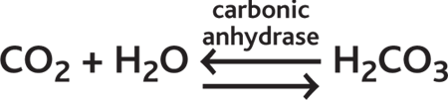
Lecture#10 Buffers System
Guyton’s Corner: Bicarbonate Buffer System
Bicarbonate Buffer System Is the Most Important Extracellular Buffer.
The bicarbonate buffer system to be powerful, for two reasons: First, the pH of the extracellular fluid is about 7.4, whereas the pK of the bicarbonate buffer system is 6.1. This means that there is about 20 times as much of the bicarbonate buffer system in the form of HCO3− as in the form of dissolved CO2. For this reason, this system operates on the portion of the buffering curve where the slope is low and the buffering power is poor. Second, the concentrations of the two elements of the bicarbonate system, CO2 and HCO3−, are not great.Despite these characteristics, the bicarbonate buffer system is the most powerful extracellular buffer in the body. This apparent paradox is due mainly to the fact that the two elements of the buffer system, HCO3− and CO2, are regulated, respectively, by the kidneys and the lungs, as discussed later. As a result of this regulation, the pH of the extracellular fluid can be precisely controlled by the relative rate of removal and addition of HCO3− by the kidneys and the rate of removal of CO2 by the lungs.
The bicarbonate buffer system consists of a water solution that contains two ingredients: (1) a weak acid, H2CO3, and (2) a bicarbonate salt, such as NaHCO3.
H2CO3 is formed in the body by the reaction of CO2 with H2O.
This reaction is slow, and exceedingly small amounts of H2CO3 are formed unless the enzyme carbonic anhydrase is present. This enzyme is especially abundant in the walls of the lung alveoli, where CO2 is released; carbonic anhydrase is also present in the epithelial cells of the renal tubules, where CO2 reacts with H2O to form H2CO3.
H2CO3 ionizes weakly to form small amounts of H+ and HCO3− :
Because of the weak dissociation of H2CO3, the H+ concentration is extremely small.
When a strong acid such as HCl is added to the bicarbonate buffer solution, the increased H+ released from the acid (HCl → H+ + Cl−) is buffered by HCO3−.
As a result, more H2CO3 is formed, causing increased CO2 and H2O production. From these reactions, one can see that H+ from the strong acid HCl reacts with HCO3− to form the very weak acid H2CO3, which in turn forms CO2 and H2O. The excess CO2 greatly stimulates respiration, which eliminates the CO2 from the extracellular fluid.
The opposite reactions take place when a strong base, such as sodium hydroxide (NaOH), is added to the bicarbonate buffer solution.

Slide 109

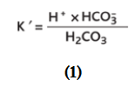
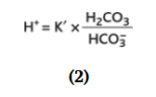
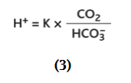
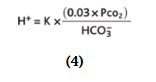
Cont.
Guyton’s Corner: Bicarbonate Buffer System
Quantitative Dynamics of the Bicarbonate Buffer System
All acids, including H2CO3, are ionized to some extent. From mass balance considerations, the concentrations of H+ and HCO3 are proportional to the concentration of H2CO3.
For any acid, the concentration of the acid relative to its dissociated ions is defined by the dissociation constant K′.
This equation indicates that in an H2CO3 solution, the amount of free H+ is equal to :
The concentration of undissociated H2CO3 cannot be measured in solution because it rapidly dissociates into CO2 and H2O or to H+ and HCO3−. However, the CO2 dissolved in the blood is directly proportional to the amount of undissociated H2CO3. Therefore, equation 2 can be rewritten as :
The dissociation constant (K) for equation 3 is only about 1/400 of the dissociation constant (K′) of equation 2 because the proportionality ratio between H2CO3 and CO2 is 1:400.
Equation 3 is written in terms of the total amount of CO2 dissolved in solution. However, most clinical laboratories measure the blood CO2 tension (PCO2) rather than the actual amount of CO2. Fortunately, the amount of CO2 in the blood is a linear function of PCO2 multiplied by the solubility coefficient for CO2; under physiologic conditions, the solubility coefficient for CO2 is 0.03 mmol/mm Hg at body temperature. This means that 0.03 millimole of H2CO3 is present in the blood for each mm Hg PCO2 measured. Therefore, equation 3 can be rewritten as

Slide 110

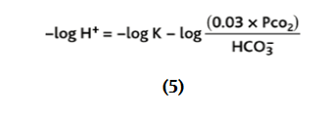
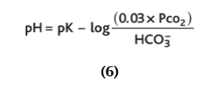


Cont.
Guyton’s Corner: Bicarbonate Buffer System
Henderson-Hasselbalch Equation
As discussed earlier, it is customary to express H+ concentration in pH units rather than in actual concentrations. Recall that pH is defined as pH = −log H+.
The dissociation constant can be expressed in a similar manner.
Therefore, we can express the H+ concentration in equation 4 in pH units by taking the negative logarithm of that equation, which yields :
Therefore,
Rather than work with a negative logarithm, we can change the sign of the logarithm and invert the numerator and denominator in the last term, using the law of logarithms to yield :
For the bicarbonate buffer system, the pK is 6.1, and equation 7 can be written as :

Slide 111
Cont.
Equation 8 is the Henderson-Hasselbalch equation, and with it, one can calculate the pH of a solution if the molar concentration of HCO3− and the PCO2 are known.
From the Henderson-Hasselbalch equation, it is apparent that an increase in HCO3− concentration causes the pH to rise, shifting the acid-base balance toward alkalosis. An increase in PCO2 causes the pH to decrease, shifting the acid-base balance toward acidosis.
The Henderson-Hasselbalch equation, in addition to defining the determinants of normal pH regulation and acid-base balance in the extracellular fluid, provides insight into the physiologic control of acid and base composition of the extracellular fluid. As discussed later, the HCO3− concentration is regulated mainly by the kidneys, whereas the PCO2 in extracellular fluid is controlled by the rate of respiration. By increasing the rate of respiration, the lungs remove CO2 from the plasma, and by decreasing respiration, the lungs elevate PCO2. Normal physiologic acid-base homeostasis results from the coordinated efforts of both of these organs, the lungs and the kidneys, and acid-base disorders occur when one or both of these control mechanisms are impaired, thus altering either the HCO3− concentration or the PCO2 of extracellular fluid.
When disturbances of acid-base balance result from a primary change in extracellular fluid HCO3− concentration, they are referred to as metabolic acid-base disorders. Therefore, acidosis caused by a primary decrease in HCO3− concentration is termed metabolic acidosis, whereas alkalosis caused by a primary increase in HCO3− concentration is called metabolic alkalosis. Acidosis caused by an increase in PCO2 is called respiratory acidosis, whereas alkalosis caused by a decrease in PCO2 is termed respiratory alkalosis.

Slide 112
Cont.
Guyton corner:
Phosphate Buffer System
Although the phosphate buffer system is not important as an extracellular fluid buffer, it plays a major role in buffering renal tubular fluid and intracellular fluids.
The main elements of the phosphate buffer system are H2PO4− and HPO4=. When a strong acid such as HCl is added to a mixture of these two substances, the hydrogen is accepted by the base HPO4= and converted to H2PO4−.
The phosphate buffer system has a pK of 6.8, which is not far from the normal pH of 7.4 in the body fluids; this allows the system to operate near its maximum buffering power. However, its concentration in the extracellular fluid is low, only about 8 percent of the concentration of the bicarbonate buffer. Therefore, the total buffering power of the phosphate system in the extracellular fluid is much less than that of the bicarbonate buffering system.
In contrast to its rather insignificant role as an extracellular buffer, the phosphate buffer is especially important in the tubular fluids of the kidneys, for two reasons: (1) phosphate usually becomes greatly concentrated in the tubules, thereby increasing the buffering power of the phosphate system, and (2) the tubular fluid usually has a considerably lower pH than the extracellular fluid does, bringing the operating range of the buffer closer to the pK (6.8) of the system.
The phosphate buffer system is also important in buffering intracellular fluid because the concentration of phosphate in this fluid is many times that in the extracellular fluid. Also, the pH of intracellular fluid is lower than that of extracellular fluid and therefore is usually closer to the pK of the phosphate buffer system compared with the extracellular fluid.

Slide 113
Cont.
Guyton corner:
Proteins Are Important Intracellular Buffers
Proteins are among the most plentiful buffers in the body because of their high concentrations, especially within the cells.
The pH of the cells, although slightly lower than in the extracellular fluid, nevertheless changes approximately in proportion to extracellular fluid pH changes. There is a slight diffusion of H+ and HCO3− through the cell membrane, although these ions require several hours to come to equilibrium with the extracellular fluid, except for rapid equilibrium that occurs in the red blood cells. CO2, however, can rapidly diffuse through all the cell membranes. This diffusion of the elements of the bicarbonate buffer system causes the pH in intracellular fluid to change when there are changes in extracellular pH. For this reason, the buffer systems within the cells help prevent changes in the pH of extracellular fluid but may take several hours to become maximally effective.
In the red blood cell, hemoglobin (Hb) is an important buffer.
Approximately 60 to 70 percent of the total chemical buffering of the body fluids is inside the cells, and most of this results from the intracellular proteins. However, except for the red blood cells, the slowness with which H+ and HCO3− move through the cell membranes often delays for several hours the maximum ability of the intracellular proteins to buffer extracellular acid-base abnormalities.
In addition to the high concentration of proteins in the cells, another factor that contributes to their buffering power is the fact that the pKs of many of these protein systems are fairly close to intracellular pH.

Slide 114
Cont.
The second line of defense against acid-base disturbances is control of extracellular fluid CO2concentration by the lungs. An increase in ventilation eliminates CO2 from extracellular fluid, which, by mass action, reduces the H+ concentration. Conversely, decreased ventilation increases CO2, thus also increasing H+ concentration in the extracellular fluid.
Pulmonary Expiration of CO2 Balances Metabolic Formation of CO2
CO2 is formed continually in the body by intracellular metabolic processes. After it is formed, it diffuses from the cells into the interstitial fluids and blood and the flowing blood transports it to the lungs, where it diffuses into the alveoli and then is transferred to the atmosphere by pulmonary ventilation. About 1.2 mol/L of dissolved CO2 normally is in the extracellular fluid, corresponding to a PCO2 of 40 mm Hg.If the rate of metabolic formation of CO2 increases, the PCO2 of the extracellular fluid is likewise increased. Conversely, a decreased metabolic rate lowers the PCO2. If the rate of pulmonary ventilation is increased, CO2 is blown off from the lungs and the PCO2 in the extracellular fluid decreases. Therefore, changes in either pulmonary ventilation or the rate of CO2 formation by the tissues can change the extracellular fluid PCO2.
Increasing Alveolar Ventilation Decreases Extracellular Fluid H+ Concentration and Raises pH
If the metabolic formation of CO2 remains constant, the only other factor that affects PCO2 in extracellular fluid is the rate of alveolar ventilation. The higher the alveolar ventilation, the lower the PCO2; conversely, the lower the alveolar ventilation rate, the higher the PCO2. As discussed previously, when CO2concentration increases, the H2CO3 concentration and H+ concentration also increase, thereby lowering extracellular fluid pH
Guyton corner:
Respiratory Regulation of Acid-Base Balance

Slide 115

Cont.
Guyton corner:
Secretion of H+ and Reabsorption of HCO3− by the RenalTubules
Hydrogen ion secretion and HCO3− reabsorption occur in virtually all parts of the tubules except the descending and ascending thin limbs of the loop of Henle. Figure 30-4summarizes HCO3− reabsorption along the tubule. Keep in mind that for each HCO3− reabsorbed, a H+ must be secreted.
About 80 to 90 percent of the bicarbonate reabsorption (and H+ secretion) occurs in the proximal tubule, so only a small amount of HCO3− flows into the distal tubules and collecting ducts. In the thick ascending loop of Henle, another 10 percent of the filtered HCO3− is reabsorbed, and the remainder of the reabsorption takes place in the distal tubule and collecting duct. As discussed previously, the mechanism by which HCO3− is reabsorbed also involves tubular secretion of H+, but different tubular segments accomplish this task differently
The rest of the nonbicarbonate, non-NH4+ buffer excreted in the urine is measured by determining a value known as titratable acid. The amount of titratable acid in the urine is measured by titrating the urine with a strong base, such as NaOH, to a pH of 7.4, the pH of normal plasma, and the pH of the glomerular filtrate. This titration reverses the events that occurred in the tubular lumen when the tubular fluid was titrated by secreted H+. Therefore, the number of milliequivalents of NaOH required to return the urinary pH to 7.4 equals the number of milliequivalents of H+ added to the tubular fluid that combined with phosphate and other organic buffers. The titratable acid measurement does not include H+ in association with NH4+ because the pK of the ammonia-ammonium reaction is 9.2, and titration with NaOH to a pH of 7.4 does not remove the H+ from NH4+.
Thus, the net acid excretion by the Kidneys can be assessed as:
The reason we subtract HCO3− excretion is that the loss of HCO3− is the same as the addition of H+ to the blood. To maintain acid-base balance, the net acid excretion must equal the nonvolatile acidproduction in the body. In acidosis, the net acid excretion increases markedly, especially because of increased NH4+ excretion, thereby removing acid from the blood. The net acid excretion also equals the rate of net HCO3− addition to the blood. Therefore, in acidosis, there is a net addition of HCO3− back to the blood as more NH4+ and urinary titratable acid are excreted.
In alkalosis, titratable acid and NH4+ excretion drop to 0, whereas HCO3− excretion increases.Therefore, in alkalosis, there is a negative net acid secretion. This means that there is a net loss of HCO3−from the blood (which is the same as adding H+ to the blood) and that no new HCO3− is generated by the kidneys.

Slide 116
Lecture 11
Linda corner:
Disturbances of acid-base balance are among the most common conditions in all of clinical medicine. Acid- base disorders are characterized by an abnormal concentration of H+ in blood, reflected as abnormal pH. Acidemia is an increase in H+ concentration in blood (decrease in pH) and is caused by a pathophysiologic process called acidosis. Alkalemia, on the other hand, is a decrease in H+ concentration in blood (increase in pH) and is caused by a pathophysiologic process called alkalosis.
Disturbances of acid-base balance are described as either metabolic or respiratory, depending on whether the primary disturbance is in HCO3− or CO2. There are four simple acid-base disorders, where simple means that only one acid-base disorder is present. When there is more than one acid-base disorder present, the condi- tion is called a mixed acid-base disorder.

Slide 117
Cont.
Linda corner:
Disturbances of acid-base balance are described as either metabolic or respiratory, depending on whether the primary disturbance is in HCO3− or CO2. There are four simple acid-base disorders, where simple means that only one acid-base disorder is present. When there is more than one acid-base disorder present, the condi- tion is called a mixed acid-base disorder.
Metabolic acid-base disturbances are primary disor- ders involving HCO3−. Metabolic acidosis is caused by a decrease in HCO3− concentration that, according to the Henderson-Hasselbalch equation, leads to a de- crease in pH. This disorder is caused by gain of fixed H+ in the body (through overproduction of fixed H+, ingestion of fixed H+, or decreased excretion of fixed H+) or loss of HCO3−. Metabolic alkalosis is caused by an increase in HCO3− concentration that, according to the Henderson-Hasselbalch equation, leads to an increase in pH. This disorder is caused by loss of fixed H+ from the body or gain of HCO3−.
Respiratory acid-base disturbances are primary disorders of CO2 (i.e., disorders of respiration). Respiratory acidosis is caused by hypoventilation, which results in CO2 retention, increased PCO2, and decreased pH. Respiratory alkalosis is caused by hyperventilation, which results in CO2 loss, decreased PCO2, and increased pH.

Slide 118
Cont.
Linda corner:
When there is an acid-base disturbance, several mechanisms are utilized in an attempt to keep the blood pH in the normal range. The first line of defense is buffering in ECF and ICF. In addition to buffering, two types of compensatory responses attempt to nor- malize the pH: respiratory compensation and renal compensation. A helpful rule of thumb to learn is this: If the acid-base disturbance is metabolic (i.e., disturbance of HCO3−), then the compensatory response is respiratory to adjust the PCO2; if the acid-base distur- bance is respiratory (i.e., disturbance of CO2), then the compensatory response is renal (or metabolic) to adjust the HCO3− concentration. Another helpful rule is this: The compensatory response is always in the same direction as the original disturbance. For example, in metabolic acidosis, the primary disturbance is a decrease in the blood HCO3− concentration. The respiratory compensation is hyperventilation, which decreases the PCO2. In respiratory acidosis, the primary disturbance is increased PCO2. The renal compensation increases the HCO3− concentration.
As each acid-base disorder is presented, the buff- ering and compensatory responses are discussed in detail. Table 7-2 presents a summary of the four simple acid-base disorders and the expected compensatory responses that occur in each.

Slide 119
Cont.
Linda corner:
Disturbances of blood pH can be caused by a primary disturbance of HCO3− concentration or a primary disturbance of PCO2. Such disturbances are best under- stood by considering the Henderson-Hasselbalch equation for the HCO3−/CO2 buffer. Recall that the equation states− that blood pH is determined by the ratio of the HCO3 concentration to the CO2 concentration. Thus, changes in either HCO3− concentration or PCO2 will produce a change in pH.
Two types of compensatory responses attempt to normalize the pH: respiratory compensation and renal compensation
If the acid-base disturbance is respiratory (i.e., disturbance of CO2), then the compensatory response is renal (or metabolic) to adjust the HCO3− concentration. The compensatory response is always in the same direction as the original disturbance.

Slide 120
Cont.
Guyton corner : In metabolic acidosis, an excess of H over HCO3 occurs in the tubular fluid primarily because of decreased filtration of HCO3−. This decreased filtration of HCO3− is caused mainly by a decrease in the extracellular fluid con- centration of HCO3−. In respiratory acidosis, the excess H+ in the tubular fluid is due mainly to the rise in extracellular fluid PCO2, which stimulates H+ secretion. As discussed previously, with chronic acidosis, regard- less of whether it is respiratory or metabolic, there is an increase in the production of NH4+, which further con- tributes to the excretion of H+ and the addition of new HCO3− to the extracellular fluid. With severe chronic acidosis, as much as 500 mEq/day of H+ can be excreted in the urine, mainly in the form of NH4+; this excretion, in turn, contributes up to 500 mEq/day of new HCO3 that is added to the blood.
Thus, with chronic acidosis, increased secretion of H+ by the tubules helps eliminate excess H+ from the body and increases the quantity of HCO3− in the extracellular fluid. This process increases the HCO3− part of the bicarbonate buffer system which, in accordance with the Henderson-Hasselbalch equation, helps raise the extracellular pH and corrects the acidosis. If the acidosis is metabolically mediated, additional compensation by the lungs causes a reduction in Pco2, also helping to correct the acidosis.

Slide 121
Cont.
Guyton corner : Metabolic Acidosis Results from Decreased Extracellular Fluid HCO₃⁻ Concentration
The term metabolic acidosis refers to all other types of acidosis besides those caused by excess CO₂ in the body fluids. Metabolic acidosis can result from several general causes:
(1) failure of the kidneys to excrete metabolic acids normally formed in the body, (2) formation of excess quantities of metabolic acids in the body, (3) addition of metabolic acids to the body by ingestion or infusion of acids, and (4) loss of base from the body fluids, which has the same effect as adding an acid to the body fluids. Some specific conditions that cause metabolic acidosis are the following.
Renal Tubular Acidosis.
This type of acidosis results from a defect in renal secretion of H⁺ or in reabsorption of HCO₃⁻, or both. These disorders are generally of two types: (1) impairment of renal tubular HCO₃⁻ reabsorption, causing loss of HCO₃⁻ in the urine, or (2) inability of the renal tubular H⁺ secretory mechanism to establish normal acidic urine, causing the excretion of alkaline urine. In these cases, inadequate amounts of titratable acid and NH₄⁺ are excreted, so there is net accumulation of acid in the body fluids. Some causes of renal tubular acidosis include chronic renal failure, insufficient aldosterone secretion (Addison’s disease), and several hereditary and acquired disorders that impair tubular function, such as Fanconi’s syndrome.

Slide 122
Cont.
Guyton corner :
Diarrhea.
Severe diarrhea is probably the most frequent cause of metabolic acidosis. The cause of this acidosis is the loss of large amounts of sodium bicarbonate into the feces. The gastrointestinal secretions normally contain large amounts of bicarbonate, and diarrhea results in the loss of HCO₃⁻ from the body, which has the same effect as losing large amounts of bicarbonate in the urine. This form of metabolic acidosis can be particularly serious and can cause death, especially in young children.
Vomiting of Intestinal Contents.
Vomiting of gastric contents alone would cause loss of acid and a tendency toward alkalosis because the stomach secretions are highly acidic. However, vomiting large amounts from deeper in the gastrointestinal tract, which sometimes occurs, causes loss of bicarbonate and results in metabolic acidosis in the same way that diarrhea causes acidosis.
Diabetes Mellitus.
Diabetes mellitus is caused by lack of insulin secretion by the pancreas (type I diabetes) or by insufficient insulin secretion to compensate for decreased sensitivity to the effects of insulin (type II diabetes). In the absence of sufficient insulin, the normal use of glucose for metabolism is prevented. Instead, some of the fats are split into acetoacetic acid, and this is metabolized by the tissues for energy in place of glucose. With severe diabetes mellitus, blood acetoacetic acid levels can rise very high, causing severe metabolic acidosis. In an attempt to compensate for this acidosis, large amounts of acid are excreted in the urine, sometimes as much as 500 mmol/day.

Slide 123
Cont.
Guyton corner :
Ingestion of Acids.
Rarely are large amounts of acids ingested in normal foods. However, severe metabolic acidosis occasionally results from the ingestion of certain acidic poisons. Some of these include acetylsalicylics (aspirin) and methyl alcohol (which forms formic acid when it is metabolized).
Chronic Renal Failure.
When kidney function declines markedly, there is a buildup of the anions of weak acids in the body fluids that are not being excreted by the kidneys. In addition, the decreased glomerular filtration rate reduces the excretion of phosphates and NH₄⁺, which reduces the amount of HCO₃⁻ added back to the body fluids. Thus, chronic renal failure can be associated with severe metabolic acidosis.
Linda corner:
In ICF, the excess fixed H+ is buffered by organic phosphates and proteins. To utilize these intracel- lular buffers,
H+ first must enter the cells. H+ can enter the cells with an organic anion such as ketoan- ion, lactate, or formate,
or it can enter the cells in exchange for K+. When the H+ is exchanged for K+, hyperkalemia occurs.

Slide 124
Cont.
Linda corner:
Loss of fixed acid; The classic example of metabolic alkalosis is vomiting, in which HCl is lost from the stomach. The gastric parietal cells produce H+ and
HCO3− from CO2 and H2O. The H+ is secreted with Cl− into the lumen of the stomach to aid in digestion, and the HCO3− enters the blood. In normal persons, the secreted H+ moves from the stomach to the small intestine, where a low pH triggers the
the HCO3 added to blood by the parietal cells is later removed from blood in the pancreatic secretions. However, when vomiting occurs, H+ is lost from the stomach and never reaches the small intestine. HCO3− secretion from the pancreas, therefore, is not stimulated, and the HCO3− remains in the blood, resulting in an increase in HCO3− concentration.

Slide 125
Cont.
Guyton corner : increased HCO3− concentration in the extracellular fluid increases the filtered load of HCO3−, which, in turn, causes excess HCO3− over H+ secreted in the renal tubular fluid. The excess HCO3− in the tubular fluid fails to be reabsorbed because there is no H+ to react with, and it is excreted in the urine.
In metabolic alkalosis, the primary compensations are decreased ventilation, which raises Pco2, and increased renal HCO3− excretion, which helps−compensate for the initial rise in extracellular fluid HCO3 concentration.

Slide 126
Cont.
Guyton corner :
A convenient way to diagnose acid-base disorders is to use an acid-base nomogram, as shown in the Figure. This diagram can be used to determine the type of acidosis or alkalosis, as well as its severity. In this acid-base diagram, pH, HCO3−concentration, and PCO2 values intersect according to the Henderson-Hasselbalch equation. The central open circle shows normal values and the deviations that can still be considered within the normal range. The shaded areas of the diagram show the 95 percent confidence limits for the normal compensations to simple metabolic and respiratory disorders

Slide 127
Cont.
Guyton corner: (Table 31-3) summarizes the characteristics associated with respiratory and metabolic acidosis, as well as respiratory and metabolic alkalosis, which are discussed in the next section. Note that in respiratory acidosis, there is a reduction in pH, an increase in extracellular fluid H+ concentration, and an increase in PCO2, which is the initial cause of the acidosis. The compensatory response is an increase in plasma HCO3−, caused by the addition of new HCO3−to the extracellular fluid by the kidneys.The rise in HCO3− helps offset the increase in PCO2 , thereby returning the plasma pH toward normal. In metabolic acidosis, there is also a decrease in pH and a rise in extracellular fluid H+ concentration. However, in this case, the primary abnormality is a decrease in plasma HCO3−. The primary compensations include increased ventilation rate, which reduces PCO2, and renal compensation, which, by adding new HCO3−to the extracellular fluid, helps minimize the initial fall in extracellular HCO3−concentration.

