Slide 1
Renal Function and GFR
We advise that you study the anatomy and histology of the kidney before studying these lectures; then quickly review them from here!
Red: very important.
Green: Doctor’s notes.
Pink: formulas.
Yellow: numbers.
Gray: notes and explanation.
Physiology Team 436 – Renal Block Lectures 1 & 2
For further understanding please check our “Extra Notes” file which contains extra explanation for reference books.

Slide 2
Objectives for Lectures 1 & 2
Enumerate general functions of the kidney
Identify and describe that the nephron is the structural and function unit of the kidney
Explain glomerular filtration membrane & filtration forces
Describe mechanism of filtration & composition of the glomerular filtrate
Calculate the net filtration pressure using parameters of Starling forces
Describe that the mechanism of urine formation include three basic processes; glomerular filtration, tubular reabsorption and tubular secretion.
Define GFR and quote normal value.
Identify and describe the factors controlling GFR in terms of starling forces, permeability with respect to size, shape and electrical charges and ultra-filtration coefficient.
Describe Intrinsic and extrinsic mechanism that regulate GFR.
Describe autoregulation of GFR & tubuloglomerular feedback mechanism.

Slide 3
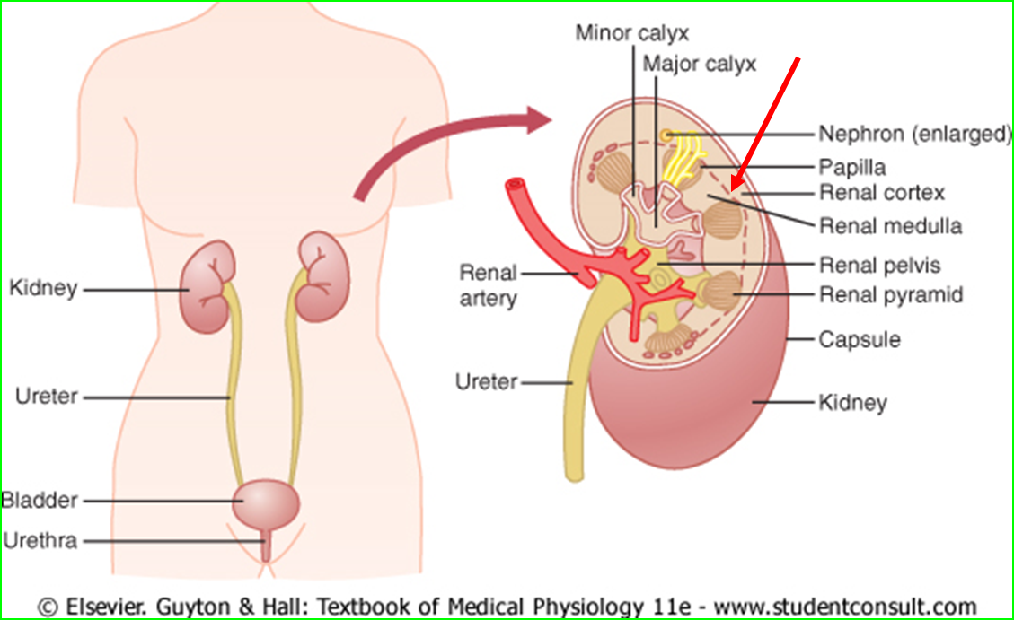
Urinary System Organs
Weight of Kidneys: Each kidney of the adult human about 150 gram
Size of Kidneys: as a clenched fist.
Kidney
Ureter
Urinary bladder
Urethra

Slide 4
Function of the Kidney
The kidneys serve many important homeostatic functions, including the following :
Regulation of :
Body fluid osmolality (including water) and electrolyte concentrations and balance (K,Na,Cl,.)
Arterial blood pressure (RAAS renin–angiotensin aldesterone system, excretion of excess salt and water )
Acid-base balance (H+ concentration along with lung).
Excretion of :
metabolic waste products and foreign chemicals (Nitrogenous Wastes) :
UREA (proteins→amino acids →NH2 removed →forms ammonia, liver converts to urea) , CREATININE , URIC ACID , Bilirubin
Drug and Detoxification of pesticides
Synthesizing/Activating functions :
Erythropoietin production → RBC production by bone marrow
Renin formation
Gluconeogenesis: synthesis of glucose from amino acid during prolonged fasting (Glucose can be synthesized in the liver and kidneys during prolonged fasting)
25, cholecalciferol will be activated in the kidneys to 1,25 dihydrocholecalciferol D3 (calcitrol)
Kidney Filter 200 liters of blood daily, allowing toxins, metabolic wastes, and excess ions to leave the body in urine,
The only hormone secreted from kidney is erythropoietin

Slide 5
Nitrogenous Wates
3-Creatinine | 2- Uric acid | 1- Urea
-from muscle creatine -Creatinine is the more specific than urea in diagnosing renal diseases. Why? Because unlike creatinine, urea is affected by the diet (E.g. urea is increased when protein consumption is increased). | from nucleic acids‘ | Formation: from the metabolism of “amino acids” Proteins → amino acid → NH2 removed → forms ammonia → liver converts to urea.
Differences between secretion and excretion :
Secretion : is excretion within the body,
Excretion : is excreting a substance out of the body.

Slide 6
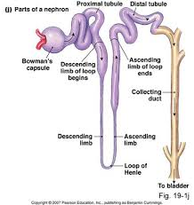
Nephron: the functional unit of the kidney
Nephron
Renal Corpuscle
Glomerulus
Bowman's Capsule
Renal tubules
Proximal convoluted tubules
Loop of Henle
Distal convoluted tubules
Connecting tubules
Intercalated cells
Principal cells
Nephron: is the functional and structural unit of the kidney.
Each kidney in the human body contains about 800,000 to 1,000,000 “one million” nephrons, each capable of urine formation.

Slide 7
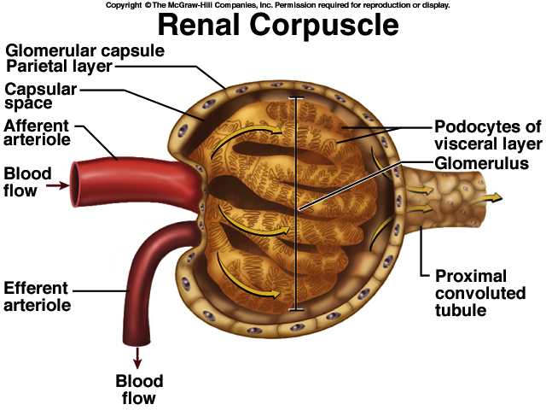
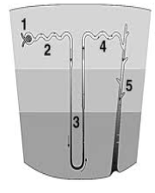
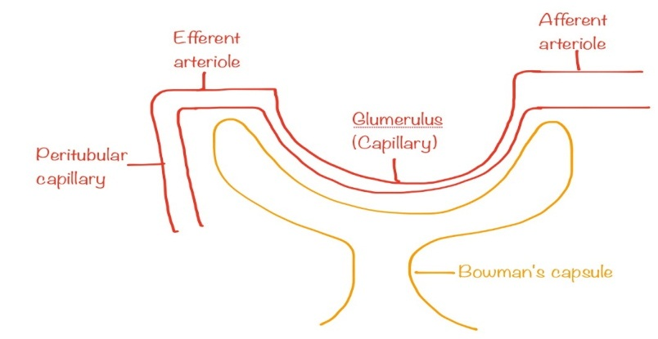
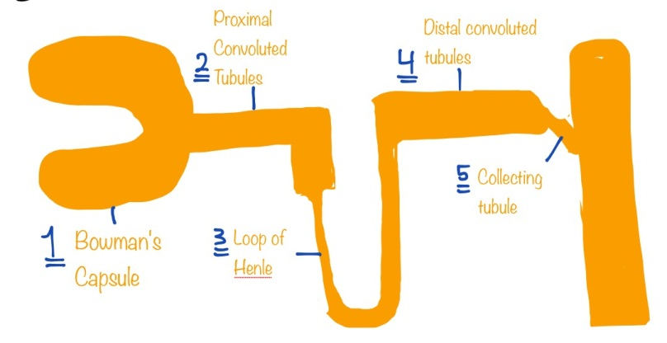
Structure of Nephron
Nephrons
Vessels
Tubes (5) : in which filtered fluid eventually is converted into urine.
Bowman's capsule: around the Glomerulus and receives the filtrate.
Proximal convoluted tubules
( in the cortex).
loop of Henle
Distal convoluted tubules
(in the renal cortex).
Connecting tubule, cortical collecting, and the cortical collecting ducts, which run downward in the medulla and become: Medullary collecting duct
Afferent arteriole : delivers blood into the glomeruli
The Glomerulus : capillary network or tuft in which large amount of fluid is filtered from blood (produces filtrate) it will be collected in capsular space then flows into urinary/renal tubule..
Efferent arterioles : delivers blood from glomeruli to peritubular capillaries
Peritubular capillary : vasa recta
Note that the pressures along the afferent arteriole, glomerulus and efferent arteriole are high. Why? to increase filtration.
Note that the afferent arteriole is larger than the efferent arteriole.
Glomerular filtrate collects in capsular space then flows into renal tubule.
Although blood circulation in the kidneys passes through two capillary beds (Glomeruli and peritubular capillaries), it is not considered a portal circulation. Why? Because glomeruli contain arterial capillaries only (There’s no venous blood).
In the blood supply of the kidney, the straight arterioles of kidney (or vasa recta renis) are a series of straight capillaries in the medulla (Latin: vasa, "vessels"; recta, "straight").
These figures are similar to those drawn by Dr.manan in the lecture.
Video of (Nephron Structure and functions) Duration: (4:38) mins
Video of (A Journey Through the Nephron) Duration: (3:44)mins

Slide 8
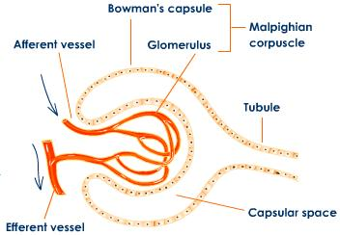
The Nephron
Nephrons are the structural and functional units of the kidneys that form urine, consisting of renal corpuscle and renal tubules . Each kidney has 1 million nephrons, each nephron is capable of urine formation.
Renal corpuscle – the glomerulus and its Bowman’s capsule
Glomerulus – a tuft of capillaries associated with a renal tubule
Glomerular (Bowman’s) capsule – blind, cup-shaped end of a renal tubule that completely surrounds the glomerulus
Anatomy of the glomerular capsule:
The external parietal layer is a structural layer
The visceral layer consists of modified, branching epithelial podocytes
Extensions of the octopus-like podocytes terminate in foot processes
Filtration slits – openings between the foot processes that allow filtrate to pass into the capsular space
Glomerular endothelium – fenestrated epithelium that allows solute-rich, virtually protein-free filtrate to pass from the blood into the glomerular capsule

Slide 9
Renal Tubules
Proximal convoluted tubule:
Has microvilli and mitochondria.
Reabsorbs water and solutes from filtrate and secretes substances into it.
Connecting Tubules
Two important cell types are found here:
Intercalated cells
Has a microvilli.
Function in maintaining the acid-base balance of the body.
Principal cells
Without microvilli.
Help maintain the body’s water and salt balance.
Distal convoluted tubule (DCT):
Without microvilli that function more in secretion than reabsorption.
Loop of Henle:
a hairpin-shaped loop of the renal tubule
Proximal part is similar to the proximal convoluted tubule.
Proximal part is followed by the thin segment and the thick segment.

Slide 10
Capillary Beds of the Nephron
Every nephron has two capillary beds
Glomerulus
Peritubular capillaries vasa recta
Each glomerulus is:
Fed by an afferent arteriole
Drained by an efferent arteriole
Blood pressure in the glomerulus is high because:
Arterioles are high-resistance vessels
Afferent arterioles have larger diameters than efferent arterioles
Fluids and solutes are forced out of the blood throughout the entire length of the glomerulus
Capillary Beds
Peritubular beds are low-pressure, porous capillaries adapted for absorption that:
Arise from efferent arterioles
adhere to adjacent renal tubules (because it takes electrolytes from Renal Tubules)
Empty into the renal venous system
In cortex
Vasa recta – long, straight efferent arterioles of juxtamedullary nephrons

Slide 11
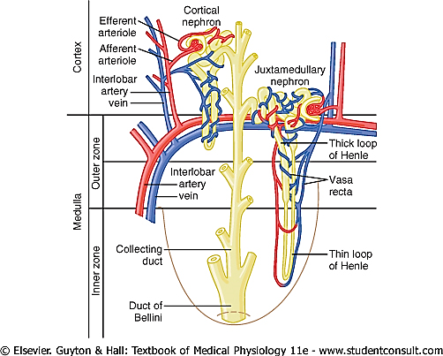
Types of Nephrons
Juxtamedullary nephrons: (15%) 1-2% of blood flows through them | Cortical nephrons: (85%)
located at the cortex-medulla junction They’re located in the cortex with in the border of the the medulla only Henle’s loop extend to the medulla) | Their glomeruli in the outer portion of cortex
Maintain salt gradient, helps conserve water ( You’d expect camels to have abundant of these nephrons for more water reabsorption). | -
Have long loops extended into the medulla with extensive thin segments Are involved in the production of concentrated urine | Have short loops of Henle
Continue from efferent as :Vasa recta | Continues from efferent as : Peritubular capillaries
Originates in outer 2/3 of cortex.
Originates in inner 1/3 of cortex.
- Juxtamedullary nephrons are counter current in structure like this. , allowing more water reabsorption.
- Juxtamedullary nephrons work during prolong fasting

Slide 12
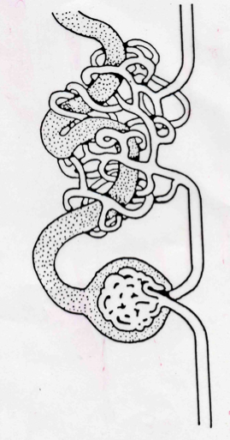
Vascular Resistance in Microcirculation
ONLY IN MALES’ SLIDES
Afferent and efferent arterioles offer high resistance to blood flow
Blood pressure declines from 95 mmHg in renal arteries to 8 mmHg in renal veins
Proximal convoluted tubule
Bowman’s capsule
Resistance in afferent arterioles:
Protects glomeruli from fluctuations in systemic blood pressure
Resistance in efferent arterioles:
Reinforces high glomerular pressure
Reduces hydrostatic pressure in peritubular capillaries
Afferent arteriole
Peritubular capillaries
Efferent arteriole
Glomerular capillary bed
High pressure vascular bed,
increasing oncotic pressure
Good for filtration
Peritubular capillary bed,
Low pressure vascular bed,
high oncotic pressure.
Good for re-absorption

Slide 13
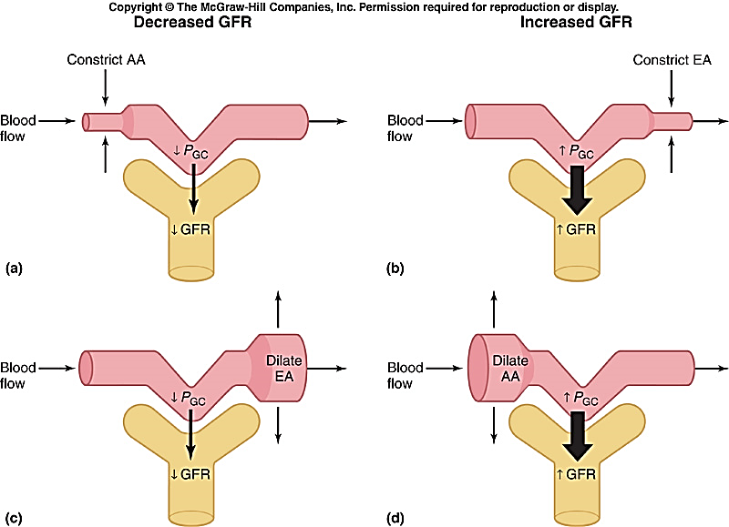
Afferent & Efferent Arteriolar Resistance Affect
As vasodilation and vasoconstriction of the afferent and efferent arterioles alter the blood flow through the glomerular capillaries, there are corresponding alterations in the glomerular filtration rate (GFR).
Constriction of Afferent
E.g.: Sympathetic stimulation (sever stimulation on shock (not affected on daily sympathetic stimulation) → Afferent artery constrict → decrease blood flow to glomerular → ↓PGC → ↓GFR
Constriction of Efferent E.g.: Angiotensin II
- Mild to moderate constriction → some fluid will be accumulated in the glomerular and the other will pass → ↑PGC → ↑GFR
- Sever constriction → fluid will be accumulated in the glomerular → have only one way leave by filtration → ↑GFR → ↑FF → ↑ πg → ↓GFR
Note that, as the afferent arteriole constricts in response to sympathetic stimulation, prostaglandins are released to cause vasodilation to prevent further damage and renal failure. This explains why NSAIDs should not be given at this point.
Dilation of Efferent ↓PGC →↓GFR
Dilation of Afferent by : NO ,PKs → ↑PGC →↑GFR

Slide 14
Juxtaglomerular Apparatus (JGA)
Juxtaglomerular apparatus
JG cells
Macula densa
Mesangial cells
Mesangial cells have defense mechanisms (phagocytosis)

Slide 15
Juxtaglomerular Apparatus (JGA)
JGA: here the distal tubule lies against the afferent (sometimes efferent) arteriole
Arteriole walls have juxtaglomerular (JG) cells
Enlarged, smooth muscle cells
Have secretory granules containing renin
Act as mechanoreceptors
Macula densa
Tall, closely packed distal tubule cells
Lie adjacent to JG cells
Function as chemoreceptors or osmoreceptors
The cells of the macula densa are sensitive to the ionic content and water volume of the fluid in the tubule
produce molecular signals that promote renin secretion by the juxtaglomerular cells
Mesangial cells
Have phagocytic and contractile properties
Influence capillary filtration
Intraglomerular mesangial cells provide structural support and regulate blood flow of the glomerular capillaries by their contractile activity

Slide 16
1- Glomerular filtration
The FIRST step in urine formation is glomerular filtration.
It is the filtration of fluid from the glomerular capillaries into the
renal tubules.
It contains all substances present in plasma except proteins.
we will know why on the next slides
GFR is normally 125 ml/min = 20% renal plasma flow.
Glomerular filtration rate (GFR) is the rate of production of filtrate at the glomeruli from plasma (ml/min) = 20% of renal plasma flow → means 1.25 L of the C.O. is being filtered
1.25 L x 60 min = 7,5L/h x 24h = 180L/day is filtered , if we excrete all of this we may die so the body try to compensate by: 99% of filtrate are reabsorbed so only 1 to 2 L urine excreted per day .
In order to know what molecules are filtered , we should know :
a) glomerular membrane layers
b) Factor controls passage of molecules through this membrane
c) Forces responsible for passage of fluid (filtrate) through this membrane
On next slides

Slide 17
Filtration Membrane
Filter that lies between the blood and the interior of the glomerular capsule
It is composed of three layers
Fenestrated endothelium of the glomerular capillaries (Pores are 50-100 nm in diameter)
Visceral membrane of the glomerular capsule (podocytes)
Basement membrane composed of fused basal laminae of the other layers.
Glomerular filtration membrane is highly permeable to water and small molecules (less than 10.000 MW)
Large molecules (more than 70.000 MW especially proteins are not filtered due to their large size and negative electrical charge because their passage is repulsed by negatively charged glycoproteins present on endothelial pores, basement membrane and podocytes.

Slide 18
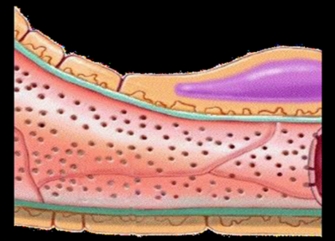
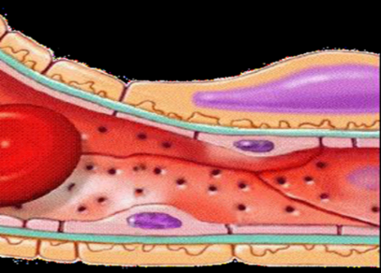
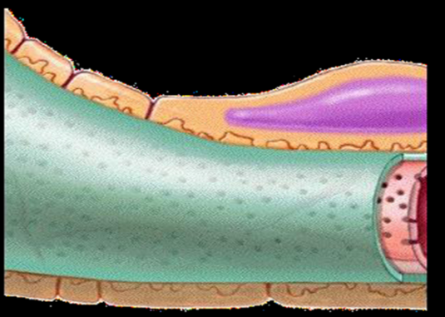
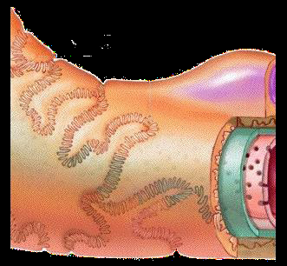
a)Glomerular membrane
All Layers
Blood in the glomerulus is separated from the fluid in the Bowman’s space by a filtration barrier (glomerular membrane) consisting of three layers: (from glomerular toward bowman’s capsule )
1- Single layer of capillary endothelium - picture ”b” shows glomerular capillary in longitudinal section | a) b)
2- Basement membrane between endothelium and epithelium. (contain glycoprotein which is negative in charge)
3- Single epithelial lining of Bowman’s capsule (Podocytes : cell body with nucleus ) - It consist of 2 layers : primary - Secondary : which contain foot processes , during filtration the fluid moves between their foot processes (pseudopodia). - Slits is the space between these foot processes

Slide 19
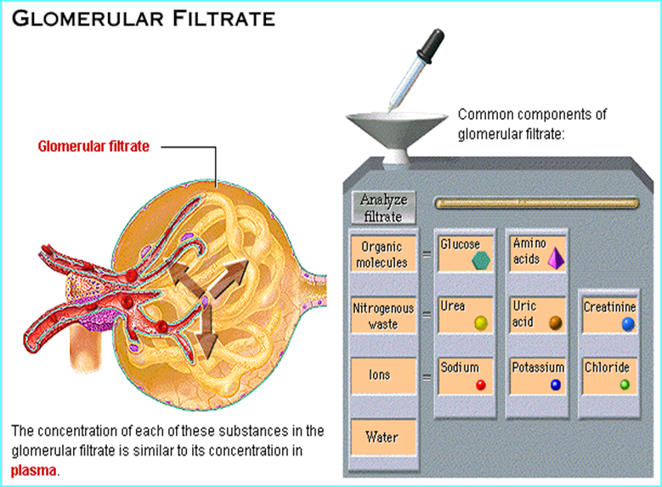
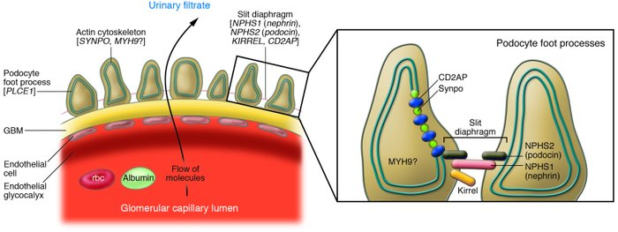
b) Factor controls passage of molecules through this membrane (Characteristics of glomerular membrane)
Membrane allow passage of molecules up to 70,000 D
Factors control passage of molecules through this membrane :
Negative charge : Albumin does not normally pass as they are repelled by the negative charge of the glycoproteins material of basement membrane.
Size :Blood cells do not normally pass through the membrane. Due to the big size , (that’s why there is no Red color in the urine)
Albumin is exactly the size of the fenestrae (i.e. it’s size allows it to be filtered) but it is negatively charged and thus repelled by the negative basement membrane.
Certain renal diseases neutralize the negative charge of the basement membrane and eventually causing albuminuria.

Slide 20
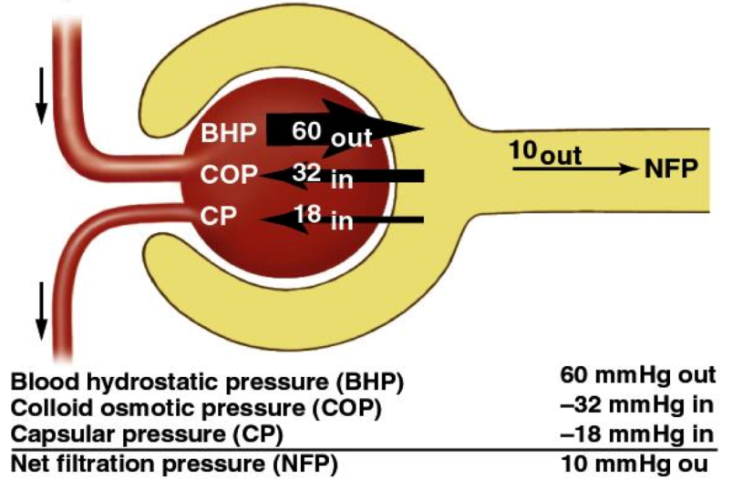
c) Forces responsible for passage of fluid (filtrate) through this membrane: Starling’s forces
The net filtration pressure (NFP) is the sum of :
The NFP formula is VERY IMPORTANT!!
In Glomerular
In bowman’s capsule
1. glomerular hydrostatic pressure (Pg = 60 mmHg). It promotes filtration.
2. hydrostatic pressure in Bowman’s capsule (Pb = 18 mmHg). It opposes filtration.
3. colloid osmotic pressure of glomerular plasma proteins
(πg = 32 mmHg). It opposes filtration.
Colloid Osmotic Pressure of Bowman’s proteins (Πb) = 0 mmHg (Promotes filtration)
As we knew filtration membrane doesn't allow proteins to pass therefore bowman's space has NO proteins which means oncotic pressure = 0 mmHg
Hydrostatic pressure
Colloid osmotic pressure
This figure is similar to that drawn by Dr.manan in the lecture. Thanks deema :). (Team435)
So, NFP = 60 – 32 – 18 = +10 mmHg
GFR = Kf x [ (Pg – Pb) – (πg – πb) ] →
GFR = Kf x [ (60 – 18) – (32 – 0) ]

Slide 21
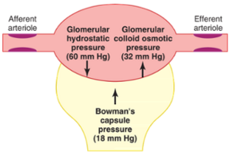
How changes in forces determining GFR affect GFR?
Physiological regulation of the GFR involves mechanisms that affect mainly the Pg.
Increased Pg Increases GFR.
This pressure is affected by:
Increased πg Decreases GFR By :
Plasma pressure
Filtration Fraction = GFR/RPF
The normal = 125/600 = 20%
If RPF increase → decrease FF → increase πg → decrease GFR
Arterial blood pressure
(Explained on Regulation on GFR lecture )
Afferent arteriolar resistance (next slide)
GFR = Glomerular Filtration Rate
RPF = Renal Plasma Flow
Efferent arteriolar resistance (next slide)
Increased Pb Decreases GFR
In urinary obstruction
e.g. stones or tumors.
Obstruction in tubule → plasma won’t pass → increase in the pressure
Pg = Glomerular hydrostatic pressure
Pb = Bowman’s hydrostatic pressure
π g = Colloid osmotic pressure of glomerular plasma proteins

Slide 22
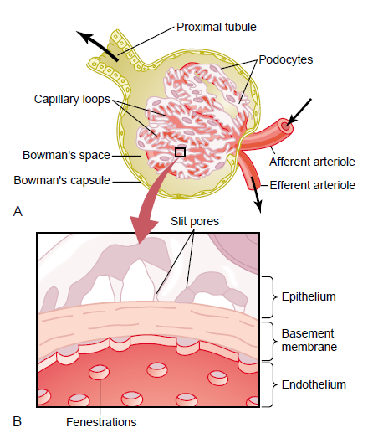
Composition of Glomerular Filtration
Filtration membrane
Glomerular Filtrate has almost the same composition as that of plasma, except that it has no significant amount of proteins (it has about 0.003%)
It is less than 1/2000 protein as compared with plasma.

Slide 23
Renal blood flow
Although blood circulation in the kidneys passes through two capillary beds (Glomeruli and peritubular capillaries), it is not considered a portal circulation. Why? Because glomeruli contain arterial capillaries only (There’s no venous blood).
In the blood supply of the kidney, the straight arterioles of kidney (or vasa recta renis) are a series of straight capillaries in the medulla (Latin: vasa, "vessels"; recta, "straight").
The blood flows to each kidney through a renal artery.
Renal blood flow to the kidney represents 20% - 22% of cardiac output.(C.O = 5L → 5x0.2=1L )
Features of renal circulation:
Upon to the previous sentence it has a High blood flow rate (1200 ml/min). “Range: 1018-1200”
Presence of two capillary beds: glomerular and peritubular.
major sites of renal resistance are : Efferent and afferent arterioles are

Slide 24
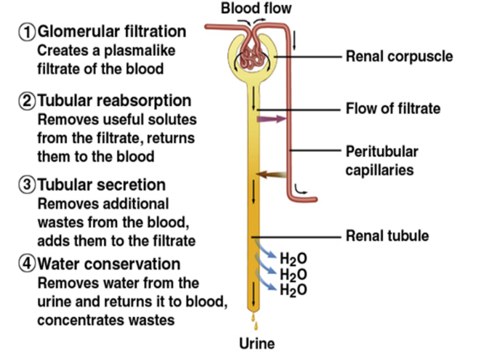
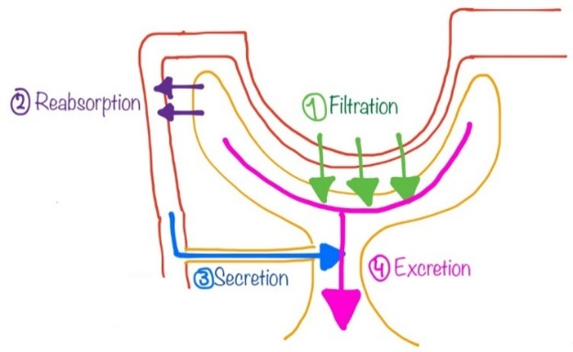
Urine Formation
The primary function of the kidney is to ‘clear’ unneeded substances from the blood to be excreted in urine.
Steps of urine formation (basic renal processes) :
1- Glomerular filtration: Filtration of fluid from glomerular capillaries into the renal tubules.
2- Tubular reabsorption
3- Tubular secretion.
4- Excretion.
Urinary excretion rate = Filtration rate - reabsorption + secretion
More filtration, more urine production.
More reabsorption, less urine production.
Note that only plasma (excluding plasma proteins) is filtered into the capsule.
Plasma proteins are not filtered. Why?
Because they’re negatively charged, they repel the negative basement membrane of the glumerular barrier.
Because they’re large in size.
Filtrate = Plasma – Plasma proteinsC
This figure is similar to that drawn by Dr.manan in the lecture. Thanks deema :). (Team435)

Slide 25
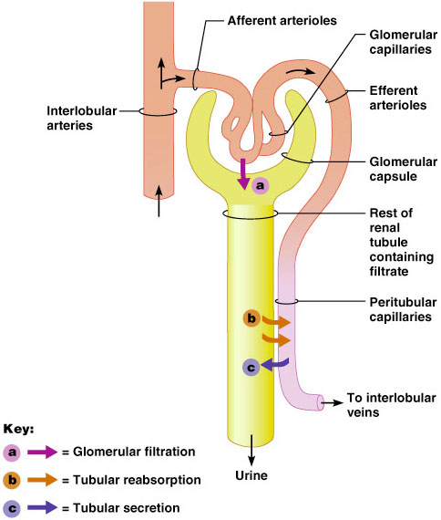
Mechanisms of Urine Formation
Urine formation and adjustment of blood composition involves three major processes
Glomerular filtration
Tubular reabsorption
Tubular Secretion
Excretion
Glomerular Filtration:
The first step in urine formation
Filtered through the glomerular capillaries into the Bowman’s capsule.
~20% of plasma entering the glomerulus is filtered
125 ml/min filtered fluid
Proteins do not cross filtration membrane
Tubular Reabsorption:
Movement of substances from tubular lumen back into the blood.
Carried by the peri-tubular capillaries to the venous system.
Most of the filtered plasma is reabsorbed.

Slide 26
Mechanisms of Urine Formation (continue)
Tubular Secretion:
The selective transfer of substances from the peritubular capillary into the tubular lumen.
Allows for rapid elimination of substances from the plasma via extraction of the 80% of unfiltered plasma in peritubular capillaries and adding it to the substances already in tubule as result of filtration.
Urine Excretion:
The elimination of substances from the body in the urine
All plasma constituents filtered or secreted, but not reabsorbed remain in the tubules and pass into the renal pelvis to be excreted as urine and eliminated from the body
Tubular Reabsorption “is nonselective (takes everything back) only toxins and wastes are excreted”
Secretion is “selective”

Slide 27
Glomerular Filtration Rate (GFR)
Glomerular Filtration Rate (GFR) :
The volume of filtrate produced by both kidneys per minute. (the rate of production of filtrate at the glomeruli from plasma)(rate is imp in definition)
Averages : 125 ml/min (Typically 80 – 140 ml/min)
Totals about : 180 L/day ( 45 gallons ). “ 125 ml/min x 60min (in 1hour) = 7500 ml/ h x 24 (in 1day) = 180000 ml/day =180L/day ”
So most filtered water must be reabsorbed or death would ensue from water lost through urination!
Glomerular Filtration Rate ( GFR ) is directly proportional to the
net filtration pressure (NFP) :
- When NFP increase → GFR increase
- When NFP decrease → GFR decrease
Changes in GFR normally result from changes in glomerular blood pressure.
ايش الحكمة من إن الفلتريشن يصير بهالكمية كل يوم مع إن كمية الدم بالجسم تقريبا ٥لتر ؟ نتخيل عندنا غرفة وتنظف مرة وحدة باليوم ، فرضا لو صارت تنظف مرتين أو ثلاث أو أربع مرات بكل الأحوال راح تكون نظيفة لكن كل ما زاد عدد المرات أو تكرار العملية راح نضمن نظافتها أكثر. بنفس الفكرة بالجسم معدل الفلتريشن باليوم تقريبا من٤٠-٦٠ مرة يضمن لي إن الدم راح ينظف بشكل أفضل.
Regulation of GFR
If the GFR is too high :
Fluid flows through tubules too rapidly to be absorbed.
↓
Urine output rises.
↓
Creates threat of dehydration and electrolyte depletion. (It will lead to Hypo. Cases)
If the GFR is too low :
Fluid flows sluggishly through tubules
↓
Tubules reabsorb wastes that should be eliminated
↓
Azotemia develops (high levels of nitrogen-containing substances in the blood)

Slide 28
Glomerular Filtration Rate (GFR)
Glomerular filtration rate (GFR) is the rate of production of filtrate at the glomeruli from plasma
– Typically 80 – 140 ml/min depending on age, sex etc.
– Sum of the filtration rates of all functioning nephrons
– Index of kidney function
If the GFR is too high:
Needed substances cannot be reabsorbed quickly enough and are lost in the urine
If the GFR is too low:
Everything is reabsorbed, including wastes that are normally disposed of
Factors governing filtration rate at the capillary bed are:
Total surface area available for filtration (directly proportional to GFR)
Filtration membrane permeability (directly proportional to GFR)
Net filtration pressure (directly proportional to GFR)
Changes in GFR normally result from changes in glomerular blood pressure

Slide 29
GFR = 125 ml/min
180 L /day , 1% excreted , 99% reabsorbed.
اللي يدخل ال glomerulus هذا اللي يصيرله filtration كميته 20% من البلازما وبعديم من ال 20 % يفضل 1% والباقي يرجع للبلازما بس ال toxins و ال waste products يصيرلها excretion وممكن من كمية البلازما اللي مرت وما صارلها filtration يكون فيه waste products يصيرلها SECRETION مرة ثاني في lumen of the tubule
أتمنى فهمت ☺
EXTRA EXPLANATION :
20% of Plasma volume enters the glomerulus through the afferent arteriole will be filtered and 80% will go through the efferent arteriole to the peritubular capillary then to systemic circulation without filtration. 20% which is filtered 99% of it will be absorbed to the peritubular capillary and only very small amount 1% will be excreted to keep body fluid volume in balance.
The most important step in urine formation is filtration. When 1000 ml of blood enters the glomeruli through Afferent arterioles only 600 plasma is filtrated the rest RBC won’t be filtrated. Also not all the 600 ml of plasma is filtrated only 20 % of it is filtrated which equal 125 ml.

Slide 30
Goals of Glomerular Filtration Rate (GFR)
Index of kidney function
Sum of the filtration rates of all functioning nephrons (indicator for number of functioning nephrons)
الفائدة
Factors governing filtration rate at the capillary bed are:
Net filtration Pressure:
The pressure responsible for filtrate formation
NFP equals the glomerular hydrostatic pressure (HP_{g}) minus the oncotic pressure of glomerular blood (OP_{g}) combined with the capsular hydrostatic pressure (HP_{c})
GFR
Net filtration pressure (NFP)
Total surface area available for filtration
Filtration membrane permeability
NFP = HP_{g} – (OP_{g +} HP_{c})
Or
NFP = P_{GC} – P_{BS} - O_{GC}

Slide 31
Glomerular filtration rate (GFR)
Determined by:
NFP = 10 mmHg
1-the net filtration pressure across the glomerular capillaries.
GFR=125 ml/min
Kf = 12.5
2-The glomerular capillary filtration coefficient
depend on:
Surface area
Permeability
Nephrectomy will decrease surface area → decrease Kf
It is determined by Starling’s forces (next slide)
Early in diabetes, GFR is high. It drops later due to membrane thickening.
Diabetes and hypertension thicken the membrane, reducing permeability and filtration coefficient.

Slide 32
Hydrostatic, Colloid and Filtration Pressure
Filtration: Hydrostatic Pressure
glomerular hydrostatic pressure (GHP)
→ pushes fluid out of vessels
capsular hydrostatic pressure (CsHP)
→ pushes fluid back into vessels
net hydrostatic pressure (NHP)
NHP = GHP – CsHP
35 = 50-15 mm Hg
Filtration: Colloid Pressure
blood colloid osmotic pressure (BCOP)
proteins in blood (hyperosmotic) draws water back into blood
~ 25 mm Hg
Oncotic = colloid = osmotic
Filtration: Filtration Pressure (FP)
FP = NHP – BCOP
10 = 35 - 25 mmHg
importance of blood pressure
20% drop in blood pressure
50mmHg to 40mm Hg → filtration would stop
الأرقام مب للحفظ، ممكن يجي أي رقم

Slide 33
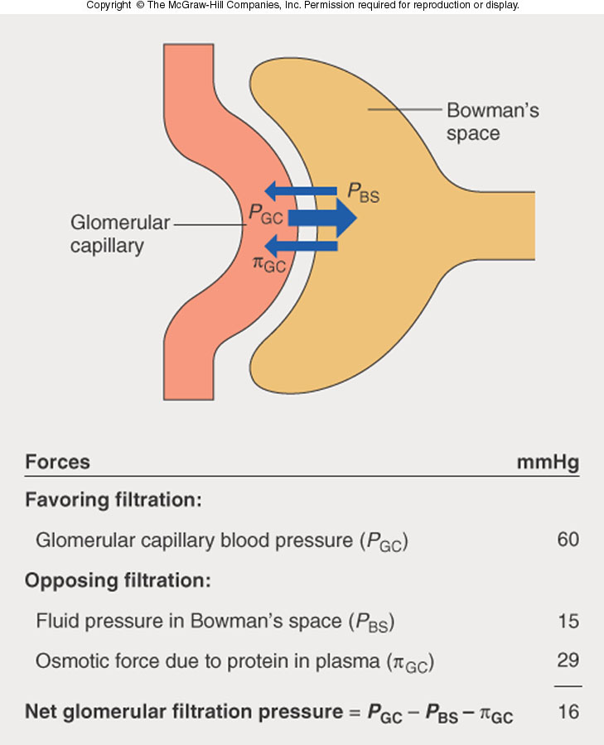
Filtration pressure Example
VERY IMPORTANT!!!
Driven by Starling forces
Pressure inside capillaries > Pressure outside
⇒ movement of fluid from blood
Forces in capillaries: hydrostatic pressure P_{GC} = + 60mmHg
oncotic pressure π_{GC} = - 29 mmHg
∴ net outward pressure = 60 – 29 = 31mmHg
Forces in capsule: hydrostatic pressure P_{BS} = -15 mmHg
oncotic pressure π_{GBS} = 0 mmHg
Overall: 31 – 15 = 16 mmHg outward
Male adults GFR: ~ 90 – 140 ml/min
Female: 80 – 125 ml/min
125 ml/min usually good average
الأرقام مب للحفظ، ممكن يجي أي رقم

Slide 34
Glomerular Filtration Rate
Sub urine = amount of substance in urine
Urine flow rate = Volume / time
Sub plasma = amount of substance in plasma
Measurement of creatinine concentration in a urine sample, urine flow rate and plasma creatinine concentration can be used to determine GFR.
Only 15 – 20 % of plasma entering glomerulus filtered
Composition of filtrate:
Similar to plasma BUT NO large proteins or cells

Slide 35
From 435:
د. أحمد قال عن الـ inulin انه افضل شيء لقياس الـ GFR ولكن ليس في البشر “موضع سؤال في الـ MCQs “
فإذا لم يحدد في السؤال البشر : أنيولين, أما إذا حدد : كرياتينين.
Substances Used to Measure GFR
Details in the next lecture :)
Inulin
Inulin, a polymer of fructose, is used in research to precisely measure GFR
- Freely filtered into the Bowman’s capsule
- Not reabsorbed, NOT secreted NOT metabolized by the nephron
- Non-endogenous, has to be infused intravenously (our bodies don’t produce it)
Best marker.
Not used in humans
Creatinine
endogenously released into plasma by skeletal muscle
Not as accurate as inulin as a small quantity is secreted into the proximal tubule
amount excreted > amount filtered
Reasonably accurate measurement of GFR
Clinically , Best marker.
Explanation: next slide
Assume: (Don’t memorize numbers)
– [Inulin]_{urine} = 30 mg/ml
– [Inulin]_{plasma} = 0.5 mg/ml
– urine flow rate = 2 ml/min
GFR = 120 ml/min or 172.3 L/day
The usual analytical method for creatinine measurement (alkaline picrate method) also detects substances in the plasma other than true creatinine, leading to increase in plasma creatinine value.
Thus, these two errors usually cancel each other and gives a correct estimate of GFR.
35

Slide 36
EXPLANATION
جهاز الي يحسب الكرياتينين في الدم يغلط ويحسب مواد ثانية على أساس انها كرياتينين ( لأن تركيبها شبيه في الكرياتين)
بس جسمنا ينتج كرياتين ويسويله سكريشن
عشان كذا تطلع القراءة دقيقة ( الكمية الي حسبها الجهاز انها كرياتين = الكمية الي ينتجها جسمنا )

Slide 37
Regulation of GFR & RBF
Regulation of GFR
Autoregulation
(intrinsic)
Sympathetic control
Hormonal mechanism: renin and angiotensin
(extrinsic)
Changes in the GFR result primarily from changes in glomerular capillary blood pressure.
Because the net filtration pressure that accomplishes glomerular filtration is simply the result of an imbalance of opposing physical forces between the glomerular capillary plasma and bowman’s capsule fluid, alteration in any of these physical forces affect the GFR.
Intrinsic Autoregulation:
- Renal vasculature also exhibits a well developed intrinsic ability to adjust its resistance in response to changes in arterial BP and thus to keep BF and GFR essentially constant = autoregulation.
- In man, effective over a range of MBP from 75-160mmHg. Below 75mmHg, filtration falls and ceases altogether when MBP = 50mmHg.
Remember, GFR depends on
NFP, Surface area, Membrane permeability
The Auto-regulatory mechanism is the most important one and it is intrinsic to the kidney itself. Let’s imagine that you donate your kidney to someone, this mechanism will not change even within his body.

Slide 38
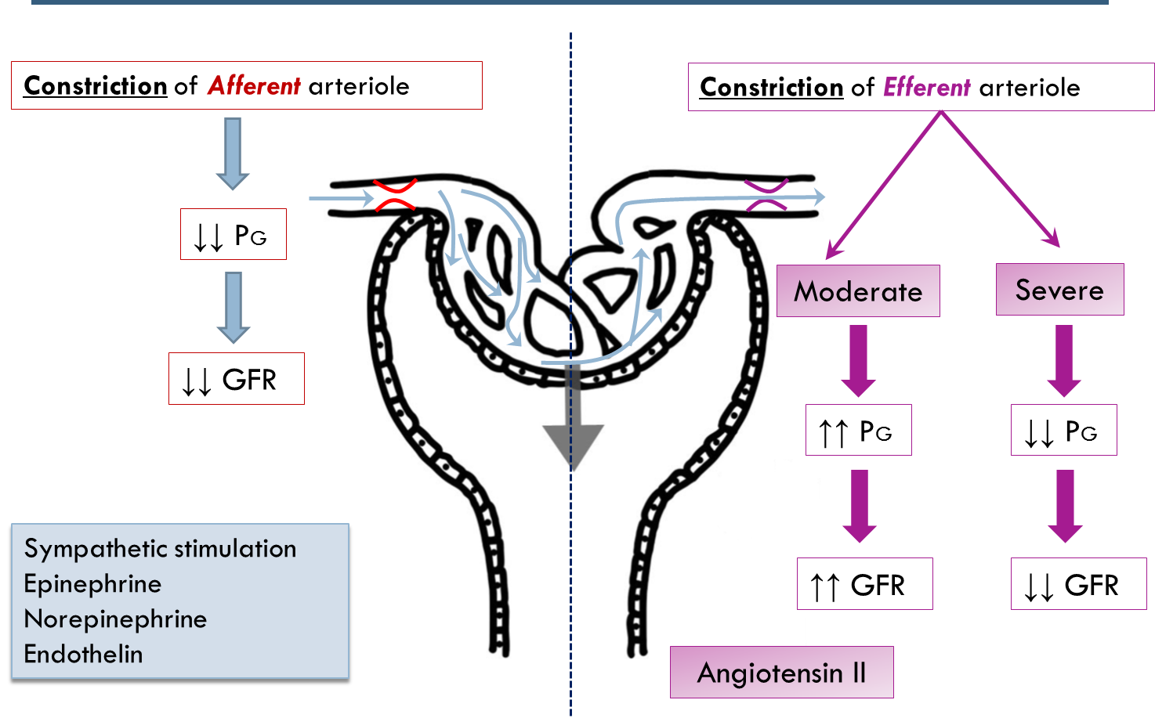
Physiologic Regulation of GFR

Slide 39
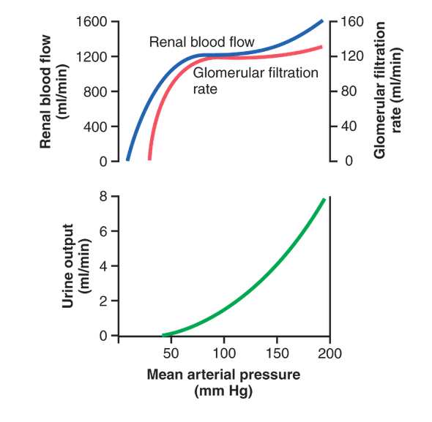
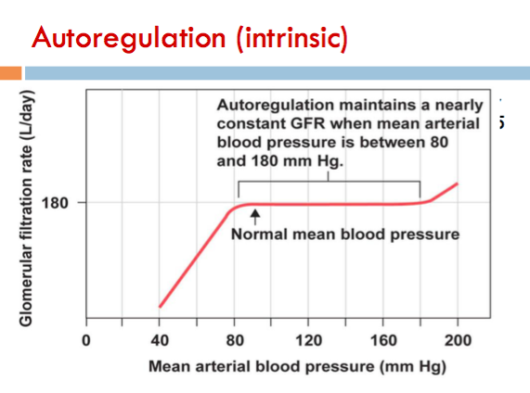
1- Autoregulation (intrinsic)
It is the relative constancy of GFR and renal blood flow in response to changes in blood pressure range from 75 to 160 mmHg
However, autoregulation is not perfect but it prevents potentially great changes in GFR , with changes in blood pressure, therefore, kidney continue to excrete waste
That means in a normal kidneys, a decrease in arterial blood pressure as low as 75 mmHg, or an increase as high as 160 mmHg causes a change in GFR by only a few percentage
if it drops below 75 the GFR keeps decreasing until the ABP become 50 then the filtration stops throw glomerulus

Slide 40
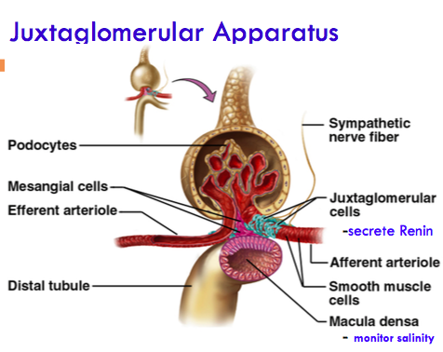
1- Autoregulation (intrinsic)
General information
Refer to feedback mechanisms intrinsic to the kidney
keep the renal blood flow and GFR relatively constant despite fluctuations in ABP
Achieved by 2 major mechanisms
1. Myogenic auto-regulation
2. Tubulo -glomerular feedback
These mechanisms operate over an ABP ranging between 75 -160 mmHg (systolic)

Slide 41
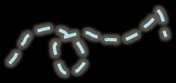
Juxtaglomerular complex
Low blood flow → low Hydrostatic pressure → low GFR → Decrease delivery of NaCl to the macula densa cells which are sensor for Na level.
They have two main mechanism to return to normal level
1) vasodilatation of AFFERENT arterioles (Direct)
2) Increase in Renin release from the juxtaglomerular cells → Ang II → cause vasoconstriction of EFFERNT Arteriole.(indirect)
Secretes renin
باختصار رح تحس انه في نقص صوديوم تقوم تحفز افراز هرمون renin
Monitor Salinity
Juxtaglomerular apparatus composed of : macula densa cells , Juxtaglomerular cells , Afferent and efferent arterioles
juxtaglomerular cells : the site where the renin is released

Slide 42
1- Autoregulation (intrinsic)
Renal Autoregulation of GFR
Efferent arteriole | Afferent arteriole | Blood pressure
Dilation | Constriction | ↑ BP
Constriction (mild to moderate) | Dilation | ↓ BP
If mean arterial P ↑, there is an automatic ↑ in afferent arteriolar constriction, preventing a rise in glomerular pressure . Dilatation occurs if P falls.
Autoregulation is independent of nerves or hormones, occurs in denervated and in isolated perfused kidneys.
Can not compensate for extreme BP changes.
Stable for BP range of 75 to 160 mmHg (systolic).
When BP increases → Afferent and Efferent arterioles CONSTRICT ( mainly afferent)
When BP decreases → arterioles dilate
Autoregulation is effective 75 – 160
Below 75 filtration decreases and stops at 40-50 mmHg
Video of (control of GFR ) Duration: (4:13)mins

Slide 43
Effect of arterial blood pressure on GFR
Normally when ABP increase → GFR increase
But, because of the auto-regulation the body maintains constant GFR over an ABP range of 75-160 mmHg.
Filtration stops when > 50 mmHg.
Explanation of autoregulation in next slide

Slide 44
General notes about autoregulation of GFR
If we are in stressful condition our blood pressure increases →the blood flow increase which result in increased hydrostatic pressure → NFP increase → GFR increase. But even though we don’t urinate, why? Because kidney has mechanism to regulate by itself (auto regulation ) within certain blood pressure range .
If the BP within 75-160 the kidney is auto regulated which mean GFR is constant . And its auto regulated by 2 mechanism THE 1ST one is myogenic mechanism : if the BP increases the renal blood flow increases which will stretch the A.A this will stimulate Ca+2 channels to open → Ca+2 influx to smooth muscle cells in the wall of A.A leading to vasoconstriction → decreased blood flow → decreased Pg→ decreased NFP→ decreased GFR .
Remember :GFR in addition to renal plasma flow are constant → due to autoregulation
At the beginning of distal convoluted tubules ( between A.A & E.A ) there are cells called macula densa cells. The cells opposite to macula densa are called juxtaglomerular cells. Macula densa is sensitive to NaCl (salt). Let’s say BP is increased, fluid going to A.A increases therefore increased GFR, and the filtrated fluid in proximal convoluted tubules increases and moves very fast which make no time for reabsorption in PCT. When this fluid reach to macula densa in DCT it will sense high sodium chloride and send signals that stimulate vasoconstriction of A.A . In addition, it prevents release of renin by juxtaglomerular cells and prevent production of Ang II, no vasoconstriction of E.A.
Low BP→ Low blood flow →low Pg →low GFR → Fluids enter the proximal convoluted tubule are low and move slowly which make them reabsorbed → Decrease delivery of NaCl to the macula densa cells → vasodilatation of Afferent arterioles → Increase in Renin release from the juxtaglomerular cells to → Ang II → cause vasoconstriction of EFFERNT Arteriole. In addition , it stimulates juxtaglomerular cells to release renin → produce Ang II → causing vasoconstriction of E.A.

Slide 45
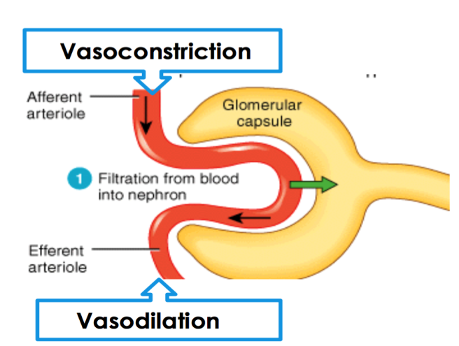
1- Autoregulation : Tubuloglomerular Feedback Mechanism
Increase blood flow in renal tubules
→ increase GFR
Decrease reabsorption by renal tubules (caused by the rapid flow)
Macula densa releases signals which will cause vasoconstriction of Afferent arterioles.
Inhibit the release of Renin from the juxtaglomerular cells leading to vasodilation of EFFERNT arterioles.
Increase delivery of NaCl to the macula densa cells, which are capable of sensing this change
Increase in ABP
Net result :
Decrease glomerular hydrostatic Pressure.
GFR back to its normal rate.

Slide 46
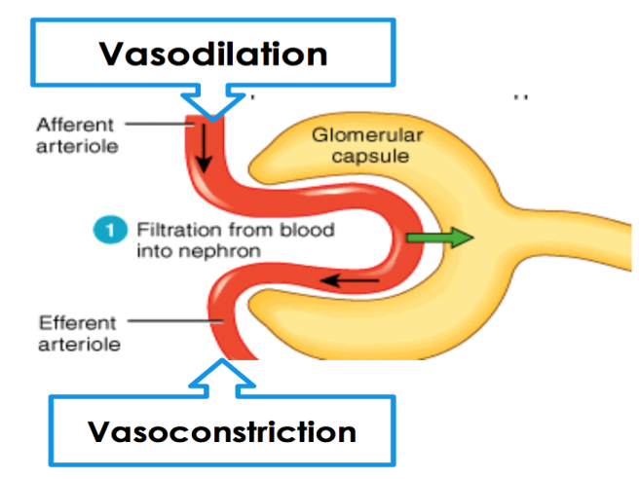
1- Autoregulation : Tubuloglomerular Feedback Mechanism
Decrease blood flow in renal tubules
→ Decrease GFR
Increase reabsorption by renal tubules
Macula densa releases signals which will cause vasodilatation of Afferent arterioles.
Increase in Renin release from the juxtaglomerular cells to → Angiotensin II → cause vasoconstriction of EFFERNT Arteriole.
Decrease delivery of NaCl to the macula densa cells, which are capable of sensing this change
Decrease in ABP
Net result :
Increase glomerular hydrostatic Pressure.
GFR back to its normal rate.

Slide 47
1- Autoregulation : Myogenic auto-regulation Mechanism
It is the intrinsic capability of blood vessels to constrict when blood pressure is increased
This constriction prevents excess increase in renal blood flow and GFR when blood pressure rises
When blood pressure decreases , the myogenic mechanism reduces vascular resistance and the vessel dilates
Increase in blood pressure → Stretch of the vessel’s well (Arterioles) → activation of stretch receptor → stretch-induced vascular depolarization → open the calcium channel → rapidly increases calcium ion entry → Vasoconstriction → decease the blood flow → decrease GFR

Slide 48
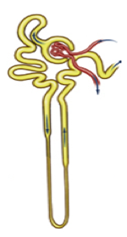
Example of autoregulation
High GFR
Rapid flow of filtrate in renal tubules
Less reabsorption
Macula densa senses high NACL concentration
Unidentified paracrine secretion
Constriction of afferent arteriole
Reduced GFR

Slide 49
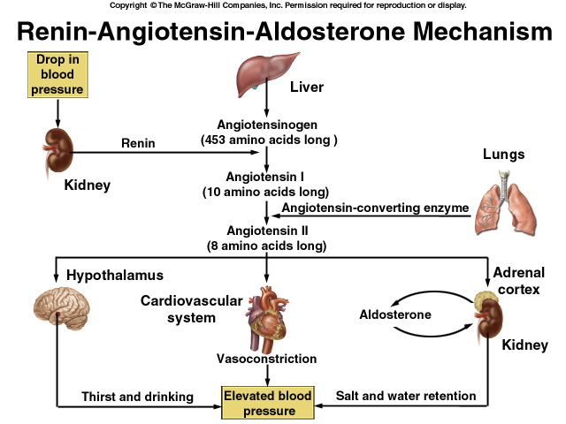
2-(Extrinsic): Hormonal Control of GFR
Hormonal control through Ang II – low BP → stimulate renin release will result in production of Ang II .
Ang II release result in vasoconstriction of E.A → increase GFR, and also it will affect hypothalamus to stimulate thirst and drinking → increase fluid → normal GFR , also Ang II stimulate the suprarenal gland to release aldosterone → salt and water retention. All these mechanisms work together to maintain the GFR constant .

Slide 50
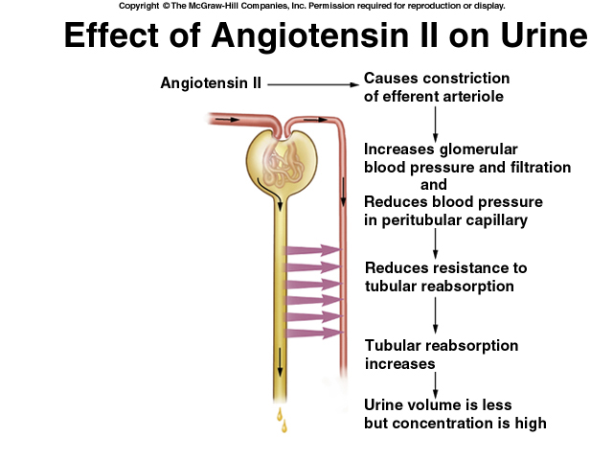
2-(Extrinsic): Hormonal Control of GFR
Hormonal factors
Epinephrine, Nor-Epinephrine, Angiotensin II, Prostaglandin (F) and Thromboxane cause renal vasoconstriction and results in decrease in RBF and GFR.
Physiological factors
Cold, deep anesthesia, fright, sever exercise, hypoxia and ischemia stimulate sympathetic nerve fibers leading to renal vasoconstriction and decrease in RBF.
Posture
RBF increase in supine than sitting than standing. Changing the posture from lying to standing leads to a decrease of about 15% in RBF due to the stimulation of sympathetic NF.
Acetylcholine, Bradykinin, Prostaglandin (D, E, and I), and bacterial pyogens cause renal vasodilation and results in increase in RBF and GFR.
And decease the pressure in peritublar capillary.
And the blood return back to the body.
RBF = Renal Blood Flow

Slide 51
3- Sympathetic Control of GFR.
Under stress
Norepinephrine is released by the sympathetic nervous system.
Afferent arteriole constrict and filtration is inhibited
stimulation of renin angiotensin mechanism → This induces vasoconstriction of efferent arteriole
Renal blood vessels are maximally dilated
Autoregulation mechanisms prevail
Epinephrine is released by the adrenal medulla
At rest
Note: during fight or flight blood is shunted away from kidneys
Such as in the shock we may have renal failure due to this effect, which direct the blood away from the kidney to brain and heart. It does not a daily mechanism

Slide 52
Factors Affecting Renal Blood Flow and GFR
Factors that decrease GFR + RBF
Factors that increase GFR+RBF
Factors that decrease RBF
Aging
Sympathetic Stimulation of Renal Arterioles
Norepinephrine
High Protein Diet
Hyperglycemia
Same (glucose is reabsorbed with Na+)
Fever
Angiotensin II
(Constricts efferent arteriole more than afferent)
Why ? A high-protein meal ↑ release of amino acids into the blood, which are reabsorbed in the proximal tubule. Because amino acids and sodium are reabsorbed together by the proximal tubules, ↑ amino acid reabsorption → stimulates sodium reabsorption in the proximal tubules. This decreases sodium delivery to the macula densa which elicits a tubuloglomerular feedback–mediated ↓ in resistance of the afferent arterioles,→ ↓ afferent arteriolar resistance then ↑ renal blood flow and GFR. This ↑ GFR allows sodium excretion to be maintained at a nearly normal level while ↑ excretion of the waste products of protein metabolism, such as urea.
52

Slide 53
Thank you!
اعمل لترسم بسمة، اعمل لتمسح دمعة، اعمل و أنت تعلم أن الله لا يضيع أجر من أحسن عملا.
The Physiology 436 Team:
Female Members:
Elham Alami Hayfaa Alshaalan
Lina alwakeel
Layla Mathkour
Rana Barasain
Ashwaq Almajed
Rawan Alqahtani
Male Members:
Abdullatif Alabdullatif
Abdullah Abu Amaarah
Team Leaders:
Qaiss Almuhaideb
Lulwah Alshiha
Contact us:
Physiology436@gmail.com
@Physiology436
References:
Girls’ and boys’ slides.
435 Team.
Guyton and Hall Textbook of Medical Physiology (13th Edition).
Linda (5th Edition).
Link to Editing File
Special thanks to Team435!

