Slide 1
Renal Clearance
Red: very important.
Green: Doctor’s notes.
Pink: formulas.
Yellow: numbers.
Gray: notes and explanation.
Physiology Team 436 – Renal Block Lecture 3
For further understanding please check our “Extra Notes” file which contains extra explanation for reference books.

Slide 2
Objectives
Describe the concept of renal plasma clearance.
Use the formula for measuring renal clearance.
Use clearance principles for inulin, creatinine etc. for determination of GFR.
Explain why it is easier for a physician to use creatinine clearance Instead of Inulin for the estimation of GFR.
Describe glucose and urea clearance.
Explain why we use of PAH clearance for measuring renal blood flow.

Slide 3
Regulation of GFR and RBF
ONLY IN MALES’ SLIDES
Regulation of GFR and RBF
Intrinsic
Myogenic
Tubuloglomerular feedback (TGF)
Extrinsic
Nurogenic (sympathetic/
parasympathetic)
Humoral and pharmacological
Physiological stress
Posture

Slide 4
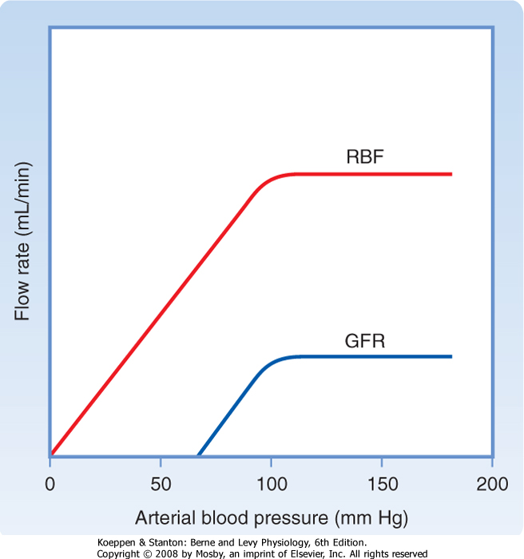
ONLY IN MALES’ SLIDES
Intrinsic Regulation of GFR and RBF
1) Myogenic mechanism
2) Tubuloglomerular feedback
normal response of vascular smooth muscle
that is, increased stretch due to pressure rise depolarises the cells, calcium enters and causes a vasoconstriction
well developed in the kidney
[NaCl] dependent mechanism
macula densa cells in JGA detect [NaCl] send signals to afferent arteriole
e.g. ↑ GFR = ↑ [NaCl] filtrate
sensed by JGA ⇒ arteriole constricts
(resistance ↑ ⇒ ↓ blood flow)
mediator can be Adenosine or Renin (mainly, it’s Adenosine)
Remember that the Macula Densa is an osmochemo receptor → detect osmolarity of tubular fluids
GFR is high → no time for reabsorption → Nacl is high in tubules → macula densa sends signals to JG → renin release→ vasoconstriction → increased resistance → drop in GFR and RBF
Pressure → Stretching → depolarizations → more calcium enters → vasoconstriction

Slide 5
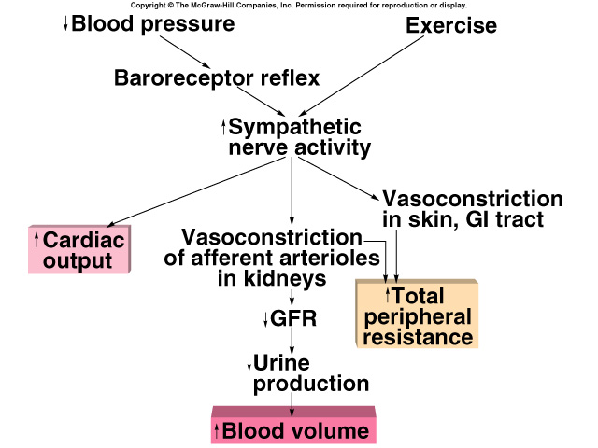
Extrinsic Regulation of GFR and RBF (Neurogenic factors)
ONLY IN MALES’ SLIDES
Sympathetic
Sympathetic Nerve Fiber: is the major NF to kidney. Stimulation of sympathetic NF causes renal vasoconstriction and results in decrease of RBF and GFR.
Stimulates vasoconstriction of afferent arterioles. Preserves blood volume to muscles and heart.
Parasympathetic
There are some parasympathetic NF to efferent arterioles, most predominantly to juxtamedullary nephrons and sphincters of vasa recta. Stimulation of parasympathetic NF causes renal vasodilation and results in increase in RBF and GFR.
Cardiovascular shock:
Decreases glomerular capillary hydrostatic pressure.
Decreases urine output (UO).
NF: Nerve Fiber

Slide 6
Extrinsic Regulation of GFR and RBF Continue
ONLY IN MALES’ SLIDES
4) Posture:
RBF increases in supine than sitting than standing.
Changing the posture from lying to standing leads to a decrease of about 15% in RBF due to the stimulation of sympathetic NF.
2) Humoral and pharmacological factors:
Epinephrine, Nor-Epinephrine, Angiotensin II, Prostaglandin (F), and Thromboxane cause renal vasoconstriction and results in decrease in RBF and GFR.
Acetylcholine, Bradykinin, Prostaglandin (D, E, and I), and bacterial pyogens cause renal vasodilation and results in increase in RBF and GFR.
3) Physiological Stress:
cold, deep anesthesia, fright, sever exercise, hypoxia and ischemia
stimulate sympathetic NF leading to renal vasoconstriction and decrease in RBF.
Very Important: Know that PG F causes vasoconstriction , while PG D/I/E cause vasodilation

Slide 7
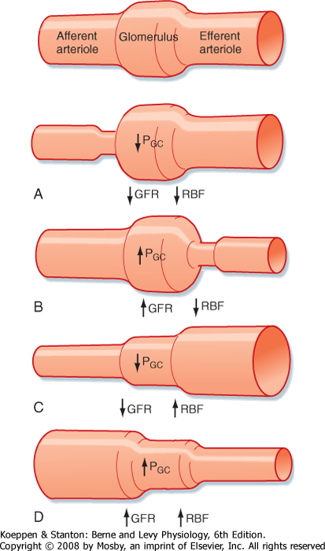
ONLY IN MALES’ SLIDES
Afferent arteriolar constriction
Due to: Renin/Adenosine
Causes: Low GFR low RBF low Pgc
Normal
Afferent arteriolar constriction
Efferent arteriolar constriction
Efferent arteriolar dilatation
Afferent arteriolar dilatation
B) Efferent arteriolar constriction:
Due to: ANG II
Causes : Increased GFR and Pgc and Decreased renal blood flow
C) Efferent arteriolar dilation:
Due to: parasympathetic activation
Causes: Decreased GFR and Pgc and Increased RBF
D) Afferent arteriolar dilation
Due to: -
Causes: increased GFR, RBF and Pgc

Slide 8
Concepts Of Clearance
The clearance value of a certain substance : [means the volume of plasma which is cleared from this substance in urine each minute]. | Definition
The formula is : C = $\frac{U X V}{P}$ C = Renal clearance (ml/min) (V) = Volume of urine (ml /min). (urine flow rate) (U) = Conc. of the substance in urine (mg/ml). (P) = Conc. of the substance in plasma/serum (mg/ml). U X V = Excretion rate of substance . | Calculation
The properties of any exogenous substance used in plasma clearance tests are: 1. Stays in the plasma (does not enter the RBC’s). 2. Does not affect the renal functions. 3. Not metabolized by the kidney. 4. Easily measured in plasma & urine. 5. Non toxic. | Plasma Clearance Tests
If the substance is freely filtered at the glomeruli and is not reabsorbed, secreted or metabolized in the nephron (such as Inulin), then: Amount filtered per minute = Amount excreted per minute [sub]_{plasma} x GFR = [sub]_{urine} x urine flow rate | Assume

Slide 9
Renal Handling of The Different Substances
Filtration.
No secretion.
Partial reabsorption.
Ex. : Urea & Sodium (electrolytes)
Filtration only.
No secretion.
No reabsorption.
Complete excretion.
Ex. : Inulin
Filtration.
No secretion.
Complete reabsorption.
No excretion.
Ex. : Glucose & Amino acids
Filtration.
Secretion.
No reabsorption.
Ex. : Creatinine & P.A.H.A
*Every single word in this slide is VERY IMPORTANT !
P.A.H.A (Para-Aminohippuric acid)

Slide 10
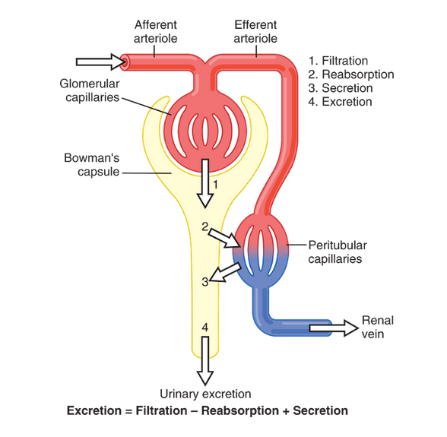
Concepts of Clearance
ONLY IN FEMALES’ SLIDES
Amount of substance excreted = (filtered – reabsorbed + secreted) { U x V = GFR x Px ± Tx }
The amount of any substance = conc. X volume
[ Before starting the lecture, we have to know ] :
- What does clearance mean ?
كمية الدم التي تم تنظيفها من مادة معينة.
Clearance is for blood not kidney
⬆clearance = ⬆efficacy of the kidney
Increased Filtration = increased Excretion
Increased Reabsorption = Decreased Excretion
Increased Secretion = Increased Excretion
What does the clearance depend on?
Clearance of a substance depend on excretion. If excretion is high = clearance will be high
لو ثبتنا الconcentration كل ما صار الاكسكريشن اكثر للمادة وطلع بالurine اكثر زاد ال clearance
2) Conc. of substance in plasma, if its high = clearance will be less
3) Clearance of a substance depend on it GFR and tubular activities.
if Plasma conc. of inulin = 1mg/100ml
Urinary conc of Inulin = 120 mg /100ml
Urine flow (UV) = 1 ml /min then, the clearance of inulin will be?
C = 120 ml/min

Slide 11
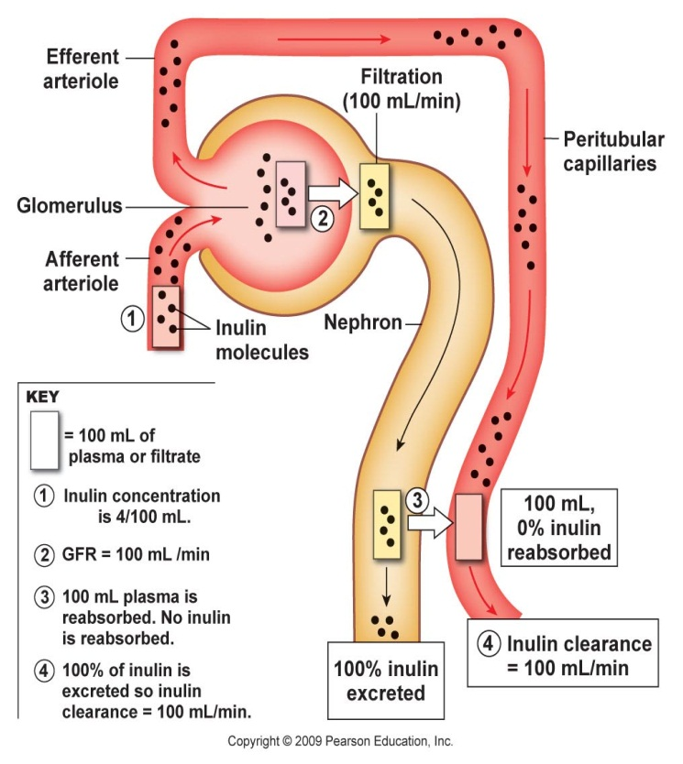
Types of Clearance Tests
Types of clearance tests
Exogenous | Endogenous
Inulin Para amino hippuric acid (PAHA) . Diodrast (di-iodo pyridone acetic acid ) | Creatinine Urea Uric acid
ONLY IN FEMALES’ SLIDES
Inulin :
A plant product that is filtered but not reabsorbed or secreted. Used to determine GFR and therefore nephron function.

Slide 12
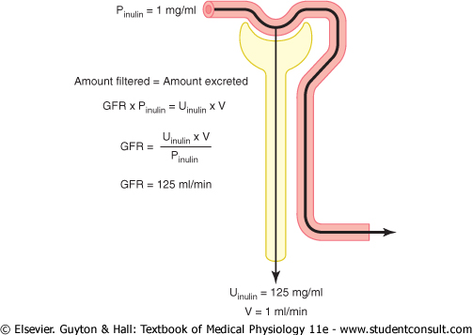
Criteria of a Substance Used for GFR Measurement
Freely filtered
Not secreted by the tubular cells.
Not reabsorbed by the tubular cells.
Should not be toxic
Should not be metabolized
Easily measurable.
if Plasma conc. of inulin = 1mg/100ml
Urinary conc. of Inulin = 120 mg /100ml
Urine flow = 1 ml /min
The clearance of inulin will be?
Clearance = GFR = U x V / PX
= (120 mg/100ml )(1 ml/min ) = 120 ml/min
( 1 mg/100ml )
Examples of such a substance:
Exogenous | Endogenous
Inulin It is a polysaccharide with a molecular weight of about 5200 and it fits all the above requirements. | Creatinine by-product of skeletal muscle metabolism
example
Inulin is better but toxic for human , thus practically we use creatinine
Video of (Renal Clearance of Inulin) Duration: (2.43)mins

Slide 13
Importance of renal clearance
Plasma clearance tests can be used for:
Plasma Clearance Test
Measurement of the GFR
Measurement of the renal plasma flow rate
Determining the renal handling of the different substances
Assess severity of renal damage
#Note:
whether or not the substance is reabsorbed or secreted by the renal tubules
From there we can calculate the renal blood flow rate.
Clearance values can also be used to determine how the nephron handles a substance filtered into it. In this method the clearance for inulin or creatinine is calculated and then compared with the clearance of the substance being investigated.

Slide 14
Calculation of tubular reabsorption or secretion from renal clearance
Clearance measurements are also used to examine renal management of substances absorbed or secreted by the kidney.
For substances secreted by the kidney:
( [sub]_{plasma} x GFR ) + T = [sub]_{urine} x V (urine flow rate)
So, What goes into the nephrons = What leaves the nephrons.
Secretion into nephrons is occurring when: C sub.> C inulin
For substances absorbed by the kidney (Nephrons):
[sub]_{plasma} x GFR = T + ( [sub]_{urine} x V (urine flow rate)
So, What goes into the nephrons = What leaves the nephrons.
Absorption from nephrons is occurring when: C sub.< C inulin
T = ( [sub]_{plasma} x GFR ) - ( [sub]_{urine} x V ) | Conclusion
[sub]_{urine} x V = normally zero for glucose & amino acids. | Note
Which means: glucose & amino acids will be completely reabsorbed by the renal tubules and there will be no excretion.
T = Amount Transported (amount reabsorbed or secreted)
C sub. = clearance of substance,
C inulin = clearance of inulin

Slide 15
Calculation of tubular reabsorption or secretion from renal clearance
ONLY IN FEMALES’ SLIDES
Calculation of tubular reabsorption
Substances highly reabsorbed (Na+) | Substances that are completely reabsorbed from the tubules (amino acids, glucose)
clearance < 1% of the GFR. | clearance = zero because the urinary secretion is zero.
Reabsorption rate can be calculated= Filtration rate - excretion rate = (GFR X P*)-(U* X V)
* The substance needed to be assessed.
If excretion rate of a substance is greater than the filtered load, then the rate at which it appears in the urine represents the sum of the rate of glomerular filtration + tubular secretion
Secretion* = (U* X V) - (GFR X P*).
* indicate the substance

Slide 16
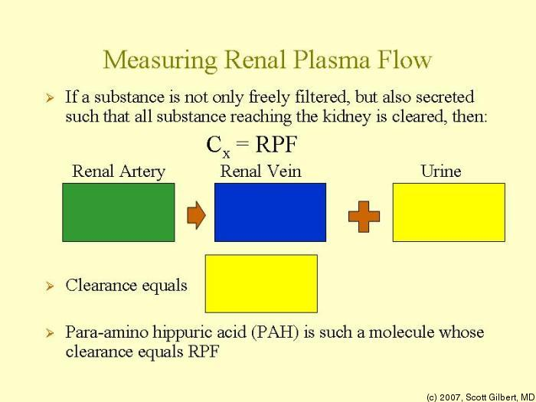
ONLY IN FEMALES’ SLIDES
Measurement of Renal Blood Flow & Plasma Flow
To measure Renal blood flow:
Measure renal plasma flow
Calculate actual blood flow from hematocrit
Substances used for measurement of GFR are not suitable for the measurement of Renal Blood Flow.
Because Inulin clearance only reflects the volume of plasma that is filtered, and not that remains unfiltered and yet passes through the kidney → it is known that only 1/5 of the plasma that enters the kidneys gets filtered, so, we use other substances with special criteria.
Criteria of substance needed to measure Renal Plasma flow by clearance method : ( Properties )
1. Freely Filtered 2. Rapidly and completely secreted by the RTC
3. Not reabsorbed 4. Non toxic 5. Easily measured .
Example: Para-amino-hippuric-Acid (PAHA):
90% of plasma flowing through the kidney is completely cleared of PAHA. Even when it goes through peritubular capillaries it get secreted completely
RTC = renal tubular cell

Slide 17
Para-aminohippuric Acid (PAHA) and its Clearance
It is one of the special substances used to measure the RBF (Renal blood flow) . ( using clearance method )
Properties: When it presents below a certain concentration in the blood; it is completely cleared from the renal plasma by a single circulation through the kidney, due to it being:
Freely (easily) filtered
Secreted by renal tubules
Not reabsorbed after filtration
Other properties (as mentioned in slide 12):
Doesn’t enter RBC’s or other tissue cells - isn’t metabolized by tissues -
Not toxic - Not adsorbed to the unfiltrated plasma proteins .
IMPORTANT
Effective Renal plasma flow (ERPF) is the clearance of PAHA:
Amount entering kidney = RPF x PPAHA
Amount entered = Amount excreted
ERPF x PPAHA = UPAHA x V
ERPF = UPAHA x V
PPAHA
PAHA Clearance (example):
- Conc. of PAHA in urine = 25.2 mg/ml
- Conc. of PAHA in arterial blood= 0.05 mg/ml
- Urine flow = 1.1 ml/min
Renal Plasma Flow (CPAH) =
(25.2 x 1.1) / 0.05 = 560 ML/ min
- Hematocrit = 45%
Renal blood flow =
(560 x 100)/(100-45)= 1018 ml/min
ONLY IN FEMALES’ SLIDES

Slide 18
How to Measure Renal Blood Flow PAH Clearance: Example
If the concentration of PAH in the urine and plasma and the urine flow are as follows:
Conc. of PAH in urine=25.2 mg/ml
Urine flow=1.1 ml/min
Conc of PAH in arterial blood=0.05 mg/ml
Then CPAH or Renal Plasma Flow=
(25.2 x 1.1)/0.05 = 560 ML/ min
Lets say the hematocrit is 45%, then renal blood flow will be:
(560 x 100)/(100-45)= 1018 ml/min

Slide 19
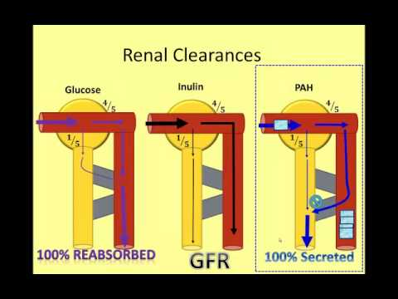
Renal clearance indications
ONLY IN FEMALES’ SLIDES
Renal Clearance gives an indication of the kidneys’ function
Clearance can also be used to determine renal handling of a substance
Clearance values can also be used to determine how the nephron handles a substance filtered into it
Which means that inulin is the standard and other substances are compared to it ..
In this method the clearance for inulin or creatinine is calculated and then compared with the clearance of the substance being investigated.

Slide 20
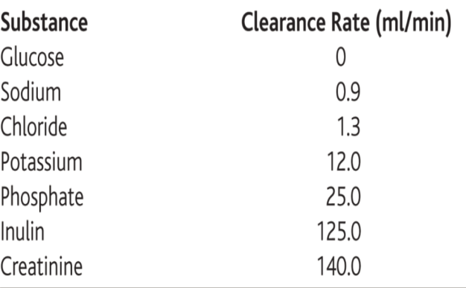
Comparison of clearance of a substance with clearance of inulin
Comparison of clearance of a substance with clearance of inulin
> Inulin clearance | < inulin clearance | = inulin clearance
Secreted by nephron tubules | Reabsorbed by nephron tubules | Only filtered not reabsorbed or secreted
Listed below are the approximate clearance rates for some of the substances normally handled by the kidneys:
Remember : Filtered amount + Secreted = Excreted
Filtered amount – Reabsorbed = Excreted
If substance is secreted:
Excreted = Filtered + secreted
If substance is reabsorbed
Excreted = filtered – reabsorbed

Slide 21
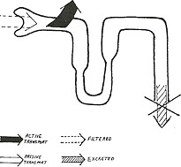
Filtration fraction Glucose clearance
ONLY IN FEMALES’ SLIDES
Filtration fraction: is the ratio of GFR to renal plasma flow. “see the equation below”
The glucose clearance is zero at plasma glucose values below the threshold and gradually rises as plasma glucose rises.
We can express the excretion of glucose quantitatively at plasma concentrations beyond the threshold, where the glucose reabsorption rate (Tm) has reached its maximum :
Tubular transport maximum (Tmax)
The Maximum limit/rate at which a solute can be transported across the tubular cells of kidneys is called tubular transport maximum.
Average Tm for Glucose is 375 mg/min
Privilege of T-max is given to the important solutes and some organic molecules such as glucose .

Slide 22
Renal Threshold
Is the concentration of a substance dissolved in the blood above which the kidneys begin to remove it into the urine.
After this level ⇒ the filtered load exceeds the absorptive capacity of the tubules.
Substances of high threshold: glucose, amino acids & vitamins.
Substances of medium threshold: K+ & urea.
Substances of low threshold: phosphate & uric acid.
Substances of no threshold: creatinine, mannitol & inulin.

Slide 23
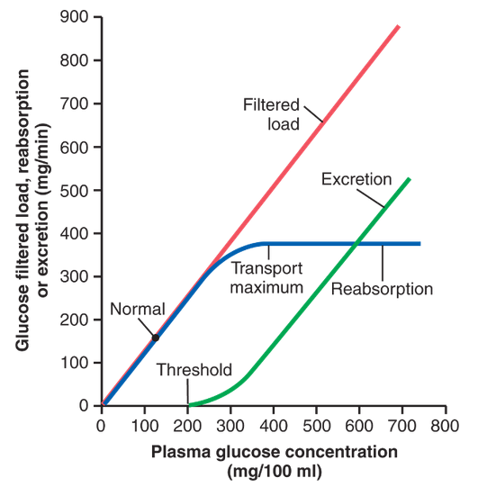
Glucose reabsorption
ONLY IN FEMALES’ SLIDES
FBG = 60-110 mg/dl
RBG = 110-200 mg/dl
Transport max :
375 mg/min
Renal Threshold :
200mg/dl
ليش ال threshold عند 200 مو300 ؟
لأن مو كل النفرونس لها نفس ال efficacy بعضهم اقل من 300 فتختلف قدرتهم على نقل الجلوكوز .
وأفضل وأعلى نفرون يكون الماكسيمم 375
No limitation because glucose freely filtered
النقطة اللي يبدأ ال glucoseيطلع بال urine
However, when the plasma concentration of glucose rises above about 200 mg/100 ml, increasing the filtered load to about 250 mg/min, a small amount of glucose begins to appear in the urine. This point is termed the threshold for glucose. Note that this appearance of glucose in the urine .
(at the threshold) occurs before the transport maximum is reached. One reason for the difference between threshold and transport maximum is that not all nephrons have the same transport maximum for glucose, and some of the nephrons excrete glucose before others have reached their transport maximum. The overall transport maximum for the kidneys, which is normally about 375 mg/min, is reached when all nephrons have reached their maximal capacity to reabsorb glucose .
FBG : Fasting Blood Glucose / RBG : Random Blood Glucose

Slide 24
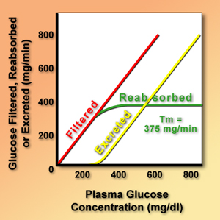
Tubular transport maximum for glucose
Filtered load | GFR x [P]_{glucose} ↑ plasma [glucose]= ↑ Filtration
plasma [glucose] < 200 mg/dl | Filtered load of glucose is completely reabsorbed. clearance = zero
plasma [glucose] > 200 mg/dl | Filtered load is not completely reabsorbed. “ Threshold” or plasma [glucose] at which glucose is first excreted in urine
plasma [glucose] > 300 mg/dl | Filtered load is not completely reabsorbed. Na+ - glucose (SGLT) cotransporters are completely saturated. Maximal glucose reabsorption (Tm)
Mechanism
Urea Clearance Test (Just read it)
After 1 hr: Take blood & urine samples and drinks another glass of water.
Drinks a glass of water.
After 2 hrs: Take another urine sample.
Evacuates (empty) the patient’s bladder.
Calculate the urine vol. /min.
If it is above 2 ml /min
we get the maximal urea clearance (MC) .
MC = 75 ml /min. (normally) .
If it is below 2 ml /min
we get the standard urea clearance (SC) .
SC = 54 ml /min. (normally) .

Slide 25
Tubular Transport Maximum
Definition:
It is the maximal amount of a substance (in mg) which can be transported (reabsorbed or secreted) by tubular cells/min.
Notice:
Appearance of glucose in urine before the transport maximum is reached is termed “Splay” and results from:
Nephron variability: “in glomerular size & tubular length”.
Variability in the number of glucose carriers & the transport rate of the carriers.
IMPORTANT NOTES
Renal threshold of glucose = 180 mg/dL,
Tmax= 375 mg/min
(notice how Tmax is a rate while threshold isn’t)
When glucose is less than180, all glucose is reabsorbed.
When glucose levels are elevated more than 180 it starts to be excreted in urine; however, reabsorption is still activated ( meaning not all the excess amount is excreted )
untill it reaches 300 mg/dl where reabsorption stops and everything above 300 mg/dl is excreted.
(Glucose concentration of 300 mg/dl equals Tmax 375 mg/min when GFR= 125 ml/min)
300 x 1.25 = 375 mg/min
Will be explained in the next slides
Splay is between threshold (180 mg/dL) and Tmax (300 mg/dL)
Splay differs from one person to another, it depends on:
1- nephron ( glomerular size and tubules length)
2- glucose carriers ( number and rate of transport)

Slide 26
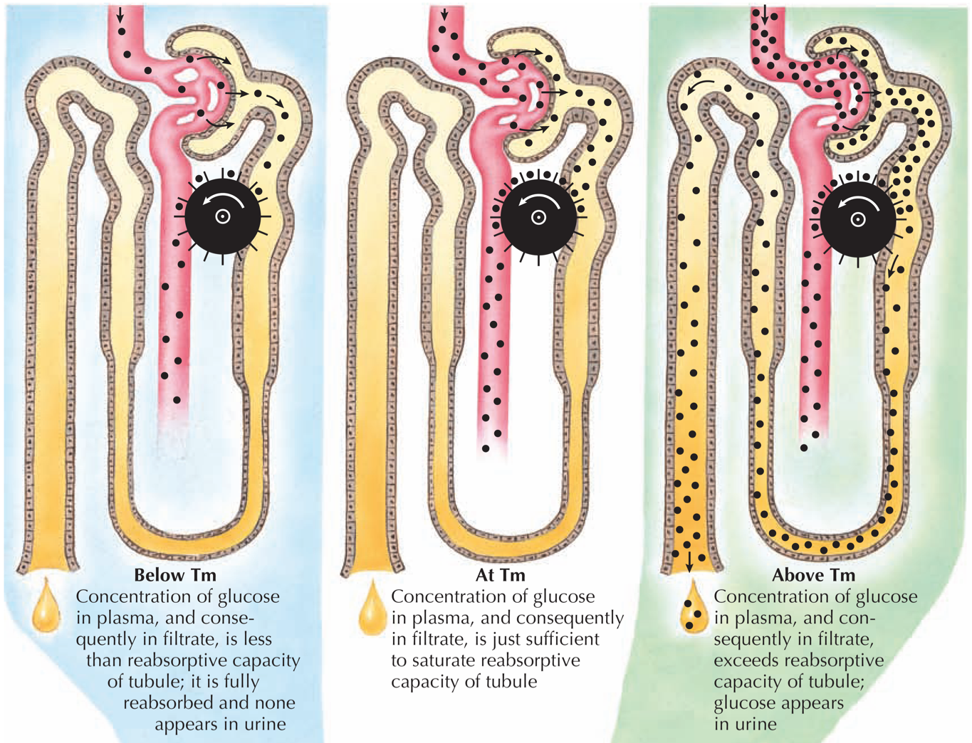
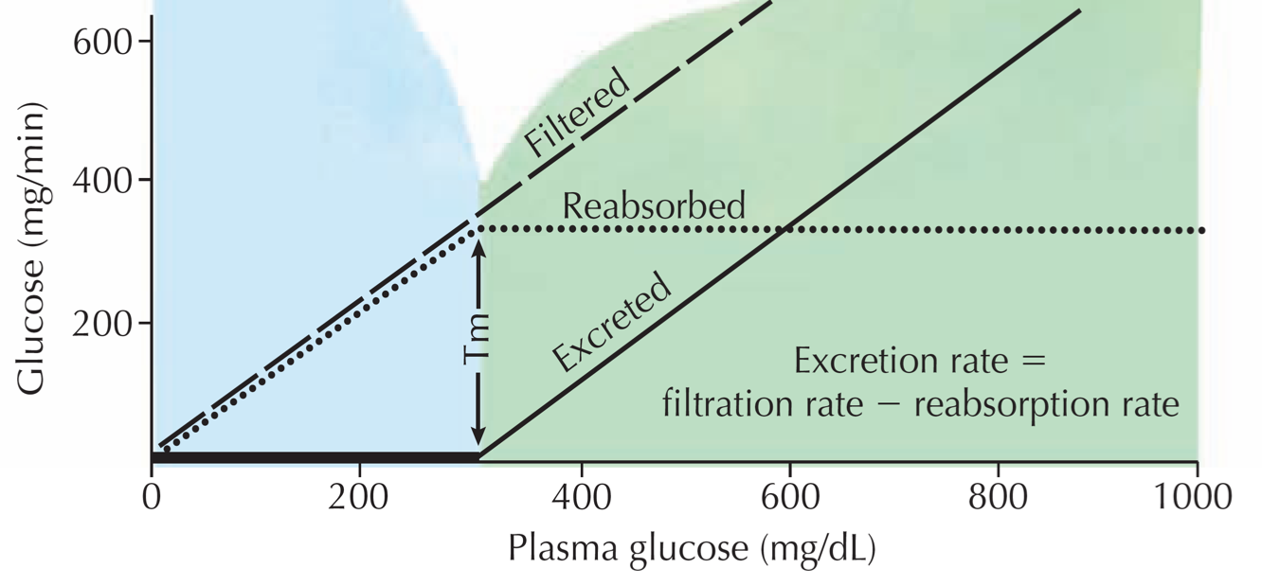
Tubular Transport Maximum
ONLY IN MALES’ SLIDES
Many substances are reabsorbed by carrier mediated transport systems e.g. glucose, amino acids, organic acids, sulphate and phosphate ions.
Carriers have a maximum transport capacity (T_{m}) which is due to saturation of the carriers. If T_{m} is exceeded, then the excess substrate enters the urine.
Glucose is freely filtered, so whatever its [plasma] that will be filtered.
For amino acids, T_{m} also very high → no urinary excretion occurs.
Once T_{m} is reached for all nephrons, further ↑ in tubular load are not reabsorbed, but are then excreted.
Threshold (T) is the plasma conc. at which tubular load just exceeds T_{m} for reabsorption, where below threshold all solute molecules are reabsorbed, and above threshold, some solutes are not
T

Slide 27
Tubular Transport Maximum
ONLY IN MALES’ SLIDES
In man for plasma glucose up to 180 mg/dl, all will be reabsorbed. Beyond this level of plasma [glucose], it appears in the urine = Renal plasma threshold for glucose.
Kidney does NOT regulate [glucose], (insulin and glucagon). Normal [glucose] of 90 mg/dl, so T_{m} is set way above any possible level of (non-diabetic) [glucose] at 380 mg/min. Thus, ensure that all this valuable nutrient is normally reabsorbed. The appearance of glucose in the urine of diabetic patients = glycosuria, is due to failure of insulin, NOT, the kidney.
Tubules are lined by cells.
Those cells have 2 walls:
1- Luminal membrane: which is the wall facing the lumen (no carriers)
2- Basolateral membrane: wall facing away from lumen ( carries are in basolateral membrane )
--
For a substance to move from lumen to blood it has to cross luminal membrane and basolateral membrane
27

Slide 28
Test yourself IMPORTANT
ONLY IN MALES’ SLIDES
There are two possible ways to be asked:
A) The glucose plasma level is in the splay ( between renal threshold= 180 mg/ml and Tmax=375 mg/min
B) The glucose plasma level is above Tmax=375mg/min
Steps:
Calculate filtrated plasma glucose level by multiplying glucose plasma level with GFR/100
Subtract filtrated plasma glucose level from Tmax
Steps:
Subtract plasma glucose level from renal threshold
VERY IMPORTANT !!!!
Question: If Tmax = 375 mg/min and
glucose level is 500, how much glucose is excreted if:
A: GFR = 125 ml/min
B: GFR = 90 ml/min
Question: If plasma [glucose] = 275 mg/dl and renal threshold=180mg/dl. How many mg/dl wil be exreted?
275-180= 95 mg/dl excreted
Filtrated plasma glucose level:
500 mg/dl x 1.25 ml/min = 625 mg/min
Excreted= 625 – 375 = 250 mg/min
B) Filtrated plasma glucose level:
500 mg/dl x 0.9 ml/min = 450 mg/min
Excreted= 450 – 375 = 75 mg/min

Slide 29
Glucose Reabsorption
This diagram has 3 important curves:
Red line: Filtration ( all glucose is filtered)
Blue line: reabsorption ( up to Tmax )
Green line: excretion ( above Tmax is excreted )
Threshold 180 mg/dl
No excretion before threshold only filtration and reabsorption
Transport Max: 375 mg/min
Renal Threshold: 200 mg/dl
FBG = 60-100 mg/dl
RBG + 110-200 mg/dl
Relations among the filtered load of glucose, the rate of glucose reabsorption by the renal tubules, and the rate of glucose excretion in the urine. The transport maximum is the maximum rate at which glucose can be reabsorbed from the tubules. The threshold for glucose refers to the filtered load of glucose at which glucose first begins to be excreted in the urine.
Tubular reabsorption is highly selective. Some substances, such as glucose and amino acids, are almost completely reabsorbed from the tubules, so the urinary excretion rate is essentially zero. Many of the ions in the plasma, such as sodium, chloride, and bicarbonate, are also highly reabsorbed, but their rates of reabsorption and urinary excretion are variable, depending on the needs of the body. Waste products, such as urea and creatinine, conversely, are poorly reabsorbed from the tubules and excreted in relatively large amounts.

Slide 30
Thank you!
اعمل لترسم بسمة، اعمل لتمسح دمعة، اعمل و أنت تعلم أن الله لا يضيع أجر من أحسن عملا.
The Physiology 436 Team:
Female Members:
Amal Alshaibi
Rana Barasain
Male Members:
Fahad AlFayez
Mohammad almutlaq
Team Leaders:
Qaiss Almuhaideb
Lulwah Alshiha
Contact us:
Physiology436@gmail.com
@Physiology436
References:
Girls’ and boys’ slides.
435 Team.
Guyton and Hall Textbook of Medical Physiology (13th Edition).
Linda (5th Edition).
Link to Editing File
Special thanks to Team435!

