Slide 1
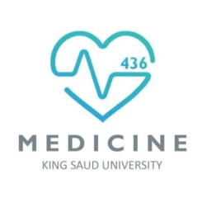
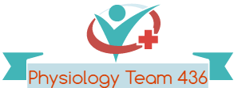

Tubular Reabsorption
Red: very important.
Green: Doctor’s notes.
Pink: formulas.
Yellow: numbers.
Gray: notes and explanation.
Physiology Team 436 – Renal Block Lecture 5
For further understanding please check our “Extra Notes” file which contains extra explanation for reference books.

Slide 2
Objectives
Define tubular reabsorption, tubular secretion, transcellular and paracellular transport.
Identify and describe mechanisms of tubular transport
Describe tubular reabsorption of sodium and water
Revise tubulo-glomerular feedback and describe its physiological importance
Identify and describe mechanism involved in Glucose reabsorption
Study glucose titration curve in terms of renal threshold, tubular transport maximum, splay, excretion and filtration
Identify the tubular site and describe how Amino Acids, HCO₃⁻, PO₄⁻ and Urea are reabsorbed

Slide 3
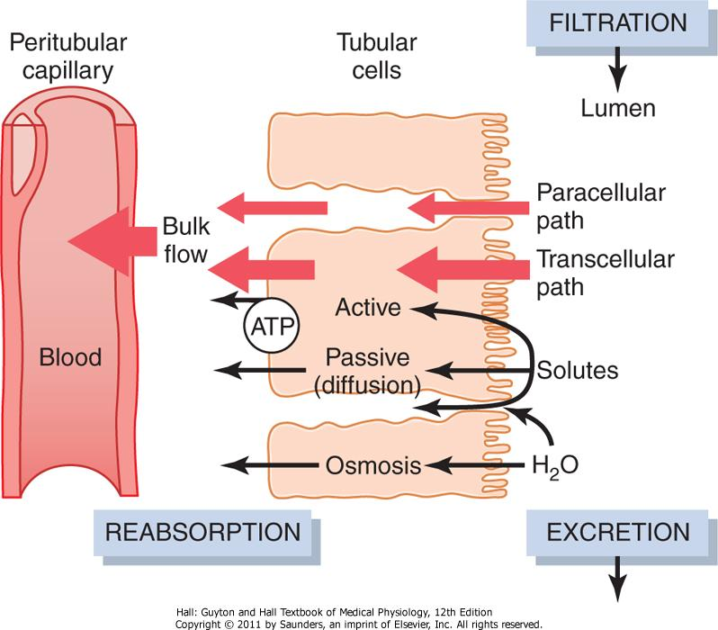
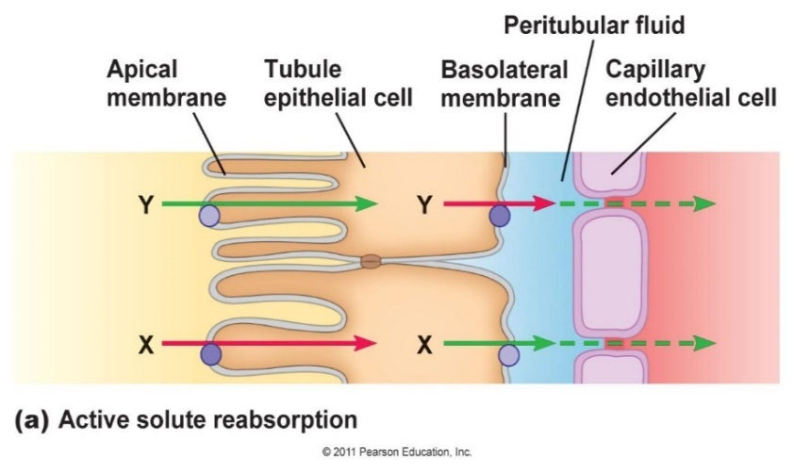
Tubular Reabsorption
Transported substances move through three membranes :
Luminal “Apical” membranes of tubule cells.
Basolateral membranes of tubule cells
Endothelium of peritubular capillaries
Ca²⁺, Mg²⁺, K⁺, and some Na⁺ can be reabsorbed via paracellular pathway. “بين الفراغات”
paracellular means that the pathway is between cells.
Transcellular means through cell.
Paracellular:
Passive diffusion – Down gradient– Cross tight junction.
Transcellular:
Active Transportation of solutes Cross a cell.

Slide 4
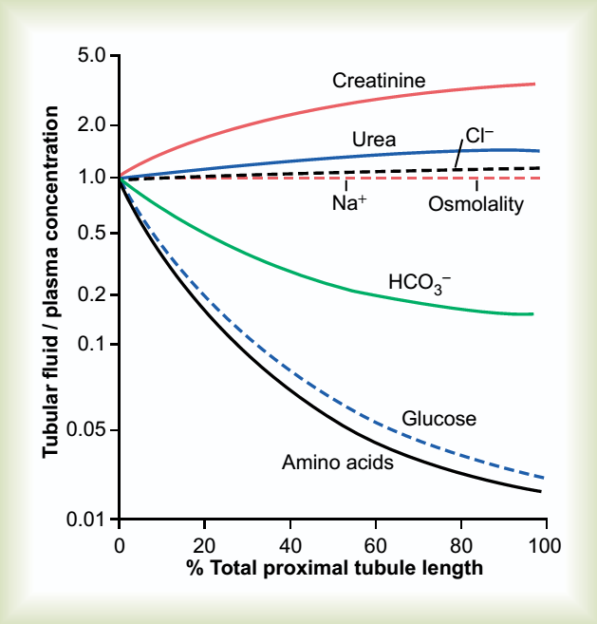
Tubular Reabsorption
Tubular reabsorption
All organic nutrients are reabsorbed
Reabsorption may be an active (requiring ATP) or passive process
Water and ion reabsorption is hormonally controlled
Examples :
ADH Reabsorb water (retention of water).
Aldosterone tends to promote Na⁺ and water retention, and lower plasma K⁺ concentration.
There is also a secondary active reabsorption which move particles by atp from another pump in glucose Example

Slide 5
Sodium Reabsorption: Primary Active Transport Sodium
In all areas of the nephron
Na+ reabsorption is almost always by active (Needs energy) transport
Na+ enters the tubule cells at the luminal membrane.
Is actively transported out of the
tubules by a Na+-K+ ATPase pump
Other important solutes are linked either directly or indirectly to reabsorption of Na⁺.
Exchanges the sodium with potassium
3 Na+ out, 2 K+ in
In the basolateral membrane of the Tubular cells

Slide 6
Mechanisms of Tubular Absorption & secretion
Down chemical/electrical gradient
Passive diffusion
Facilitated diffusion
(Down hill = no energy, but needs a carrier)
Against chemical/electrical gradient (needs energy)
Active transport
Endocytosis
(bicarbonate)

Slide 7
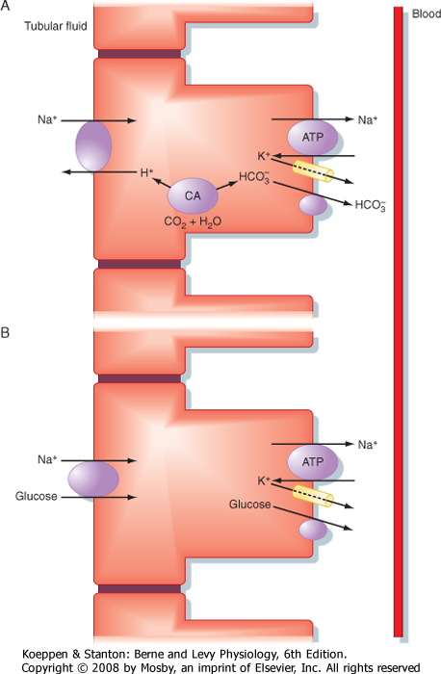
Proximal Convoluted Tubule Reabsorption (PCT): Early stage
We will be looking at the reabsorption and secretion mechanisms of each part of the nephron
The epithelium is leaky, and it’s permeable to ions & water.
70% of Na+, Cl-, K+ & water is absorbed passively (with/follows Na+).
Sodium will pull water with it
Sodium leaves the pump through the symporters.
Na+ Reabsorption (transcellular):
Early PCT Na+ absorbed:
exchanged with H+,
but HCO3- reabsorbed
with organic substances
glucose, amino acids, lactate, Pi
Early PCT reabsorption
Exchange: Na+/H+ exchanger (the transporter) takes up Na+ for H+. Which eventually Causes reabsorption of HCO3-
Symport: Symporters (or cotransporters) are:
- Na+ - glucose
- Na+ - amino acid
- Na+ - Pi
- Na+ - lactate
Na+/K+-ATPase important

Slide 8
Glucose Reabsorption
From tubular lumen to tubular cell: Sodium co-transporter (Carrier-mediated secondary active transport). Uphill transport of glucose driven by electro-chemical gradient of sodium, which is maintained by Na-K pump presents in basolateral cell membrane. (Na is downhill)
From tubular cell to peritubular capillary: Facilitated diffusion (Carrier-mediated passive transport) (the glucose don’t forget ☺)
So, it needs glucose and a carrier and it’s an active transport
So, it’s a passive transport but with carrier
-Carrier mediated = needs protein
-So it’s an active process and needs protein

Slide 9
Tubular Handling of Glucose (Lecture 3: Renal Clearance)
IF plasma [glucose] = 275 mg/dl
275 mg/dl will be Filtered
180 mg/dl Reabsorbed
95 mg/dl Excreted
Tubular Transport Maximum of Glucose
Kidney does regulate some substances by means of the T_{m} mechanism e.g sulphate and phosphate ions.
Also subject to PTH regulation for phosphate, [ PTH ↓ reabsorption ].
*PTH = parathyroid hormone

Slide 10
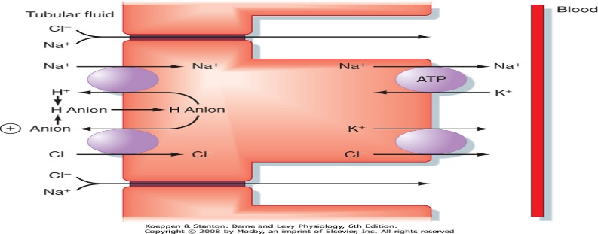
PCT Na+ Reabsorption: Late stage
Late = related to Cl-, the reason isn’t important.
2-Paracellular
passive diffusion With Cl-
driven by high [Cl-] in tubule
140mEq/L in the tubule lumen and 105 mEq/L in Interstitium
This conc. gradient favors diffusion of Cl- from the tubular lumen a cross the tight junction into the lateral intercellular space.
Late Proximal Convoluted Tubule:
Na+ Reabsorbed mainly with Cl- , Why ?
- Due to different transport mechanisms in late PCT.
- Lack of organic molecules
Differentiae between the early and the late:
- This one is with Cl- .
May be Transcellular or Paracellular .
Conc. Of cl will favor the reabsorption into blood.
only in males slides
1-Transcellular
Na+ entry using NHE & 1 or 2 Cl- -anion antiporters
Secreted H⁺ & anion combine in the tubular fluid & reenter the cell.
Anions involved: OH⁻, formate, oxalate, sulfate
Cl- drags Na+ with it.

Slide 11
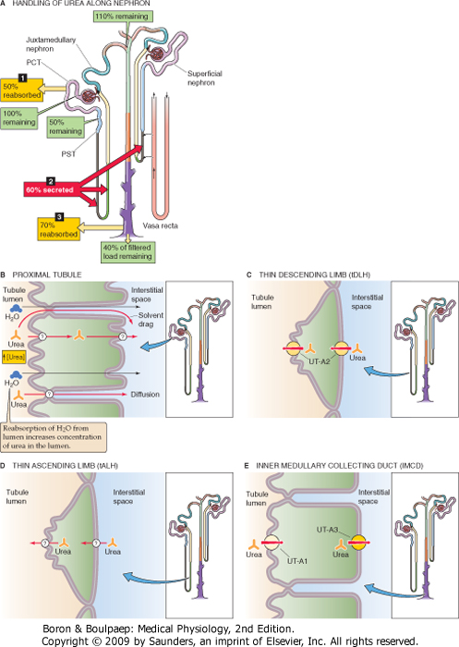
Urea Reabsorption
Normal plasma level of urea 2.5-6.5 mM/L (15-39 mg/100ml).
Mechanism of urea reabsorption:
About 40-70% of filtered load of urea is reabsorbed in (areas of reabsorption):
- Second half of PCT.
- Medullary CT and CD (ADH dependent).
Due to water reabsorption in the first half of PCT, the conc. of urea is increased in the second half and urea is reabsorbed by simple diffusion (downhill).
فقد الماء زاد من تركيز اليوريا مما أدى إلى سهولة انتقاله إلى الدم (passive diffusion)

Slide 12
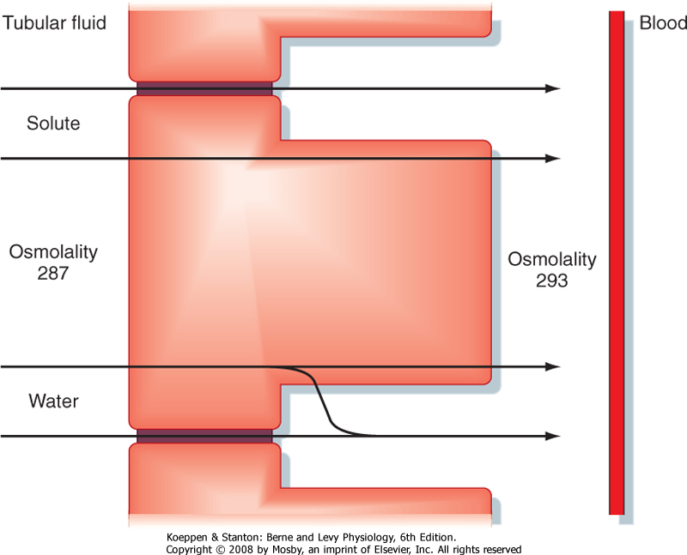
Water reabsorption
It’s not important
The percentages in all of them are important
PCT cells permeable to water.
PCT Passively reabsorbs 67% of filtered water.
Transtubular Passive (osmosis)
due to osmotic active substances that are absorbed, e.g. Na+, glucose, HCO3-, Cl-
⇒ ↓ tubule osmolality.
↑ intracellular space osmolality.
Solvent drag: K+, Ca2+, carried with water & hence reabsorbed
The accumulation of fluid and solutes within the lateral intercellular space increases hydrostatic pressure in this compartment
The increased hydrostatic pressure forces fluid and solutes into the capillaries. Thus, water reabsorption follows solutes.
Not important but read it
The proximal tubule reabsorption is isosmotic
Osmosis: concentration of water, from high water conc. To low water conc.

Slide 13
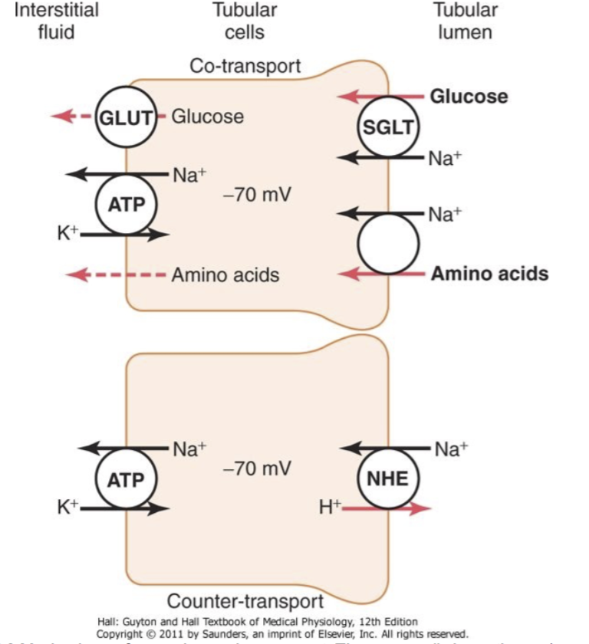
Protein Reabsorption
Peptide hormones, small proteins & amino acids are reabsorbed in PCT.
Has a maximum capacity: (T Max)
if too much protein is filtered → Proteinuria.
Peptide hormones, small proteins & amino acids undergo Endocytosis into the PCT, either intact or after being partially degraded by enzymes.
Once protein is inside (engulfed) the cell, enzymes digest them into amino acids, which leave the cell to the blood.
If the reabsorption exceeds it’s capacity we will find protein in the urine, same with glucose. Both are abnormal.
Protein enters the cell by endocytosis
Endocytosis is a form of active transport in which a cell transports molecules (such as proteins) into the cell, by engulfing them in an energy-using process.

Slide 14
Organic Ion / Cation Secretion
Endogenous Compounds:
- End products of metabolism
- Bile Salts
- Creatinine
- Catecholamine :
(Adrenaline , Noradrenaline)
Exogenous Compounds:
- Penicillin
-NSAIDs
(e.g. Ibuprofen)
- Morphine
Organic Ion/Cation Secretion in PCT
Harmful substances, the body gets rid of them.

Slide 15
HCO₃⁻ Reabsorption
The renal tubules are poorly- permeable to HCO₃⁻ . However, it is still reabsorbed but in the form of CO₂ (to which the tubules are highly permeable)
This occurs through the following steps:
Tubules are highly preamble to CO2 > H+ ions are formed inside the cells >secreted in the tubular fluid through NHE pump > H+ combines with CO2 to form H2CO3 in the tubular fluid > CA disassociate H2CO3 into CO2 and H+ > CO2 diffuse into the cell where combines with water and it keep repeating > CO2 gets out the cell by passive diffusing into the interstitial fluid (blood) H+ is secreted through the pump tubular lumen.
By activity of Carbonic Anhydrase enzyme (C.A.) in the Tubular cells, H₂CO₃ dissociates into CO₂ & H₂O
H⁺ is formed inside the cells then secreted into the tubular fluid (through Na+ H+ pump)
H⁺ Combines with HCO₃⁻ in the tubular fluid forming H₂CO₃ ₍unstable₎
CO₂ Diffuses into the cells Where it combines with H₂O (By activity of intracellular C.A), Forming H₂CO₃ which dissociates into HCO₃⁻ & H⁺
HCO₃⁻ passively diffuses into the interstitial fluid (then to the blood) while H⁺ is secreted into the tubular fluid to help more reabsorption of HCO₃⁻
It gets in through the reaction , never gets in directly
H+ out in exchange of Na+

Slide 16
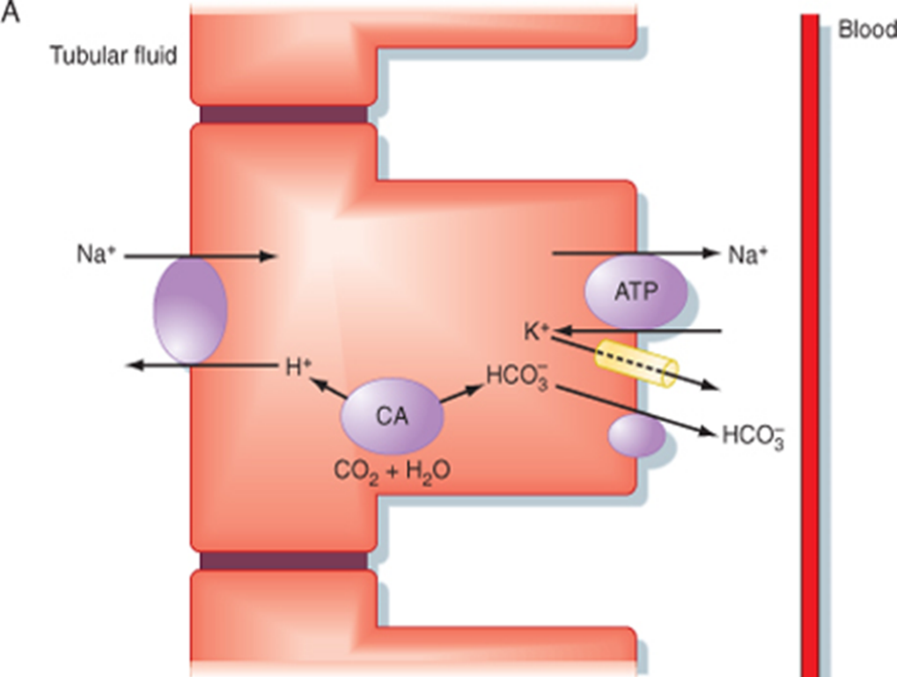

HCO₃⁻ Reabsorption, Cont..
Factors Affecting HCO₃⁻ Reabsorption:
Arterial P_{CO2}
Plasma [K⁺]
Plasma Aldosterone
Plasma [Cl⁻]
- Low levels of Pco2 = decreased the levels of reabsorption. Vice versa
- High Pco2 = investigate the lungs

Slide 17
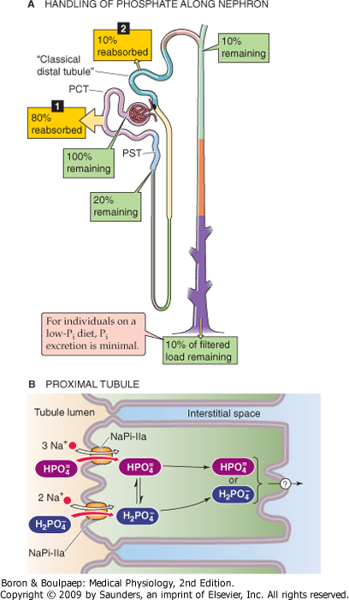
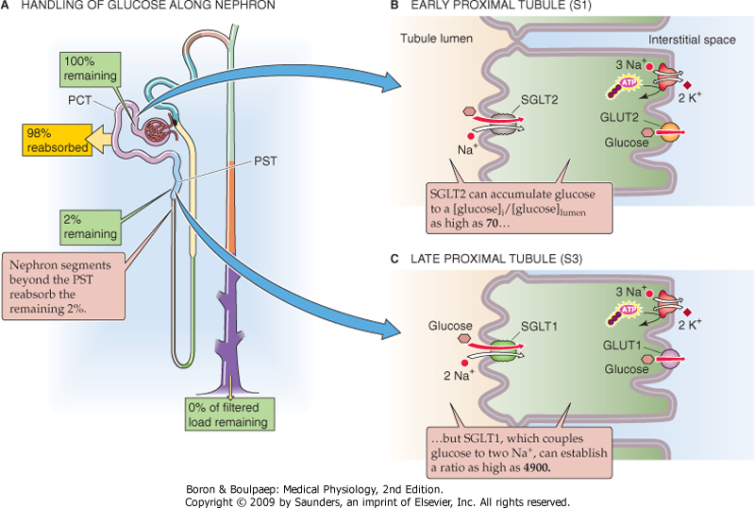

Slide 18
Thank you!
اعمل لترسم بسمة، اعمل لتمسح دمعة، اعمل و أنت تعلم أن الله لا يضيع أجر من أحسن عملا.
The Physiology 436 Team:
Female Members:
Allulu Alsulayhim
Ghada Alhadlaq
Male Members:
Ali Alsubaie
Abdullah Abuamara
Team Leaders:
Qaiss Almuhaideb
Lulwah Alshiha
Contact us:
Physiology436@gmail.com
@Physiology436
References:
Girls’ and boys’ slides.
435 Team.
Guyton and Hall Textbook of Medical Physiology (13th Edition).
Linda (5th Edition).
Link to Editing File
Special thanks to Team435’s Leaders: Meshal Alhazmy & Khawla Alammari and members!

