Slide 1
Renal Transport Process 2:Tubular Secretion
Red: very important.
Green: Doctor’s notes.
Pink: formulas.
Yellow: numbers.
Gray: notes and explanation.
Physiology Team 436 – Renal Block Lecture 6
For further understanding please check our “Extra Notes” file which contains extra explanation from reference books.

Slide 2
Objectives
Describe tubular secretion with PAH transport and K+
Identify and describe the characteristic of loop of Henle, distal convoluted tubule and collecting ducts for reabsorption and secretion
Identify the site and describe the influence of aldosterone on reabsorption of Na+ in the late distal tubules.

Slide 3
Overview
Loop of Henle
Ascending
loop of Henle
Descending
loop of Henle
limb (TAL) : Thick ascending
- Impermeable to water (isosmotic)
Important in concentrating urine-
25% NaCl, K+ reabsorbed as well as Ca₂⁺,HCO₃⁻
Solute absorption (TAL)
Thin ascending limb
Thin descending limb :
- 15% water absorbed
- permeable to water (filtrate hyperosmotic)
The only part in loop of Henle which is permeable to water
paracellular (50%)
Transcellular (50%)
Loss of NaCl in tubule
Na+/2Cl-/K+ cotransporter/ symporter
NHE ( Na – H exchange )
i) Na+ in
ii) H+ out
iii) HCO3- in
-Its important to know each segment of the nephron and the osmolality of the filtrate in it.
-Its important to know each segment of the nephron and what is it permeable and Impermeable to.

Slide 4
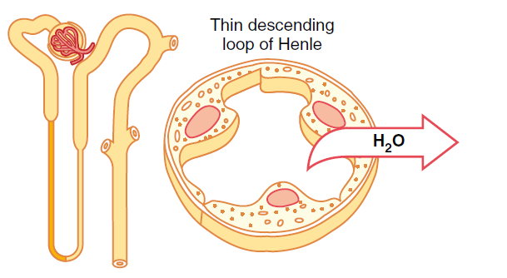
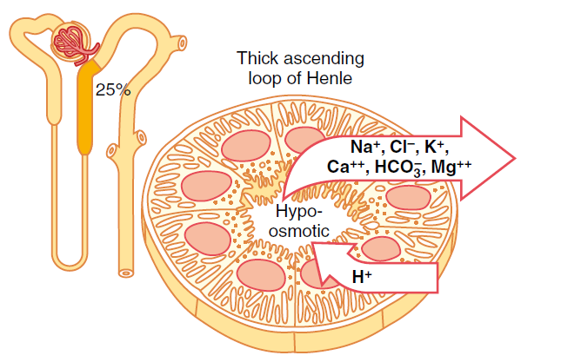
Loop of Henle
Thin descending limb :
- 15% water reabsorbed
- permeable to water (filtrate hyperosmotic)
to allow simple diffusion
Thick ascending limb :
- Impermeable to water (isosmotic) Thin Ascending Limb Hyposmotic
-Important in concentrating urine (more details in next lecture)
- 25% NaCl, K+ reabsorbed as well as Ca₂⁺ and HCO₃⁻
Mechanisms of Solute reabsorption (inTAL):
1- Transcellular needs to enter the cell (50%)
1) Na+/2Cl-/K+ cotransporter*/ symporter**
2) NHE (Na, H exchange)
Na+ in \ H+ out \ HCO3- in
2- Paracellular (50%)
Loss of NaCl in tubule
Remember:
the beginning of the loop of henle has a similar structure to PCT
Tubular fluid reaches early segment of loop of henle as isotonic (equal in sodium and water)
loop of henle has 3 segments 2 of them aren’t permeable to water and one is (thin descending is permeable) (thin ascending and thick ascending aren’t permeable)
The thick ascending limb reabsorbs 25% of NaCl and K, but the majority (70%) is reabsorbed in the proximal convoluted tubules. Transcellular is when ions enter the blood circulation after passing through tubular cells.
Hydrogen secreted through the sodium hydrogen exchanger (NHE) is obtained from the dissociation of carbonic acid in the presence of carbonic anhydrase.
*means all of them enter together **all in same direction

Slide 5
Loop of Henle
Furosemide block the channel making tubular fluid highly osmoler

Slide 6
Loop of Henle
Thick ascending limb
Transcellularly
Sodium hydrogen exchanger:
HCO3 + Na
H (out)
Na + 2 Cl + K cotransporter
Few K (out)
Paracellularly
Na+
K+
Ca++
Mg++
Solute absorption (TAL):
1) Transcellular (50%)
a) Na+/2Cl-/K+ cotransporter/ symporter
b) NHE
i) Na+ in
ii) H+ out
iii) HCO3- in
2) Paracellular (50%)
Loss of NaCl in tubule
⇒ ↑ positive charge compared to blood drives absorption
NaCl moves from lumen to interstitium this leaves behind positive charged molecules, positivity will increase in tubular fluid so equilibrium must be met in tubular fluid → Ca K Mg follows NaCl

Slide 7
Overview
Terminal nephron
Early distal convoluted tubule
Reabsorbs Na and Cl
(Na/Cl cotransporter)
Impermeable
to water
Late distal convoluted tubule
and collecting duct
Na reabsorption (ENaC)
Principal cells
Water reabsorption (ADH)
Secrete K
Intercalated cells
Secrete H and reabsorb HCO3
Reabsorb K (K/H pump)

Slide 8
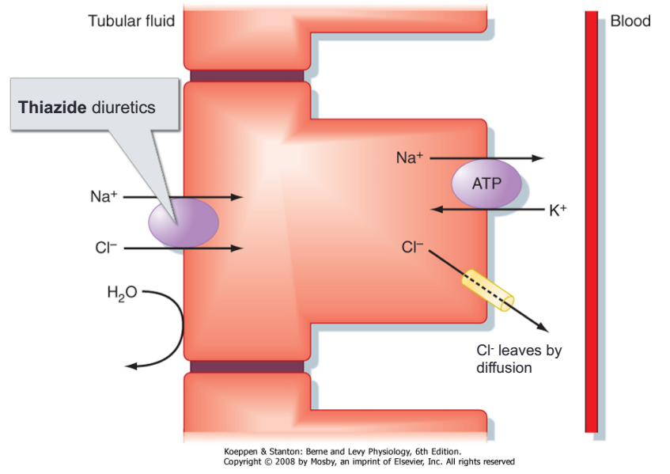
Distal convoluted tubule (DCT) & collecting duct (CD)
7% NaCl reabsorbed مهمة النسبة ومقارنتها مع البروكسميل
8 – 15 % water reabsorbed (needs ADH)
Some K⁺, H⁺ secreted into tubule
Reabsorbs Na⁺, Cl⁻
Impermeable to water.
Diuretics:
Mannitol is a hyperosmolar material so it will attract huge amounts of water
A less powerful diuretic is Furosemide (loop of henle)(blocks NKCC pump)
Least powerful is thiazide (early DCT) (blocks Na Cl pump)
Thiazides are most commonly used in HTN
Early DCT

Slide 9
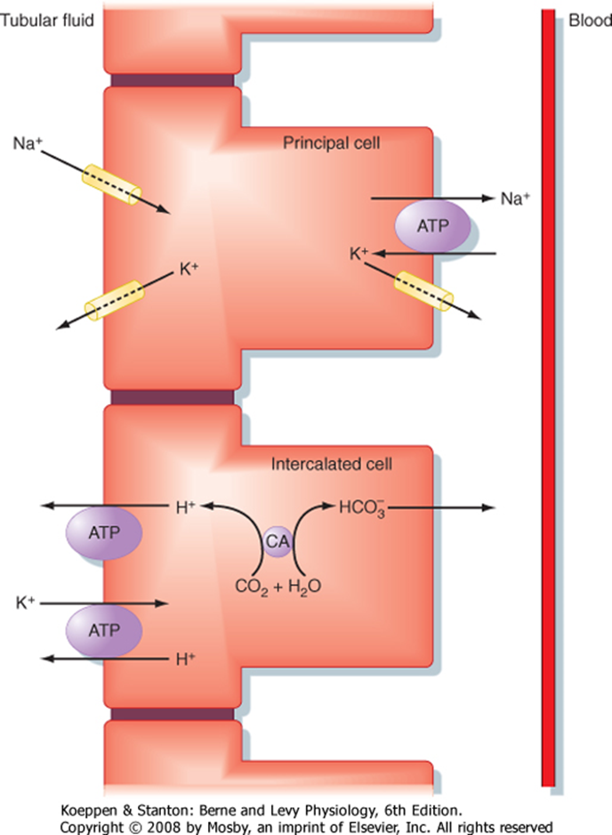
Distal convoluted tubule (DCT) & collecting duct (CD)
Principle cells:
Reabsorb Na⁺, Na+ diffuses via selective channels.
Reabsorb water
Secrete K⁺ down the conc gradient
Intercalated cells:
Secrete H+
Reabsorb HCO3⁻
Reabsorb K⁺ (by K, H exchanger)
this area is under control of hormones:
Aldosterone:
↑Na reabsorption by principle cells,
↑K+ secretion
Late DCT
Secretion is most at the distal end of nephron
Secretion in collecting duct is higher than secretion in DCT and so on…
Intercallated cells :
if blood is acidic; reabsorbs bicarbonate secretes H .
If blood alkaline; reabsorbs H secretes bicorbonate
Principal and intercalated cells are both hormonally regulated.
The intercalated cells reabsorb K by the K/H pump (active transport).

Slide 10
ONLY IN MALES’ SLIDES
Factors Affecting Na Reabsorption
GFR: when increased causes an increase in filtration of Na which sensitise the macula densa.
Aldosterone.
Estrogen: Increase reabsorption of Na and decrease Na excretion.
Natriuretic hormone.
Osmotic diuresis (Increase Glucose, Mannitol and Urea) increase their conc. In the filtered load then causes a decrease in water reabsorption and Na.
Diuretic Drugs (Lasix)
Poorly reabsorbed anions causes retention of equal amount of Na.
1- More GFR > more filteration > more excretion
less GFR > less filteration > more reabsorption
2- Aldesterone secreted by adrenal gland in zona glomerulosa
Functions: Sodium/water retention and Potassium secretion
3-Estrogen: Why is there edema in pregnancy > elevated estrogen > increase reabsorption of Na
4- ANP’s functions are opposite to aldosterone; sodium/water excretion and potassium reabsorption
5- Osmotic diuresis: increase osmolalrity of tubules > so they pull water with them ( negative effect on reabsorption )
6- Lasix = furosemide
7- Anions negatively charged, so Na will be attracted to these anions in the tubules and won’t be reabsorbed

Slide 11
Transport of potassium K+
Most abundant cation (+) in the body
98% is intracellular [150mM]
Regulates intracellular function such as Cell volume, Acid/base status,
cell growth & division
3,500-4,000 mmol in blood. قليل ولازم يظل قليل ولا أدى الى اعراض خطيرة مميته منها اريثميا
2 % K extra-cellular [3.5-5mM]
This regulates membrane potentials in excitable cells and diffusion
potentials in transporting epithelia.
K+ Intake 80-120 mmol/day
Tissue damage leading to cell lysis increases plasma [K+]
Both extracellular [K+] and total body potassium are tightly regulated.
HOW?
INTERNAL DISTRIBUTION
(This regulates extracellular [K+] )
RENAL K+ EXCRETION
(This regulates total body potassium)
If extracellular K is increased massively or decreased → hyper-excitation / paralysis / arrhythmia

Slide 12
Internal potassium distribution
ONLY IN MALES’ SLIDES
Potassium content of average meal is 30-40 mmol.
This is rapidly absorbed.
Why can exercise increase plasma K levels?
More action potentials > more K efflux
some cells are damaged (not very common)
B-blocker are contraindicated in exercise > they increase K level (increase uptake of cells even more)
Renal elimination is slow. It can take up to six hours eliminate this load.
If nothing happened then this absorbed load would cause Plasma [K+] to rise by
2-5 mmol which is potentially lethal.
Buffering of the load occurs by increased intracellular uptake via Na+/K+ pump into Skeletal Muscle, Liver, Bone RBCs etc.
Loss of K+ from exercising muscle can seriously increase plasma K+ ,trained athletes show accelerated uptake after exercise

Slide 13
Renal excretion of potassium
90-95% of Dietary K ⁺ excreted via the kidneys .
5-10% in Sweat & Feces (This is unregulated and may become significant in diarrheas).
In normal individual intake is matched by excretion and potassium balance is maintained.
Filtered load of potassium ~ 720 mmol/day .
Bulk reabsorbed by proximal tubule and loop of Henle.

Slide 14
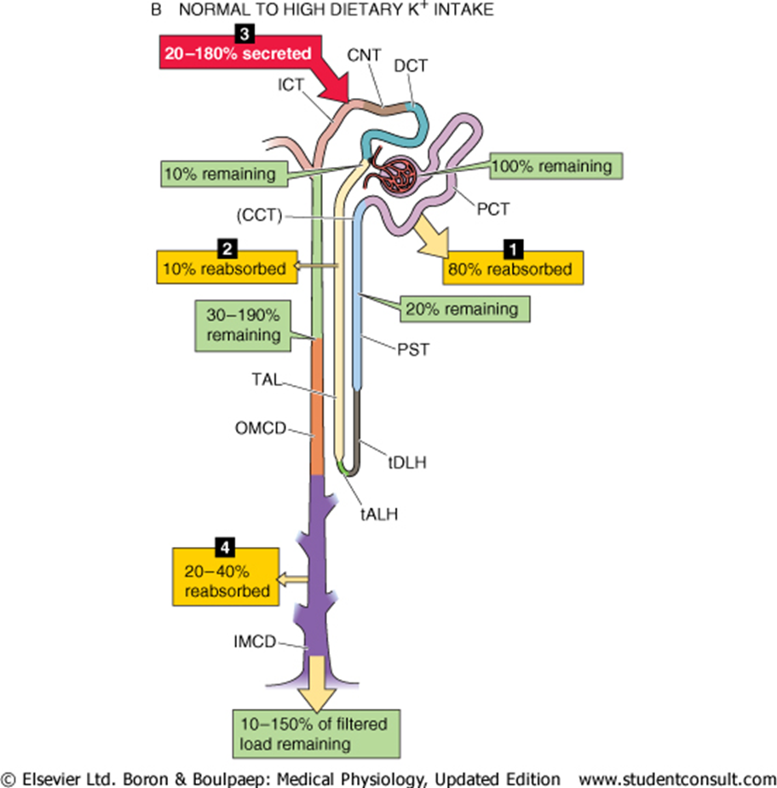
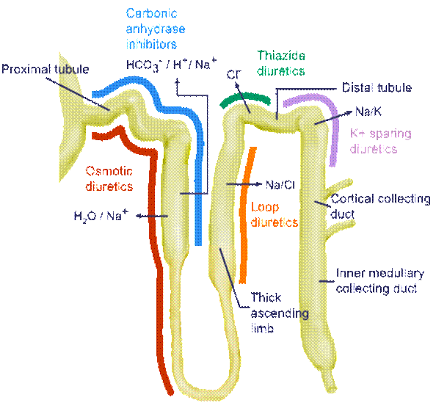
Renal K+ Transport mechanismsكلها اخذناها قبل بس هنا مرتبة للبوتاسيوم
Cell membrane transporters :
Na-K ATPase, H-K ATPase
K ⁺ channels, K:Cl cotransport
Na:K:2Cl cotransport
K ⁺ is Reabsorbed in :
PT (Proximal tubules) by solvent drag
TAL (thick Ascending limb of loop of Henle) NKCC ( luminal membrane )
Intercalated cell in CCD (cortical collecting duct)
K ⁺ Secreted in :
Late distal tubule
principal cells of late DT (Distal Tubules)
CCD (cortical collecting duct)

Slide 15
Renal K+ Transport mechanisms كلها إعادة
Proximal Tubule: K ⁺ is absorbed by intercellular solvent drag whereby fluid movement driven by Na+ absorption entrains K ⁺ ions.في المحاضرة السابقة
TAL: Na:K:2Cl in luminal membrane.
K:Cl co-transport in Baso-lateral membrane
CD:
-K reabsorption is by the intercalated cells via a luminal H-K ATPase.
-K+ secretion in the principal cells (via luminal K channels and basolateral Na-K ATPase).

Slide 16
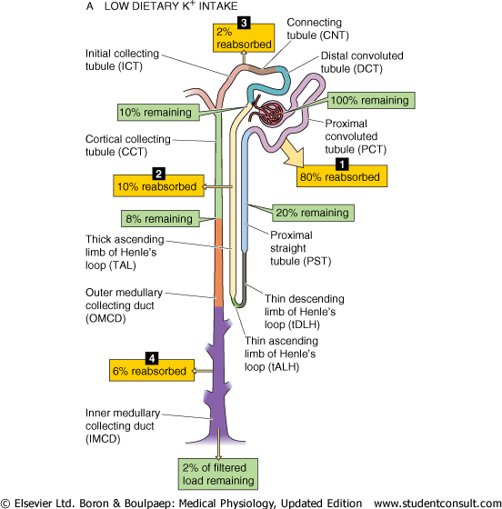
ONLY IN MALES’ SLIDES
A) Low dietary K intake ( not normal )
B) Normal to high K intake
100% is filtered
80% is reabsorbed in PCT
10% reabsorbed in thick ascending
2% reabsorbed along the DCT
6% reabsorbed in medullary part of collecting duct
2% excreted
(notice how there’s no secretion of potassium )
100: filtered
80% is reabsorbed in PCT
10% reabsorbed in thick ascending
20-180 % secretion in Principal cells
20-40% reabsorbed in medullary collecting duct
10-150% eliminated in urine
20-180% is NOT a range (this Is just an example)

Slide 17
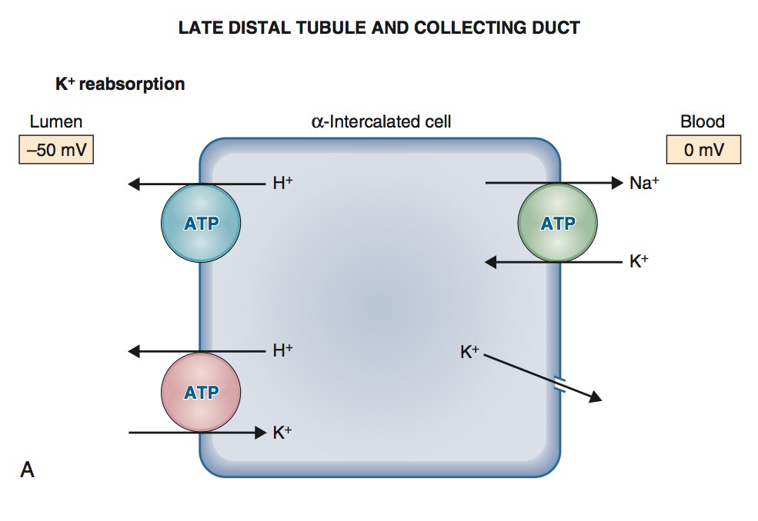
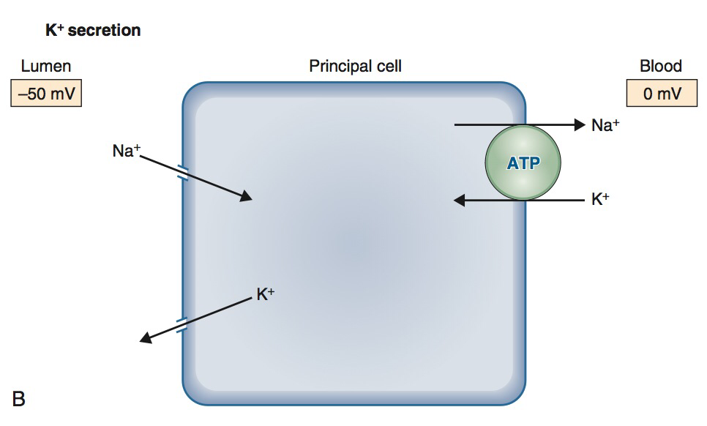
Renal K+ transport mechanism
When a person is on a low K+ diet
K+ reabsorption is by the intercalated cells via a luminal H-K ATPase (primary active transport)
K+ secretion in the principal cells (via luminal K channels and basolateral Na-K ATPase)

Slide 18
Factors affecting potassium secretion/reabsorption
Peritubular factors (change inside tubular cells.) (All Increase the secretion and excretion of potassium)
3- Alkalosis | 2- Hyper-aldosteronism | 1- Hyper-kalemia
Alkalosis=↑Ph=↓H ions Increase H-K exchange at basolateral membrane then increase in the secretion and excretion of K. فعشان ادخل هيدروجين لازم اطلع بوتاسيوم | Increase aldosterone increases the secretion and excretion of K. (Its main action is reabsorbe Na and secretion of K) | Increase K in tubular cell and incresase chemical grdient of K between tubular cell and tubular lumen which lead to increase in the secretion and excretion of K.
Luminal factors
Diuresis: increase volume of urine and decrease concentration of K in lumen which causes secretion via chemical gradient (increase secretion and excretion) ( has a negative impact on sodium reabsorption )
Increased urinary excretion of Na : increase in Na-K exchange at luminal membrane causes an increase in secretion and excretion of K.فإذا زاد اخراج الصوديوم لأي سبب راح يزيد معها اخراج البوتاسيوم
Increased urinary excretion of bicarbonate, phosphate, sulphate and ketone acids: increase negativety of lumen then increase electrochemical gradient between cell and lumen causes secretion and excretion of K. بسبب الشحنة
Secretion=from tubular sell to tubular lumen, excretion =get ride of it out the body

Slide 19
NaCl Transport along the Nephron (summary)
Major Regulatory Hormones | Mechanism of Na+ Entry across the apical Membrane | Percentage of Filtrate reabsorbed | Segment
Angiotensin II , (Norepinephrine , Epinephrine) Dopamine | Na⁺-H⁺ antiporter, Na⁺ symporter with amino acids and organic solutes, 1Na⁺- 1H⁺-2Cl--anion antiporter, paracellular | 67% | Proximal tubule
Aldosterone, Angiotensin II | 1Na⁺-1K⁺-2Cl- symporter | 25% | Loop of Henle
Aldosterone, Angiotensin II | NaCl symporter (early) Na⁺ channels (late) | ≈ 5% | Distal tubule
(Aldosterone, ANP), BNP, urodilatin, uroguanylin, guanylin,(angiotensin II) | Na⁺ channels | ≈ 3% | Collecting ducts
()= sympathetic
()*Prof. Mona Saied these are enough

Slide 20
Water Transport along the Nephron (summary)
Hormones That Regulate Water Permeability | Mechanism of Water Reabsorption | Percentage of Filtrate reabsorbed | Segment
None | Passive | 67% | Proximal tubule
None | Descending thin limb only; passive | 15% | Loop of Henle
None | No water reabsorption | 0% | Distal tubule
(ADH, ANP), BNP* | Passive | 8% - 17% ≈ | Late distal tubule 20 and collecting duct
*Prof. Mona Saied these two are enough

Slide 21
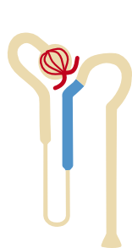
Summary
Early Distal Convoluted Tubule
Late Distal Convoluted Tubule & Collecting Duct
Cortical diluting segment
Impermeable to H₂O
Na/Cl reabsorption
Principal and intercalated cells
Permeable to H2O (ADH-regulated)
Na, H2O, HCO3, K are reabsorbed
K and H are secreted
Thick Ascending Limb
Isosmotic
Load dependent
Na, Cl, K, HCO3, Ca, Mg are reabsorbed
H and K are secreted
Thin Descending Limb
Hyperosmotic
Permeable to H₂0
Permeable to NaCl and urea
Solutes are secreted
Thin Ascending Limb
Hyposmotic
impermeable to H₂0
Permeable to NaCl

Slide 22
Thank you!
اعمل لترسم بسمة، اعمل لتمسح دمعة، اعمل و أنت تعلم أن الله لا يضيع أجر من أحسن عملا.
The Physiology 436 Team:
Female Members:
Lama alfawzan
Ghada Almazrou
Male Members:
Mohammad almutlaq
Team Leaders:
Qaiss Almuhaideb
Lulwah Alshiha
Contact us:
Physiology436@gmail.com
@Physiology436
References:
Girls’ and boys’ slides.
435 Team.
Guyton and Hall Textbook of Medical Physiology (13th Edition).
Linda (5th Edition).
Link to Editing File
Special thanks to Team435’s Leaders: Meshal Alhazmy & Khawla Alammari and members!

