Slide 1
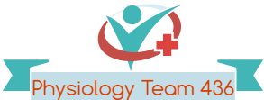
Renal Regulation of Body Fluids
Red: very important.
Green: Doctor’s notes.
Pink: formulas.
Yellow: numbers.
Gray: notes and explanation.
Physiology Team 436 – Renal Block Lecture 7
For further understanding please check our “Extra Notes” file which contains extra explanation from reference books.

Slide 2
Objectives
Identify and describe the role of the Sensors and Effectors in the renal regulation of body fluid volume & osmolality
Describe the role of the kidney in regulation of body fluid volume & osmolality
Understand the role of ADH in the reabsorption of water and urea
Identify the site and describe the influence of aldosterone on reabsorption of Na+ in the late distal tubules.

Slide 3
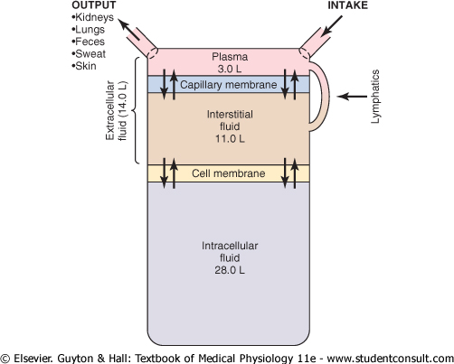
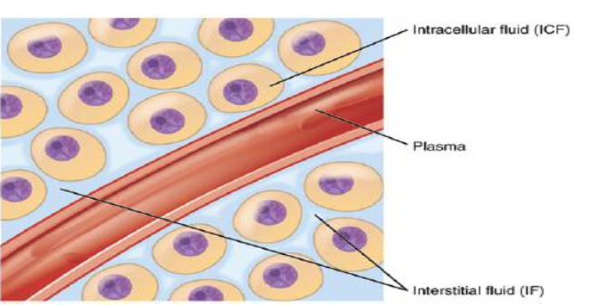
Recall from Foundation: Body Fluids
Fluid Compartments
Extracellular fluid
Plasma
Interstitial fluid
Intracellular Fluid
Transcellular fluid
Pericardial "around heart"
Peritoneal "in abdominal cavity"
CSF "in brain"
Synovial "in joints"
Digestive Secretions
Pleural
Major Body Fluid Compartments

Slide 4
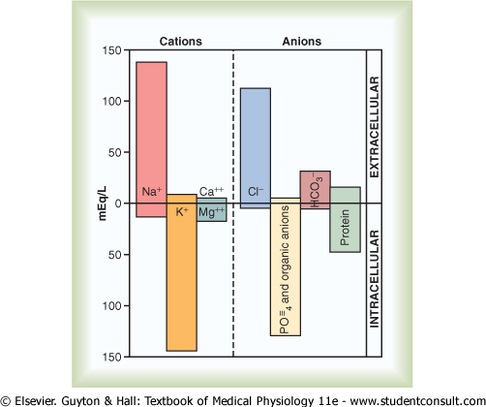
Recall From Foundation: Body Fluids IC vs EC
Intracellular Fluid
Potassium (K) is the chief cation (+)
Phosphate is the chief anion (-)
Extracellular Fluid
Sodium (Na) is the chief cation (+)
Chloride (Cl) is the chief anion (-)
Ionic composition is very different between extracellular and intracellular.
(Means the balance or the amount of Na+ and K+ in extra-intra-cellular, but not the charge).
Total ionic concentration is very similar
(means the amount of the positive charges of K should be equal or nearly equal to the amount of positive charge of Na+).
Total osmotic concentrations virtually identical.
(means the balance between extra-intra-cellular are maintained by the permeability of the cell membrane).

Slide 5
Regulation of Volume & Osmolality
Body water balance must be maintained. Kidneys concentrate or dilute urine. (as a response for any change of the fluid volume).
To remain properly hydrated, water intake must equal water output. Increases in plasma osmolality trigger thirst and release of antidiuretic hormone (ADH).
The volume of the body fluid don’t have certain receptor to detect the change of the fluid volume but it has sensors

Slide 6
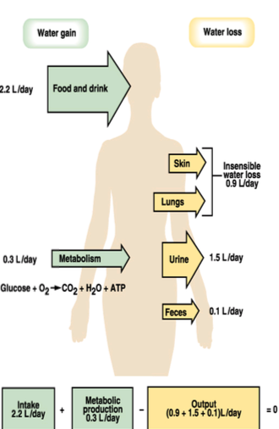
Water Steady State
Amount ingested = amount eliminated.
Pathological losses:
Vascular bleeding
vomiting
diarrhea
if those pathological conditions occur we need to increase input to maintain steady state

Slide 7
Control of Circulating Volume
Volume sensors
Vascular
High pressure
Low pressure
Central nervous system
Hepatic
All down to Na+ balance i.e. absorption & excretion.
Absorption or excretion of Na will facilitate the reabsorption and excretion for other electrolyte e.g. ; water
Volume sensors: (Effective pressure receptors)
• Vascular: 1) Low pressure sensors: Sensors that are found in the low pressure area such as atria (right atrium > venous blood)
Cardiac atria (ANP), pulmonary vasculature.
2) High pressure:
Sensors that are found in the high pressure area
Carotid sinus, aortic arch and juxtaglomerular apparatus of the kidney.
• Central nervous system.
• Hepatic.
High and low pressure is due to their location; High pressure is found in places where pressure is high and vice versa

Slide 8
Volume Sensor Signals: Neural
Volume sensor signals/Mediators:
If the pressure decreased↓ , Renal sympathetic will be stimulated and causes :
a) Afferent & Efferent arterioles constrict:
GFR decreased.
Less Na+ filtered.
More Na+ absorbed by PCT. (Proximal convoluted tubule)
b) Renin released :
increase Aldosterone secretion. (to increase the Na+ reabsorption)
increase angiotensin II formation. (vasoconstriction)

Slide 9
Control of Circulating Volume: Hormonal
1. Renin-angiotensin-aldosterone system ( decrease pressure):
Renin secreted by:
a) Sympathetic stimulation b) decrease perfusion pressure c) decrease Na+ reaching macula densa.
Angiotensin II:
a) Aldosterone release by adrenal cortex. Aldosterone increase Na+ reabsorption in TAL, DT, CD.
c) Vasoconstriction.
d) ADH release.
e) increase Na+ reabsorption in PCT.
2 .ANP : (Atrial natriuretic peptide)
Released from atrial myocytes by stretch of atrium, thus increase NaCl & water excretion.
Antagonist of renin-angiotensin:
Vasodilation of afferent arteriole,
Vasoconstriction of efferent ;i.e. increase GFR
Decrease Renin release.
Direct decrease aldosterone release.
Decrease Na+ reabsorption in CD (collecting duct)
Decrease ADH release.
Low pressure → RAAS High pressure → ANP
ANP opposite to Aldosterone

Slide 10
Actions of Angiotensin II
Second action: (Vascular actions)
Angiotensin II is one of the most potent vasoconstrictors known.
Constriction of vascular smooth muscle leads to a prompt rise in blood pressure.
It plays an important role in maintaining vascular tone and blood pressure in volume depleted states, for example haemorrhage and fluid depletion.
First action:
Angiotensin II receptors are found on the zona glomerulosa cells of the adrenal cortex.
Activation of these receptors leads to an immediate and rapid increase in Aldosterone secretion.
Aldosterone acts on the distal tubule and collecting duct to cause sodium retention.
This is likely to be an important mechanism for determining long-term sodium balance.
Adrenal gland is the suprarenal gland and its composed of cortex and medulla so the receptors of AngII are located in the zona glomerulosa cells in the cortex of adrenal gland
long term because it will stimulate aldosterone and after that aldosterone will regulate sodium balance .
Aldosterone Action : DT & CD > sodium retention = sodium reabsorption.

Slide 11
Regulation of volume & osmolality
Large water intake
Hypoosmotic urine
Diluted urine (~ 50 mOsm/kg)
Large volume (up to 18 L/day)
Low water intake
Hyperosmotic urine
concentrated urine
(up to 1200 mOsm/kg)
small volume (0.5 L/d)
Increase water intake = Decreased osmolality = Diluted urine = Hypoosmotic.
Dehydration contributes to concentrated urine = Hyperosmotic.
we need to keep the balance of the main solute of the body with normal range as well as water balance
( constant osmolality of blood ) .
Renal water excretion mechanisms independent of solute excretion
which allows water balance maintenance without damaging solute homeostasis (e.g. Na+, K+).

Slide 12
Antidiuretic hormone (ADH)/ Vasopressin
Characters of ADH:
Prevents water loss.
Small protein hormone (formed only by 9 amino acids).
Fast acting, short half life in the circulation.
Stimulates thirst center, also thirst will stimulate secretion of ADH.
Antidiuretic hormone (ADH):
It is synthesized in neuroendocrine cells located within the supraoptic
and paraventricular nuclei of the hypothalamus.
The synthesized hormone is packaged in granules that are transported down the axon of the cell and stored in nerve terminals located in the neurohypophysis in the posterior lobe of pituitary gland.
ADH is synthesized in hypothalamus and secreted by posterior pituitary gland .Its main action is to stimulate water reabsorption.
Its structure is protein hormone (small amino acid number )
short half life means once it release it will produce action and metabolized
one of triggers of ADH → thirst
If we have hyperosmotic plasma → increase release of ADH.
If we have hypoosmotic plasma → decrease ADH release.
hemodynamic indicates changes in BP and BV
ANP is stimulated by increased BV→ stretch the wall of atrium → release of ANP that decrease BV → so it will inhibit ADH release .
Dr ahmed mentioned that: ADH is synthesized by the hypothalamus and secreted by the
posterior lobe of pituitary gland, that’s why we mentioned it’s synthesized in neuroendocrine cells.

Slide 13
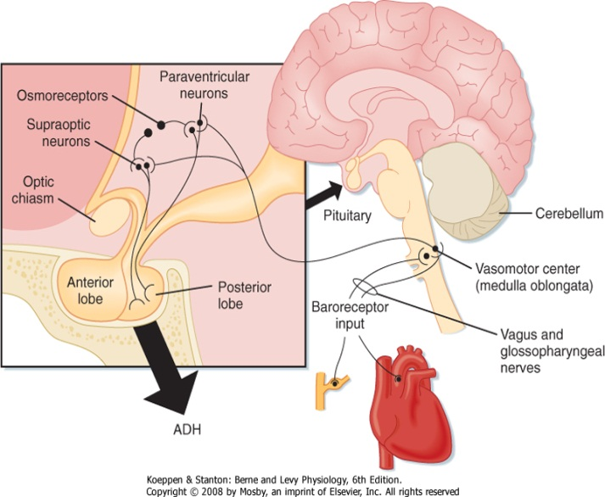
Antidiuretic hormone (ADH) / Vasopressin
Factors influencing ADH release:
Osmolality.
Increased osmolality will stimulate secretion of ADH, also low osmolality will suppress secretions of ADH.
Haemodynamic factors.( BP – V )
What meant by factors either hypovolemia or hypervolemia
يعني لو زاد الحجم او الضغط قل إفرازه والعكس
Nausea → will stimulate ADH release.
Atrial nitric peptide (ANP) → will inhibit ADH release.
Angiotensin II → will stimulate ADH release.
Explanation of the diagram:
Baroreceptors detect pressure changes → send signals to the vasometer center in medulla oblongata → which will send signals to the supraoptic and paraventricular nuclei of the hypothalamus to synthesize the hormone.
*Colored with red are the Main physiological factors

Slide 14
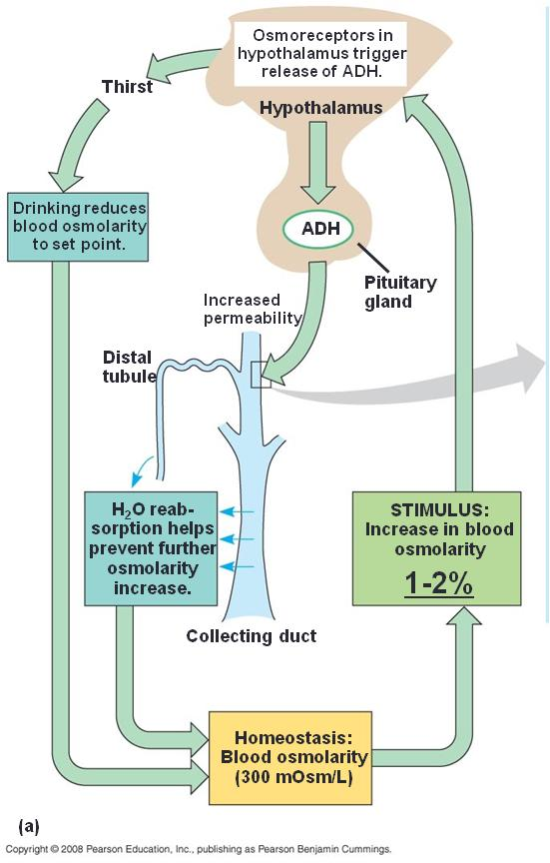
In normal situations: osmolarity = 300
A 1-2 % increase in osmolarity ( even if it’s the osmolarity in the hypothalamus interstitium ) will trigger the release of ADH --> will increase permeability of distal portion of the nephron
→ Increase reabsorption of water + stimulation of thirst center→ osmolarity isback to normal

Slide 15
Osmolality
Osmolality estimation:
A rough estimate of ECF osmolality can be obtained by doubling Plasma sodium concentration.
Example:
{ 145 mEq/l X 2 = 290 (Normal 285-295 mOsm/kg H2O) }
Sodium concentration gives best estimate of effective osmolality of ECF.
Above 295 → increased osmolality → increased ADH secretion.
Under 285 → decreased osmolality → decreased ADH secretion.
Clinically:
In clinical situations glucose & urea concentrations (mmols) are also taken into account,
useful in cases of patients with diabetes mellitus or chronic renal failure.
Neither glucose or urea are effective osmoles ,they do not shift fluid between ECF & ICF.
Non-absorbed glucose in kidney tubule can however prevent fluid absorption
generating an osmotic diuresis.* الجلوكوز يسحب الماء معاه
*Osmotic diuresis is increased urination due to the presence of certain substances in the fluid filtered by the kidneys.
This fluid eventually becomes urine. These substances cause additional water to come into the urine, increasing its amount.
Also potassium levels are important but we have to consider if the patient is dehydrated or not.
↑ osmolality ⇒ ADH release
↓ blood volume ⇒ ADH release
If you double the amount of Na+ , this equals the plasma osmolality (290).
glucose and urea account for plasma osmolality but they will not cause fluid shift (fluid shift = reabsorption of water ).

Slide 16
Osmolality
Osmoreceptors :
Are usually found in hypothalamus outside blood-brain barrier.
It will detect changes in osmolality and stimulate the secretion of ADH.
Set point : ~ 280 – 285 mOsm/kg H2O
“At this range the osmoreceptors won’t stimulate the secretion of ADH as the osmolality is still considered low and therefore your body will not see the need to secrete ADH to balance out the osmolality”
Osmoreceptors sense any changes in plasma osmolality and they are located in hypothalamus.
Set point : The point at which increase in the plasma osmolality will stimulate ADH to be released.
( Exceeding normal plasma osmolality ).
Diagram explanation: When it increase above the normal range this stimulate release of ADH. As the plasma osmolality increases the ADH release increases. (Directly proportional)
If there's a slight increase in osmolality ( shift in the set point ) → ADH release

Slide 17
Blood volume
Decreased blood volume
will stimulate ADH release.
د.منى قالت انه اول سطر بس المهم
It’s less sensitive than osmolality.
To stimulate ADH secretion you’ll need
a significant amount of blood to be lost.
(5%-10% of the blood).
Changes in blood volume/pressure
affect osmolality so any change in the osmolality above or lower than the set point would either stimulate or suppress the secretion of ADH.
↓ volume/BP ⇒ ↓ set point steeper ”sharp” curve.
1-2% increase in osmolarity → ADH
5-10% decrease in volume → ADH
If the blood volume decreases (drop blood pressure) I need ADH to preserve the blood volume and correct the BP
Osmolality is more potent stimulant of ADH than blood volume.
We need 5-10% drop in Blood volume in order to start stimulating ADH.
Decreased Blood volume = Increased osmolality.

Slide 18
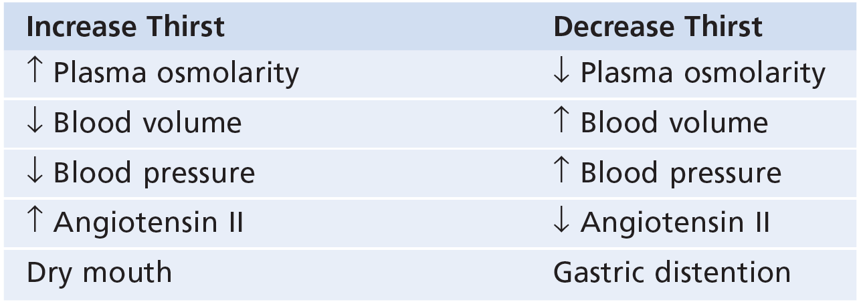
Control of ADH secretion
ONLY IN MALES’ SLIDES
NOT IMPORTANT

Slide 19
ADH renal target
ADH doesn’t effect all parts of the nephron, it effects:
Collecting duct cells only permeable to water in presence of ADH.(مهم جدًا )
مايشتغل الا بجهاز الي اهو CD
ADH
ADH causes in increased urea permeability
in inner medullary collecting ducts.
ADH stimulates reabsorption of NaCl by the thick ascending limb of Henle’s loop and by the distal convoluted tubules and cortical segment
of collecting ducts. (هذي الجمله د. منى حذفتها عشان مانتلخبط )
In the previous lecture we said that the collecting duct & DCT are permeable to water only in the presence of ADH which mean that they are hormone-dependent.

Slide 20
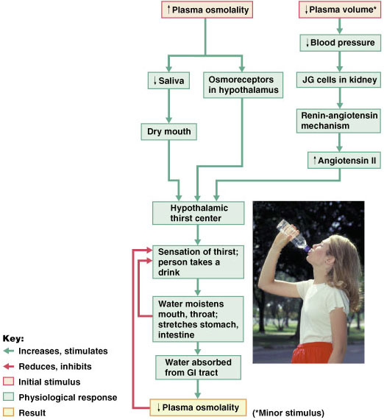
Regulation of water intake
The hypothalamic thirst center is stimulated by:
1- a decline in plasma volume of 10%–15%
2- increases in plasma osmolality of 1–2%
Baroreceptor
input will be stimulated by sympathetic division, angiotensin II will be secreted, and other stimuli and all of the previously mentioned will stimulate secretion of ADH.
Thirst is quenched as soon as we begin to drink water, feedback signals that inhibit the thirst center include:
Moistening of the mucosa of the mouth and throat.
Activation of stomach and intestinal stretch receptors.
Baroreceptors sense the drop in BP it will stimulate thirst center → blood volume correction as well as blood pressure.
Once you sense the thirst and drink water the feedback mechanism will be inhibited – when water reaches the stomach will inhibit the thirst center.
“Quenched : overcome”

Slide 21
Thank you!
اعمل لترسم بسمة، اعمل لتمسح دمعة، اعمل و أنت تعلم أن الله لا يضيع أجر من أحسن عملا.
The Physiology 436 Team:
Female Members:
Najd AlTheeb
Munirah Aldofyan
Male Members:
Fouad Bahgat
Team Leaders:
Qaiss Almuhaideb
Lulwah Alshiha
Contact us:
Physiology436@gmail.com
@Physiology436
References:
Girls’ and boys’ slides.
435 Team.
Guyton and Hall Textbook of Medical Physiology (13th Edition).
Linda (5th Edition).
Link to Editing File
Special thanks to Team435’s Leaders: Meshal Alhazmy & Khawla Alammari and members!

