Slide 1



Basics of Acid Base
Balance
Red: very important.
Green: Doctor’s notes.
Pink: formulas.
Yellow: numbers.
Gray: notes and explanation.
Physiology Team 436 – Renal Block Lecture 9
For further understanding please check our “Extra Notes” file which contains extra explanation from reference books.

Slide 2
Objectives
Lecture: 9
Define: acid and base.
Explain what is meant by strong and weak acids and bases.
List and identify the names/formulas for the common strong acids and strong bases.
To explain the role of Henderson-Hasselbalch equation in acid-base regulation.
Lecture 10 & 11
To define buffer system and discuss the role of blood buffers and to explain their relevant roles in the body.
To describe the role of kidneys in the regulation of acid-base balance
To describe the role of lungs in the regulation of acid-base balance
To explain the principles of blood gas and acid-base analysis
To interpret blood gas analysis and diagnose various acid base disorders
Describe causes of acid base disorders
Understand use of acid base nomograms

Slide 3
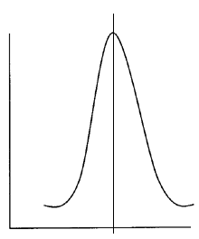
Acid – Base Balance
Acid – Base balance ( as known as pH HOMEOSTASIS ) : one of the essential functions of the body, it is concerned with the precise regulation of free (unbound) hydrogen ion concentration in body fluids.
When discussing acid - base balance, we are normally concerned with regulation of H+ ion balance ( although HCO3- plays a vital role in this balance ).
To avoid disturbances in [H+], and to maintain its homeostasis :
the amount generated / taken in MUST EQUAL the amount secreted.
(e.g. hydrogen bonding and charge on proteins
altered by pH so tertiary structure and function affected.)
Why is control of [H⁺] so important?
1- Highly reactive chemical species (protons).
combine easily with negatively charged ions and bases
3- Precise [H⁺] regulation is vital because activity of almost all enzyme systems / proteins (inc. ion channels) influenced by pH
2- Most enzymes function optimally at pH ~ 7.4
( except gastric enzymes )
So slight deviation in H⁺ have profound effects on enzyme and protein activity and thus the body’s metabolic activity in general.
4- Acid-base imbalances can cause cardiac arrhythmias and abnormal neuronal excitation due to its affect on K⁺ levels in the body.
Enzyme activity
7.4
pH
Enzymes of the body can’t function properly if the H+ ions balance is disturbed

Slide 4
Acid – Base Balance
Definitions ( Bronsted-Lowry )
ACIDS : Molecules containing hydrogen atoms that can release ( Donate ) H⁺ into solution.
( e.g. HCl (hydrochloric aicd) ⇔ H⁺ + Cl⁻ , H₂CO₃ (carbonic acid)).
Classified to :
BASES (alkalis) : ions or molecules that can ( Accept ) H⁺. (e.g., HCO₃⁻ (Bicarbonate ions), Hydrogen phosphate HPO₄⁻²)
Classified to :
Proteins in body function as weak bases as some constituent amino acids have net negative charge and attract H+ (e.g. HAEMOGLOBIN).
Strong acid
all their H+ is dissociated completely in H₂O
Weak acid
dissociate partially in H2O and are efficient at preventing pH changes
Weak base
dissociate easily in H₂O and quickly bind H⁺
Strong base
accept H⁺ more slowly (e.g., HCO₃⁻ and NH₃)
HCO3- has negative charge → it can accept hydrogen ion to form carbonic acid.
Proteins are negatively charged, they accept H+ ions and behave as weak bases.

Slide 5
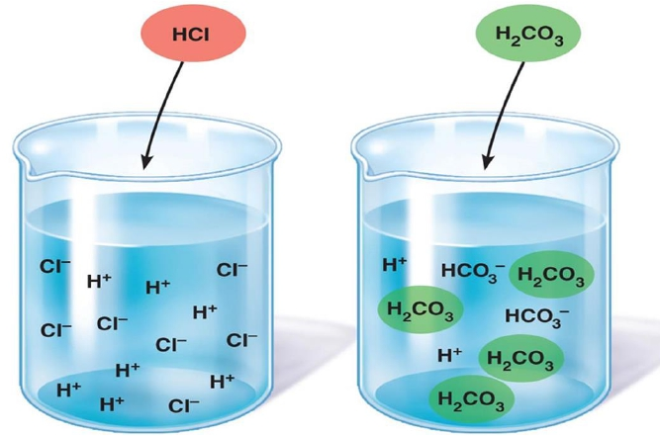
Acid – Base Balance
Definitions ( Bronsted-Lowry )
Strong acids dissociate rapidly and release large amounts of H⁺ in solution.
Weak acids dissociate incompletely and less strongly releasing small amounts of H⁺ in solution.

Slide 6

ONLY IN FEMALES’ SLIDES
Free hydrogen ions are extremely unstable. Therefore, for any acid and any base, the equilibrium established is:
Base
Conjugate Acid
Acid
Conjugate Base
Every acid has a conjugate base associated with it, and vice versa.
Water usually is amphoteric compound depend on the added compound (acidic or basic)
When water behaves as a base, it accepts H+ and forms a hydronium ion; H3O+
When it behaves as an acid, it loses a proton and forms a hydroxide ion; OH-
A conjugate base : is the particle that is left over after the acid loses its hydrogen ion
This is general equation but we can replace A with chloride or any other elements so the same equation has to be established.
The hydronium ion concentration can be found from the pH by the reverse of the mathematical operation employed to find the pH
amphoteric : substances that can act as an acid or as a base.

Slide 7
Physiologically important Acids and Bases
ONLY IN MALES’ SLIDES
Physiologically important acids include
Carbonic acid
(H2CO3)
Pyruvic acid
(C3H4O3)
Physiologically important bases include
Bicarbonate
(HCO3- )
Biphosphate
(HPO4-2 )
Lactic acid
(C3H6O3)
Phosphoric acid
(H3PO4)
In bones
These acids are dissolved in body fluids “Fixed acids”

Slide 8
pH
ONLY IN FEMALES’ SLIDES
What is pH ?
The pH of a solution is a measure of the acidity of the solution not the strength of an acid, so it is the H⁺ ion concentrations. (normal pH= 7.35 – 7.45)
pH = -log (H⁺) , When H⁺ increases > pH decreases and vice versa.
It is defined as :
Where [H3O+] is the concentration of hydronium ions in the solution
The pH of water is 7. This means that a solution of pure water has a 10–7 mol dm–3 of hydronium ions.
The acid in the question
The concentration of the solution
pH depends on two things:
if we have two equally concentrated solutions of acids, the solution of a strong acid will have a lower pH than that of a weak acid, because it is more fully dissociated and therefore produces more H₃O⁺ ions. HCl, for example, is completely dissociated.
If we have two solutions of the same acid, the more concentrated solution will have more free H₃O⁺ ions and therefore a lower pH.
For example, if we have 2 concentrations of the same acid (HCL) :
HCl = 5 mEq / HCl = 10 mEq
The HCl with 10 mEq will have lower pH thus it will be more acidic

Slide 9
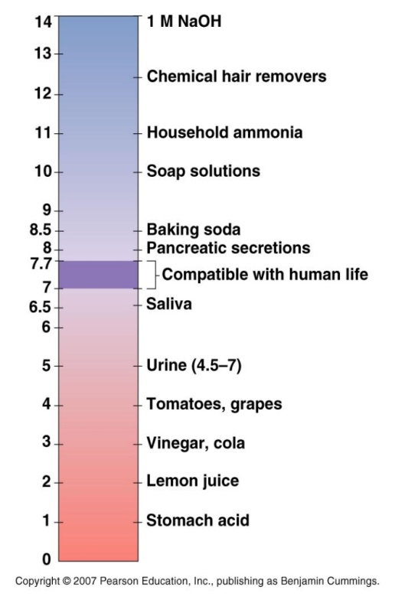
Acid – Base Balance pH Scale (Sørensen, 1909)
Relative to other ions, [H+] of body fluids kept VERY LOW
e.g., ECF [Na+] ≈ 145 mM/L
ECF [H+] ≈ 0.00004 mM/L (40nM)
(~ 3.5 million fold difference).
Because [H⁺] so low, easier to express
[H⁺] on a logarithmic scale ⇒ pH units.
Normal pH = -log [0.00000004]
= 7.4
1
pH = log = - log [H⁺]
Free hydrogen ions in the body are very low that’s why we use Logarithm to calculate it.
[H⁺]
Guyton corner :
Equally important, the normal variation in H+ concentration in extracellular fluid is only about one millionth as great as the normal variation in sodium ion (Na+) concentration. Thus, the precision with which H+ is regulated emphasizes its importance to the various cell functions.
Linda corner:
When using pH instead of H+ concentration, there are two points of caution. First, because of the minus sign in the logarithmic expression, a mental reversal is necessary: As H+ concentration increases, pH decreases, and conversely. Second, the relationship between H+ concentration and pH is logarithmic, not linear. Thus, equal changes in pH do not reflect equal changes in H+ concentration.

Slide 10
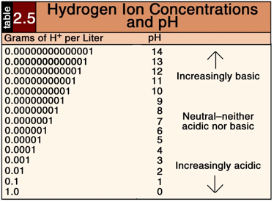
Acid – Base Balance pH Scale (Sørensen, 1909)
ONLY IN FEMALES’ SLIDES
Note that a change of 1 pH unit = 10x change in [H+] (log₁₀ scale)

Slide 11
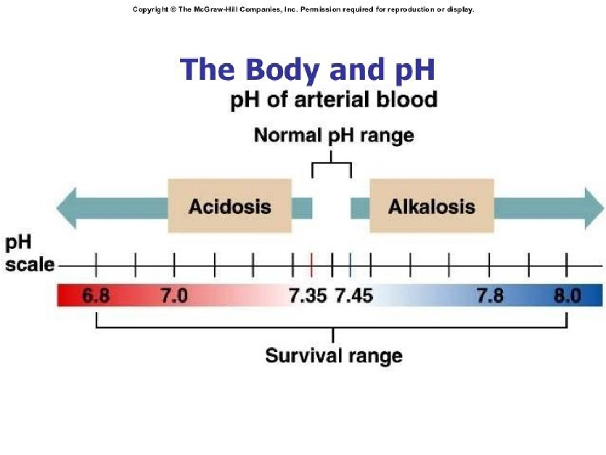

Acid – Base Balance pH Scale (Sørensen, 1909)
pH INVERSELY related to [H+]
as [H+] ↑, pH ↓ – acidosis (below 7.35)
as [H+] ↓, pH ↑– alkalosis (above 7.45)
Normal BLOOD pH
range for adults = 7.35 – 7.45
maintained by chemical buffer systems, kidneys and lungs.
In pH, even the slight change is taken in consideration, as when pH = 7.34 it is acidic ..
As when someone takes Aspirin overdose it makes the blood very acidic and the pH becomes below 6.8 causing death if gastric lavage is not performed ..
The normal pH is slightly basic which may be because the body does a lot of acidic processes so we are at more risk of acidosis.
Increasing or decreasing pH (even with a small range) should be fixed immediately to prevent damage.
pH range Compatible with human life = (6.8-7.8).
It likely cause Death: if the pH is higher or less than this range

Slide 12
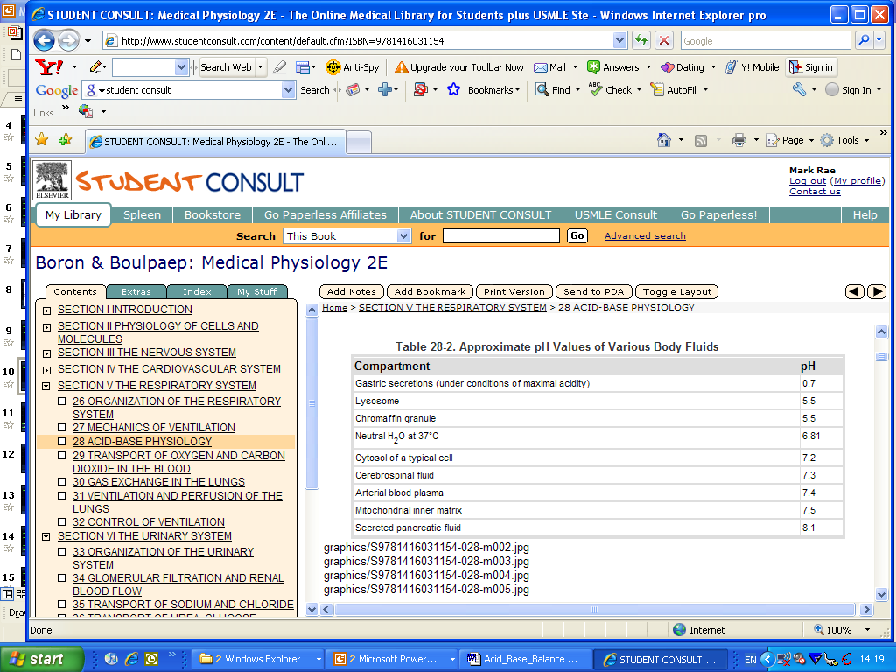
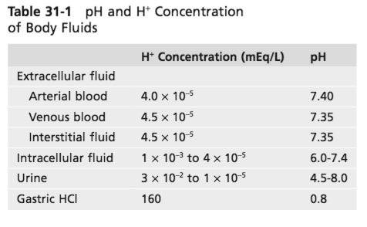
Acid – Base Balance pH Scale (Sørensen, 1909)
ONLY IN FEMALES’ SLIDES
There are a range of pH values within different body fluids - dependent on function.

Slide 13
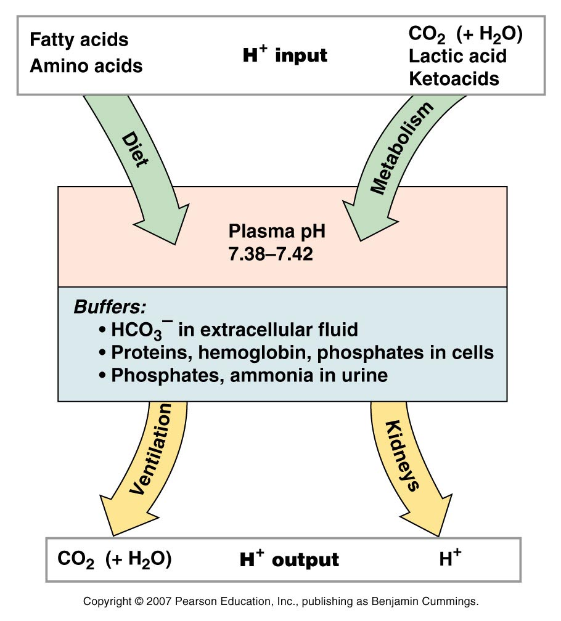
Sources of H+
Hydrogen and pH Balance in the Body
The body generally PRODUCES more acids than bases.
1) Cellular aerobic metabolism produces 15,000 mmol CO2/day
CO2 + H20 ↔ H2CO3 ↔ H⁺ + HCO3⁻ (volatile acid)
Normally all volatile acid excreted by the lungs.
2) DIET : incomplete anarobic metabolism of carbohydrates (lactate), lipids (ketones) and proteins (H2SO4 , H3PO4 ) generates fixed (non-volatile) acids ~50 -100 mEq per day.
In order to maintain balance, acids need to be BUFFERED and/or EXCRETED.
Catabolism of SULFUR containing amino acid AA gives H₂SO₄(sulfuric acid
• CO2 is an important source of acidity.
• Buffer
• Excretion by lungs CO2
• If there’s no wash out of CO2 it will bind to water > High H⁺> Acidosis
  Catabolism of phospholipids/ phosphoproteins gives H₃PO₄ ( phosphoric acid)

Slide 14
How is [H+] Controlled?
Three systems involved :
1) BUFFERS
• First defense
• second to second regulation of [H+]
2) Excretion of CO2 (↓H2CO3) by LUNGS (removal of volatile acid)
• Second defense
• regulation in minutes - to – hours
3) Excretion of H+ (↑HCO3-) by KIDNEYS (fixed acids)
• Third defense
• regulation over several hours to days
• slowest, but most POWERFUL, of body’s acid-base regulatory systems.
Buffers has the ability to do immediate regulation for the pH but it only limits the change without eliminating it.
Lungs work better with respiratory problems (like respiratory acidosis and alkalosis)

Slide 15
Henderson-Hasselbalch Equation
هذي معادلة تقيس البي اتش باستخدام العلاقة بين تركيز ثاني أكسيد الكربون والبايكاربونيت في الدم .. يعني نحتاج فيها
Blood sample
Details are not important just know how to calculate the pH
It’s a Relative concentrations of CO2 and HCO3 - in plasma / ECF , determine pH.
Show the relationship between pH, hydrogen ion concentration and the ratio of buffer membrane in a solution.
log [HCO3⁻]
PH= is the negative logarithm of H+ in mol/L.(tells us how acidic a solution is).
PK= is negative logarithm of overall dissociation constant for the reaction = 6.1 in health. (tells us how acidic or not a given hydrogen atom in a molecule is).
S= is solubility of CO2 in solution = 0.03 at 37ºC. In health, [HCO3-] = 24 mmol/L & PCO2 = 40 mm Hg
pH = pK’ +
S (PCO₂)
log [HCO3⁻]
pH = 6.1 +
0.03 (PCO₂)
7.4 = 6.1 + 1.3

Slide 16
What happen to the pH using H-H ?
In case if the HCO3 in Plasma remains normal
If Pco2 increased, the ratio of [HCO3]P/ 0.03 Pco2 will decrease which lead to acidosis.
If Pco2 decrease, the ratio will increase and pH will increase causing alkalosis.
In case the Pco2 remains normal
Increase bicarbonate in plasma causes an increase in the ratio which leads to alkalosis.
Decrease in bicarbonate in plasma causes a decrease in the ration which leads to acidosis.

Slide 17
Body Fluid Buffers
Don’t worry about the number of slides; they are mostly pictures to help you understand
Red: very important.
Green: Doctor’s notes.
Pink: formulas.
Yellow: numbers.
Gray: notes and explanation.
Physiology Team 436 – Renal Block Lecture 10
For further understanding please check our “Extra Notes” file which contains extra explanation from reference books.

Slide 18
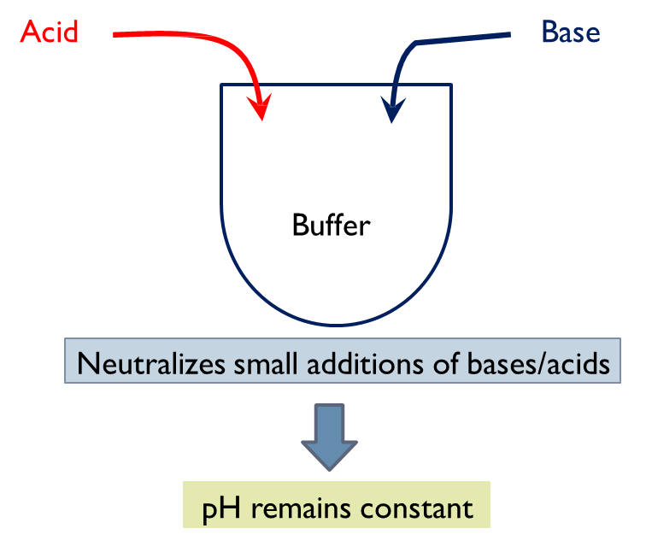
What is a Buffer?
ONLY IN FEMALES’ SLIDES
A buffer: a solution that resists changes in pH upon addition of small amount of acids and bases.
A buffer: is a mixture of a weak acid and a weak base that are in equilibrium.
Made of:
A weak base and its conjugated acid
A weak acid and its conjugated base
NH3 & NH4+
H2CO3 & NaHCO3-

Slide 19

Control of [H+] - Buffers
ONLY IN MALES’ SLIDES
Buffer is substance that stabilizes (limits the change of) [H+] when H+ ions are added or removed from a solution.
They do not eliminate H+ from body , REVERSIBLY bind H+ until balance is re-established.
General form of buffering reaction usually in form of conjugate acid-base pair:
Reaction direction and dissociation rate dependent on effective concentration of each chemical species.
If :
[H+ ]↑ then equation moves Leftwards.
[H+ ]↓ then equation moves Rightwards - minimises changes in [H+].
HA = undissociated acid
A- = conjugate base (any anion)

Slide 20
Buffer system
Buffer system
Chemical buffer system
Physiological buffer system
“First line of defense against pH shift”
[H+] act within seconds.
Some are more powerful extracellularly and others are more powerful intracellularly.
“Second line of defense against pH shift”
1- Bicarbonate buffer system
2- Phosphate buffer system
3- Protein buffer system
4- Bone buffer system ( only in males slides )
1- Respiratory mechanism (CO2 excretion)
2- Renal mechanism
3- (H+ mechanism)

Slide 21
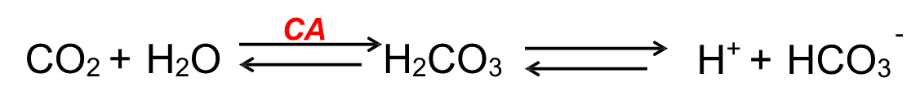
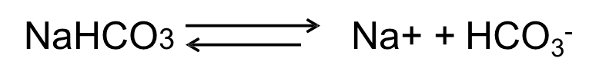

Chemical buffering system
Bicarbonate buffer is the most important
1- Bicarbonate buffer system :
Most important buffering system and the main ECF buffer system.
Works by acting as proton acceptor for carbonic acid.
Composed of:
A weak acid (H2CO3).
Its conjugated base (NaHCO3).
ONLY IN FEMALES’ SLIDES
To maintain pH of 7.4, HCO₃⁻ : H₂CO₃ = 20:1 – if ratio
changes, so too will pH.
When enough [H⁺] added to halve [HCO₃⁻], pH would drop
to 6.0, BUT, H₂CO₃ ⇔ H₂O + CO₂ → ventilation↑ and CO₂ is
removed.
∴ buffering means that pH only drops to ~ 7.2.
[H2CO3] very low (6800 x less than HCO3-), difficult to measure but directly proportional
to dissolved arterial [CO2] = Pco2 x solubility coefficient (0.03 for CO2).

Slide 22
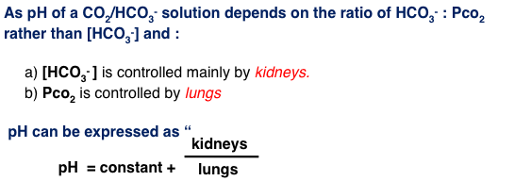
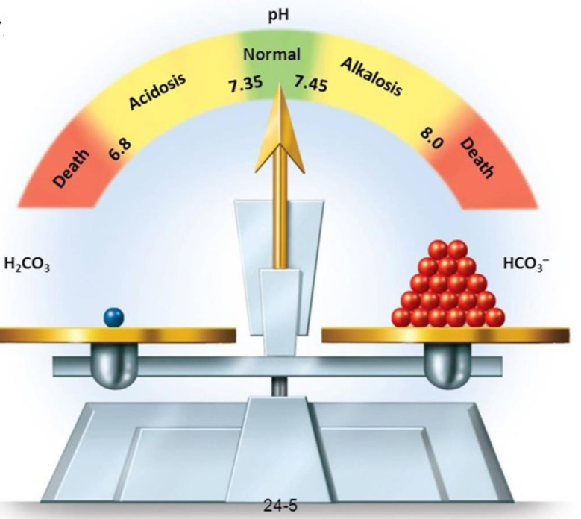
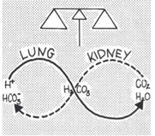
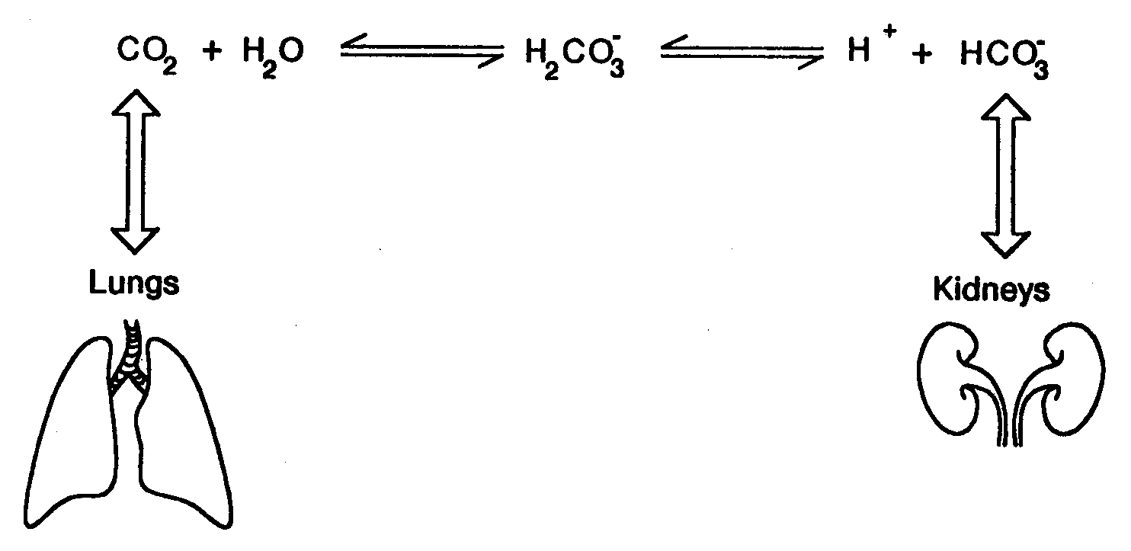
Chemical Buffering System
Buffering power of CO2/HCO3- system (against acids but not bases) usually only limited by depletion of HCO3-
↑↑ HCO₃⁻ will ↑↑ pH
↑↑ PCO2 will ↓↓ pH
Ratio of
^{𝑯𝑪𝑶𝟑 −} is ≈ 20:1
𝑷𝑪𝑶𝟐

Slide 23
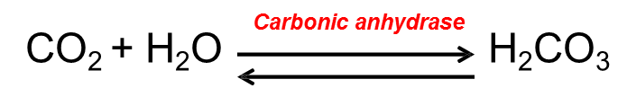
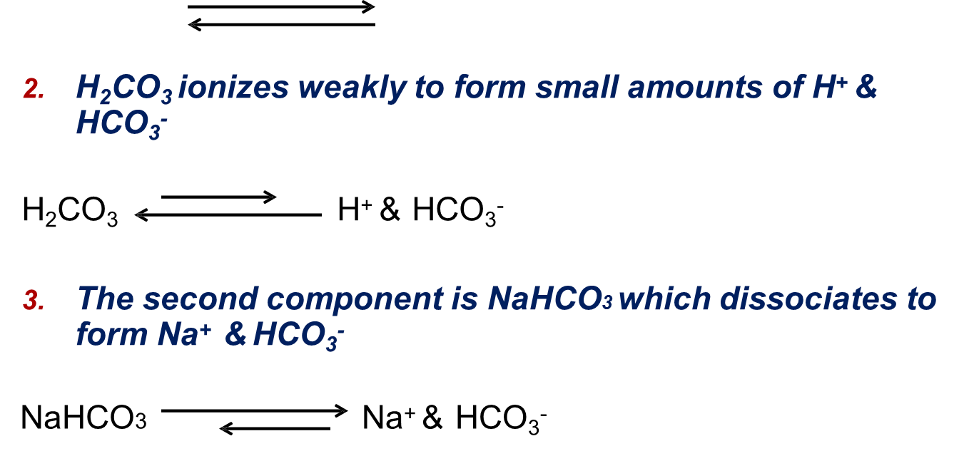

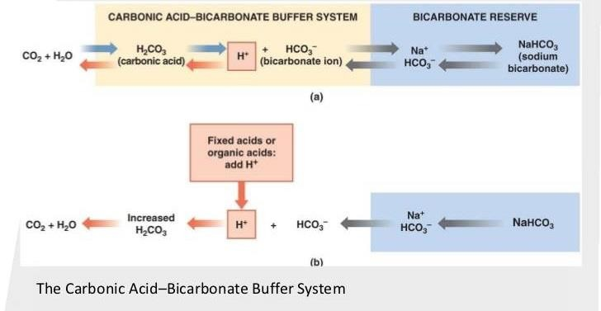
The Bicarbonate Buffer System
ONLY IN FEMALES’ SLIDES
H₂CO₃ forms in the body by the reaction of CO₂ & H₂O
H2CO3 ionizes weakly to form small amounts of H+ & HCO3-
The second component is NaHCO3 which dissociates to form Na+ & HCO3-
Putting all together:

Slide 24
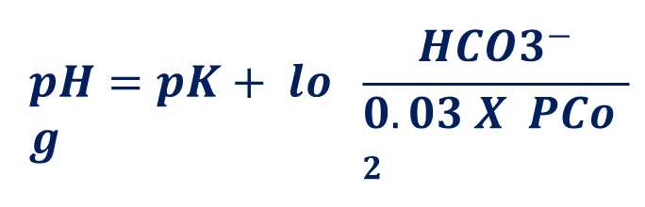
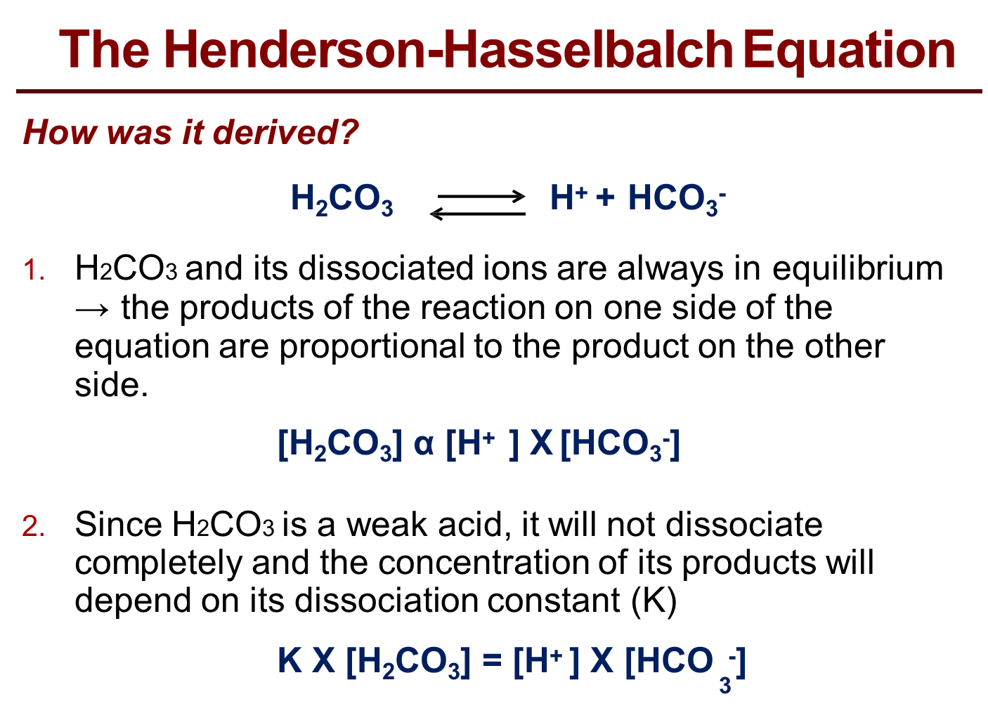
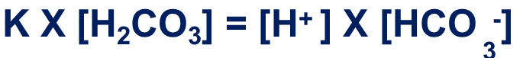
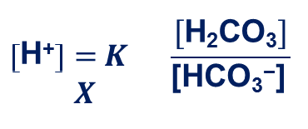
The Bicarbonate Buffer System
Henderson-Hasselbalch Equation
ONLY IN FEMALES’ SLIDES
NOT important
What is the HHE?
It is an equation that enables the calculation of pH of a solution.
What is it?
How was it derived?
1- H2CO3 and its dissociated ions are always in equilibrium→ the products of the eaction on one side of the equation are proportional to the product on the other side.
2- Since H2CO3 is a weak acid, it will not dissociate completely and the concentration of its products will depend on its dissociation constant (K).
3- Based on the previous equation, [H+] can be expressed as follows:
K = dissociation constant, pK = 6.1
Solubility of CO2 = 0.03

Slide 25
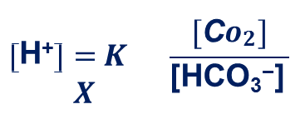

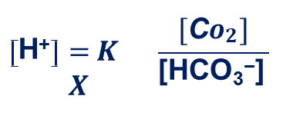
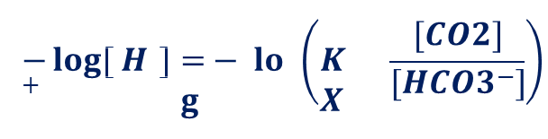
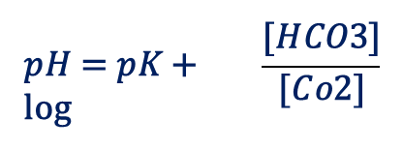
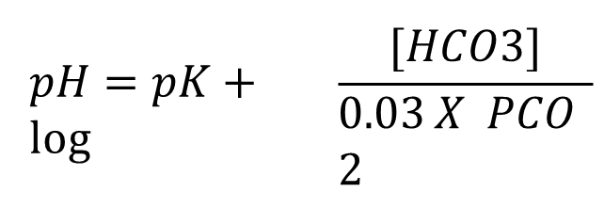
The Bicarbonate Buffer System
Henderson-Hasselbalch Equation
ONLY IN FEMALES’ SLIDES
NOT important
4- Because H2CO3 can rapidly dissociate into CO2 and H2O. And since CO2 is much easier to measure it can replace H2CO3 in the equation:
5- In 1909, Sorensen created the pH scale to express [H+ ]
6- In 1916, Hasselbalch decided to merge Henderson’s equation with Sorensen’s pH scale creating what we now know as the “Henderson-Hasselbalch equation”.
7-Since it is much easier to measure PCO2 rather than dissolved [CO2] and because dissolved CO2 is proportional to PCO2 multiplied by the solubility of CO2 (0.03 mmol/mmHg) → [CO2] was replaced by PCO2 X 0.03
This is Henderson’s
equation(1908)
It means that:
↑ [CO2] →↑ [H+], ↑ [HCO3-] → ↓ [H+]
This is Henderson-Hasselbach equation (1908)

Slide 26

The Bicarbonate Buffer System
Henderson-Hasselbalch Equation
ONLY IN MALES’ SLIDES
At 37°C :
As pH and Pco2 can both easily be measured, possible to estimate [HCO3-]
(normally ~ 24 mEq/L in arterial blood) → Can estimate [acid or base] required to
correct imbalance.
To maintain pH of 7.4 :
HCO3- : H2CO3 = 20:1 [ if ratio changes, so too will pH ]. “Because our bodies produce a lot od acids, we need a lot of base in order to maintain balance” .
When enough [H+] added to halve [HCO3-], pH would drop to 6.0
BUT, H2CO3 ⇔ H2O + CO2 → ventilation↑ and CO2 is removed.
Buffering means that pH only drops to ~ 7.2.

Slide 27
Chemical Buffering System
2-Phosphate Buffering System
Phosphate buffer system is not important as extracellular fluid buffer ( concentration too low ) . " it is an intracellular anion"
However, major intracellular buffer and important in renal tubular fluid.
  Main components are : HPO42- (Hydrogen phosphate) and H2PO4-(dihydrogen phosphate)
H+ + HPO42- ↔ H2PO4-
(Strong acid converted to weak acid ∴ less effect on pH)
OH- + H2PO4- ↔ H2O + HPO42-
(Strong base converted to weak base ∴ less effect on pH)
ONLY IN MALES’ SLIDES

Slide 28
Chemical Buffering System
Protein buffer is the most abundant
3-Protein buffers
Contributes to buffering inside cells.E.g. Hb.
Proteins among most plentiful buffers in body, particularly highly concentrated intracellularly.
~ 60 - 70% of total chemical buffering of body fluids is located intracellularly, mostly due to intracellular proteins.
Carboxyl and amino groups on plasma proteins are effective buffer.
Most important non-bicarbonate buffering proteins are titratable groups on HAEMOGLOBIN (Hb also important for buffering CO2).
“Deoxygenated Hb is a better buffer than oxygenated Hb.”
pH of cells changes in proportion to pH of extracellular fluid.
CO2 can rapidly traverse cell membrane.
ONLY IN MALES’ SLIDES
RCOOH ↔ RCOO- + H+
RNH3+ ↔ RNH2 + H+
CO2 + H2O ↔ H2CO3 ↔ H+ + HCO3-➡️ H+ + Hb- ↔ HHb

Slide 29
4-Bone:
ONLY IN MALES’ SLIDES
Chemical Buffering System
Probably involved in providing a degree of buffering (by ionic exchange) in most acid-base disorders.
However, important source of buffer in Chronic metabolic acidosis (i.e. renal tubular acidosis & uremic acidosis).
CaCO3 (base) “Calcium carbonate” is most important buffer released from bone during metabolic acidosis.
Results in major depletion of skeletal mineral content (e.g. Chronic metabolic acidosis that occurs with renal tubule acidosis (RTA) can lead to development of Rickets / osteomalacia).

Slide 30
Summary of Body’s Buffering Systems
Control of (H(+-Buffers
Remember that all of these buffer systems work in tandem*, NOT in isolation.
Buffers can only limit changes in pH, they cannot reverse them.
Once arterial pH has deviated from normal value, can only be returned to normal by respiratory or renal compensation.
*Tandem : one after the other
ONLY IN FEMALES’ SLIDES
Buffer systems do not work independently in body fluids but actually work together.
A change in the balance in one buffer system, changes the balance of the other systems.
Buffers do not reverse the pH change, they only limit it.
Buffers do not correct changes in [H+] or [HCO3-], they only limit the effect of change on body pH until their concentration is properly adjusted by either the lungs or the kidney.
ONLY IN MALES’ SLIDES

Slide 31
Respiratory Regulation of Acid-Base Balance
ONLY IN MALES’ SLIDES
Respiratory system
2nd line of defence against acid-base disturbances in thebody.
Pulmonary expiration of CO2 normally BALANCES metabolic formation of CO2 .
HOW? By modulating CO2 excretion
Changes in alveolar ventilation can alter plasma Pco2 ↑ [H⁺] → ↑ ventilation, ↓Pco2 , ↑pH ↓ [H⁺] → ↓ ventilation, ↑ Pco2 , ↓ pH Normally, PCO2 = 40 mmHg (35-45 mmHg)
Changes in [H+ ] also alters ALVEOLAR VENTILATION.
POWERFUL (1-2 x better than extracellular chemical buffers), but cannot fully rectify disturbances outside respiratory system, i.e. with fixed acids like lactic acid.
Acts relatively RAPIDLY to stop [H+ ] changing too much until renal buffering kicks in but DOES NOT eliminate H+ (or HCO3 - ) from body.
Abnormalities of respiration can alter bodily [H+ ] resulting in; RESPIRATORY ACIDOSIS - Or - RESPIRATORY ALKALOSIS.

Slide 32
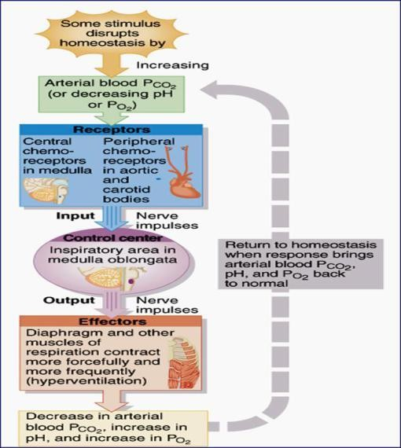
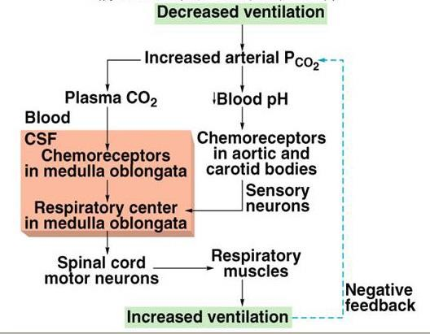
Respiratory Regulation of CO2
ONLY IN FEMALES’ SLIDES

Slide 33
Renal regulation of Acid-Base Balance
ONLY IN MALES’ SLIDES
Renal system
MOST EFFECTIVE regulator of pH but much SLOWER (i.e. max. activity after 5-6 days) than other processes.
Responsible for ELIMINATING the 80 -100 mEq of fixed ACIDS generated each day.
Normally, must also PREVENT renal LOSS of freely – filterable HCO3 - in order to preserve this primary buffer system.
BOTH PROCESSES are dependent on both H+ filtration / secretion into renal tubules and secretion / reabsorption of plasma [HCO3 - ].
Kidneys also responsible for COMPENSATORY CHANGES in [HCO3 - ] during respiratory acid-base disorders.
ONLY IN FEMALES’ SLIDES
3rd line of defence against acid-base disturbances and the most powerful.
It regulates by excreting either an acidic or basic urine.
HOW?
Secreting H+
Reabsorbing HCO3-
Generating “new” bicarbonate ions.
IF KIDNEYS FAIL, pH BALANCE WILL FAIL

Slide 34
Renal regulation of Acid-Base
ONLY IN MALES’ SLIDES
Overall mechanism straightforward:
- large [HCO3 - ] continuously filtered into tubules
- large [H+ ] secreted into tubules
if more H+ secreted than HCO3 – filtered
= a net loss of acid → ↑pH
if more HCO3 - filtered than H+ secreted
= a net loss of base → ↓pH

Slide 35
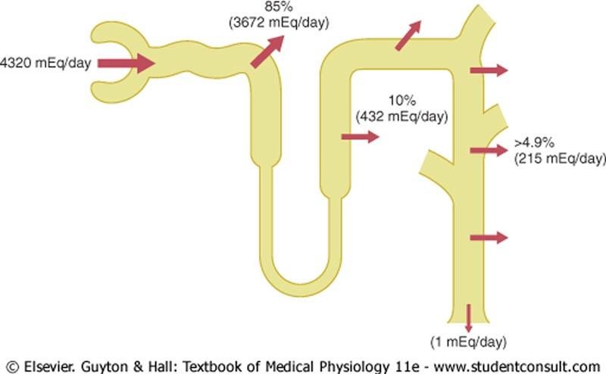
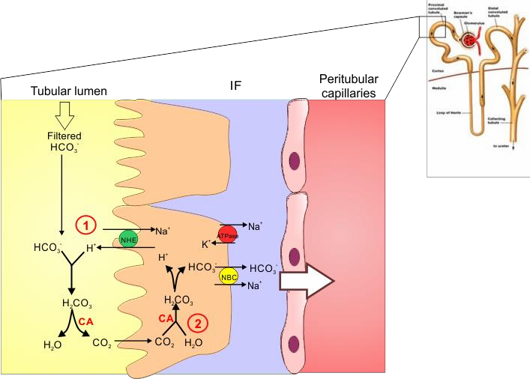
Cont.
ONLY IN FEMALES’ SLIDES
Overview HCO3- Reabsorption by the Renal Tubules
How is HCO3- Reabsorbed by the tubules?
What happens at the PCT?
The PCT reabsorbs, “reclaims”, 80- 90% of the filtered HCO3-
HCO3-reabsorption is linked to H+ secretion.

Slide 36
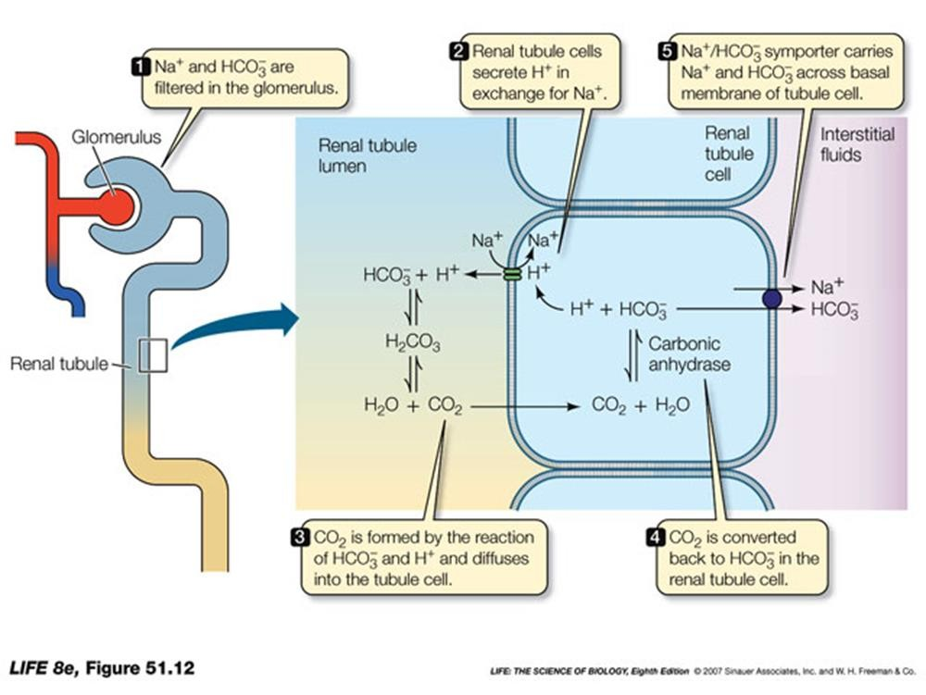
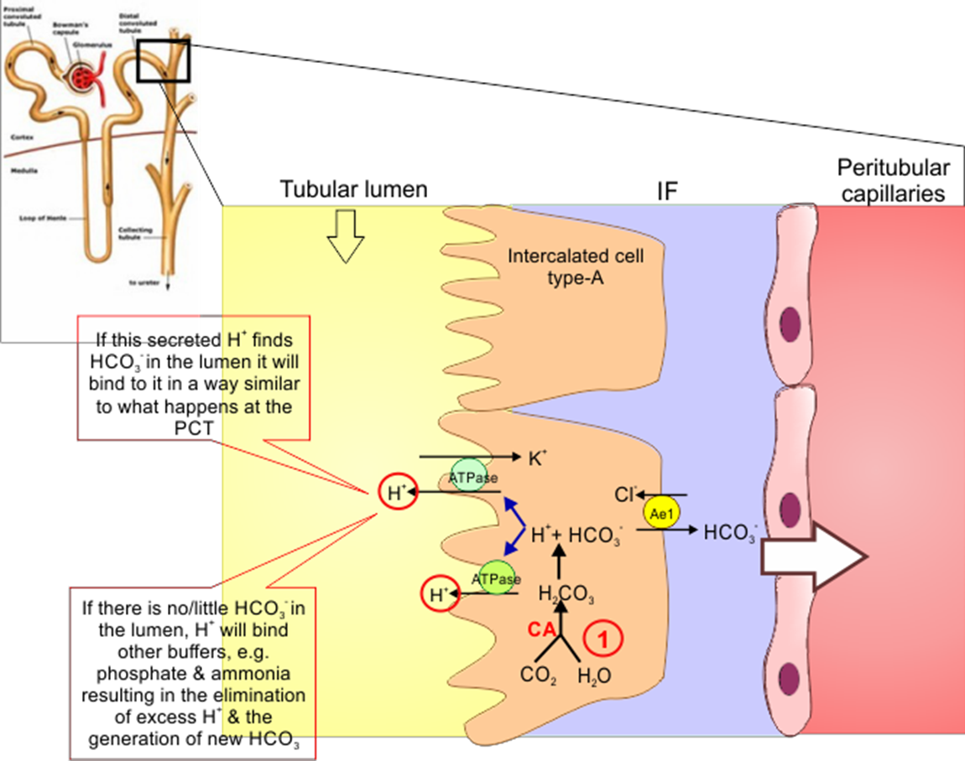
Cont.
ONLY IN FEMALES’ SLIDES
HCO3- Reabsorption by the PCT
What happens at the DCT & CT?

Slide 37
What happens at the late DCT & CT?
ONLY IN FEMALES’ SLIDES
The filtrate arriving at the DCT & CT is low in HCO₃⁻.
The distal segments of the nephron are characterised by the presence of “intercalated cells” capable of actively secreting H⁺ through H⁺-ATPase and H⁺-K⁺ ATPase present on their apical membrane (Type-A intercalated cells).
Only a limited number of H⁺ can be excreted in its free form in urine.
Lowest possible urine pH=4.5 → ≈ 0.04 mmol/L of free H⁺.

Slide 38
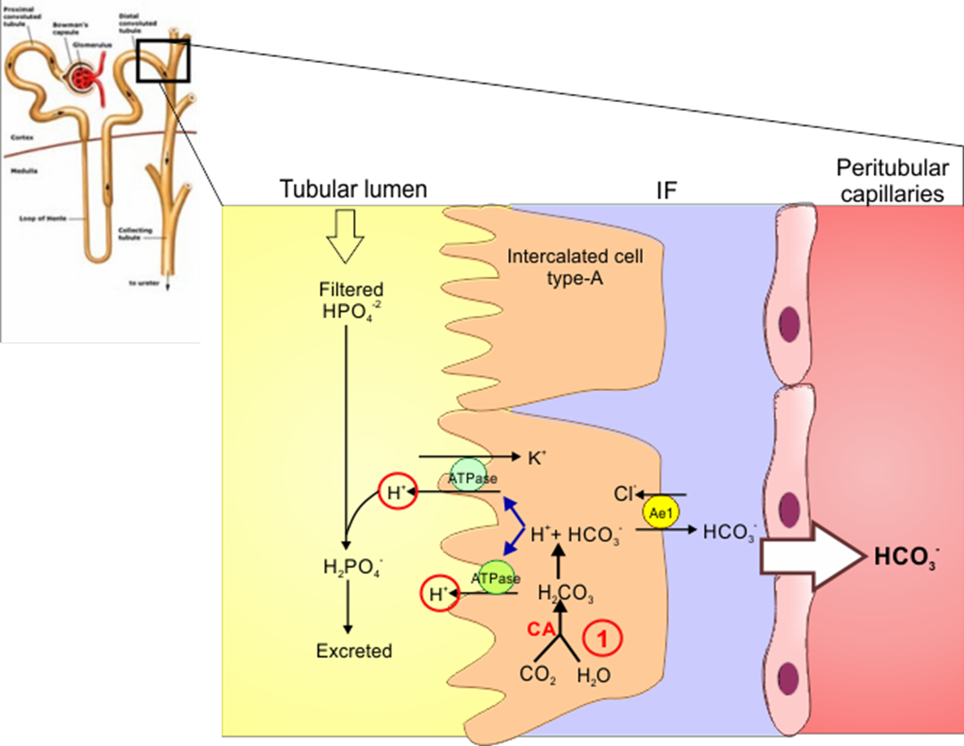
Non-Bicarbonate Buffers in the Tubular
Lumen?
ONLY IN FEMALES’ SLIDES
The extra H+ secreted will need to be buffered in
the tubular lumen
Excretion of H+ and Generation of New HCO3
2 main non-bicarbonate buffers in the tubule
Filtered
Synthesized
Phosphate buffer system
Ammonia buffer system
H₂PO₄⁻ ↔ HPO₄⁻² + H⁺
(acid) (base)
NH₄⁺ ↔ NH₃ + H⁺
(acid) (base)
Excretion of H⁺ as phosphate is capable of handling a limited amount of H⁺ and will not be enough to rid the body of its daily acid load nor if there is unusually high acid production.

Slide 39
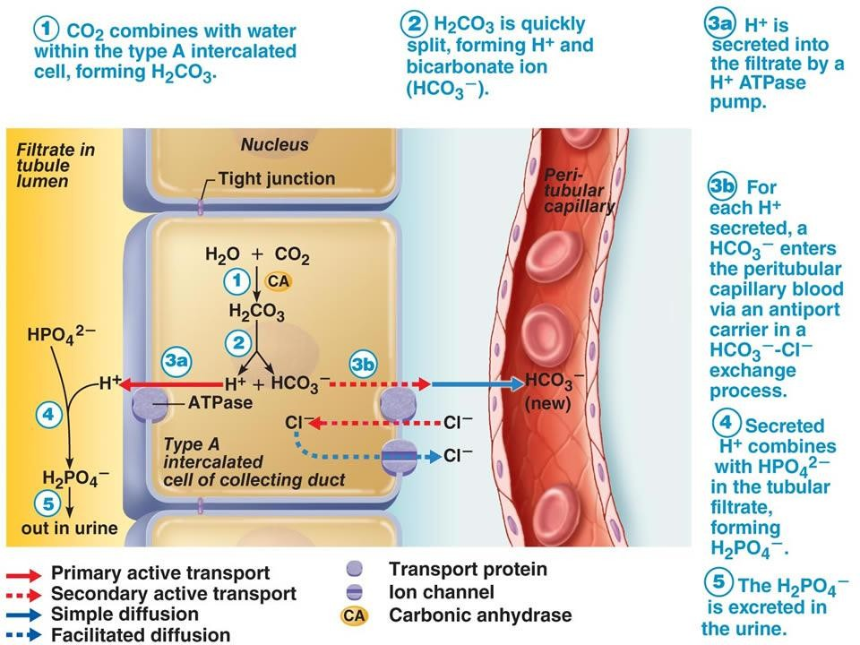
Cont.
ONLY IN FEMALES’ SLIDES

Slide 40
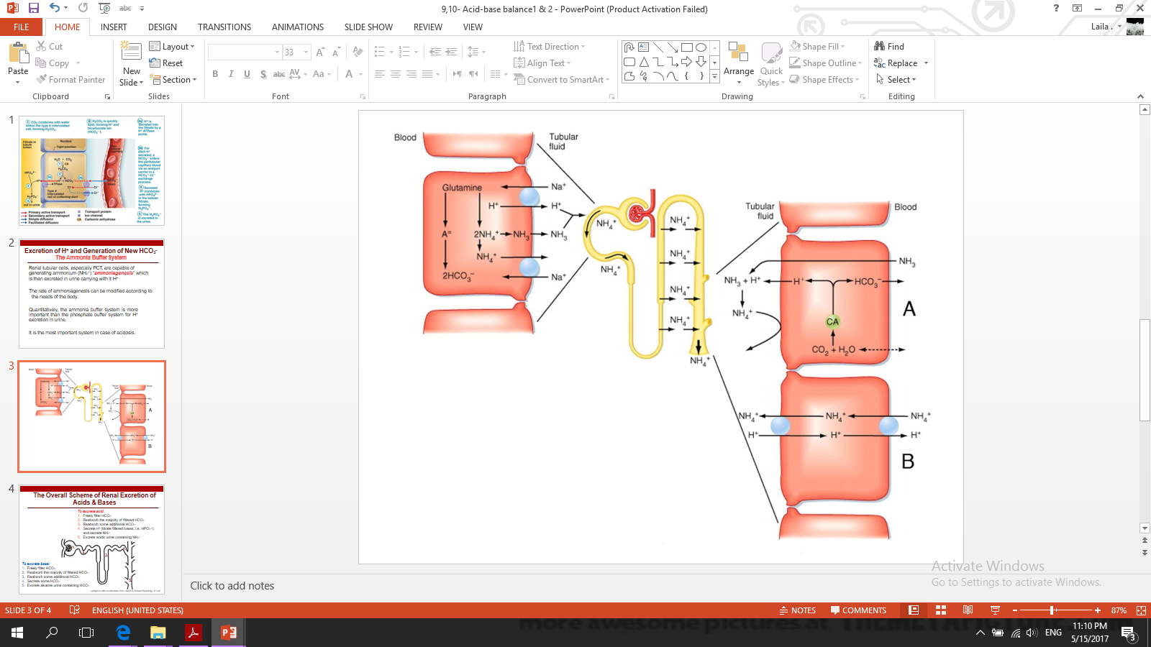
Excretion of H+ and Generation of New HCO3
(The Ammonia Buffer System)
ONLY IN FEMALES’ SLIDES
Renal tubular cells, especially PCT, are capable of generating ammonium (NH4+) “ammoniagenesis” which is then excreted in urine carrying with it H+.
The rate of ammoniagenesis can be modified according to the needs of the body.
Quantitatively, the ammonia buffer system is more important than the phosphate buffer system for H+ excretion in urine.
It is the most important system in case of acidosis.

Slide 41
H+ / HCO3- Control by the Kidney:
ONLY IN MALES’ SLIDES
Renal H+ secretion
Bicarbonate handling
H+ enters filtrate by FILTRATION through glomeruli and SECRETION into tubules.
Most H+ secretion (80%) occurs across wall of PCT via Na+ /H+ antiporter (& H+ - ATPase in type A cells of DCT).
This H+ secretion enables HCO3 - reabsorption.
The primary factor regulating H+ secretion is systemic acid-base balance
a) ACIDOSIS stimulates H+ secretion
b) ALKALOSIS reduces H+ secretion
HCO3 - FREELY FILTERABLE at glomeruli (3 mM/min) and undergoes significant (> 99%) reabsorption in PCT, aLoH & cortical collecting ducts (CCDs).
Mechanisms of HCO3 - reabsorption at PCT (& aLoH) and CCD are similar but not identical (will look at CCD cells in acid-base practical)
Renal HCO3 - reabsorption is an ACTIVE process - BUT dependent on tubular secretion of H+ , NO apical transporter or pump for HCO3 - .

Slide 42
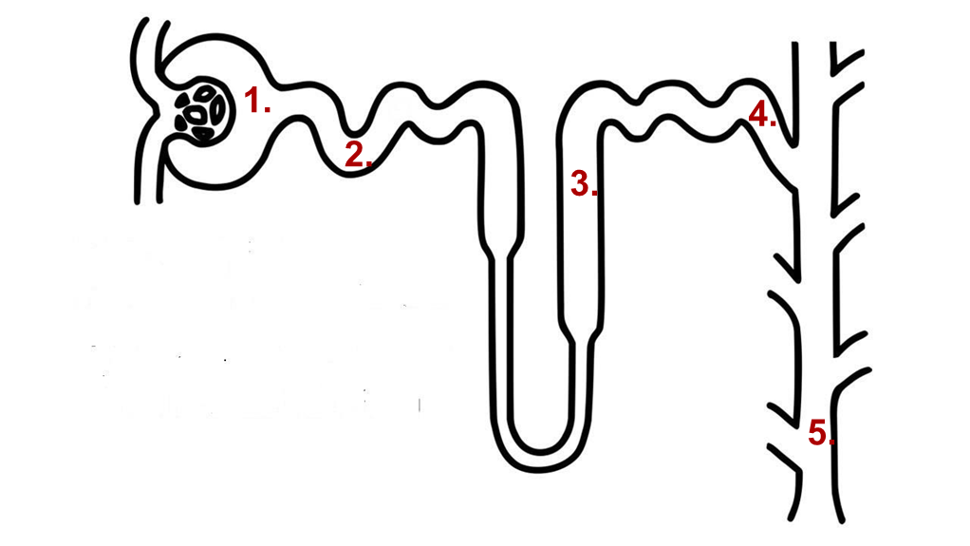
The Overall Scheme of Renal Excretion of
Acids & Bases
ONLY IN FEMALES’ SLIDES
To excrete acid:
Freely filter HCO₃⁻
Reabsorb the majority of filtered HCO₃⁻
Reabsorb some additional HCO₃⁻
Secrete H⁺ (titrate filtered bases, i.e. HPO₄⁻²) and secrete NH₄⁺
Excrete acidic urine containing NH₄⁺
To excrete base:
Freely filter HCO₃⁻
Reabsorb the majority of filtered HCO₃⁻
Reabsorb some additional HCO₃⁻
Secrete some HCO₃⁻
Excrete alkaline urine containing HCO₃⁻

Slide 43
Acid Base Disorders
This work is based on MALES’ slides and contains Dr. Maha’s notes and cases but NOT all of the females’ slides since she did not go through them all.
Red: very important.
Green: Doctor’s notes.
Pink: formulas.
Yellow: numbers.
Gray: notes and explanation.
Physiology Team 436 – Renal Block Lecture 11
For further understanding please check our “Extra Notes” file which contains extra explanation from reference books.

Slide 44
Overview (Important)
Acid-base disturbances
Acidosis: Low PH
Alkalosis: High PH
Respiratory
Mainly , increase in PCO2
Metabolic
Mainly, decrease in HCO3
Metabolic
Mainly, increase in HCO3
Respiratory
Mainly, decrease in PCO2
Renal compensatory mechanism, by increasing HCO3
Renal compensatory mechanism, by decreasing PCO2
Renal compensatory mechanism, by decreasing HCO3-
Respiratory compensatory, by increasing PCO2
- Inhibition of respiratory center
Lung damage
Airway obstruction
- Renal tubular acidosis
- Diarrhea - Diabetes
- Ingestion of:
• acids (alcohol or aspirin)
• Proteins • Drugs
• Vegetables and fruits are alkyl by they cause acidosis
- Ch. renal failure
- Psychoneurosis
- Diuretics except CAI
- Excess aldosterone
• Loss of acid= vomiting
• Gain of HCO3 alkaline=
• Drugs such as; sodium bicarb and almost all diuretics except Carbonic anhydrase inhibitor, it causes acidosis because there’s no HCO3 absorption in the cycle .
Normal PH: 7.35-7.45
Less= acidosis,
More = alkalosis.
$pH= \frac{[HCO3]}{PCO2}$

Slide 45
Disturbances of Acid-Base Balance
Acid-base disturbances may be either RESPIRATORY or METABOLIC.
pH problems due to
a respiratory disorder
pH problems arising from acids or bases of a non-CO2 origin
RESPIRATORY acidosis or alkalosis
METABOLIC
acidosis or alkalosis.
Linda corner:
Disturbances of acid-base balance are among the most common conditions in all of clinical medicine. Acid- base disorders are characterized by an abnormal concentration of H+ in blood, reflected as abnormal pH. Acidemia is an increase in H+ concentration in blood (decrease in pH) and is caused by a pathophysiologic process called acidosis. Alkalemia, on the other hand, is a decrease in H+ concentration in blood (increase in pH) and is caused by a pathophysiologic process called alkalosis.
Disturbances of acid-base balance are described as either metabolic or respiratory, depending on whether the primary disturbance is in HCO3− or CO2. There are four simple acid-base disorders, where simple means that only one acid-base disorder is present. When there is more than one acid-base disorder present, the condi- tion is called a mixed acid-base disorder.

Slide 46
Respiratory Acidosis
Associated with
Respiratory failure
(e.g. COPDs like emphysema)
Inadequate alveolar ventilation
Impaired gas
diffusion
( pulmonary edema)
Hypoventilation = less co2 excretion= increase PCO2, decrease PH.
Kidney messes with HCO3 to increase PH, so: increase HCO3.
Characterized by ↑ Pco2 (hypercapnia) and ↓ plasma pH.
Initial response is :
Increased conversion of CO2 to H+ and HCO3 Increase in ECF [H+] and plasma [HCO3-].
INCREASED [ COMPENSATORY MECHANISM ]
Renal SECRETION OF H+
ABSORPTION OF HCO₃
Alveolar ventilation : عملية التنفس وهي أخذ الأكسجين وطرح ثاني أكسيد الكربون
the kidney act as a compensatory mechanism to correct respiratory acidosis caused by the lung

Slide 47
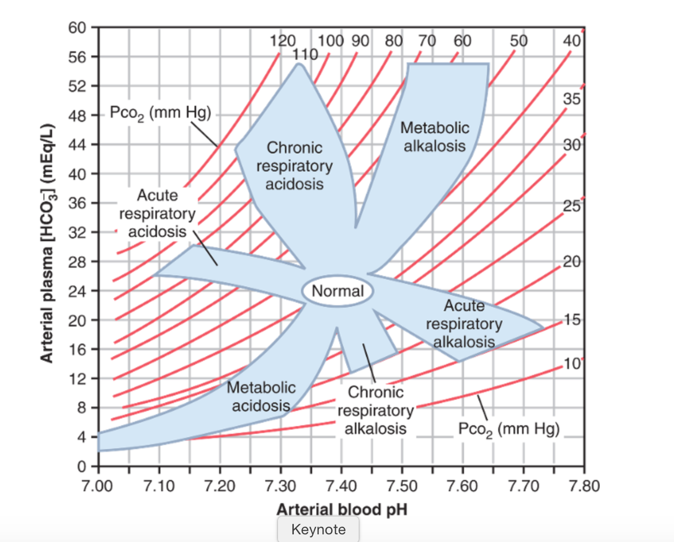
Respiratory Acidosis
ممكن يجي عليها سؤال مهمة
Respiratory Acidosis
↓ plasma pH
↑ Pco2
↑ plasma [HCO3-]
- the diagram shows the acid base disorders. The shaded area show the range of values usually seen for each of the disorders.
- the reason why the HCO3 is high in respiratory acidosis is because it compensate the disorder. In other words, respiratory acidosis is compensated by metabolic alkalosis. Why?? The Henderson-hasselbalch equation can be used to understand why the increased HCO3 conc. is a compensatory response. It's used to normalize the ratio of HCO3/CO2 . Because when CO2 increase the ration will decrease leading to low ph. But when HCO3 also increase the PH will be normal

Slide 48
Respiratory Alkalosis
  Characterised by : Reduced plasma Pco₂ (hypocapnia) and elevated pH↓ Pco₂ & ↑ plasma pH
  Causes: (results from ↑ ventilation and ↓ Pco2 ) increased gas exchange mainly due to HYPERVENTILATION (Anxiety / fear/High altitude).
  Reduction in Pco₂ shifts buffering reaction to the left Decrease in ECF [H⁺] and plasma [HCO₃⁻]
  COMPENSATORY MECHANISM : Decreased : *↓ Renal Secretion of H⁺ *↓ Absorption of HCO₃⁻ (still an excess of HCO₃⁻ relative to H⁺).
- in high altitude, the O2 is less, so to compensate this loss hyperventilation is triggered leading to depletion of Co2. Thus respiratory alkalosis may occur.
HCO3 buffering reaction is shifted to left to decrease the amount of HCO3 and increase extracellular amount of Co2
In alkalosis, the loss of HCO₃⁻ helps return the plasma pH toward normal.
- Hyperventilation results in= increase PH, PCO2 decrease.
- If someone is going through a panic attack, we give him a paper bag so he can re-inhale CO2 and doesn't’t go through alkalosis

Slide 49
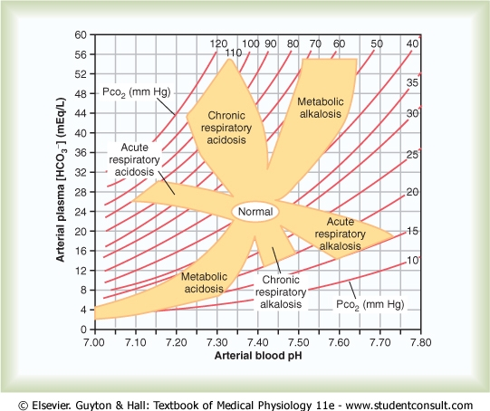
Davenport Diagram Acid-base alterations
Respiratory Alkalosis
↑ plasma pH
↓ Pco2
↓ plasma [HCO3-]
renal compensation for respiratory alkalosis consist of decrease excretion of H+ and decreased synthesis of new HCO3. Therefore decrease its reabsorption. And again the ration of HCO3/Co2 in the equation will be normalized
From the diagram :
PH : 7.6 “HIGH”
HCO3- : 20 “low”
Pco2 : 20 “low”

Slide 50
Metabolic Acidosis & Alkalosis
- Metabolic acidosis by
Ingestion of:
Proteins
Drug
Vegetables and fruits are alkyl by they cause acidosis
  Metabolic acidosis and alkalosis ( Non-Co₂) includes all situations other than those in which primary problem is respiratory.
  By definition, metabolic acidosis and alkalosis cannot be due to excess retention or loss of CO2
  ↑ [H+] in acidosis will reflexely stimulate ventilation to lower Pco2. Conversely, ventilation will be inhibited in alkalosis to restore [H+].
  Remember, plasma Pco2 changes during metabolic acidosis / alkalosis are a result of, not cause of, compensatory reflex responses to non-respiratory abnormalities.
- Metabolic alkalosis:
• Loss of acid= vomiting
• Gain of HCO3= drugs such as; sodium bicarb and almost all diuretics except Carbonic anhydrase inhibitor, it causes acidosis because there’s no HCO3 absorption in the cycle
  Does arterial Pco2 remain unchanged in these cases? NO!
- In shock: lactate accumulate > acidosis
- Diabetics: miss an insulin dose > hyperventilating (kussmaul breathing) > they go through acidosis and by breathing the compensate it
Loss of HCO3:
• From GIT or kidney:
Renal tubular acidosis
الرئة ليست السبب في تغير الهيدروجين لكنها تساعد في تعديل هذا التغيير عن طريق التحكم بالتنفس.

Slide 51


Metabolic Acidosis
Metabolic Acidosis
Can occur in response to:
‘Causes
Heavy exercise stimulates anaerobic metabolism, producing lactic acid.
High protein diet : protein catabolism produces
phosphoric acid and sulphuric acid.
Addition of fixed acids
(e.g. diabetic ketoacidosis ).
High fat diet
fat catabolism produces fatty acids.
Alterations in renal function (inability to excrete H⁺ ).
Severe diarrhoea loss of bicarbonate from intestines
Ingested substances such as methanol, aspirin (acetylsalicylic acid), ethylene glycol
Tissue hypoxia (produces lactic acid)
Characterized by :
DECREASED [HCO3-] (<25mM) and pH.
- Reduction in pH + ↑ in ECF H+ concentration
Caused by :
Increased acid production
Impaired acid excretion

Slide 52
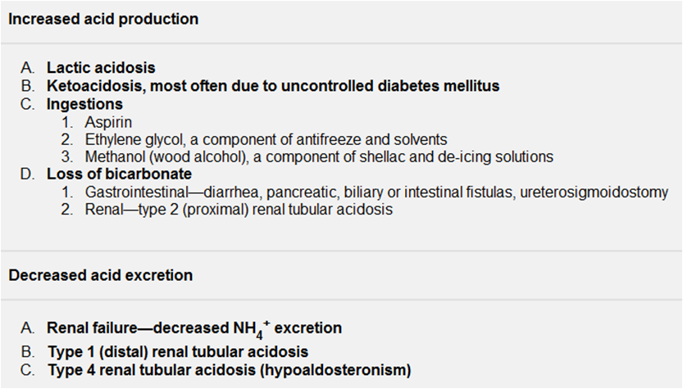
Major Causes of Metabolic Acidosis
ONLY IN FEMALES’ SLIDES

Slide 53
Metabolic Acidosis
Metabolic acidosis is characterized by decreased HCO⁻₃ (<25mM) and pH.
Maintaining pH
Shift of buffering reactions to the left, to neutralize excess acid (for HCO⁻₃, cell & bone buffers)
(first line of defense)
Increased renal secretion of H+ and absorption of HCO⁻₃
ECF [HCO₃⁻] increases.
Increased expiration of CO₂ reduces Pco₂ levels which
increases pH of ECF (respiratory compensation).
Increased ventilation rate (via chemoreceptor activation)
shift to left to decrease H+ and accumulate Co2 to get rid of it in lungs on onset of metabolic acidosis, the HCO3 will be decreased. After the correction of the kidney it will increase.

Slide 54
Metabolic Acidosis
For cells: there is uptake of excess H+ & loss of ICF K+ (and Na+) to ECF to maintain Electroneutrality.
So, metabolic acidosis is often associated with increased plasma K+ relative to that expected from state of potassiumbalance.
Hyperkalemia can develop even though body K+ stores are diminished.
“Cation shift” is reversed with correction of acidosis.
Linda corner:
In ICF, the excess fixed H+ is buffered by organic phosphates and proteins. To utilize these intracel- lular buffers,
H+ first must enter the cells. H+ can enter the cells with an organic anion such as ketoan- ion, lactate, or formate,
or it can enter the cells in exchange for K+. When the H+ is exchanged for K+, hyperkalemia occurs.

Slide 55
Davenport Diagram Acid-base Alterations
Metabolic Acidosis
↓ plasma pH,
↓ plasma [HCO₃⁻]
↓ Pco₂,

Slide 56
Metabolic Alkalosis
Rare, occur in response to:
Excessive vomiting: (loss of HCl from stomach which will cause retention of duodenal HCO₃ into circulation)
Excessive ingestion of bicarbonate antacids paired with renal failure.
Volume contraction via diuretic therapy will increase plasma HCO₃
Excess aldosterone will stimulate collecting duct H⁺-ATPase to excrete H⁺
Alterations in renal function “increased excretion of titratable acid..(E.g. thiazide & loop diuretics) will increase Na+ reabsorption.. Which eventually increase excretion of H+”
Linda corner:
Loss of fixed acid; The classic example of metabolic alkalosis is vomiting, in which HCl is lost from the stomach. The gastric parietal cells produce H+ and
HCO3− from CO2 and H2O. The H+ is secreted with Cl− into the lumen of the stomach to aid in digestion, and the HCO3− enters the blood. In normal persons, the secreted H+ moves from the stomach to the small intestine, where a low pH triggers the
the HCO3 added to blood by the parietal cells is later removed from blood in the pancreatic secretions. However, when vomiting occurs, H+ is lost from the stomach and never reaches the small intestine. HCO3− secretion from the pancreas, therefore, is not stimulated, and the HCO3− remains in the blood, resulting in an increase in HCO3− concentration.

Slide 57
Metabolic Alkalosis
Characterized by elevated plasma HCO₃ & PH
Loss of acid increases the dissociation of H₂CO₃, which elevates HCO₃⁻ level.
The elevation of pH will reduce ventilation rate, elevating Pco₂ levels.
Kidneys will reduce their absorption and increase excretion of HCO₃⁻ in the nephron.
Guyton corner : increased HCO3− concentration in the extracellular fluid increases the filtered load of HCO3−, which, in turn, causes excess HCO3− over H+ secreted in the renal tubular fluid. The excess HCO3− in the tubular fluid fails to be reabsorbed because there is no H+ to react with, and it is excreted in the urine.
In metabolic alkalosis, the primary compensations are decreased ventilation, which raises Pco2, and increased renal HCO3− excretion, which helps−compensate for the initial rise in extracellular fluid HCO3 concentration.

Slide 58
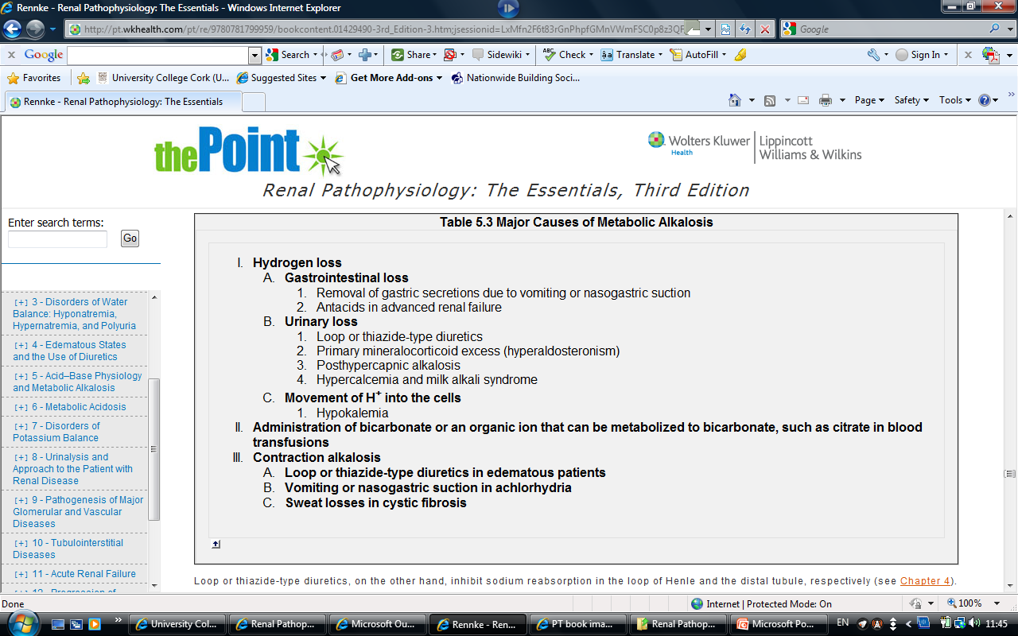
Major Causes of Metabolic Alkalosis
ONLY IN FEMALES’ SLIDES

Slide 59
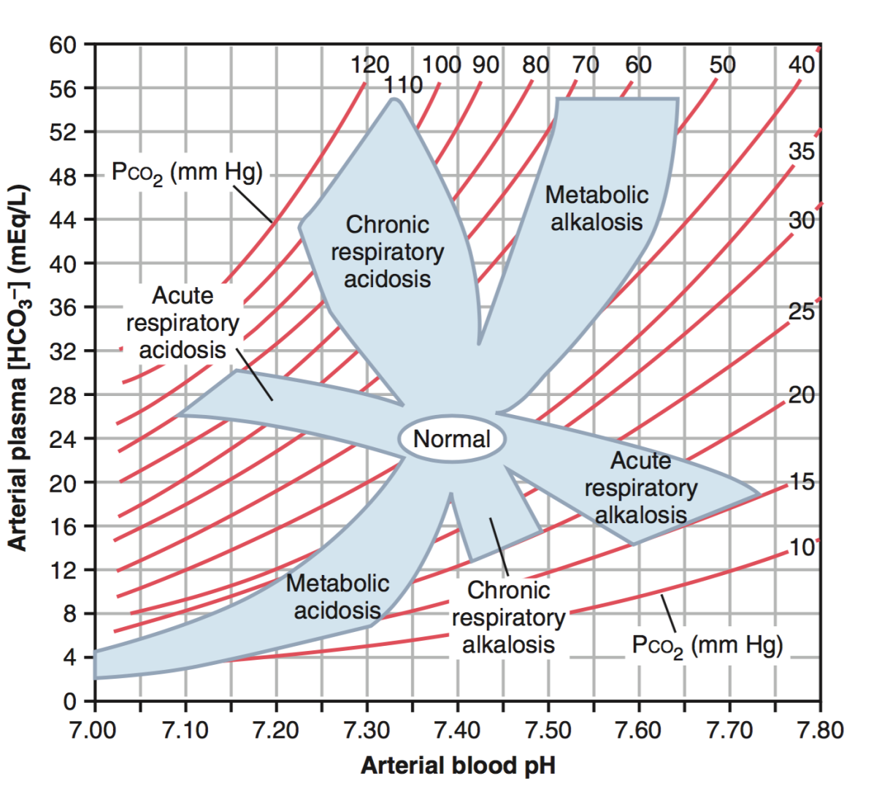
Davenport Diagram
In Metabolic Acidosis:
↓ plasma pH
↓ Pco₂
↓ plasma [HCO₃⁻]
In Metabolic Alkalosis:
↑ plasma pH
↑ plasma [HCO₃⁻]
↑ Pco₂
- pCo2 is low due to the respiratory compensation
- PCo2 is high due to respiratory compensation by accumulating it

Slide 60
Acid-Base Imbalances (Summary)
Acid-base balance can be altered in one of four ways
RESPIRATORY ACIDOSIS
METABOLIC ALKALOSIS
METABOLIC ACIDOSIS
RESPIRATORY ALKALOSIS
caused by ↓ H+ production, ↑ elimination
of H+ or ↑ in bicarbonate
caused by ↓ elimination of
CO2, secondary to either ↓ respiration or gas exchange.
caused by ↑ H+ production/intake or ↓[bicarbonate].
caused by ↑ elimination of
CO2 (by hyperventilation).
60

Slide 61

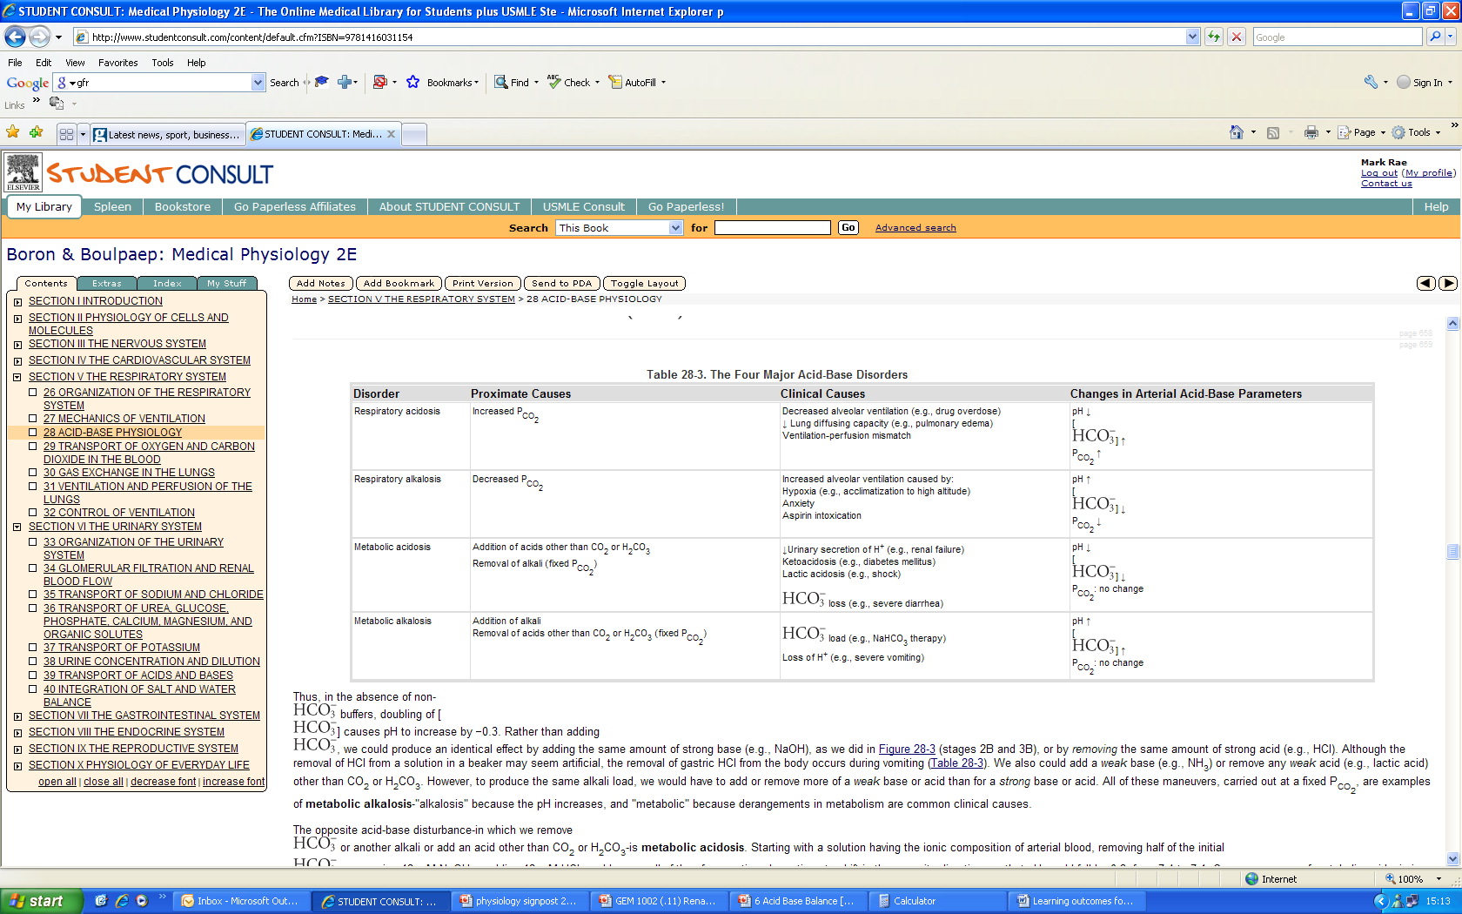
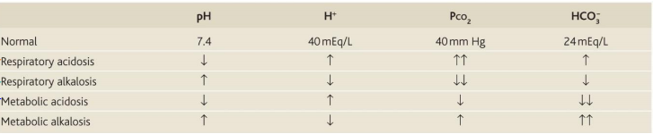
Acid / Base Disorders Summary

Slide 62
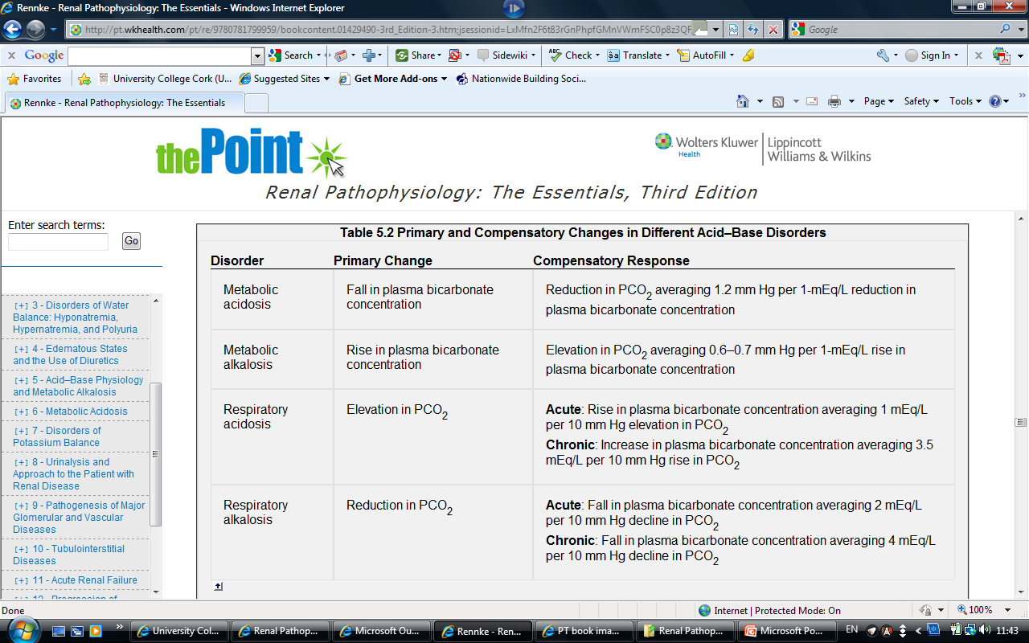
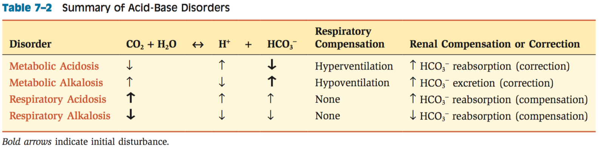
Primary and compensatory changes in different acid-base disorders
ONLY IN FEMALES’ SLIDES

Slide 63
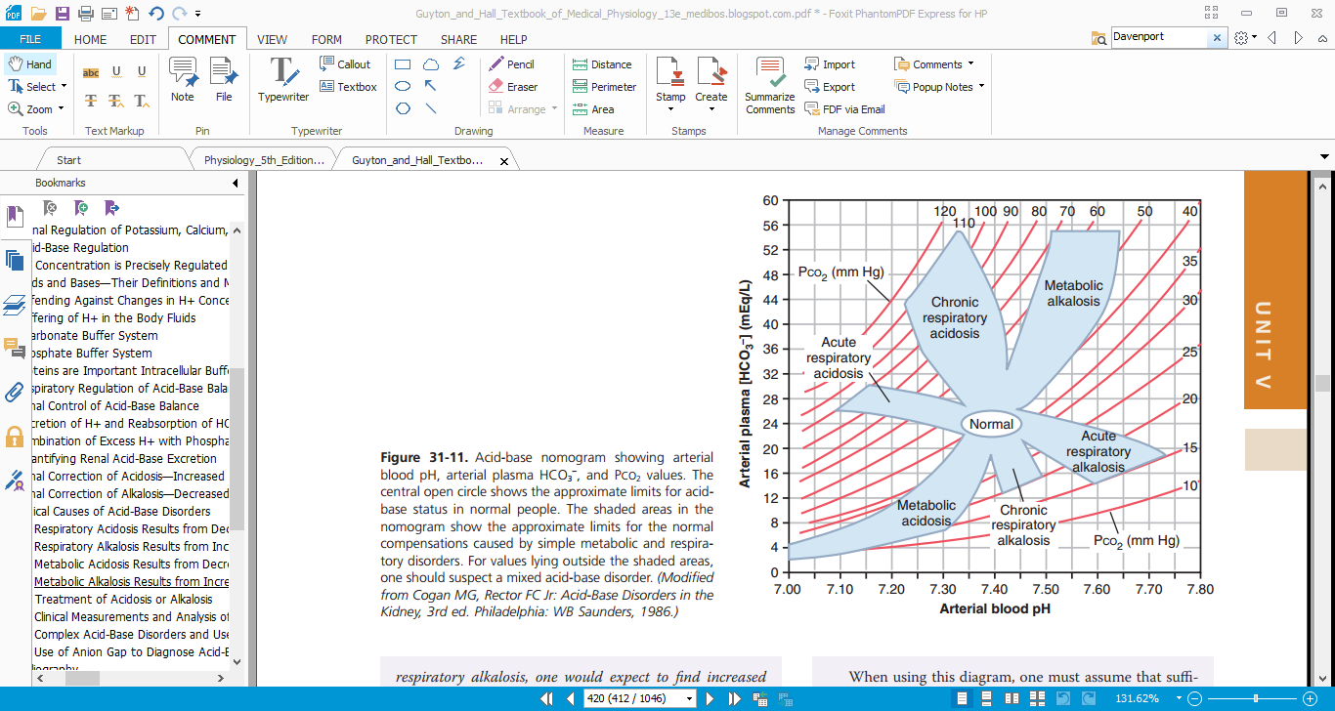
Analysis of Acid-Base Disorders
ONLY IN FEMALES’ SLIDES
Analysis aimed at identifying underlying cause of disorder such that appropriate therapy can be initiated.
In addition to usual history taking and physical findings, sampling of arterial blood can yield valuable information.
Analysis of blood sample data is straightforward if approached systematically either using the Davenport nomogram or flow diagram.
Guyton corner :
A convenient way to diagnose acid-base disorders is to use an acid-base nomogram, as shown in the Figure. This diagram can be used to determine the type of acidosis or alkalosis, as well as its severity. In this acid-base diagram, pH, HCO3−concentration, and PCO2 values intersect according to the Henderson-Hasselbalch equation. The central open circle shows normal values and the deviations that can still be considered within the normal range. The shaded areas of the diagram show the 95 percent confidence limits for the normal compensations to simple metabolic and respiratory disorders

Slide 64
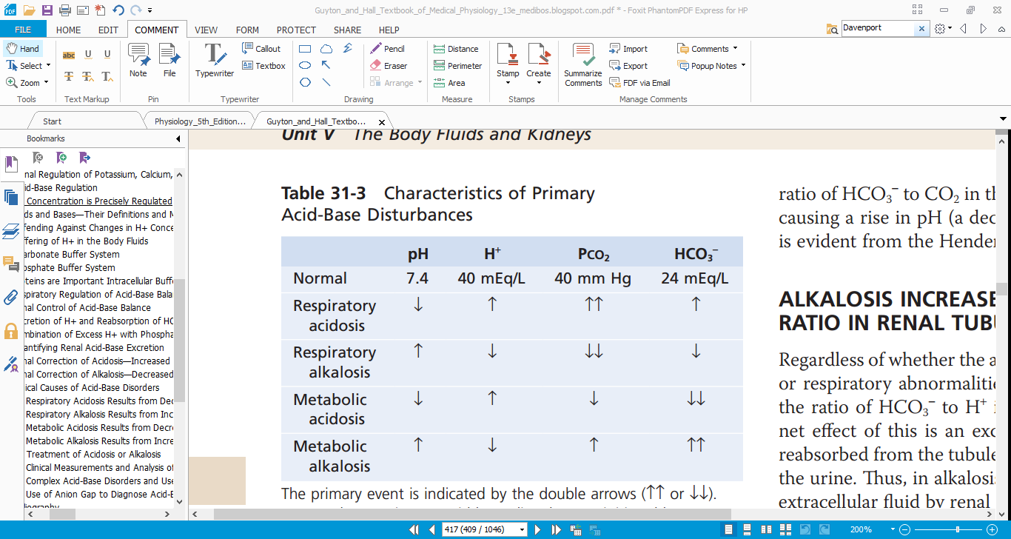
How to Analyze an ABG
HCO3 | PCO2 | pH | PO2
22-26 mmol/L | 35-45 mmHg | 7.35_7.45 | 80-100mmHg | normal
< 22 | >45 | <7.35 | - | acidotic
> 26 | <35 | >7.45 | - | alkalotic
Guyton corner: (Table 31-3) summarizes the characteristics associated with respiratory and metabolic acidosis, as well as respiratory and metabolic alkalosis, which are discussed in the next section. Note that in respiratory acidosis, there is a reduction in pH, an increase in extracellular fluid H+ concentration, and an increase in PCO2, which is the initial cause of the acidosis. The compensatory response is an increase in plasma HCO3−, caused by the addition of new HCO3−to the extracellular fluid by the kidneys.The rise in HCO3− helps offset the increase in PCO2 , thereby returning the plasma pH toward normal. In metabolic acidosis, there is also a decrease in pH and a rise in extracellular fluid H+ concentration. However, in this case, the primary abnormality is a decrease in plasma HCO3−. The primary compensations include increased ventilation rate, which reduces PCO2, and renal compensation, which, by adding new HCO3−to the extracellular fluid, helps minimize the initial fall in extracellular HCO3−concentration.

Slide 65
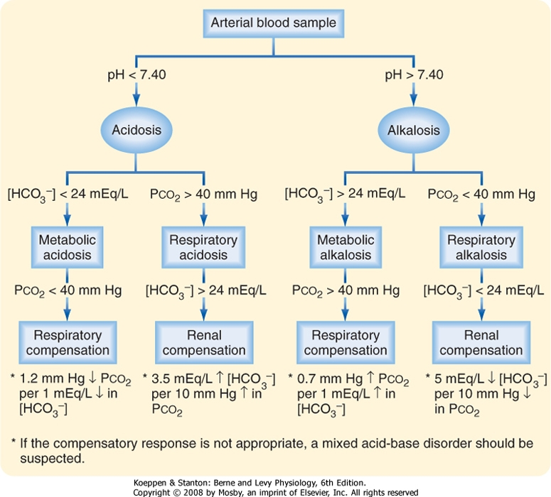
Analysis of Acid-Base Disorders
Example :
pH = 7.35
[HCO3-] = 16mEq/L
PCO2 = 30 mm Hg
1)Evaluate pH - acid
2) Metabolic or respiratory source?
[HCO3-] < 24mM = metabolic
3) Analysis of compensatory
response.
↓ PCO2 – respiratory compensation
Mixed acid-base disorders can also occur
(e.g. emphysema with diarrhea)
in which an appropriate compensatory
response has not occurred.
الخطوات بسيطة:
١- ناظر ال ph
٢-ناظر pco2 عشان تعرف (ميتابولك ولا ريسبايراتوري)
٣- ناظر hco3 عشان تعرف compensated ولا لا او هيا ميتابولك اسيدوسز ولا الكلوسز
The normal range of pH [7.35-7.45] it depends on the oxygenation in venous blood it is 7.35 (slightly acidic, why?) there are more CO2 in the arterial blood it is 7.4

Slide 66
Cases:
Normal PCO2= 35-45 mmHg
Normal (HCO3-) = 33-28 mEq/L
Case 1 :
A patient known to have COPD presented with 3-day history of fever, SOB, and cough productive of yellowish sputum. His ABGs showed:
pH = 7.25
PCO2 = 80 mmHg.
HCO3- = 34 mEq/L.
Case 2:
A 21 year old man with IDDM presents to ER with mental status changes, nausea, vomiting, abdominal pain and rapid respirations. His ABGs showed:
pH = 7.2
PCO2 = 20 mmHg
HCO3 = 8 mEq/l
Case 3:
A 2-year old child who is lethargic and dehydrated has a 3-day history of vomiting. His ABGs showed:
pH = 7.56
PCO2 = 44 mmHg
HCO3- = 37 mEq/l
Answer:
Alkalosis
PCO2= Normal
HCO3- = High
Uncompensated metabolic alkalosis
Answer:
Acidosis
PCO= matches PH
HCO3= this a result of compensatory mechanism
3 days HISTORY!!
Compensating mechanism is incomplete.
Answer:
PH= Acidosis
PCO2= low, matches PH
HCO3 = low, doesn’t match PH
Respiratory compensating

Slide 67
Cases:
Case 4:
A 20-year old student suffered a panic attack while awaiting an exam. Her ABGs showed:
pH = 7.6
PCO2 = 24 mmHg.
HCO3 = 23 mEq/L.
Case 5:
A 69 year old patient had a cardiac arrest soon after return to the ward following an operation. Resuscitation was commenced and included intubation and ventilation. Femoral arterial blood gases were collected about five minutes after the arrest. Other results: Anion gap 24, Lactate 12 mmol/l.
• pH 6.85
• pCO2 82 mmHg
• HCO3 14 mmol/l
Ignore anion gap
Answer:
Alkalosis
PCO2= Low
HCO3 = Normal
Uncompensated Respiratory alkalosis
Answer:
Severe acidosis
PCO2= High, matching
HCO3- = Low, matching
Mixed acid base disorder

Slide 68
Thank you!
اعمل لترسم بسمة، اعمل لتمسح دمعة، اعمل و أنت تعلم أن الله لا يضيع أجر من أحسن عملا.
The Physiology 436 Team:
Female Members:
Amal AlQarni
Heba Alnasser
Deena AlNowiser
Reema Alotaibi
Laila Mathkour
Ghada Alskait
Ghada Alhadlaq
Male Members:
Mohammed Alayed
Mohammad Almutlaq
Mohammed Baqais
Mohammad Naser
Abdullah Abuamarah
Team Leaders:
Qaiss Almuhaideb
Lulwah Alshiha
Contact us:
Physiology436@gmail.com
@Physiology436
Link to Editing File
References:
Girls’ and boys’ slides.
435 Team.
Guyton and Hall Textbook of Medical Physiology (13th Edition).
Linda (5th Edition).
Special thanks to Team435’s Leaders: Meshal Alhazmy & Khawla Alammari and members!

