Slide 1


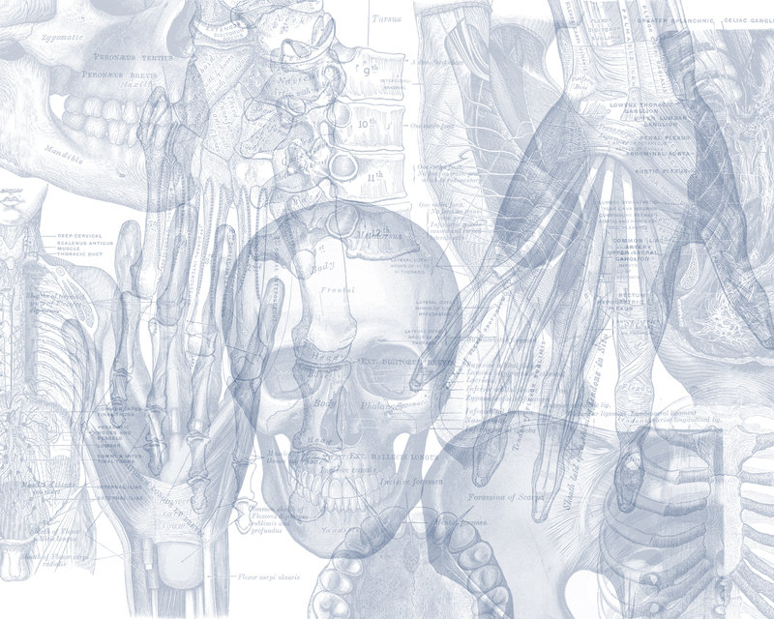


Radiology of the Renal System
Color Code
Important
Doctors Notes
Notes/Extra explanation
Please view our Editing File before studying this lecture to check for any changes.

Slide 2
Objectives
Modality used for assessment of the urinary system
  X-ray
  US
  CT
  MRI
  Nuclear
Normal anatomy
Common pathologies
  Kidney
  Ureter
  Bladder
  Urethra
This lecture is included in the MCQ exam only

Slide 3
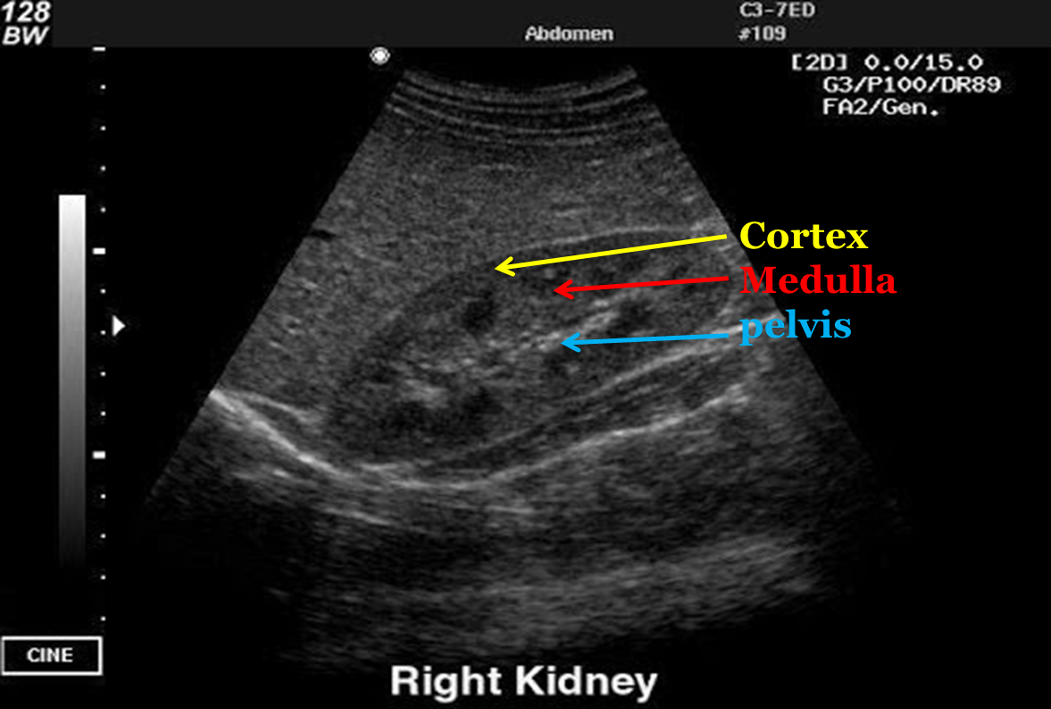
Modalities used:
US (Ultra Sound)
Pros
1. No ionizing radiation 2. Inexpensive 3. Portable
Cons
1. Operator dependent 2. Time consuming
Image Key:
White | Stones and calcification
Grey | Soft tissue
Black | Fluid

Slide 4
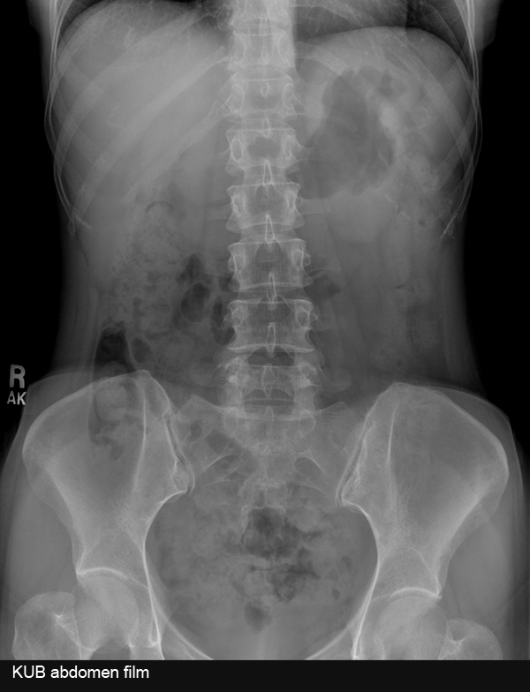
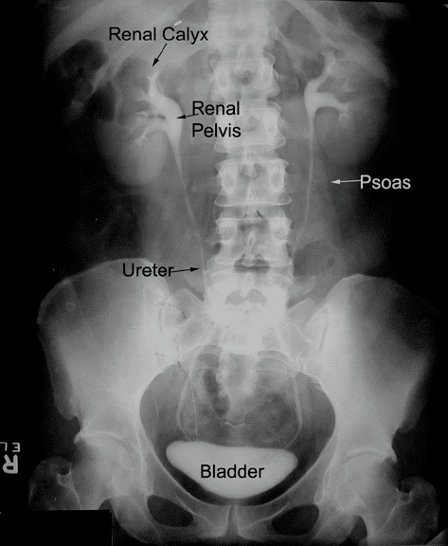
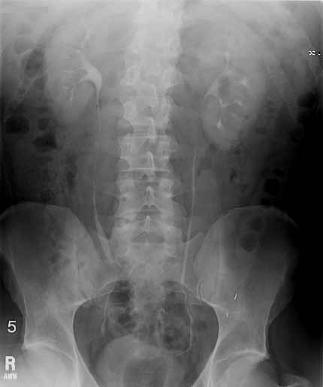
Modalities used:
X-Ray
IVP (intravenous pyelogram):
injecting the patient with a contrast (صبغة) intravenously
Pros
1. Inexpensive 2. Quick
Cons
Ionizing radiation Not definitive
Image Key:
White | Bones and calcification
Grey | Soft tissue
Black | Air

Slide 5
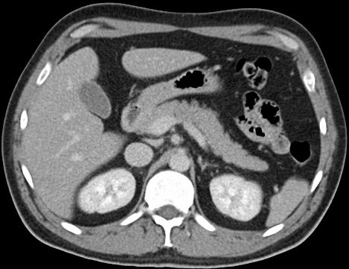
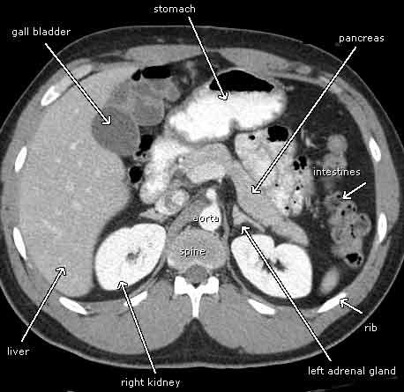
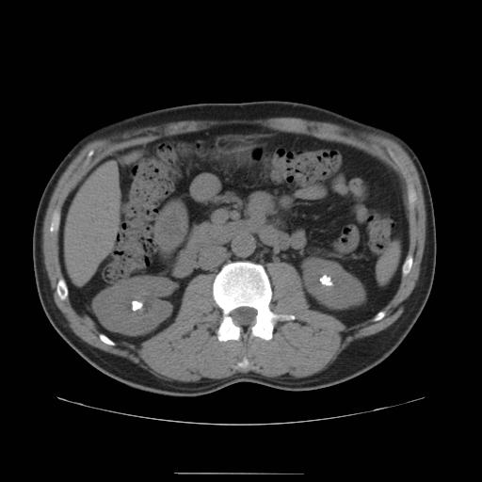
Modalities used:
CT
Pros
Quick A lot of information
Cons
Ionizing radiation Expensive
Image Key:
White | Bones and calcification
Grey | Soft tissue
Black | Air
The best modality for diagnosis of renal stones is non-contrast CT
(the contrast will hide the stone)

Slide 6
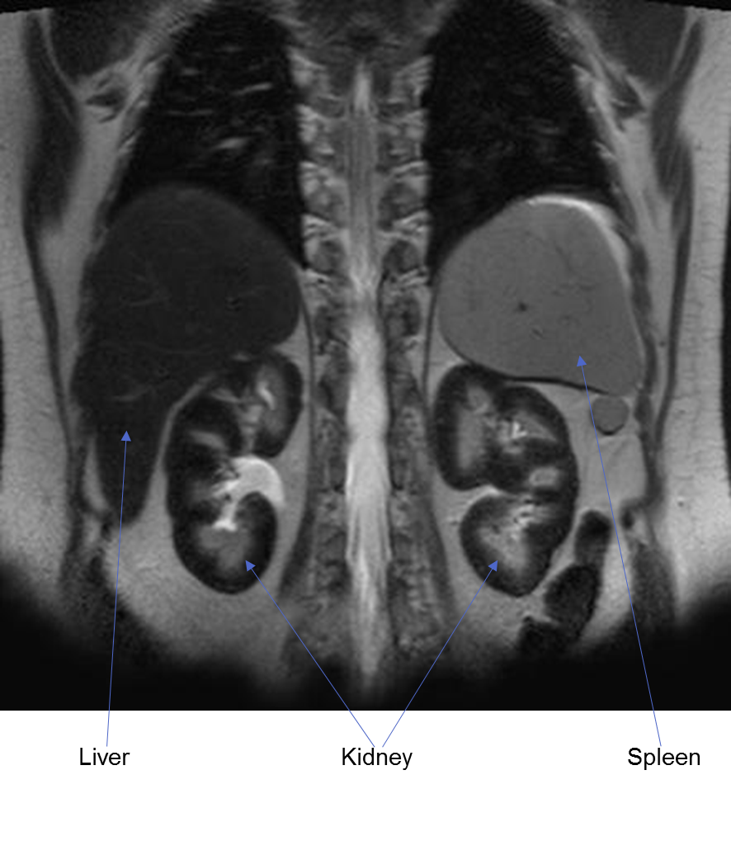
Modalities used:
MRI
Pros
No ionizing radiation A lot of information
Cons
Expensive Time consuming
Image Key:
White | High intensity
Grey to Black | Low Intensity

Slide 7
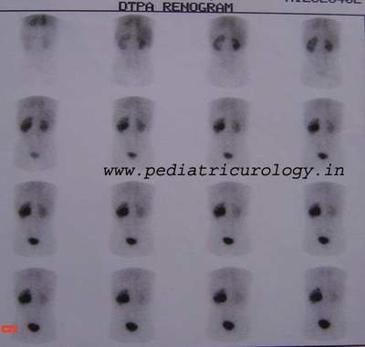
Modalities used:
Nuclear Scans
Pros
Asses the function.
Cons
Time consuming Radioactive materials
The previous modalities were used to asses the anatomy of the renal system whereas the nuclear scan assesses the function.
Nuclear medicine imaging uses small amounts of radioactive materials called radiotracers that are typically injected into the bloodstream. They travel through the area being examined and gives off energy in the form of gamma rays which are detected by a special camera.
Note: Unlike other modalities in nuclear scans the right and left are not opposite. So your right is right an left is left.
*the left kidney is not functioning well as the right one because it was unable to excrete all the urine and material.

Slide 8
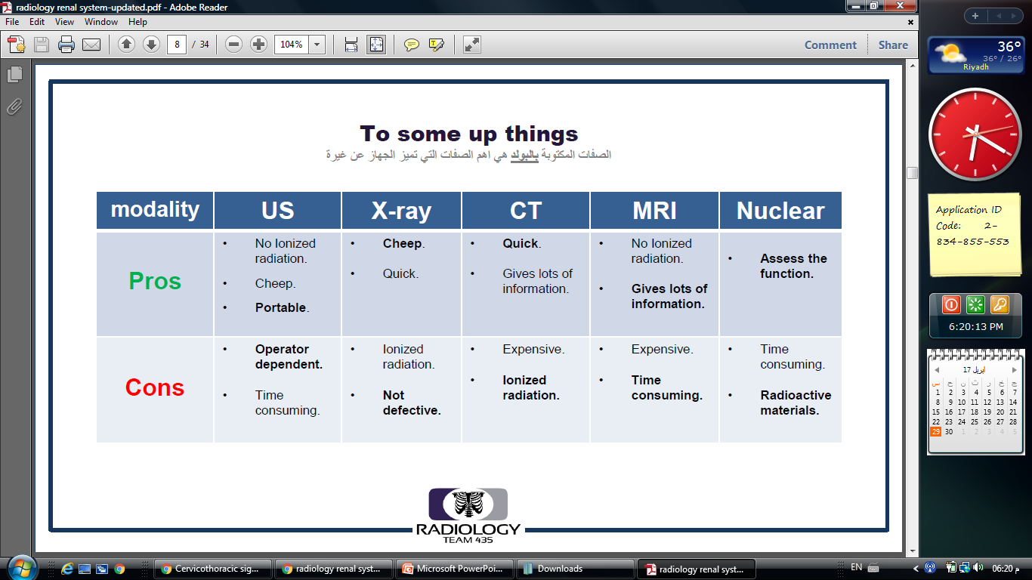
SUMMARY
Modality | White | Grey | Black
Ultrasound (US) | stones and calcification | soft tissue | fluid
X-Ray | bone and calcification | soft tissue | air
CT | bone and calcification | soft tissue | air
MRI | High intensity | Low intensity

Slide 9
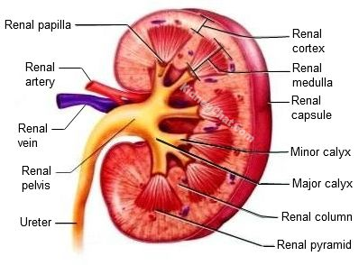
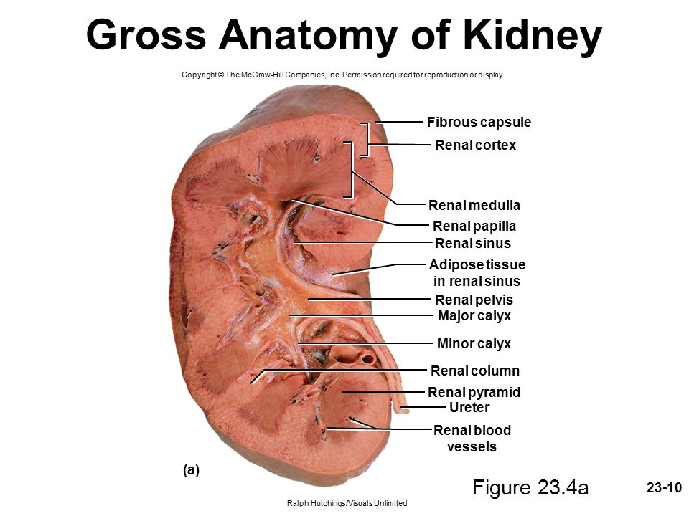
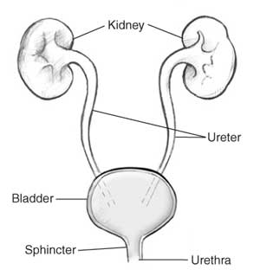
Anatomy of the Urinary System
Gross Anatomy of the Kidney

Slide 10
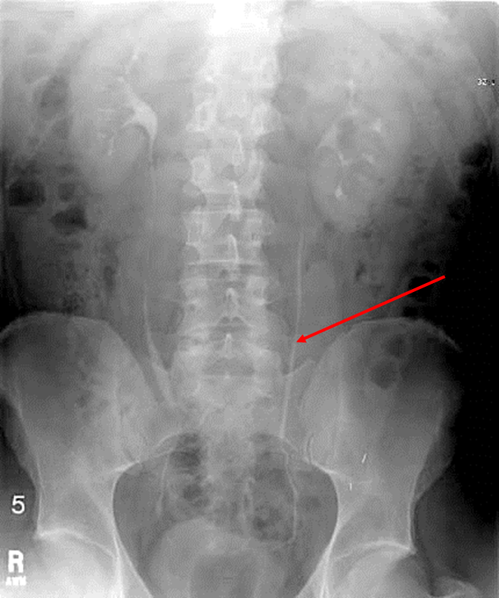
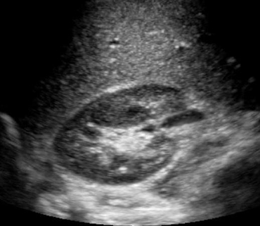
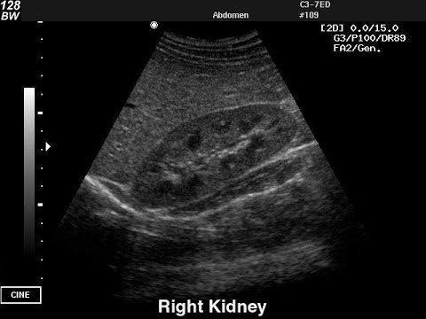
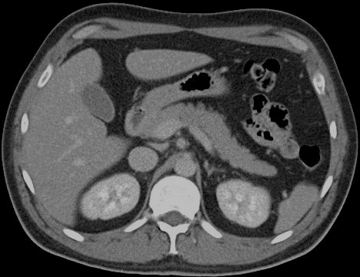
Kidneys
Cortex
Medulla
Renal pelvis
Ureter
Ureters

Slide 11
Ureters (IVP)

Slide 12
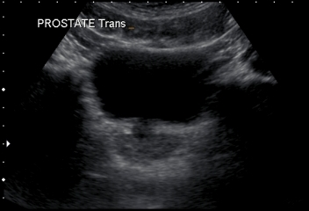
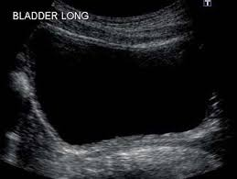
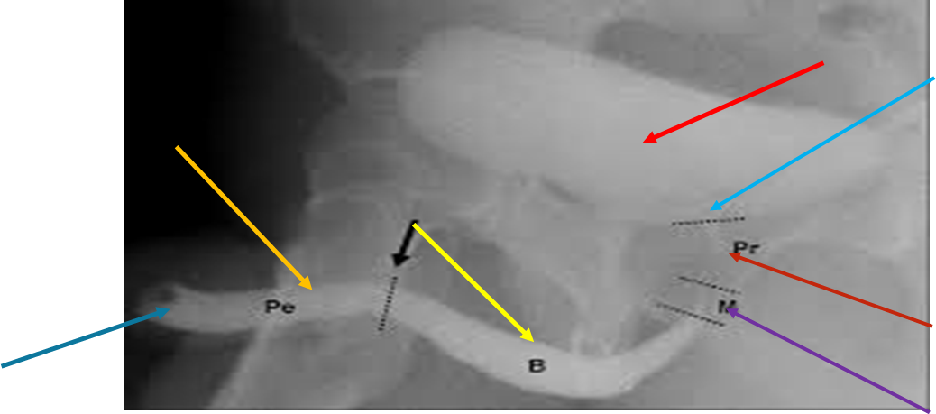
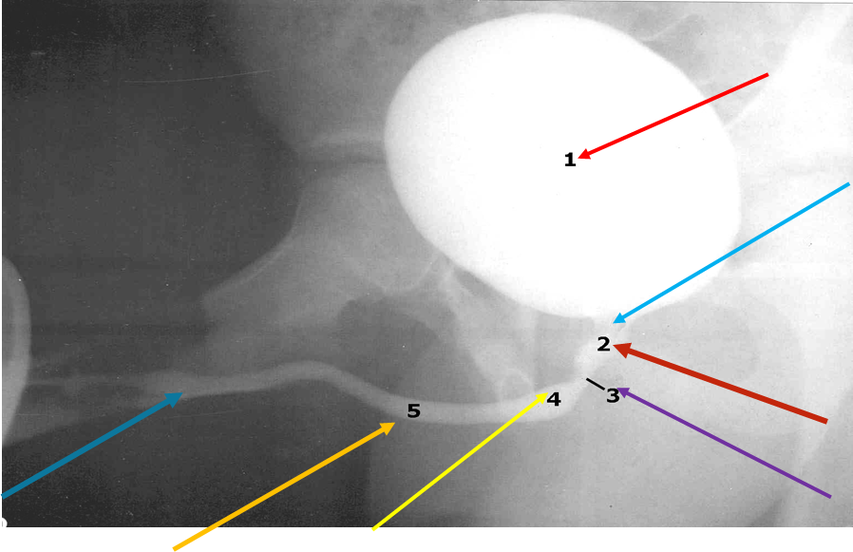
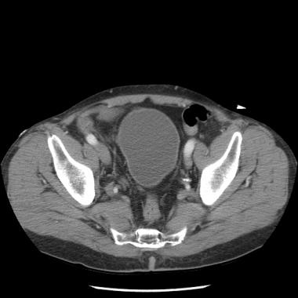
Urinary Bladder
Urethra
Bladder
Bladder neck
Prostatic urethra
Membranous urethra
Bulbar urethra
Penile urethra
Urethral meatus
US
CT

Slide 13
Common Renal System Pathologies
*Summery
Kidneys
Ureter
Bladder
Cysts
Stones
Prostate hypertrophy
Stones
Vesicoureteral reflux disease
Cystitis
Pyelonephritis
Congenital
Bladder rupture
Hydronephrosis
Renal Artery Thrombosis
Renal Vein Thrombosis
ESRD
Tumor
Congenital

Slide 14
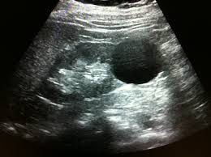
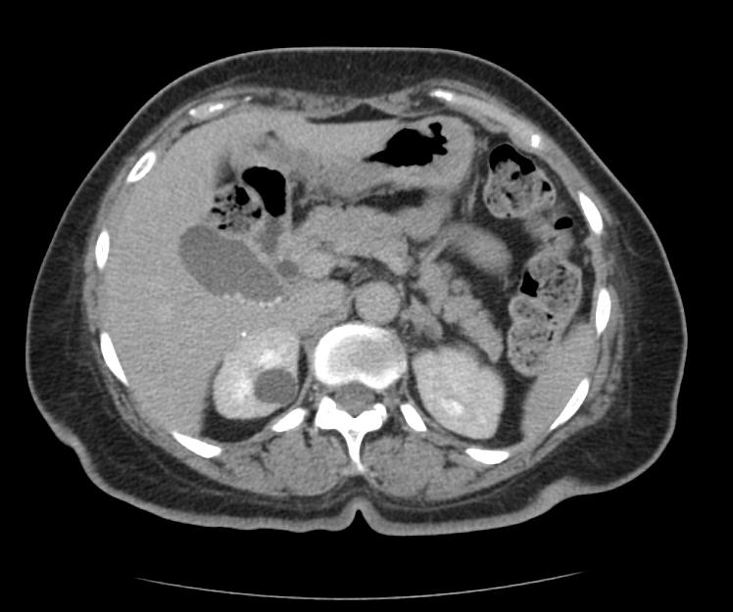
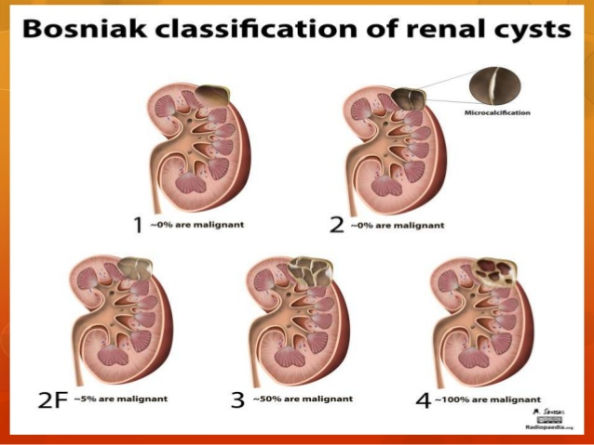
Common Kidney Pathologies:
Cysts
Benign.
Common.
Bosniak classification*.
*Bosniak classification : it divides renal cystic masses into five categories based on imaging characteristics on contrast-enhanced CT. It’s helpful in predicting a risk of malignancy and suggesting either follow up or treatment.
ANECHOIC circular mass , clear borders
Hypo-dense clear border mass in right kidney

Slide 15
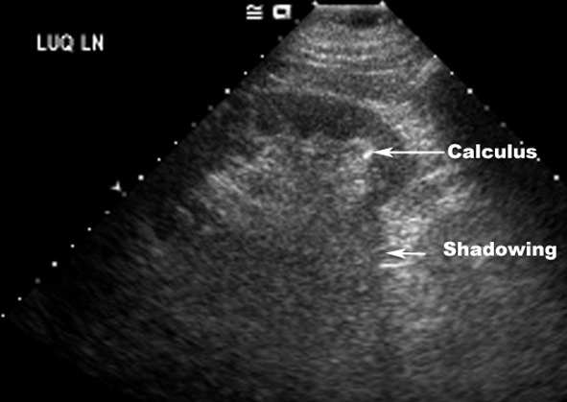
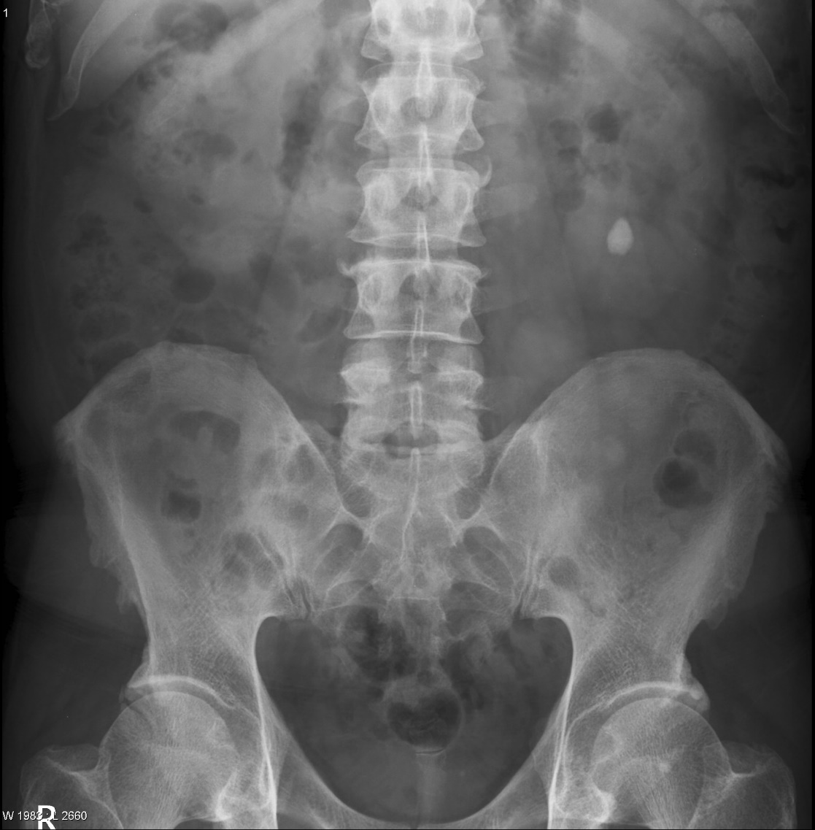
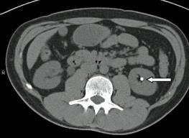
Common Kidney Pathologies:
Stones
Radio-opaque (calcium , struvite). Referring to a material or tissue that blocks passage of X-rays, and has a bone or near-bone density; radiopaque structures are white or nearly white on conventional X-rays, so it appears in imaging.
Radio-lucent (uric acid , cysteine). materials that allow x-rays to penetrate with a minimum of absorption, so it doesn’t appear in imaging.
US
CT

Slide 16
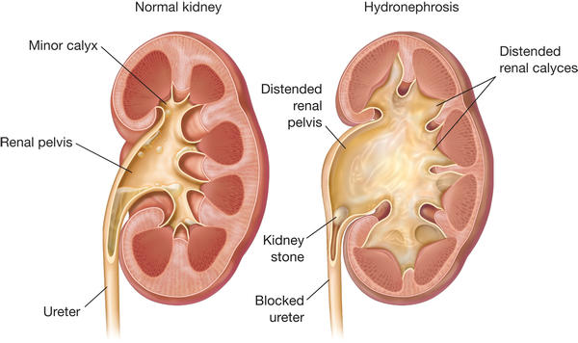
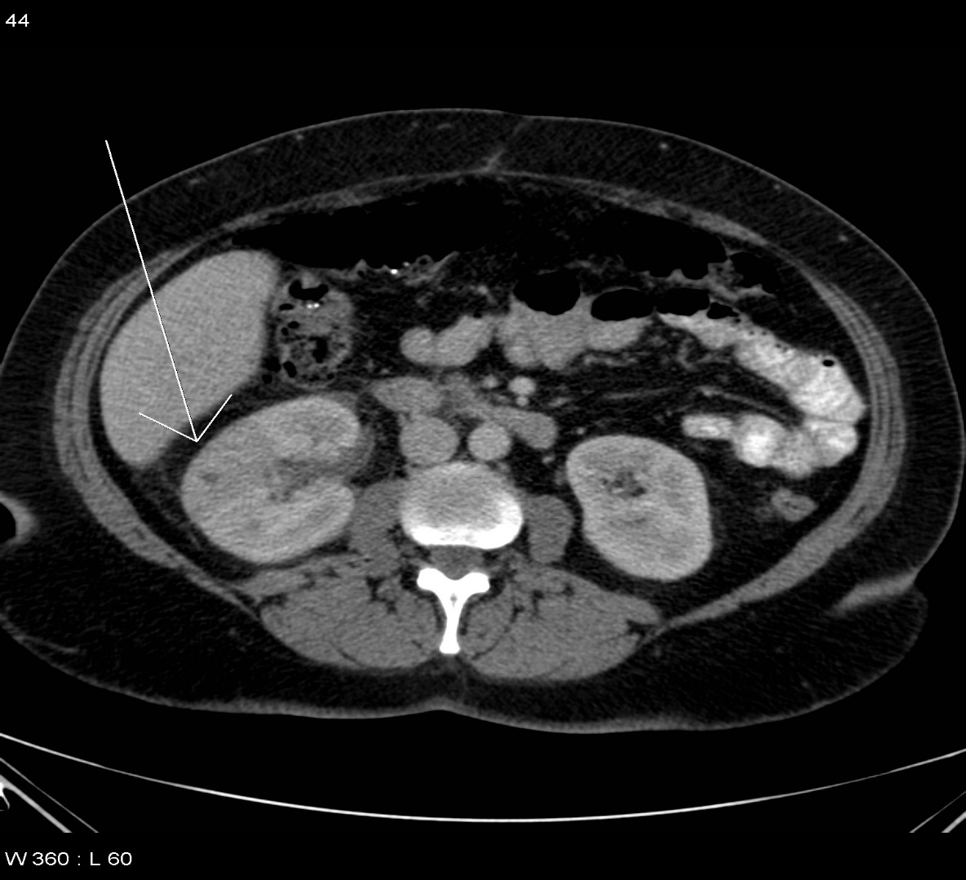
Common Kidney Pathologies:
Pyelonephrosis
is the infection of the kidney.
Acute pyelonephritis results from bacterial invasion of the renal parenchyma. Bacteria usually reach the kidney by ascending from the lower urinary tract.
CT scan for a patient with pyelonephritis, we do it only if the patient doesn’t respond to the treatment or he had a recurrent pyelonephritis.

Slide 17
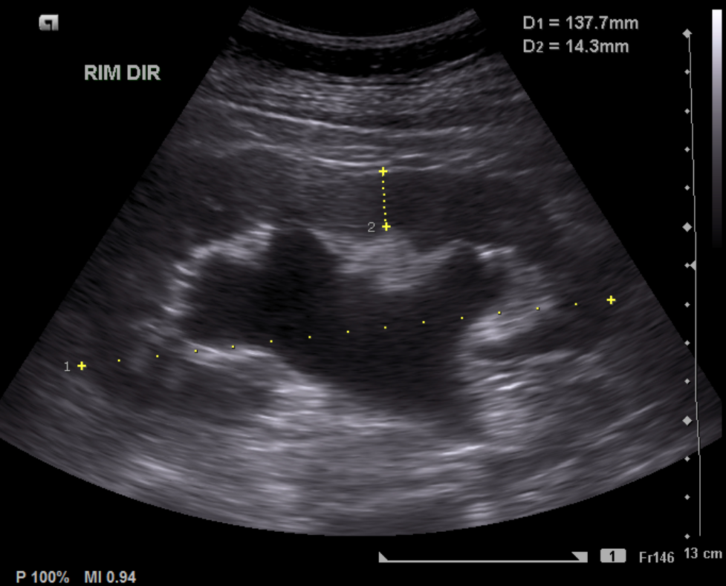
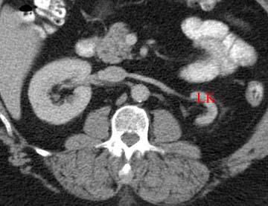
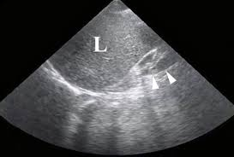
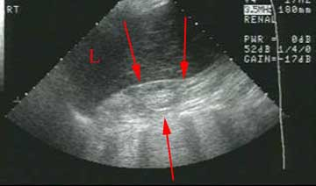
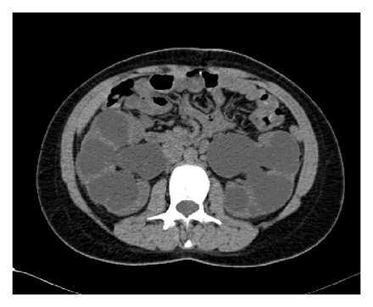
Common Kidney Pathologies:
Hydronephrosis
ESRD (End Stage Renal Disease)
is a condition that typically occurs when the kidney swells due to the failure of normal drainage of urine from the kidney to the bladder.
Kidney failure, also called end-stage renal disease (ESRD), is the last stage of chronic kidney disease. The kidney undergoes atrophy
Notes:
is a condition that typically occurs when the kidney swells due to the failure of normal drainage of urine from the kidney to the bladder.

Slide 18
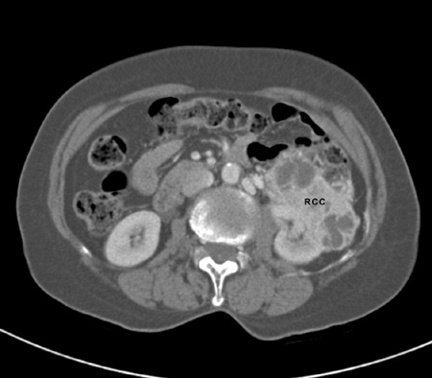
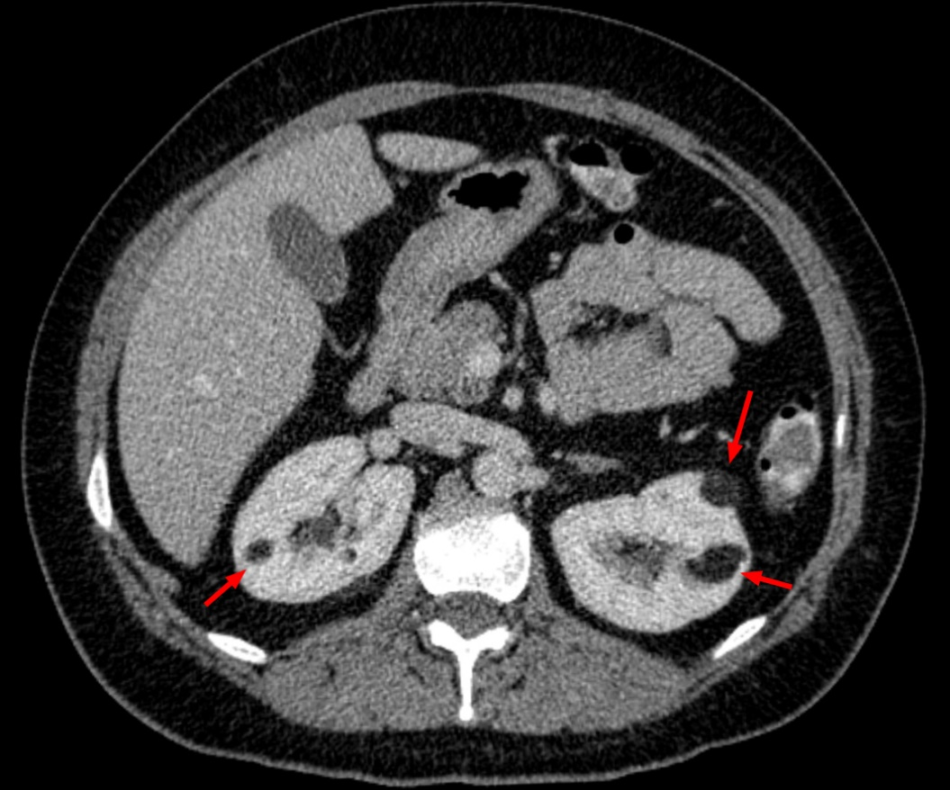
Common Kidney Pathologies:
Tumors
  Benign: most common benign is angiomyolipoma.
  Malignant: most common type is renal cell carcinoma.

Slide 19
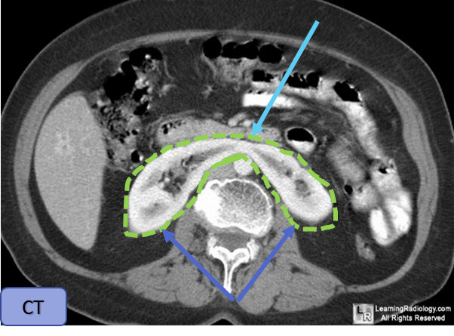
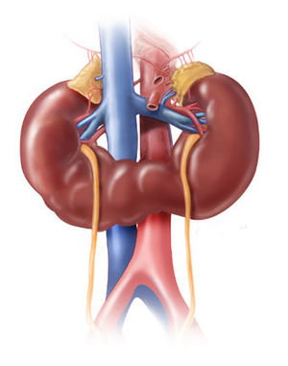
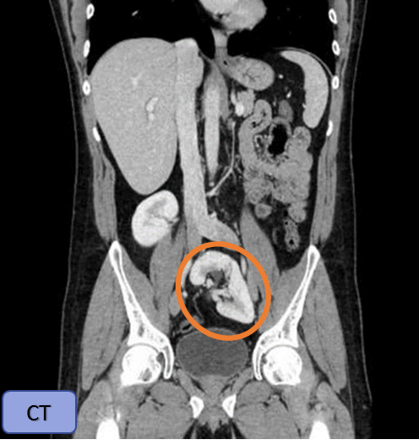
Common Kidney Pathologies:
Congenital
Lower pole of kidneys, Upper poles of kidneys, Horseshoe kidney
1- Horseshoe Kidney:
The kidneys are fused together from their lower pole.
2- Ectopic Kidney:
It is when a kidney fails to completely ascend and is left in the pelvic region.
As the kidneys develop in the pelvis, they may fuse together at their lower pole.
As they ascend, they pass by the inferior mesenteric artery, which can act as an obstacle, causing them to be lower than normal.
Patients live normally
It has an abnormal orientation. Therefore they may form kidney stones or infections more than others.
Usually asymptomatic, no intervention is needed.
Affects about 1 in 400 people.
Patient lives normally, but is more prone to infections.

Slide 20
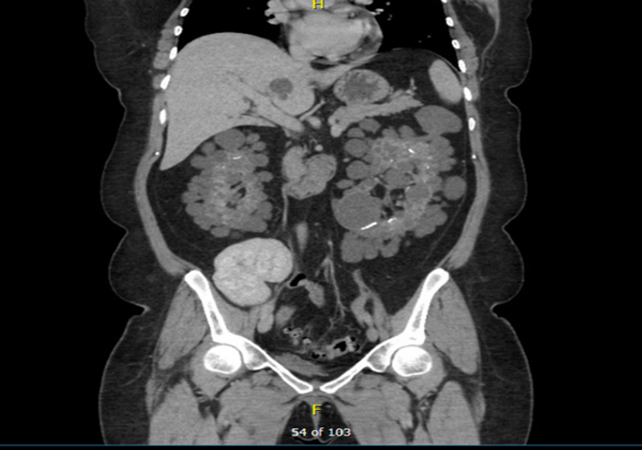
Common Kidney Pathologies:
Congenital
3-Polycystic Kidney Disease (PKD)
It is a genetic disorder, in which abnormal cysts (fluid filled sacs) develop in the kidneys, causing the kidneys to become non functional.
Two types:
Autosomal dominant polycystic kidney disease (ADPKD). symptoms usually appear in adulthood.
Autosomal recessive polycystic kidney disease (ARPKD). symptoms usually manifest in infancy.
The original kidneys are not removed from the body.
Why? Because we are trying to minimize unnecessary surgical procedures.
Extra information:
Hyper-dense/intense: appears lighter
Hypo-dense/intense: appears darker
CT
Polycystic kidneys, transplanted kidney

Slide 21
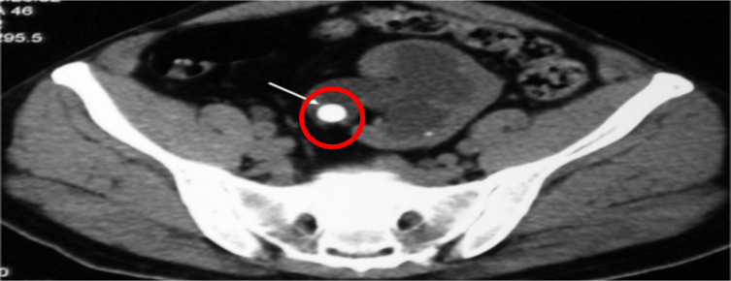
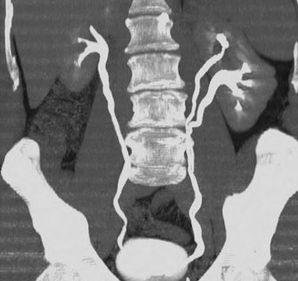
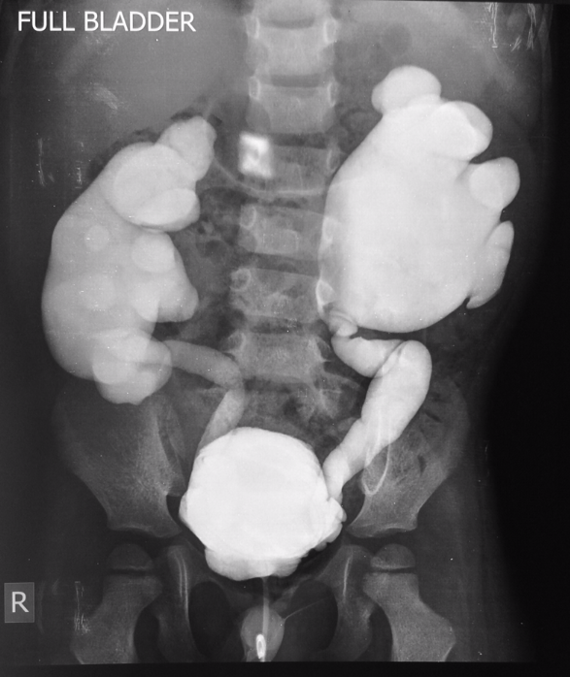
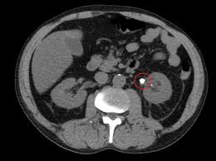
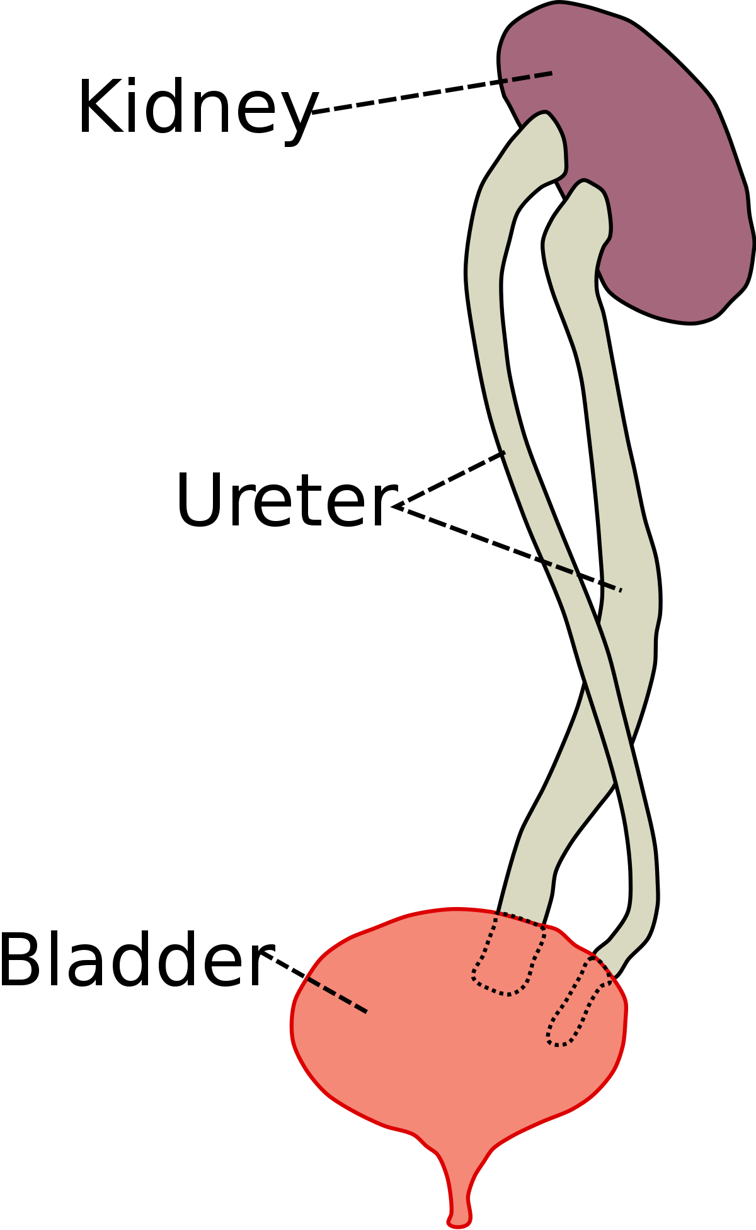
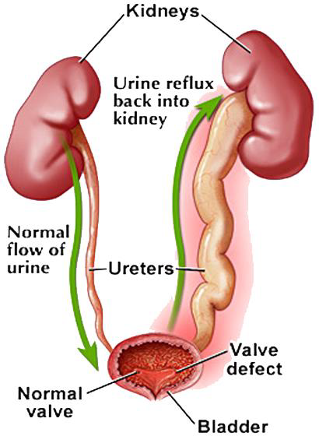
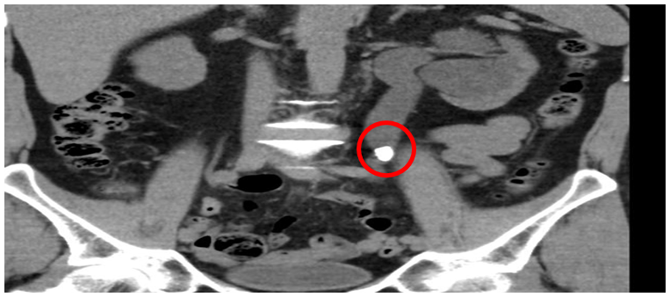
Common Ureter Pathologies:
1- Ureteric Stone:
stones in the ureter will make a obstruction and block the urines way to the bladder, which may cause Hydronephrosis.
2- Vesicoureteral reflux disease
the backward flow of urine from the bladder into the kidneys. It may be caused by an obstruction or Insufficient submucosal length of the ureter entering the bladder ( normal= ¾ inch ).. From anatomy
3- Duplicating Collecting System
It is the most common renal abnormality, occurring in approximately 1% of the population.

Slide 22
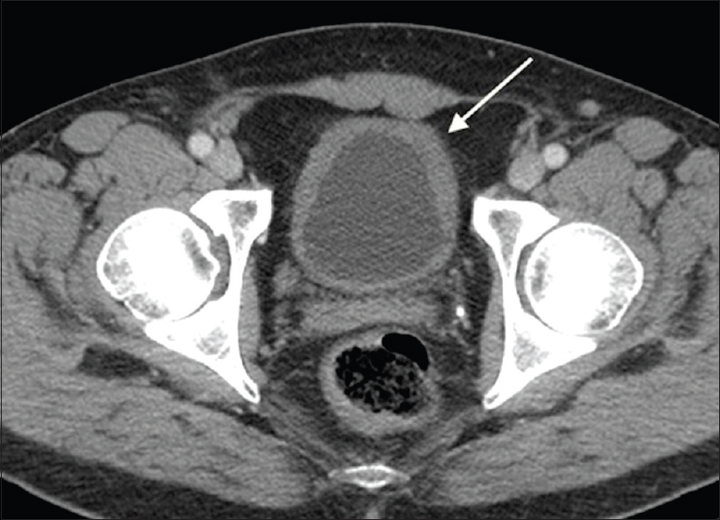

Common Urinary Bladder Pathologies:
Cystitis
IMPORTANT!
    Image 1:
    an inflamed urinary bladder (thick surrounding walls)
    Image 2:
    This bladder has gas bubbles that could be due to inflammation or infection from ‘gas producing’ bacteria

Slide 23




Benign Prostate Hypertrophy
Common Urinary Bladder Pathologies:
Bladder rupture:
  The abdomen is lined with the peritoneum from inside.
  The bladder is located below the membrane of the peritoneum

Slide 24


Common Urinary Bladder Pathologies:
Bladder Rupture (cont..)
Extra Peritoneum:
any rupture or leakage to the content of the bladder does not enter the peritoneum. Patient does not need surgery.
    Intra Peritoneum:
    there is a rupture in both bladder and peritoneum. In this case, patient will need surgery.

Slide 25
* Online Quiz *
https://www.onlinequizcreator.com/radiology-of-the-renal-system/quiz-275250

Slide 26


Leaders:
Nawaf AlKhudairy
Jawaher Abanumy
Members:
Abdulmalik Alhadlaq
Abdullah jammah
Abdullah Alhashem
Majed Alzain
Abdulhakeem Alonaiq
anatomyteam436@gmail.com
@anatomy436

