Slide 1
Major Metabolic Pathways of Glucose and Glucose Transport
Clinical Chemistry Unit Pathology Department
College of Medicine, KSU

Slide 2
Objectives
By the end of the lecture, students are expected to:
Define a metabolic pathway.
Describe the general metabolic pathways for glucose (production and utilization)
Briefly describe the HMP
Recognize the mechanisms of glucose transport

Slide 3
Metabolic Pathway
Definition
Site:
Cellular (tissue) and Subcellular
Reactions
Rate-limiting enzyme(s)
Regulatory mechanism(s):
Rapid,
short-term
Slow,
long-term
Covalent modification
Allosteric
Induction/repression

Slide 4
Metabolic Pathways of Glucose- production and utilization
Glycogenolysis
Hexose interconversion
Gluconeogenesis
Production
Glucose
Utilization
Glycolysis
HMP/PPP
Glycogenesis
Hexose interconversion
Krebs cycle

Slide 5
Metabolic Pathways of Glucose- catabolic and anabolic
Catabolic cycles
Glycolysis (Mainly)
Krebs (Mainly)
Glycogenolysis
HMP
Anabolic cycles
Gluconeogenesis
Glycogenesis

Slide 6
Glycolysis
Oxidation of glucose to provide energy.
Pyruvate is the end product of glycolysis in cells with mitochondria and an adequate supply of oxygen- aerobic glycolysis
In absence of oxygen and in cells that lack mitochondria, the end product is lactate- anaerobic glycolysis

Slide 7
Glycogenesis and Glycogenolysis
Glycogenesis:
Synthesis of glycogen from glucose
Mainly liver and muscle, Cytosol
Glycogenolysis
Degradation of glycogen into glucose
Mainly liver and muscle, Cytosol

Slide 8
Gluconeogenesis
Synthesis of glucose from non-carbohydrate precursors.
The precursors could be lactate, pyruvate, glycerol and alpha-keto acids.
It requires both mitochondria and cytosolic enzymes
Liver and kidney

Slide 9
Hexose Monophosphate shunt(HMP) or Pentose Phosphate Pathway (PPP)
HMP shunt is an alternative pathway of glucose oxidation
It is not involved in the generation of energy
Around 10% of glucose is entered in this pathway
In liver and kidney, this percentage is upto 30%

Slide 10
Biomedical Importance
It has two main functions-
Provides NADPH which is required for –
synthesis of fatty acids, steroid and some amino acids
Detoxification of drugs by cytochrome p450
In scavenging the free radicals
Provides Pentoses
This pentose and its derivatives are useful in the synthesis of
Nucleic acids (DNA and RNA)
Nucleotides (ATP, NAD, FAD and CoA)

Slide 11
Tissue Distribution
Location- Cytosol
Liver
Lactating mammary gland
Adrenal cortex
Gonads
Adipose tissue
Erythrocytes to reduce glutathione
Lens and cornea

Slide 12
Phases of HMP Shunt
It has two phases-
Oxidative phase
Non-oxidative phase

Slide 13
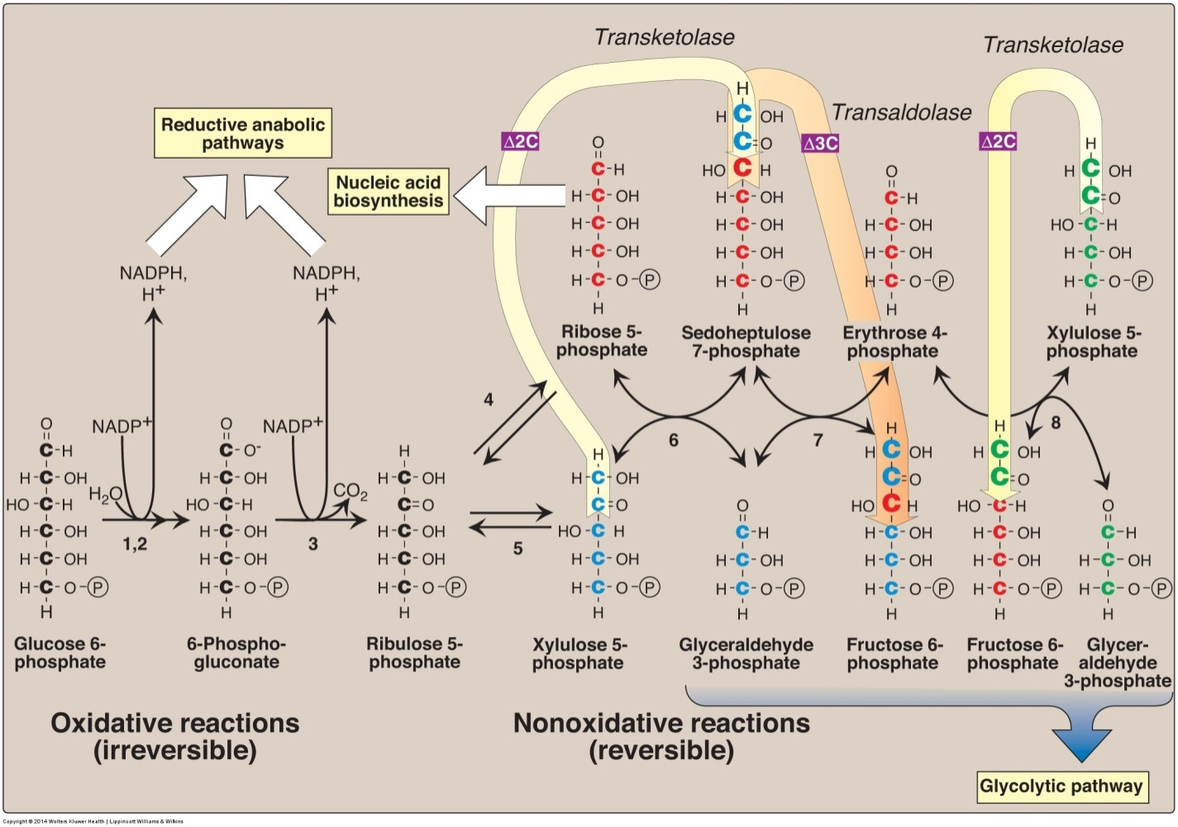
Enzymes numbered above are: 1, 2) glucose 6-phosphate dehydrogenase and 6-phosphogluconolactone hydrolase, 3) 6-phosphogluconate dehydrogenase, 4) ribose 5-phosphate isomerase, 5) phosphopentose epimerase, 6 and 8) transketolase (coenzyme: thiamine pyrophosphate), and 7) transaldolase.

Slide 14
Phase 1- Oxidative pathway
G6PD- Glucose 6-Phosphate Dehydrogenase
Lactonase- 6 phosphogluconolactone hydrolase
6PGD- 6 phosphogluconate dehydrogenase
Source – wordpress.com

Slide 15
Phase 2- Non-oxidative a) Interconversion of pentoses

Slide 16
Phase 2- Non-oxidative

Slide 17
Phase 2- Non-oxidative a) Conversion of pentose phosphate to hexose phosphates

Slide 18
Transketolation

Slide 19
Transaldolation

Slide 20
Transketolation

Slide 21
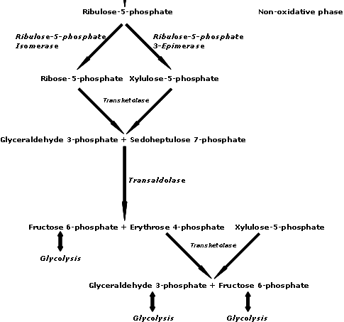
Source – wordpress.com

Slide 22
Clinical Correlations

Slide 23
Glucose Transport
Na⁺-Monosaccharide Cotransporter:
Against concentration gradient
Energy dependent
Carrier-mediated
Coupled to Na⁺ transport
Small intestine, renal tubules & choroid plexus
Na⁺-Independent Facilitated Diffusion:
Down the concentration gradient
Energy Independent
Glucose Transporters (GLUT 1-14)

Slide 24
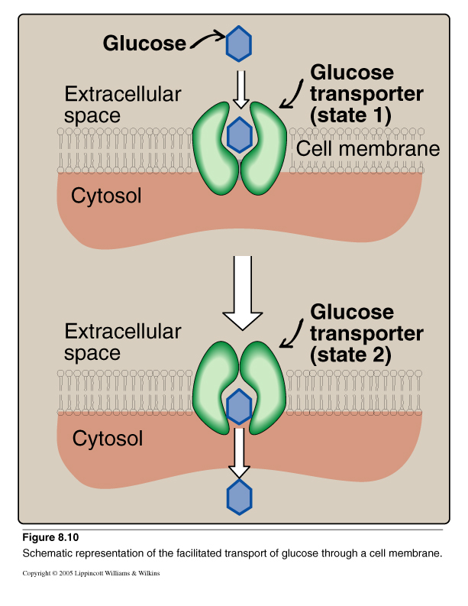
Glucose Transport: Facilitated Diffusion

Slide 25
Glucose Transporters
Tissue-specific expression pattern
GLUT-1 RBCs and brain
GLUT-2 Liver, kidney & pancreas
GLUT-3 Neurons
GLUT-4 Adipose tissue & skeletal muscle
GLUT-5 Small intestine & testes
GLUT-7 Liver (ER-membrane)
Functions:
GLUT-1, 3 & 4 Glucose uptake from blood
GLUT-2 Blood & cells (either direction)
GLUT-5 Fructose transport

Slide 26
Take Home Messsage
There are multiple pathways for glucose that can be grouped in to catabolic (utilizing glucose) or anabolic (producing glucose)
Glycolysis is the major metabolic pathway of glucose breakdown to provide energy

Slide 27
Take Home Messsage - HMP
Alternative pathway for glucose oxidation but not meant for producing energy
Has two phases- oxidative and non-oxidative
During oxidative phase, glucose-6-P is oxidized with generation of 2 moles of NADPH, and one mole of pentose phosphate, with liberation of CO2
During non-oxidative phase, pentose phosphate is converted to intermediates of glycolysis

Slide 28
References
Lippincott’s Illustrated Reviews- Biochemistry 6th Edition- pages: 96-97,117,126,128,145-147
http://www.biochemden.com/the-hexose-monophosphate-shunt/

