Slide 1
Human Genetics
Lecture Three
Mode of Inheritance

Slide 2
Objectives:
By the end of this lecture, students should be able to:
Assess Mendel’s laws of inheritance
Understand the bases of Mendelian inheritance
Define various patterns of single gene inheritance using family pedigree and Punnett square

Slide 3
Father of Genetics
Born in 1822
Monk and teacher
Discovered some of the basic laws of heredity
His published his work, entitled Experiments on Plant Hybrids in1866 However, largely ignored
He died in 1884 with his work still unnoticed
His work rediscovered in 1900.

Slide 4
Interpreting the outcomes of Mendel’s breeding experiments:
The plant characteristics being studied were each controlled by a pair of factors, one of which was inherited from each parent.
The pure-bred plants, with two identical genes, used in the initial cross would now be referred to as homozygous.
The hybrid F1 plants, each of which has one gene for tallness and one for shortness, would be referred to as heterozygous.
The genes responsible for these contrasting characteristics are referred to as allelomorphs, or alleles for short.

Slide 5
Genotypes

Slide 6
Punnett Square
Each parent can only contribute one allele per gene
These genes are found on the chromosomes of gametes of parents
Offspring will inherit 2 alleles to express that gene
Notes:
A Punnett Square Can Be Used to Predict the Outcome of Crosses
An easy way to predict the outcome of simple genetic crosses is to use a Punnett square, a method originally proposed by Reginald Punnett . To construct a Punnett square, you must know the genotypes of the parents. With this information, the Punnett square enables you to predict the types of offspring the parents are expected to produce and in what proportions.
A Punnett square illustrates how alleles combine in offspring. The different types of gametes of one parent are listed along the top of the square, with those of the other parent listed on the left-hand side. Each compartment displays the genotype that results when gametes that correspond to that compartment join.

Slide 7
COMPLETE DOMINANCE - one allele is dominant to another allele RECALL MENDEL’S 1st EXPERIMENT
Law of Dominance or Uniformity
CROSS: Pure bred purple female x White male
P1 generation = PP x pp Female gametes
Male gametes
Genotype ratio =1Pp
F1 generation
Phenotype ratio =1 purple
P
P
p
Pp
Pp
p
Pp
Pp
Notes:
LAW OF DOMINANCE, OR UNIFORMITY OF THE FIRST HYBRID GENERATION
One of the first factors noticed by Mendel (although the phenomenon had been known even earlier) was that out of two alternative characters of the first generation hybrids (F₁) only one usually developed ‘Ex. Purple flower colour’. The second feature seemed to disappear or be suppressed ‘Ex. white flower colour’. Thus, studying Purple and white colours of flowers, Mendel found out that all flowers of F₁ plant were purple.
Mendel called the characters, such as revealed in flowers with a purple colour, dominant; and those with white form, recessive.
In subsequent investigations carried out by other scientists, many characteristics were found which showed complete and incomplete dominance. However, the importance of the phenomenon discovered by Mendel consisted of the fact that the appearance of a specimen could no longer be considered as an exact indicator of its hereditary constitution, because domination resulted in a hybrid or cross having the appearance of a pure-bred specimen. Later this principle of domination found its expression in such terms as phenotype (appearance) and genotype (hereditary constitution).
Mendel’s first proposal was that the variant for one character is dominant to another variant. For example, the variant of Purple flowers is dominant to that of white flowers. The term recessive is used to describe a variant that is masked by the presence of a dominant trait but reappears in subsequent generations.
¹ The parental generation is denoted with “P” (parental), the first generation after crossing - “F₁” (filial), the second - “F₂” etc.

Slide 8
RECALL MENDEL’S 2nd EXPERIMENT
Law of segregation
CROSS: Two F1 generation offspring with each other
P1 generation = Pp x Pp
Female gametes
Male gametes
F1 generation Genotype ratio =1PP:2Pp:1pp
Phenotype ratio = 3 purple:1 white
P
p
P
PP
Pp
p
Pp
pp
Notes:
In this experiment Mendel crossed the F1 hybrids which produced the F2 generation that lost trait appeared with predictable ratios.
This led to the formulation of the segregation mode of inheritance. Eukaryotes have two copies of most genes. These copies may be the same or they may differ. The term allele refers to different versions of the same gene. With this modern knowledge, the above results shown in Figure are consistent with the idea that each parent transmits only one copy of each gene (i.e., one allele) to each offspring.
Mendel’s law of segregation states:
The two copies of a gene segregate (or separate) from each other during transmission from parent to offspring.
Therefore, only one copy of each gene is found in a gamete. At fertilization, two gametes combine randomly, potentially producing different allelic combinations.

Slide 9
Law of independent assortment
Definition
During gamete formation, different pairs of alleles segregate independently of each other.
Interpretation
In a dihybrid cross, each pair of alleles assorts independently during gamete formation. In the gametes, Y is equally likely to be found with R or r (that is, Y R = Y r ); the same is true for y (that is, y R = y r ).
As a result, all four possible types of gametes ( Y R , Y r , y R , and y r ) are produced in equal frequency among a large population.
Notes:
Law of independent assortment
Investigated the pattern of inheritance for two different characters.
Mendel carried out two-factor crosses in which he followed the inheritance of two different characters within the same groups of individuals. These experiments led to the formulation of the independent assortment law.

Slide 10
THE CHROMOSOME THEORY OF INHERITANCE AND SEX CHROMOSOMES
How chromosomal transmission is related to the patterns of inheritance observed by Mendel?
Notes:
The Chromosome Theory of Inheritance Relates the Behavior of Chromosomes to the Mendelian Inheritance of Traits
According to the chromosome theory of inheritance, the inheritance patterns of traits can be explained by the transmission
patterns of chromosomes during meiosis and fertilization. This theory is based on a few fundamental principles as follow:
1. Chromosomes contain the genetic material that is transmitted from parent to offspring and from cell to cell.
2. Chromosomes are replicated and passed along, generation after generation, from parent to offspring. They are also passed from cell to cell during the development of a multicellular organism. Each type of chromosome retains its individuality during cell division and gamete formation.
3. The nuclei of most eukaryotic cells contain chromosomes that are found in homologous pairs—they are diploid. One member of each pair is inherited from the mother, the other from the father. At meiosis, one of the two members of each pair segregates into one daughter nucleus, and the homolog segregates into the other daughter nucleus. Gametes contain one set of chromosomes—they are haploid.
4. During the formation of haploid cells, different types of (non-homologous) chromosomes segregate independently of each other.
5. Each parent contributes one set of chromosomes to its offspring. The maternal and paternal sets of homologous chromosomes are functionally equivalent; each set carries a full complement of genes.

Slide 11
Mendel’s law of segregation can be explained by the segregation of homologs during meiosis
The two copies of a gene are contained on homologous chromosomes.
In this example using pea seed color, the two alleles are Y (yellow) and y (green).
During meiosis, the homologous chromosomes segregate from each other, leading to segregation of the two alleles into separate gametes.
Notes:
Genes→Traits
The gene for seed color exists in two alleles, Y (yellow) and y (green). During meiosis, the homologous chromosomes that carry these alleles segregate from each other. The resulting cells receive the Y or y allele, but not both. When two gametes unite during fertilization, the alleles they carry determine the traits of the resulting offspring.

Slide 12
Mendel’s law of independent assortment can be explained by the random alignment of bivalents during metaphase of meiosis I
This figure shows the assortment of two genes located on two different chromosomes, using pea seed color and shape as an example (YyRr).
During metaphase of meiosis I, different possible arrangements of the homologs within bivalents can lead to different combinations of the alleles in the resulting gametes.
For example, on the left, the dominant R allele has sorted with the recessive y allele; on the right, the dominant R allele has sorted with the dominant Y allele.
Notes:
Genes→Traits
Most species have several different chromosomes that carry many different genes. In this example, the gene for seed color exists in two alleles, Y (yellow) and y (green), and the gene for seed shape is found as R (round) and r (wrinkled) alleles. The two genes are found on different (nonhomologous) chromosomes. During meiosis, the homologous chromosomes that carry these alleles segregate from each other. In addition, the chromosomes carrying the Y or y alleles will independently assort from the chromosomes carrying the R or r alleles. As shown here, this provides a reassortment of alleles, potentially creating combinations of alleles that are different from the parental combinations. When two gametes unite during fertilization, the alleles they carry affect the traits of the resulting offspring.

Slide 13
MODES OF INHERITANCE FOR SINGLE GENE DISORDERS
Autosomal
Sex Linked
Recessive
Dominant
Y Linked
X Linked
Recessive
Dominant
Notes:
MENDELIAN INHERITANCE (simple pattern of inheritance)
- Over 11,000 traits/disorders in humans exhibit single gene unifactorial or Mendelian inheritance.
- A trait or disorder that is determined by a gene on an autosome is said to show autosomal inheritance.
- A trait or disorder determined by a gene on one of the sex chromosomes is said to show sex-linked inheritance.

Slide 14
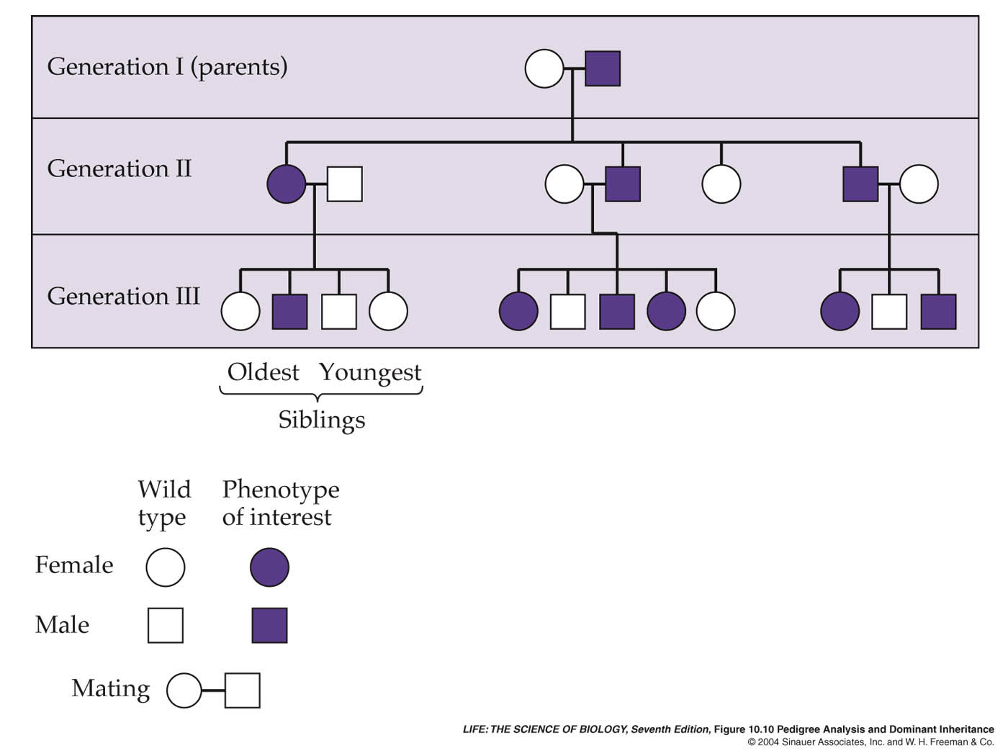
A Pedigree Analysis
Notes:
for Huntington’s Disease

Slide 15
Autosomal Dominant
The trait (character, disease) appears in every generation.
Unaffected persons do not transmit the trait to their children.
Examples: Huntington disease, Myotonic dystrophy, Neurofibromatosis type 1, Marfan syndrome etc.

Slide 16
Family Tree of an Autosomal Dominant Mode of Inheritance
Note the presence of male-to-male
(i.e. father to son) transmission

Slide 17
Autosomal Recessive
The trait (character, disease) is recessive
The trait expresses itself only in homozygous state
Unaffected persons (heterozygotes) may have affected children (if the other parent is heterozygote)
The parents of the affected child maybe related (consanguineous)
Males and female are equally affected
Examples:
Cystic fibrosis, Phenyketonuria, Sickle cell anaemia, Thalassaemia etc.

Slide 18
Punnett square showing autosomal recessive inheritance
1-) Both Parents Heterozygous:
25% offspring “affected Homozygous”
50% Trait “Heterozygous normal but carrier”
25% Normal
 | A | a
A | AA | Aa
a | Aa | aa
Mother
Father

Slide 19
(2) One Parent Heterozygous:
Female 50% normal but carrier “Heterozygous”
50% Normal
(3) One Parent Homozygous:
Female 100% offspring carriers.
 | A | a
A | AA | Aa
A | AA | Aa
 | A | A
a | Aa | Aa
a | Aa | Aa

Slide 20
Family tree of an Autosomal recessive disorder Sickle cell disease (SS)
A family with sickle cell disease -Phenotype
Hb Electrophoresis
AA AS SS

Slide 21
Sex – Linked Inheritance
This is the inheritance of a gene present on the sex chromosomes.
The Inheritance Pattern is different from the autosomal inheritance.
Inheritance differs in males from females.

Slide 22
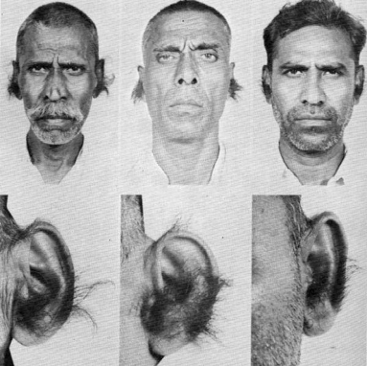
Y – Linked Inheritance
The gene is on the Y chromosomes
The gene is passed from fathers to sons only
Daughters are not affected
Hairy ears in India
Male are Hemizygous, the condition exhibits itself whether dominant or recessive
Father
 | X | Y*
X | XX | XY*
X | XX | XY*
Mother

Slide 23
X – Linked Inheritance
The gene is present on the X chromosome
The inheritance follows specific pattern
Males have one X chromosome, and are hemizygous
Females have 2 X chromosomes, they may be homozygous or heterozygous
These disorders may be : recessive or dominant

Slide 24
X – Linked Recessive Inheritance
The incidence of the X-linked disease is higher in male than in female
The trait is passed from an affected man through all his daughters to half their sons
The trait is never transmitted directly from father to sons
An affected women has affected sons and carrier daughters
X - Linked Recessive Disorders: Albinism, Fragile X syndrome, Hemophilia, Muscular dystrophy, Retinitis pigmentosa

Slide 25
X – Linked Recessive Inheritance
(1) Normal female, affected male
Mother
 | X | X
X* | X*X | X*X
Y | XY | XY
Father
All sons are normal
All daughters carriers “not affected”

Slide 26
(2) Carrier female, normal male:
Mother
 | X* | X
X | XX* | XX
Y | X * Y | XY
50% sons affected
50% daughters carriers
Father
(3) Homozygous female, normal male:
- All daughters carriers.
- All sons affected.

Slide 27
X-Linked Dominant Disorders
The gene is on X Chromosome and is dominant
The trait occurs at the same frequency in both males and females
Hemizygous male and heterozygous females express the disease.

Slide 28
Punnett square showing X – linked dominant type of Inheritance
(1) Affected male and normal female:
Mother
 | X | X
X* | X*X | X*X
Y | XY | XY
Father
All daughters affected, all sons normal
(2) Affected female (heterozygous) and normal male:
Mother
 | X* | X
X | XX* | XX
Y | X*Y | XY
Father
50% sons & 50% daughters are affected

Slide 29
TAKE HOME MESSAGE:
An accurate determination of the family pedigree is an important part of the workup of every patient
Pedigrees for single-gene disorders may demonstrate a straightforward, typical mendelian inheritance pattern
These patterns depend on location of the gene locus on the chromosomal, which may be autosomal or sex chromosome-linked, and whether the phenotype is dominant or recessive

