Slide 1
Learnig Skills Course (SKLL 101)
Dept. of Medical Education
College of Medicine
King Saud University

Slide 2
Contents
General Information
Why Learning Skills Course??
Outcome of the Learning Skills Course
Sessions Objectives
Topics
Teaching & Learning methods
Assessment
Conclusion

Slide 3
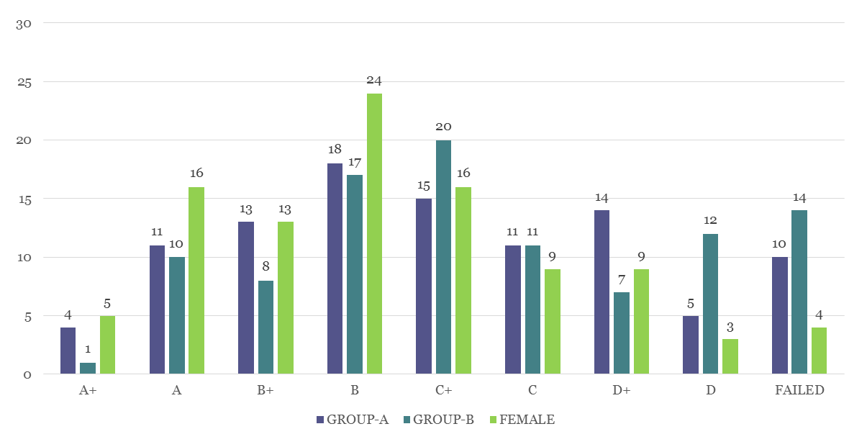
COMPARISON OF PERFORMANCE IN FOUNDATION BLOCK AMONG 3 GROUPS OF STUDENTS FOR THE ACADEMIC YEAR 2016-2017
YOUR COMMENTS

Slide 4
General Information
Course Title: Learning Skills
Course Code & Number: SKLL 101
Credit Hour: 2
Course Duration: First Semester
Course Starting Date: 17 of September

Slide 5
Course Directors
Course Committee:
Prof. HAMZA M. ABDULGHANI Chairman
Prof. MAHMOUD SALAH Member
Dr. TAUSEEF AHMAD Member
Ms. RUQAIAH ZABARAH Course Secretary
maesimplys@yahoo.com
Tel: 4699170

Slide 6
Outcome of the Learning Skills course
By the end of the course the students will be able to:
Identify the university, academic organization and student support systems.
Apply principles of adult learning.
Describe different learning styles, and explain their own styles.
Explain the concepts, principles and practice the process of learning in small group.
Enumerate the principles of evidence-based practice and demonstrate the skill of information gathering.
Manage their time and set his priorities.
Communicate effectively with patients and their peers
Demonstrate professional behavior expected from medical students.
Recognize symptoms of stress and develop the ability to handle their stress and anxiety.
Describe the college to assessment system to motivate himself for high grade achievement.

Slide 7
Topics
Introduction to learning skills course
Blackboard Training
Becoming a PBL student
Time management*
Learning how to learn-General principles*
How to remain as high achieving students*
Stress management*
Information Gathering: searching Internet for Medical References
Introduction to Evidence-based medicine
College Assessment System
Motivation*
Professionalism in Medical Education
Doctor-Patient Communication General principles

Slide 8
Teaching & Learning methods
Large Group Instruction
Interactive lectures and discussion
Live Demonstration:
Video presentations; Educational broadcasts, Examples from real life
Individualized learning Directed study of scientific articles, study of open-learning materials; mediated self-instruction, Application of concepts and principles to real life activities.
Reflection; the most important strategy of learning anything and every things
Group learning: Class discussions; Discussion Board, PBLs, seminars; group tutorials; games and simulations in skills lab; etc.

Slide 9
Assessment
System
of the Course

Slide 10
Assessment Methods
Portfolio-Based Assessment:
Learning skills application and demonstrating evidence of achievement and reflection on its real practice
Your presence in the class for discussion (6%)
Five assignments:
Based on agreed portfolio criteria
No cut and past
Your own writing
Clear reflective ideas
Timely submitted
See portfolio students’ guide
First three assignments (60%)
Second two assignments (34%)

Slide 11
Detailed Objectives
of each
Sessions

Slide 12
Session objectives Session-1 Orientation
Explain the content, teaching / learning and assessment methods of learning skills course.
Apply appropriate student-centered learning methods for different courses of the curriculum.
Describe the key topics and main theme of the course.
Localize different facilities available for them like students' support system, library, Internet access, cafeteria and so forth.
Enumerate the different library sections which will help them in using library
Apply the searching abilities to search some topics or subject in medical data- base.

Slide 13
Session-2: Blackboard training.
Explain the content of the Blackboard learning management system and it configuration
Enumerate the different uses of Blackboard.
Log on the system to explore its utilization.
Course contents
Download any materials
Check your results
Follow your progress
etc

Slide 14
Session-3: Become a PBL Student Year 1
Explain the rational of learning in a small group
Enumerate the principles of small group.
Explain the dynamic of small.
Identify their roles in a small group.
Demonstrate the ability to conduct the roles in a small group effectively.
Employ communication skills effectively to maintain group dynamics.

Slide 15
Session-4: Time Management:
Identify the importance of TM
Explain Time wasters
Plan their schedules effectively
Identify procrastination signs
Identify solution to deal with procrastination
Apply these principles to daily life situations

Slide 16
Session-5: Learning how to learn
Define “Learning”
Identify learning principles.
Compare and contrast undergraduate versus secondary school learning.
Identify different types of learning
Differentiate between superficial and deep learning
Apply the learning principles to their daily learning activities

Slide 17
Session 6. How to remain high achieving students:
Recognize levels of academic performance
Identify the factors lead to high academic achievement
Discuss the manner of improving academic performance.
Address the factors would help to improve their academic performance.
Select factors which suite individual student for his/her academic performance.
Apply these concepts and principles in real life situation.

Slide 18
Session 7: Stress Management
Define stress
Identify types of stress
Explain the mechanisms of stress
Discuss the relation of stress to human health
Explain the stress management strategies
Apply these principles to daily life situation

Slide 19
Session-8: Introduction to Medical Search Using internet
Identify different search engine for literature review.
Apply different methods of finding relevant scientific literature.
Demonstrate some sites of electronic journals and its features.
Apply searching steps to different Database.

Slide 20
Session-9: Introduction to Evidence-based Medicine (EBM)
Discuss the principles of EBM approach.
Utilize the sources of EBM Database.
Differentiate between primary and secondary data sources.
Discuss some common terminologies used in EBM practice
Value the EBM application to daily clinical practice.

Slide 21
Session10. College assessment system:
Identify rules and regulations of the assessment system in the college
Recognize the different components of the assessment system
Discuss the development process of a course assessment
Identify the pass/fail criteria for different courses
Discuss the strategies to improve academic performance in a test.

Slide 22
Session 11. Motivation
Define motivation
Recognize different types of motivation.
Enumerate the factors which influence or decrease student motivation.
Identify how motivation could influence academic performance.
Recognize how low motivation is associated with restricted growth in achievement.
Apply motivation concepts in real life situation.

Slide 23
Session-12: Professionalism in Medical Education
Define Professionalism.
Identify professional and unprofessional behaviors.
Explain why professionalism is an important part of the curriculum.
Discuss the strategies to become professional

Slide 24
Session-13: Communication skills:
Discuss the principles of effective communication.
Compare and contrast between active and passive communication.
Demonstrate verbal and non-verbal communication, including body language.
Analyze scenarios or videos of communication skills to give feedback.
Role play in safe environment and give and receive feedback by peers and tutors.

Slide 25
Conclusion
Learning Skills Course is to improve your style of learning
The course discusses concepts and principles of learning
These skills to be applied in your practical life
Reflection to be learnt to become a better learner
Application of these skills will improve your academic performance and keep you
high academic achiever

Slide 26
References (Power Point Slides & the Guide)
Samy A Azer, Rana Hasanato, Sami Al-Nassar, Ali Somily and Muslim M AlSaadi. Introducing integrated laboratory classes in a PBL curriculum: impact on student’s learning and satisfaction; BMC Medical Education 2013, 13:71.
Ali Alhaqwi, Tariq Mohamed, Abdulaziz Alkabba, Sultan Alotaibi, Ali Alshehri, Hamza Abdulghani, Motasim Badri; Problem-based learning in undergraduate medical education in Saudi Arabia: Time has come to reflect on the experience; Med.Teh. 2015, 37: S61–S66
Hamza Abdulghani; Abdulmajeed Aldrees; Mahmood Khalil; Farah Ahmad; Gominda Ponnamperuma; Zubair Amin; What factors determine academic achievement in high achieving undergraduate medical students? A qualitative study; Medical Teacher; 2014, 36: S43–S48
Abdulmajeed Al- Drees, Mahmoud Salah Khalil, Sultan Ayoub Meo, Hamza Mohammed Abdulghani; Utilization of blackboard among undergraduate medical students: Where we are from the reality? Journal of Taibah university medical sciences 2014; 1-5
Kamran. S, Hamza. M. A, Tauseef. A; Jennesse. J. Shaping medical professionalism in pre-clinical medical students: Students’ perspective; Biomedical Research 2017; 28(1)

Slide 27
We wish you a very successful and enjoyable time in your course and your career
All the best

