Slide 1
Foundation Block
2013 -2014
Introduction to Parasitology

Slide 2
DEFINITIONS
Infection:
The entry , development and multiplication of an infectious agent in the body of humans or animals. The result may be:
inapparent ( asymptomatic) infection, or
manifest (symptomatic) infection..

Slide 3
DEFINITIONS
Host:
A human or animal which harbors an infectious agent under natural conditions .
Definitive host (primary host):
- A host in which the parasite passes its sexual stage.
Intermediate host (secondary host):
A host in which the parasite passes its larval or asexual stages.

Slide 4
DEFINITIONS
carrier:
A person or animal that harbors a specific infectious agent in the absence of symptoms and signs of a disease and serves as a potential source of infection
pathogenesis:
Production and development of disease.
pathogenicity:
Capability of an infectious agent to cause disease in a susceptible host.
.

Slide 5
DEFINITIONS
Parasitism:
A relationship in which an organism (the infectious agent, the parasite) benefits from the association with another organism (the host) whereas the host is harmed in some way.
commensalism:
Kind of relationship in which one organism , the commensall , is benefited whereas the other organism , the host , is not harmed or even helped by the association.

Slide 6
DEFINITIONS
Ectoparasite: parasite that lives on the outer surface of its host.
Endoparasite: Parasite that lives inside its host.
zoonosis: Disease of animals that is transmissible to humans .

Slide 7
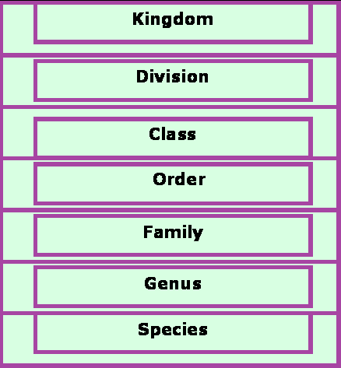
Scientific names of parasites follow Zoological Classification

Slide 8
CLASSIFICATION OF PARASITES
PROTOZOA | HELMINTHS
Unicellular Single cell for all functions | Multicellular Specialized cells
1:Amoebae: move by pseudopodia. 2:Flagellates: move by flagella. 3:Ciliates: move by cilia 4:Apicomplexa(Sporozoa) tissue parasites | Round worms (Nematodes): - elongated, cylindrical, unsegmented. Flat worms : - Trematodes: leaf-like, unsegmented. - Cestodes: tape-like, segmented.

Slide 9
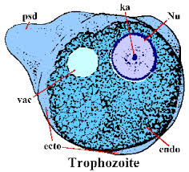
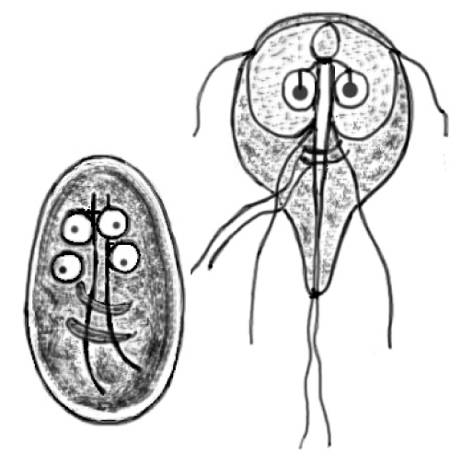
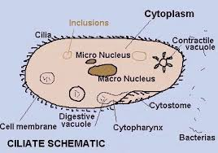
flagella
pseudopodia
cilia

Slide 10
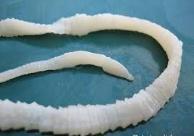
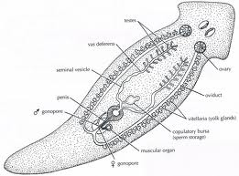
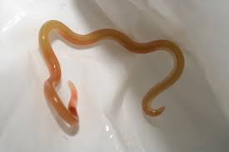
Trematodes
Cestodes
Nematodes

Slide 11
Intestinal
Parasitic Protozoa
Blood and tissues

Slide 12
Examples of Diseases caused by Intestinal Protozoa
Parasite
Disease
giardiasis
Giardia lamblia
Entamoeba histolytica
amoebiasis

Slide 13
Giardia trophozoite diagnostic stage
Giardia cyst
( infective stage &diagnostic stage)

Slide 14
Giadria lamblia an example of Intestinal Protozoa

Slide 15
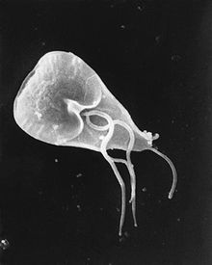
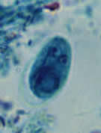
Giardia cyst
( infective stage)
Giardia trophozoite

Slide 16
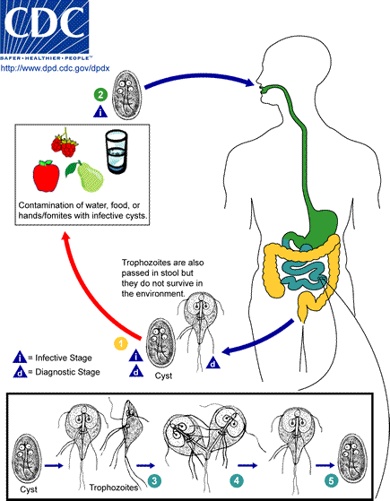
Giardia lamblia :
Life cycle

Slide 17
1-. Giardia cysts are the infective stage of G. intestinalis. As few as 10 cysts can cause infection , These cysts are ingested by consuming contaminated food or water, or fecal-orally. They can survive outside the body for several months, and are also relatively resistant to chlorination, UV exposure and freezing. 2_. When cysts are ingested, the low pH of the stomach acid produces excystation, in which the activated flagella breaks through the cyst wall. This occurs in the small intestine, specifically the duodenum. Excystation releases trophozoites, with each cyst producing two trophozoites. 3. Within the small intestine, the trophozoites reproduce asexually (longitudinal binary fission) and either float free or are attached to the mucosa of the lumen. 4. Some trophozoites then encyst in the small intestine, Both cysts and trophozoites are then passed in the feces, but only the cyst is infectious , Person-to-person transmission is possible, Animals can also be infected with Giardia .

Slide 18
Examples of Diseases caused by Blood and Tissue Protozoa
Parasite
Disease
malaria
Plasmodium spp

Slide 19
Malaria Species
Four main species of malaria :
Plasmodium falciparum
Plasmodium vivax
Plasmodium ovale
Plasmodium malariae

Slide 20
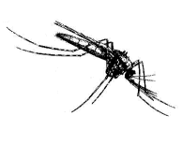
LIFE CYCLE OF MALARIA
Oocyst
Sporozoites
Zygote
Stomach Wall
Salivary Gland
sporozoites
Gametocytes
Pre-erythrocytic
(hepatic) cycle
Exo-erythrocytic
(hepatic) cycle
Erythrocytic
Cycle
Hypnozoites

Slide 21
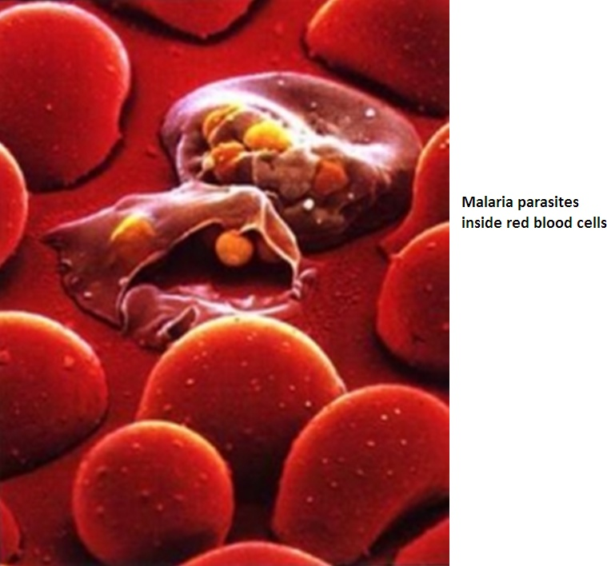
Main pathology of malaria is due to invasion of the RBCs

Slide 22
Examples of Diseases caused by Blood and Tissue Protozoa
Parasite
Disease
Leishmania major
Cutaneous leishmaniasis

Slide 23
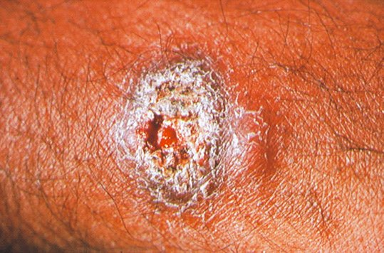
Cutaneous leishmaniasis caused by Leishmania major

Slide 24
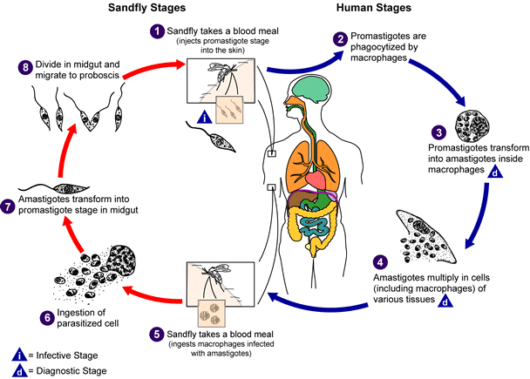

Slide 25
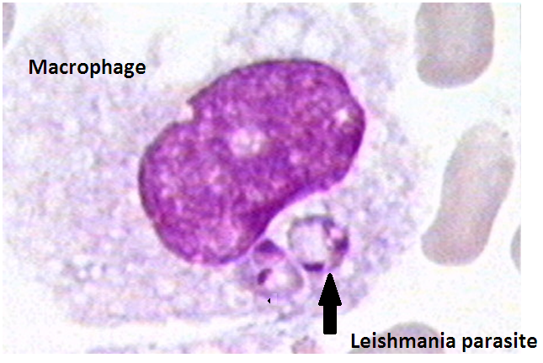

Slide 26
OBJECTIVES
By the end of this lecture the student should be able to:
1. Define common terms describing host-parasite relationship.
2. Outline the broad classification of parasites.
3. Name examples of protozoan parasites.
4. Describe the life-cycle of Giadia lamblia as an example of intestinal protozoa.
5. Describe the main stages of the life-cycle of Plasmodium as an example of blood and tissue protozoa.

Slide 27
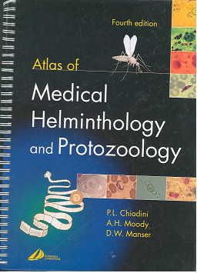
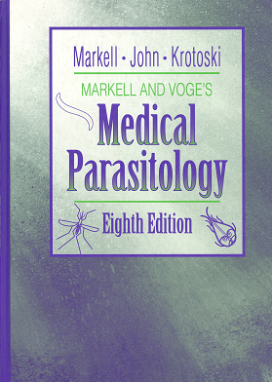
Resources on Parasitology

Slide 28
Resources on Parasitology
Centre for Disease Control and Prevention (CDC) :
http://www.dpd.cdc.gov/DPDx/HTML/Para_Health.htm

