Slide 1
INTRODUCTION TO PATHOLOGY
SUFIA HUSAIN (assist prof & consultant)
PATHOLOGY
College of medicine
KSU
RIYADH
September 2017

Slide 2
Objectives:
The student should:
Understands the role of pathology and its various subspecialities in the diagnostic process with special emphasis on histopathology and cytology.
Understands the meaning of the terminology used during the study of a disease like aetiology, pathogenesis, prognosis, sequelae, symptoms, signs, incidence etc.
Role of diagnostic pathology in disease management.
Be aware of some of the principle techniques used in pathology like light microscopy, cytology, immunohistochemistry and molecular pathology.
Have a basic knowledge of the definition of autopsy and its indications.

Slide 3
DEFINITION OF PATHOLOGY
Pathology is the study of disease by scientific methods. It is the study of changes which occur in cells and tissues as a result of any injury to the cell or tissue.
Disease is defined as an abnormality in structure or function of any part of the body.

Slide 4
Parts of Pathology
The following are the 5 major aspects studied as part of pathology of any disease.
Epidemiology
Etiology
Pathogenesis
Morphologic changes and
Clinical features (signs and symptoms)

Slide 5
1. Epidemiology
Study of the occurrence and distribution of diseases in a population and the application of this knowledge to help the health system. It is the study of the patterns, causes, and effects of disease conditions in various populations.
Epidemiology studies provide information regarding the following factors:
Sex
Age
Race
Occupation:
workers in asbestos industry can have diseases like asbestosis or tumors like mesotheliomas.
workers in aniline dye industry can have urinary bladder cancer,
hardwood workers can have nasal cancer from inhalation of wood dust etc.
Geographic location: which part of the world a particular disease is common in, e.g.
underdeveloped countries has more malnutrition and infections like tuberculosis.
developed countries have more cardiac problems, obesity related diseases etc.

Slide 6
1. Epidemiology (contd)
Socioeconomic strata: what is the social and financial status of the people affect by a particular disease.
Prevalence: is the total number of cases of a particular disease in a particular population in a particular period of time.
Incidence: is the number of new cases of a particular disease in a particular population in a particular period of time (immunization programmes affect the incidence of a disease).
Sequalea: is the complication or the consequence of a disease.
Prognosis: is the expected outcome of the disease based on severity of any disease.
Morbidity: is the presence of illness
Mortality rate is a measure of the number of people dead in a particular population during a particular period of time. Mortality rate can be calculated for any particular disease e.g. mortality rates are high for people with high grade cancers.

Slide 7
What is the Purposes or importance of Epidemiology?
To investigate the extent of a disease in a community.
To study natural pattern/history and prognosis of disease.
To identify causes and risk factors.
To provide good health care based on the findings.
To recommend and assist in various health programmes to prevent or treat disease (preventive and therapeutic measures), e.g. immunizations and screening programs for different disease etc.
To evaluate all health care facilities and programs.
Provide information on public health in order to help the health care system and develop health policies.
Notes:
7

Slide 8
2. Etiology & classification of disease
Etiology means the cause of the disease.
If the cause of the disease is unknown it is called idiopathic/ cryptogenic/ essential etc.
Diseases are classified depending on the etiology and pathogenic mechanism involved. Disease can be congenital or acquired.
CONGENITAL DISEASE: is a condition existing at birth or before birth, or that develops during the first month of life. It can be:
Genetic/ chromosomal: e.g. hemophilia (an x-chromosome linked disorder), Down syndrome(chromosomal abnormality with extra chromosome 21), inborn error of metabolism etc.
Non-genetic: an abnormal defect or deformity a child is born with e.g. a birth defect like cleft lip or spina bifida etc.
ACQUIRED DISEASES: They can be:
Inflammatory e.g. rhematoid arthiritis
Infective: bacterial, viral, fungal.
Vascular e.g. atherosclerosis (heart attack) or Immune mediated e.g. vasculitis etc.
Degenerative e.g. Alzheimer’s and Parkinsonism
Neoplastic (growth disorder) e.g. cancer
Therapeutic or recreational drug associated disease: eg. certain drugs can cause liver or kidney failure, bone marrow suppression, skin rash. Alcohol can causes liver disease, paraquat poisoning damages the lungs and excessive smoking causes lung and cardiac problems.
Metabolic: e.g. gout, diabetes mellitus etc.
Nutritional deficiency diseases e.g. anemia, protein energy malnutrition etc.
Radiation: radiation to neck can cause thyroid cancer or radiation to skin can causes skin cancer (squamous cell carcinoma) etc.
Mechanical: e.g. road traffic accident, burns etc

Slide 9
3. Pathogenesis
Pathogenesis: it is the steps that take place in the body once the problem begins (whatever it may be) that finally lead to tissue injury (pathological manifestations).
The four basic pathogenetic mechanisms (or steps that usually take place in diseases) are as follows:
Inflammatory process
Degenerative process
Carcinogenesis: transformation of normal cells to malignant.
Immunological process
All these will be dealt with in later chapters
Pathogenesis leads to morphologic changes (changes in the gross or microscopic appearance of human tissue).

Slide 10
4. Morphologic changes
The morphologic changes are the structural changes that take place in cells or tissues due to any disease.
These morphological changes can be seen
grossly (called macroscopic findings) with the naked eye
or sometimes they can only be seen under the light microscope (called microscopic/histologic findings).
Commonly diseases have certain specific gross or microscopic changes and this helps in the diagnosis of that disease.

Slide 11
5. clinical features (functional alterations)
When an organ is damaged by a disease, the normal function of that organ is affected and this will lead to the development certain clinical changes called signs & symptoms.
Symptoms: is something experienced and reported by the patient e.g. ‘I am feeling tired’, ‘I have a headache’, ‘I have a pain in my stomach’ etc. Basically it is what the patient will tell the doctor.
Signs: are findings discovered by the physician during examination of the patient e.g. doctor finds a swelling somewhere or doctor find a liver or spleen enlargement while examining the abdomen etc. Basically it is what the doctor will find on examining the patient.
The combination of signs and symptoms is called as clinical features.

Slide 12
pathology
Therefore in medicine, diseases are studied under the following headings:
Epidemiology
Etiology (the cause leads to the beginning of pathogenesis)
Pathogenesis
Morphological or chemical alteration
Clinical features (signs and symptoms)
Definition
Epidemiology of disease
Etiology
Pathogenesis and pathophysiology
Morphology: it is divided into
Gross/ macroscopic- visible to the naked eye
Microscopic- visible under a microscope
Clinical features/presentation: signs and symptoms
Differential diagnosis: is there any other alternative diagnosis/diagnoses with similar findings
Treatment and management
Prognosis

Slide 13
Course of disease
The course of a disease is the different stages in the natural history or progression of a disease in the absence of any intervention.
The different stages in the natural history or course of a disease especially infectious are as follows:
a) Exposure to causative agents or risk factors
b) There is a latent period between exposure and onset of disease. The time period from the exposure to the development of signs or symptoms in called as incubation (induction) period.
c) Onset of disease: the beginning of signs or symptoms.
d) Outcome and consequences of disease: Following clinical onset, disease may follow any of the following trends:
Recovery/resolution of disease without complication or sequalae. Person is back to normal health.
The disease recovery but with sequelae.
Development of complications
Death.

Slide 14
The diagnostic process and the role of pathologist
Any patient going to a clinic meets clinician who will take history and do clinical examination. He may ask for radiological and pathological examination in order to come to a diagnosis.
The common pathological examinations are blood, urine and stool tests. Sometimes the patient is also asked to undergo a cytopathology or a histopathology test or other special pathological tests in order to obtain an accurate diagnosis.
This way pathology plays an essential role in the diagnosis of a disease and management and treatment of patient.

Slide 15
The branches/subdivisions of pathology:
Histopathology: study of tissue biopsied/excised from body
Cytopathology: study of cell morphology, exfoliated or aspirated from body.
Hematology: a study of blood, blood cells and bone marrow, used in the diagnosis of anemias & leukemias.
Immunohistochemistry: a special staining procedure is used to detect antigens in the tissue.
Chemical pathology/ clinical biochemistry: is the analysis of bodily fluids (blood, urine, etc) for diagnosis.
Microbiology: is the study of micro-organisms
7. Immunology: is the analysis of the immune system of the body.
8. Toxicology: study of various poisonous and toxic substances.
9. Cytogenetics (clinical genetics): is a study of chromosomal abnormalities.
10. Molecular pathology: e.g. fluorescent in situ hybridization, Southern blot tests etc.
11. Autopsy: see later

Slide 16
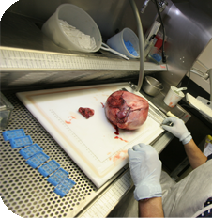
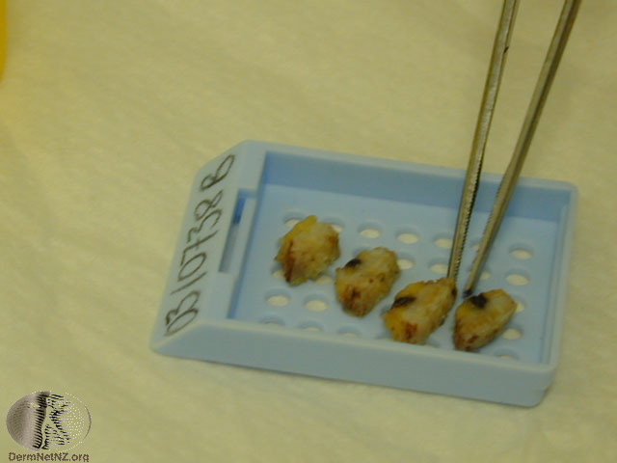
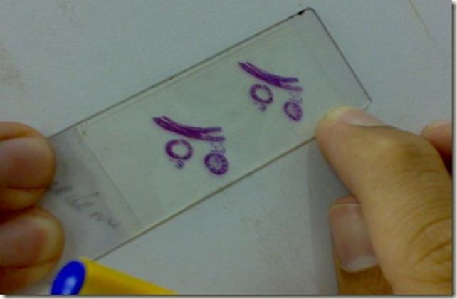
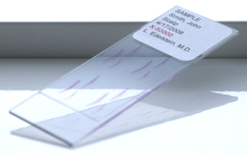
Histopathyology
STEP1
Histopathology is the study of tissues using light microscope. Tissues are obtained by doing biopsies and excision of organs by physicians & surgeons.
Once the tissue is removed from the patient’s body, it is immediately preserved (fixed) by putting it in a container of formalin (10% formaldehyde). The purpose of fixation is to prevent autolysis and decomposition of the tissue.
Tissue is processed in a special multistep way and the end result is very thin slices of stained tissue (4-6 microns) glued on a slide.
STEP2
SLIDE IS READY
THIN SLICES OF TISSUE

Slide 17
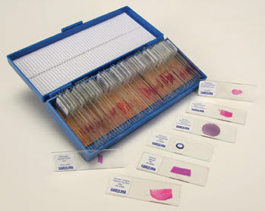
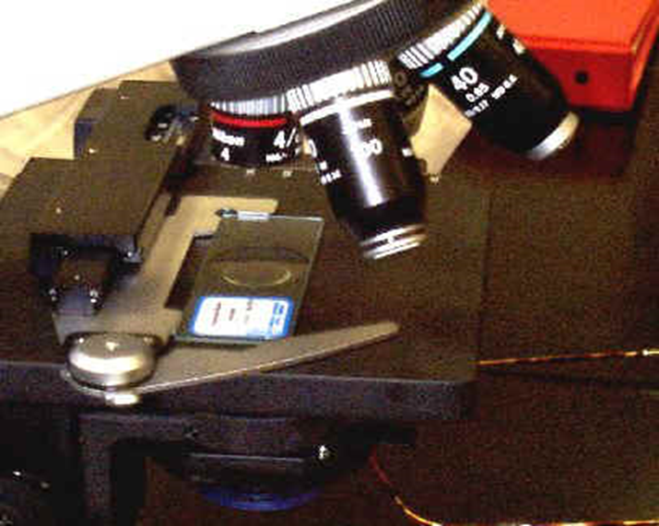
Histopathyology contd…
The most commomly used routine stain is Hematoxylin & Eosin stain. It gives the nucleus a blue/violet color & the cytoplasm a pink color.
The pathologist will look at the slide under the microscope and give a diagnosis.
Histopathology is usually the final/gold standard of diagnosis.
NOTE: sometimes during surgery an urgent diagnosis is needed INSTANTLY and tissue is processed rapidly to give results in 20 minutes. This is called frozen section.

Slide 18
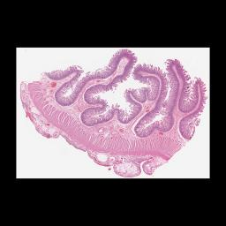
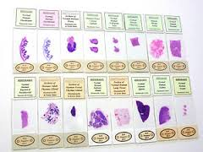
Histopathology slides ready to be examined under a light microscope

Slide 19
cytopathology
Cytopathology is the study of morphology of cells which are obtained by scraping (exfoliative cytology) or aspiration (fine-needle aspiration cytology) from various parts of body. The morphology of the cells are studied and a diagnosis made from it. It is used for the purpose of:
Screening for cancer e.g. cervical cytology is used in the screening of carcinoma of cervix.
Diagnosing cancer
The advantage of cytologic technique when compared to histopathological techniques is that the procedure is cheap, takes less time and requires no anesthesia.
Fine-needle aspiration cytology (FNAC): In it the cells are obtained by aspiration/suction of cells from affected organ or tumor mass using a needle. The cells obtained are put on a slide, stained and examined under a microscope.
Exfoliative (falling or scrapping off)cytology: The cells are scraped of any mucosa using a spatula (e.g. cervix and oral cavity) or the cells exfoliate (fall off) themselves and collect in the respective fluids/secretion (e.g. in urinary tract disease the cells which exfoliate collect in the urine, sputum etc.

Slide 20
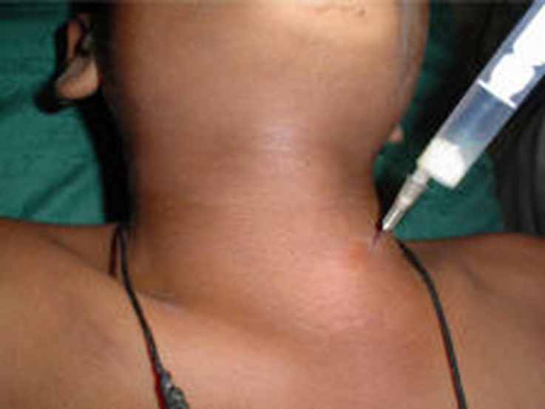
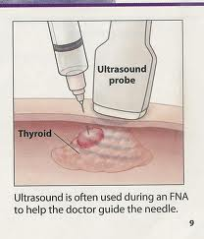
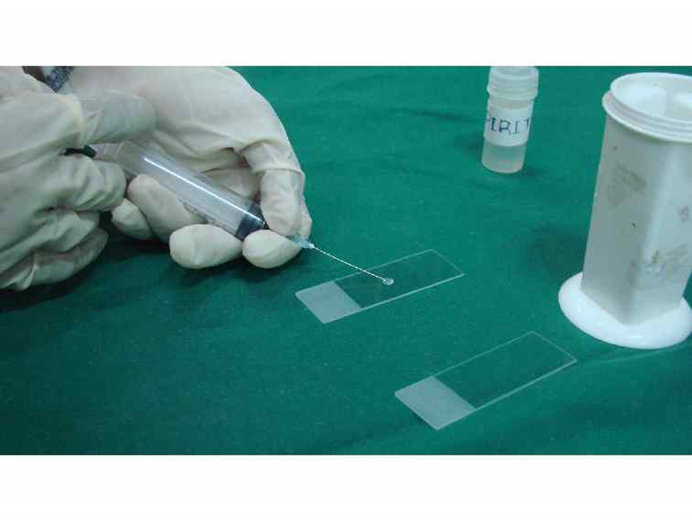
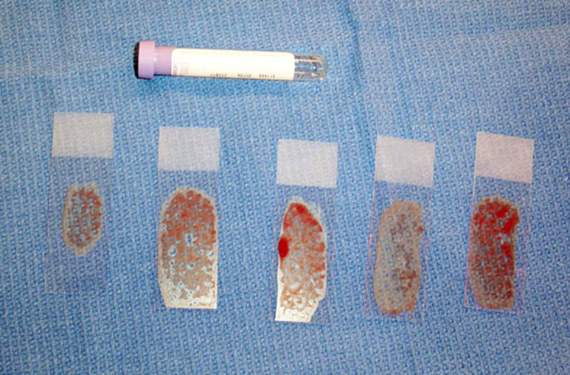
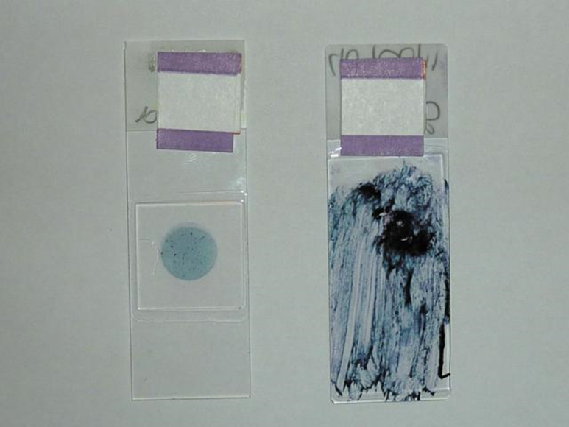
Fine needle aspiration cytology (suction of cells)
Step 1
http://themedicalpost.files.wordpress.com/2010/05/fine-needle-biospy-2_small.jpg
Step 1
Step 2
Step 3
Step 4

Slide 21
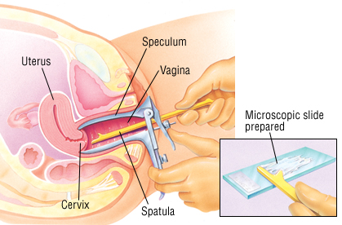
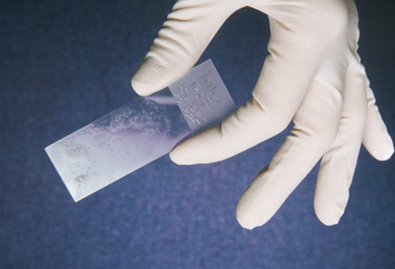
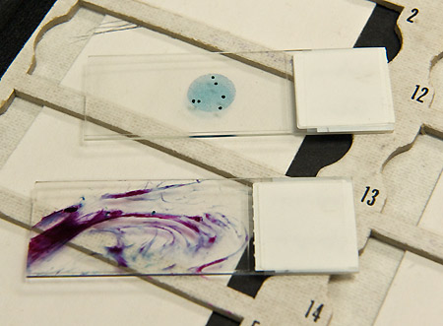
Exfoliative cytology:

Slide 22
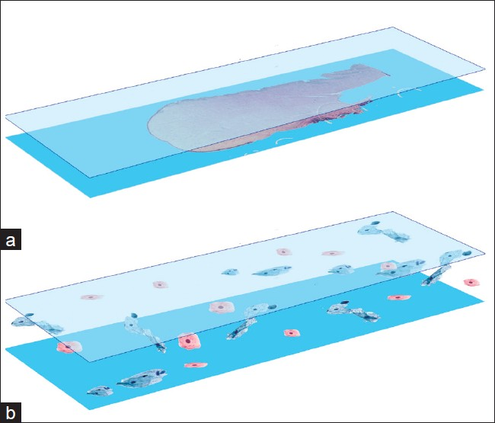
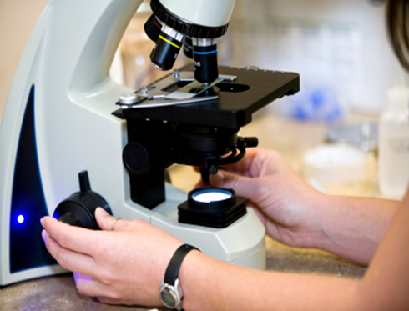
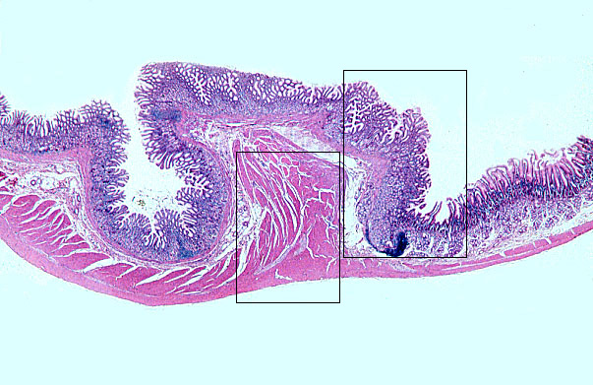
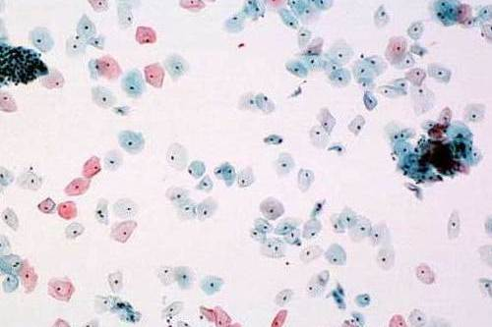
a) Histology b) Cytology
a) Histology under the microscope
b) Cytology under the microscope

Slide 23
11. AUTOPSY
It is a sub-specialty of pathology which involves examining a dead body
An autopsy is done to
To determine the cause of death (this is the main reason why autopsy is done). It can be performed in any of the following situations:
Homicidal
Suicidal
Accidental
To identify the disease
To provide useful information about various disease.
To do research.
Also it can be used as a tool to educate students, surgeons etc
Who does the autopsy? The pathologist.

Slide 24
Some instruments in Pathology
There are different diagnostic instruments used in pathology.
Some of the instruments used in pathology are
Light microscope
Immunofluorescent microscope: uses a special blue filter and a fluorescent dye on to identify various antigens in a tissue. It is used in diagnosing immunological diseases.
Electron microscope: magnifies up to two million times, which is much higher than a light microscope. It enables us to see cell structure like mitochondria, endoplasmic reticulum, viral particles etc. It is also called as ultra structural studies. It is an expensive technique.

Slide 25
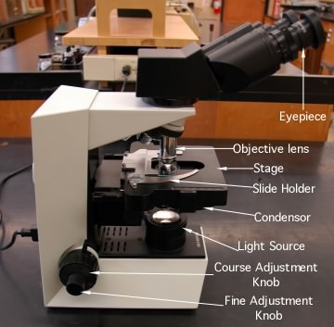
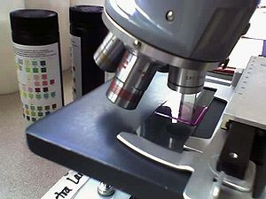
LIGHT MICROSCOPY

Slide 26
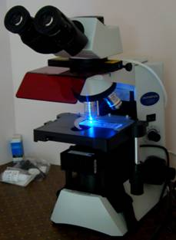
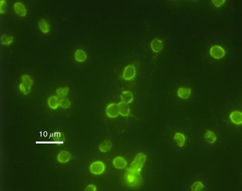
IMMUNOFLUORESCENCE MICROSCOPY

Slide 27
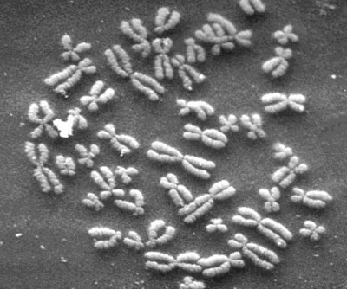
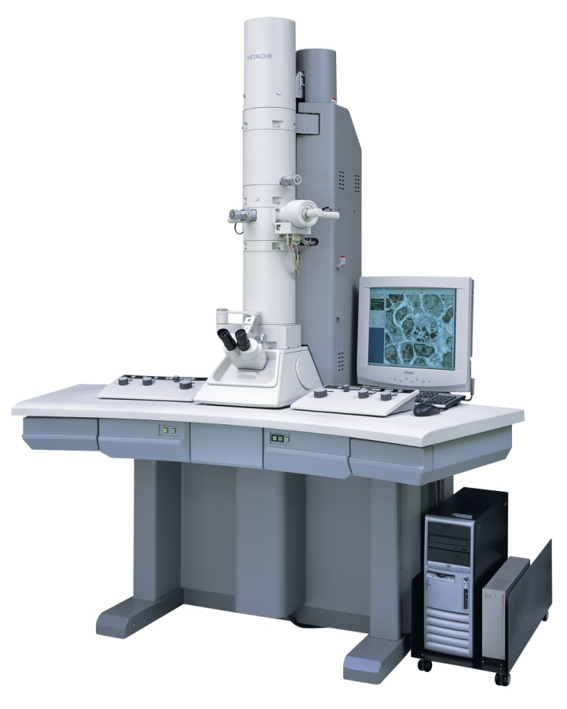
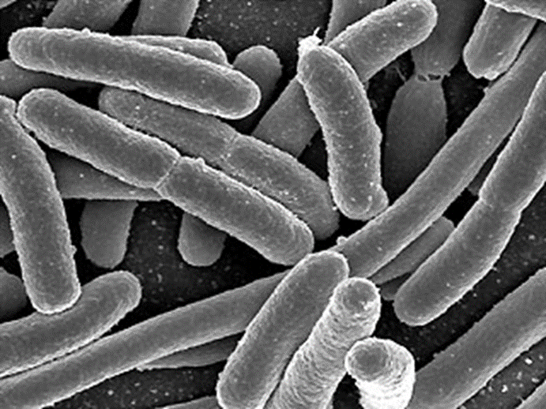
ELECTRON MICROSCOPE

