Slide 1
Foundation Block, Pathology
INFLAMMATION AND REPAIR
Lecture 4
Chemical mediator of inflammation
Systemic effect of inflammation
Dr. Maha Arafah
Associate Professor
Department of Pathology
King Khalid University Hospital and King Saud University
Email: marafah@ksu.edu.sa
marafah @hotmail.com
Oct 2017

Slide 2
Objectives
Chemical mediators of inflammation:
Definition
Know the general principles for chemical mediators.
Know the cellular sources and major effects of the mediators.
List the most likely mediators of each of the steps of inflammation.
Describe the systemic manifestations of inflammation and their general physiology, including fever, leukocyte left shift, and acute phase reactants.

Slide 3
Chemical mediators of inflammation
What are mediators?
Chemical mediators of inflammation are substances produced during inflammation inducing a specific events in acute inflammation.

Slide 4
General principles for chemical mediators
Chemical mediators of inflammation
The production of active mediators is triggered by:
microbial products
host proteins, such as the proteins of the complement, kinin and coagulation systems
( these are themselves activated by microbes and damaged tissues)

Slide 5
General principles for chemical mediators
Most mediators have the potential to cause harmful effects.
Therefore, there should be a mechanism to checks and balances their action.
Mediator function is tightly regulated by:
decay (e.g. AA metabolites)
inactivated by enzymes (kininase inactivates bradykinin)
eliminated ( antioxidants scavenge toxic oxygen metabolites)

Slide 6
Source of Chemical mediators
Chemical mediators of inflammation
Plasma-derived:
Complement
kinins
coagulation factors
Many in “pro-form” requiring activation (enzymatic cleavage)
Cell-derived:
Synthesized as needed (prostaglandin)
Preformed, sequestered and released (mast cell histamine)

Slide 7
Chemical mediators of inflammation
Chemical Mediators of Inflammation
Cell-Derived
Plasma-Protein-Derived
Vasoactive Amines
Eicosanoids
PAF
Cytokines
Chemokines
ROS
NO
Lysosomal Enzymes of Leukocytes
Neuropeptides
Notes:
.

Slide 8
Chemical mediators of inflammation
Chemical Mediators
of Inflammation
Cell-Derived
Plasma-Protein-
Derived
Complement
Coagulation and Kinin
Systems

Slide 9
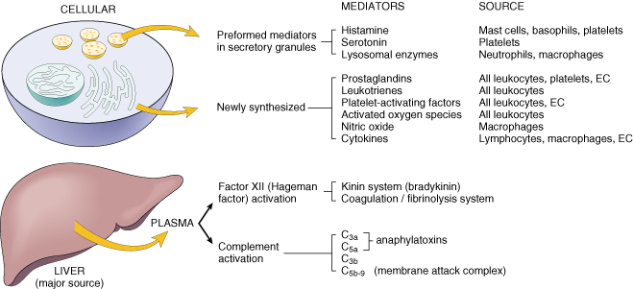
Cell-Derived Mediators
Chemical mediators of inflammation: cell derived
Producing cells:
Tissue macrophages
Mast cells
Endothelial cells
Leukocytes
Notes:
Endothelial cells at the site of inflammation
Leukocytes recruited to the site form the blood

Slide 10
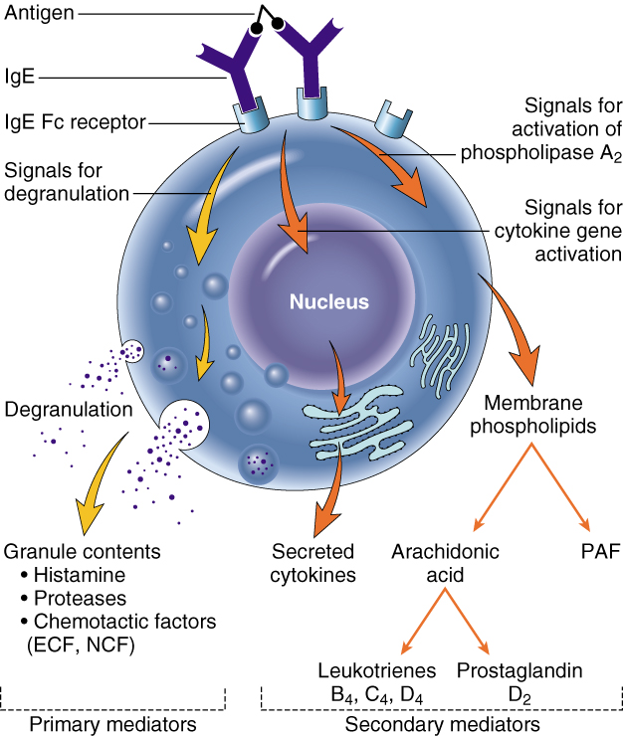
Vasoactive Amines Histamine & Serotonin
3. Chemical mediators of inflammation
Chemical mediators of inflammation: cell derived
Among first mediators in acute inflammatory reactions
Preformed mediators in secretory granules

Slide 11
Histamine
Chemical mediators of inflammation: cell derived
Source:
many cell types, esp. mast cells, circulating basophils, and platelets
Actions:
ARTERIOLAR DILATION
INCREASED VASCULAR PERMEABILITY (venular gaps)
ENDOTHELIAL ACTIVATION
Stimuli of Release:
Physical injury
Immune reactions
C3a and C5a fragments
Cytokines (e.g. IL-1 and IL-8)
Neuropeptides
Inactivated by:
Histaminase
Notes:
Histamine is the principal mediator of the immediate phase of increased vascular permeability, inducing venular endothelial contraction and interendothelial gaps.

Slide 12
Serotonin (5-HT)
3. Chemical mediators of inflammation
Chemical mediators of inflammation: cell derived
Source:
Platelets
Action:
Similar to histamine
Stimulus:
Platelet aggregation

Slide 13
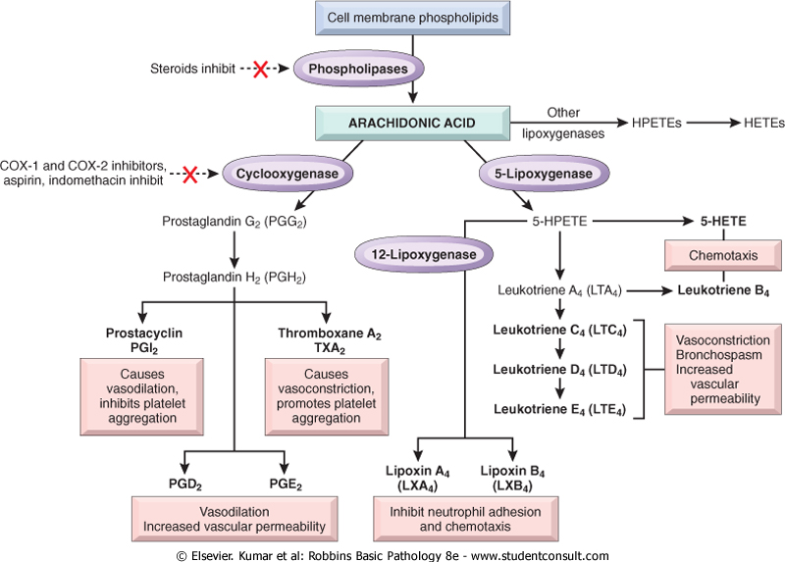
Chemical mediators of inflammation: cell derived
Source:
Leukocytes
Mast cells
Endothelial cells
Platelets
Arachidonic Acid Metabolites (eicosanoids)
Notes:
.

Slide 14
Arachidonic Acid Metabolites (eicosanoids)

Slide 15
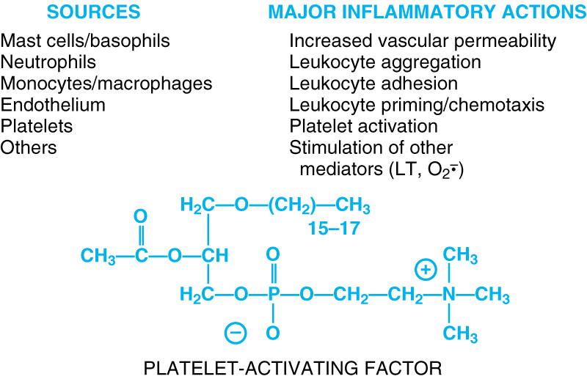
Chemical mediators of inflammation: cell derived
Chemical Mediators of Inflammation
Cell-Derived
Plasma-Protein-Derived
Vasoactive Amines
Eicosanoids
PAF
Cytokines
Chemokines
ROS
NO
Lysosomal Enzymes of Leukocytes
Neuropeptides
Notes:
.

Slide 16
3. Chemical mediators of inflammation
Chemical mediators of inflammation: cell derived
Chemical Mediators of Inflammation
Cell-Derived
Plasma-Protein-Derived
Cytokines
Polypeptides
Actions:
Involved in early immune and inflammatory reactions
Some stimulate bone marrow precursors to produce more leukocytes
Have roles in acute and chronic inflammation
Vasoactive Amines
Eicosanoids
PAF
Cytokines
Chemokines
ROS
NO
Lysosomal Enzymes of Leukocytes
Neuropeptides
Notes:
.

Slide 17
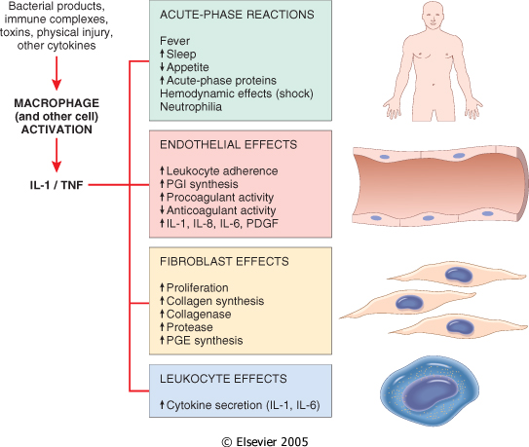
Chemical mediators of inflammation: cell derived
Cytokine of
Acute inflammation:
Interleukin (IL-1) & TNF

Slide 18
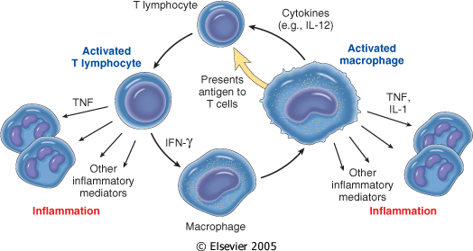
Chemical mediators of inflammation: cell derived
Chronic Inflammation: Cytokines of
Interferon-γ (INF- γ) & Interleukin ( IL-12)
Activated lymphocytes and macrophages influence each other and also release inflammatory mediators that affect other cells.

Slide 19
Chemical mediators of inflammation: cell derived
Chemical Mediators of Inflammation
Cell-Derived
Plasma-Protein-Derived
Chemokines
Small proteins
They are chemoattractants for leukocytes
Main functions:
Leukocyte recruitment & activation in inflammation
Normal anatomic organization of cells in lymphoid and other tissues
Vasoactive Amines
Eicosanoids
PAF
Cytokines
Chemokines
ROS
NO
Lysosomal Enzymes of Leukocytes
Neuropeptides
Notes:
.

Slide 20
Chemical mediators of inflammation: cell derived
Chemical Mediators of Inflammation
Cell-Derived
Plasma-Protein-Derived
Reactive Oxygen Species
Synthesized via
NADPH oxidase pathway
Source:
Neutrophils and Macrophages
Stimuli of release:
Microbes
Immune complexes
Cytokines
Action:
Microbicidial (cytotoxic) agent
Vasoactive Amines
Eicosanoids
PAF
Cytokines
Chemokines
ROS
NO
Lysosomal Enzymes of Leukocytes
Neuropeptides
Notes:
.

Slide 21
3. Chemical mediators of inflammation
Chemical Mediators of Inflammation
Cell-Derived
Plasma-Protein-Derived
Nitric Oxide ( NO)
Short-lived
Soluble free-radical gas
Functions:
Vasodilation
Antagonism of platelet activation (adhesion, aggregation, & degranulation)
Reduction of leukocyte recruitment
Microbicidial (cytotoxic) agent (with or without ROS) in activated macrophages
Vasoactive Amines
Eicosanoids
PAF
Cytokines
Chemokines
ROS
NO
Lysosomal Enzymes of Leukocytes
Neuropeptides
Notes:
.

Slide 22
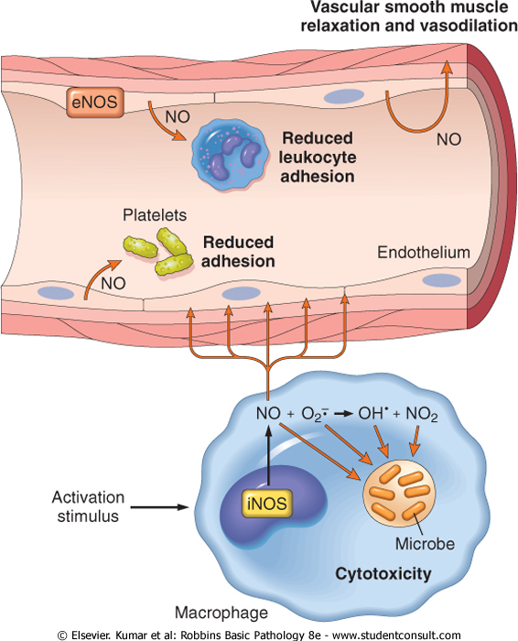
Chemical mediators of inflammation: cell derived
1
2
Actions of Nitric Oxide
3
4

Slide 23
Chemical mediators of inflammation: cell derived
Chemical Mediators of Inflammation
Cell-Derived
Plasma-Protein-Derived
Vasoactive Amines
Lysosomal Enzymes of Leukocytes
Neutrophils & Monocytes
Enzymes:
Acid proteases
Neutral proteases (e.g. elastase, collagenase, & cathepsin)
Their action is checked by:
Serum antiproteases (e.g. α1-antitrypsin)
Eicosanoids
PAF
Cytokines
Chemokines
ROS
NO
Lysosomal Enzymes of Leukocytes
Neuropeptides
Notes:
.

Slide 24
Chemical mediators of inflammation: cell derived
Chemical Mediators of Inflammation
Cell-Derived
Plasma-Protein-Derived
Neuropeptides
Small proteins
Secreted by nerve fibers mainly in lung & GIT
Initiate inflammatory response
e.g. Substance P :
Transmits pain signals
Regulates vessel tone
Modulates vascular permeability
Vasoactive Amines
Eicosanoids
PAF
Cytokines
Chemokines
ROS
NO
Lysosomal Enzymes of Leukocytes
Neuropeptides
Notes:
.

Slide 25
Chemical mediators of inflammation: Plasma protein derived
Chemical Mediators
of Inflammation
Cell-Derived
Plasma-Protein-
Derived
Complement
Coagulation and Kinin
Systems

Slide 26
PLASMA PROTEASES
Chemical mediators of inflammation: Plasma protein derived
A variety of phenomena in the inflammatory response are mediated by plasma proteins that belong to three interrelated systems
1. Kinin
2. Complement
3. Clotting systems

Slide 27
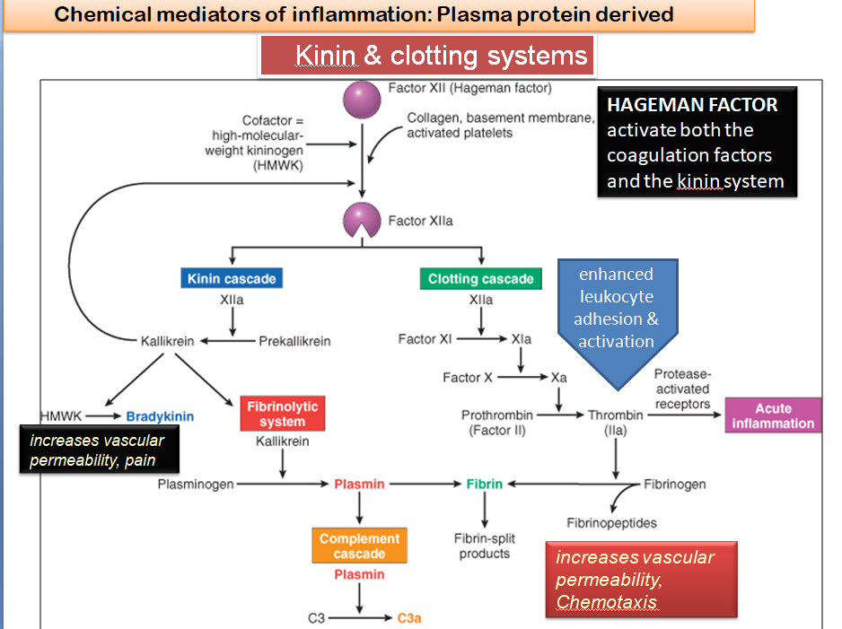

Slide 28
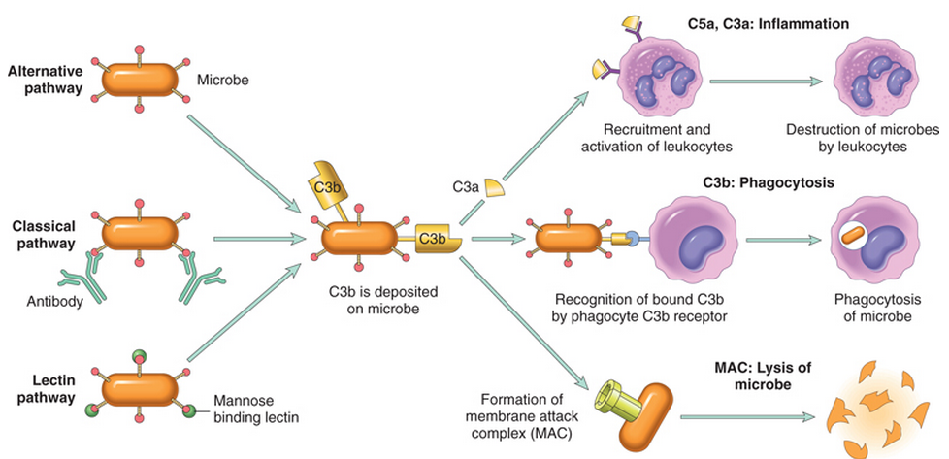
Chemical mediators of inflammation: Plasma protein derived
Complement System

Slide 29
Complement protein
Chemical mediators of inflammation: Plasma protein derived
C3a & C5a ➔ Increase vascular permeability
( anaphylatoxins)
C5a ➔ Chemotaxis
C3b ➔ Opsonization
C5-9 ➔ membrane attack complex

Slide 30
Vasodilation | Prostaglandins Histamine Nitric oxide
Increased vascular permeability | Vasoactive amines Bradykinin Leukotrienes C4, D4, E4 PAF Substance P
Chemotaxis, leukocyte recruitment and activation | C5a Leukotriene B4 Chemokines IL-1, TNF Bacterial products
Fever | IL-1, TNF Prostaglandins
Pain | Prostaglandins Bradykinin
Tissue damage | Neutrophil and macrophage lysosomal enzymes Oxygen metabolites Nitric oxide
Role of Mediators in Different Reactions of Inflammation

Slide 31
The Actions of the Principal Mediators
Principal Actions | Source | Mediators
 |  | :Cell-Derived
Vasodilation, increased vascular permeability, endothelial activation | Mast cells, basophils, platelets | Histamine
Vasodilatation, increased vascular permeability. | Platelets | Serotonin
Vasodilatation, pain, fever. | Mast cells, leukocytes | Prostaglandins
Increased vascular permeability, chemotaxis, leukocyte adhesion and activation. | Mast cells, leukocytes | Leukotrienes
Vasodilatation, increased vascular permeability, leukocyte adhesion, chemotaxis, degranulation, oxidative burst | Leukocytes, endothelial cells | Platelet-activating factor
Killing of microbes, tissue damage | Leukocytes | Reactive oxygen species
Vascular smooth muscle relaxation; killing of microbes | Endothelium, macrophages | Nitric oxide
Local endothelial activation (expres-sion of adhesion molecules), systemic acute-phase response in severe infections, septic shock | Macrophages, lymphocytes Endothelial cells, mast cells | Cytokines (e.g. TNF, IL-)

Slide 33
Systemic effects of Inflammation
Systemic manifestations of inflammation
Acute phase reaction/response
- IL-1 and TNF
Fever
Malaise
Anorexia
Bone marrow
- IL-1 + TNF
Leukocytosis
Lymphoid organs
Liver
- IL-6, IL-1, TNF
Acute phase proteins
C-reactive protein
Lipopolysaccharide binding protein
Serum amyloid A
a-2 macroglobulin
Haptoglobin
Ceruloplasmin
fibrinogen

Slide 34
Fever Produced in response to Pyrogens
Systemic manifestations of inflammation
Types of Pyrogens:
Exogenous pyrogens: Bacterial products
Endogenous pyrogens:
IL-1 and TNF
Bacterial products stimulate leukocytes to release cytokines such as IL-1 and TNF that increase the enzymes (cyclooxygenases) that convert AA into prostaglandins.

Slide 35
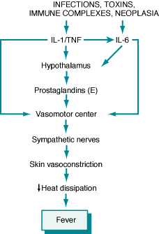
Systemic manifestations of inflammation
Fever
In the hypothalamus, the prostaglandins, especially PGE₂, stimulate the production of neurotransmitters such as cyclic AMP, which function to reset the temperature set-point at a higher level.
NSAIDs, including aspirin , reduce fever by inhibiting cyclooxygenase and thus blocking prostaglandin synthesis.

Slide 36
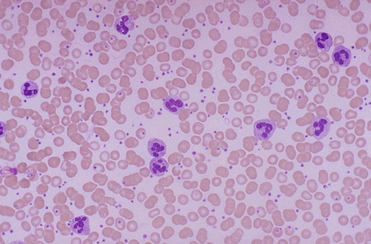
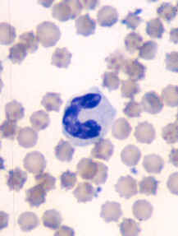
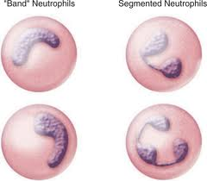
Systemic manifestations of inflammation
Leukocytosis
Shift to left
Notes:
Acute inflammation is marked by an increase in inflammatory cells. Perhaps the simplest indicator of acute inflammation is an increase in the white blood cell count in the peripheal blood, here marked by an increase in segmented neutrophils (PMN's).

Slide 37
Systemic manifestations of inflammation
Inflammation Systemic Manifestations
Leukocytosis:
WBC count climbs to 15,000 or 20,000 cells/μl
most bacterial infection (Neutrophil)
Lymphocytosis:
Infectious mononucleosis, mumps,
German measles
Eosinophilia: bronchial asthma,
hay fever, parasitic infestations
Leukopenia: typhoid fever,
infection with rickettsiae/protozoa

Slide 38
Systemic manifestations of inflammation
C-reactive protein (CRP)
Lipopolysaccharide binding protein
Serum amyloid A (SAA)
a-2 macroglobulin
Haptoglobin
Ceruloplasmin
fibrinogen
CRP and SAA, bind to microbial cell walls, and they may act as opsonins and fix complement

Slide 39
Acute phase proteins
Elevated serum levels of CRP serve as a marker for acute inflammation and increased risk of myocardial infarction in patients with coronary artery disease.
Prolonged production of these proteins (especially SAA) in states of chronic inflammation can cause:
secondary amyloidosis

Slide 40
Systemic manifestations of inflammation
Increased erythrocyte sedimentation rate (ESR)
The rise in fibrinogen causes erythrocytes to form stacks (rouleaux) that sediment more rapidly at unit gravity than do individual erythrocytes.

Slide 41
Systemic manifestations of inflammation

Slide 42
Erythrocyte sedimentation rate (ESR)
Systemic manifestations of inflammation
This is a simple test for an inflammatory response caused by any stimulus.
Fibrinogen binds to red cells and causes them to form stacks (rouleaux) that sediment more rapidly at unit gravity than do individual red cell

Slide 43
Summary
Chemical mediator of inflammation
The systemic manifestations of inflammation include fever, leukocyte left shift, and acute phase reactants.

