Slide 1
INFLAMMATION AND REPAIR
Lecture 1
Definition of inflammation; Acute Inflammation
Vascular Events in Inflammation
Lecturer: Dr. Maha Arafah
Foundation Block
Pathology
2017

Slide 2
Learning Objectives:
Define inflammation.
List cells & molecules that play important roles in inflammation
Compare between acute and chronic inflammation
Recognize the cardinal signs of inflammation.
Describe the sequence of vascular changes in acute inflammation (vasodilation, increased permeability) and their purpose.
Know the mechanisms of increased vascular permeability.
Compare normal capillary exchanges with exchange during inflammatory response.
Define the terms edema, transudate, and exudate.

Slide 3
Reference book and the relevant page numbers..
Robbins Basic Pathology 9th edition
Page: 29 - 34

Slide 4
Define inflammation.
Infection.
Trauma.
Physical injury (burns).
Chemical injury.
Immunological injury (AID).
Tissue death (MI).
Injury
Tissue damage
Tissue response
Eliminates the effect of injury (pathogen and necrotic tissue)
Repair

Slide 5
What is Inflammation?
Define inflammation.
Inflammation is a local response of the vascularized living tissue to infection and damaged tissue that brings cells and molecules of host defense from the circulation to the sites where they are needed
➔ Therefore, Inflammation is part of a broader protective response (innate immunity )
The aim: to localize and eliminate the causative agent, limit tissue injury and restore tissue to normality
The suffix “its” is added to the base word to state the condition as in appendix/appendicitis

Slide 6
Inflammation
Define inflammation.
Inflammation is terminated when the offending agent is eliminated and the secreted mediators are broken down or dissipated.
There are active anti-inflammatory mechanisms that serve to control the response and prevent it from causing excessive damage to the host.

Slide 7
Define inflammation.
Steps of inflammation
The offending agent is recognized by host cells and molecules.
Leukocytes and plasma proteins are recruited from the circulation to the site where the offending agent
The leukocytes and proteins are activated to destroy and eliminate the offending substance.
The reaction is controlled and terminated.
The damaged tissue is repaired.

Slide 8
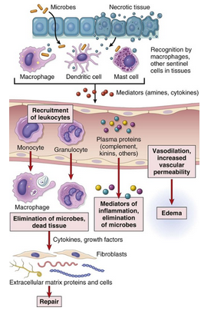
Define inflammation.

Slide 9
Can inflammation be harmful ! ?
Define inflammation.
Inflammation can induce harm:
e.g. anaphylactic reaction
rheumatoid arthritis
atherosclerosis

Slide 10
Learning Objectives:
Upon completion of these lectures, the student should:
Define inflammation.
List cells & molecules that play important roles in inflammation
Compare between acute and chronic inflammation
Recognize the cardinal signs of inflammation.
Describe the sequence of vascular changes in acute inflammation (vasodilation, increased permeability) and their purpose.
Know the mechanisms of increased vascular permeability.
Compare normal capillary exchanges with exchange during inflammatory response.
Define the terms edema, transudate, and exudate.

Slide 11
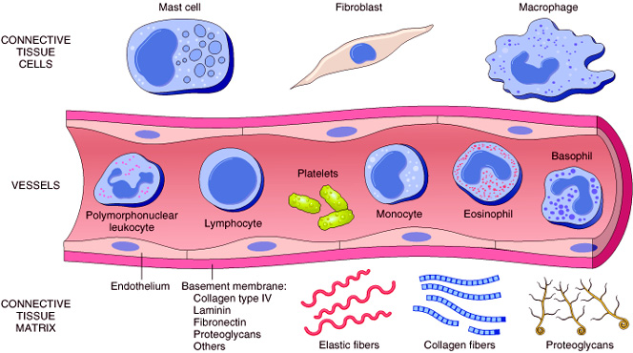
2. List cells & molecules that play important roles in inflammation
Cells of surrounding C.T.
The circulating cells:
Blood leukocytes
Plasma proteins
Extracellularmatrix of surrounding C.T.
Cells of vascular wall
The extracellular matrix

Slide 12
Chemical Mediators
2. List cells & molecules that play important roles in inflammation
Inflammation is mediated by chemical substances called
What is the source of these chemical mediators?
1. Phagocytes and other host cells
Leukocyte
Endothelium
Mast cell
2. Plasma proteins

Slide 13
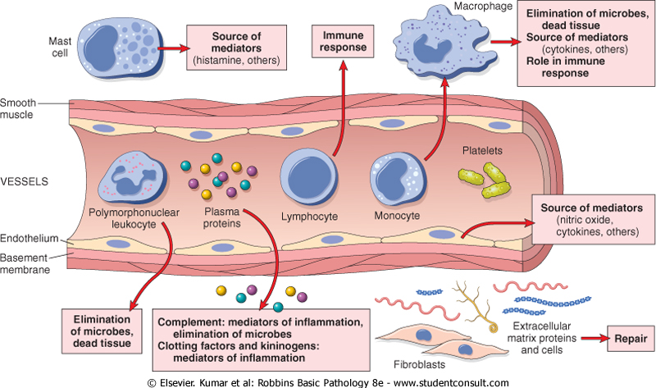
2. List cells & molecules that play important roles in inflammation

Slide 14
Learning Objectives:
Upon completion of these lectures, the student should:
Define inflammation.
List cells & molecules that play important roles in inflammation
Compare between the two types of inflammation
Recognize the cardinal signs of inflammation.
Describe the sequence of vascular changes in acute inflammation (vasodilation, increased permeability) and their purpose.
Know the mechanisms of increased vascular permeability.
Compare normal capillary exchanges with exchange during inflammatory response.
Define the terms edema, transudate, and exudate.

Slide 15
TYPES OF Inflammation
3. Compare between acute and chronic inflammation
Acute inflammation
Chronic Inflammation

Slide 16
Features of acute and chronic inflammation
3. Compare between acute and chronic inflammation
Chronic | Acute | Feature
Slow : days, weeks | Fast : minutes or hours | Onset
lymphocytes and macrophages | neutrophils | Cellular infiltrate
Often sever & progressive | Mild, self limited | Tissue injury, fibrosis
Less prominent, may be subtle | Prominent | Local (red, hot, edematous, pain) & systemic signs (fever, increased C reactive protein, raised ESR…)

Slide 17
Acute inflammation
A rapid response to an injurious agent that serves to deliver mediators of host defense-leukocytes and plasma proteins-to the site of injury.

Slide 18
The outcome of acute inflammation
is either
elimination of the noxious stimulus, followed by decline of the reaction and repair of the damaged tissue
or
persistent injury resulting in chronic inflammation

Slide 19
Learning Objectives:
Upon completion of these lectures, the student should:
Define inflammation.
List cells & molecules that play important roles in inflammation
Compare between acute and chronic inflammation
Recognize the cardinal signs of inflammation.
Describe the sequence of vascular changes in acute inflammation (vasodilation, increased permeability) and their purpose.
Know the mechanisms of increased vascular permeability.
Compare normal capillary exchanges with exchange during inflammatory response.
Define the terms edema, transudate, and exudate.

Slide 20
Clinical Features
4. Recognize the cardinal signs of inflammation
The 5 ancient cardinal signs of inflammation are
Tumor:-swelling
Rubor :– redness
Calor: – warmth
Dolor :– pain
Functio Laesa :–loss of function

Slide 21
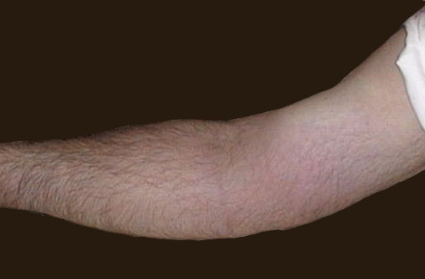
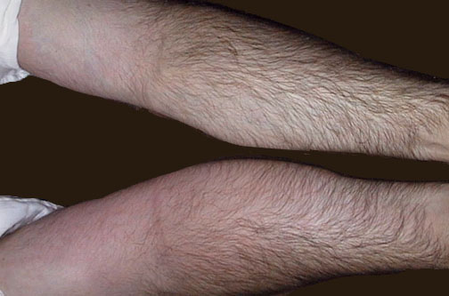
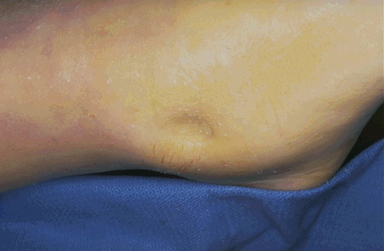
4. Recognize the cardinal signs of inflammation
Redness
Notes:
The cardinal signs of inflammation are rubor (redness), calor (heat), tumor (swelling), dolor (pain), and loss of function. Seen here is skin with erythema, compared to the more normal skin at the far right.

Slide 22
Learning Objectives:
Upon completion of these lectures, the student should:
Define inflammation.
List cells & molecules that play important roles in inflammation
Compare between acute and chronic inflammation
Recognize the cardinal signs of inflammation.
Describe the sequence of vascular changes in acute inflammation (vasodilation, increased permeability) and their purpose.
Know the mechanisms of increased vascular permeability.
Compare normal capillary exchanges with exchange during inflammatory response.
Define the terms edema, transudate, and exudate.

Slide 23
Events of acute Inflammation
5. Describe the sequence of vascular changes in acute inflammation
Acute inflammation has three main events:
(1) Hemodynamic changes
(alterations in vascular caliber that lead to an increase in blood flow)
(2) Increased vascular permeability
(structural changes in the small blood vessels that permit plasma proteins and leukocytes to leave the circulation)
(3) Emigration of the leukocytes from the microcirculation
(their accumulation in the focus of injury, and their activation to eliminate the offending agent)
vascular
cellular
Notes:
9

Slide 24
Events of acute Inflammation
5. Describe the sequence of vascular changes in acute inflammation
Vascular Events
Cellular Events
Margination

Slide 25
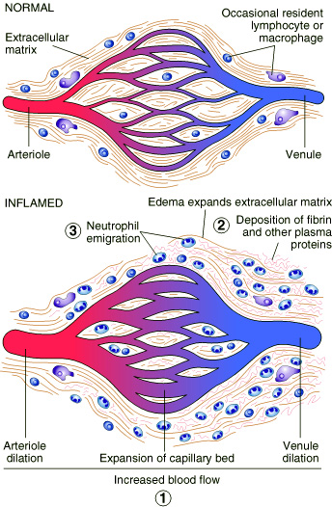
5. Describe the sequence of vascular changes in acute inflammation
Vascular Events
1.Vasodilatation
Hemodynamic changes

Slide 26
5. Describe the sequence of vascular changes in acute inflammation

Slide 27
5. Describe the sequence of vascular changes in acute inflammation
edema

Slide 28
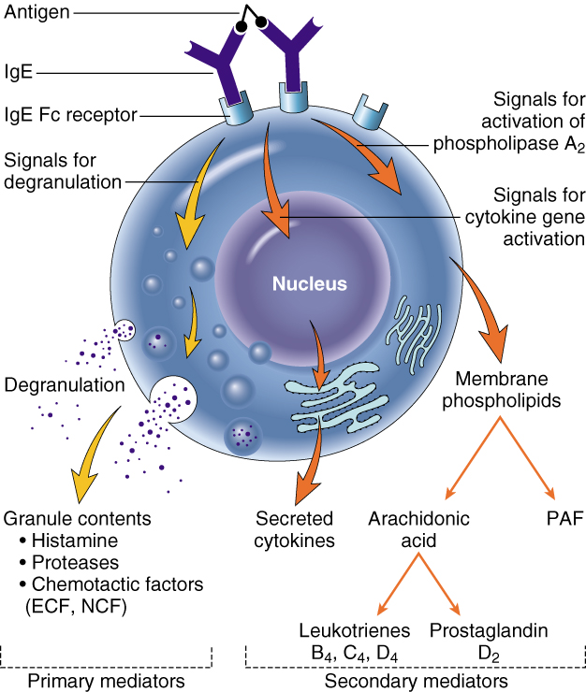
Phases of changes in Vascular Caliber and Flow
5. Describe the sequence of vascular changes in acute inflammation
1. Transient vasoconstriction of arterioles
It disappears within 3-5 seconds in mild injuries
2. Vasodilatation: It involves the arterioles results in opening of new microvasculature beds in the area leading to increasing blood flow – Histamine effect
3. Slowing of the circulation
due to increased permeability of the microvasculature, this leads to outpouring of protein-rich fluid in the extravascular tissues.
4. Stasis: slow circulation due to dilated small vessels packed with red cells

Slide 29
Slowing of the circulation
5. Describe the sequence of vascular changes in acute inflammation

Slide 30
Learning Objectives:
Upon completion of these lectures, the student should:
Define inflammation.
List cells & molecules that play important roles in inflammation
Compare between acute and chronic inflammation
Recognize the cardinal signs of inflammation.
Describe the sequence of vascular changes in acute inflammation (vasodilation, increased permeability) and their purpose.
Know the mechanisms of increased vascular permeability.
Compare normal capillary exchanges with exchange during inflammatory response.
Define the terms edema, transudate, and exudate.

Slide 31
2. Increased Vascular Permeability
6. Know the mechanisms of increased vascular permeability
Vascular Events
A hallmark of acute inflammation (escape of a protein-rich fluid).
induced by histamine, kinins, and other mediators
It affects small & medium size venules, through gaps between endothelial cells

Slide 32
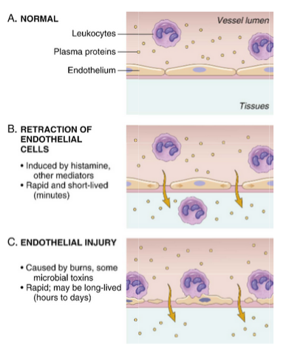
6. Know the mechanisms of increased vascular permeability
Principal mechanisms of increased vascular permeability in inflammation and their features and underlying causes
venules
Arteriols, capillaries and venules

Slide 33
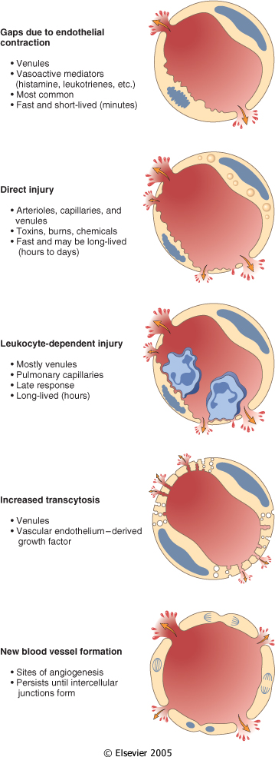
6. Know the mechanisms of increased vascular permeability
Mechanisms lead to increased vascular permeability
Endothelial cell contraction 15-30 min
Endothelial injury
immediate sustained response 6-24 hours
delayed prolonged leakage 12 hours- days
Leukocyte-mediated endothelial injury
Transcytosis (occurs via channels formed by fusion of intracellular vesicles)
Leakage from new blood vessels

Slide 34
Learning Objectives:
Upon completion of these lectures, the student should:
Define inflammation.
List cells & molecules that play important roles in inflammation
Compare between acute and chronic inflammation
Recognize the cardinal signs of inflammation.
Describe the sequence of vascular changes in acute inflammation (vasodilation, increased permeability) and their purpose.
Know the mechanisms of increased vascular permeability.
Compare normal capillary exchanges with exchange during inflammatory response.
Define the terms edema, transudate, and exudate.

Slide 35
7. Compare normal capillary exchanges with exchange during inflammatory response
Increased blood volume lead to increased local hydrostatic pressure leading to transudation of protein-poor fluid into the extravascular space.
What is the edema?
denotes an excess of fluid in the interstitial or serous cavities
It can be either an exudate or a transudate

Slide 36
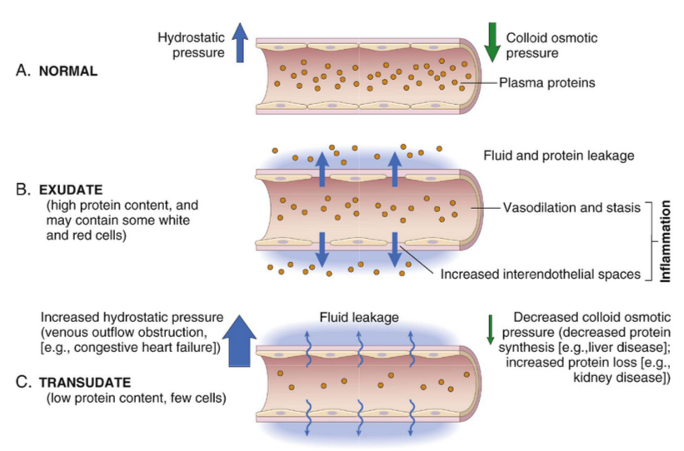
7. Compare normal capillary exchanges with exchange during inflammatory response

Slide 37
Learning Objectives:
Upon completion of these lectures, the student should:
Define inflammation.
List cells & molecules that play important roles in inflammation
Compare between acute and chronic inflammation
Recognize the cardinal signs of inflammation.
Describe the sequence of vascular changes in acute inflammation (vasodilation, increased permeability) and their purpose.
Know the mechanisms of increased vascular permeability.
Compare normal capillary exchanges with exchange during inflammatory response.
Define the terms edema, transudate, and exudate.

Slide 38
Edema is defined as an excess of fluid in the interstitial space. What is the difference between transudates and exudates?
8. Define the terms edema, transudate, and exudate
is a fluid with low protein content and a specific gravity of less than 1.012
It is essentially an ultrafiltrate of blood plasma that results from osmotic or hydrostatic imbalance across the vessel wall
without an increase in vascular permeability
An inflammatory extravascular fluid that has a high protein concentration, cellular debris, and a specific gravity above 1.020
It implies significant alteration in the normal permeability of small blood vessels in the area of injury
Transudate
Exudate

Slide 39
TAKE HOME MESSAGES
Inflammation, the local response of the vascularised living tissue to injury.
Could be acute or chronic.
Several cells & molecules that play important roles in inflammation.
Inflammation has vascular and cellular events to eliminate the cause.
Vascular events include vasodilation and increased permeability to deliver a protein rich fluid to the site of inflammation.

