Slide 1
INFLAMMATION AND REPAIR
Lecture 2
Cellular Events in Inflammation
(Foundation Block, Pathology)
Maha Arafah
Associate Professor
Department of Pathology
King Saud University
Email: marafah@hotmail.com
2017
Dr. Maha Arafah

Slide 2
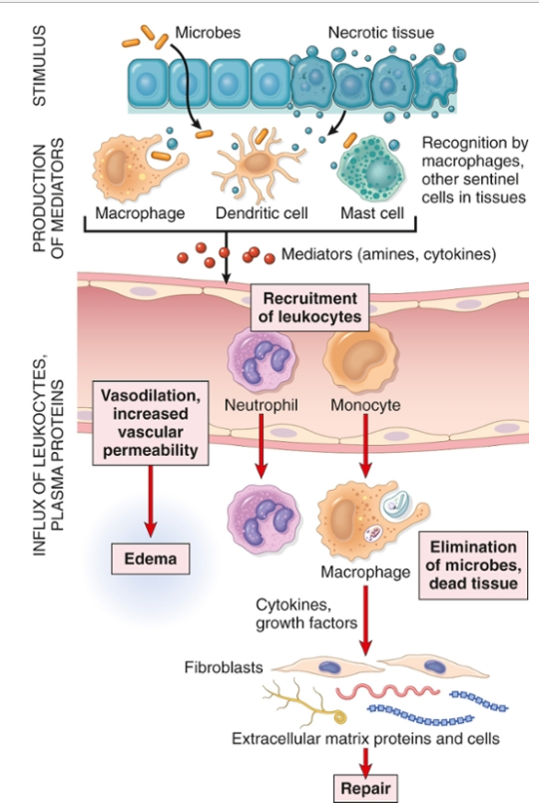

Slide 3
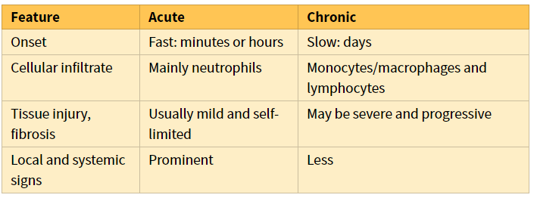

Slide 4
Events of acute Inflammation
5. Describe the sequence of vascular changes in acute inflammation
Acute inflammation has three main events:
(1) Hemodynamic changes
(alterations in vascular caliber that lead to an increase in blood flow)
(2) Increased vascular permeability
(structural changes in the microvasculature that permit plasma proteins and leukocytes to leave the circulation)
(3) Emigration of the leukocytes from the microcirculation
(their accumulation in the focus of injury, and their activation to eliminate the offending agent)
vascular
cellular
Notes:
9

Slide 5
Phases of changes in Vascular Caliber and Flow
5. Describe the sequence of vascular changes in acute inflammation
1. Transient vasoconstriction of arterioles
It disappears within 3-5 seconds in mild injuries
2. Vasodilatation: It involves the arterioles results in opening of new microvasculature beds in the area leading to increasing blood flow – Histamine effect
3. Slowing of the circulation
due to increased permeability of the microvasculature, this leads to outpouring of protein-rich fluid in the extravascular tissues.
4. Stasis: slow circulation due to dilated small vessels packed with red cells

Slide 6
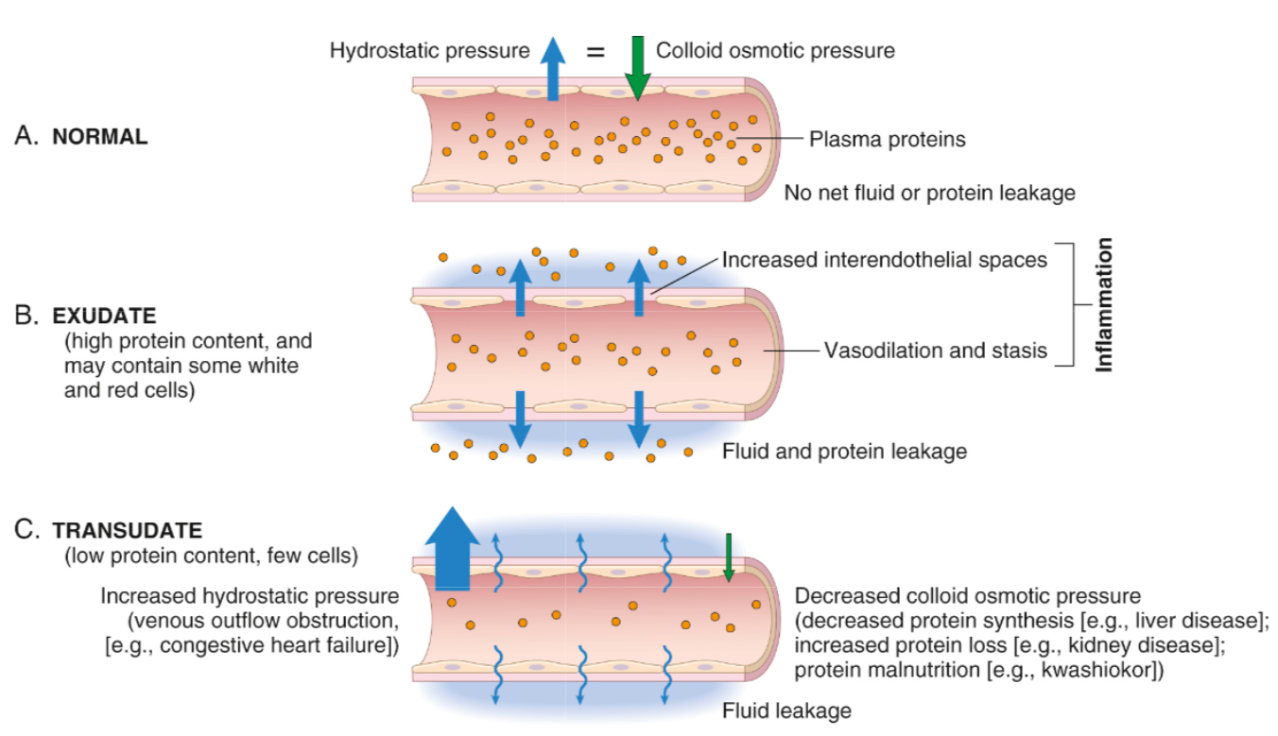

Slide 7
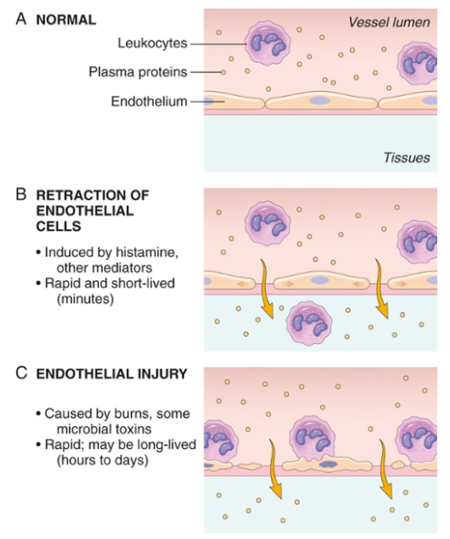

Slide 8
Objectives
Describe the steps involved in extravasation of leukocytes from the blood to the tissues.
Know the steps at which selectins and integrins act.
Describe the meaning and utility of chemotaxis. Understand the role that chemokines play in inflammation.
Describe the steps involved in phagocytosis and the role of IgG and C3b as opsonins and receptors.
List the mechanisms of microbial killing.
Know various defects in leukocyte function.

Slide 9
Reference book and the relevant page numbers..
Robbins Basic Pathology 9th edition, pages 34-41

Slide 10
Acute Inflammation CELLULAR EVENTS:
A critical function of inflammation is to deliver leukocytes to the site of injury
and to activate the leukocytes to perform their normal functions in host defense.
WHAT ARE THESE FUNCTION?
Leukocytes ingest offending agents, kill bacteria and other microbes, and get rid of necrotic tissue and foreign substances.
They may induce tissue damage and prolong inflammation, since the leukocyte products that destroy microbes and necrotic tissues can also injure normal host tissues.
LEUKOCYTE EXTRAVASATION

Slide 11
1. Describe the steps involved in extravasation of leukocytes from the blood to the tissues.

Slide 12
Recruitment of leukocytes
1. Describe the steps involved in extravasation of leukocytes from the blood to the tissues.
A multistep process involving attachment of circulating leukocytes to endothelial cells and their migration through the endothelium (extravasation)
3 steps:
In the lumen:
Margination
rolling
adhesion to endothelium
Vascular endothelium normally does not bind circulating cells
Transmigration across the endothelium (also called diapedesis)
Migration in interstitial tissues toward a chemotactic stimulus

Slide 13
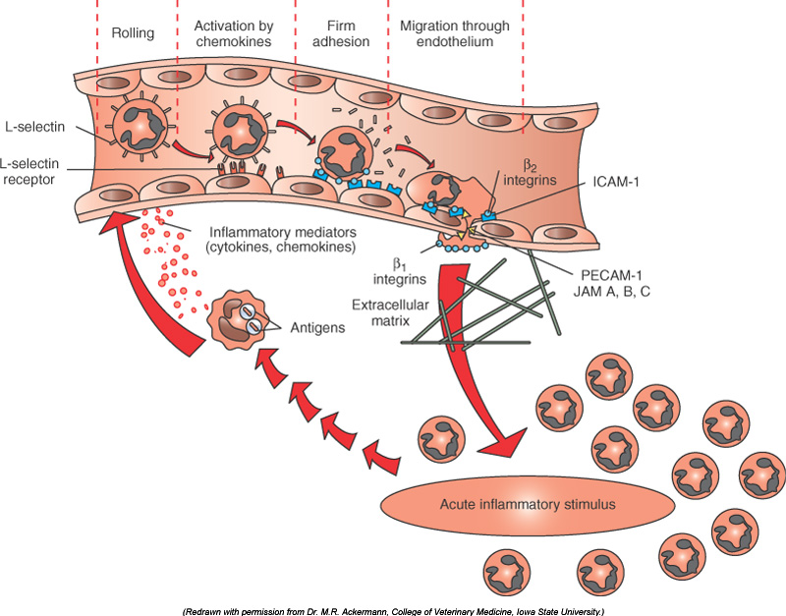
1. Describe the steps involved in extravasation of leukocytes from the blood to the tissues.
Resident tissue macrophages, mast cells, and endothelial cells respond to injury by secreting the cytokines TNF, IL-1, histamine and chemokines

Slide 14
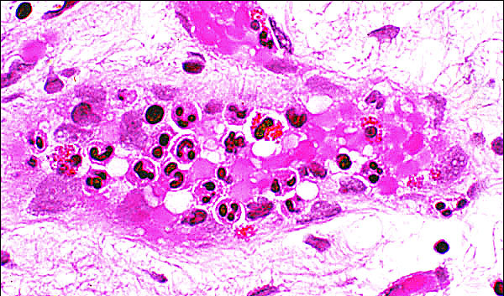
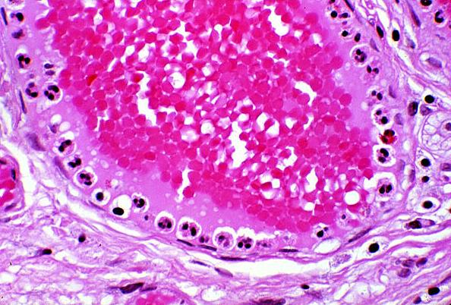
1. Describe the steps involved in extravasation of leukocytes from the blood to the tissues.
Leukocytes Rolling
Within a Venule
Margination
Because blood flow slows early in inflammation (stasis), the endothelium can be lined by neutrophils (pavementation)
Margination is the first step of leukocytes action during acute inflammation cells

Slide 15
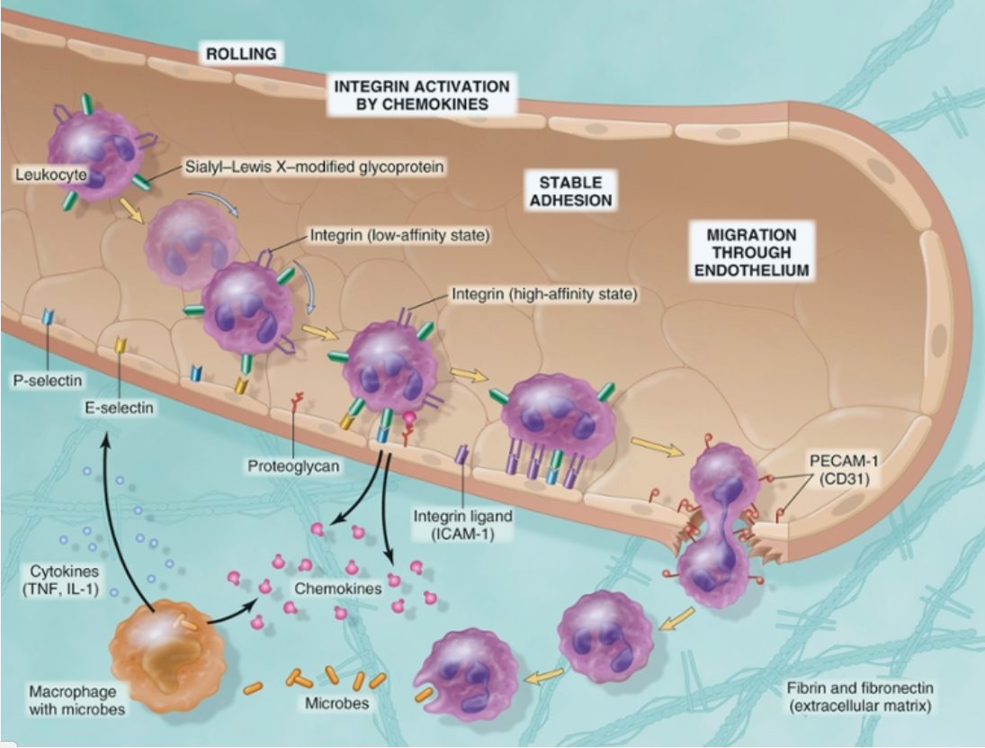
Steps involved in extravasation of leukocytes from the blood to the tissues
Rolling
Adhesion
Migration across the endothelium
margination
Diapedesis
Chemotaxis

Slide 16
Adhesion Molecules and Receptors
2. Know the steps at which selectins and integrins act.
1. Selectins, consist of:
1. E-selectin: confined to endothelium induced by TNF&IL-1
2. P-selectin: present in endothelium and platelets from Weibel-Palade bodies
3. L-selectin: expressed on most leukocyte and endothelium
Resident tissue macrophages, mast cells, and endothelial cells respond to injury by secreting the cytokines TNF, IL-1, histamine and chemokines which stimulate selectin
E-selectin & P-selectin bind to Sialyl-Lewis X glycoprotein and slow the leukocytes

Slide 17
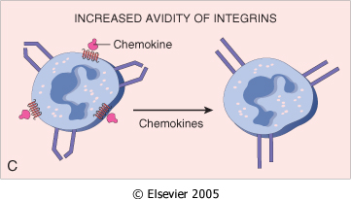
2. Know the steps at which selectins and integrins act.
Adhesion Molecules and Receptors
2. Integrins
rolling
are transmembrane heterodimeric glycoproteins, made up of α and β chains, expressed on leukocytes and bind to ligands on endothelial cells
Integrins are up regulated on leukocytes by C5a & LTB4 resulting in firm adhesion with vessel wall

Slide 18
Leukocyte Adhesion Deficiency
2. Know the steps at which selectins and integrins act.
Two types:
LAD type 1 is a deficiency of β₂-integrin
LAD type 2 is mutations in fucosyl transferase required for synthesis of sialylated oligosaccharide
These normally binds selectins.
Clinical findings:
Delayed separation of umbilical cord
Increased circulating neutrophils (leukocytosis due to loss of the marginating pool)
Recurrent bacterial infection that lack pus formation
Poor wound healing

Slide 19
2. Know the steps at which selectins and integrins act.
Adhesion Molecules and Receptors
3. The immunoglobulin family molecules :
ICAM-1 (intercellular adhesion molecule 1)
VCAM-1 (vascular cell adhesion molecule 1)
IL-1 and TNF activate intercellular adhesion molecule (ICAM) and vascular cell adhesion molecule (VCAM) on venular endothelial cells.
adhesion to endothelium

Slide 20
2. Know the steps at which selectins and integrins act.
Adhesion Molecules and Receptors
4. Mucin-like glycoproteins: PECAM-1
- these glycoproteins are found in the extracellular matrix and on cell surfaces.
Neutrophils moving along the venular endothelium dissolve the venular basement membrane (release type IV collagenase) exposed by previous histamine-mediated endothelial cell contraction and enter the interstitial tissue.
Neutrophils, monocytes, lymphocytes, eosinophils, and basophils all use the same pathway to migrate from the blood into tissues.

Slide 21
Leukocyte Adhesion and Transmigration
2. Know the steps at which selectins and integrins act.
Migration of the leukocytes through the endothelium is called:
Transmigration
or Diapedesis
Diapedesis occurs predominantly in the postcapillary venules
BV lumen
Extravascular

Slide 22
Extravasation of leukocytes from the blood to the tissues
Leukocyte Adhesion and Transmigration
The type of emigrating leukocyte varies with the age of the inflammatory response
In most forms of acute inflammation: neutrophils predominate in the inflammatory infiltrate during the first 6 to 24 hours, then are replaced by monocytes in 24 to 48 hours

Slide 23
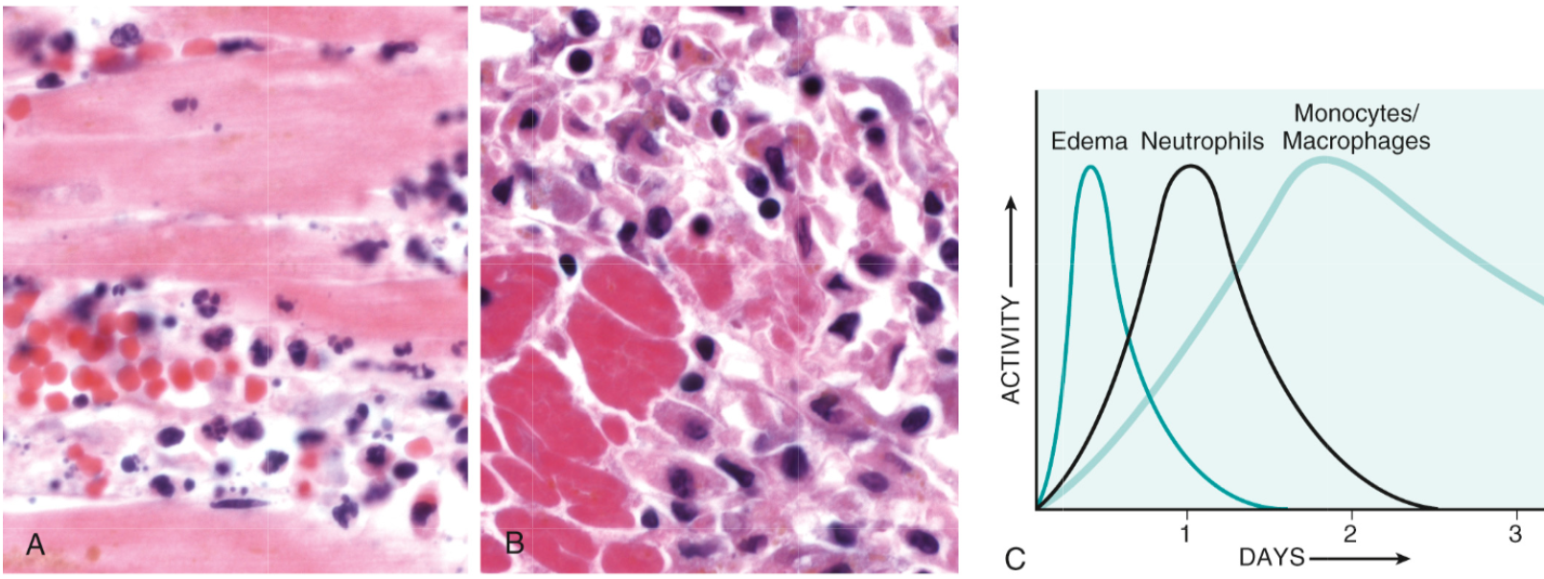
Extravasation of leukocytes from the blood to the tissues
WHY?

Slide 24
Extravasation of leukocytes from the blood to the tissues
Leukocyte Adhesion and Transmigration
neutrophils are more numerous in the blood, they respond more rapidly to chemokines,
but are short-lived; they undergo
apoptosis and disappear after 24 to 48 hours,
whereas monocytes survive longer.

Slide 25
Extravasation of leukocytes from the blood to the tissues
Leukocyte Adhesion and Transmigration
The type of emigrating leukocyte varies with the type of stimulus:
In viral infections, lymphocytes may be the first cells to arrive
In some hypersensitivity reactions and parasitic infection, eosinophil may be the main cell type
Chronic inflammation: lymphocytes, plasma cells and macrophages are present

Slide 26
Chemotaxis
3. Describe the meaning and utility of chemotaxis. Understand the role that chemokines play in inflammation.
After extravasation, leukocytes emigrate in tissues toward the site of injury by a process called chemotaxis, defined as locomotion oriented along a chemical gradient !!!!
Chemoattractants
Neutrophils are attracted by bacterial products, IL-8, C5a & LTB4
Chemokines act on the adherent leukocytes and stimulate the cells to migrate toward the site of injury or infection

Slide 27
Chemotaxis Chemoattractants
3. Describe the meaning and utility of chemotaxis. Understand the role that chemokines play in inflammation.
Exogenous and endogenous substances
Exogenous agents are bacterial products.
Endogenous chemoattractants include several chemical mediators:
components of the complement system, particularly C5a
products of the lipoxygenase pathway, mainly leukotriene B₄ (LTB₄)
cytokines, particularly those of the chemokine family (e.g., IL-8).

Slide 28
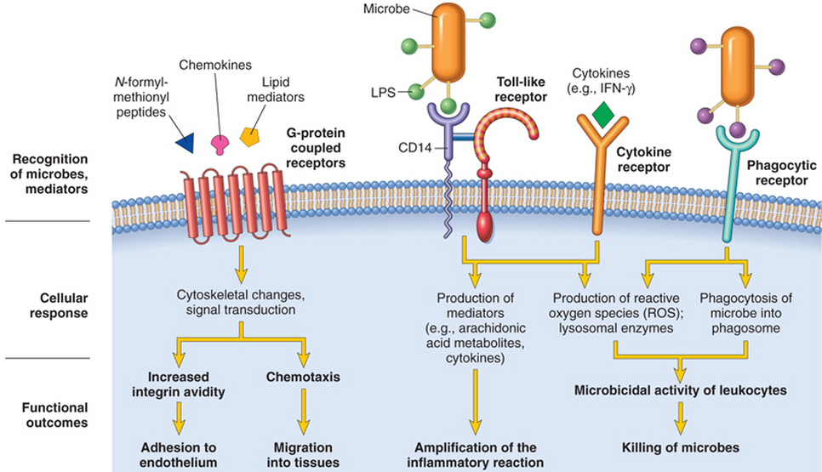
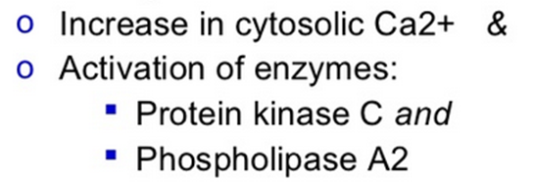
All these chemotactic agents bind to specific seven-transmembrane G-protein-coupled receptors on the surface of leukocytes

Slide 29
4. Describe the steps involved in phagocytosis and the role of IgG and C3b as opsonins and receptors.
Leukocyte Activation
Phagocytosis
Intracellular destruction
Liberation of substances that destroy
extracellular microbes and dead tissues
Production of mediators

Slide 30
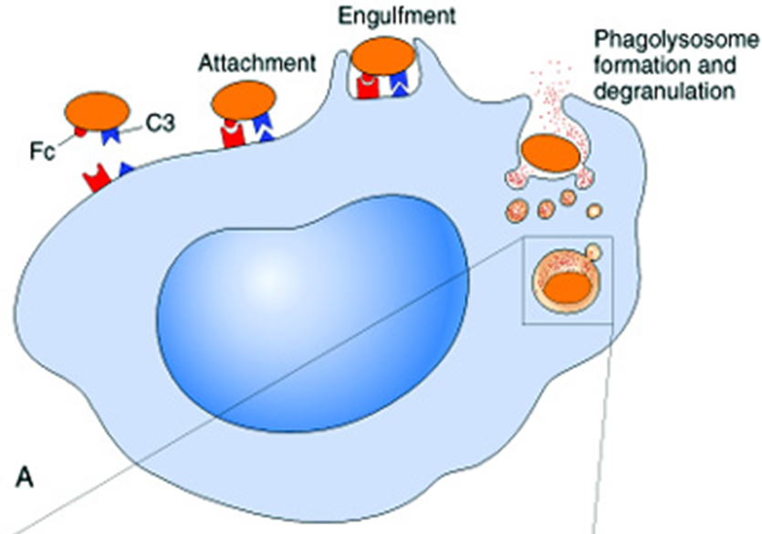
Phagocytosis
4. Describe the steps involved in phagocytosis and the role of IgG and C3b as opsonins and receptors.
Phagocytosis involves three distinct but interrelated steps
Recognition and Attachment of the particle to be ingested by the leukocyte
(2) its Engulfment, with subsequent formation of a phagocytic vacuole
(3) killing or Degradation of the ingested material.

Slide 31
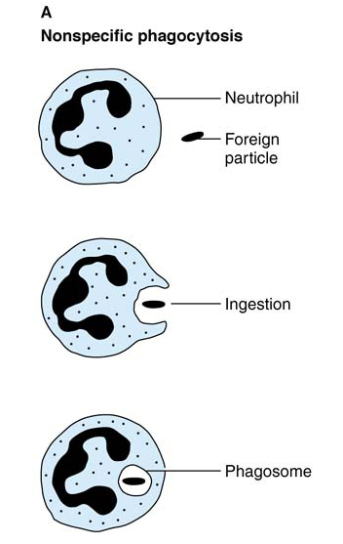
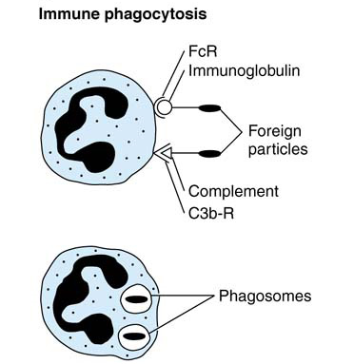
4. Describe the steps involved in phagocytosis and the role of IgG and C3b as opsonins and receptors.
Phagocytosis by neutrophils
Immune phagocytosis is much more efficient than nonspecific phagocytosis

Slide 32
Leukocyte activation (1) Recognition and Attachment (Opsonization)
4. Describe the steps involved in phagocytosis and the role of IgG and C3b as opsonins and receptors.
Is the process of coating a particle, such as a microbe, to target it for phagocytosis
The substances that do this are opsonins.
These substances include:
antibodies (IgG)
complement proteins (C3)
And others: lectins (mannose-binding lectin (MBL), collectins,fibronectin, fibrinogen, and C-reactive protein
These can coat microbes and are recognized by receptors on phagocytes (Fc and C3b receptors).

Slide 33
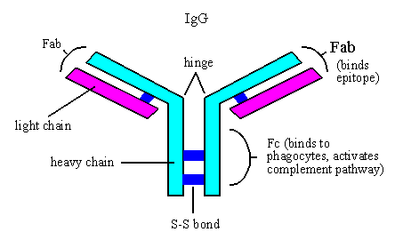
4. Describe the steps involved in phagocytosis and the role of IgG and C3b as opsonins and receptors.

Slide 34
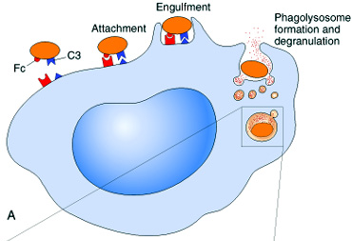
Phagocytosis 2. Engulfment
4. Describe the steps involved in phagocytosis and the role of IgG and C3b as opsonins and receptors.
During engulfment, extensions of the cytoplasm (pseudopods) flow around the particle to be engulfed, eventually resulting in complete enclosure of the particle within a phagosome
The phagocytic vacuole then fuses with a lysosomal granule, resulting in phagolysosome

Slide 35
Defects in Leukocyte Function
Chédiak-Higashi syndrome
Protein involved in organelle membrane fusion (no phagolysosomes)
Protein trafficking defect ( microtubule defect)
Autosomal recessive
Clinical feature:
Increased risk of pyogenic infection
Neutropenia (defect in generation from BM)
Giant granule formation (granules formed cannot move in cytoplasm)
Defective primary hemostasis ( platelet granule are not secreted)
Albinism
Peripheral neuropathy

Slide 36
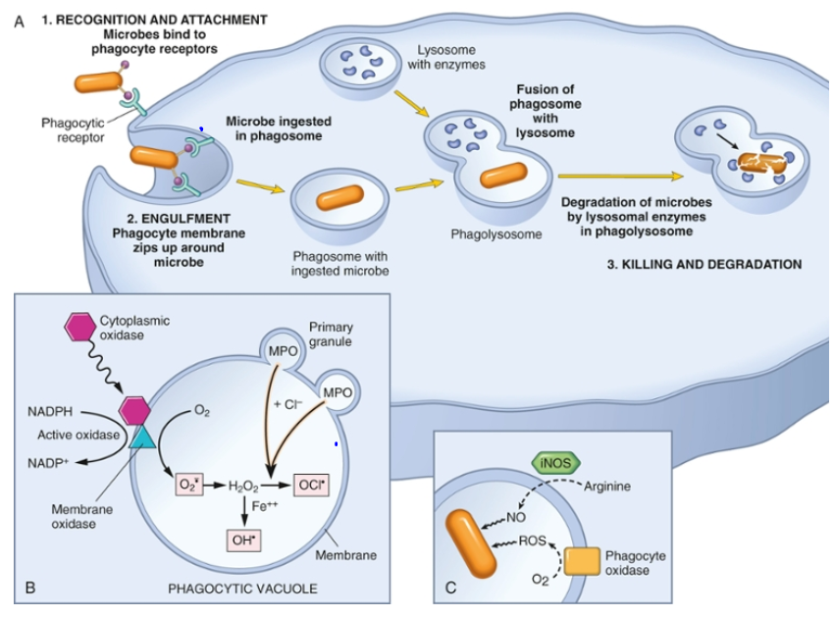
4. Describe the steps involved in phagocytosis and the role of IgG and C3b as opsonins and receptors.

Slide 37
Phagocytosis Killing and Degradation
5 . List the mechanisms of microbial killing.
2 mechanisms for Microbial killing:
1. Oxygen-dependent mechanisms
2. Oxygen-independent mechanisms

Slide 38
1. Oxygen-Dependent Mechanisms
5 . List the mechanisms of microbial killing.
The H₂O₂-MPO-halide system is the most efficient bactericidal system in neutrophils
_
O2
oxidase
O2
H2O2
MPO
HOCL
SOD
Chronic granulomatous disease
Decreased oxidative burst.

Slide 39
Oxygen-Dependent Mechanisms
Chronic granulomatous disease
Decreased oxidative burst.
2 types:
A. X-linked: NADPH oxidase (membrane component)
B. Autosomal recessive:
a. NADPH oxidase (cytoplasmic components)
b. Myeloperoxidase deficiency: (absent MPO-H2O2 system) pt. have increased risk of candida infection
Infection and granuloma formation with catalase positive organisms e.g. S aureus, Norcardia and Aspergillus

Slide 40
Oxygen-Dependent Mechanisms Comparison of Chronic Granulomatous Disease and Myeloperoxidase Deficiency

Slide 41
5 . List the mechanisms of microbial killing.
2. Oxygen-independent mechanisms
through the action of substances in leukocyte granules. These include:
Bactericidal permeability increasing protein (BPI)
Lysozyme
Lactoferrin
Major basic protein
Defensins
Neutrophil granules contain other enzymes, such as elastase, that also contribute to microbial killing
Can potentiate further inflammation by damaging tissues
These harmful proteases are controlled by a system of anti-proteases in the serum

Slide 42
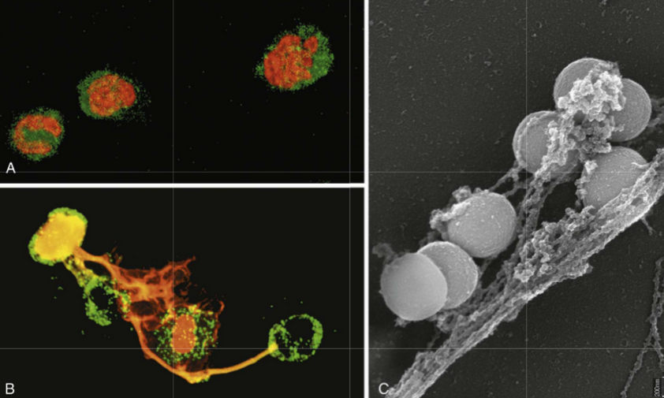
Neutrophil extracellular traps (NETs)
A, Healthy neutrophils with nuclei stained red and cytoplasm green.
B, Release of nuclear material from neutrophils (note that two have lost their nuclei), forming extracellular traps.
C, An electron micrograph of bacteria (staphylococci) trapped in NETs.
NETs provide an additional mechanism of killing microbes that does not involve phagocytosis

Slide 43
Defects in Leukocyte Function

Slide 44
Defects in Leukocyte Function
6. Know various defects in leukocyte function.
Genetic
Leukocyte adhesion deficiency 1and 2
Chédiak-Higashi syndrome
Chronic granulomatous disease:
A. X-linked: NADPH oxidase (membrane component)
B. Autosomal recessive:
a. NADPH oxidase (cytoplasmic components)
b. Myeloperoxidase deficiency

Slide 45
Defects in Leukocyte Function
6. Know various defects in leukocyte function.
Acquired
Thermal injury, diabetes, malignancy, sepsis, immunodeficiencies
Chemotaxis
Hemodialysis, diabetes mellitus
Adhesion
Leukemia, anemia, sepsis, diabetes, neonates, malnutrition
Phagocytosis and microbicidal activity

Slide 46
TAKE HOME MESSAGES:
Several steps are involved in extravasation of leukocytes from the blood to the tissues.
Phagocytosis is important step to get rid of necrotic material and bacteria.
Various defects in leukocyte function are present. These could be genetic defects or acquired.

Slide 47
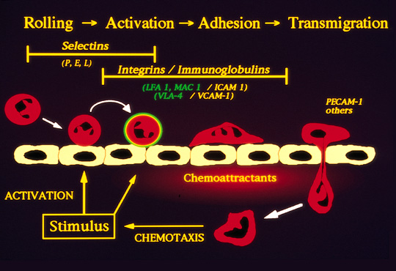
Leukocyte emigration

