Slide 1
Neoplasia
Lecture 3
CARCINOGENESIS
Dr. Maha Arafah
Dr. Abdulmalik Alsheikh, MD, FRCPC
Foundation block 2014
Pathology

Slide 2
CARCINOGENESIS
Carcinogenesis is a multistep process at both the phenotypic and the genetic levels.
It starts with a genetic damage:
  Environmental
    Chemical
    Radiation
    Infectious
  Inhereted

Slide 3
Carcinogenesis
Genetic damage lead to “ mutation”
single cell which has the genetic damage undergoes neoplastic proliferation ( clonal expansion) forming the tumor mass

Slide 4
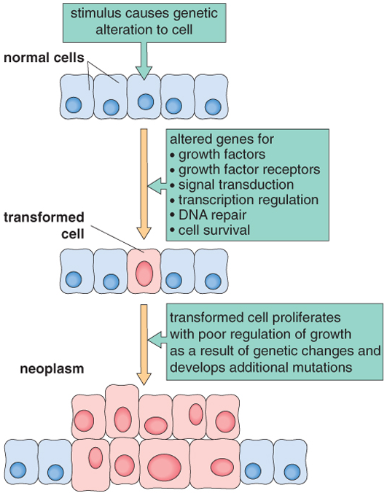

Slide 5
Carcinogenesis
Where are the targets of the genetic damage??
Four regulatory genes are the main targets:
  Growth promoting protooncogenes
    Protooncogene > mutation > oncogene
  Growth inhibiting (supressors) genes
  Genes regulating apoptosis
  DNA repair genes

Slide 6
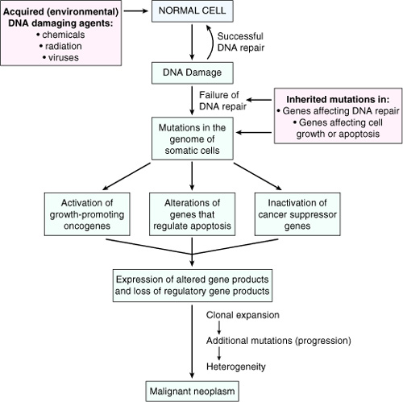

Slide 7
Carcinogenesis
Main changes in the cell physiology that lead to formation of the malignant phenotype:
  Self-sufficiency in growth signals
  Insensitivity to growth-inhibitory signals
  Evasion of apoptosis
  Limitless replicative potential
  Sustained angiogenesis
  Ability to invade and metastsize

Slide 8
Carcinogenesis
A - Self-sufficiency in Growth signals:
  Oncogene: Gene that promote autonomous cell growth in cancer cells
  They are derived by mutations in protooncogenes
  They are characterized by the ability to promote cell growth in the absence of normal growth-promoting signals
  Oncoproteins : are the products

Slide 9
Carcinogenesis
Remember the cell cycle !!
  Binding of a growth factor to its receptor on the cell membrane
  Activation of the growth factor receptor leading to activation of signal-transducing proteins
  Transmission of the signal to the nucleus
  Induction of the DNA transcription
  Entry in the cell cycle and cell division

Slide 10
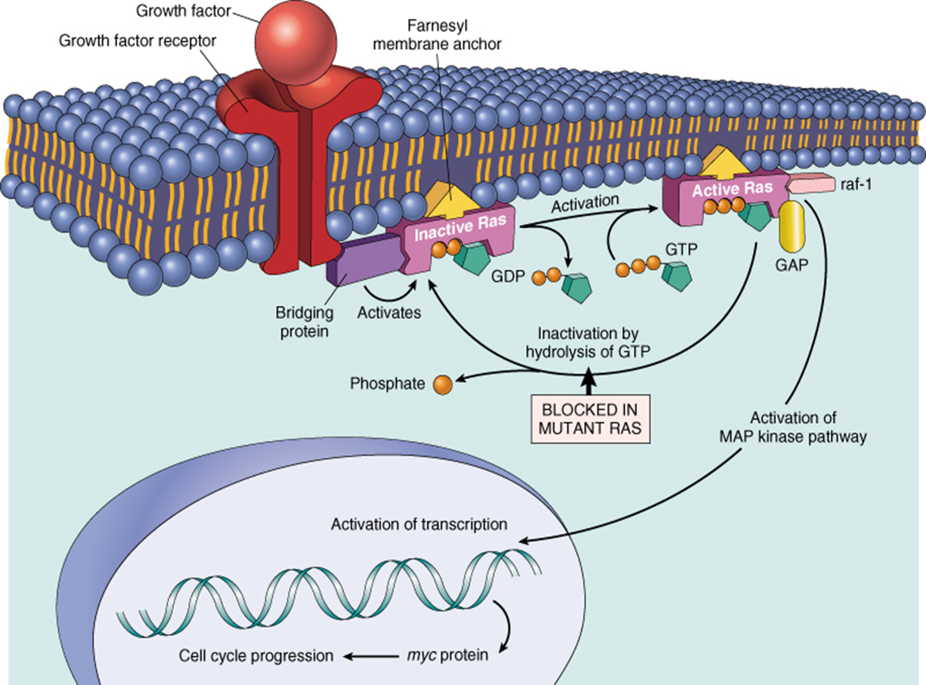

Slide 11
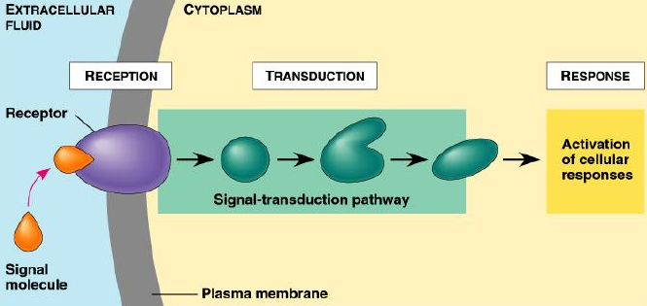
Carcinogenesis
HOW CANCER CELLS ACQUIRE SELF-SUFFICIENCY IN GROWTH SIGNALS??

Slide 12
Carcinogenesis
1- Growth factors:
  Cancer cells are capable to synthesize the same growth factors to which they are responsive
    E.g. Sarcomas ---- > TGF-α
    Glioblastoma-----> PDGF

Slide 14
Carcinogenesis
2-Growth factors receptors:
  Receptors --- mutation ----continous signals to cells and uncontroled growth
  Receptors --- overexpression ---cells become very sensitive ----hyperresponsive to normal levels of growth factors

Slide 16
Carcinogenesis
Example :
  Epidermal Growth Factor ( EGF ) Receptor family
    HER2
      Amplified in breast cancers and other tumors
      High levels of HER2 in breast cancer indicate poor prognosis
      Anti- HER2 antibodies are used in treatment

Slide 17
Carcinogenesis
3- Signal-transducing proteins :
They receive signals from activated growth factors receptors and transmitte them to the nucleus. Examples :
  RAS
  ABL

Slide 18
Carcinogenesis
RAS :
  30% of all human tumors contain mutated RAS gene . E.g : colon . Pancreas cancers
  Mutations of the RAS gene is the most common oncogene abnormality in human tumors
  Mutations in RAS --- cells continue to proliferate

Slide 19
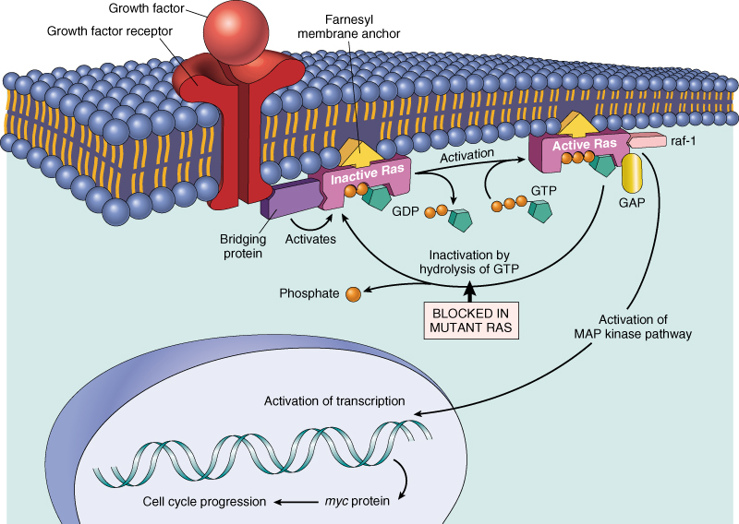

Slide 20
Carcinogenesis
ABL gene
  ABL protooncogene has a tyrosine kinase activity
  Its activity is controlled by negative regulatory mechanism
  E.g. : chronic myeloid leukemia ( CML ) :
    t( 9,22) ---ABL gene transferred from ch. 9 to ch. 22
    Fusion with BCR ---> BCR-ABL
    BCR-ABL has tyrosine kinase acttivity ---( oncogenec)

Slide 21
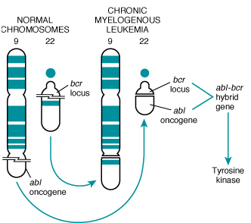

Slide 22
Carcinogenesis
CML patients are treated with ( Gleevec) which is inhibitor of ABL kinase

Slide 23
Carcinogenesis
4- Nuclear transcription factors :
  Mutations may affect genes that regulate transcription of DNA → growth autonomy
  E.g. MYC
    MYC protooncogene produce MYC protein when cell receives growth signals
    MYC protein binds to DNA leading to activation of growth-related genes

Slide 25
Carcinogenesis
Normally … MYC decrease when cell cycle begins …but ..in tumors there is sustained expression of MYC → continuous proliferation
E.g. Burkitt Lymphoma ; MYC is dysregulated due to t( 8,14)

Slide 26
Carcinogenesis
5- Cyclins and cyclins- dependent kinases (CDKs)
  Progression of cells through cell cycles is regulated by CDKs after they are activated by binding with cyclins
  Mutations that dysregulate cyclins and CDKs will lead to cell proliferation …e.g.
    Cyclin D genes are overexpressed in breast, esophagus and liver cancers.
    CDK4 is amplified in melanoma and sarcomas

Slide 27
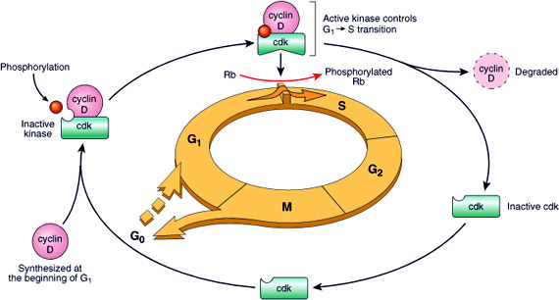

Slide 28
Carcinogenesis
Main changes in the cell physiology that lead to formation of the malignant phenotype:
  A- Self-sufficiency in growth signals
  B- Insensitivity to growth-inhibitory signals
  C- Evasion of apoptosis
  D- Limitless replicative potential
  E- Sustained angiogenesis
  F- Ability to invade and metastsize

Slide 29
Carcinogenesis
2. Insensitivity to growth-inhibitory signals
Tumor suppressor genes control ( apply brakes) cells proliferation
If mutation caused disruption to them → cell becomes insensitive to growth inhibition→ uncontrolled proliferation
Examples: RB, TGF-β, APC, P53

Slide 30
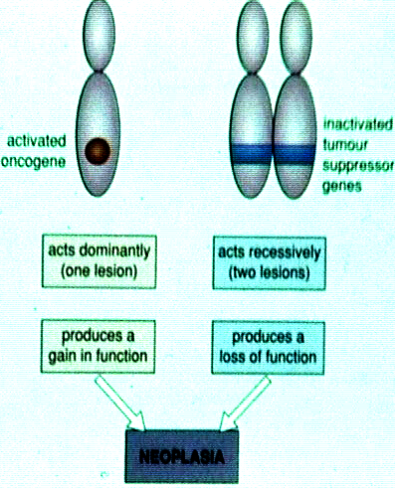

Slide 31
Carcinogenesis
RB ( retinoblastoma ) gene :
  First tumor supressor gene discovered
  It was discovered initially in retinoblastomas
  Found in other tumors, e.g. breast ca
  RB gene is a DNA-binding protein
  RB is located on chromosome 13

Slide 32
Carcinogenesis
RB gene exists in “ active “ and “ inactive” forms
If active→ will stop the advancing from G1 to S phase in cell cycle
If cell is stimulated by growth factors → inactivation of RB gene →brake is released→ cells start cell cycle …G1 →S→M …then RB gene is activated again

Slide 33
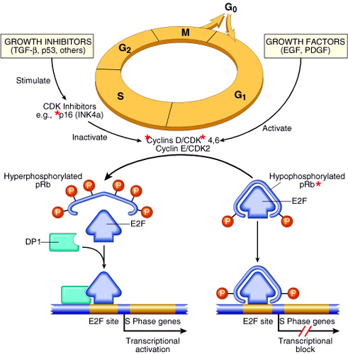

Slide 34
Carcinogenesis
  Retinoblastoma is an uncommon childhood tumor
  Retinoblastoma is either sporadic (60%) or familial ( 40% )
  Two mutations required to produce retinoblastoma
  Both normal copies of the gene should be lost to produce retinoblastoma

Slide 35
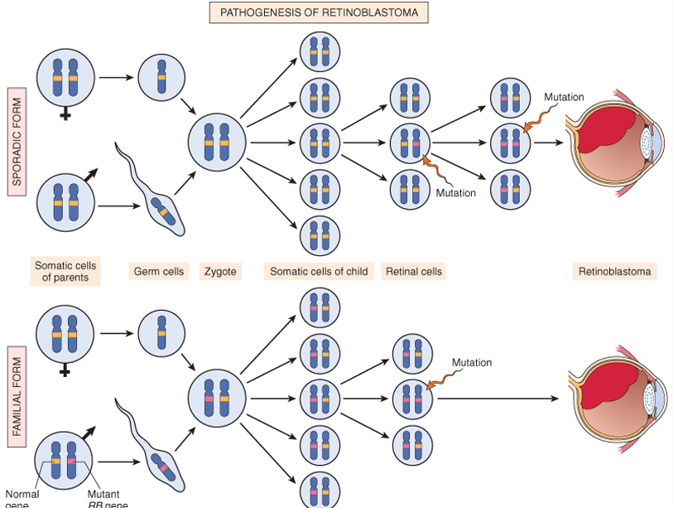

Slide 36
Carcinogenesis
Transforming Growth Factor- β pathway:
  TGF-β is an inhibitor of proliferation
  It regulate RB pathway
  Inactivation of TGF-β lead to cell proliferation
  Mutations in TGF-β pathway are present in :
    100% of pancreatic cancers
    83% of colon cancers

Slide 37
Carcinogenesis
Adenomatous Polyposis Coli – β Catenin pathway:
  APC is tumor supressor gene
  APC gene loss is very common in colon cancers
  It has anti-proliferative action through inhibition of β−Catenin which activate cell proliferation
  Individuals with mutant APC develop thousands of colonic polyps

Slide 38
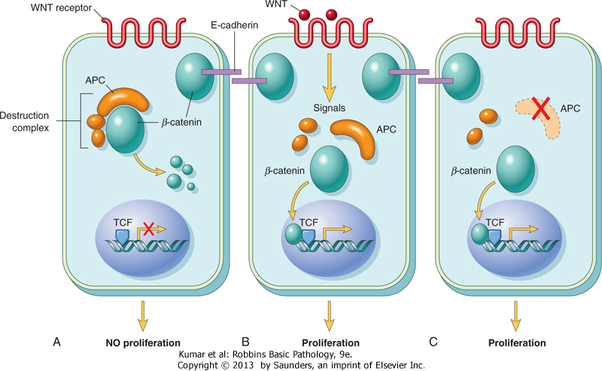
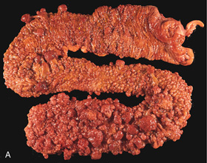
Adenomatous Polyposis Coli

Slide 39
Carcinogenesis
One or more of the polyps will progress to colonic carcinoma
APC mutations are seen in 70% to 80% of sporadic colon cancers

Slide 40
Carcinogenesis
P53
  It has multiple functions
  Mainly :
    Tumor suppressor gene ( anti-proliferative )
    Regulates apoptosis

Slide 41
Carcinogenesis
P53 senses DNA damage
Causes G1 arrest to give chance for DNA repair
Induce DNA repair genes
If a cell with damaged DNA cannot be repaired, it will be directed by P53 to undergo apoptosis

Slide 42
Carcinogenesis
With loss of P53, DNA damage goes unrepaired
Mutations will be fixed in the dividing cells, leading to malignant transformation

Slide 43
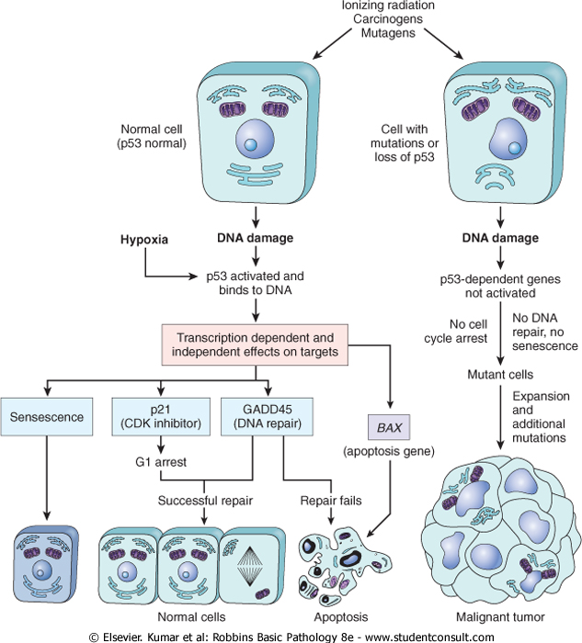
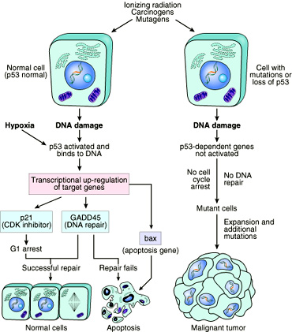

Slide 44
Carcinogenesis
P53 is called the “ guardian of the genome”
70% of human cancers have a defect in P53
It has been reported with almost all types of cancers : e.g. lung, colon, breast
In most cases, mutations are acquired, but can be inhereted, e.g : Li-Fraumeni syndrome

Slide 45
Carcinogenesis
Main changes in the cell physiology that lead to formation of the malignant phenotype:
  A- Self-sufficiency in growth signals
  B- Insensitivity to growth-inhibitory signals
  C- Evasion of apoptosis
  D- Limitless replicative potential
  E- Sustained angiogenesis
  F- Ability to invade and metastsize

Slide 46
Carcinogenesis
Evasion of apoptosis:
  Mutations in the genes regulating apoptosis are factors in malignant transformation
  Cell survival is controlled by genes that promote and inhibit apoptosis

Slide 47
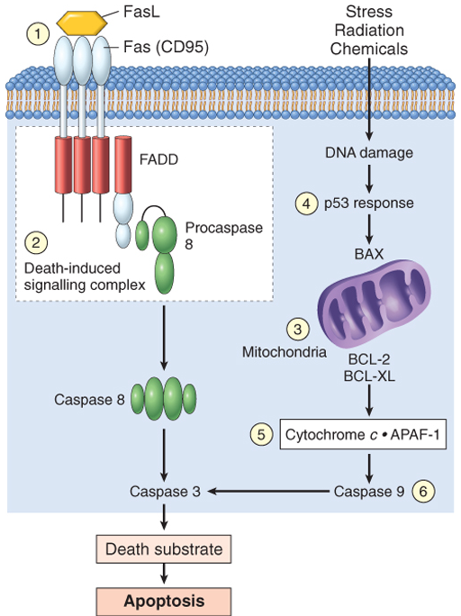
Evasion of apoptosis
Reduced CD95 level inactivate death –induced signaling cascade that cleaves DNA to cause death→ tumor cells are less susceptible to apoptosis
DNA damage induced apoptosis (with the action of P53 ) can be blocked in tumors
loss of P53 and up-regulation of BCL2 prevent apoptosis e.g. follicular lymphoma

Slide 48
Carcinogenesis
Main changes in the cell physiology that lead to formation of the malignant phenotype:
  A- Self-sufficiency in growth signals
  B- Insensitivity to growth-inhibitory signals
  C- Evasion of apoptosis
  D- Limitless replicative potential
  E- Sustained angiogenesis
  F- Ability to invade and metastsize

Slide 49
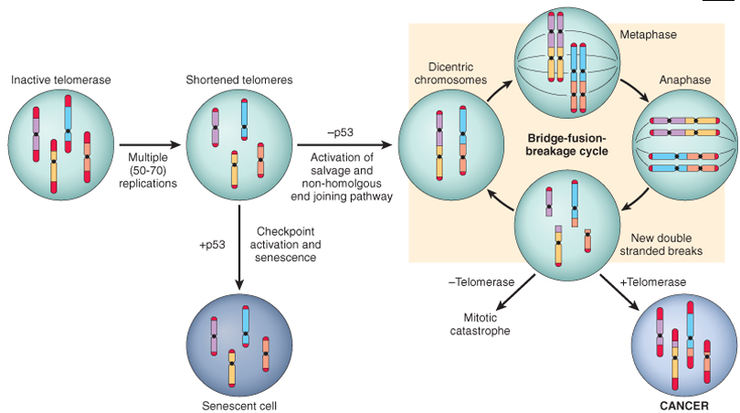
Limitless replicative potential:
  Normally there is progressive shortening of telomeres at the ends of chromosomes
  Telomerase is active in normal stem cells but absent in somatic cells
  In tumor cells : activation of the enzyme telomerase, which can maintain normal telomere length

Slide 50
Carcinogenesis
Main changes in the cell physiology that lead to formation of the malignant phenotype:
  A- Self-sufficiency in growth signals
  B- Insensitivity to growth-inhibitory signals
  C- Evasion of apoptosis
  D- Limitless replicative potential
  E- Sustained angiogenesis
  F- Ability to invade and metastsize

Slide 51
Carcinogenesis
Sustained angiogenesis
  Neovascularization has two main effects:
    Perfusion supplies oxygen and nutrients
    Newly formed endothelial cells stimulate the growth of adjacent tumor cells by secreting growth factors, e.g : PDGF, IL-1
  Angiogenesis is required for metastasis

Slide 52
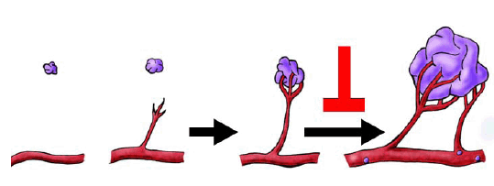
How do tumors develop a blood supply?
  Tumor-associated angiogenic factors
  These factors may be produced by tumor cells or by inflammatory cells infiltrating the tumor e.g. macrophages
  Important factors :
    Vascular endothelial growth factor( VEGF )
    Fibroblast growth factor

Slide 53
Carcinogenesis
Main changes in the cell physiology that lead to formation of the malignant phenotype:
  A- Self-sufficiency in growth signals
  B- Insensitivity to growth-inhibitory signals
  C- Evasion of apoptosis
  D- Limitless replicative potential
  E- Sustained angiogenesis
  F- Ability to invade and metastsize

Slide 54
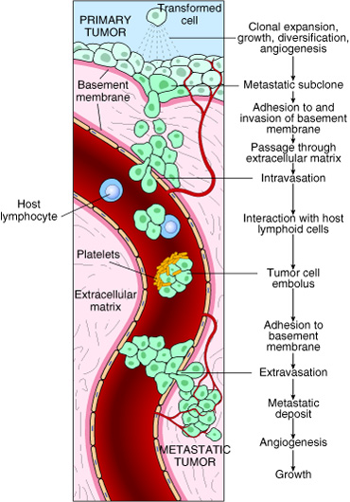

Slide 55
Carcinogenesis
Ability to invade and metastsize:
  Two phases :
    Invasion of extracellular matrix
    Vascular dissimenation and homing of tumor cells

Slide 56
Carcinogenesis
Invasion of ECM:
  Malignant cells first breach the underlying basement membrane
  Traverse the interstitial tissue
  Penetrate the vascular basement membrane
  Gain access to the circulation
  Invasion of the ECM has four steps:

Slide 57
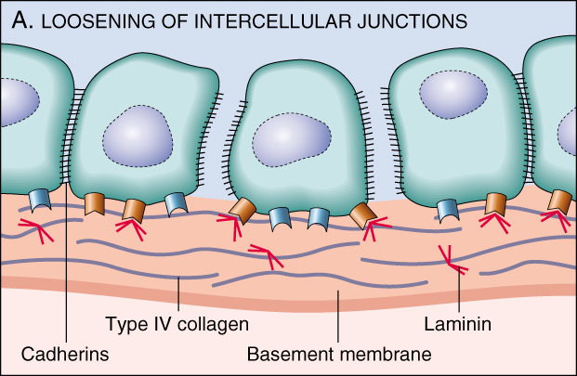
  1. Detachment of tumor cells from each other

Slide 58
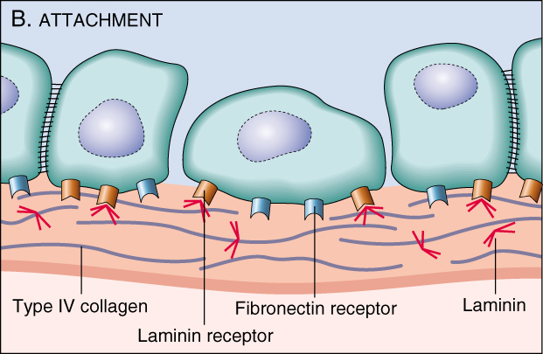
  2. Attachments of tumor cells to matrix components

Slide 59
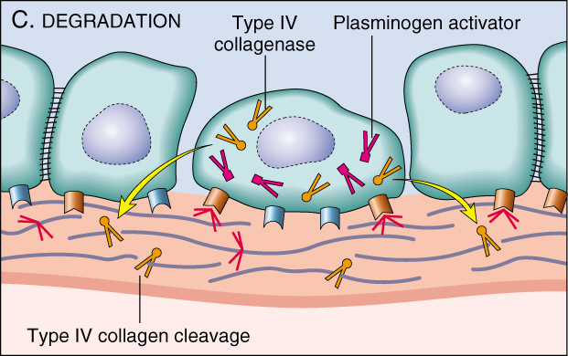
  3. Degradation of ECM by collagenase enzyme

Slide 60
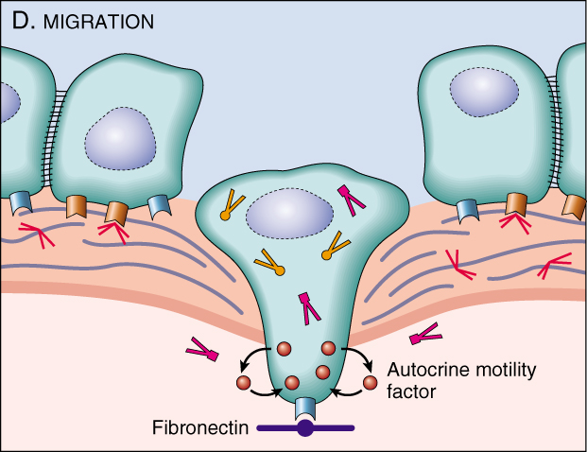
  4. Migration of tumor cells

Slide 61
Carcinogenesis
Vascular dissemination and homing of tumor cells:
  May form emboli
  Most travel as single cells
  Adhesion to vascular endothelium
  extravasation

Slide 62
Carcinogenesis
Main changes in the cell physiology that lead to formation of the malignant phenotype:
  A- Self-sufficiency in growth signals
  B- Insensitivity to growth-inhibitory signals
  C- Evasion of apoptosis
  D- Limitless replicative potential
  E- Sustained angiogenesis
  F- Ability to invade and metastsize

Slide 63
Genomic Instability
Enabler of malignancy
Due to defect in DNA repair genes
Examples:
  Hereditary Nonpolyposis colon carcinoma(HNPCC)
  Xeroderma pigmentosum
  Familial breast cancer

Slide 64
Genomic Instability
Familial breast cancer:
  Due to mutations in BRCA1 and BRCA2 genes
  These genes regulate DNA repair
  Account for 80% of familial breast cancer
  They are also involved in other malignancies

Slide 65
Molecular Basis of multistep Carcinogenesis
Cancer results from accumulation of multiple mutations
All cancers have multiple genetic alterations, involving activation of several oncogenes and loss of two or more tumor suppressor genes

Slide 66
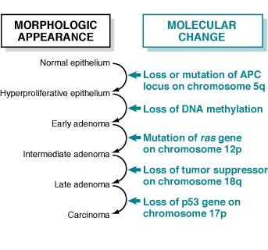
Molecular Basis of multistep Carcinogenesis

Slide 67
Tumor progression
Many tumors become more aggressive and acquire greater malignant potential…this is called “ tumor progression” …not increase in size!!
By the time, the tumor become clinically evident, their constituent cells are extremely heterogeneous

Slide 68
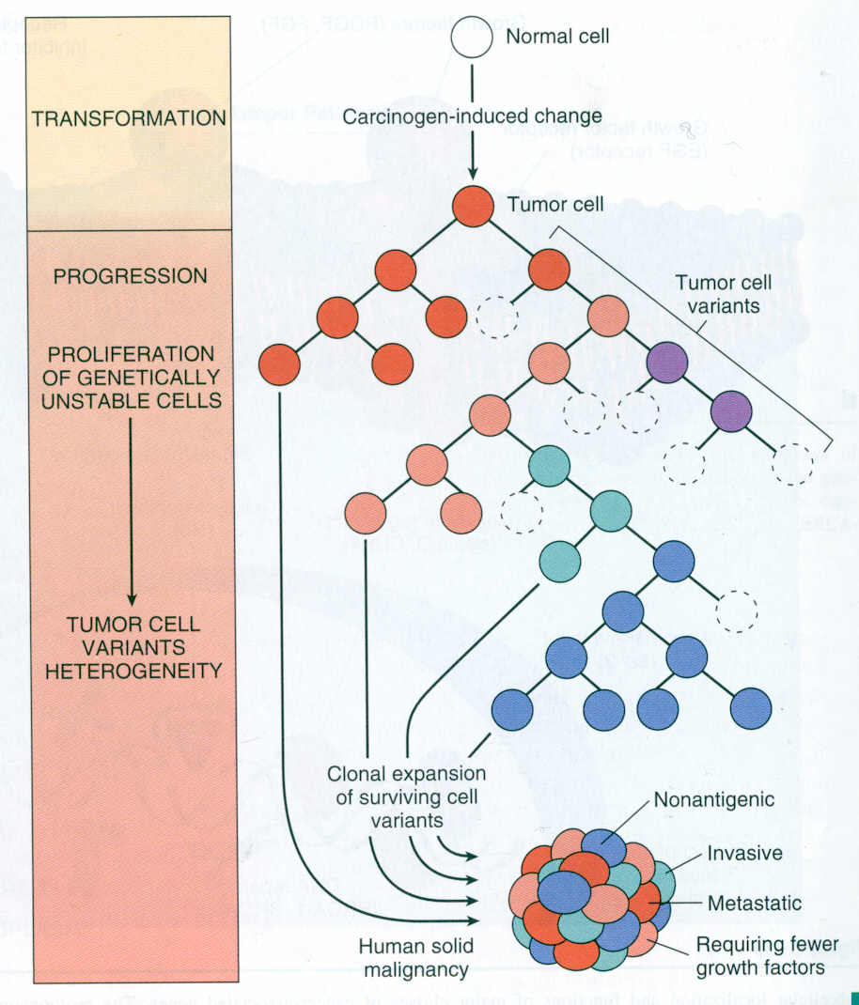

Slide 69
Karyotypic Changes in Tumors
Translocations:
  In CML : t(9,22) …” Philadelphia chromosome”
  In Burkitt Lymphoma : t(8,14)
  In Follicular Lymphoma : t(14,18)
Deletions
Gene amplification:
  Breast cancer : HER-2

Slide 70
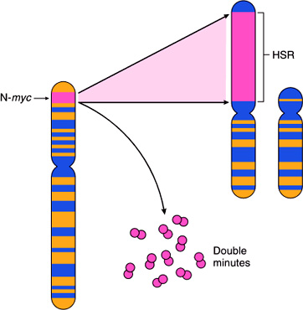
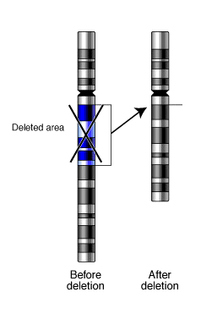
Translocations
Gene amplification

