Slide 1
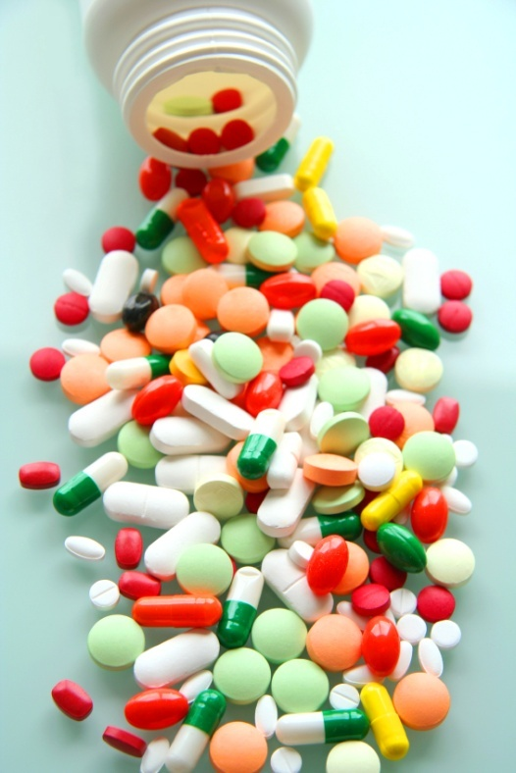
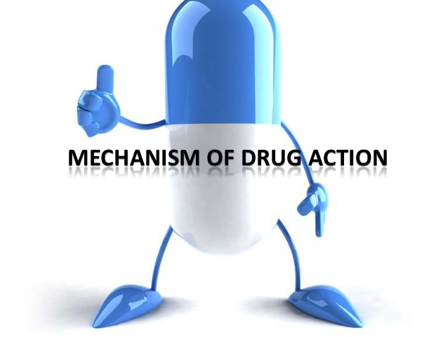
PHARMACdYNAMICS IV
TOLERANCE / DESENSITIZATION
&ADVERSE DRUG REACTIONS

Slide 2
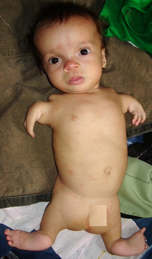
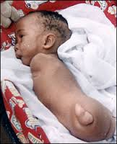
Phocomelia
Thalidomide crisis
Thalidomide was marketed in 1958 in West Germany as a hypnotic & as for morning sickness during pregnancy
Iatrogenic disease
In 1961 a report of out break of phocomelia in the neoborn babies(40000-100000 cases)

Slide 3
Ilos
Distinguish difference between tolerance and desensitization (tachyphylaxis) and reasons for their development
Recognize patterns of adverse drug reactions (ADR)

Slide 4
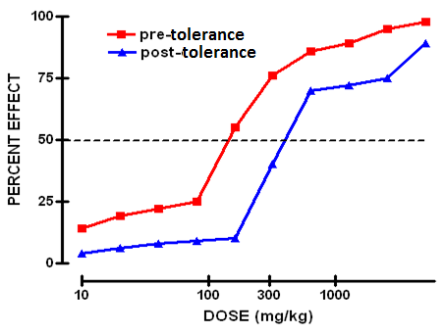
TOLERANCE and DESENSITIZATION
Phenomenon of variation in drug response, whereby there is a gradual diminution of the response to the drug when given continuously or repeatedly

Slide 5
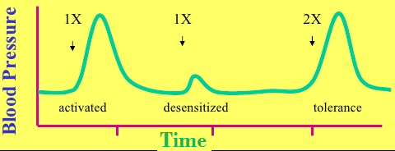
DIMINUTION OF A RESPONSE
Rapid, in the course of few minutes
Gradual in the course of few days to weeks
TACHYPHYLAXIS / DESENSITIZATION
TOLERANCE
These SHOULD BE DISTINGUISHED FROM
Loss of effectiveness of antimicrobial agent
Resistance

Slide 6
REASONS FOR DEVELOPMENT OF TOLERANCE
PRE RECEPTOR EVENTS
EVENTS AT RECEPTORS
POST RECEPTOR EVENTS
↓ drug availability at the relevant receptors due to pharmaco- kinetic variables
Nullification of drug response by a physiological adaptative homeostatic response
Drug becomes:
> metabolized or excreted
< absorbed
altered distribution to tissues
Antihypertensive effects of ACE Is become nullified by activation of renin angiotensin system by NSAIDs
eg. Barbiturates  metabolism of Contraceptive pills =  it availability
LOSS OF THERAPEUTIC EFFICACY
Refractoriness

Slide 7
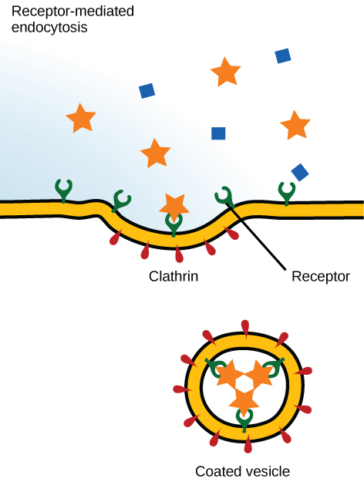
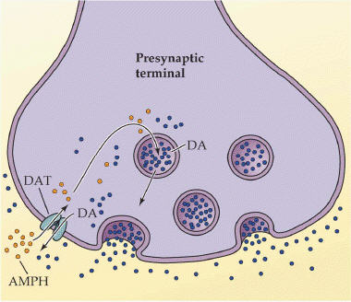
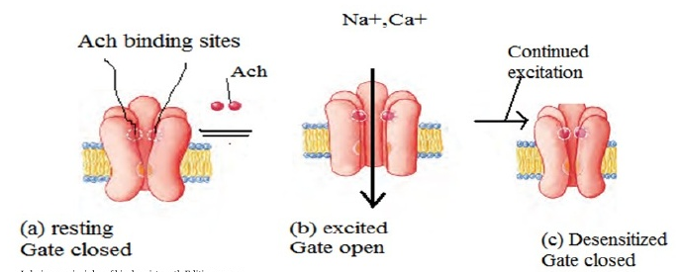
REASONS FOR DEVELOPMENT OF TOLERANCE
PRE RECEPTOR EVENTS
EVENTS AT RECEPTORS
POST RECEPTOR EVENTS
BINDING ALTERATION
DOWN REGULATION
EXHUSTION
OF MEDIATORS
Depletion of mediator stores by amphetamine
1-Phosphorylation of receptors i.e. Tight binding of ß-adrenoceptors agonists → ↓ activation of AC
2-Desenzitiation of Ach- receptors
[Functional defect]
↓ Number of receptors.
Isoprenaline activation to β receptors →↑ receptor recycling by endocytosis [Structural defect]

Slide 8
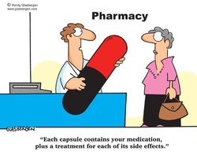
ADVERSE DRUG REACTIONS [ADRs]
Harmful or seriously unpleasant effects occurring at doses intended for therapeutic effects.

Slide 9
Types of adrs

Slide 10
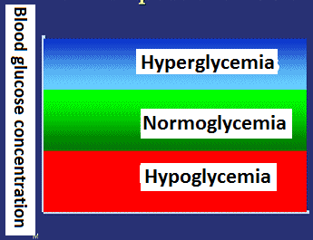
Type a
Augmented
80% of ADRs
Is it dose dependent?
Is the ADR quantitatively or qualitativel different from the primary effect?
Is it predictable?
Is the incidence high or low?
How mortal is it ?
A consequence of the primary effect of the drug
How is it treated?
e.g. Hypoglycemia from hypoglycemic drugs
Bleeding from warfarin

Slide 11
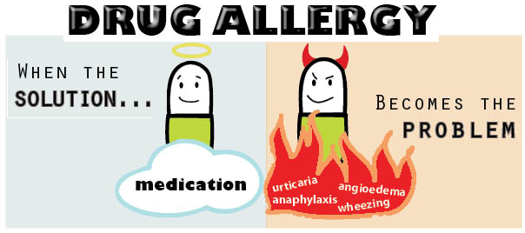
Type b
bizarre
Occurs different to known drug pharmacological effect[idiosyncrotic ]
Is it predictable?
Idiosyncratic reactions are drug reactions that occur rarely and unpredictably amongst the population
Is the ADR quantitatively or qualitativel different from the primary effect?
Is the incidence high or low?
How mortal is it ?
Is it dose dependent?
How is it treated?
Usually due to [1]immunological response or [2]patient’s genetic defect
Penicillin Anaphylactic shock
Quinine  Thrombocytopenia

Slide 12
Comparison between type A & B -ADRs
 | Type A Augmentation | Type B Idiosyncratic
Pharmacological predictability | Yes | No
Nature | Quantitative [ extension of pharmacology effect ] | Qualitative [ immune or genetic base]
Dose- dependent | Yes (dose response relationship present) | No (dose response relationship absent)
Onset of symptoms | Usually Rapid | Usually delayed
Mortality | Low | High
Treatment | Dose adjustment or Substitute by > selective + Antagonize unwanted effect of 1st drug | Stop drug + Symptomatic treatment
Example | Bradycardia β- ADR Blockers Hemorrhage Warfarin | Apnea succinylcholine Thrombocytopenia Quinine

Slide 13
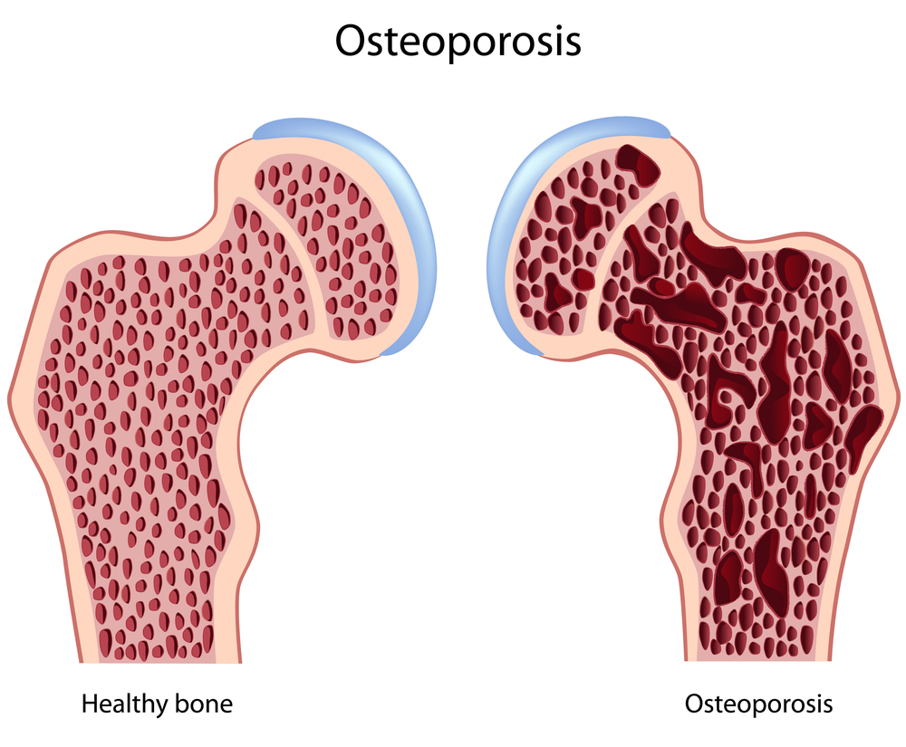
Type c
COntinued
Occurs during chronic drug administration
Osteoporosis  chronic
corticosteroid intake

Slide 14
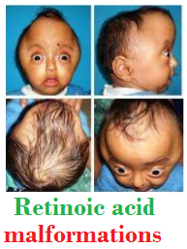
Type d
delayed
Occurs after long period of time even after drug stoppage (delayed in onset)
Refers to carcinogenic and teratogenic effects
Teratogenicity→Retinoids
Carcinogenicity→ Tobacoo smoking

Slide 15
Type e
End of use
Occurs after sudden stoppage of chronic drug use due to existing adaptive changes
Morphine Withdrawal syndrome
↑ Body ache, insomnia, diarrhea, goose flesh, lacrimation
Withdrawal of diazepam  anxiety, insomnia

Slide 16
TYPE B
[1] If due to immunological response
1st exposure to a drug
Repeated exposures
Sensitization
HYPERSENSITIVITY REACTION
TYPE I
Anaphylaxsis
TYPE II
Cytotoxic
TYPE III
Immune complex
TYPE IV
Cell mediated

Slide 17
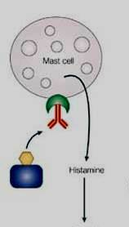
Type I hypersensitivity: Anaphylactic
Type I hypersensitivity is an allergic reaction provoked by re-exposure to a specific antigen
Fast response which occurs in minutes, rather than multiple hours or days. The reaction usually takes 15 - 30 minutes from the time of exposure to the antigen.
The reaction is mediated by IgE antibodies and produced by the immediate release of histamine, serotonin, leukotrienes from tissue mast cells or blood basophils
IgE

Slide 18
The reaction may be either local or systemic. Symptoms vary from mild irritation to sudden death from anaphylactic shock.
Some examples:
Allergic asthma
Allergic conjunctivitis
Allergic rhinitis "hay fever"
Urticaria (hives)
Anaphylaxis
- may be caused by Penicillin, Streptomycin

Slide 19
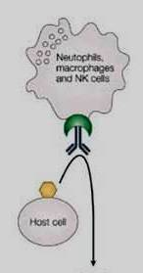
Type II hypersensitivity : Cytotoxic
Antibody-dependent
The antigens may be endogenous or exogenous chemicals (haptens) which can attach to cell membranes
The antibodies (IgM or IgG) produced by the immune response bind to antigens on the patient's own cell surfaces that is perceived by the immune system as foreign, leading to cellular destruction.
The reaction takes hours to a day
Examples: Drug-induced haemolytic anemia , thrombocytopenia
by Penicillin, Quinidine
IgG
Notes:
leading to cellular destruction via the membrane attack complexes (MAC)

Slide 20
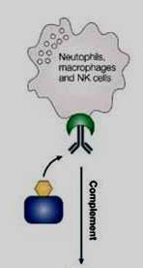
Type III hypersensitivity : Immune complex
Soluble immune complexes (aggregations of antigens and IgG and IgM antibodies) form in the blood, are not completely removed by macrophages and are deposited in various tissues (typically the skin, kidney and joints)
The reaction takes hours to days to develop
Example: Serum sickness (fever, arthritis,
enlarged lymph nodes, urticaria)
by Sulphonamides, Penicillin, Streptomycin
IgG

Slide 21
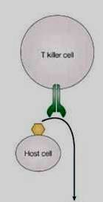
Type IV Hypersensitivity: Cell-mediated
also known as delayed type hypersensitivity as the reaction takes two to three days to develop.
Unlike the other types, it is not antibody- mediated but rather is a type of cell-mediated response.
Cytotoxic T cells cause direct damage
whereas helper T cells secrete cytokines
that attracts inflammatory cell infiltrate
Example : Contact dermatitis by local anesthetics
creams, anti -histamine creams, topical antibiotics

Slide 22
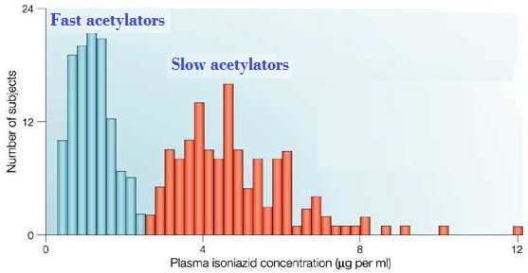
TYPE B
[2] If due to genetic defect
When isoniazid is given in identical doses /kg, two distinct groups can be identified, a group with low blood level acetylate the drug more rapidly ‘fast acetylators’ & ‘slow acetylators’
Isoniazid causes peripheral neuropathy in slow acetylators
Relapse of infection & hepatitis occur in rapid acetylators
Notes:
Isoniazid is metabolized in man at extremely variable rates, and the rate is under genetic control.

Slide 23
GOOD LUCK

