Slide 1
ميحرلا نمحرلا الله مسب

Slide 2
Dr. Abeer Al-Ghumlas M.B.B.S., MSc. Physiology Ph-D. Physiology
2

Slide 3
Objectives
At the end of this lecture student
should be able to:
1.Describe ABO blood groups types 2.Recognize Agglutinin in plasma 3.Recognize transfusion reactions
Describe Rhesus blood groups.
Describe causes of hemolytic disease of the newborn.

Slide 4
BLOOD GROUPS
Determined by:
Antigens (glycoprotein) on the surface RBC
The chief blood groups are:
Clinically most significant
1.A-B-O System
2.Rh (Rhesus) System

Slide 5
A
B
Group B
Group A
A
B
Group A B
Group O

Slide 6
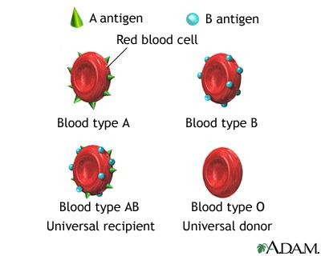
1.The ABO system:
Depends on whether the red cells contain one, both or neither of the two blood antigens:
A and B.
Four main ABO groups:
A, B, AB, O

Slide 7
The ABO Blood groups
GroupBlood | Agglutinogen | Agglutinin
A B AB O | A B A & B - | Anti-B Anti-A - Anti A+B

Slide 8
The ABO system- cont.
Anti-A & Anti-B:
They are naturally occurring antibodies.
Not present at birth, appear 2-8/12
Triggered by A & B antigens in food and bacteria

Slide 9
Definitions
•Agglutinogens: Blood group antigens on RBC
membrane (A and B)
Agglutinin: The respective antibody to the
antigen
•Agglutination: Reaction between agglutinogen
on RBC and the respective Ab.

Slide 10
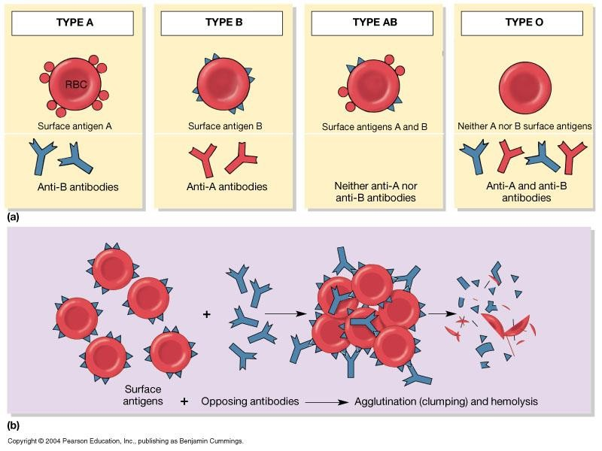

Slide 11
Inheritance of blood groups
Blood | group | Genotypes
A |  | AA, AO
B |  | BB, BO
O |  | OO
AB |  | AB
Uses of genotypes:
Sorting disputes in paternal dispute
Frequency of ABO has ethnic variation

Slide 12
The Question of paternity?
Blood types cant be used to
prove paternity
Blood types can disprove
paternity

Slide 13
2. The Question of paternity?
Nora blood (type A) and Ahmad blood (type B) Have a baby (blood type O) Can Ahmad be the father?
Phenotype | Possible genotype
Nora:A | AA or AO
Ahmad:B | BB or BO
Baby: O | OO

Slide 14
Possible Blood group Genotypes
Parent Allele | A | B | O
A | AA | AB | AO
B | AB | BB | BO
O | AO | BO | OO

Slide 15
The ABO blood groups
The table shows the four ABO phenotypes ("blood groups“) and the
genotypes that give rise to them.
Blood Group | Antigens on RBCs | Antibodies in Serum | Genotypes
A | A | Anti-B | AA or AO
B | B | Anti-A | BB or BO
AB | A and B | Neither | AB
O | Neither | Anti-A and anti-B | OO

Slide 16
2. Rhesus (Rh) Blood Group
Determined by:
Presence or absence of the Rhesus antigen (D) on the surface of RBC:
Presence of D (individual is Rh+ve)
Absence of D ( ‘ ‘ ‘ Rh–ve)
Rhesus antigens: Dd, Cc, Ee
Clinically most important is D

Slide 17
Rhesus (Rh) Blood Group
Anti-D antibody (agglutinin):
-Is not naturally-occurring
-Can be acquired by:
Transfusion of Rh-ve individual with Rh+ve blood
Rh-ve pregnancy with Rh+ve faetus.

Slide 18
Do you know which blood group you
belong to?
According to above blood grouping systems, you can belong to either of following 8 blood groups:

Slide 19
Importance of blood groups
Blood Transfusion.
Rh incompatibilty between mother and fetus

Slide 20
Blood tests before transfusion
Blood group type of patient (recipient)
Cross-matching

Slide 21
Blood tests before transfusion
A drop of patient RBC
Anti-A
Anti-B
Anti-D

Slide 22
Serum
Blood being tested
Anti-A
Anti-B
Type AB (contains
agglutinogens A and B; agglutinates with both sera)
RBCs
Type A (contains agglutinogen A; agglutinates with anti-A)
Type B (contains agglutinogen B; agglutinates with anti-B)
Type O (contains no
agglutinogens; does not agglutinate with either serum)

Slide 23
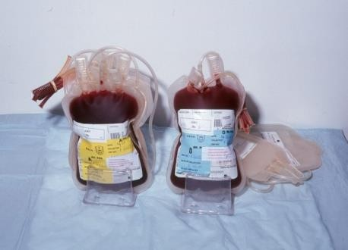
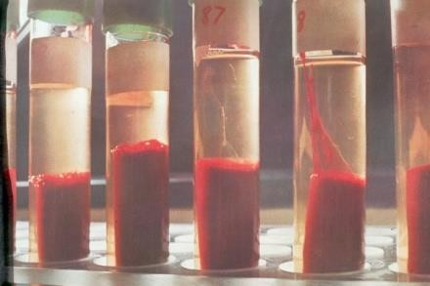
Blood tests before transfusion
2. Cross-matching:
donor cells
+
recipients (patient) serum

Slide 24
Who can
blood?
give you
People with TYPE O blood are called Universal Donors, because they can give blood to any blood type.
People with TYPE AB blood are called Universal Recipients, because they can receive any blood type.
Rh + → Can receive + or -
Rh - → Can only receive -

Slide 25
Blood Group | Antigens | Antibodies | Can give blood to | Can receive blood from
AB | A and B | None | AB | AB, A, B, O
A | A | B | A and AB | A and O
B | B | A | B and AB | B and O
O | None | A and B | AB, A, B, O | O

Slide 26
Complications of blood
transfusion
Immune reaction: Incompatible blood
transfusion leading to immediate or delayed reaction, fever, haemolysis, allergic reaction
Transmission of diseases (e.g.mlaria,
syphilis, viral hepatitis, AIDS virus)
Acute kidney failure (reaction to mismatched transfusions)
Iron overload due to multi-transfusion in case of sickle cell anemia and thalassemia

Slide 27
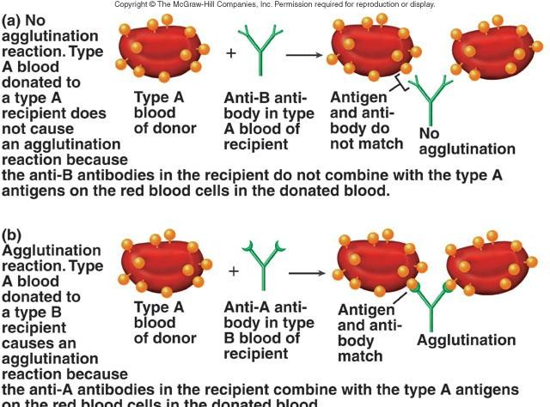
Agglutination Reaction

Slide 28
Agglutination in transfusion reaction
If a patient of blood group A transfused with blood of group B
The anti-B in plasma will agglutinate the transfused group B cells:
Outcome:
The clumped cells plug small blood
vessels (kidney shut down)
Sometimes immediate hemolysis

Slide 29
Importance of blood groups
Blood Transfusion.
Rh incompatibilty between mother and fetus

Slide 30
Rh incompatibilty between
mother and fetus

Slide 31
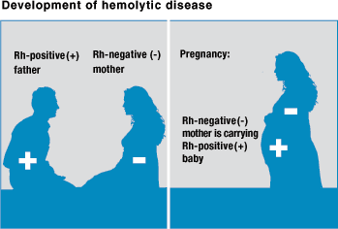
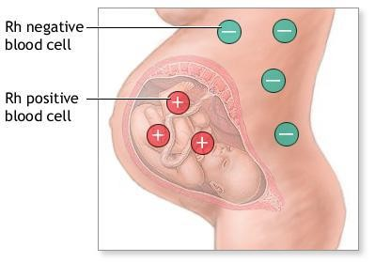

Slide 32
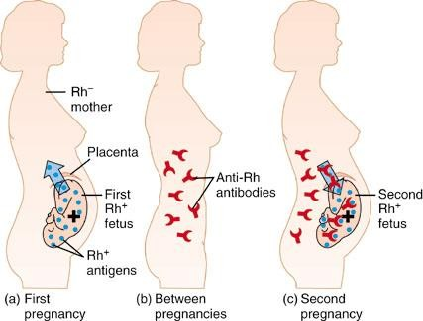

Slide 33
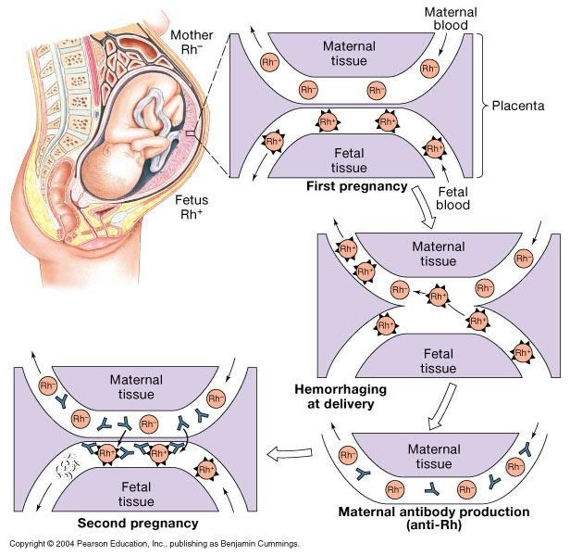

Slide 35
Rh incompatibilty between mother
and fetus
Mother Rh-ve first Rh+ve baby:
At delivery
– Fetal Rh+ RBC cross to maternal blood
The mother will develop Anti-D after delivery.
First child escapes & is safe
(If the mother is transfused with Rh+ve blood
before, first child will be affected)

Slide 36
Rh incompatibilty between mother
and fetus-cont.
Second fetus
If Rh+ve
Anti-D crosses placenta and
destroys fetal Rh+ RBC
Outcome?
Hemolytic Disease of the newborn

Slide 37
Hemolytic Disease of the
newborn
Hemolytic anemia:
– If severe:
treated with exchange transfusion: Replace baby blood with Rh-ve RBC (several times)
Hydrobs fetalis (death in utero)

Slide 38
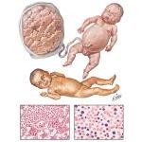
Hydrops fetalis

Slide 39
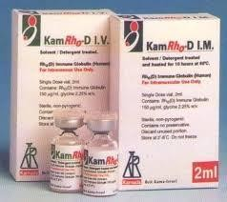
Hemolytic Disease of the
newborn-cont.
Prevention:
Injecting the mother
with anti-D immediately
after 1st
childbirth
Antenatal
(during pregnancY)
prophylaxis

Slide 40
َ سَ انلاَّ ايحَ ْ َأ امَ َّنَأكَ َف اهَ ايحَ ْ َأ نْ مَ وَ )
(اًعيمِ ج

