Slide 1
Homeostasis
Dr. Maha Saja
Physiology department,
Level 2,
Office 89,
Email: msaja@ksu.edu.sa

Slide 2
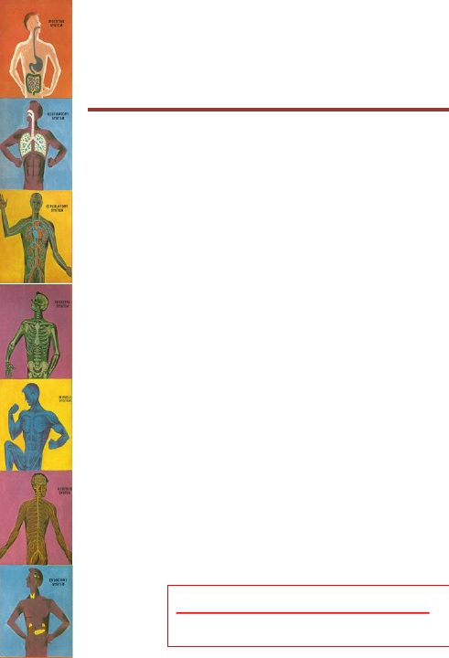
Objectives
• Define the concept of the “internal environment” and state its
physiologic importance.
• Differentiate between the external and internal environments.
• Define and discuss the concept of homeostasis and its
importance to the living organism.
• Discuss the physiologic control mechanisms that enable
maintenance of the normal steady state of the body.
• Define a feedback mechanism and describe its components.
• Differentiate between positive and negative feedback
mechanisms and give examples for each in the body.
Study source for this lecture:
(Guyton & Hall Textbook of Medical Physiology, 13th ed, Chapter 1)

Slide 3
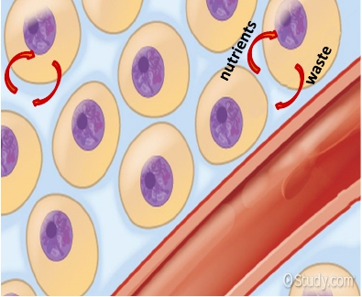
The Internal Environment
“Milieu Intérieur”
• All the cells in the body are
continuously bathing in fluid.
• Because this fluid is outside
the cell, it is called
extracellular fluid (ECF).
• It is from the ECF that cells get
the ions and nutrients needed
to maintain life.
Because,
➢All body cells live in the same environment (i.e. ECF).
➢The composition of ECF is almost similar between the different species.
It was named the “internal environment” by the French physiologist Claude
Bernard.
(Guyton and Hall Textbook of Medical Physiology. 13th ed. Ch-1)

Slide 4
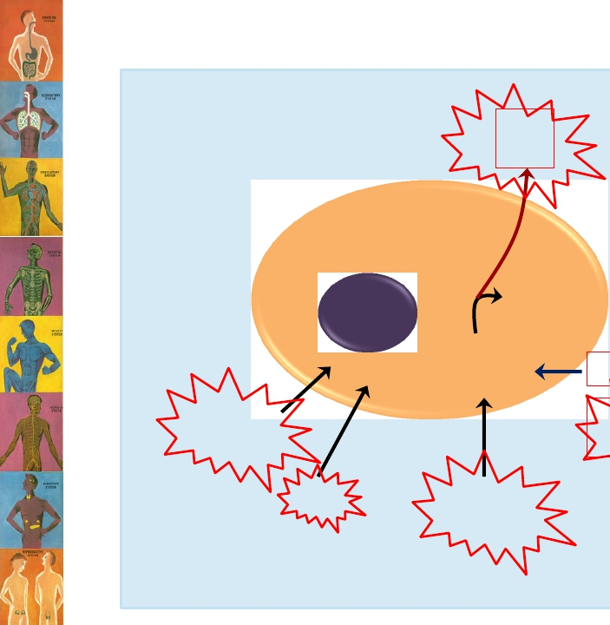
In order for the cell to function properly,
The internal environment need to
have the right amount/level of
these substances/variables.
(not too much and not too little)
waste
CO2
Urea
Energy (ATP)
Work
Chemical
reactions
enzymes
Fatty acids
Amino acids
pH
Temperature
Ions
Glucose
Oxygen
ECF
(Mr. Ford’s class-Introduction to anatomy and physiology-youtube)

Slide 5
External vs Internal
environment
• ECF = the
internal
environment.
• The skin
separates this
environment
from the outside
world which
known as the
external
environment.
5

Slide 6
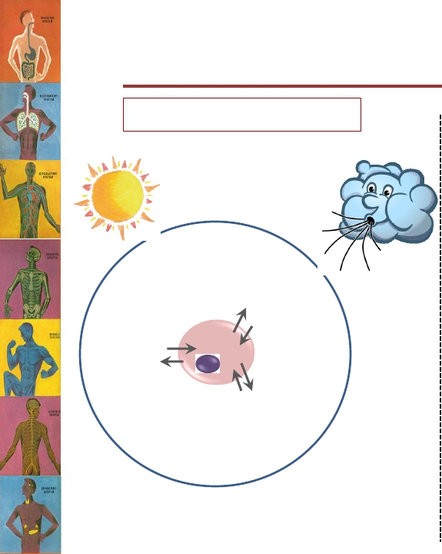
External vs Internal
environment
In Multicellular organisms
“External environment”
In Unicellular organisms
Internal environment = External environment
“Internal environment”

Slide 7
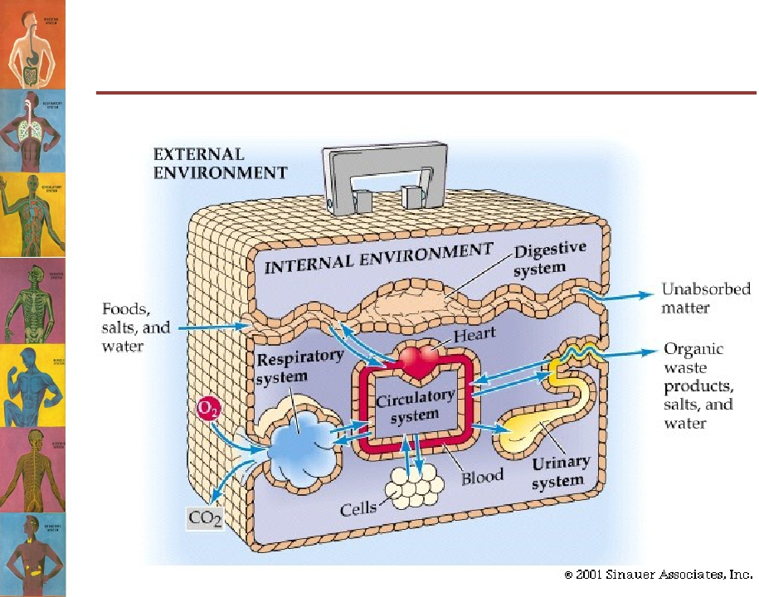
External vs Internal
environment

Slide 8
Homeostasis
• The internal environment must be kept
constant in the face of an ever changing
external environment.
• The internal environment of the body (ECF)is
in a dynamic state of equilibrium
8

Slide 9
“Homeostasis”
• The process by which the body keeps the internal
environment constant despite changes in the
external environment is known as
“Homeostasis”.
• Homeostasis means:
– Homeo- : sameness, similarity
– -stasis: standing
• Essentially all the functions of the body organs
and tissues aim at keeping the internal
environment at a nearly constant state.
(Guyton and Hall Textbook of Medical Physiology. 13th ed. Ch-1)

Slide 10
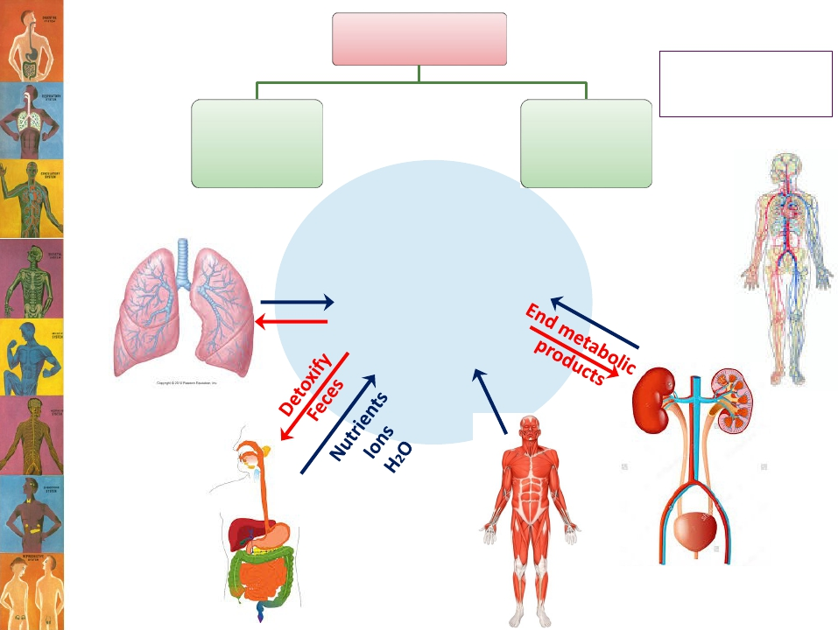
Control systems
Protection
Skin
Immune system
Nervous
system
Endocrine
systems
O2
CO2
Internal
environment

Slide 11
Body constituents are normally regulated within a range rather than a
fixed value;

Slide 12
Control Mechanisms
• The body has thousands of control systems.
• They function to restore balance when it is lost.
• Control systems operate;
– Within the organ itself
– Throughout the body → to control interrelations between organs.
12

Slide 13
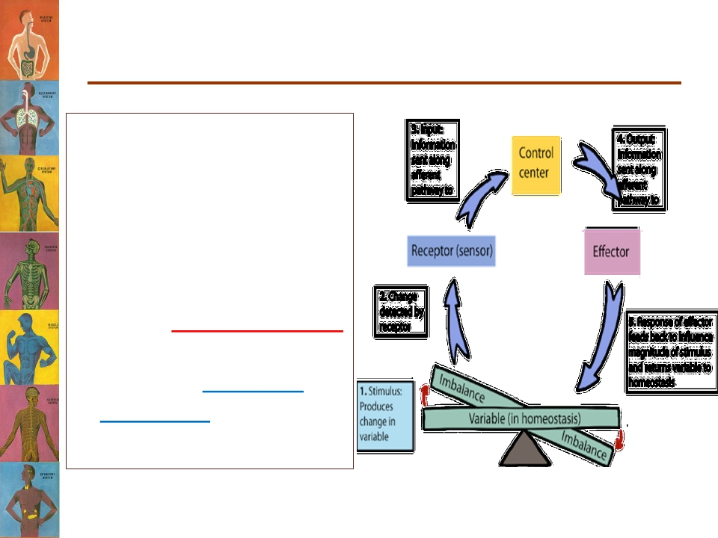
Feedback Mechanisms
What is meant by
feedback?
➢A loop system in
which the system
responds to
perturbation either
in the same direction
(positive feedback)
or in the opposite
direction (negative
feedback).

Slide 14
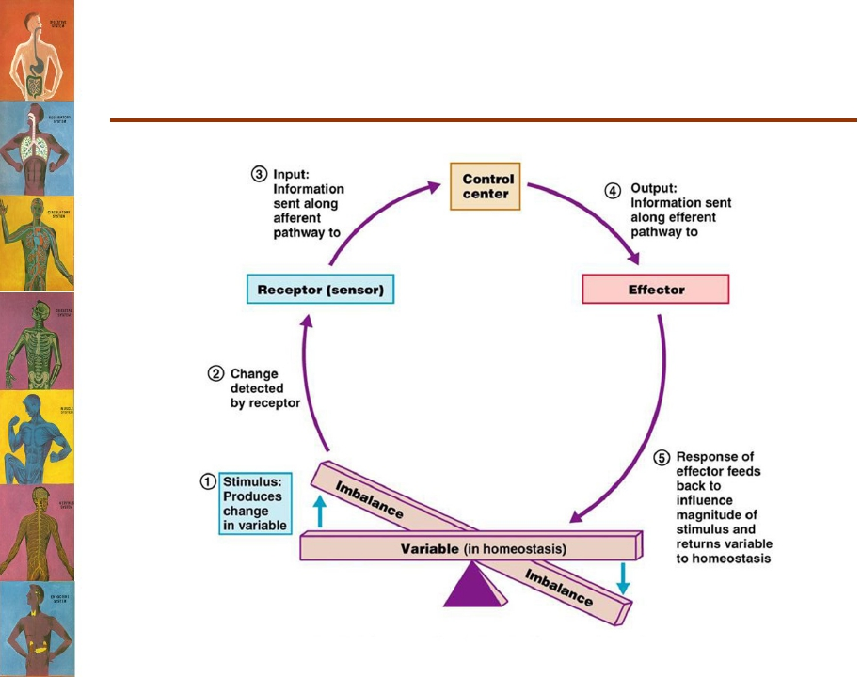
What are the components of a
feedback mechanism?

Slide 15
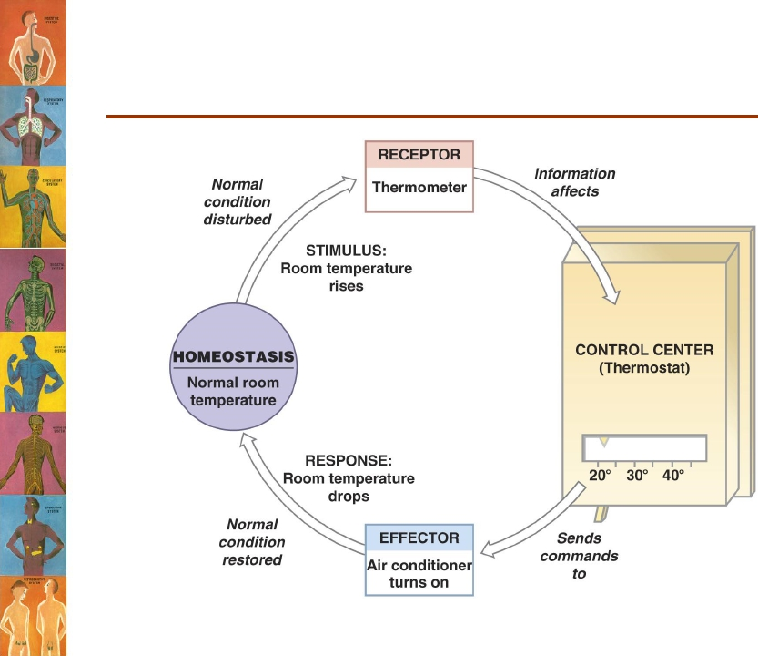
The Thermostat Analogy

Slide 16
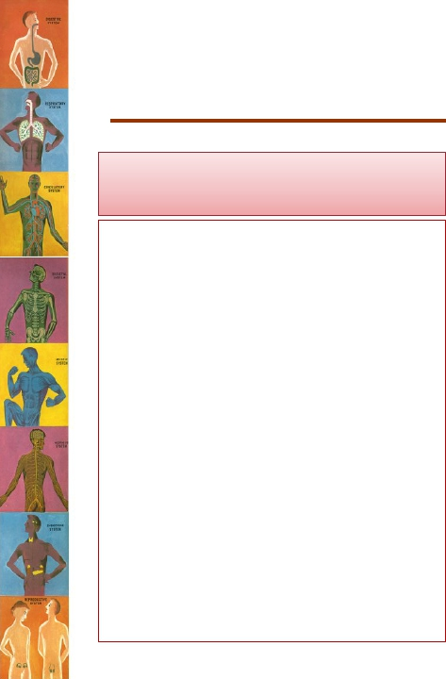
Types of Feedback Mechanisms
Negative feedback
The effector response of the
system is in the opposite
direction to the stimulus that
initiated the response.
E.g;
• A high level of in CO2 in the
ECF will increase pulmonary
ventilation, increasing the
amount of CO2 expired
which will bring the level of
CO2 in ECF down.
• Most of the control systems
of the body act by negative
feedback.
Positive feedback
The effector response is in the
same direction of the stimulus
that initiated the response.
E.g;
• In nerve signaling, entry of a
small amount of Na+ into
the cell will open more Na+
channels causing more Na+
to enter the cell.
• Only few systems display
positive feedback
mechanisms.. WHY?
(Guyton and Hall Textbook of Medical Physiology. 13th ed. Ch-1)

Slide 18
Examples of Negative Feedback
Mechanisms
Body temperature control

Slide 19
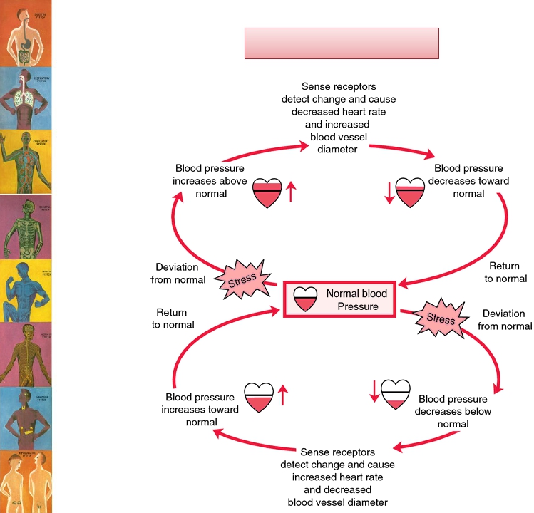
Blood pressure control

Slide 20
Examples of Positive Feedback
Mechanisms
Childbirth
Can you find other
examples for a positive
feedback mechanism in
the body?

Slide 21
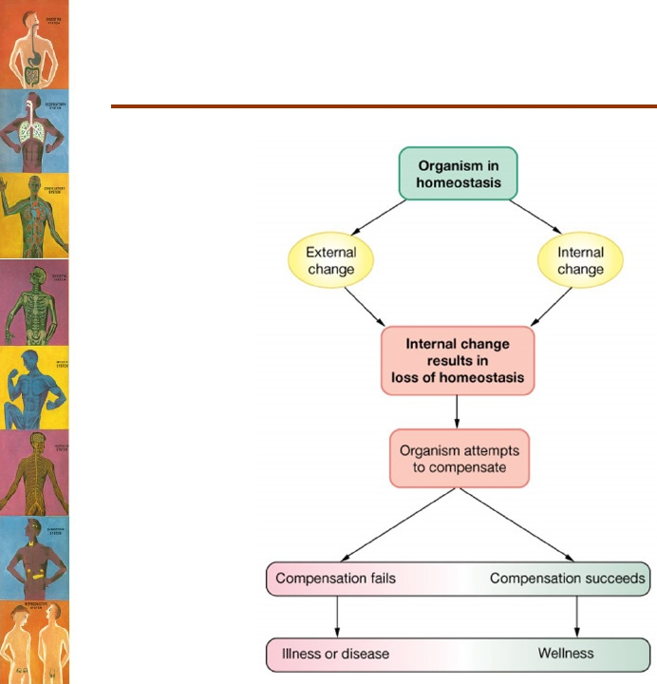
Disease is a state of disturbed
homeostasis

Slide 22
