Slide 1
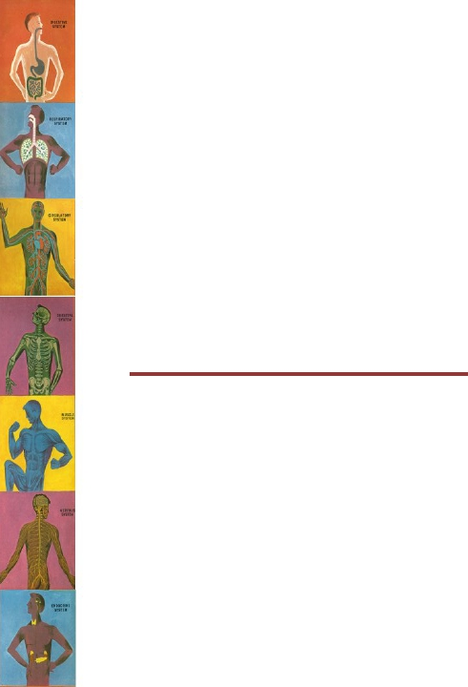
Transport of Substances
Through the Cell
Membrane
Dr. Maha Saja
Physiology department,
Level 2,
Office 89,
Email: msaja@ksu.edu.sa

Slide 2
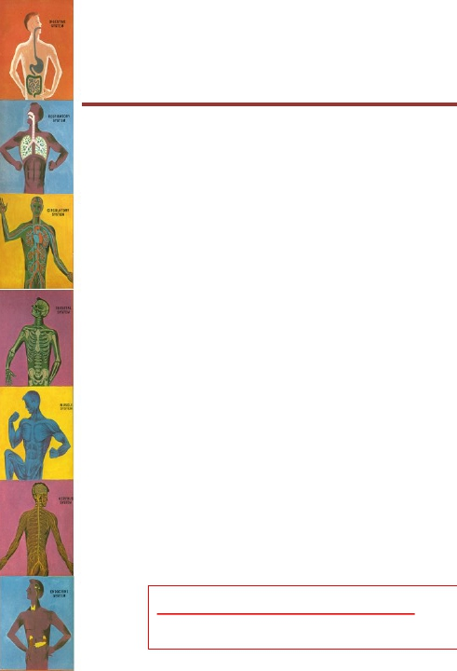
Objectives
At the end of this session, the students should be able to:
• Describe the fluid mosaic model of membrane structure and
function.
• Define permeability and list factors influencing permeability.
• Differentiate between passive and active transport mechanisms and
give examples on each.
• Describe the different forms of passive transport and state the
differences between them and the molecules transported by each
type.
• Describe the different forms of active transport and state the
difference between primary and secondary types giving examples for
each in the human body.
Study source for this lecture:
(Guyton & Hall Textbook of Medical Physiology, 13th ed, Chapter 4)

Slide 3
Structure of the Cell
Membrane

Slide 4
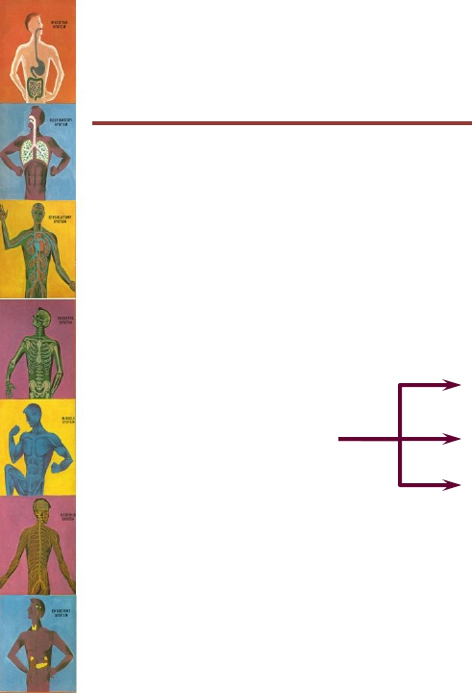
Structure of the Cell
Membrane
• Cell membrane = plasma membrane.
• Thickness = 7.5-10 nm.
• Composed of:
➢Lipids (42%)
➢Proteins (55%)
➢Carbohydrates (3%)
Phospholipids (25%)
Cholesterol (13%)
Other lipids (4%)
(Guyton and Hall Textbook of Physiology. 13th ed. Chapter-2)

Slide 5
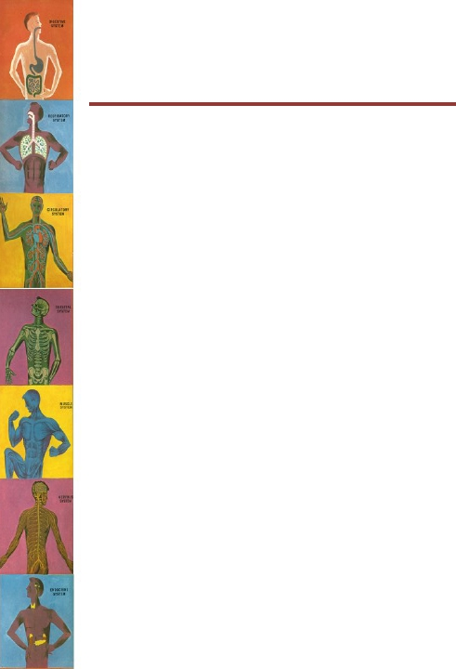
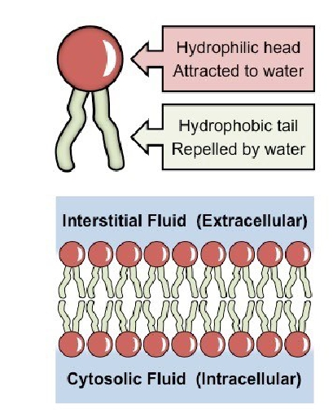
Structure of the Cell Membrane
• The cell membrane = a
lipid bilayer.
• The most abundant lipid =
phospholipids.
• A phospholipid molecule
have two ends:
➢ Hydrophilic (phosphate
end)
➢ Hydrophobic (fatty acid
end)
(Guyton and Hall Textbook of Physiology. 13th ed. Chapter-2)

Slide 6
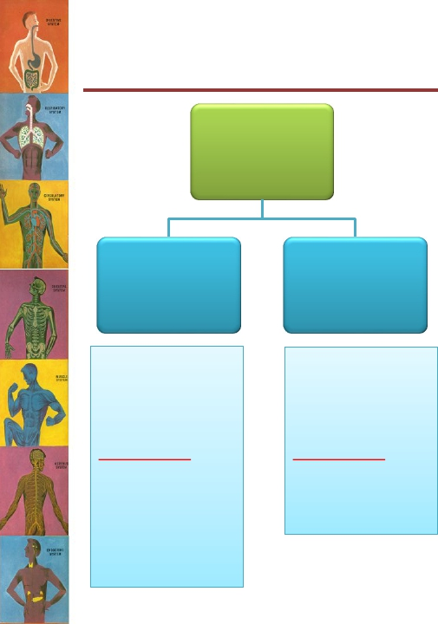
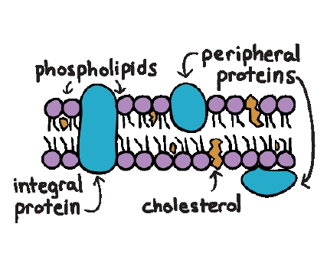
Structure of the Cell Membrane
Membrane
proteins
Integral
Span the
thickness of the
cell membrane.
Function as:
Peripheral
Are attached to
one surface of
the membrane.
Function as:
1. Channels (or
pores).
2. Carrier
proteins.
3. Receptors.
•
•
Enzymes.
Adhesion
molecules.
(Guyton and Hall Textbook of Physiology. 13th ed. Chapter-2)

Slide 7
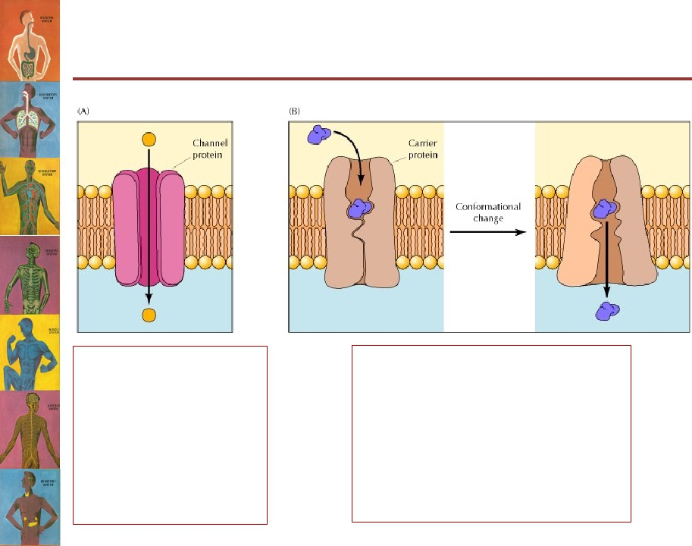
Channel vs. Carrier Proteins
Channel proteins
form open pores
through which
molecules of the
appropriate size
(e.g., ions) can cross
the membrane.
Carrier proteins selectively
bind the small molecule to be
transported and then undergo
a conformational change to
release the molecule on the
other side of the membrane.

Slide 8
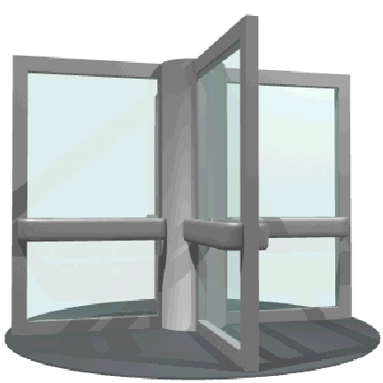

Channel
Carrier

Slide 9
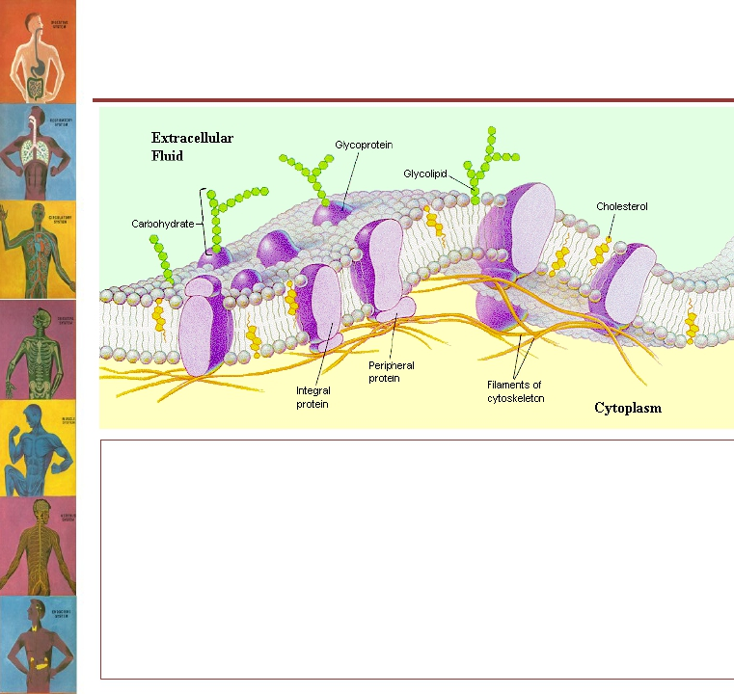
Structure of the Cell Membrane
Function of
CHOs:
• Receptors.
• Cell-to-cell
interaction.
• Immune
reactions.
• Carbohydrates (CHOs) in the cell membrane are
invariably attached to:
– Proteins → Glycoproteins
– Lipids → Glycolipids
• Carbohydrate molecules protrude to the outside of the
cell forming a loose carbohydrate coat = “glycocalyx”

Slide 10
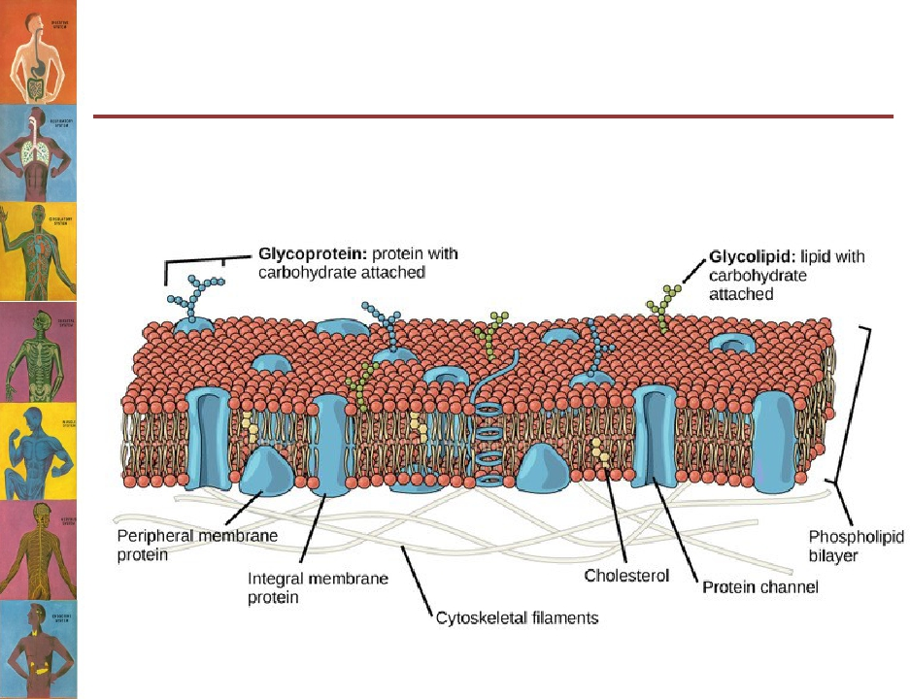
The Fluid Mosaic Model of
Plasma Membrane

Slide 11
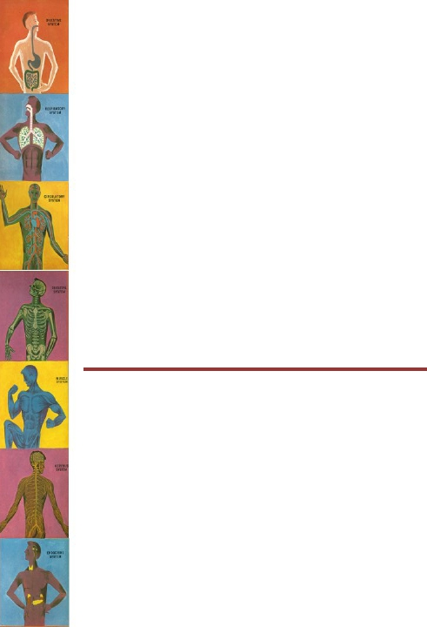
Movement (Transport) of
Substances Across the Cell
Membrane

Slide 12
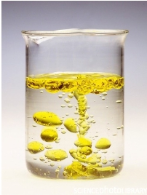
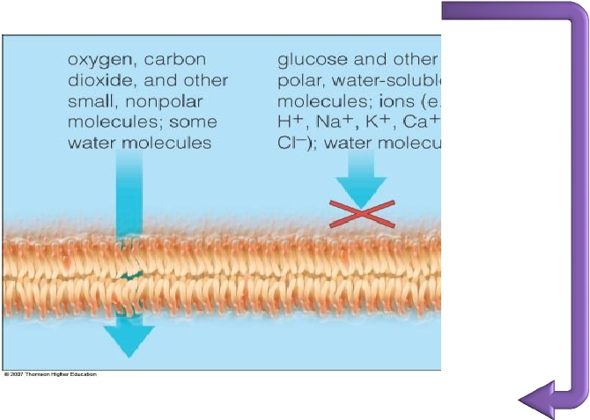
Substances that can Across the
Cell Membrane
Lipid soluble
substances
Water soluble
substances
Oil and water do not mix
Alternative route
Cross freely by
diffusion
Through membrane
proteins

Slide 13
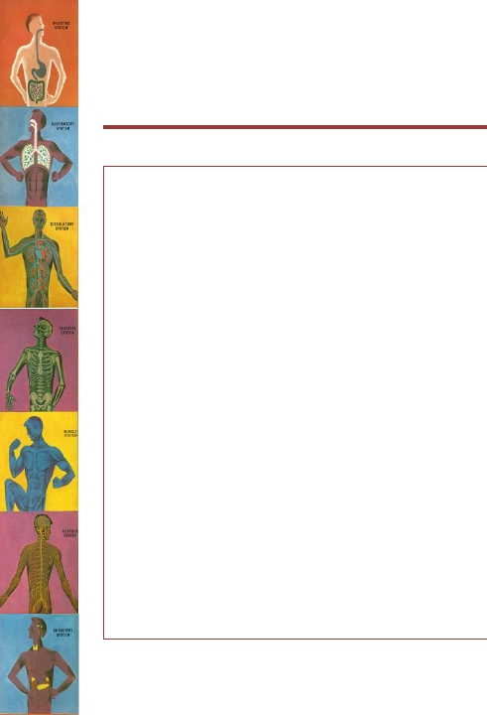
“Selective Permeability”
• The cell membrane is “selectively
permeable”… what does this mean?
• The membrane allows some substances to
cross it but not others.
• It arises from the membrane’s structure.
• It controls the type & amount of substances
entering and leaving the cell.

Slide 14
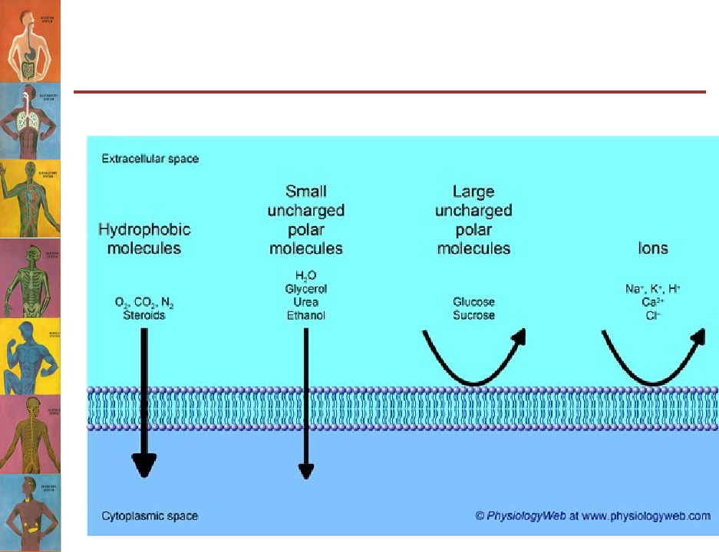
Substances That Can Move
Across the Cell Membrane

Slide 15
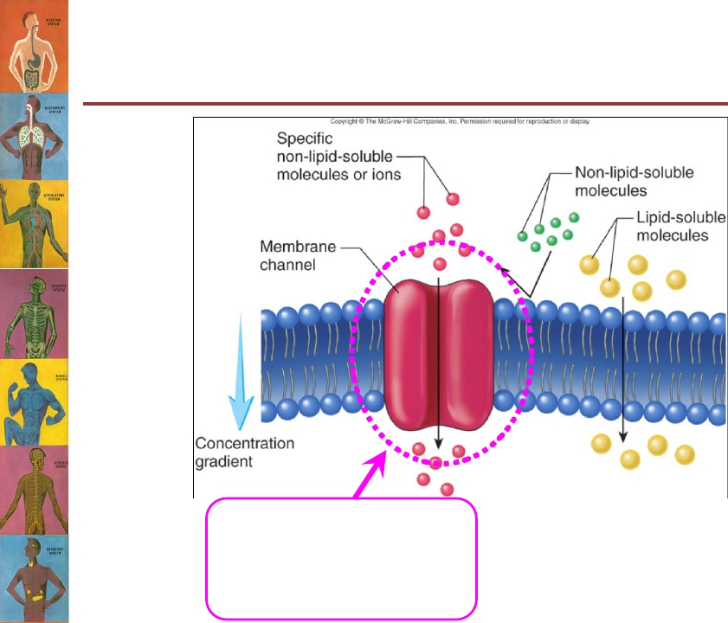
Substances that Cannot Cross
the Cell Membrane
Will enter the cell through a
trans-membrane protein
carrier/transporter/channel

Slide 16
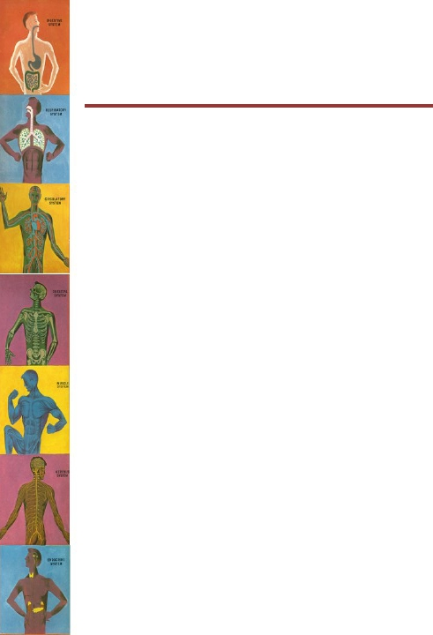
Transport Mechanisms
• The transport of material between body or
cellular compartments can be divided into:
1. Passive Transport = does not require energy.
2. Active Transport = requires energy.

Slide 17
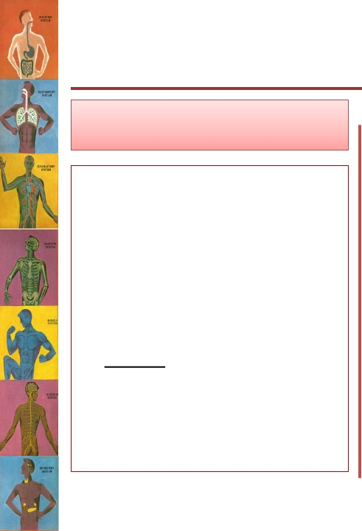

Transport Mechanisms
Passive Transport
• Molecules move along
their energy gradient.
• Does not require
energy.
• Types:
– Simple Diffusion.
– Facilitated Diffusion.
– Osmosis.
Active Transport
• Molecules move against
their energy gradient.
• Requires energy.
• Types:
– Primary Active Transport.
– Secondary Active Transport.

Slide 18
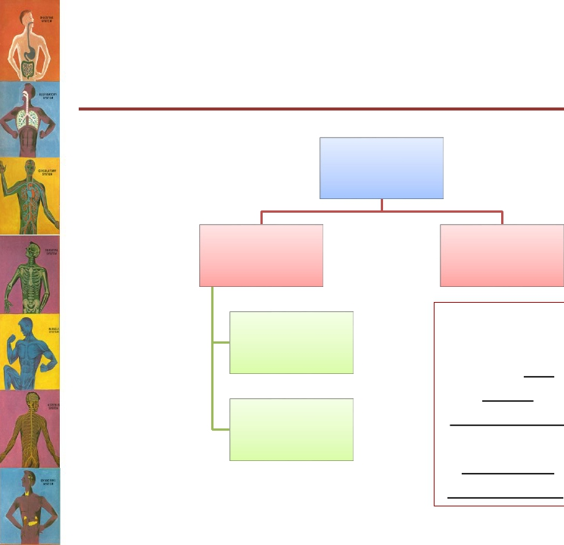
Passive Transport
Mechanisms
Passive
Transport
Diffusion
Simple
Facilitated
Osmosis
Movement of
water from an
area of low
solute
concentration
to an area of
high solute
concentration.

Slide 19
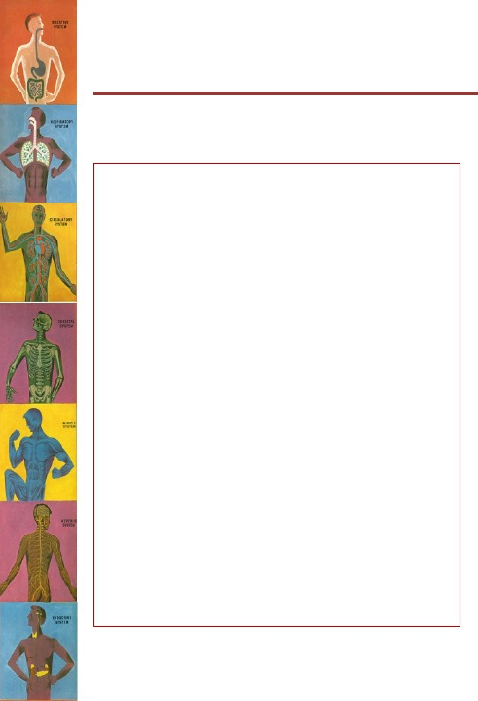
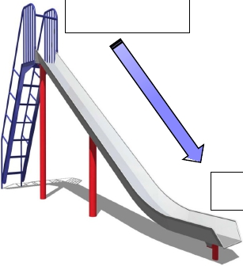
Diffusion
• Diffusion = the
random movement
of substances down
an energy gradient.
• This gradient can be:
– Concentration gr.
– Electrical gr.
– Pressure gr.
High conc.
substances will move
“down” their
concentration
gradient
Low conc.

Slide 20
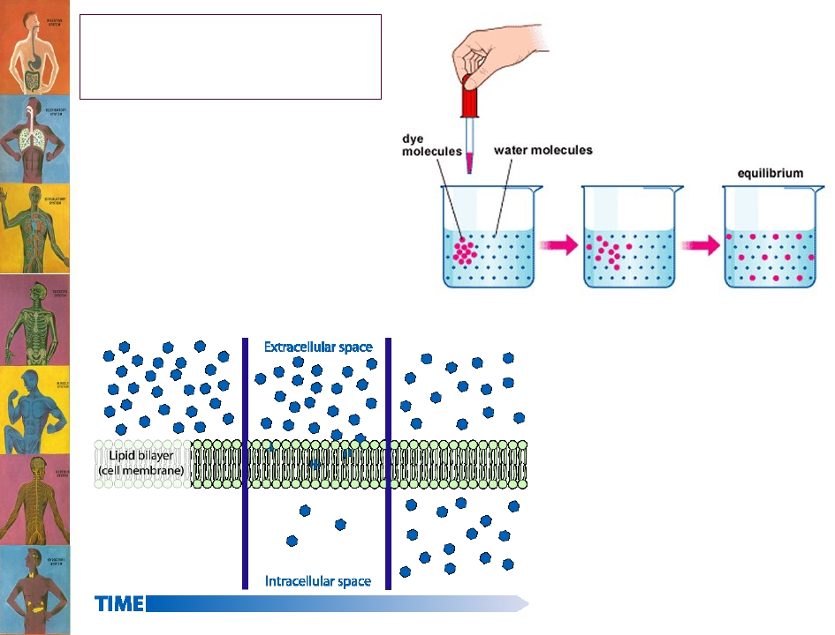
Diffusion

Slide 21
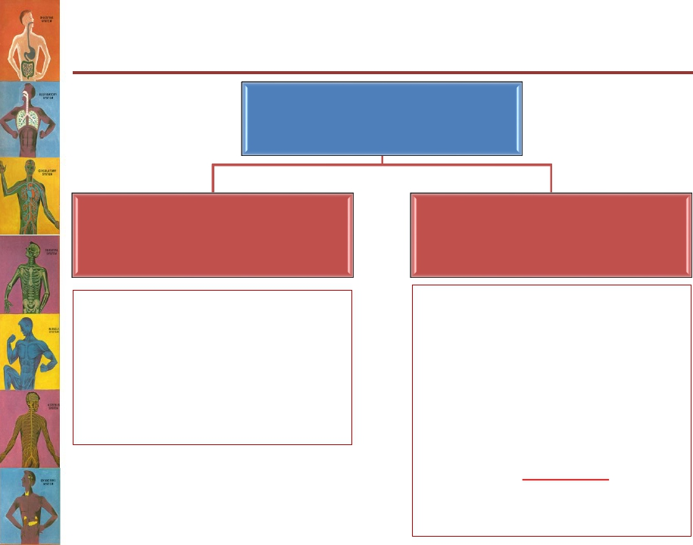
Types of Diffusion
Diffusion
Facilitated
Diffusion
The transported molecule binds
to a carrier protein which then
undergoes a conformational
change allowing the molecule
to pass through to the other
side of the cell membrane.
The carrier facilitates passage
of the molecule through the
CM
Simple Diffusion
The movement of molecules
through the intermolecular
spaces or membrane openings
(channels) without the
necessity of binding to a carrier
protein on the membrane.

Slide 22
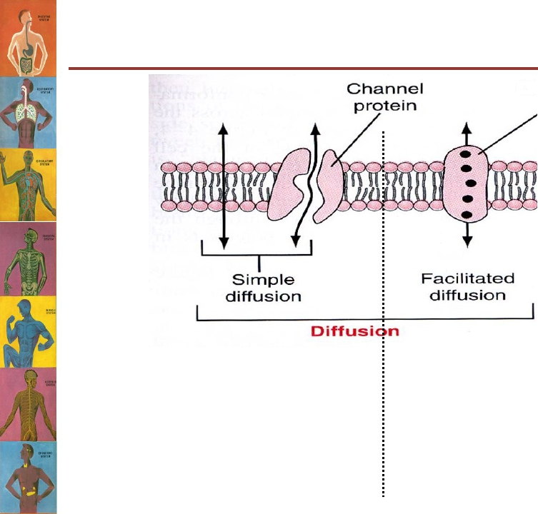
Types of Diffusion
Carrier protein
• Also called “Carrier-mediated
diffusion”.
• Diffusion of a substance is
“facilitated” by the use of a specific
carrier protein.
• Examples (glucose, amino acids).
1. Lipid-soluble substances (e.g. O2,
CO2, and alcohol)→ Pass through
the interstices of the lipid bilayer.
2. Water-soluble substances (water,
ions) → pass through channels
that penetrate all the way
through the CM.

Slide 23
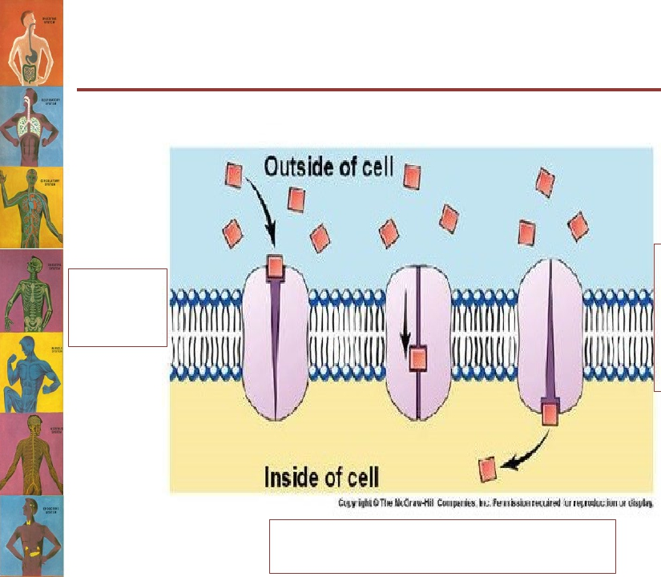
General Steps for Facilitated
Diffusion
(Or any carrier-mediated transport)
3. Release
of solute
on the
opposite
side of the
membrane
1. Solute-
binding
step
2. Change in carrier conformation
allowing solute to pass through

Slide 24
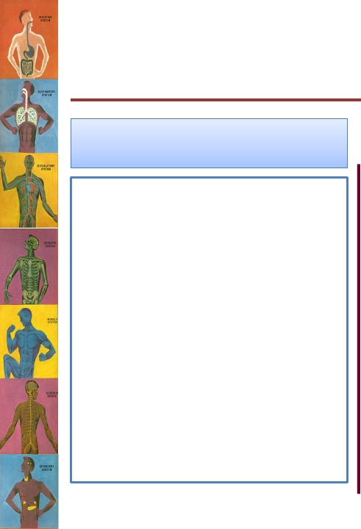

What is the difference between
simple and facilitated diffusion?
Simple diffusion
The rate of diffusion
increases proportionately
with the concentration of
the diffusing substance.
Facilitated diffusion
• The rate of diffusion
increases proportionately
with the concentration of
the diffusing substance until
it reaches a transport
maximum (Tmax).
• At Tmax, an increase in the
concentration of the
diffusing substance does
not increase the rate of
diffusion.

Slide 25
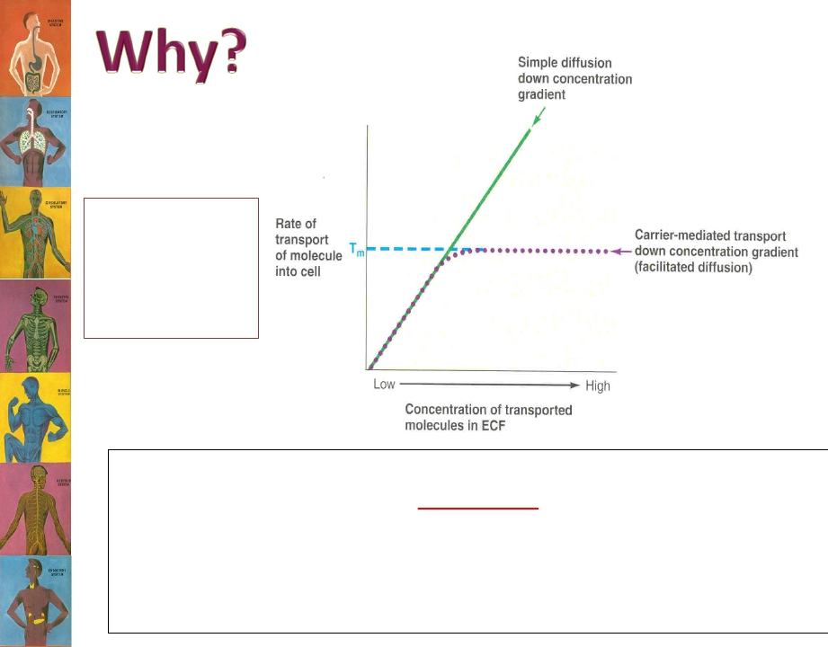
Tm = transport
maximum = the
transport rate at
which saturation
occurs.
The rate at which molecules can be transported by facilitated diffusion
depends on:
1.
The number of solute-binding sites on the carrier.
2.
The rate at which the carrier protein molecule can undergo
conformational change back and forth between its bound and
unbound state.

Slide 26
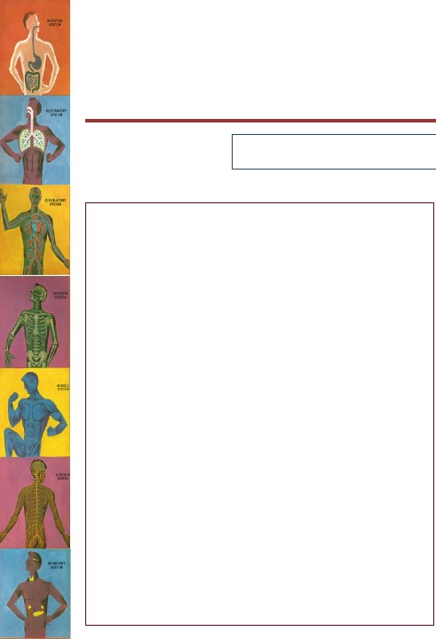
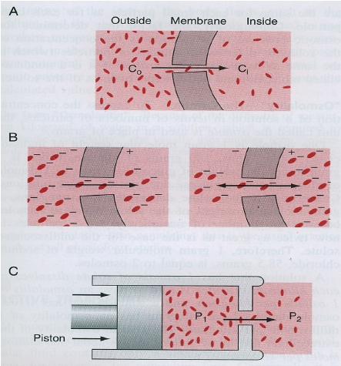
Factors Affecting Rate of
Diffusion
������������������������ ������������ ������������������������������������������������������ = ������ ������ ������ (������������ − ������������)
1. P = Permeability
coefficient.
a.
b.
c.
d.
Temperature.
Size of molecule.
Solubility in lipids.
Thickness of membrane.
2.
3.
A = surface area.
C1-C2 = gradient
difference:
a.
b.
c.
Concentration difference
Electrical difference.
Pressure difference.

Slide 27
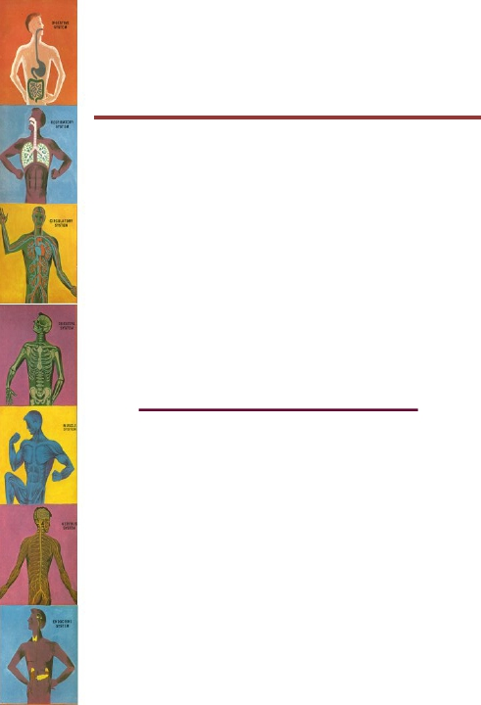
Active Transport
• Occurs when a cell membrane moves
molecules or ions “uphill” against a
concentration gradient (or an electrical or
pressure gradient).
• Examples include:
➢
➢
Ions like: sodium, potassium, calcium, iron, iodine,
hydrogen ions.
Amino acids, glucose and other sugars.
•
Requires energy and a carrier protein.

Slide 28
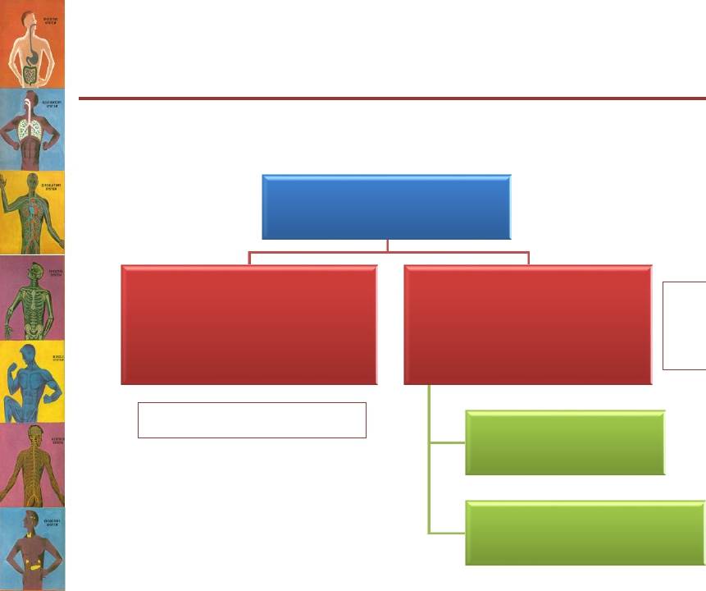
Active Transport
According to the source of energy used to fuel transport, it
can be divided into;
Active Transport
Primary Active
Transport
Direct source of energy
Secondary Active
Transport
Co-transport
Indirect
source of
energy
Counter-transport

Slide 29
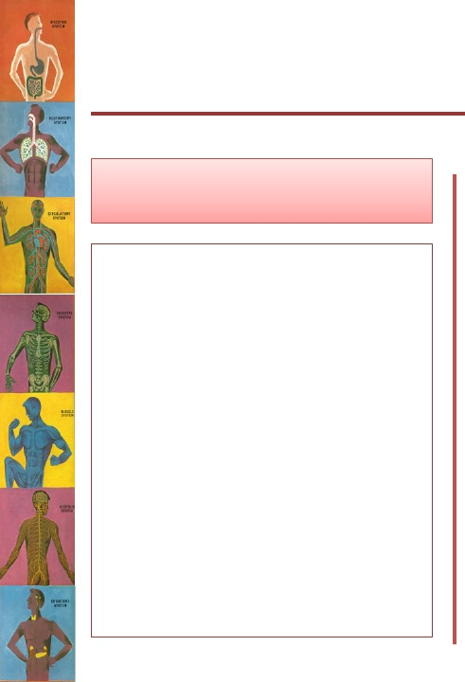

Types of Active Transport
Primary Active
• The energy is derived
directly from breakdown
of adenosine
triphosphate (ATP) or
some other high-energy
phosphate compound.
• 3 main examples:
➢ Sodium-potassium
ATPase pump.
➢ Calcium ATPase pump
➢ Hydrogen ATPase pump.
Secondary Active
• The energy is derived
indirectly by using the
concentration or
electrochemical gradient
generated by a primary
active transporter.

Slide 30
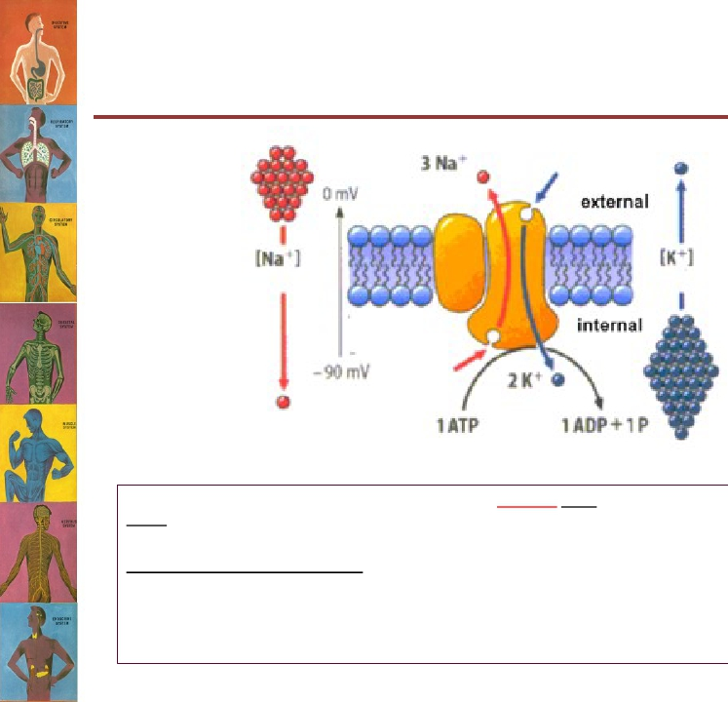
Primary Active Transport
This pump functions by moving 3 molecules of sodium OUT and 2 molecules of potassium
INTO the cell both against their concentration gradients.
The importance of this pump:
•
•
•
Maintaining Na+ and K+ concentration differences across the cell membrane.
Establishes a negative electrical voltage inside the cell.
Is the basis for nerve signal transmission.

Slide 31
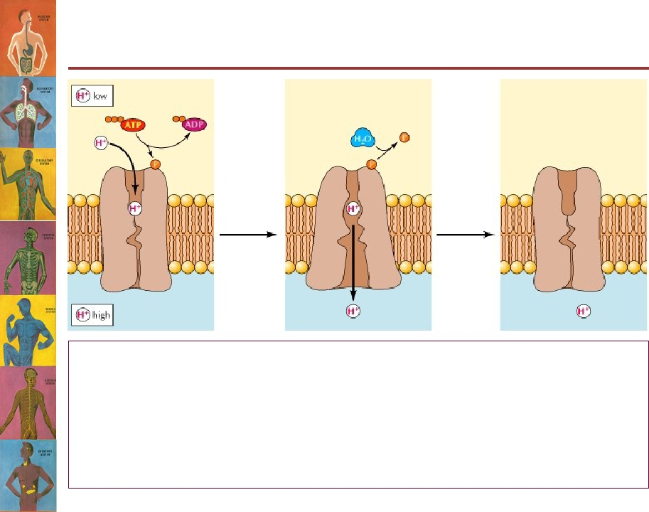
Primary Active Transport
H+-ATPase Pump
Present in:
• Parietal cells of stomach → secretion of HCl in the stomach.
• Intercalated cells of distal renal tubules → excretion of acids from the
body.
Pumps H+ out of the cell and into the lumen.

Slide 32
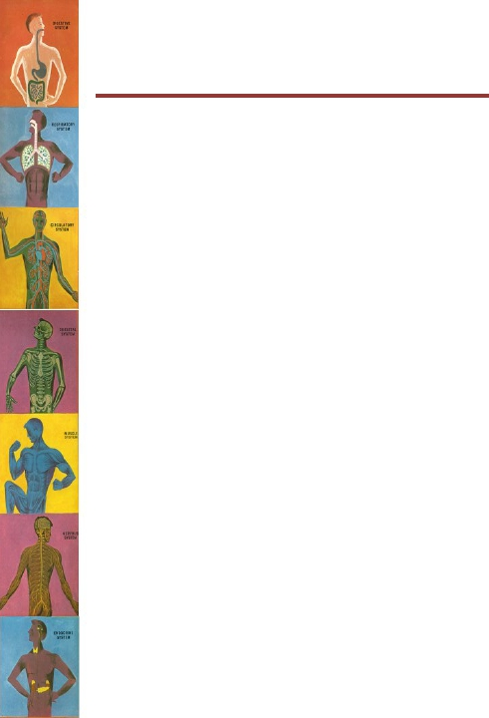
Primary Active Transport
Ca+2 ATPase Pump
• Present in:
– Sarcoplasmic reticulum in muscle cells
– Mitochondria
– Some cell membranes.
• Maintains low Ca+2 concentration inside the cell.

Slide 33
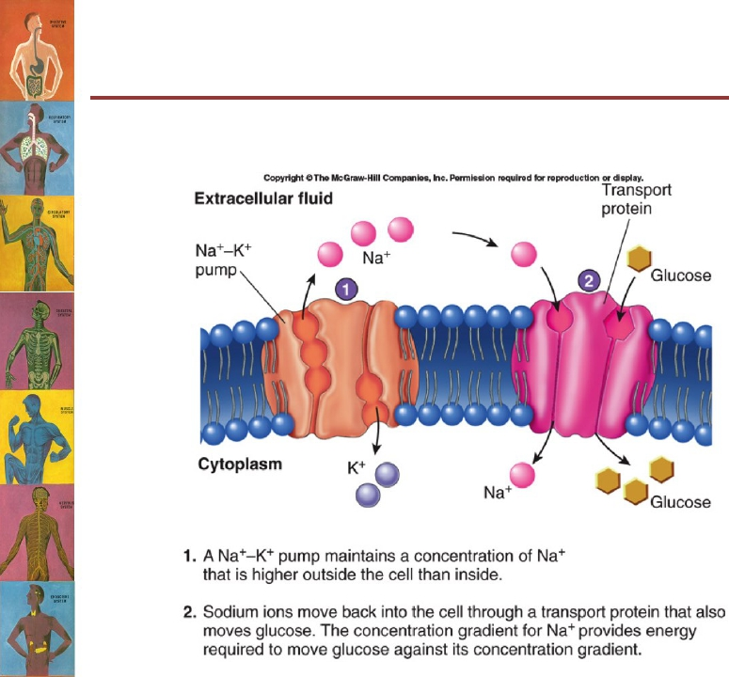
Secondary Active Transport
(Co-transport)
Derives energy indirectly… How?

Slide 34
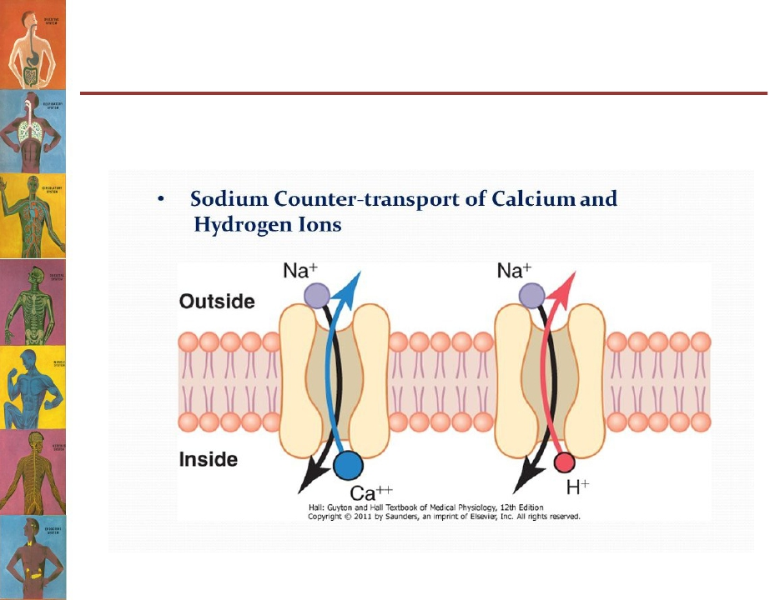
Secondary Active Transport
(Counter-transport)

Slide 35
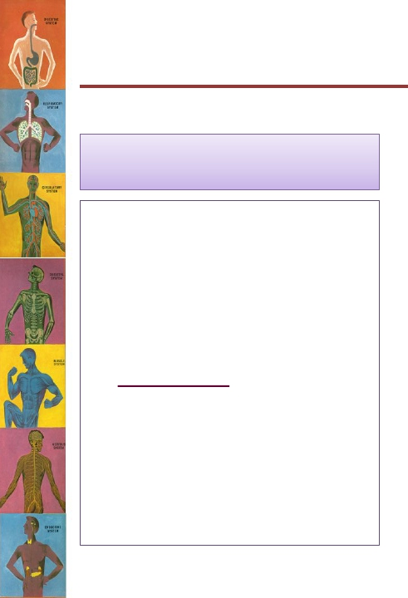

Types of Secondary Active
Transport
Co-Transport
• When both substances
are transported
together in the same
direction.
• Examples;
– Na+-glucose co-transporter
(PCT)
– Na+-amino acid co-
transporter (PCT)
Counter-Transport
• When one substance is
transported in the
opposite direction to the
other substance.
• Examples;
– Na+-H+ counter-transporter
(PCT)
– Na+-Ca+2 counter-transporter
N.B. PCT = proximal convoluted tubules in the kidney

Slide 36
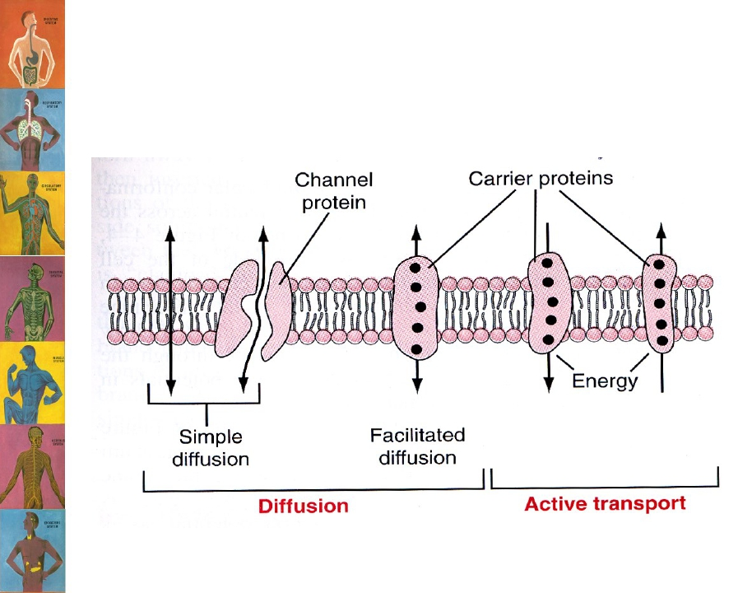
Revision!

Slide 37
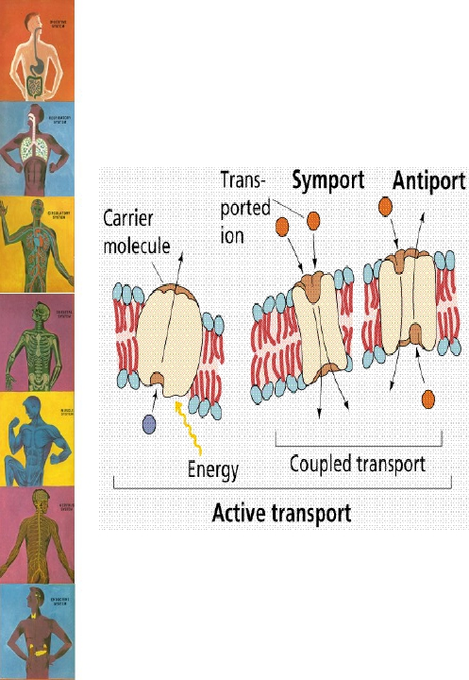
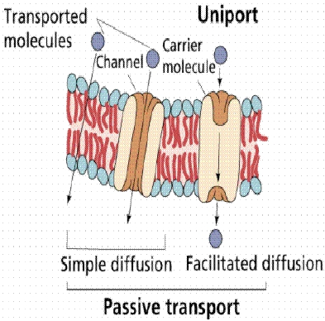
Revision!

Slide 38


